Slide 1
UITF Noteworthy developments
(9/28/2020)
Recall we stopped run0 when the CTF went down for repairs, but having accomplished enough to close out remaining CATS items and ask for permission to operate
On 31 August we officially started run1 by recalibrating the booster GSets, which now accurately represent the gradients in the cavities
UITF turns ON reliably at 9.5 MeV/c, the desired momentum for HDIce tests
Empirically found quad magnet settings that minimize beam jitter at the HDIce copper target (qsUtility not yet providing useful quad settings)
Need magnet settings that put beam on viewers on either side of IBC. Last week we battled a perceived a kink in the beamline: installed a bigger viewer at input of IBC, and implementing a dogleg magnet solution (plan A and B)
Raster magnet doesn’t work well, beam dwells at the center
More thorough radiation surveys now limit average current to 25 nA, which is fine for the HDIce test program but more shielding is required for 100 nA operation, let alone desired 10 uA long term goals
BPMs don’t work, which is fine for now, but not for 100 nA or 10 uA programs

Slide 2
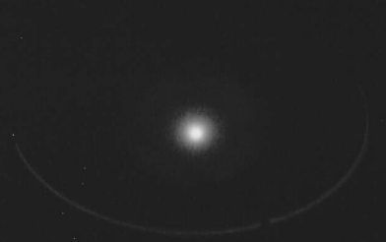
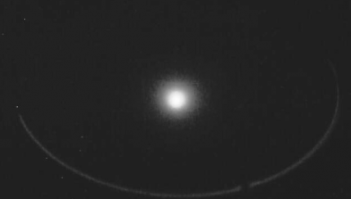
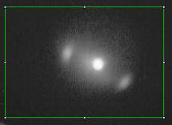
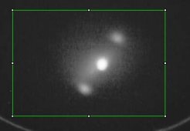
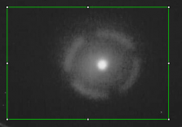
UITF Noteworthy developments
(9/28/2020)
Beam through copper target inside IBC: magnets OFF, main magnet ON
Raster X, raster Y, and raster X/Y (see outline of copper target)

Slide 3
Booster commissioning, for installation at CEBAF
(9/28/2020)
Characterizing booster performance (aka QCM, aka ¼ CM) on hold, we are focused on HDIce tests now
Will need to finish booster characterization in 2021
GSet values now representative of cavity gradients, we are not over-driving the booster
2-cell RF is “dirty”, with prominent 59 Hz modulation
Energy jitter is significant, need to quantify and fix before the booster is installed at CEBAF
Microphonics, yes, seems to be a problem. Frequent trips from GRD mode to SEL mode. Some days good, some days bad, only a problem at Building 58?
Promised MOLLER, this booster will improve PQ beam, need to measure:
Emittance at 2, 5 and 9.5 MeV
Energy spread
Energy jitter
Bunchlength (no instrumentation for this)
x/y rotation
Beam deflection

Slide 4
Thoughts
(9/28/2020)
Run1 should finish successfully this week (define golden orbit, set aperture hole sizes, improve and set amplitude of raster, calibrate viewer-image intensity versus CW beam current)
Run2 unpolarized target, begins at the end of October
Run3 polarized target, stops December 18
Runs 0 and 1 each required one month, and did not achieve all goals
Eight weeks to complete runs 2 and 3, not good - but might be possible ?
Insufficient Ops staffing at present, but happy to hear Operators have volunteered to provide 3 shift support for future runs 2 and 3, thanks
Covid limits control room staffing to just 2 people, so it’s hard to train people
Roof tile removal eats up time, will likely need Andy to pare down run 2 and 3 goals
Excellent support from:
DC Power for magnets (Kevin B., Jason D., Onish K., Jim C., Eric D.)
Ops Software (Scott H., Gary C., Sue W. and Theo L.)
Yan Wang, Max Bruker, dedicated and enthusiastic, they deserve big raises
I&C (Chris N., Keith C. and Anthony D.)
RadCon (Dave H. and his team)
Jonathan Creel, for whipping the CTF into shape, coordinating work at VTA
RF Group (Manny D., Tomasz P., Rama B, Clyde M.)
Installation Group, rapid response to shielding deficiencies (Neil, Ricky and Bern)

