Slide 1
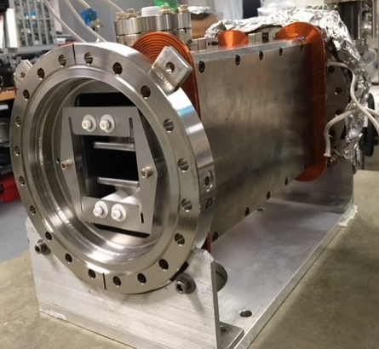
VERTICAL Wien filter GPT simulations with spline electrodes profile surveyed by metrology group 01/08/21
Gabriel Palacios Serrano
04/06/2021
gabrielp@jlab.org

Slide 2
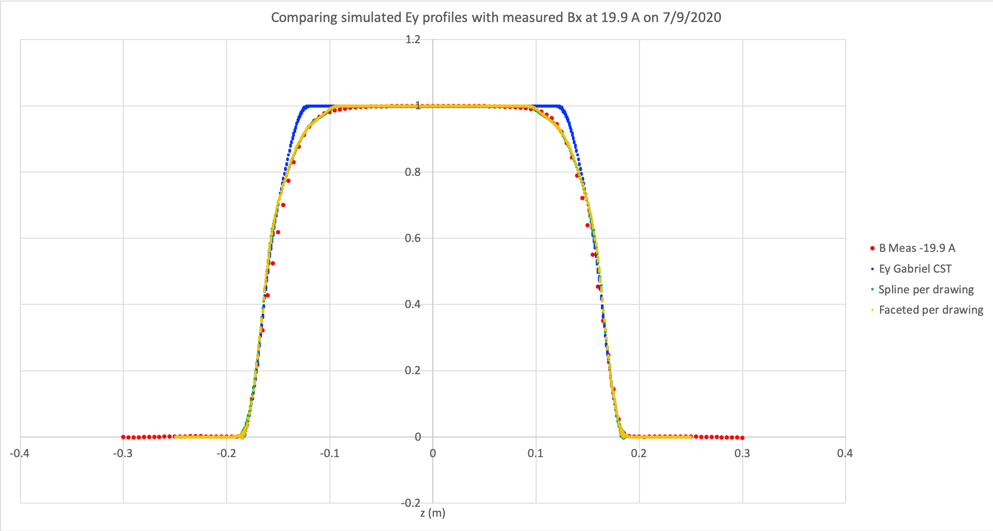
Details of GPT simulations
This presentation compares results from 3 models for the Wien filter all for 15 mm electrode gap
Initial fields maps generated by Gabriel using CST contain a geometrical mistake where the electrode’s flat transitions to the Rogowski profile
This was Gabriel’s working model until realizing the presence of a ‘hump’ in the electric field map compared to that generated by Bruce Dunham in POISSON. Upon close inspection, it was realized that the very first coordinate defining the start of the Rogowski profile was inadvertently omitted. This was corrected and correspondingly named Spline electrode profile model.
The GPT deck with its corresponding field map can be found in: O:\inj_group\Gabriel\Wien filter\200 keV Gabs E field

Slide 3
Details of GPT simulations continued
Spline (our latest working model to 04/05/2021)
The ME under D. Machie created a 3D spline model based on the manufacturing drawing and thus representing the actual VERTICAL Wien electrodes. The Horizontal Wien electrodes are faceted, not spline.
Gabriel then used this 3D model to produce E field maps using CST that now agree with Dunham’s and subsequently generated GPT beam simulations for his PhD dissertation and Wien filter paper.
The GPT deck with its corresponding field map can be found in: O:\inj_group\Gabriel\Wien filter\200 keV Spline E field
VERTICAL Wien electrodes have spline profile
HORIZONTAL Wien electrodes are faceted

Slide 4
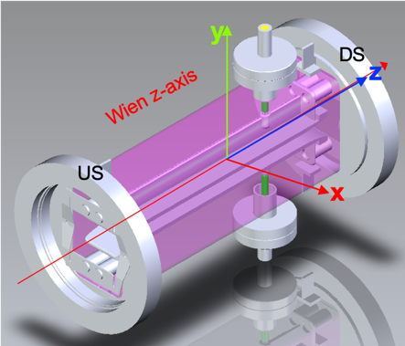
Details of GPT simulations continued
VERTICAL Wien with spline electrode profile Surveyed (based on the S&A data from 01/08/21). The modeling process for this one is explained in the slides 3 to 11.
This is the Spline model, but in this case Gabriel applied pitch and roll to both electrode plates, based on the information from S&A.
The GPT deck with its corresponding fieldmap can be found in: O:\inj_group\Gabriel\Wien filter\200 keV Spline E field - surveyed

Slide 5
Details of GPT simulations
The GPT simulations where all made with Alicia’s beam:
Alicia produced a “good” description of the particle distribution at the photocathode, then propagated this beam in GPT through two simulated solenoids with “realistic” parameters, all the way to the entrance of the Wien filter location. Then she recorded the particle distribution information (i.e. coordinates and momentums) to a file named “gdfselect_jg_p_2.493772_unphased_results.gdf” that is used in my GPT deck as the initial particle distribution.
The electric field maps correspond to each case (i.e. Gab’s fields, spline, or spline surveyed) and are in the deck folder. The scaling factor is found in the GPT deck file with extension *.mr (multiple run) with the variable name “Escale”.
The magnetic field maps are scaled versions of Jay’s original field map (as far as I am aware). The scaling factor is found in the GPT deck file with extension *.mr (multiple run) with the variable name “Bscale”.
For slides 13 to 20, the simulation results have all the same scaling of the electric field. This is to show how much deviation we get from the Surveyed model without changing the electric field.

Slide 6
Reference frame S&A
Beam exits
Top plate points
Downstream
10
9
8
7
6
1
2
3
4
5
Nose
Clockwise
Rotation!
Beam enters
Upstream
10
9
8
7
6
1
2
3
4
5
Tail
Bottom plate points

Slide 7
Reference frame CST based on S&A
Top plate
Beam exits
Downstream
Beam enters
Upstream
Bottom plate

Slide 8
From S&A: ROLL
With respect to z-axis

Slide 9
From S&A: PITCH
With respect to z-axis

Slide 10
Setting up the problem based on S&A
Top plate points, upstream
Bottom plate points, upstream
Points used to contruct electrode plane
Top Plane | X (mm) | Y (mm) | Z (mm) |  | Bottom Plane | X (mm) | Y (mm) | Z (mm)
p1 US | 19.28 | 7.44 | -78.08 |  | p1 US | 13.71 | -7.63 | -76.93
p2 US | 8.39 | 7.41 | -78.62 |  | p2 US | 7.59 | -7.63 | -77.44
p3 US | 0.12 | 7.41 | -77.95 |  | p3 US | 0.55 | -7.61 | -77.63
p4 US | -8.52 | 7.39 | -77.90 |  | p4 US | -5.91 | -7.61 | -76.52
p5 US | -15.06 | 7.38 | -78.79 |  | p5 US | -11.28 | -7.60 | -77.95
AVG. |  | 7.41 |  |  | AVG. |  | -7.62
p6 DS | -10.28 | 7.15 | 79.79 |  | p6 DS | -18.54 | -7.66 | 77.74
p7 DS | -1.43 | 7.16 | 77.76 |  | p7 DS | -11.00 | -7.66 | 77.94
p8 DS | 3.51 | 7.16 | 77.27 |  | p8 DS | -2.60 | -7.67 | 77.82
p9 DS | 10.35 | 7.17 | 77.17 |  | p9 DS | 4.99 | -7.68 | 76.88
p10 DS | 18.20 | 7.18 | 76.97 |  | p10 DS | 13.40 | -7.71 | 78.42
AVG. |  | 7.16 |  |  | AVG. |  | -7.68
Top plate points, downstream
Remember: the points are not evenly distributed, so be careful when comparing (x, y, z) coordinates!
Bottom plate points, downstream

Slide 11
Pitch: Top plate
Dealing with the top plate (plane):
Points 1 to 5 upstream are higher than points 6 to 10 downstream
This means the top plate’s nose is pointing downwards
Points used to contruct electrode plane
Top Plane | X (mm) | Y (mm) | Z (mm) |  | Bottom Plane | X (mm) | Y (mm) | Z (mm)
p1 US | 19.28 | 7.44 | -78.08 |  | p1 US | 13.71 | -7.63 | -76.93
p2 US | 8.39 | 7.41 | -78.62 |  | p2 US | 7.59 | -7.63 | -77.44
p3 US | 0.12 | 7.41 | -77.95 |  | p3 US | 0.55 | -7.61 | -77.63
p4 US | -8.52 | 7.39 | -77.90 |  | p4 US | -5.91 | -7.61 | -76.52
p5 US | -15.06 | 7.38 | -78.79 |  | p5 US | -11.28 | -7.60 | -77.95
AVG. |  | 7.41 |  |  | AVG. |  | -7.62
p6 DS | -10.28 | 7.15 | 79.79 |  | p6 DS | -18.54 | -7.66 | 77.74
p7 DS | -1.43 | 7.16 | 77.76 |  | p7 DS | -11.00 | -7.66 | 77.94
p8 DS | 3.51 | 7.16 | 77.27 |  | p8 DS | -2.60 | -7.67 | 77.82
p9 DS | 10.35 | 7.17 | 77.17 |  | p9 DS | 4.99 | -7.68 | 76.88
p10 DS | 18.20 | 7.18 | 76.97 |  | p10 DS | 13.40 | -7.71 | 78.42
AVG. |  | 7.16 |  |  | AVG. |  | -7.68
 | RX FROM Y (PITCH) | RY FROM Z (Yaw) | RZ FROM X (Roll)
Top Electrode | -179.9100 | N/A | -89.9269
Bottom Electrode | -179.9763 | N/A | -90.0841
180° - 179.91° = 0.09°
Creates ~0.3 mm difference between nose and tail y-coordinates in S&A and in CST

Slide 12
Pitch: Bottom plate
Dealing with the bottom plate (plane):
Points 1 to 5 upstream are higher than points 6 to 10 downstream
This means the top plate’s nose is pointing downwards
Points used to contruct electrode plane
Top Plane | X (mm) | Y (mm) | Z (mm) |  | Bottom Plane | X (mm) | Y (mm) | Z (mm)
p1 US | 19.28 | 7.44 | -78.08 |  | p1 US | 13.71 | -7.63 | -76.93
p2 US | 8.39 | 7.41 | -78.62 |  | p2 US | 7.59 | -7.63 | -77.44
p3 US | 0.12 | 7.41 | -77.95 |  | p3 US | 0.55 | -7.61 | -77.63
p4 US | -8.52 | 7.39 | -77.90 |  | p4 US | -5.91 | -7.61 | -76.52
p5 US | -15.06 | 7.38 | -78.79 |  | p5 US | -11.28 | -7.60 | -77.95
AVG. |  | 7.41 |  |  | AVG. |  | -7.62
p6 DS | -10.28 | 7.15 | 79.79 |  | p6 DS | -18.54 | -7.66 | 77.74
p7 DS | -1.43 | 7.16 | 77.76 |  | p7 DS | -11.00 | -7.66 | 77.94
p8 DS | 3.51 | 7.16 | 77.27 |  | p8 DS | -2.60 | -7.67 | 77.82
p9 DS | 10.35 | 7.17 | 77.17 |  | p9 DS | 4.99 | -7.68 | 76.88
p10 DS | 18.20 | 7.18 | 76.97 |  | p10 DS | 13.40 | -7.71 | 78.42
AVG. |  | 7.16 |  |  | AVG. |  | -7.68
 | RX FROM Y (PITCH) | RY FROM Z (Yaw) | RZ FROM X (Roll)
Top Electrode | -179.9100 | N/A | -89.9269
Bottom Electrode | -179.9763 | N/A | -90.0841
180 - 179.9763 = 0.0237
Creates around 0.5 mm difference between nose and tail y-coordinates in S&A and in CST

Slide 13
Roll: Top plate
Seems displaced but it’s not because the points are not evenly distributed
Rotating clockwise
Dealing with the top plate (plane):
Upstream Point 1 is higher than point 5. This means the top plate’s is rotating clockwise.
Downstream similarly.
Points used to contruct electrode plane
Top Plane | X (mm) | Y (mm) | Z (mm) |  | Bottom Plane | X (mm) | Y (mm) | Z (mm)
p1 US | 19.28 | 7.44 | -78.08 |  | p1 US | 13.71 | -7.63 | -76.93
p2 US | 8.39 | 7.41 | -78.62 |  | p2 US | 7.59 | -7.63 | -77.44
p3 US | 0.12 | 7.41 | -77.95 |  | p3 US | 0.55 | -7.61 | -77.63
p4 US | -8.52 | 7.39 | -77.90 |  | p4 US | -5.91 | -7.61 | -76.52
p5 US | -15.06 | 7.38 | -78.79 |  | p5 US | -11.28 | -7.60 | -77.95
AVG. |  | 7.41 |  |  | AVG. |  | -7.62
p6 DS | -10.28 | 7.15 | 79.79 |  | p6 DS | -18.54 | -7.66 | 77.74
p7 DS | -1.43 | 7.16 | 77.76 |  | p7 DS | -11.00 | -7.66 | 77.94
p8 DS | 3.51 | 7.16 | 77.27 |  | p8 DS | -2.60 | -7.67 | 77.82
p9 DS | 10.35 | 7.17 | 77.17 |  | p9 DS | 4.99 | -7.68 | 76.88
p10 DS | 18.20 | 7.18 | 76.97 |  | p10 DS | 13.40 | -7.71 | 78.42
AVG. |  | 7.16 |  |  | AVG. |  | -7.68
 | RX FROM Y (PITCH) | RY FROM Z (Yaw) | RZ FROM X (Roll)
Top Electrode | -179.9100 | N/A | -89.9269
Bottom Electrode | -179.9763 | N/A | -90.0841
90 – 89.9269 = 0.0731 CLOCKWISE!
Creates ~0.06 mm difference on y-axis between tail’s left-most (p1) and right-most (p5) points in S&A and in CST.
This means I am rolling in the right direction.
0.03 mm difference in y-axis in S&A vs 0.06 mm difference in CST on the nose’s left-most and right-most points.

Slide 14
Roll: Bottom plate
Dealing with the bottom plate (plane):
Upstream Point 1 is lower than point 5. This means the bottom plate is rotating counter-clockwise.
Points used to contruct electrode plane
Top Plane | X (mm) | Y (mm) | Z (mm) |  | Bottom Plane | X (mm) | Y (mm) | Z (mm)
p1 US | 19.28 | 7.44 | -78.08 |  | p1 US | 13.71 | -7.63 | -76.93
p2 US | 8.39 | 7.41 | -78.62 |  | p2 US | 7.59 | -7.63 | -77.44
p3 US | 0.12 | 7.41 | -77.95 |  | p3 US | 0.55 | -7.61 | -77.63
p4 US | -8.52 | 7.39 | -77.90 |  | p4 US | -5.91 | -7.61 | -76.52
p5 US | -15.06 | 7.38 | -78.79 |  | p5 US | -11.28 | -7.60 | -77.95
AVG. |  | 7.41 |  |  | AVG. |  | -7.62
p6 DS | -10.28 | 7.15 | 79.79 |  | p6 DS | -18.54 | -7.66 | 77.74
p7 DS | -1.43 | 7.16 | 77.76 |  | p7 DS | -11.00 | -7.66 | 77.94
p8 DS | 3.51 | 7.16 | 77.27 |  | p8 DS | -2.60 | -7.67 | 77.82
p9 DS | 10.35 | 7.17 | 77.17 |  | p9 DS | 4.99 | -7.68 | 76.88
p10 DS | 18.20 | 7.18 | 76.97 |  | p10 DS | 13.40 | -7.71 | 78.42
AVG. |  | 7.16 |  |  | AVG. |  | -7.68
 | RX FROM Y (PITCH) | RY FROM Z (Yaw) | RZ FROM X (Roll)
Top Electrode | -179.9100 | N/A | -89.9269
Bottom Electrode | -179.9763 | N/A | -90.0841
90 – 90.0841 = -0.0841 COUNTER-CLOCKWISE!
Creates ~0.07 mm difference on y-axis between tail’s left-most (p1) and right-most (p5) points in CST vs a 0.03 difference in S&A
This means I am rolling in the right direction.

Slide 15
GPT results: Average vertical deviation
Extra 1 mm introduced by the deviations
Negligible difference between Spline and Gab’s
In the case of the Spline surveyed, the trajectory deviates due to unintended electrodes pitch and roll after assembly. The trajectory was not restored in the simulation since it needs an extra correction to the electric field to do so. This study was to check how much extra deviation we get from introducing the pitch and roll from S&A.

Slide 16
GPT results: Spot size
~2.3 % variation between the three models at exit

Slide 17
GPT results: Normalized vertical emittance
Negligible variation between the three models at exit

Slide 18
GPT results: Bunch length
<1.0 % variation between the three models at exit. Normalized though!

Slide 19
GPT results: Average kinetic energy
Negligible variation between the three models at exit

Slide 20
GPT results: Energy spread
Negligible variation between the three models at exit

Slide 21
GPT results: Avg vertical force

Slide 22
GPT results: Avg longitudinal force

Slide 23
FIN

