Slide 1
More thoughts on energy upgrade & positron injectors at LERF
Joe Grames
Aug 3, 2022

Slide 2
How to build one LERF with two injectors? a) using the same existing vault/floorspace, b) retaining same/similar SRF footprint (three CM), c) making use of recirculation (for the energy upgrade, e+?).
Finally, an overarching goal is compatibility between the positron and energy injectors, to be cost and time effective transitioning from one to another.

Slide 3
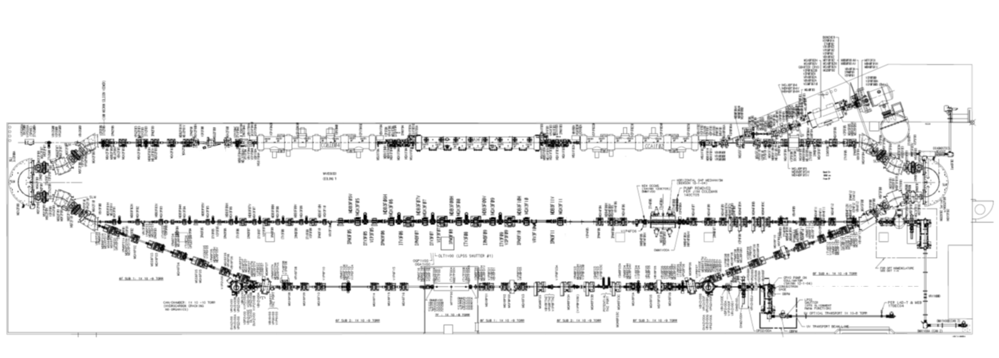
FEL/LERF
Alex Bogacz
Options for Recirculating Injector at 650 MeV

Slide 4
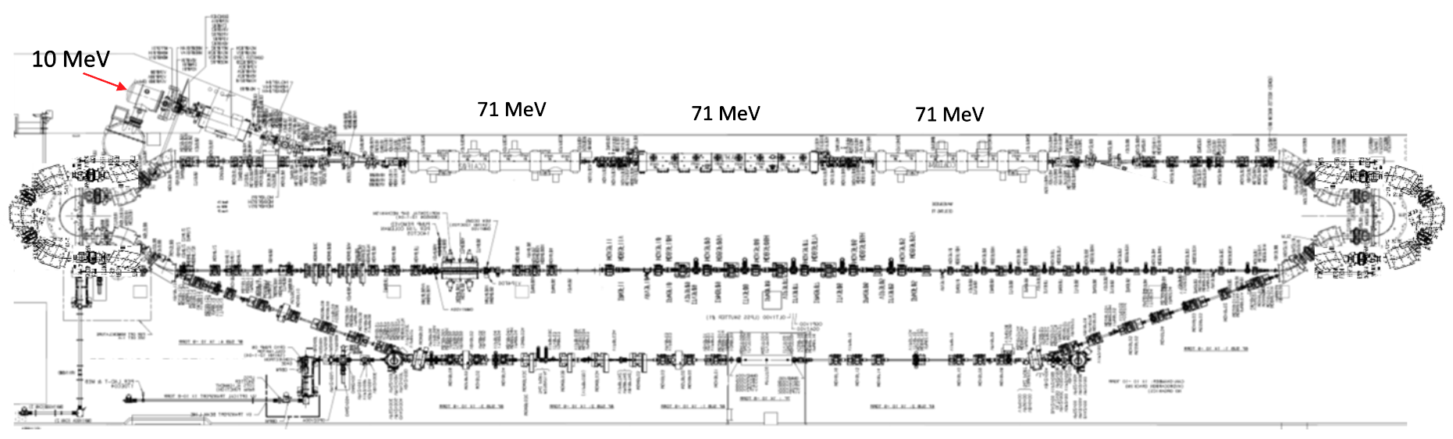
Recirculating Injector – Option 2 (3-pass)
650 MeV
Alex Bogacz
Options for Recirculating Injector at 650 MeV

Slide 5
Overlaying 650 MeV 3-pass into vault

Slide 6
Overlaying 650 MeV 3-pass into vault
Exiting “north” difficult
Exiting here still looks easier

Slide 7
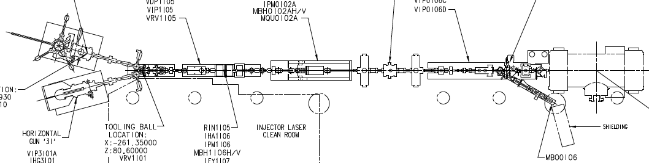
Trying counter-clockwise again…
CEBAF injector too big here
CEBAF injector too big here
Exiting here still looks easier

Slide 8
650 MeV e- injector for FFA >22 GeV
#4 – Extract 650 MeV from linac
#3 – 3-pass SRF acceleration to 650 MeV
Vertically stacked return lines to save floor space
#2 – Inject 10 MeV e- to linac
#1 – CEBAF style polarized e- injector 10 MeV
#5 – Transport e- at 650 MeV to exit LERF

Slide 9
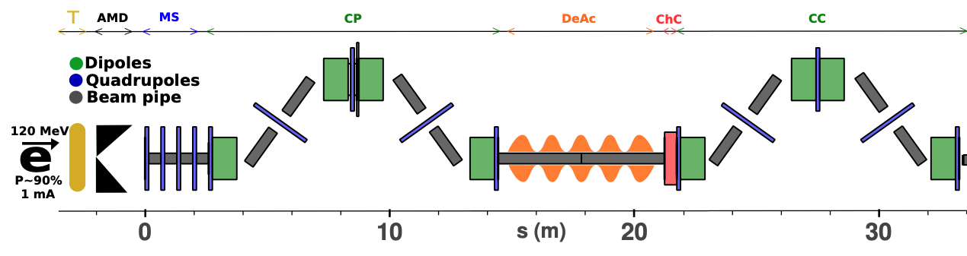
123 MeV e+ injector for 12 GeV positrons
#1A – FEL style compact e- injector 10 MeV
#6 – SRF accelerate e+ to 123 MeV
#2 - SRF accelerate >100 MeV
#5 – Injector e+ to linac
#3 – Extract e- to target
#4 - Produce e+ accelerate to 50-70 MeV
#1B – CEBAF style polarized e- injector 10 MeV
#7 – Transport e+ at 123 MeV to exit LERF

Slide 10
Still wondering about e+ @ 650 for 3-pass later…
Run e- near crest
Run e+ near zero-cross
Final e+ accel 123 MeV
?
Exiting here looks easier

