Slide 1
Bubble Chamber Experiments at UITF
Riad Suleiman

Slide 2
Study Nucleosynthesis Reactions
There are very important nuclear reactions that can be studied at Jefferson Lab:
¹⁶O(γ,α)¹²C
¹⁹F(γ,α)¹⁵N
Gamma beam is generated when electron beam hits a radiator
Jefferson Lab Program Advisory Committee (PAC40) approved proposal: “Measurement of ¹⁶O(γ,α)¹²C with a bubble chamber and a bremsstrahlung beam”
PAC41 identified this experiment as High Impact
Performed two engineering runs at CEBAF Injector
beam
target
signal
γ + ¹⁶O → ¹²C + α

Slide 3
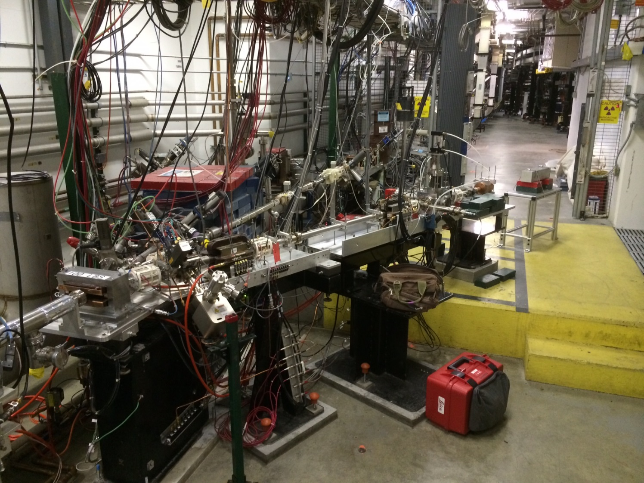
Bubble Chamber at CEBAF Injector
Bubble
Chamber
location
Dipole
5D Spectrometer

Slide 4
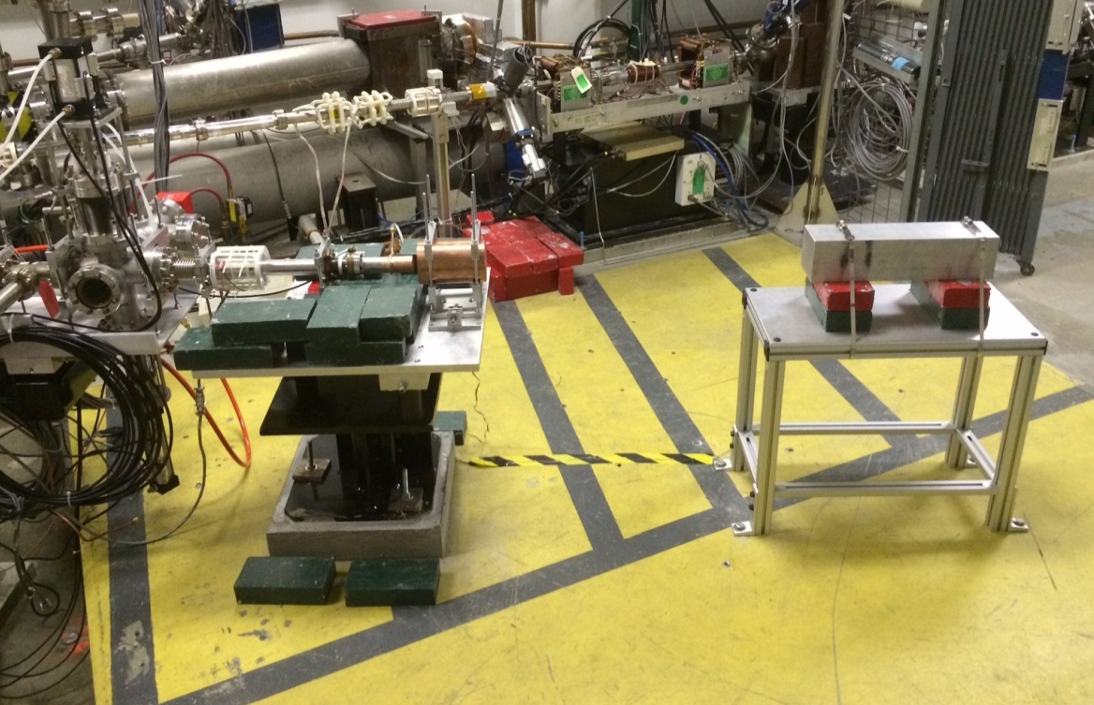
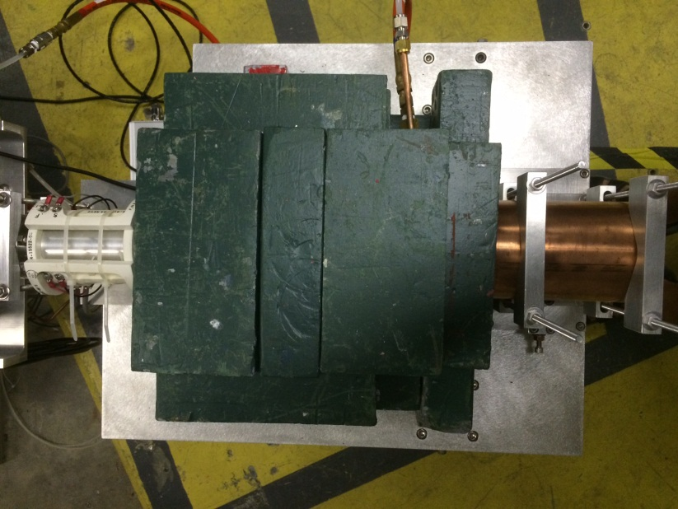
Cu Electron Radiator/Dump
Al Gamma Dump
Cu Gamma Collimator

Slide 5
Bubble
Chamber

Slide 6
Beam Requirements
Electron Beam:
Beam Time:
Two engineering runs, two weeks each
Production run: three weeks
Beam Kinetic Energy, (MeV) | 4.0 – 10.0
Beam Current (µA) | 0.01 – 100
Absolute Beam Energy Uncertainty | <0.1%
Relative Beam Energy Uncertainty | <0.02%
Energy Resolution (Spread), σ_{T} /T | <0.06%
Beam Size, σ_{x,y} (mm) | 1
Polarization | None

