Slide 1
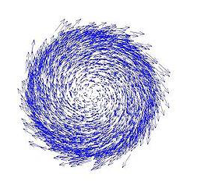
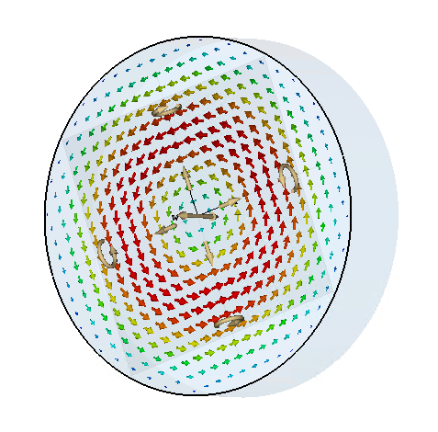
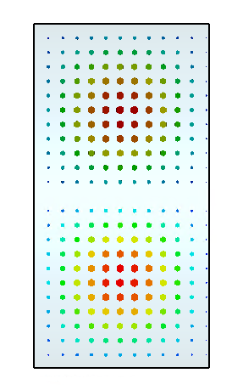
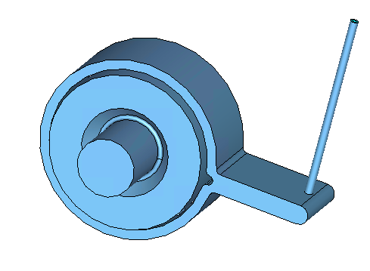
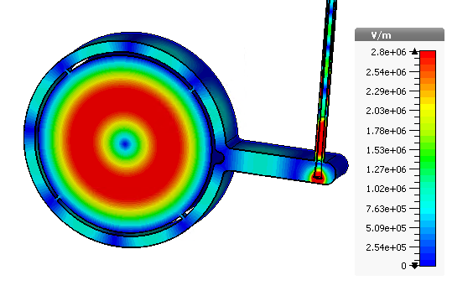
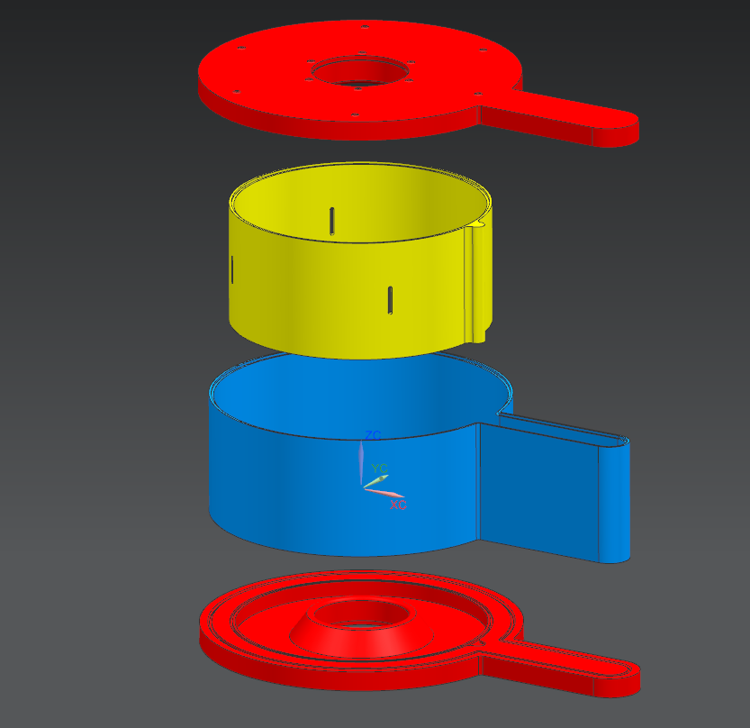
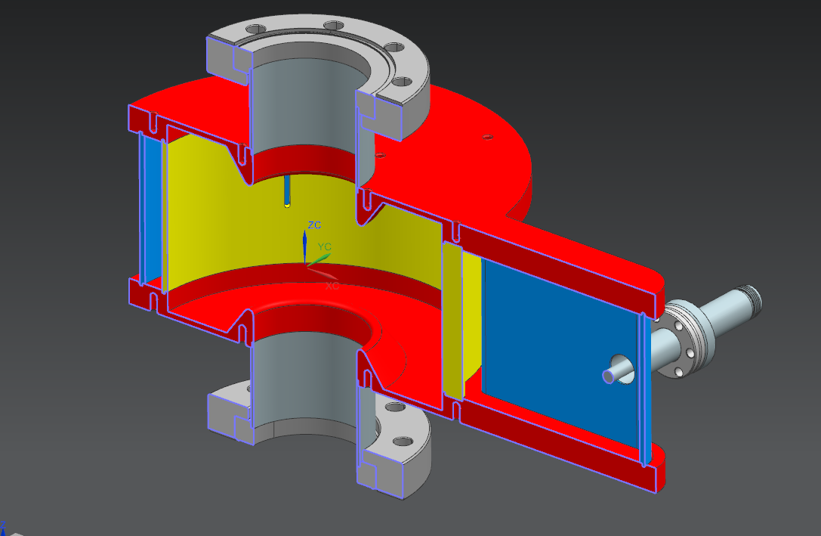
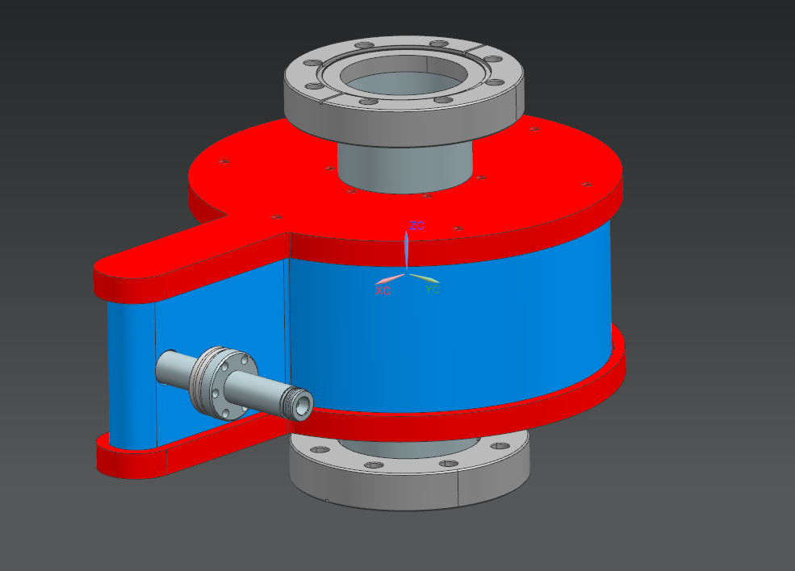
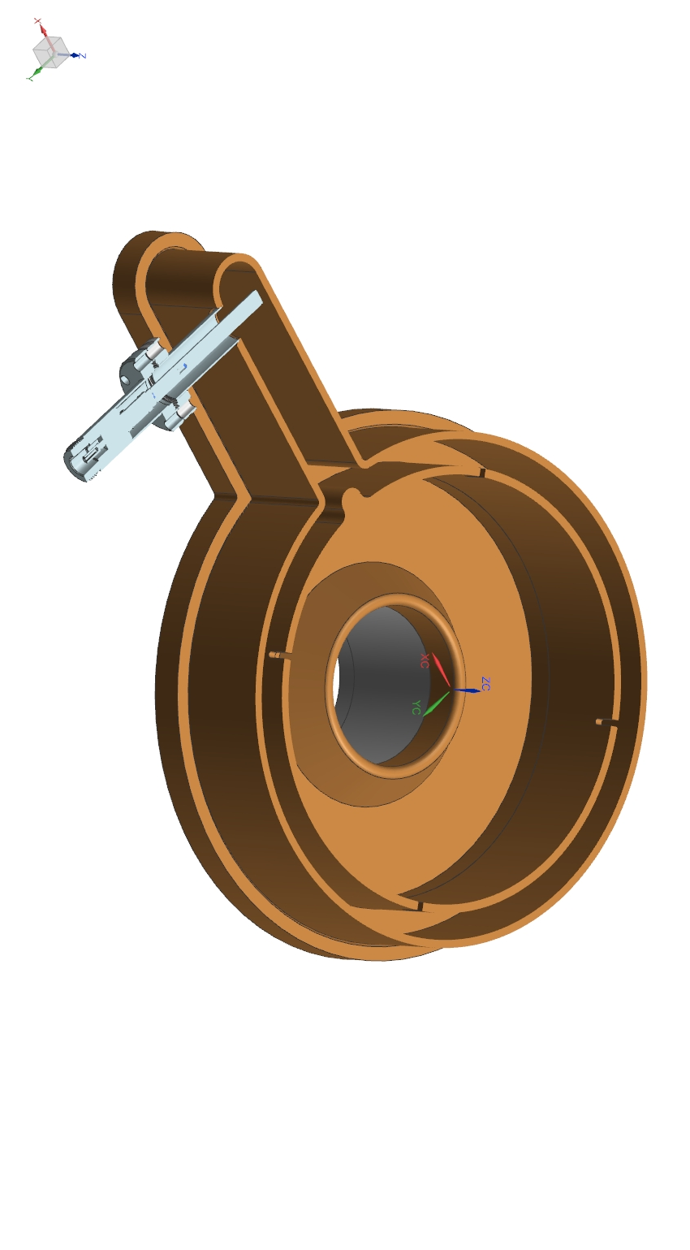
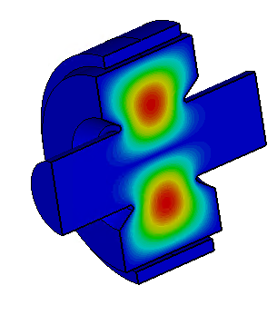
MOPVA130
A Non-Invasive Magnetic Momentum Monitor Using a TE011 Cavity*
J. Guo#, J. Henry, M. Poelker, R. A. Rimmer, R. Suleiman, H. Wang, JLAB, Newport News, VA 23606, USA
Abstract
The Jefferson Lab Electron-Ion Collider (JLEIC) design relies on cooling of the ion beam with bunched electron beam. The bunched beam cooler complex consists of a high current magnetized electron source, an energy recovery linac, a circulating ring, and a pair of long solenoids where the cooling takes place. A non-invasive real time monitoring system is highly desired to quantify electron beam magnetization. The authors propose to use a passive copper RF cavity in TE011 mode as such a monitor. In this paper, we will show the mechanism and scaling law of this device, as well as the design of the prototype cavity
JLEIC Circulating Cooler Ring (CCR)
RF Cavity TE₀₁₁ Mode and Magnetized Beam
top ring: CCR
magnetization flip
magnetization flip
ion beam
Canonical angular momentum of a particle
$$L=γmρ^{2}\dot{φ}$$
Magnetic Momentum
$$M=L\frac{e}{2mc}$$
Typical JLab GTS beam
$$\left\langle M\right\rangle =200neVs, E_{k}=200−300keV,$$
$$\left\langle \dot{φ}\right\rangle =1.1×{10}^{11}{Rad}/s, \left\langle \dot{ρ^{2}}\right\rangle =1{mm}^{2}$$
$I=5−32mA$ (~140mA for JLEIC CCR)
ion beam
B < 0
B > 0
linac
B > 0
B < 0
a.
b.
fast extraction kicker
beam dump
injector
fast injection kicker
septum
circulating bunches
septum
Transverse cross-section of a beam with longitudinal magnetic momentum
De-chirper
extracted
injected
Re-chirper
E-field of a pillbox cavity in TE011 mode
a. Transverse cross-section. b. x-z cross section with zero longitudinal field
vertical bend
bottom ring: ERL
JLEIC bunched beam cooler requires a magnetized electron beam from the injector, so when the electron beam enters the cooling channel, the cooling solenoid’s edge field will cancel the rotation of the beam and the beam will be (almost) rotation free in the channel.
Non-invasive measurement of the magnetic momentum of such electron beam is highly desired. A prototype of such a device can be tested at JLab’s Gun Test Stand (GTS).
The angular momentum and magnetic momentum of a charged particle is determined by its motion in azimuthal direction
In a perfect pillbox RF cavity, the electric field of TE011 mode has only azimuthal component, and will be zero in other directions (radial or longitudinal).
(Perfect) TE011 mode will only have energy exchanging interaction with the azimuthal motion of a particle, making it an ideal candidate for magnetic momentum monitor.
TE₀₁₁ Mode and Magnetized Beam Interaction: Analytical Results in a Perfect Pillbox Cavity
Cavity Coupler Design
Assuming the beam-cavity interaction has negligible perturbation on beam trajectory
For a pillbox with thickness d and radius a, the TE₀₁₁ mode azimuthal E-field’s amplitude follows the derivative of the Bessel function of first kind; when ρ/a<0.3, the E-field can be can be approximated (within 1% error) as
By integrating E-field over the particle trajectory, the cavity R/Q can be calculated as
$\frac{R_{⊥}}{Q}=\frac{{V⊥}^{2}}{ωU}=\frac{{\left(\frac{1}{2βc}cos\frac{ωd}{2βc}\left(\frac{1}{\left(\frac{π}{d}−\frac{ω}{βc}\right)}−\frac{1}{\left(\frac{π}{d}+\frac{ω}{βc}\right)}\right)\right)}^{2}{\left(\dot{φ}ρ^{2}\right)}^{2}}{ωJ_{0}^{2}\left(3.832\right)\frac{εa^{4}πd}{8×{3.832}^{2}}}$
The total power deposited into such a passive cavity by a CW beam will be
${P_{tot}=\frac{R}{Q}I^{2}Q_{loaded}=〈{\left(\dot{φ}ρ^{2}\right)}^{2}〉I^{2}Q_{loaded}\frac{{\left(\frac{1}{2βc}cos\frac{ωd}{2βc}\left(\frac{1}{\left(\frac{π}{d}−\frac{ω}{βc}\right)}+\frac{1}{\left(\frac{π}{d}+\frac{ω}{βc}\right)}\right)\right)}^{2}}{ωJ_{0}^{2}\left(3.832\right)\frac{εa^{4}πd}{4∗{3.832}^{2}}}}_{}$
$P_{emitted}=P_{tot}\frac{Q_{loaded}}{Q_{ext}}$ will be maximized to 1/2 of P_{tot} with critical coupling
The emitted power will be proportional to $I^{2}\left\langle {\left(M/γ\right)}^{2}\right\rangle$, which means it should work as a magnetic momentum monitor, and will be more sensitive for particles with low γ
Given cavity frequency f=1497MHz and beam velocity β=0.78, we can optimize the cavity dimensions to d=0.1530m (≈0.98βλ) and a=0.1615m to maximize cavity impedance R/$〈{\left(\dot{φ}ρ^{2}\right)}^{2}〉$. Assuming copper cavity with critical coupling, with typical Jlab GTS beam parameters M=200neVs and I=5mA, the emitted power will be 3.45μW(-24.6dBm), which is reasonable to be detected.
The transit time factor (TTF) of such a cavity and beam velocity is only 0.352.
For electrons with M=200neVs and 300keV kinetic energy, R/Q is only 8.6μΩ for the previously mentioned cavity dimensions. The major challenge for this device is to exclude the excitation of TE011 mode from non-magnetized beam. The longitudinal R/Q of this mode needs to be controlled to <100nΩ level with careful coupler design and fabrication precision, while the beam center trajectory needs to be well aligned to the cavity center.
4 coupling slots
Coax pickup
$$E_{φ}={{\sin\left({πz}/d\right)jηρkH}_{0}}/2$$
E-field in the center (mirror) plane
The coupler design strategy to achieve low longitudinal impedance is to preserve the longitudinal mirror symmetry and the cylindrical symmetry as much as possible.
The design is similar to the SLAC X-band wrap-around rectangular waveguide TE10 to circular TE01 mode launcher [1], with 4 equally spaced longitudinal slots coupling to the wrap-around waveguide, and a lip combining the two branches of the waveguide.
The waveguide width is adjusted so the slot spacing equals λ_{g}. With 4 slots, the waveguide width is slightly smaller than the optimized cavity length.
A matched coax pickup will couple to instruments
Slot size designed to be slightly overcoupled, budgeting for conductivity loss and mismatch in the coax pickup
The 4 slots will be sensitive to TE(4N)xx modes, and rejecting the other modes
For the prototype, the only damping mechanism for HOM and LOM is the cavity wall loss, which would be sufficient.
Beampipe dampers might be needed on devices for higher beam current
Cavity Mechanical Design
Cavity RF Design and Scaling
By adding beampipes to the pillbox, fringe field reduced the TE011 mode TTF and the transverse impedance.
Nosecones are added to restore TTF.
Initially 1497MHz frequency was considered for the prototype cavity, but it’s not required to match any other system’s frequency, since the laser rep-rate at JLab GTS is adjustable.
With a given cavity aspect ratio, $P_{emit}∝ω^{1.5}ρ^{4}{\dot{φ}}^{2}$
If the cavity size is not limiting the beam’s maximum angular momentum, $P_{emit}∝ω^{1.5}$, smaller cavities is more sensitive
Smaller cavities are also less sensitive to longitudinal impedance. More important, smaller cavities are easier to fabricate and can use pass the mechanical stress requirement with thinner wall.
We decided to design the prototype in 2994MHz with constant beampipe size
Fringe field becomes worse, canceled the impedance gain due to smaller cavity size
For M=200neV β=0.78 beam, R/Q=15.6μΩ, R=573mΩ, same transverse impedance as the optimized 1497MHz cavity
Four copper parts brazed into the cavity body
The main cavity body contains 4 parts machined from two blocks of OFHC copper, including two end-plates, the inner cavity wall, and the outer wrap-around waveguide wall.
To preserve the symmetry, the 4 copper parts and the 2 stainless steel beampipes will be brazed together (instead of weld).
RF bench measurement can be done by clamping the parts together before the final braze.
Frequency tuning is not required in the prototype, as we can tune the laser rep-rate to fit the actual cavity frequency.
Summary
We proposed and designed a Beam Magnetic Momentum Monitor using an RF cavity in TE011 mode. The RF signal power excited by the beam is theoretically proportional to the square of the beam’s magnetic momentum. For low velocity beam, the cavity could provide sufficient signal strength and low noise. The cavity fabrication will start soon.
We would like to thank J. Armstrong, F. Fors, L. Turlington, S. Williams, for their help in the mechanical design of this cavity.
E-field in the 2994MHz cavity
Tangential E-field in the 2994MHz cavity seen by the beam with x’=50mrad, y0=0.01m, equivalent to M=2127neVs
References:
1. S. Tantawi et al., “The Generation of 400-MW RF Pulses at X-Band Using Resonant Delay Lines”, IEEE Trans. on MTT, Vol. 47, No. 12, Dec. 1999
# jguo@jlab.org

