Slide 1
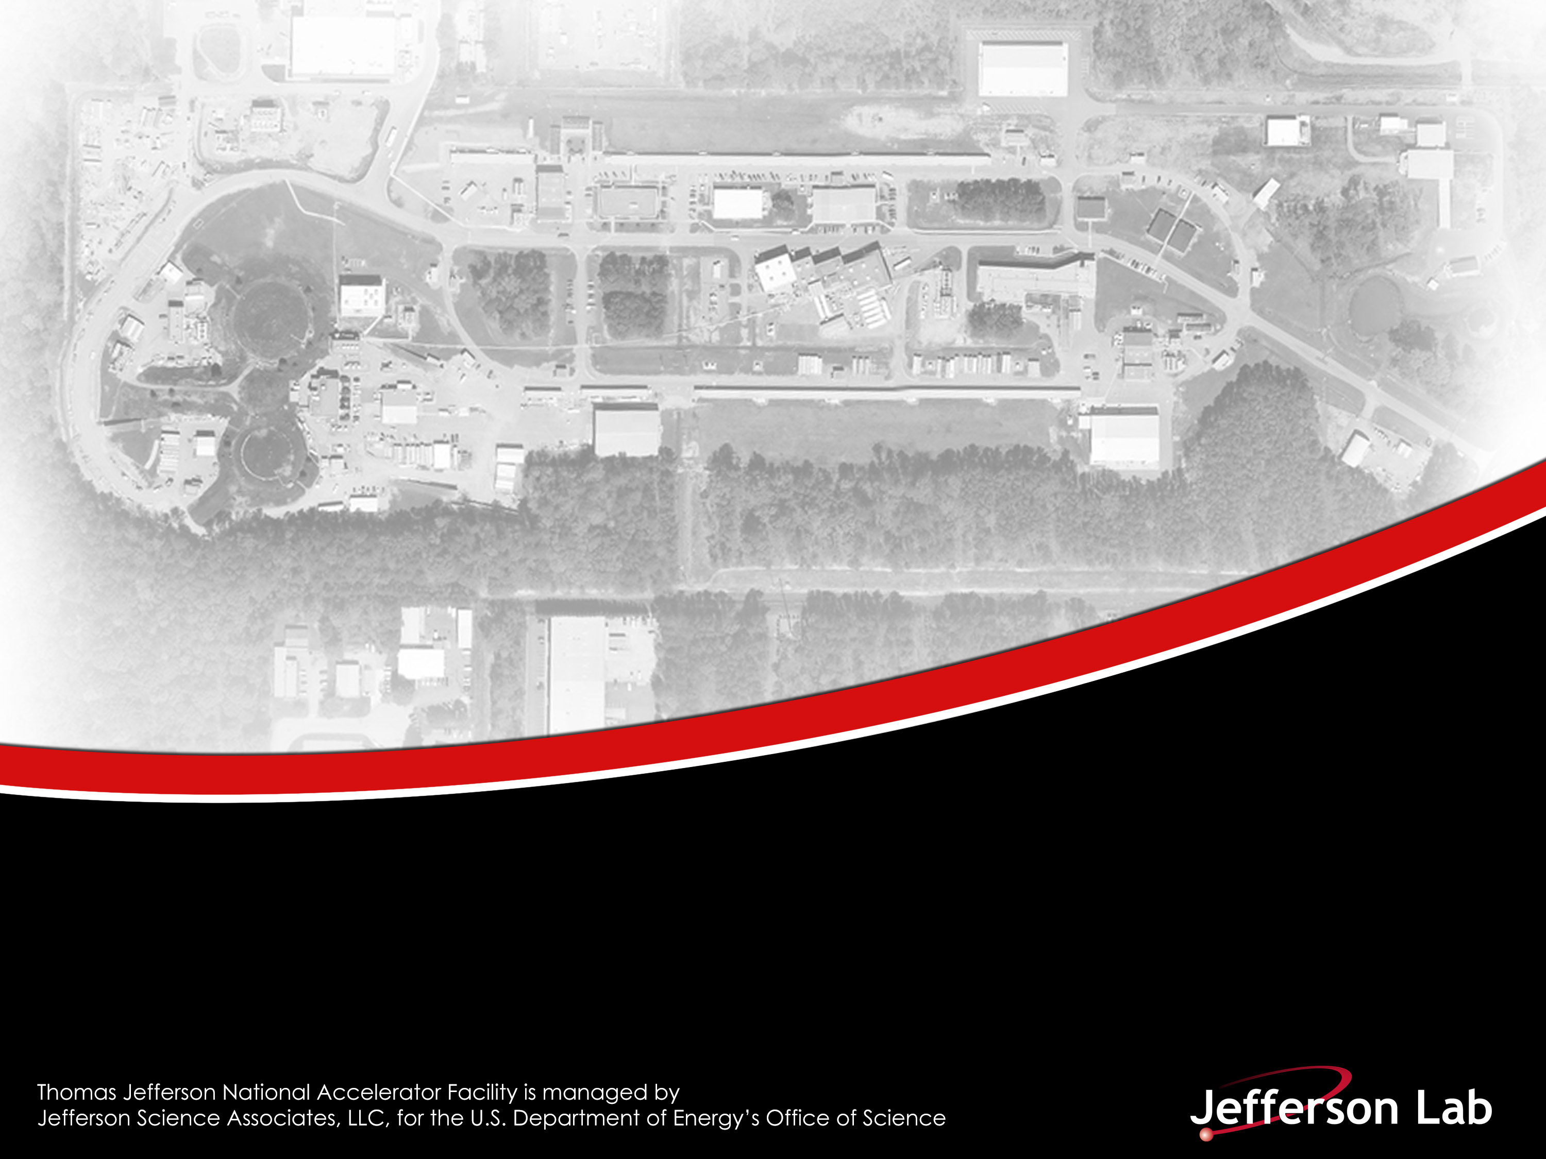
Extreme High Vacuum
Marcy Stutzman, Ph.D Jefferson Lab Center for Injectors and Sources
Notes:
Title Page Design 3

Slide 2
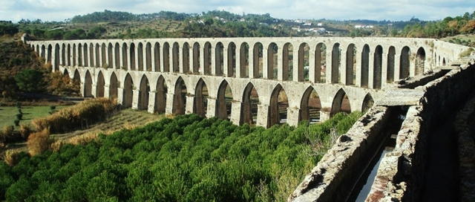
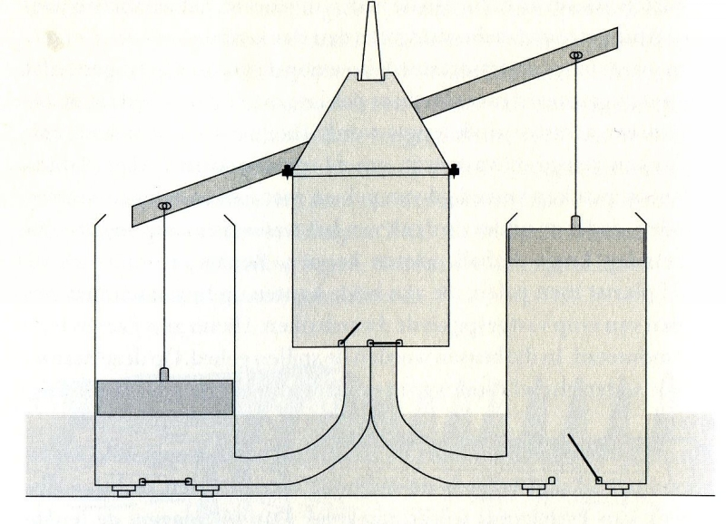
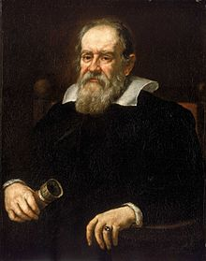

Early vacuum production
Suction pumps for water from Roman times
Improvements by 1635 – vacuum produced with suction pumps
  Water could not be sucked up a height over 30 feet - Why???
  Galileo commissioned to investigate
http://www.romanaqueducts.info/
http://www.conestogaworks.com/vacuum_history.html
Marcy Stutzman July 31, 2018

Slide 3
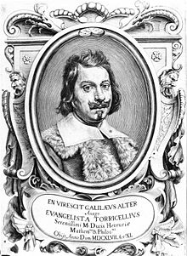
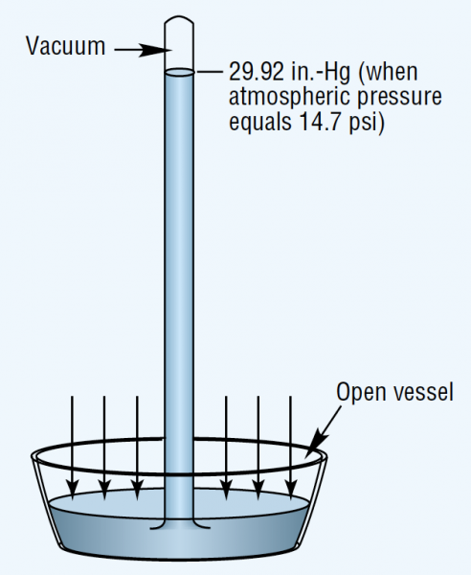
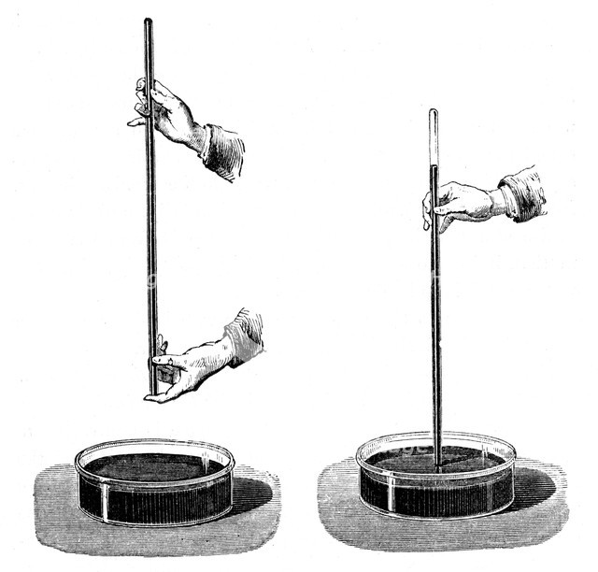
Beginnings of vacuum measurement
Evangelista Torricelli
1608-1647
Inventor of mercury barometer
https://www.hydraulicspneumatics.com/
https://www.pbslearningmedia.org
Marcy Stutzman July 31, 2018

Slide 4
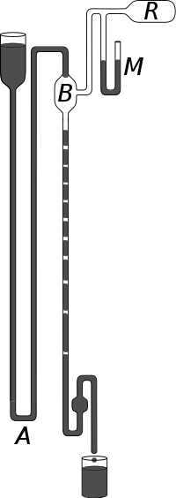
Early vacuum pumps
Sprengel pump
  Mercury drops fall through bulb B
  Gas in bulb B and vessel R are trapped and exhausted at bottom
  Barometer/manometer M measures vacuum
Can achieve ~10⁻⁵ Torr
Pumps for first light bulb evacuation
“The supply of mercury is contained in the reservoir on the left. It flows over into the bulb B, where it falls in drops into the long tube on the right. These drops entrap between them the air in B. The mercury which runs out is collected and poured back into reservoir on the left. In this manner practically all the air can be removed from the bulb B, and hence from any vessel R, which may be connected with B. At M is a manometer which indicates the pressure in the vessel R, which is being exhausted.
Falling mercury drops compress the air to atmospheric pressure which is released when the stream reaches a container at the bottom of the tube. As the pressure drops, the cushioning effect of trapped air between the droplets diminishes, so a hammering or knocking sound can be heard, accompanied by flashes of light within the evacuated vessel due to electrostatic effects on the mercury.
The speed, simplicity and efficiency of the Sprengel pump made it a popular device with experimenters. Sprengel's earliest model could evacuate a half litre vessel in 20 minutes.^{[5]} “
https://en.wikipedia.org/wiki/Sprengel_pump
Marcy Stutzman July 31, 2018

Slide 5
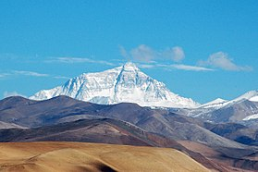
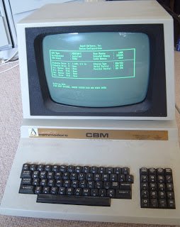
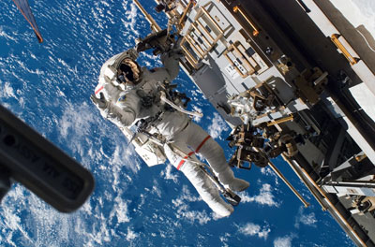
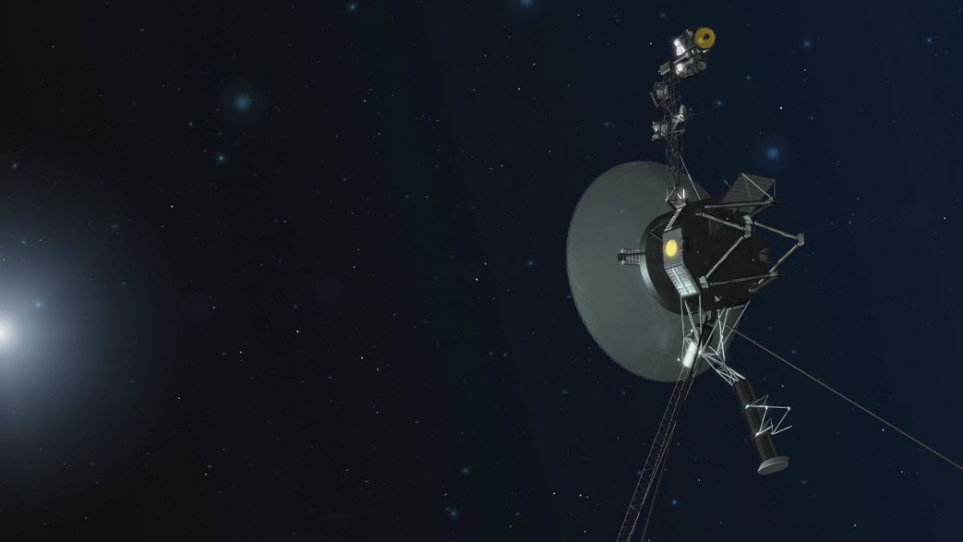
Vacuum levels
 | Example | Pressure (Torr) | atoms/cm³
Atmosphere | Atmosphere at sea level | 760 | 27,000,000,000,000,000,000 or 2.7x10¹⁹
Low vacuum (1-300 Torr) | Atmosphere on Mount Everest | 252 | 1x10¹⁹
 | Pressure in bell jar experiment, Mars | 1-10 | 1-3 x 10¹⁷
Medium vacuum (1 Torr-1mTorr) | Insulating vacuum, atmosphere on Pluto | 10⁻³ | 10 quadrillion
High vacuum (1 mTorr- 1x10⁻⁷) | Scattering chambers | 10⁻⁵ | 100 trillion
Ultra high vacuum (UHV, 1x10⁻⁷ – 1x10⁻¹²) | Vacuum tubes, Cathode Ray tubes, beamline vacuum | 10⁻⁸ | 100 million
 | Pressure outside Space Station (400 km) | 10⁻¹⁰ | 1 million
 | JLab Electron Gun | 10⁻¹² | 10,000
Extreme high vacuum (XHV <1x10⁻¹²) | Interstellar space estimate ~ 1 atom / cm³ | 10⁻¹⁷ | 1
Voyager space probe
Marcy Stutzman July 31, 2018

Slide 6
Jefferson Lab vacuum
Beamline vacuum:
Ultra-high vacuum
Polarized electron source:
Approachng Extreme High vacuum
Cryomodule vacuum at 2K:
Calculated to be
Extreme High vacuum
Cryomodule insulating vacuum
Medium-High vacuum
Experimental scattering chambers:
High vacuum
Marcy Stutzman July 31, 2018

Slide 7
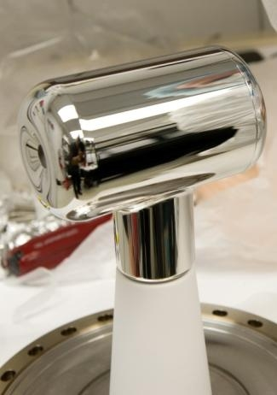
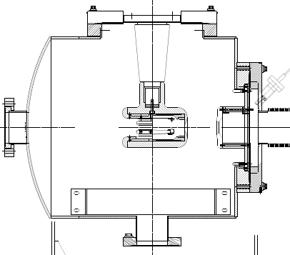
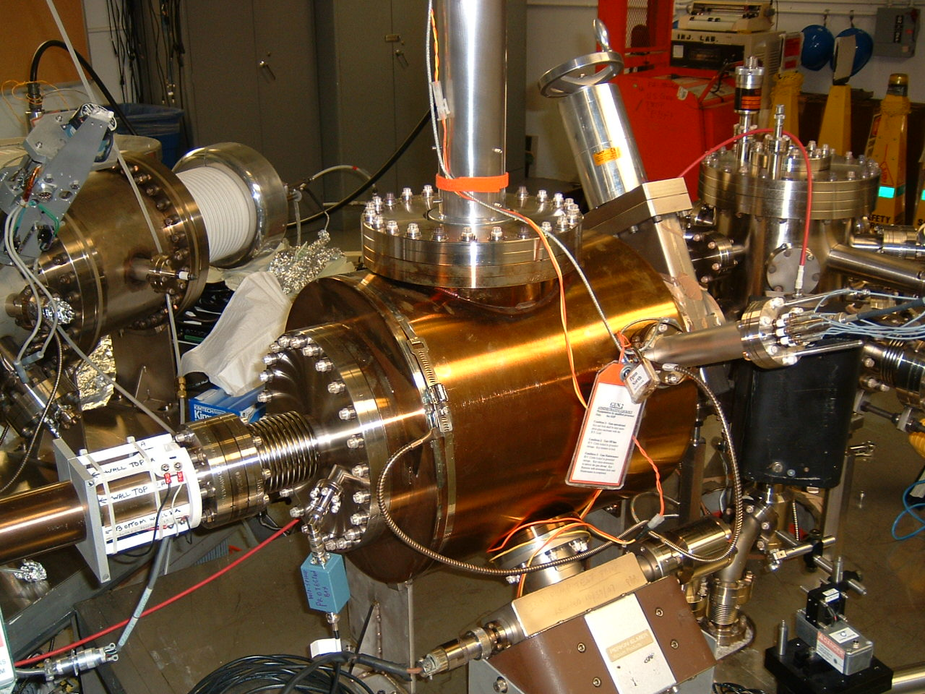
Photoemission Source
-130 kV DC (vs. RF) electrode bias
x-ray standard “inverted” insulator
Pumps with NEG modules and ion pump
Base pressure approaching XHV ≡ P < 1x10⁻¹² Torr
-130kV
light in
electrons out
photocathode
Marcy Stutzman July 31, 2018

Slide 8

  Any gas in chamber can be ionized by electron beam, accelerated back toward the photocathode and
  limit photocathode operational lifetime
Marcy Stutzman July 31, 2018

Slide 9
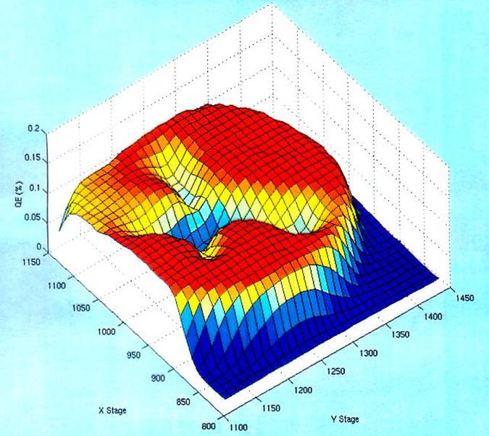
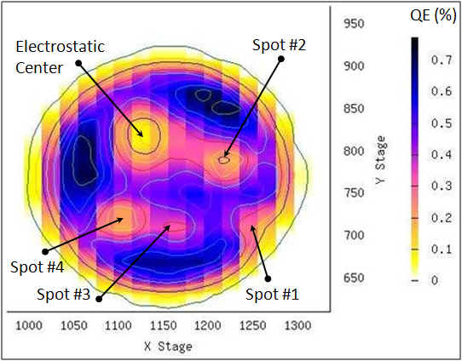
Photocathode Lifetime
Ion bombardment – with characteristic QE “trench” from laser spot to electrostatic center of photocathode – damages NEA of GaAs
High energy ions are focused to electrostatic center: create QE “hole”
  Don’t run beam from electrostatic center.
QE can be restored, but takes about 8 hours to heat and reactivate

Slide 10
How to reach XHV ≡ P < 1x10⁻¹² Torr?
Pump gas away
Less gas in
Measure pressure
Marcy Stutzman July 31, 2018

Slide 11
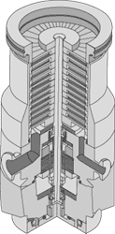
Modern Vacuum Pumps
Gas Transfer Pumps
Capture Pumps
Rotary vane pumps
Roots pumps
Turbo pumps
Ion pumps
Getter pumps
Cryopumps
Remove molecules from gas phase
Compress rarified gas
Move gas to higher pressure exhaust
Marcy Stutzman July 31, 2018

Slide 12
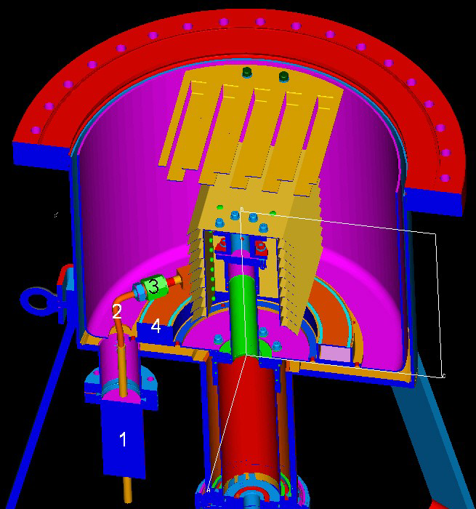
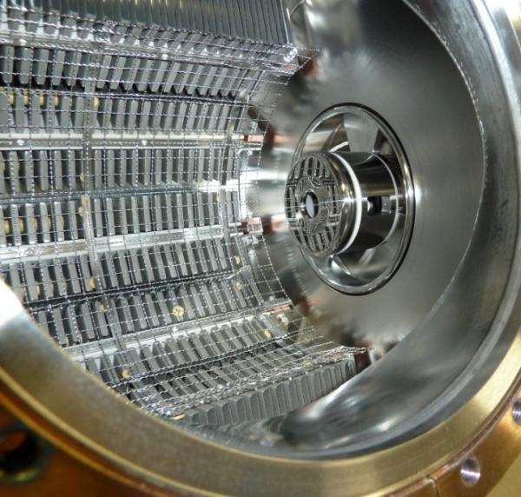
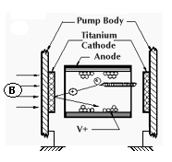
Capture Pumping
Ion pumps
Gas ionized
High voltage accelerates ions into plates
Ion implant in plates - captured
Getter pumps
Chemically reactive surface
Gas molecules incident on surface stick
Chemisorption removes gas
Cryopumping
Large surface area material
Cooled below freezing temperature of desired gas
Gas incident on cold surface sticks

Slide 13
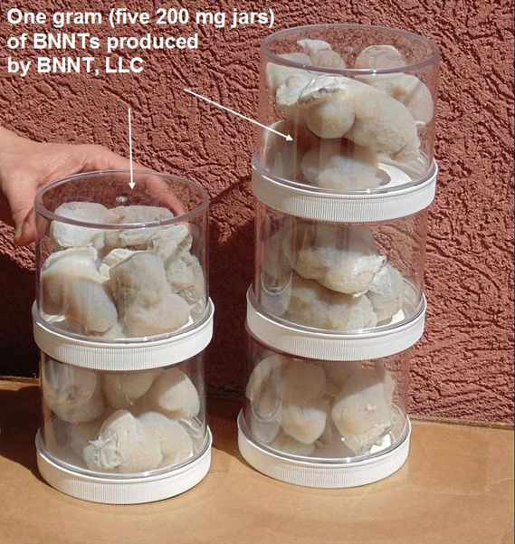
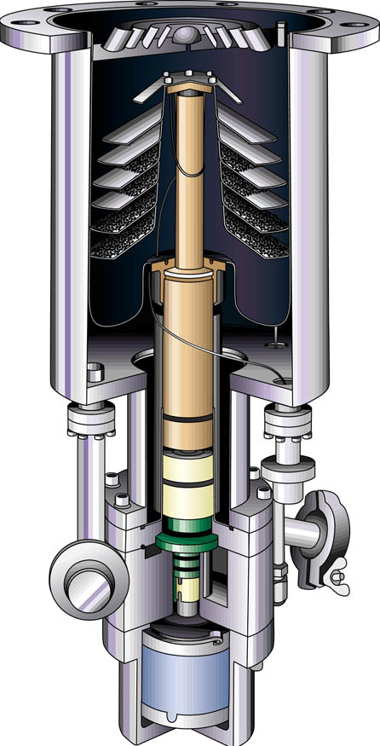
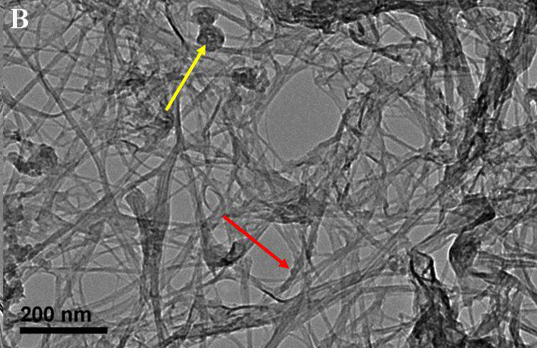
New cryosorber: Nanomaterial
Typical cryopumps glue charcoal to cold surface
  Large surface area allows cryosorption rather than cryocondensation
  Lower pressure
Requires Low temperature adhesives
  Can’t bake system well
Boron-Nitride Nanotubes have
  Huge surface area
  Good thermal
  Are freestanding
  Are manufactured across street (JLab spin-off)
Can we use these for cryosorber material?
Marcy Stutzman July 31, 2018

Slide 14
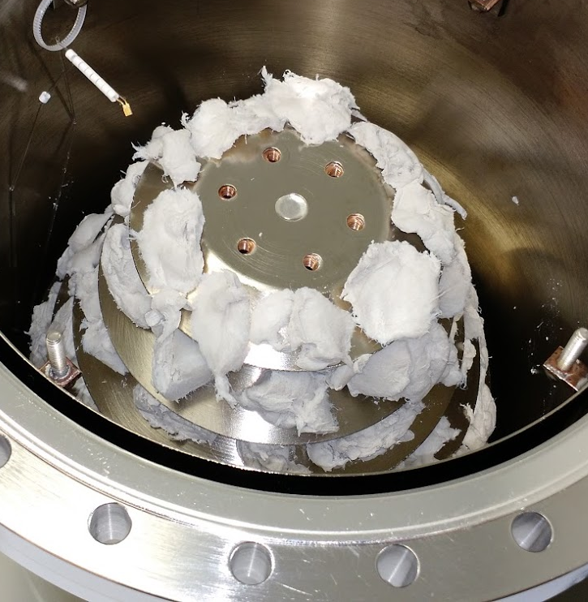
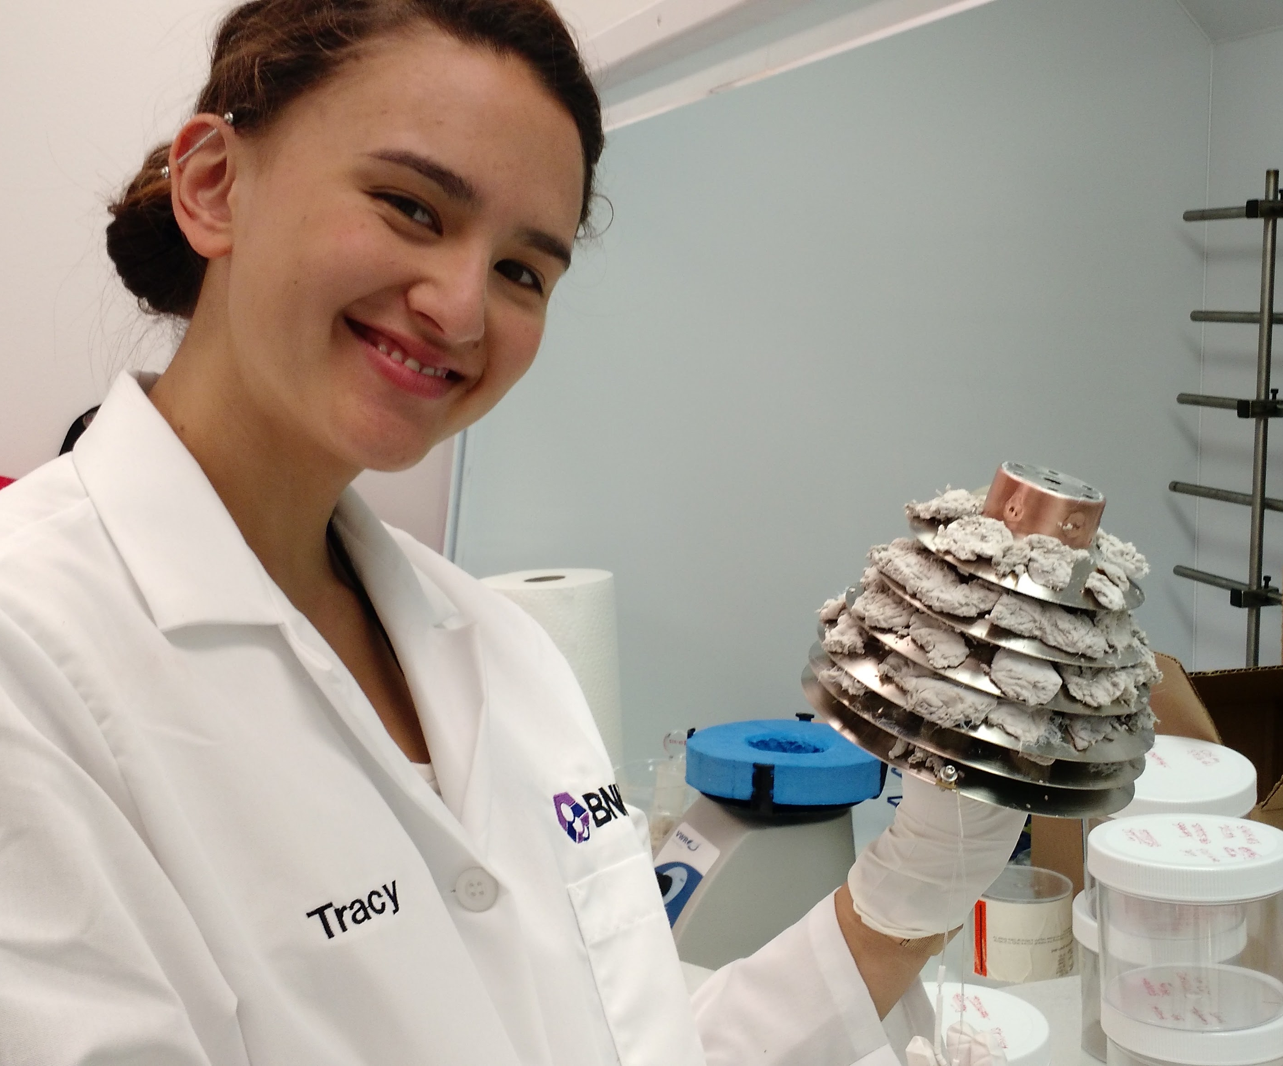
Mounting BNNT for Cryopumping
1 g BNNT material
Copper grid
~4 g BNNT material
“sewn on” with wires
SULI Student, 2016
Veronica
Marcy Stutzman July 31, 2018

Slide 15
Results
BNNT outgassing low
  No valve
  P~3x10⁻¹² Torr BNNT warm
Cryopump reduces pressure
x-ray limit 1.2x10⁻¹² Torr dominates extractor gauge reading
3BG readings still have good signal:background, negligible x-ray effect
Before x-ray subtraction
after
Marcy Stutzman, Roy Whitney and Kevin Jordan “Nano-materials for adhesive-free adsorbers for bakable extreme high vacuum cryopump surfaces” Patent US9463433B2
Marcy Stutzman July 31, 2018

Slide 16
How to reach XHV ≡ P < 1x10⁻¹² Torr?
Pump gas away
Less gas in
Measure pressure
Marcy Stutzman July 31, 2018

Slide 17
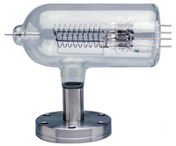
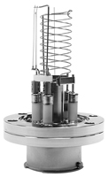
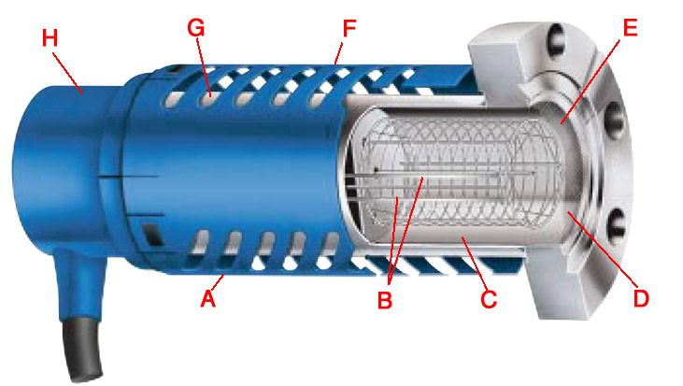
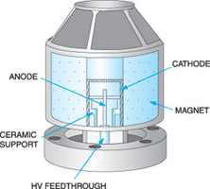
High/Ultra High Gauges
+V
Lowest pressures:
  10⁻⁸ Torr – 10⁻¹¹ Torr
  up to $4,000
Bayard-Alpert Gauges
+
filament
A
collector
Stabil-Ion gauge
Cold Cathode gauge
Marcy Stutzman July 31, 2018

Slide 18
Measure Pressure:
Hot cathode gauge operation and errors
True gas ionization
  Positive current
X-ray effect
  e- on anode -> photons emitted
  Photons on collector -> electrons emitted
  Extra positive current
Anode
+
1
Additional effects:
  Inverse X-ray effect
  Electron Stimulated Desorption
2
e⁻
Cathode
Marcy Stutzman July 31, 2018

Slide 19
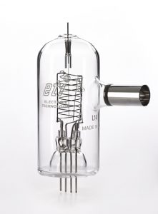
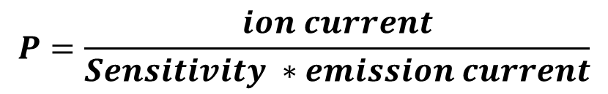
Ionization gauge pressure calibration
Chamber evacuated
Gauge energized
Current measured
Calibration factor to translate measured current to pressure
x-ray limit determines lowest pressure that can be measured
$$P=\frac{ion current}{Sensitivity ∗emission current}$$
Marcy Stutzman July 31, 2018

Slide 20
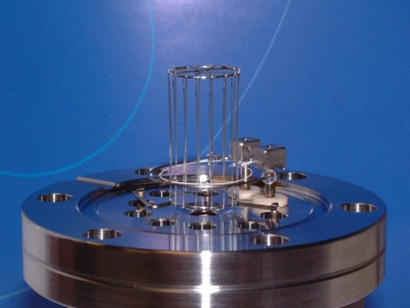
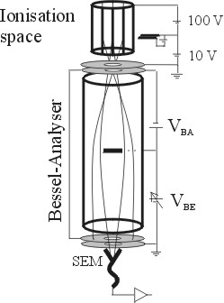
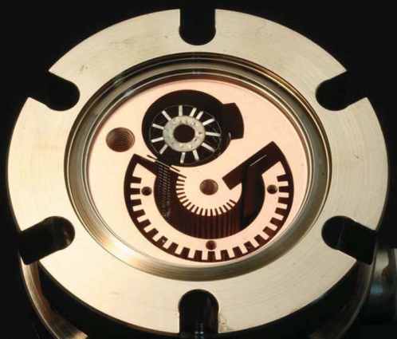
XHV gauges: reduce x-ray limit
Hot filament
extractor
Extractor gauge
  available commercially for decades
  x-ray limit reduced through geometry
  x-ray limit quote: 7.5x10⁻¹³ Torr
  $4,300
Axtran gauge
  Bessel box energy discrimination
  electron multiplier to assist in low current measurements
  Quoted limit: 3.75x10⁻¹³ Torr
  $7,500
Watanabe BBB (Bent Belt Beam) gauge
  Uses Leybold IE540 controller
  230° deflector BeCu housing
  JVSTA 28, 486 (2010)
  Quoted limit: 4x10⁻¹⁴ Torr
  $13,000 + Ext. controller ($2,600)
Axtran
BBB
Marcy Stutzman July 31, 2018

Slide 21
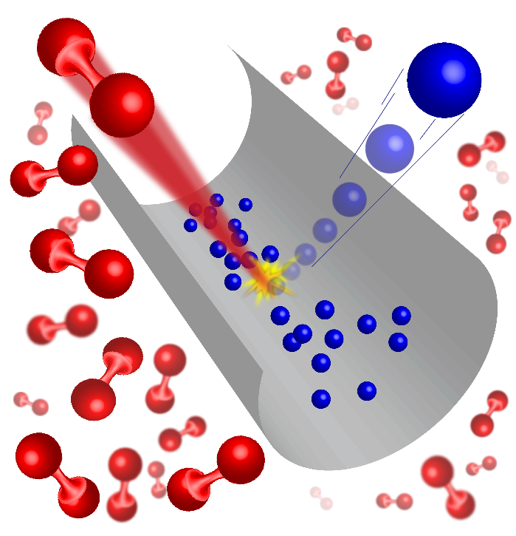
Cold Atom Vacuum Standard (CAVS)
World’s only absolute UHV/XHV sensor and standard
Cover range of 10⁻¹⁰ to 10⁻⁵ Pa
  Presently no primary standards
Move from classical to quantum based standard
Two Versions:
300 K Gas
Ultra-cold atoms
    Lab Scale
    Miniature (portable) scale
Thanks to Julia Scherschligt and Jim Fedchak

Slide 22
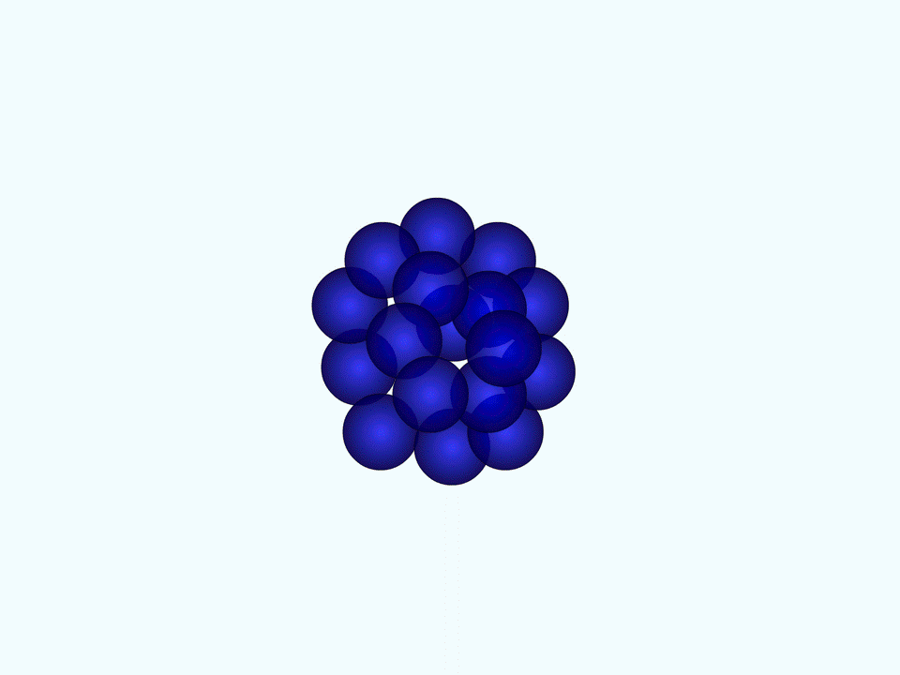
Ultra-cold atoms make ideal vacuum sensors
Laser cool sensor atoms to ~10 μK
Background Gas (H₂)
Transfer cold atoms to shallow magnetic trap
ΔE / k_{B} ~ 10 μK
300 K background atoms easily kicks 10 μK atoms from magnetic trap
Loss rate of cold-atoms is a measurement of vacuum
Depends on:
Collision rate coefficient (atomic property)
Density of background gas
10 μK sensor atoms

Slide 23
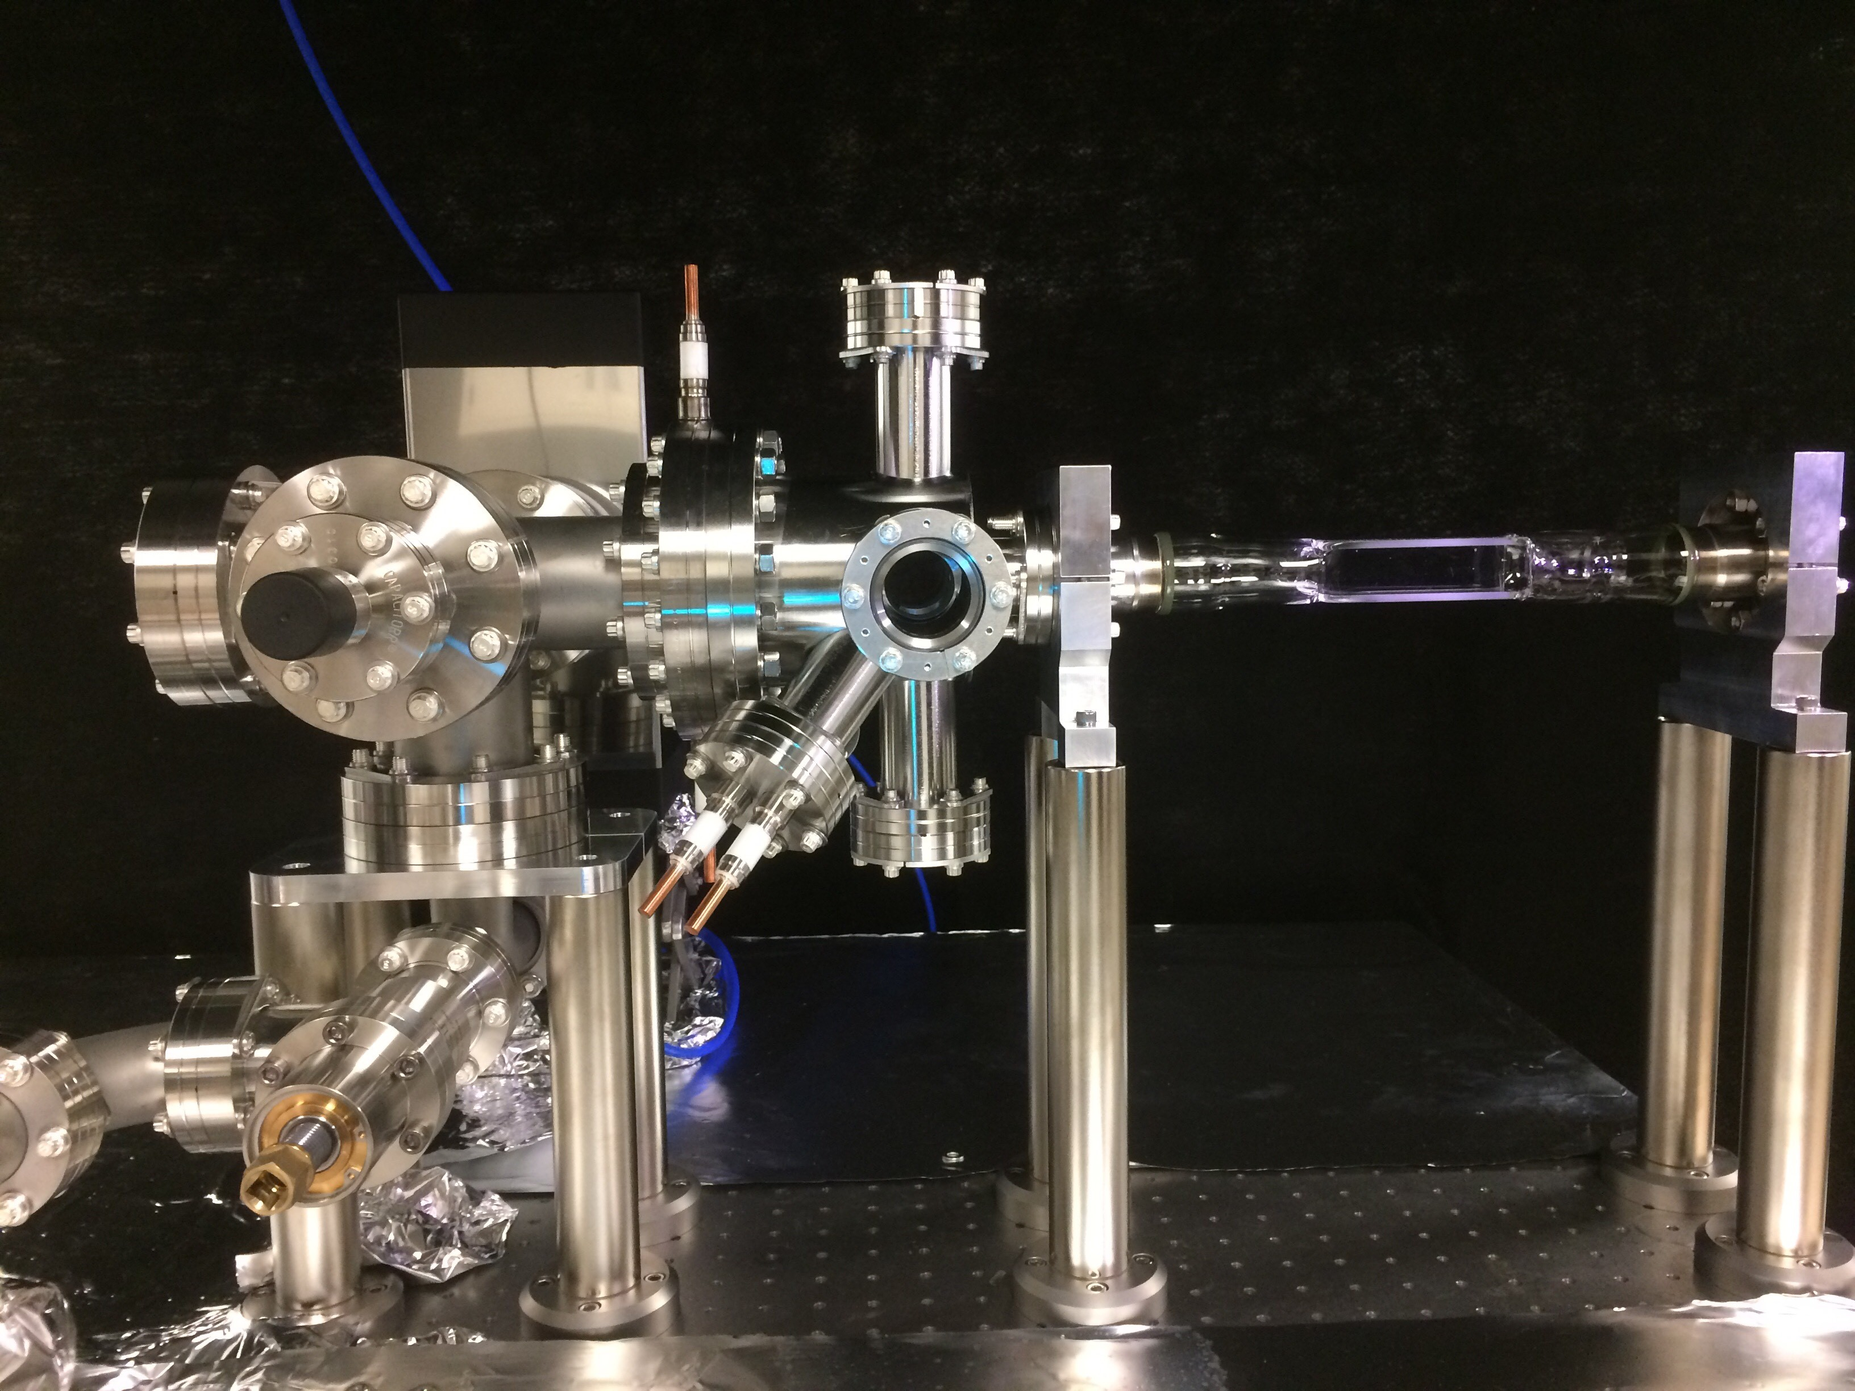
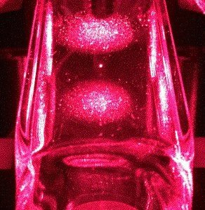
Basis of the CAVS
Ion & getter pumps
vacuum under test attaches here
2D MOT
Ion gauge
3D MOT
Atomic source

Slide 24
Summary
High polarization photocathodes require vacuum near or at XHV for long lifetime
We’re optimizing the existing pumps and innovating on new XHV pumping
Current ionization gauges may be replaced by Quantum standards and gauges
300 K Gas
Ultra-cold atoms

Slide 25
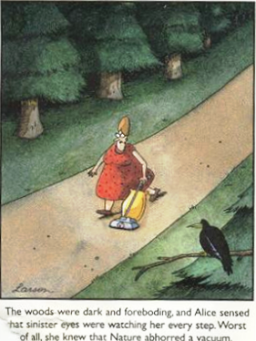
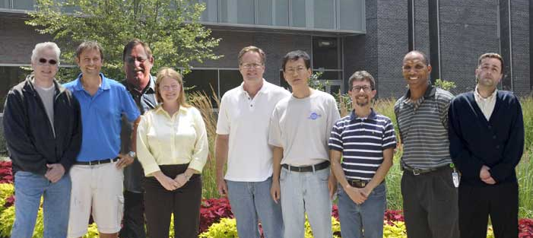
Questions?
“The woods were dark and foreboding, and Alice sensed that sinister eyes were watching her every step. Worst of all, she knew that Nature abhorred a vacuum” – Gary Larson
Jefferson Lab Center for Injectors and Sources
Matt Poelker, Joe Grames, Bubba Bullard
Marcy Stutzman, John Hansknecht, Shukui Zhang
Carlos Hernandez Garcia, Phil Adderley, Riad Suleiman

