Slide 1
Viewer resistance measurements
Marcy Stutzman, Oct 18 2022

Slide 2
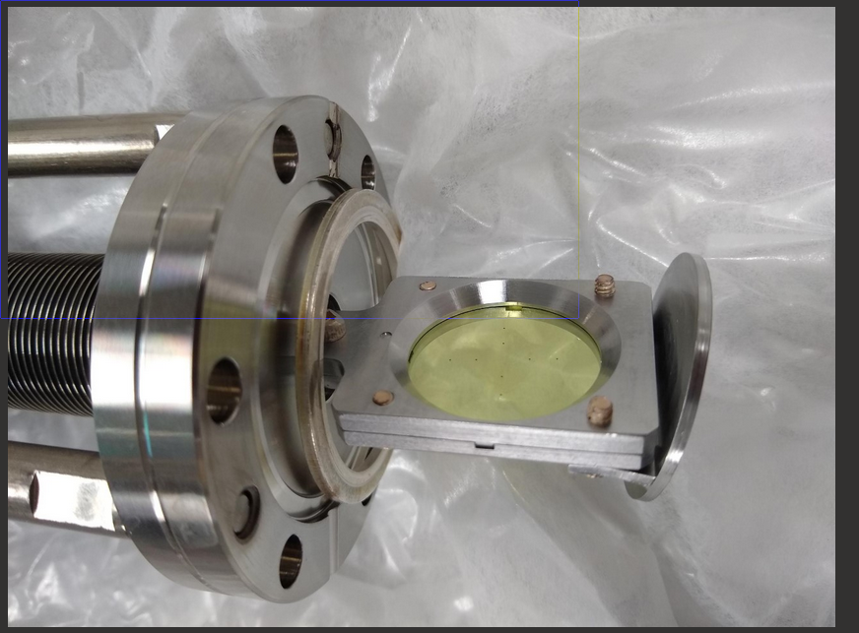
Viewer induced beam motion
Harp and viewer both installed at IHA0I02 location
Harp typically does not share the cross with a viewer
Harp does not completely retract from cross
Crashed top hat of viewer into harp
YAG coated with conductive ITO coating, 90 nm thick, to bleed charge
Removed top hat at ITV0I02

Slide 3
Evidence for charge/discharge beam motion

Slide 4
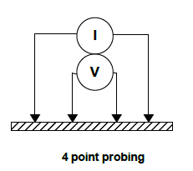
4 point resistance measurements
Contact resistance dominates for conductive films
Use 4 point measurement technique

Slide 5
Results
Broken sample – old viewer from GTS, no coating
Resistance matches that of open probe (∞)

Slide 6
Results 2
New viewer with fiducials, ITO coating
Sheet resistance
Rs = π/ln(2) *V/I (ohms/square)
528.5 ohms/square
Viewer should discharge any beam incident on it

Slide 7
Solution
Adjust harp retracted position
White: schematic of current
Red: new fully retracted position
Install viewer with top hat again
Puzzle over why conductive viewer is charging

