Slide 1
Change Laser Rep Rate for the Fall 2015 / Spring 2016 Configuration

Slide 2
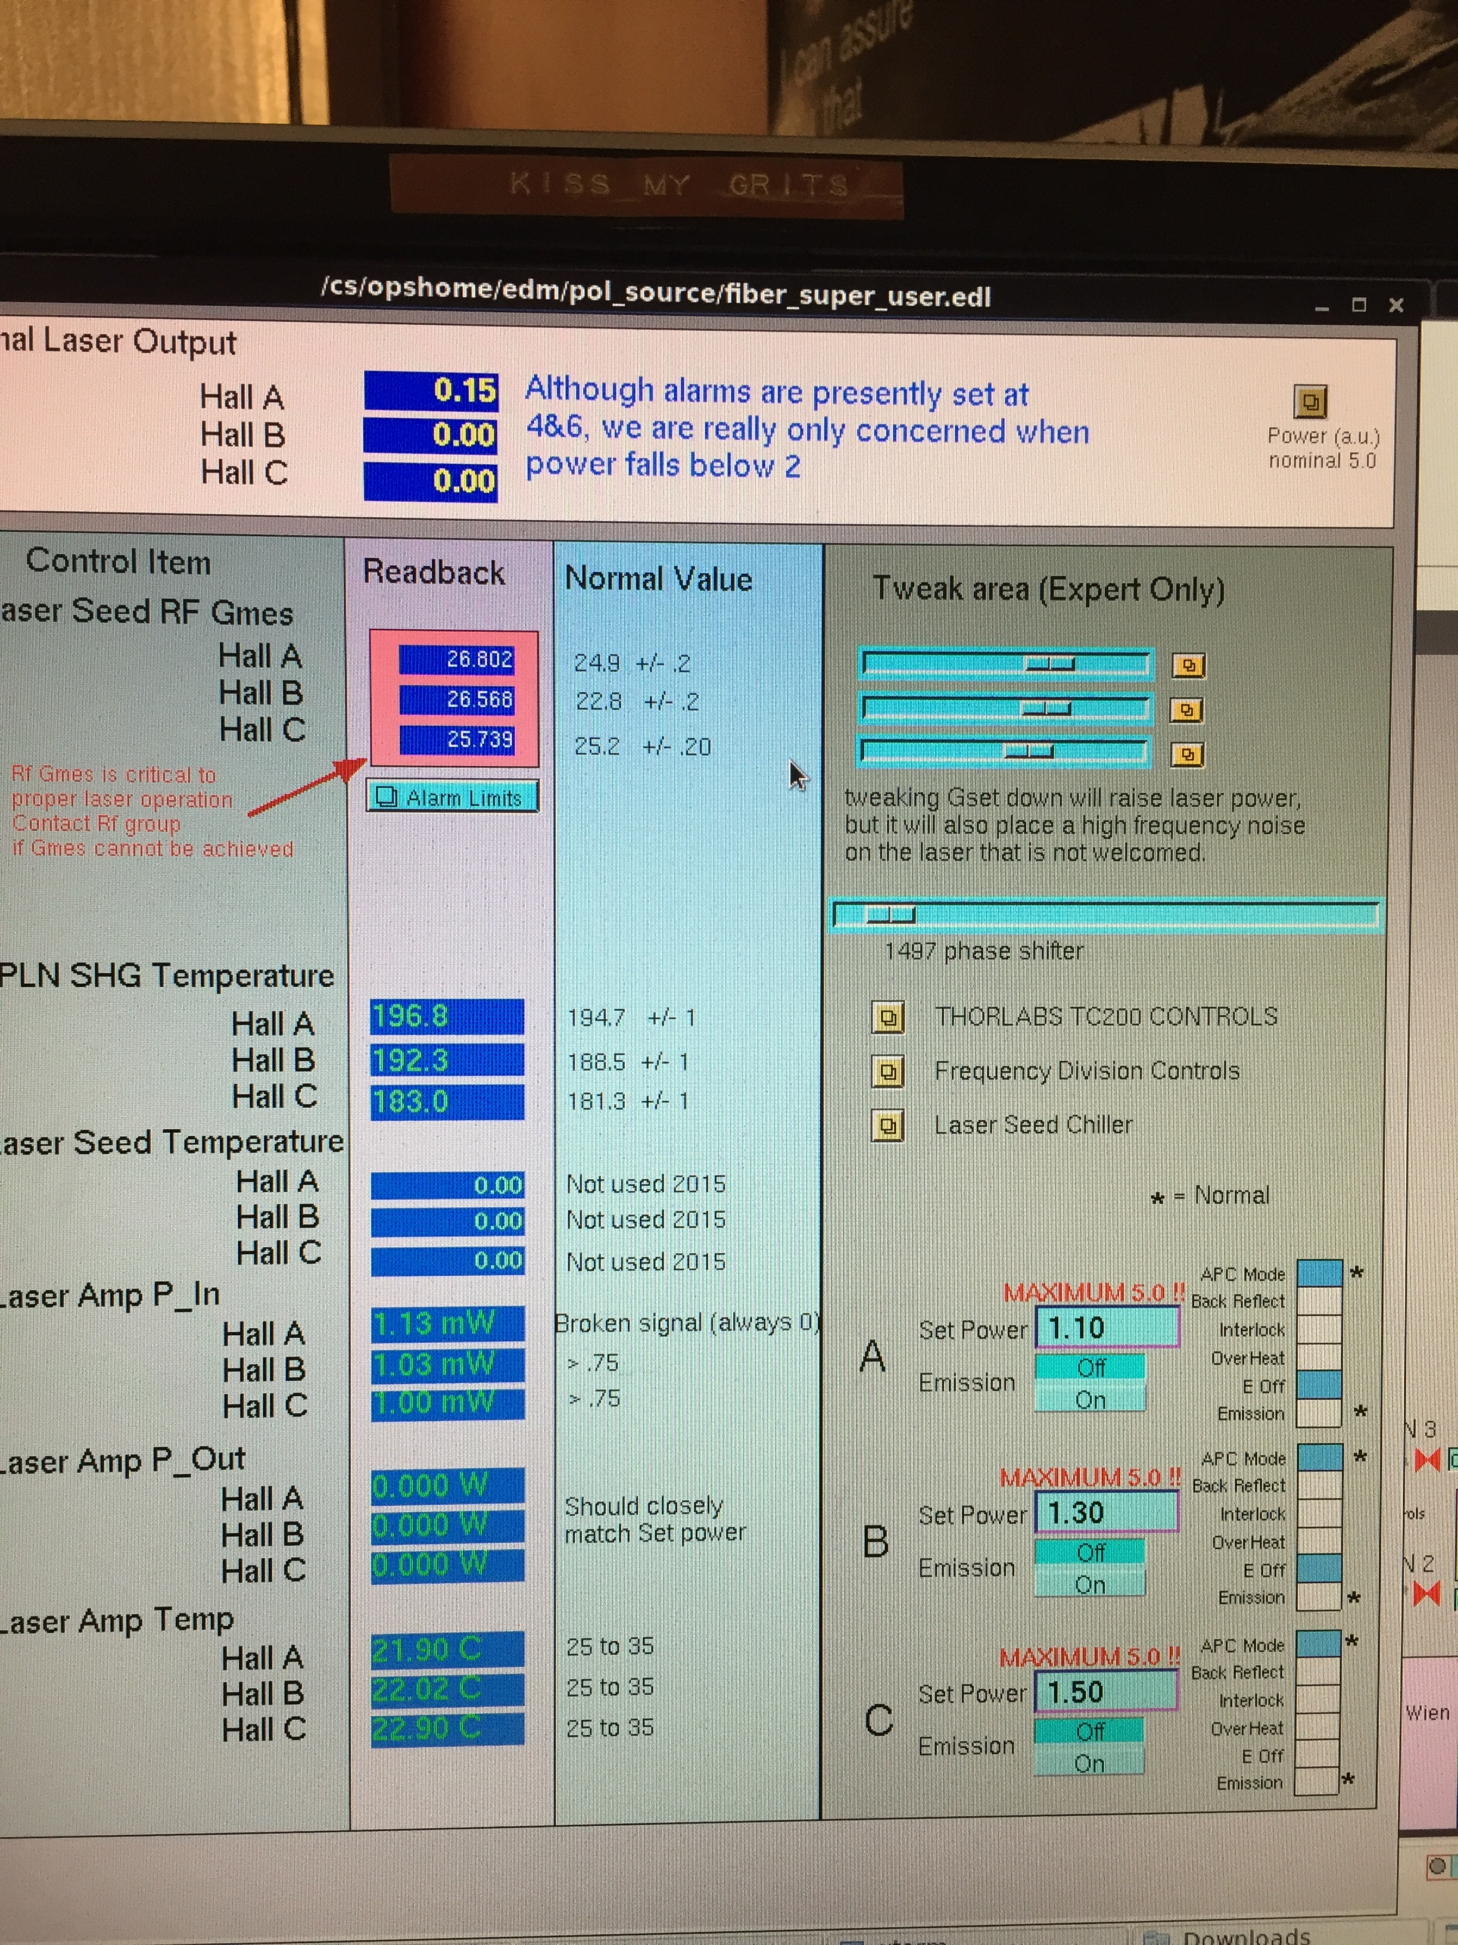
Step 3. You should also see Laser Output zero.
Step 4. The LLRF can be left on. These are the good values.
Step 5. Open the Frequency Division Controls (see next page)
Step 1. Turn laser amplifier emission OFF.
Step 2. You should see “Emission” bit OFF and “E Off” bit ON.

Slide 3
TOP ROW = LLRF @ 499MHz INTO CHASSIS
Step 6. Rear IN01B04 connect each laser (A/B/C) to either:
250 MHz = MIDDLE OUTPUT
499 MHz = BOTTOM OUTPUT
Note - Here, A/C=250 and B=499
B
A
C
Note - Splitter on low row provides LLRF 499MHz to close feedback look – do not remove!

Slide 4
Step 8. The seed power will report a value of about 200 when connected to the same LLRF output (499 or 249.5)
Step 7. For each laser enter “*a02” for seed to operate at 499MHz or “*a04” to operate at 249.5 MHz

Slide 5
Step 11. You should also see Laser Output 4-6.
Step 9. Turn laser amplifier emission ON.
Step 10. You should see “Emission” bit ON and “E Off” bit OFF.

Slide 6
Procedure Complete

