Slide 1
JLAB Compton Transmission Polarimeter (COMTRA)
Fabrication & Installation Organization Meeting
Jan 20, 2022

Slide 2
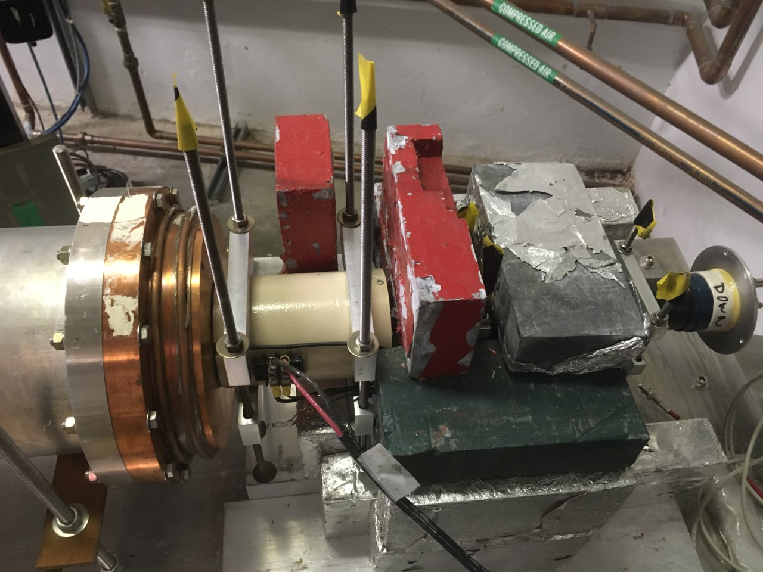
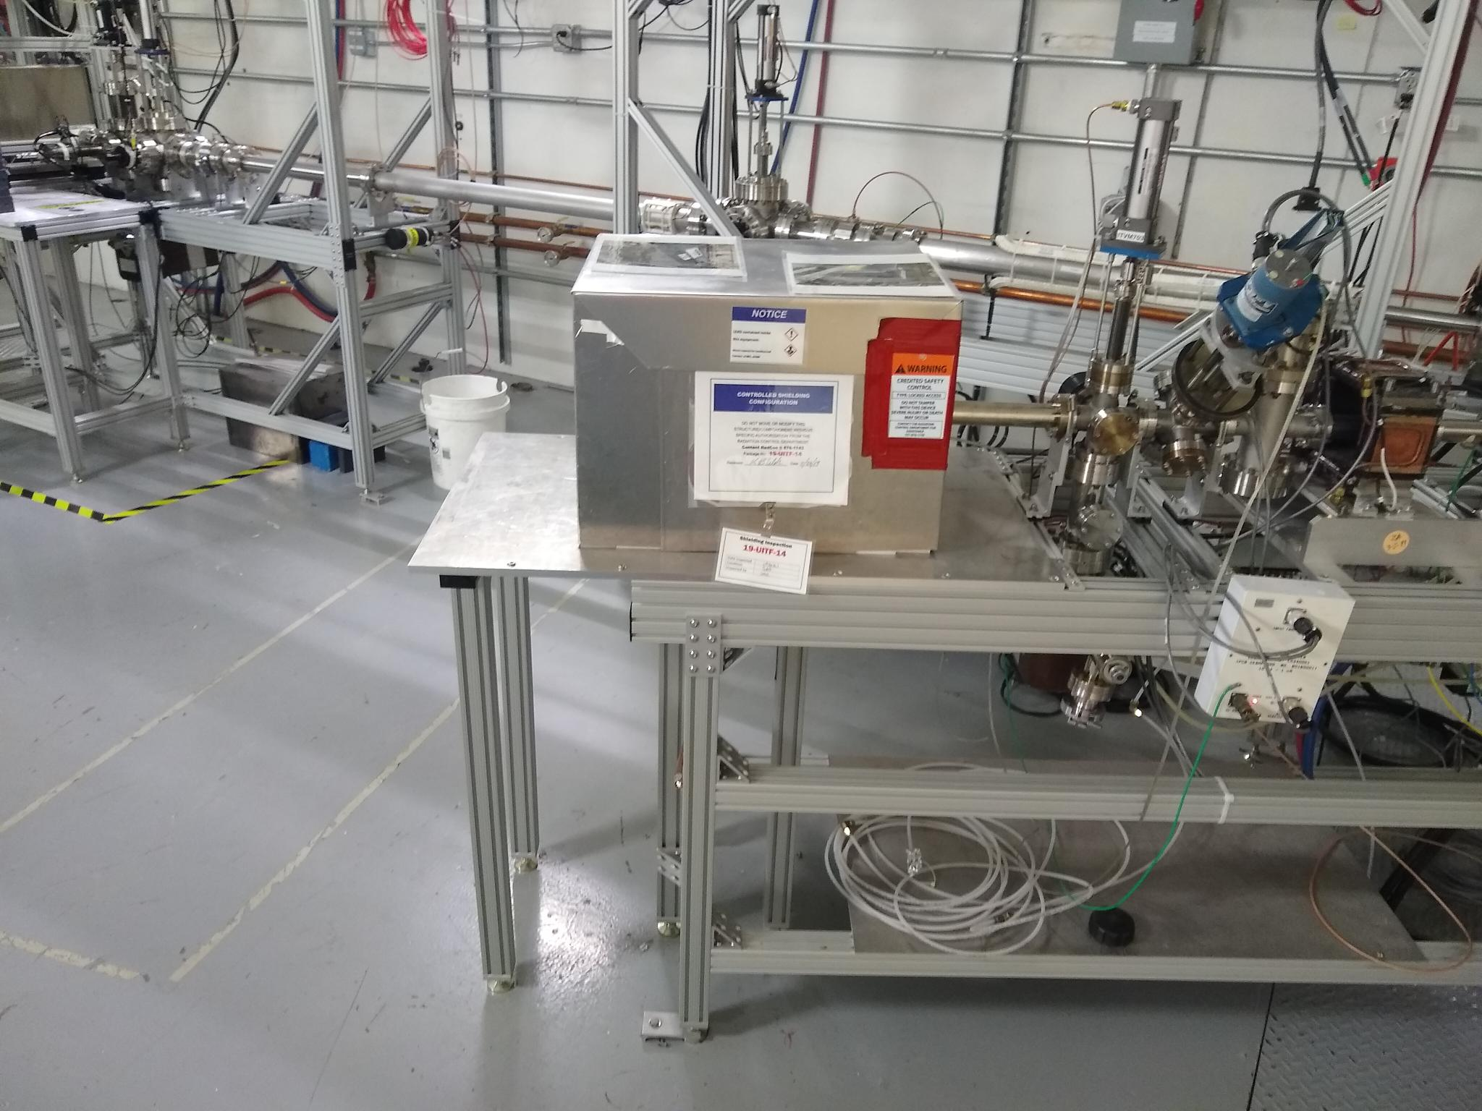
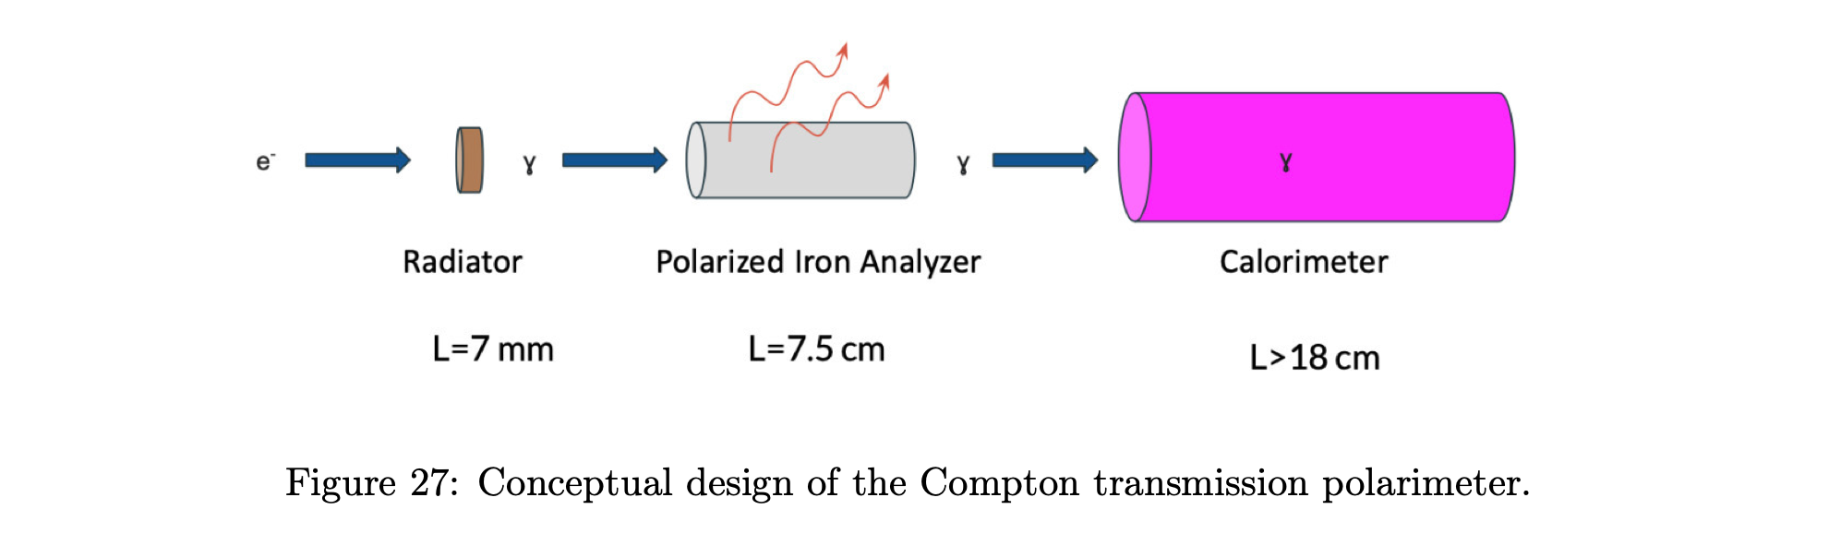
CEBAF – Mott dump (3D)
UITF – MeV spectrometer ()
Dump/
radiator
Electromagnet +
Polarized Target
X-ray
shield
Xstal &
PMT
Dump/radiator
Replace existing with 5D Bubble radiator
Build a spare identical 5D radiator
Electromagnet/Target
Design/fabricate brand new
Support & integrate PS/probes
X-ray shield
Isolate detector parts
Modify UITF dump enclosure
Xstal & PMT
Purchase/assemble brand new
Support & integrate cables
NEW optimized design

Slide 3
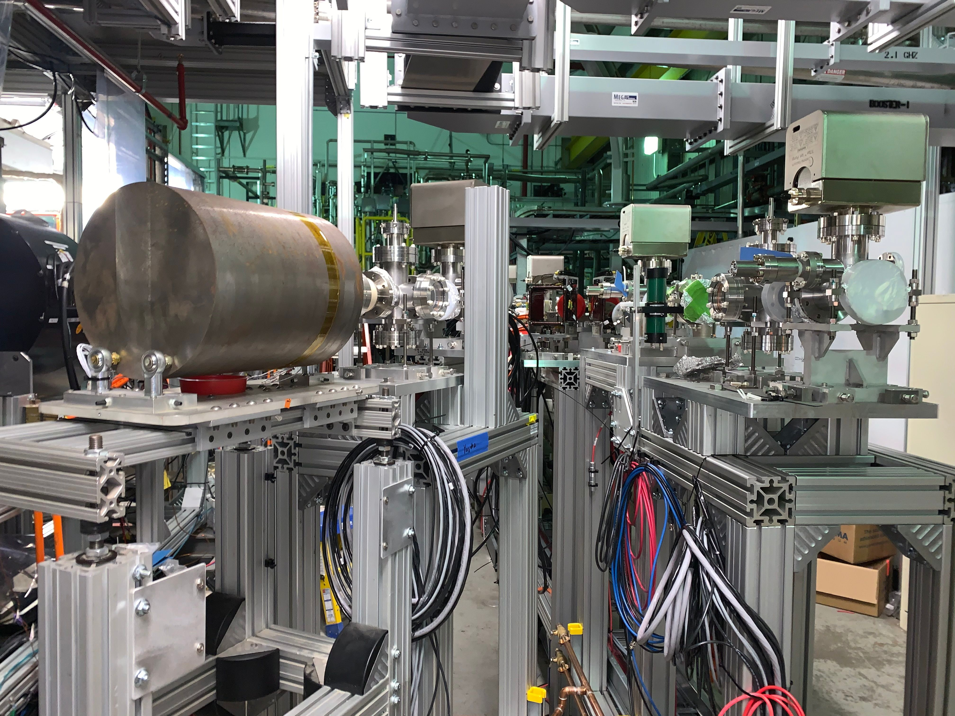
We are building two of everything.
One system remains at JLAB.
One system will be installed at BNL.

Slide 4
UITF Schedule for Discussion
Today
Can we design, fab, assemble, install in 7 months ?
Beam Studies Window
BNL Schedule for Discussion
What are our responsibilities?
Who do we liaison with?

