Slide 1
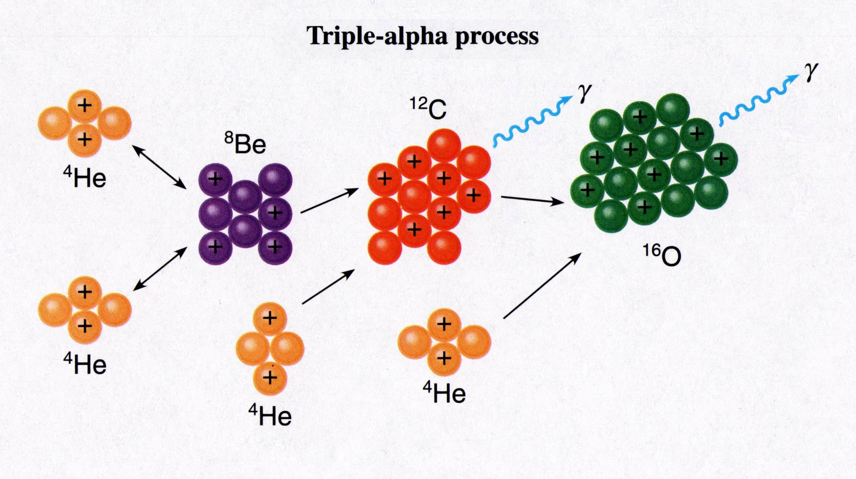
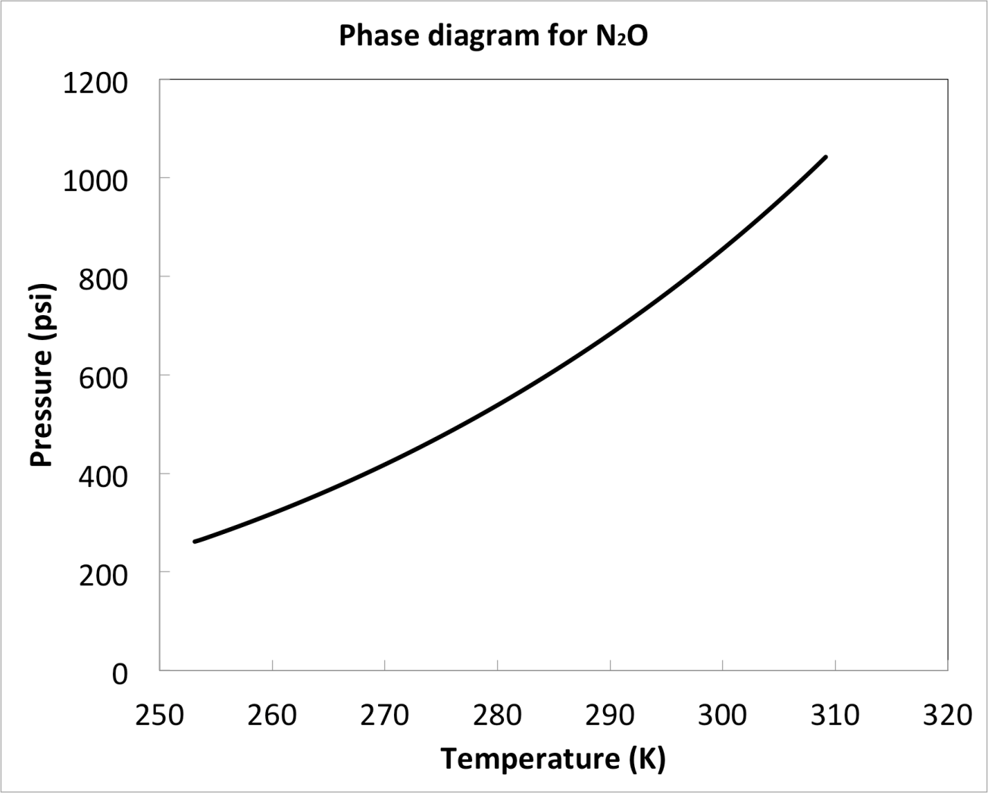
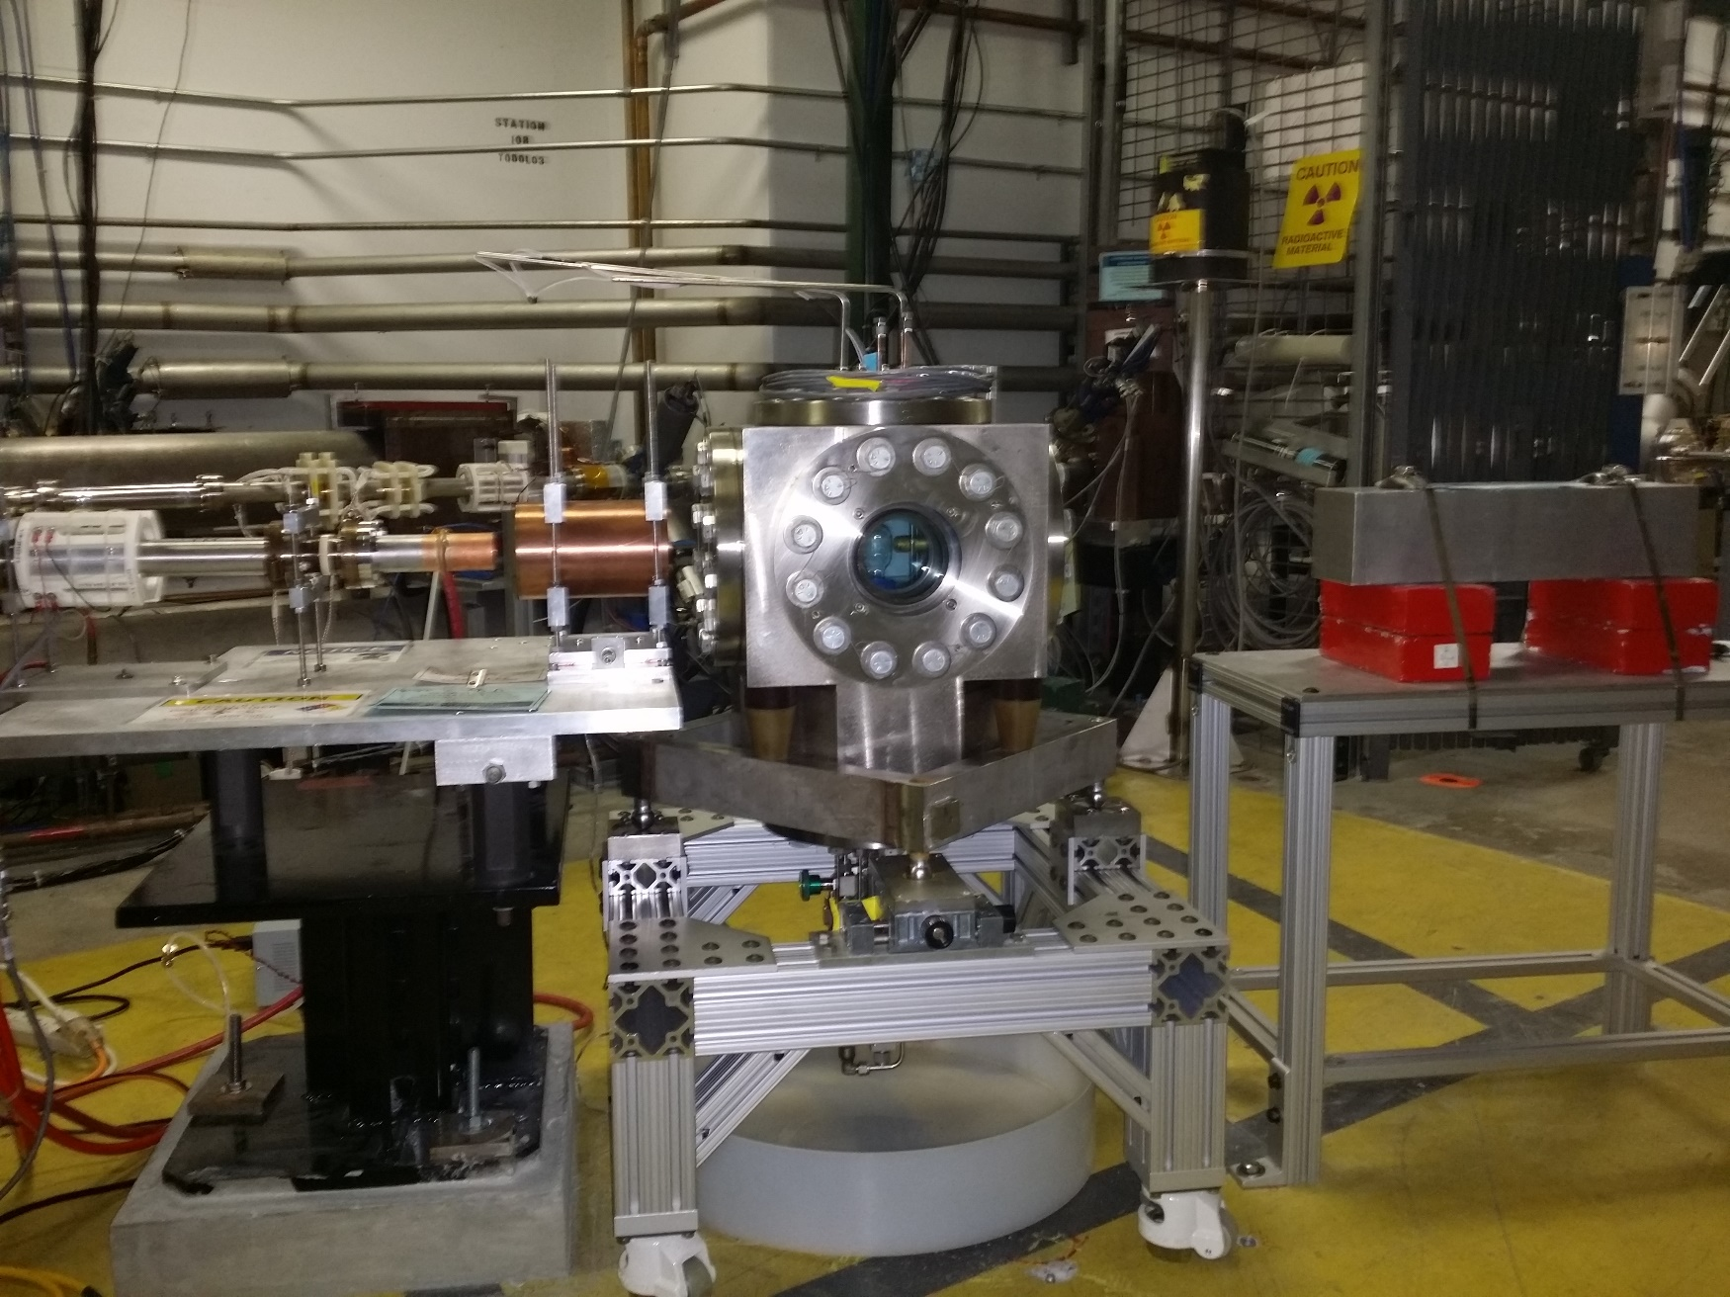
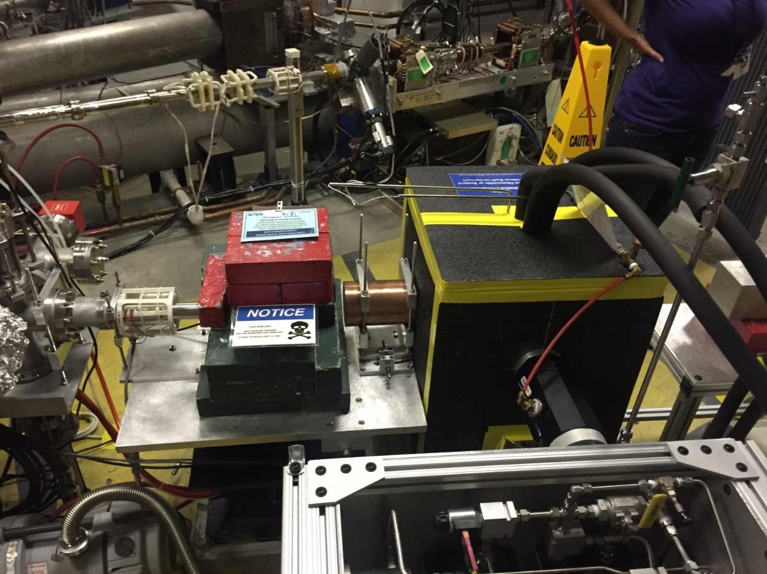
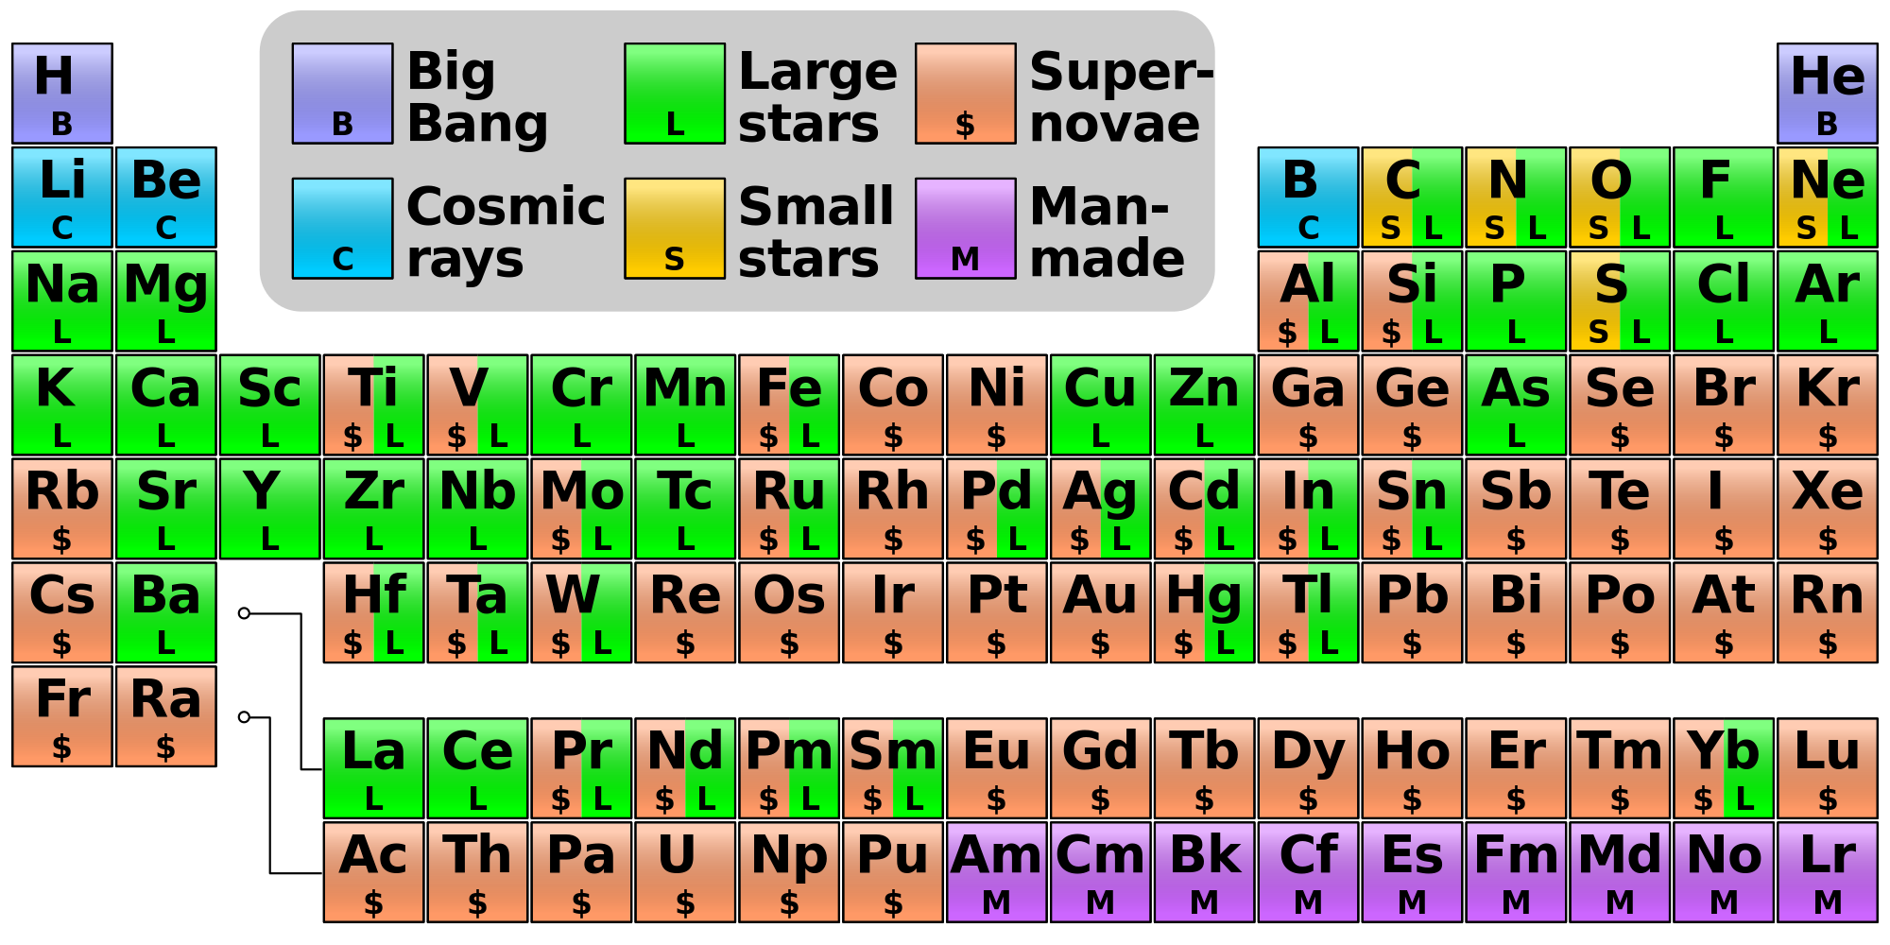
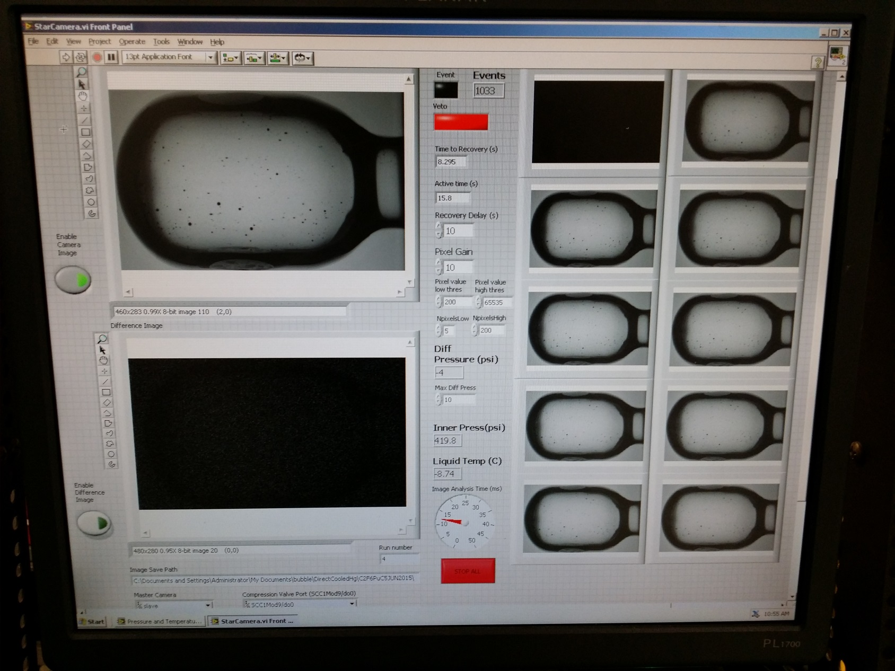
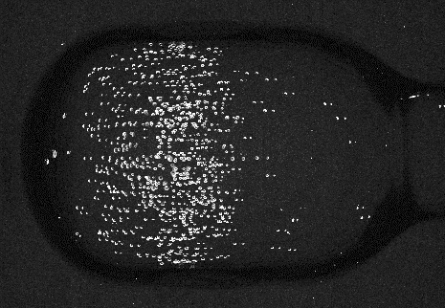
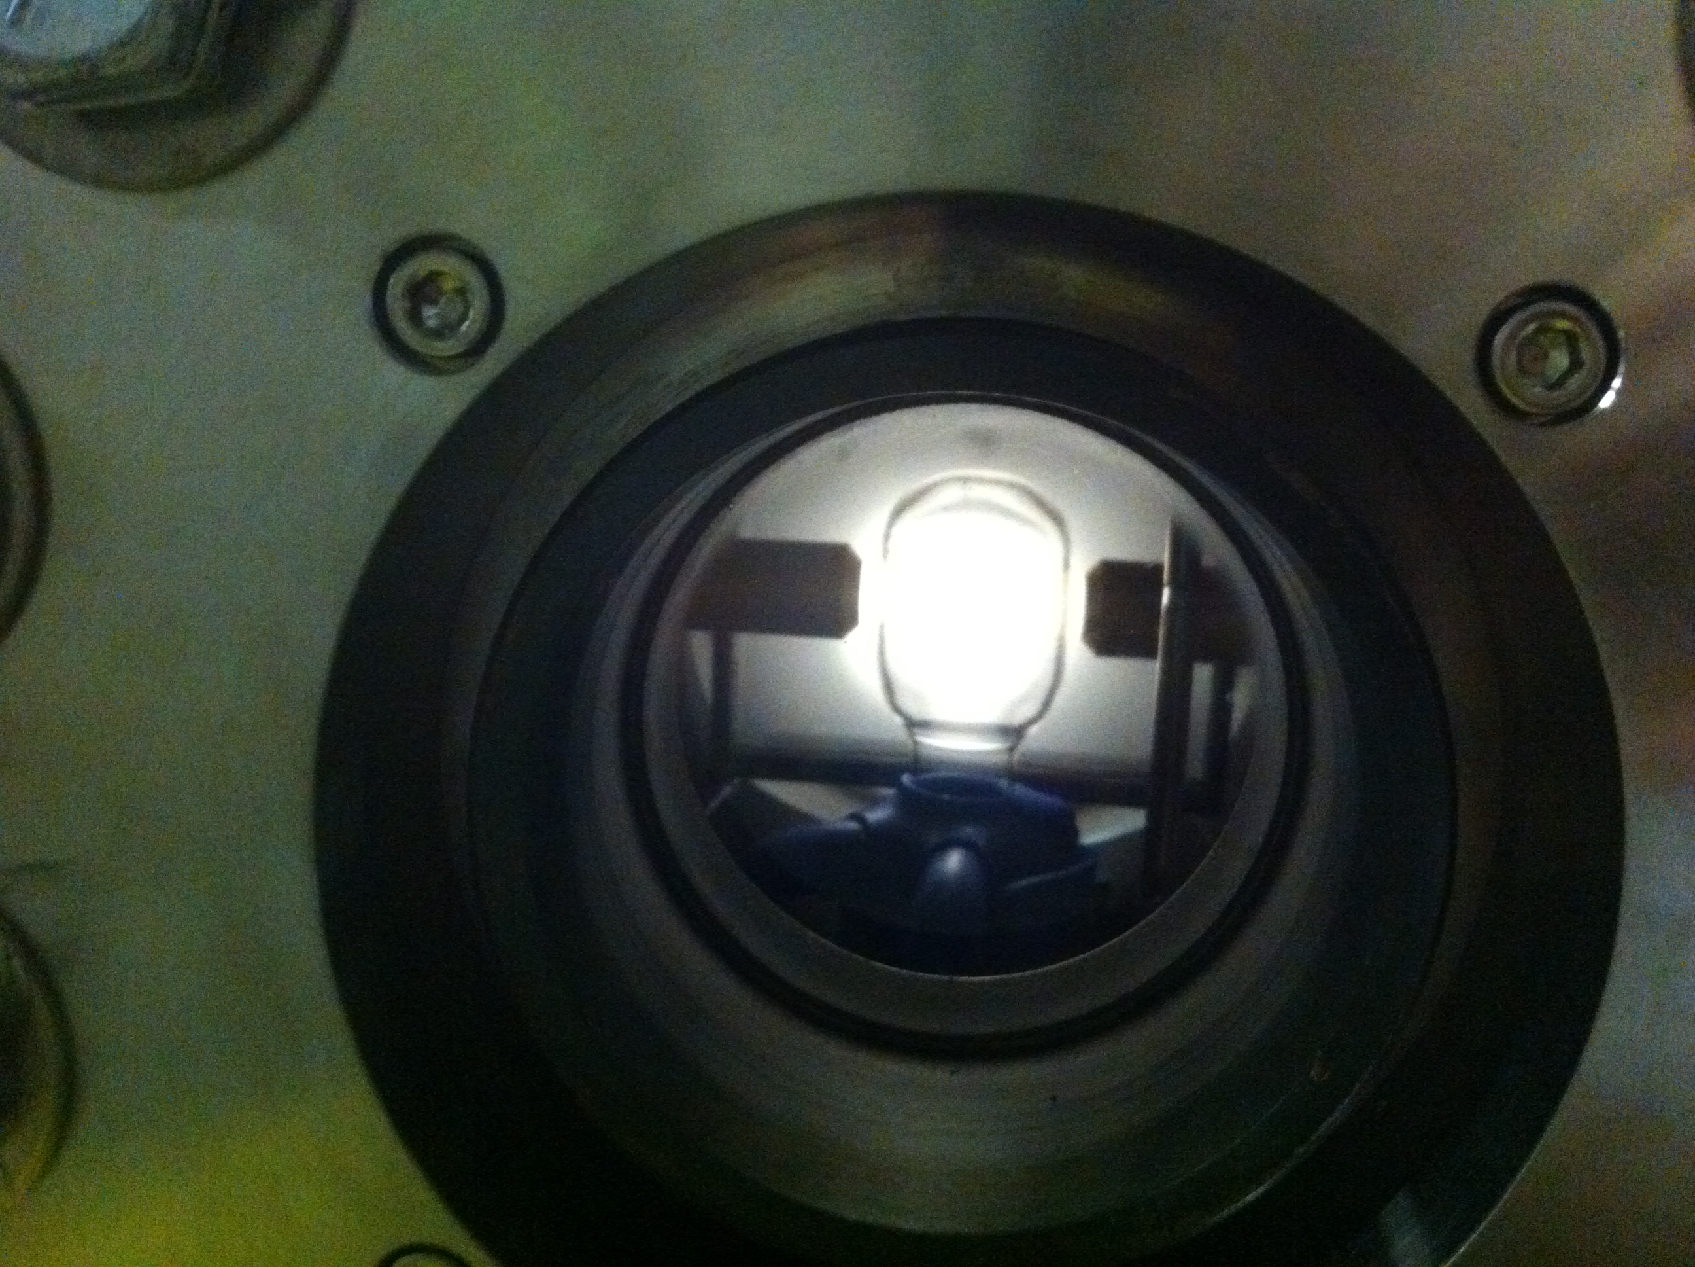
Measuring Stellar Reaction Rates with Bubble Chamber
Jefferson Laboratory, Argonne National Lab, Fermi National Laboratory, University of Illinois
Motivations
Our Investigation
Next Step
Learn more about the helium-carbon fusion reaction:
What is our experiment?
How does the Chamber Work?
Goal <±10%
Helium burning is an important process in stellar nucleosynthesis (star T = 200,000,000 K)
¹²C(α,γ)¹⁶O is very difficult to measure in the laboratory. We plan to obtain the rate for the helium-carbon fusion reaction by measuring the inverse process:
The photo-disintegration of oxygen into helium and carbon
¹⁶O(γ,α)¹²C
This measurement is achieved by using a novel bubble-chamber technique
1 Cell is cooled then filled with room temperature gas
2 Gas is cooled and condenses into liquid
Once cell is completely filled with liquid, pressure is reduced creating a superheated liquid
3 Nuclear reactions induce bubble nucleation
2 Camera detects bubble; system re-pressurizes
3 System depressurizes; ready for another cycle
Currently, reaction rate error is large (±35%)
2
Liquid
1
Test the Bubble Chamber during the Summer of 2016
Improve systematic uncertainties of our set up
Move camera further back to allow for more radiation shielding
Study acoustic signal to distinguish any background events (the helium-carbon bubbles have very distinct sound)
beam
target
signal
3
Vapor
The process we are investigating is the fusion of helium and carbon into oxygen
γ + ¹⁶O → ¹²C + α
¹²C
¹⁶O
T = -10˚C (263 K , 14˚F); P = 20 atm (294 psi)
¹²C(α,γ)¹⁶O
1. Produce Gammas
Our Data
α
γ
Gammas are generated by an electron beam hitting a copper radiator
The recoiled helium and carbon nuclei will heat up small parts of the unstable liquid causing it to vaporize. We capture this bubble event with a 100 Hz digital camera
Why is the ¹²C(α,γ)¹⁶O Reaction Important?
Summary
Helium-carbon fusion to form oxygen is a very important reaction → it is considered to be the key reaction in the helium burning of stars
For our purposes, it is much easier to measure the time reversal reaction (the disintegration of oxygen into helium and carbon when bombarded with gamma rays)
At Jefferson Lab, we use our electron beam to generate gammas by colliding them into a copper radiator
These gammas hit oxygen nuclei in laughing gas (N₂O) inside of the bubble chamber
The helium and carbon nuclei from the breakup of oxygen heat up small parts of the unstable liquid vaporizing it
This event generates a small bubble which we capture using a high speed digital camera
Affects the synthesis of most of the elements of the periodic table
Camera
2. Gammas Collide with the Target
A super-heated liquid (N₂O) is sensitive to recoiling helium and carbon nuclei produced by photo-disintegration of the oxygen
Sets the N(¹²C)/N(¹⁶O) (≈0.4) ratio in the universe
Determines the minimum mass a star requires to become a supernova
8 MeV, 0.035 μA electron beam
Acknowledgement: This work has been supported by US DOE (DE-AC02-06CH11357)
and Jefferson Science Associations, LLC (DE-AC05-06OR23177)

