Slide 1

Ce⁺BAF
Present concept (and how we got here)
Topics we’ll address at this meeting
  Joe, polarized e⁻ source
  Andriy, high power e⁺ target
  Sami, layout of e⁺ beam collection
  Dennis, transport of e⁺ beam to halls
Coffeetime discussions
Joe Grames

Slide 2

12 GeV Ce⁺BAF : present high level goals
Machine Parameter | Electrons | Positrons
Hall Multiplicity | 4 | 1 or more
Energy (ABC/D) | 11/12 GeV | 11/12 GeV
Beam Repetition | 249.5/499 MHz | 249.5/499/1497 MHz
Duty Factor | 100% cw | 100% cw
Unpolarized Intensity | 170 μA | > 1 μA
Polarized Intensity | 170 μA | > 50 nA
Beam Polarization | > 85% | > 60%
Fast/Slow Helicity Reversal | 1920 Hz/Yes | 1920 Hz/Yes
Hall multiplicity tied to intensity and rep rate
Cannot copy existing pulsed mode technology
Beam distributions are characteristically different
Few positrons with highest spin polarization

Slide 3


Exploit electron spin polarization to produce polarized positrons
When a longitudinally polarized e⁻ beam strikes matter, e⁺ produced in the shower carrying >50% of the e⁻ beam energy are significantly longitudinally spin polarized…
Polarized Bremsstrahlung
Polarized Pair Creation
P_{circ}(γ) / P_{z} (e⁻)
P_{z} (e⁺) / P_{circ} (γ)
…so why not take advantage of this?
E_{γ} / T_{e-}
T_{e+} / (E_{γ} – 2m_{e+})
E.A. Kuraev, Y.M. Bystritskiy, M. Shatnev, E.Tomasi-Gustafsson, PRC 81 (2010) 055208

Slide 4

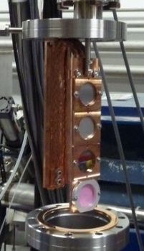
PEPPo : was approved as a proof-of-principle for e+ beam generation
J. Grames, E. Voutier et al.,JLab Experiment E12-11-105 (2011)
8 MeV, 1μA, 85% polarization
“e+ Beam” would’ve been ~10’s fA
Tungsten (1mm)
Record for linac positron polarization.
P(e+) = 82.2 %
PEPPo possible due to support from SLAC E166, DESY, Princeton, Cornell, International Linear Collider Project and the Jefferson Science Associates
Efficiency >95%
D. Abbott et al., Phys. Rev. Lett. 116 (2016) 214801

Slide 5
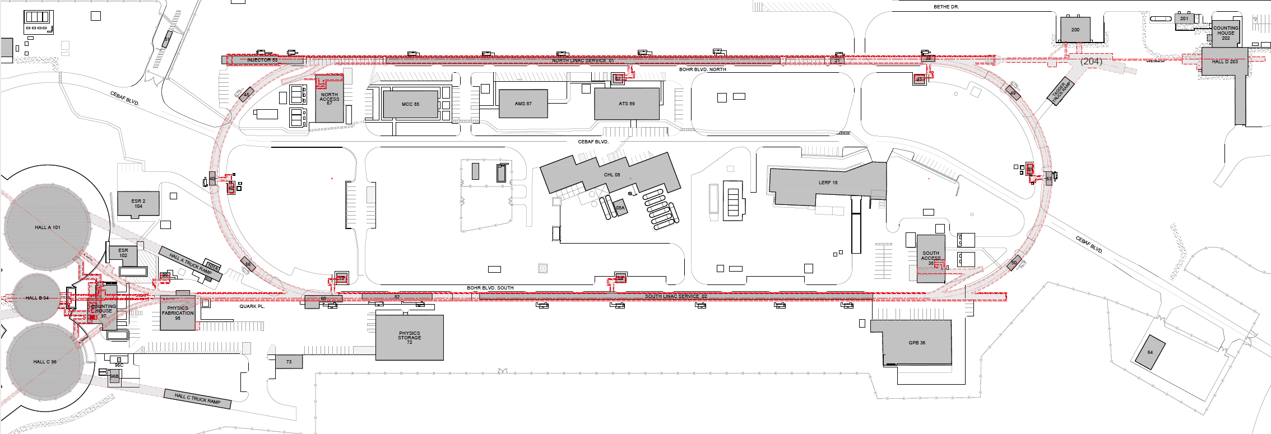
Solution for CEBAF
Need to transition from 10 Watt of beam power (PEPPo) to 10-100 kiloWatts of beam power
One year ago we were exploring e⁺ production at 10, 100, 1000, 10000 MeV supported by a LDRD…
Today we have a beams working group focused on creating e⁺ using the Low Energy Research Facility

Slide 6
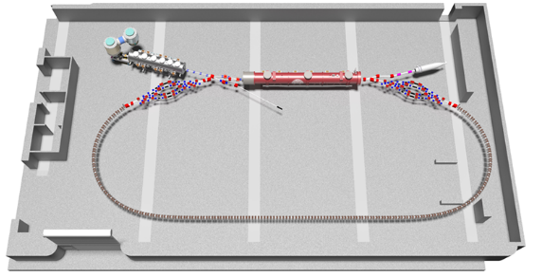
Future CEBAF Framework
Initially adds e+ capability to 12 GeV
Builds new 123 MeV positron injector
Retains existing polarized e- injector
Multi-hall capability is a high priority
Capability happens after Moller
Later expands e- energy reach to 22 GeV
Builds new 650 MeV electron injector
Builds upon e+ infrastructure
Adds permanent magnets (FFA) for highest energies
Retains multi-hall capability
Production of Highly Polarized Positrons Using Polarized Electrons at MeV Energies, D. Abbott et al., Phys. Rev. Lett. 116 (2016) 214801
CBETA: First Multipass Superconducting Linear Accelerator with Energy Recovery, A. Bartnik, et al., Phys. Rev. Lett. 125 (2020) 4, 044803

Slide 7




Ce⁺BAF Working Group
J. Benesch, A. Bogacz, L. Cardman, J. Conway, S. Covrig, J. Grames, J. Gubeli, C. Gulliford, S. Habet, C. Hernandez-Garcia, A. Hofler,
R. Kazimi, V. Kostroun, F. Lin, V. Lizarraga-Rubio, M. Poelker, Y. Roblin, A. Seryi, K. Smolenski, M. Spata, R. Suleiman, A. Sy, D. Turner, A. Ushakov, C. Valerio, E. Voutier, S. Zhang, Y. Zhang

Slide 8
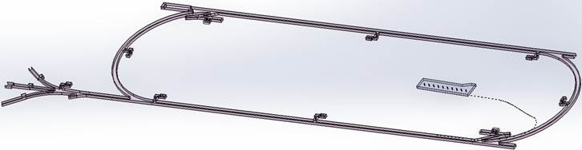

Turning the LERF into the new injector facility for CEBAF
123 MeV e+
(650 MeV e-)
Inject e⁺ into North Linac to usual 12 GeV (w/ magnets reversed)
Build e⁺ injector at the LERF
Build new LERF to CEBAF tunnel
123 MeV e+
(650 MeV e-)
Build new transport line along South Linac and West Arc

Slide 9
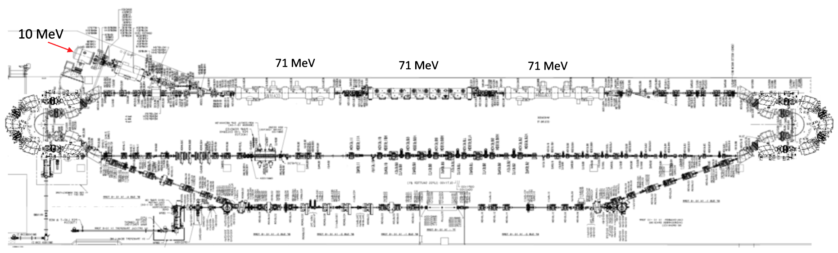
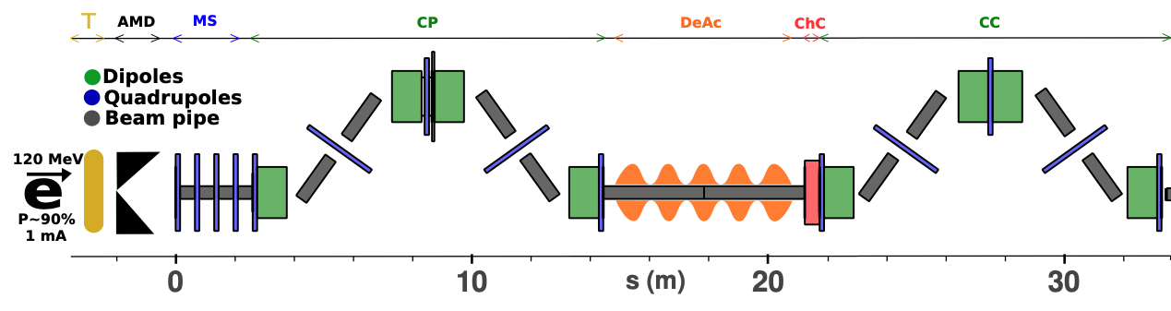
LERF Polarized Positron Injector Concept
Focus is developing a S2E technical report based on a polarized e⁺ injector at LERF
  High current polarized electron injector (10 MeV/10 mA)
  High current 1-3 mA LINAC (two C75 CM)
  Positron conversion target (~100 kW)
  Positron bunch collection and momentum selection
  Positron bunch compression and acceleration to 123 MeV
#1 – Compact 10 mA P-Gun, Wien filter, 10 MeV e- injector
#6 – SRF accelerate e+ to 123 MeV
#2 - SRF accelerate to 120 MeV
#5 – Transport e+
#3 – Extract e- to target
#4 - Produce and collect e+ 20 to 60 MeV
#7 – Evaluating 123 MeV spin rotator concept
#8 – Transport e+ at 123 MeV to CEBAF

Slide 10
Resources and outlook
FY22 – positron research was supported at the division level
  ~2 FTE spread across CIS, CASA, OPS departments
  Includes one full-time scientist and one PhD grad student
FY23 – Ce⁺BAF working group has grown and with broader collaboration
  JLab Physics division developing high power target designs, will start on magnet soon
  JLab Engineering division evaluating electrical requirements of magnets reversal & diagnostics
  SRF Dept. developing a plan for 4 SRF cryomodules needed, will start on capture linac soon
  IJCLab remains a strong collaborator, contributing to design and target development
  ORNL contributing to conceptual design of a 123 MeV e⁺ spin rotator
  HEP proposal submitted in support of e⁺ collaboration (SLAC/KEK/JLAB)
  Xelera Inc. awarded SBIR Phase 1 to evaluate a liquid metal target option
FY24 – Ahead and out-years
  Publish a start-to-end technical conceptual report
  Developing a plan to build up 10 MeV/10 mA “pre-accelerator”, demonstrate source & target tests
  Need to develop planning for LCLS-II and EIC commitments planned for LERF over next decade

Slide 11
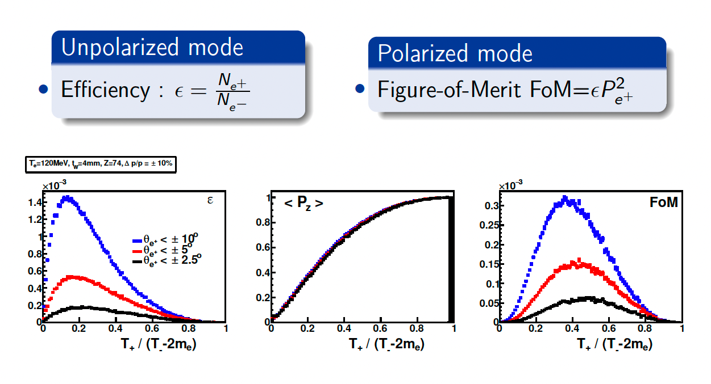
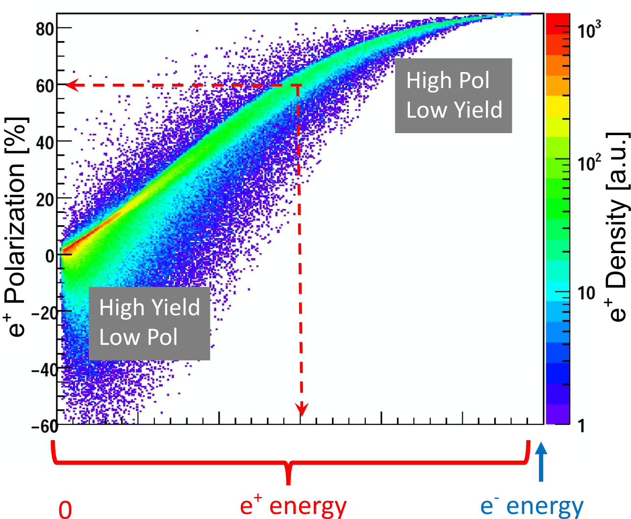
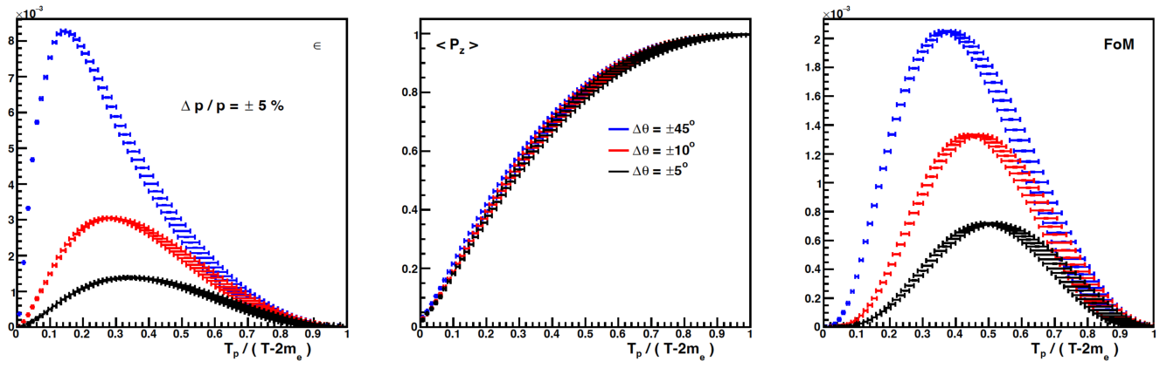
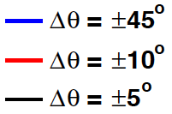
Yield and Polarization => multiply your desired e+ current by 10³ to 10⁴
e⁺ Polarization vs Energy
4 mm Tungsten Target
120 MeV e‒
Efficiency
FoM
e⁺
e‒
e⁺
e‒
Positron beamline has to be designed
for efficient capture and transport of e⁺ with different energies

Slide 12
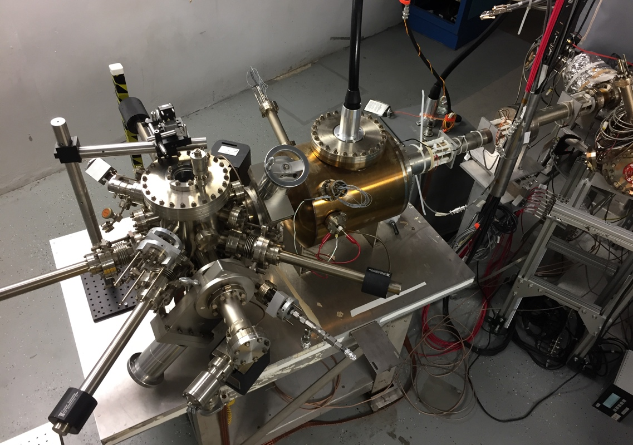
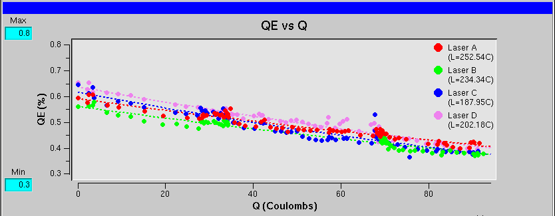
CEBAF polarized electron source
Gun2 Photocathode (Fall 2016 – Spring 2017)
  Lifetime ~200 C (σ_{4D} ~ 1mm) with intensity @ 200 μA
Gun vacuum ~ 1x10⁻¹² Torr
Preparation
Chamber
Activation Laser
HV Chamber
QE = QE₀ e ^{-(Q/Lifetime)}
GaAs
Storage
Loading
Chamber
P. Adderley et al., Phys. Rev. Accel. Beams 13, 010101 (2010)
[µA]

Slide 13
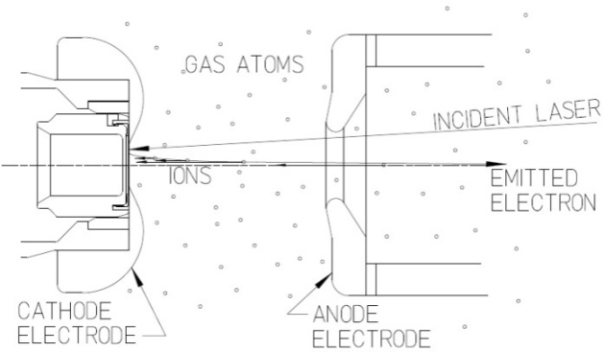

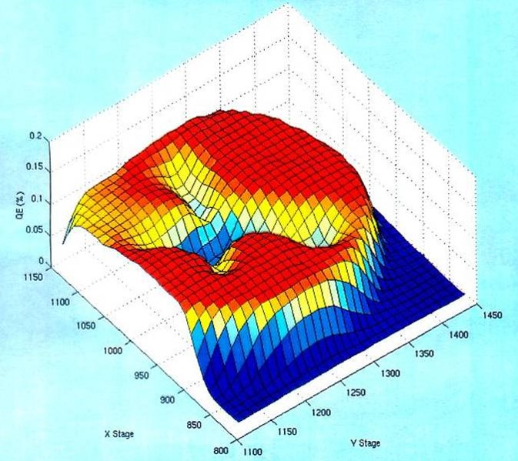
Imperfect Vacuum = Ion Bombardment
Ion bombardment – notice characteristic “trench” from laser spot to electrostatic center of photocathode
Active area = 5mm
Laser spot = 0.5mm dia.

Slide 14
Extend electron source performance by factor of 100 – 1000…
Charge “used” in 2 weeks vs. gun current
JLab Polarized Positron Source (see Sami’s talk on Positron collection design for CEBAF )
JLab envisions a polarized e- driven PEPPo Injector, for generating e+ beams with polarization >60% and current >100 nA
Because overall efficiency is small, the polarized electron source must provide 1 to 10 mA (continuous wave, RF frequency of 1497 MHz)
And to satisfy experimental program, we need polarized electron source to operate without interruption for at least 2 weeks
Coulombs delivered in 2 weeks ≈ 10³ to 10⁴ C
New gun must be better than CEBAF by a factor 100 – 1000 i.e., factor of current increase multiplied by factor of charge (lifetime) increase
Ce+BAF
”bias
trick”
”laser
trick”
CEBAF
Today

Slide 15
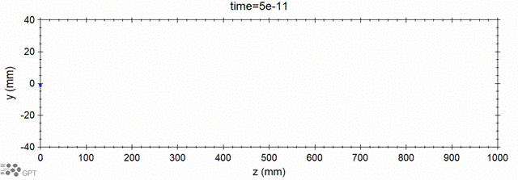
Modeling ion generation and bombardment
PhD work of J. Yoskowitz in preparation for PR-AB
GPT custom element IONATOR simulates electron-impact ionization of residual beam line gasses and tracks outgoing particles.
e- beam
ions
ejected e-
scattered e-
Simulation of biased anode
PhD work of Josh Yoskowitz
With a >400 C lifetime we could operate at 1 mA for almost 1 week

Slide 16



PES: reducing ion surface density to increase lifetime
Increasing laser beam size at photocathode has increased charge lifetime…
J. Grames, et al., Phys. Rev. ST Accel. Beams 14 043501 (2011)
Bulk 532nm
GaAs/GaAsP 780nm

Slide 17
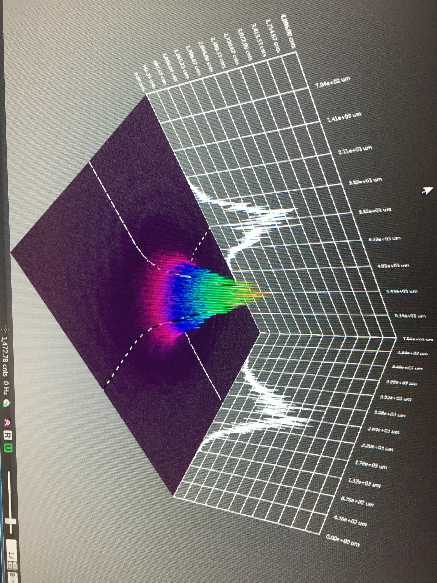

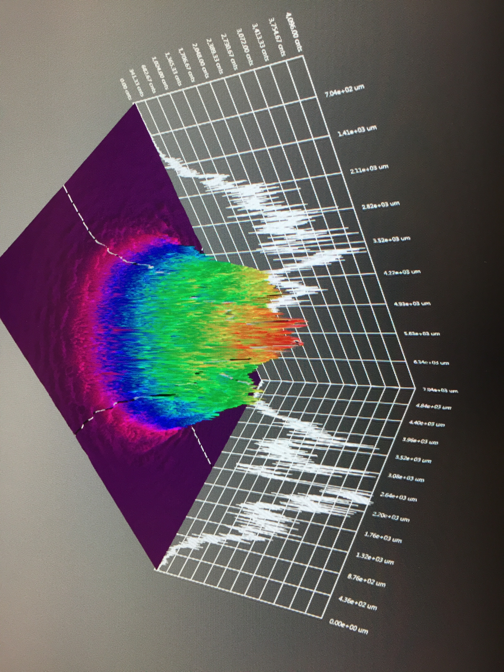
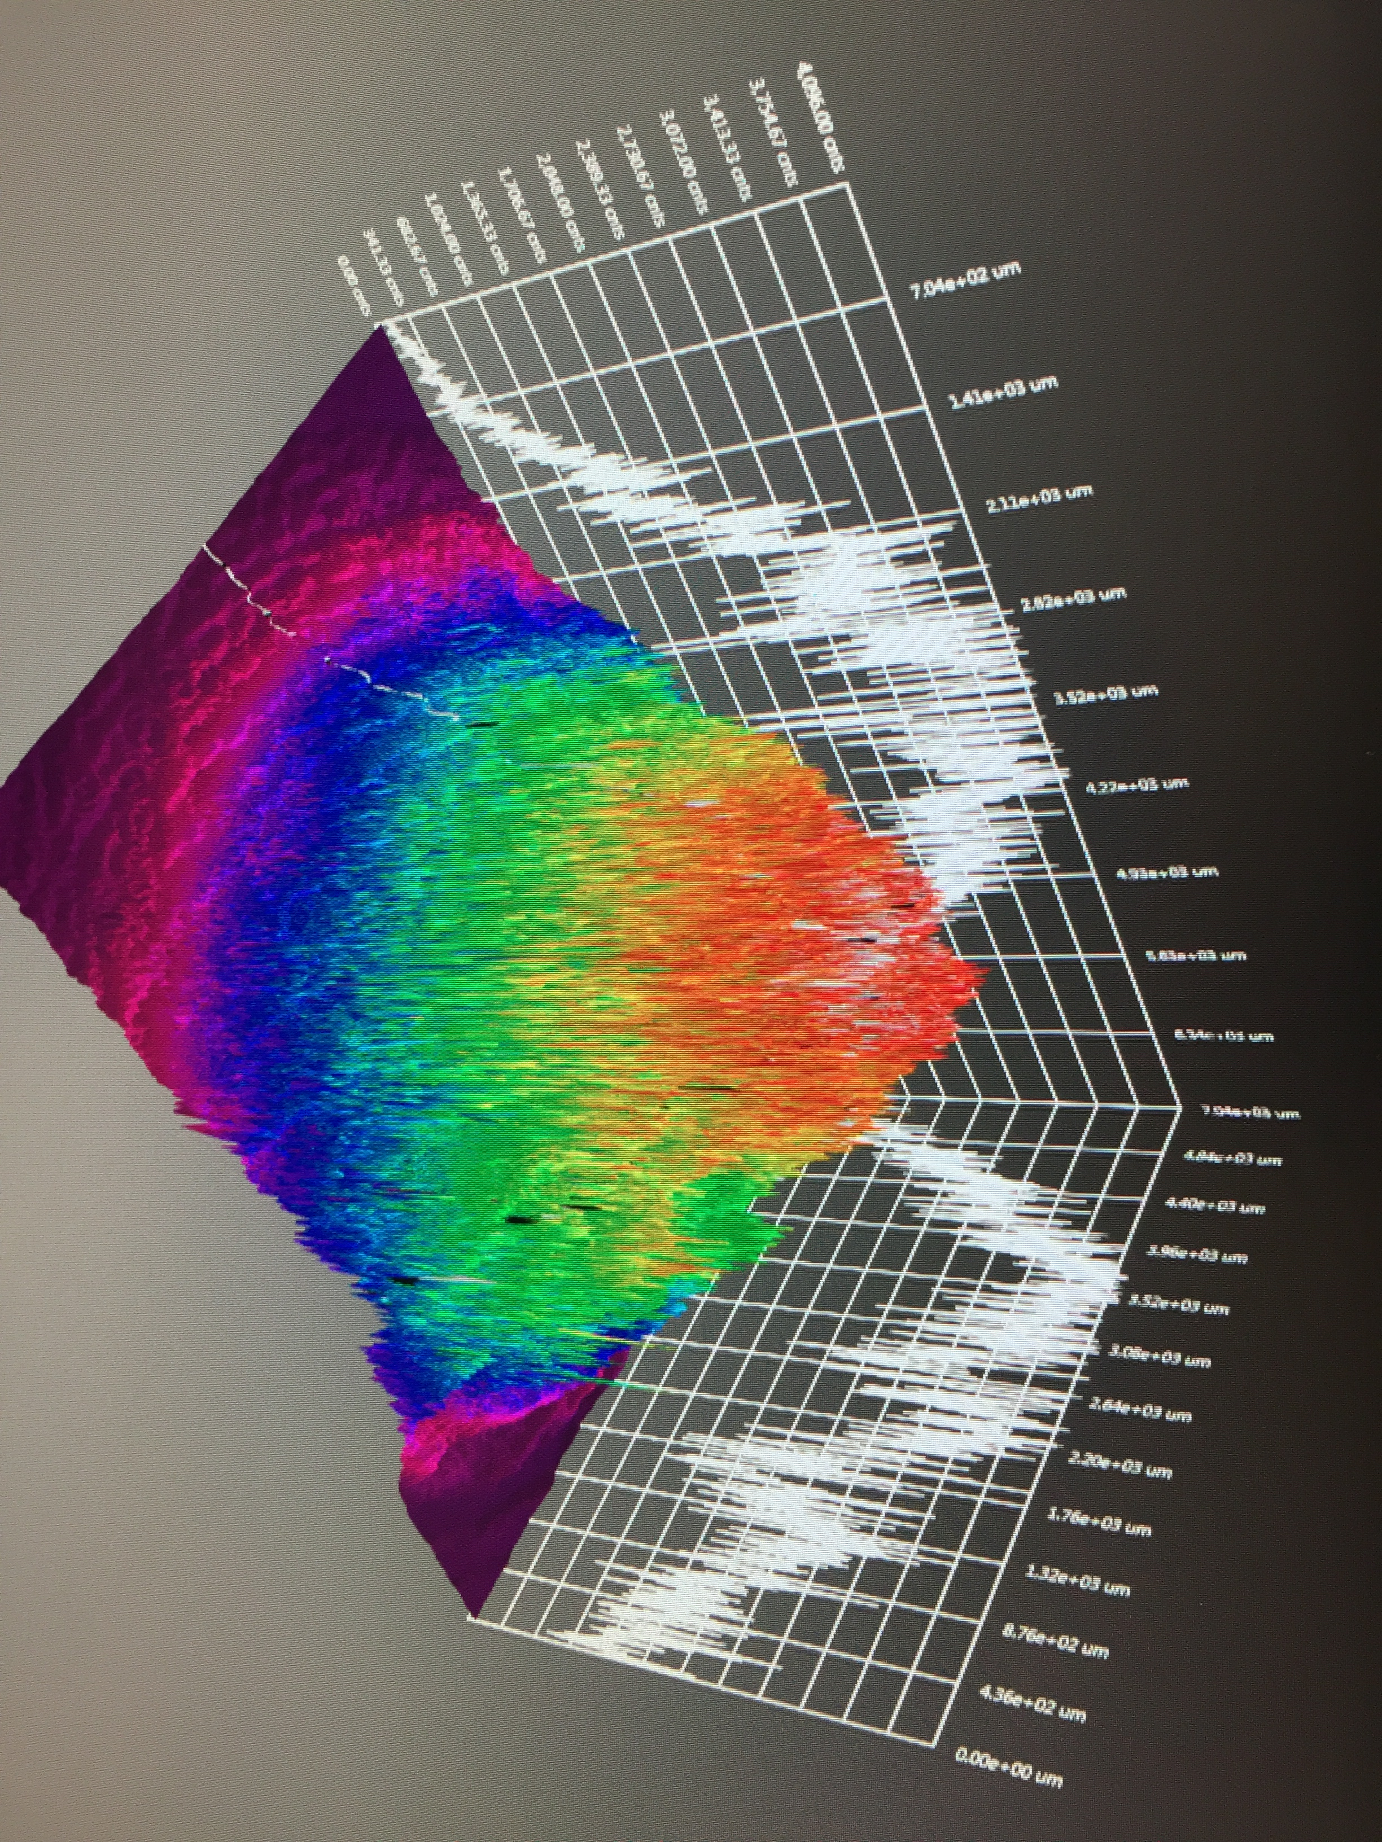
GaAs/GaAsP charge lifetime at milliamp current
Results from PSTP’17 suggests increasing laser spot size is viable to exceed >500 C lifetime; however we need to build another gun to test this assertion.
J. Grames, P. Adderley, J. Hansknecht, R. Kazimi, M. Poelker, D. Moser, M. Stutzman, S. Zhang, “Milliampere beam studies using high polarization photocathodes at the CEBAF Photoinjector” Polarized Sources, Targets and Polarimeters Workshop, Dajeon South Korea (2017)
Measurements were performed without anode biasing
Days
Trend we want to realize

Slide 18
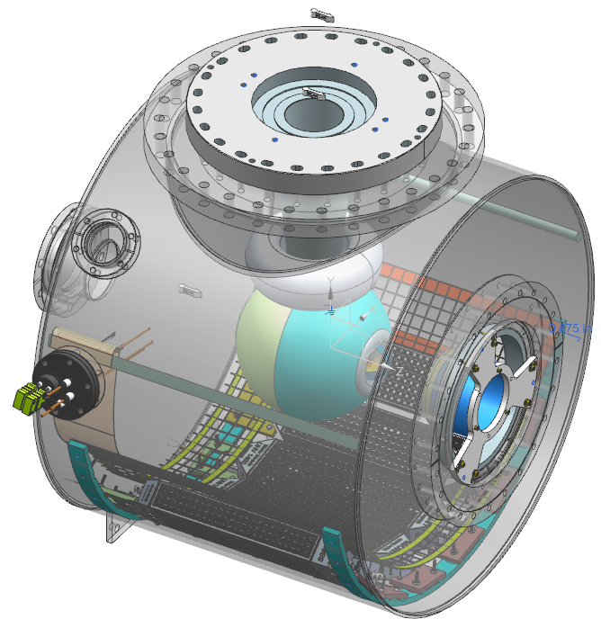
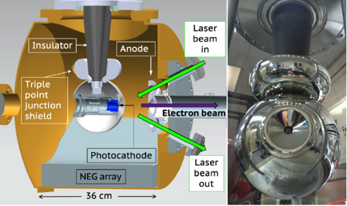
Build a mA polarized gun for e⁺
  We will combine our lessons learned and experience with the Magnetized 4mA/300 kV gun and new Polarized CEBAF 200 kV gun to build a new third gun optimized for positron generation…
300 kV Magnetized Beam Electron Source (CsKSb)
CEBAF 200 KV Polarized Gun (GaAs/GaAsP)
C. Hernandez-Garcia et al., Phys. Rev. Accel. Beams 22, 113401 (2019)
R30 inverted geometry ceramic insulator
Conditioned to 350 kV
Demonstrated 4.5 mA CW 300 keV
Operate at >200 kV without field emission
HV conditioning >350 kV (uses R30 inverted ceramic insulator)
Dynamic pressure (during beam delivery) ~ 1x10⁻¹² Torr

Slide 19
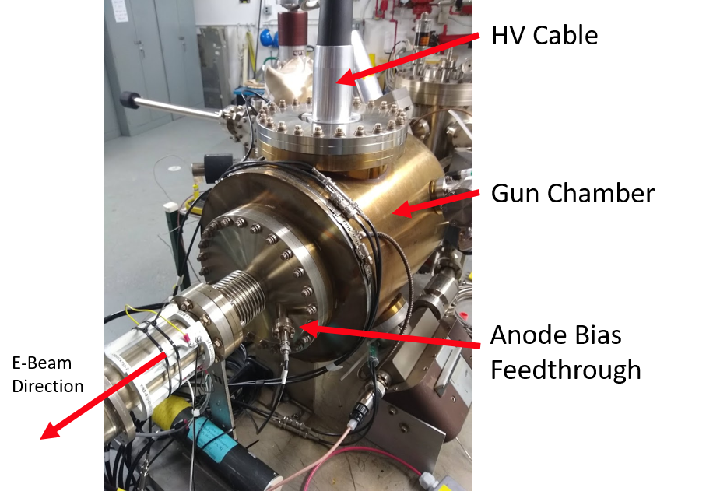
“Tricks” used to improve lifetime, to “get around” ion bombardment…
No short focal length elements near the photogun – these introduce beam loss and even small amounts are bad
Reduce the active area of photocathode
Off-axis illumination with laser
Large laser beam
Biased anode
Operate at higher bias voltage?
Black interior surface to minimize scattered light and unwanted photoemission?
Sadly, we’re run out of tricks
but milliampere applications require kiloCoulomb charge lifetime to provide uninterrupted operation of reasonable duration
J. Grames, R. Suleiman, P. A. Adderley, J. Clark, J. Hansknecht, D. Machie, M. Poelker, and M. L. Stutzman, "Charge and fluence lifetime measurements of a DC high voltage GaAs photogun at high average current", Phys. Rev. ST Accel. Beams 14, 043501 (2011)

Slide 20
“Tricks” used to improve lifetime, to “get around” ion bombardment…
Charge “used” in 2 weeks vs. gun current
JLab Polarized Positron Source (see Sami’s talk on Positron collection design for CEBAF )
JLab envisions a polarized e- driven PEPPo Injector, for generating e+ beams with polarization >60% and current >100 nA
Because overall efficiency is small, the polarized electron source must provide 1 to 10 mA (continuous wave, RF frequency of 1497 MHz)
And to satisfy experimental program, we need polarized electron source to operate without interruption for at least 2 weeks
Coulombs delivered in 2 weeks ≈ 10³ to 10⁴ C
New gun must be better than our best trick’s by a factor 100 – 1000 i.e., factor of current increase multiplied by factor of charge (lifetime) increase
Ce+BAF
Improve vacuum
”bias
trick”
”laser
trick”
CEBAF
Today

Slide 21
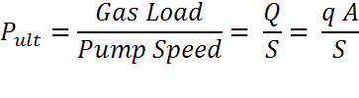

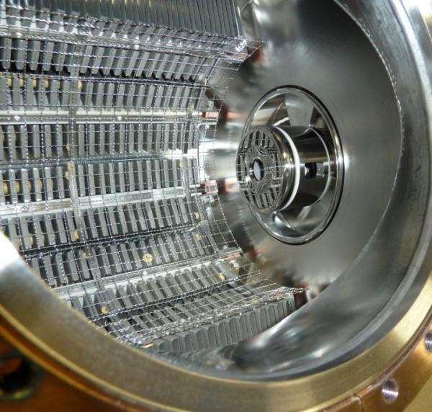
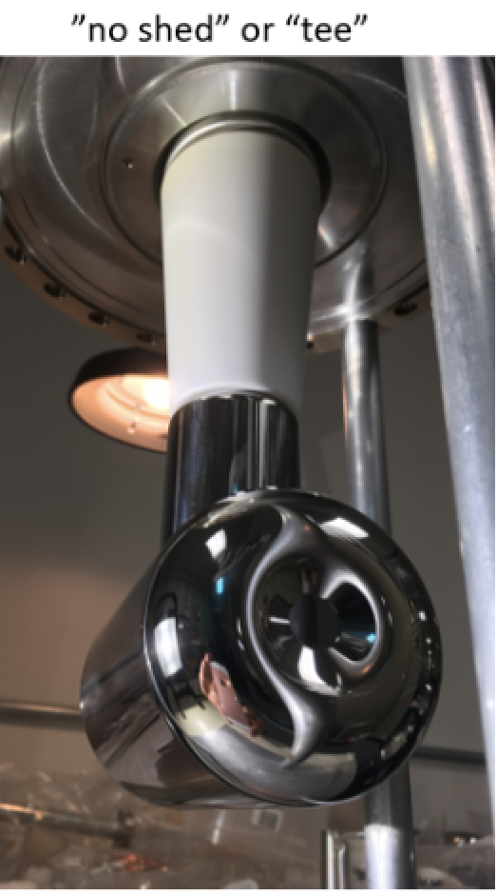
Improve Vacuum and Improve Lifetime
NEG pumps
Q= gas load, q= outgassing rate, A = surface area, S = pump speed
Strategy: Reduce Gas Load, Increase the Pump Speed
Baked gun, baked beamline, no leaks
Perform vacuum “dirty work” inside the preparation chamber, i.e., heat and activate the photocathode
Degas all vacuum components at 400 °C to reduce outgassing rate
Minimize the surface area of our chamber by adopting inverted insulator geometry
Lots of H₂ pumping - non-evaporable getter pumps. Plus a small ion pump for other gas (methane, argon, helium)
C. Hernandez-Garcia et al., Phys. Rev. Accel. Beams 22, 113401 (2019)

Slide 22
No alternative, we must improve vacuum…
Work of Md. Abdullah Mamun, M. Poelker and ODU student A. Al-Allaq
Original gun (1990’s) used only an ion pump: 1x10⁻¹⁰ Torr
NEG pumps (a CERN invention): 1x10⁻¹¹ Torr
400 °C bakeout (LIGO/VIRGO): 1x10⁻¹² Torr
Low carbon steel (Park*, CERN, LIGO): 1x10⁻¹⁴ Torr - 1x10⁻¹⁵ Torr
Recently growing interest about low-carbon steel….
Learned there’s likely a surface transformation that happens, ferrite transforming to magnetite, which could be good…faster pump down, lower temps and shorter bakeout time, black surface to reduce scattered light which reduces operating lifetime
Team meets regularly with Ranier Wiess (MIT Nobel prize winner for LIGO) and his Caltech team, CERN Vacuum Group headed by Paulo Chiggiato (mentored by Benvenuti), Fred Dylla (former Associate Director for the JLab Free-Electron Laser) and Dennis Manos of W&M
*C. D. Park, T. Ha, and B. Cho, JVST A 34, 021601 (2016)

Slide 23
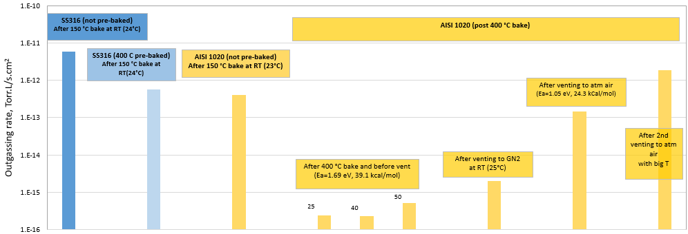
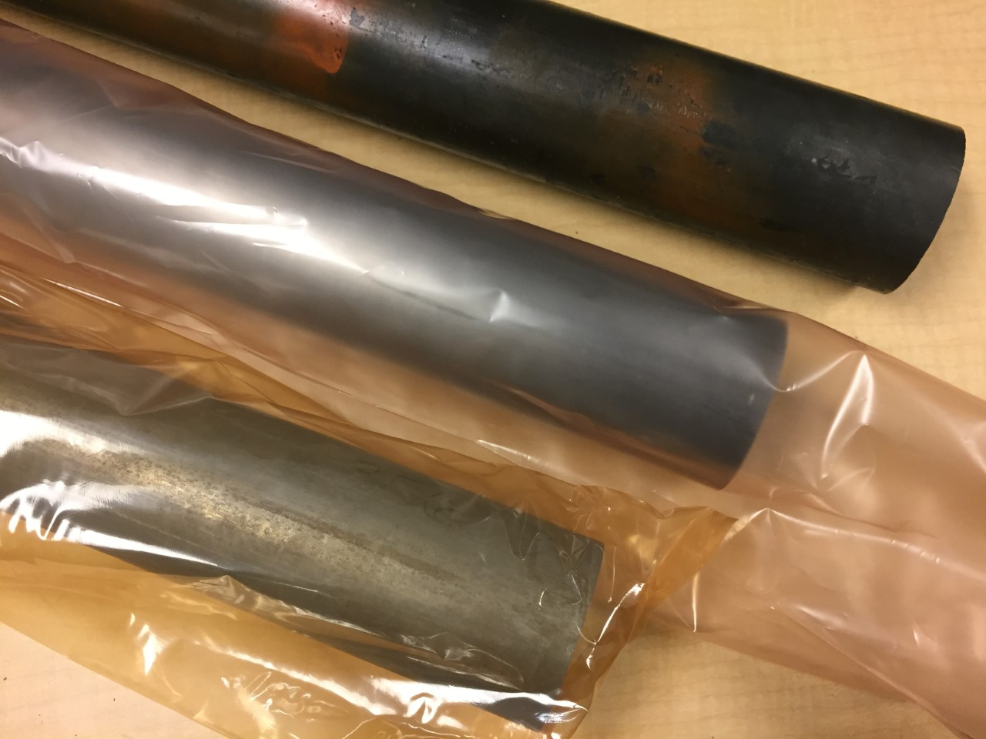
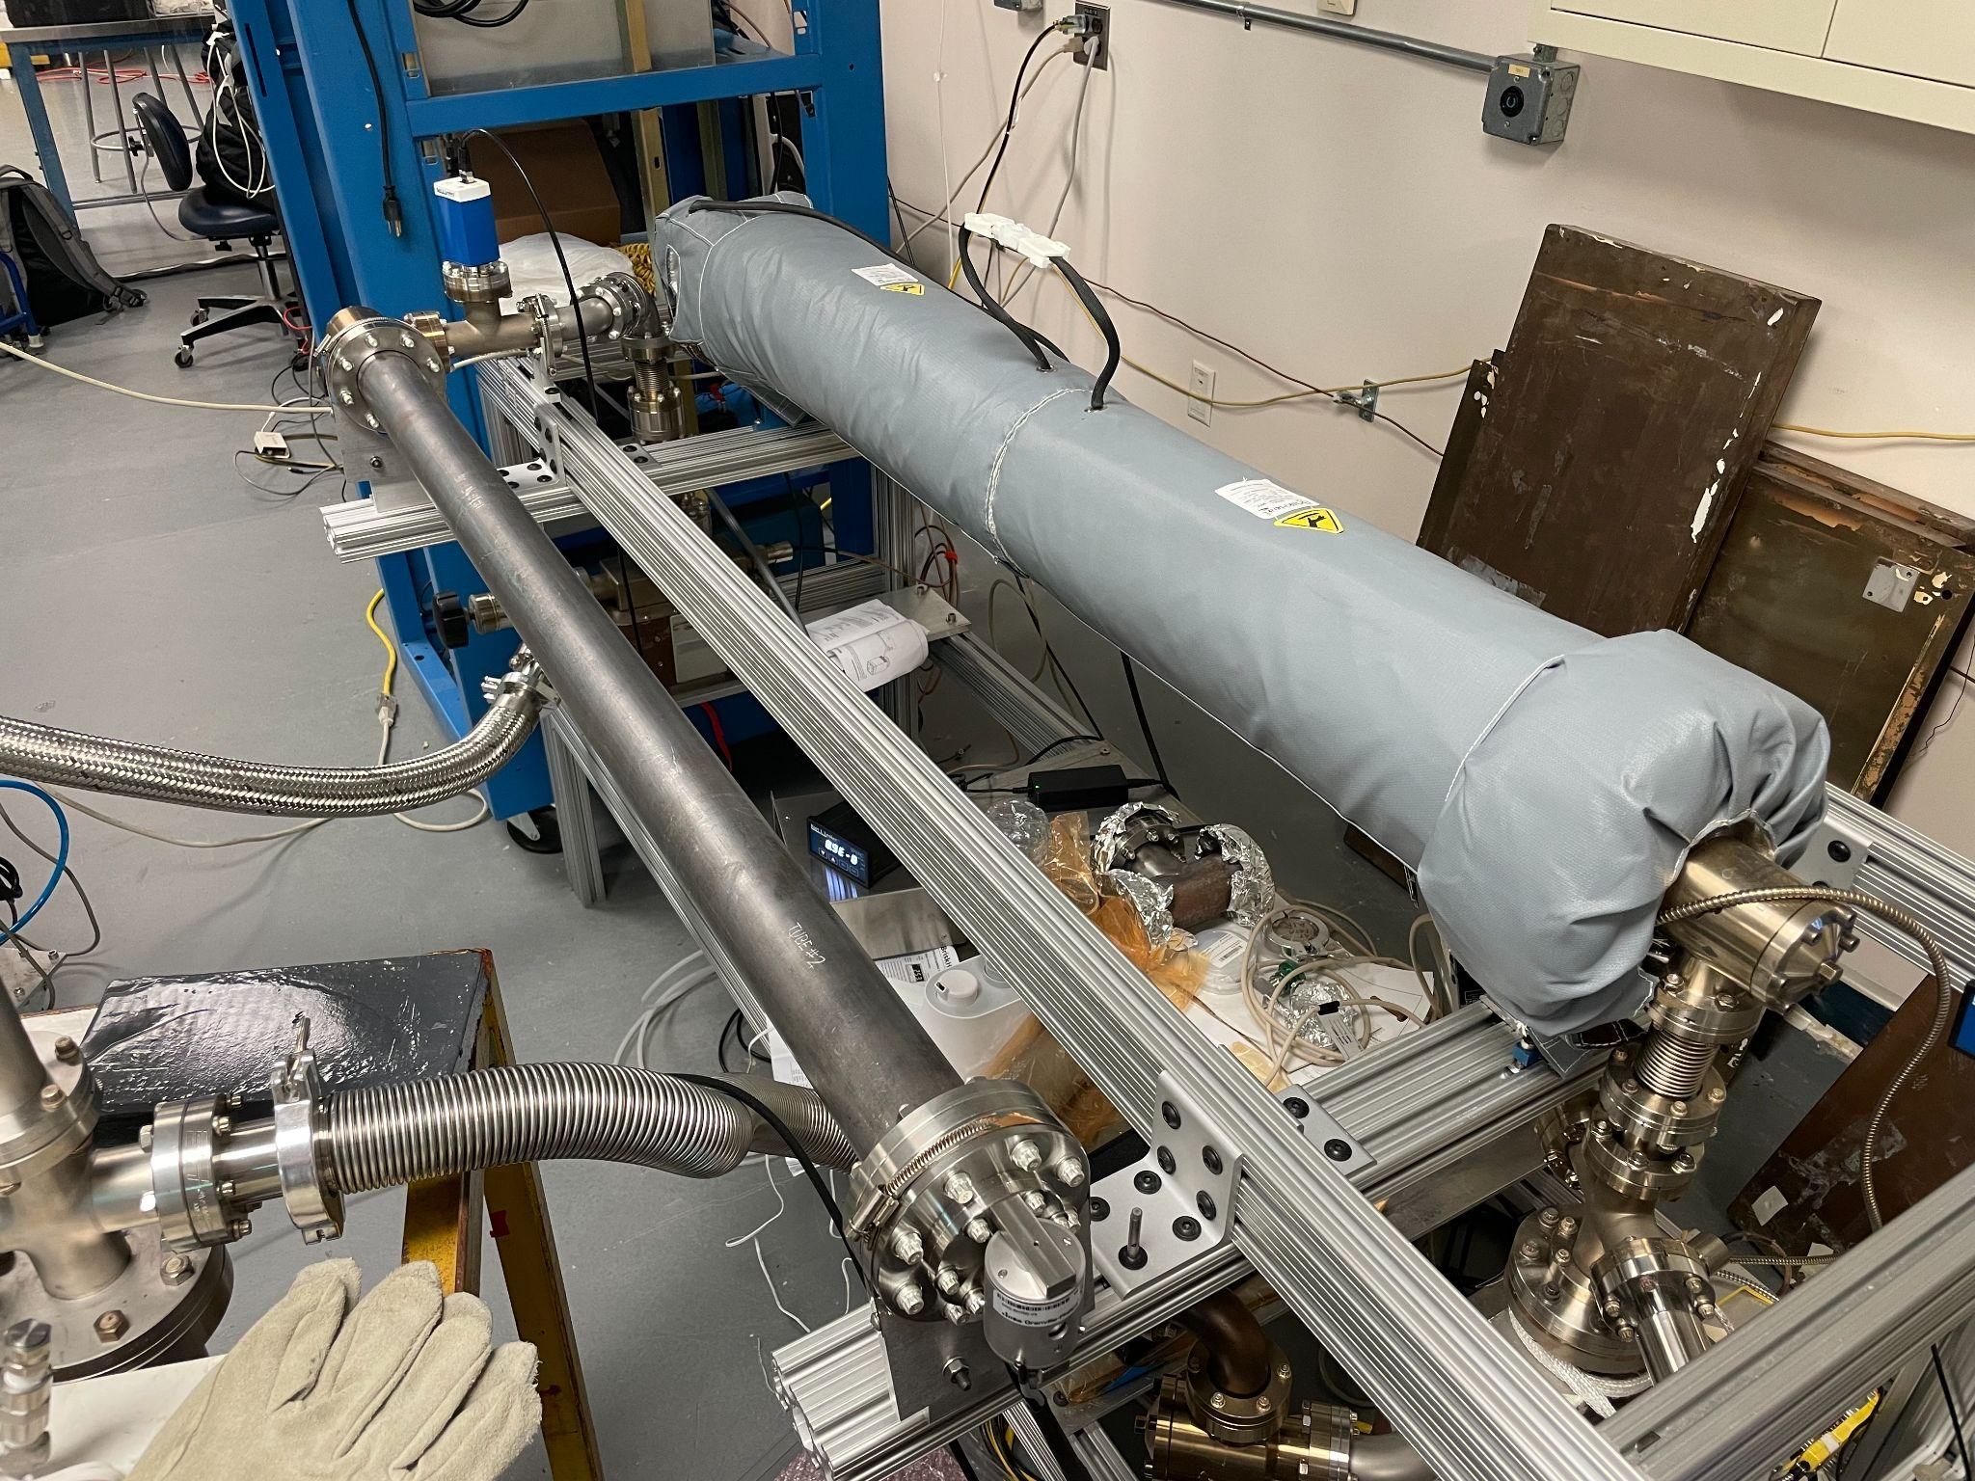
JLab’s first measurements of hydrogen outgassing rate,
AISI 1020 steel
Work of Md. Abdullah Mamun, M. Poelker and ODU student A. Al-Allaq
1020 as received
1020 high pressure rinsed
1020 acid etched
Two year long data taking during the COVID-19
Studies performed at JLab and W&M with baked vacuum chambers made of low carbon steel show very low H₂ outgassing, ~ 1000 times lower than stainless steel, ~ consistent with measurements made at CERN and reported by Park et al.*
The remarkably small outgassing rate of low-carbon steel represents the next major breakthrough in spin-polarized photogun development.
The idea of a photogun with black internal surface is appealing – could prolong operating lifetime of gun by eliminating scattered light
A recent study at CERN suggested that a low temperature heat treatment results in magnetite conversion in low carbon steel. Can this magnetite layer further reduce the pump down time?
*C. D. Park, T. Ha, and B. Cho, JVST A 34, 021601 (2016)

Slide 24
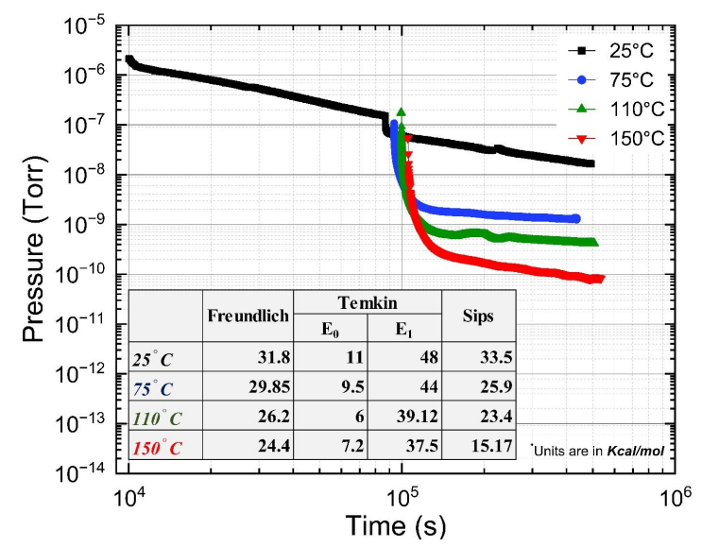
Just getting serious…….
Work of Md. Abdullah Mamun, M. Poelker and ODU student A. Al-Allaq
New thesis project started this year
Extensive evaluation of H₂ and water outgassing rate
Induction heater tests
Other materials, can foundry techniques of low carbon steel be applied to stainless steels?
Interior black coatings: AlTiN, DLC films
Build a setup for thermal desorption spectroscopy. Small samples (coupons), faster testing for binding energy……
Low carbon steel coupons heated in air, various humidity levels, temperature and duration, look for microscopic and macroscopic surface transformation
Build a “gun-sized” chamber made of 1020 low carbon steel, filled with NEGs, hoping to “bottom-out” the extractor gauge (extractor gauge pressure limit mid 10⁻¹³ Torr)
Measure the magnetic field inside gun chamber versus applied fields
Vacuum improvements ALWAYS enable new science
Mamun is proposing an Early Career Award to build a gun with significantly lower base pressure for positron production
Aiman is learning fitting data with isotherm models to evaluate binding energy of water on surface

Slide 25
ECA proposal: Year wise deliverables
Work of Md. Abdullah Mamun, M. Poelker and ODU student A. Al-Allaq
Years 1 & 2 (at CIS vacuum Lab)
Vacuum demonstration via ultimate pressure and hydrogen outgassing measurements on gun sized vacuum chambers (material:low carbon steel s.a., AISI1020, uncoated chamber and chambers with DLC and AlTiN internal black coating). Fall back option chamber: SS304 chamber with the optimum black coating coating.
Build the TDS system and characterize the binding energy for gas desorption
Study magnetic property of low carbon steel chamber
Electrode design with heat removal technique, CST modeling and simulation
Gun design, GPT simulation,
Photocathode chamber upgrade work
Year 3 (at CIS vacuum Lab)
Build the gun with photocathode cooling and attach to the diagnostic beamline at LERF vault
Scale CEBAF 780 nm fiber based laser power from 500 mW to ~ 3 W
Modify photocathode fabrication load lock chamber
Year 4 (at LERF vault)
Commission the gun and charge lifetime study @ mA beam current from photogun
Year 5 (at LERF vault)
Charge lifetime study @ mA beam current: Gun + buncher + 1/4 CM
Demonstrate kC charge lifetime at currents up to 10 mA

Slide 26
Summary
Jefferson Lab’s framework of a 22 GeV/e+ upgrade has helped define the goals of the Ce+BAF working group
We are on track to deliver in 2023 a technical report describing a start-to-end concept of positron beams for Ce⁺BAF 12 GeV
New concept is based on repurposing the LERF as a high power electron and positron injector (of course a long road ahead … source, target, solenoid, NC linac, shielding.
Spin polarized e⁻ sources operating at milliamp intensities, with high spin polarization >90% and large charge lifetime >1000 C at milliamp intensity are essential.

