Slide 1
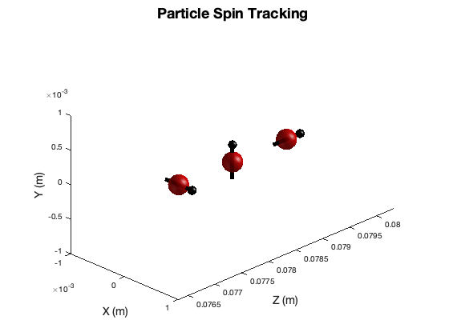
New Spin Tracking Software Developed For General Particle Tracer
Examples of Existing Software
Motivation for Development and Current Applications
Particle Tracking and Spin Dynamics
GPT: Element and Programs
GPT: Versatility and Customizability
GDFMGO (Multi-objective genetic global optimizer)
GDFSolve
Mark Stefani & S.B. van der Geer

Slide 2
Examples of existing Spin tracking Software
BMAD
Runge–Kutta integration, FFTs, interpolation and extrapolation
software toolkit for the simulation of charged particles and X-rays
Provides a simple mechanism for lattice function calculations from within control system programs.
Use Examples:
Lattice design, X-ray simulations, Spin tracking, Wakefields and HOMs, Beam breakup simulations in ERLs, Intrabeam scattering (IBS) simulations, Coherent Synchrotron Radiation (CSR)
Zgoubi
NEW: General Particle Tracer -Spin

Slide 3
Examples of existing Spin tracking Software
BMAD
Zgoubi
Dynamics calculated by integrating the Lorentz equation, based on Taylor series expansion,
closed orbits in periodic machines, computation of optical functions and parameters, tune scans, dynamic aperture scans, spin dynamics data treatment, graphic scripts, FFA and cyclotron design, AGS and RHIC studies, synchrotron radiation losses.
Unique Reference frame and coordinates
Use Examples:
Neutrino Factory simulations, lepton and hadron colliders, spin dynamics investigations at SuperB, RHIC, etc.
NEW: General Particle Tracer -Spin

Slide 4
Examples of existing Spin tracking Software
BMAD
Zgoubi
NEW: General Particle Tracer –Spin
Fifth order Runge-Kutta driver with adaptive stepsize control
Fully relativistic 3D charged-particle dynamics
Most standard beam-line components are represented in GPT. Users of GPT can easily extend the code to perform highly specialized calculations for specific applications.
Hierarchical data analysis, automatic parameter scans and graphical output allow for fast and detailed interpretation of simulation results.
Use Examples:
Ultrahigh spectral brightness femtosecond XUV and X-ray sources, Coherent Synchrotron Radiation (CSR), laser plasma wakefield accelerator design, space-charge induced distortions of ultrafast electron diffraction, high power proton drivers
Now polarized positron collection and injector design. Many more potential uses.

Slide 5
Motivation for Development and Current Applications
GPT has been the principle software used in countless studies. There are at least 81 publications on GPT specific applications alone.
Expansion of applications with spin tracking capabilities are numerous.
This expansion of GPT capabilities was part of a Laboratory Directed Research & Development project at Jefferson National Laboratory focused on the conceptual design of a polarized positron sources as an upgrade to the existing CEBAF Machine.
An efficient, robust, and versatile simulation software would be necessary to fully capture the physics of particle dynamics, spin dynamics, space charge, 3D fields and particle particle interactions to successfully design a polarized positron collection and injection scheme. Sophisticated analysis and optimization codes would also be necessary.

Slide 6
Motivation for Development and Current Applications
Particles distributions from GEANT4, poisson/SF Adiobatic Matching Device field maps and build in accelerator elements
Investigating E-field bending element for longitudinal to horizontal spin.
Legend
Target
Conical Solenoid
Solenoid
Quadrupole
Dipole
Collimator/dump
RF Cavity

Slide 7
Particle Position and Momentum tracking in GPT
The position x and the momentum p = 𝛾𝑚v are used as the coordinates of a particle. The equations of motion for particle i are given by:
The force on particle i is calculated using:
Due to the spacecharge, the force on each particle depends on the position of all other particles. vector y(t) containing the six coordinates of all the particles.
The only boundary conditions are the initial particle coordinates at a specified time.
GPT solves all particles variables simultaneously, the results are always self-consistent

Slide 8
Particle Position and Momentum tracking in GPT
fifth-order Runge-Kutta advances y(t) to y(t+h) by performing the following steps:
To monitor the accuracy of y(t+h) each step is calculated again using an embedded fourth-order formula:
The error estimate is given by:
Keeping specified accuracy is done by adjusting the stepsize h.

Slide 9
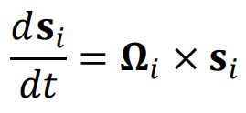
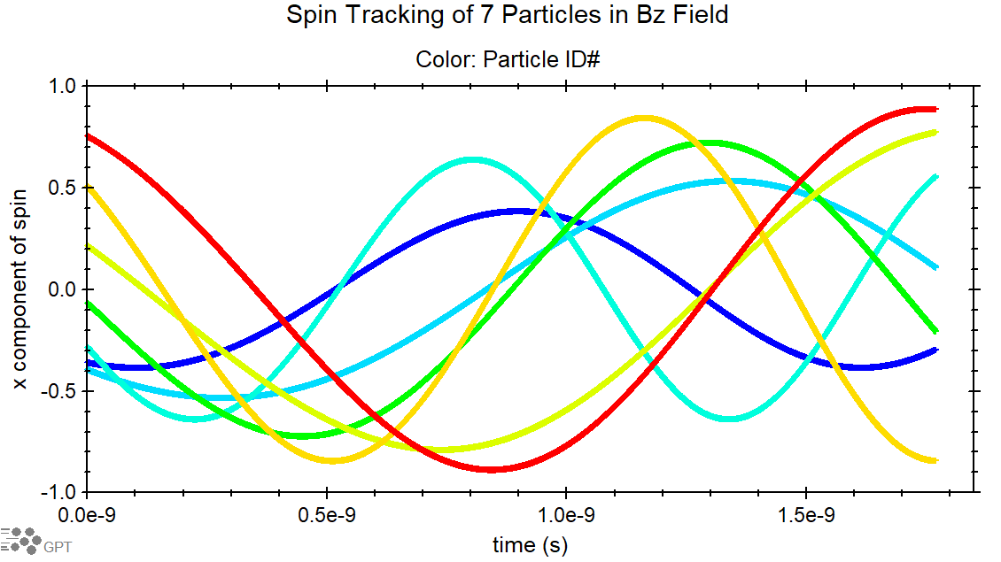
Particle Spin tracking in GPT
With spin-tracking, additional differential equations are solved for each particle
Generalized Thomas-BMT equation
In Lab Frame
s is the particle spin coordinate
$a_{i}=\frac{g}{2}−1$
g is the particle’s magnetic moment.

Slide 10
Benchmark Simulations
Simple Example: Wien Filter, Solenoid, and Dipole Pair Beamline
Total spin processions in lab frame; not relative to momentum.
Theoretical values make approximations of field integration and time of flight.
Solenoid: $θ=\frac{180}{π} \frac{e}{m} T [\frac{1}{γ}\left(a+1\right)\vec{B_{∥}}]$
Dipole: $θ=\frac{180}{π} \frac{e}{m} T [\left(a+\frac{1}{γ}\right)\vec{B_{⊥}}]$ $T≅\frac{L}{βc}$
Wein filter: $θ=\frac{180}{π} \frac{e}{m} T[a\frac{E}{βc}+\left(\frac{1}{γ^{2}−1}−a\right)\frac{βE}{c}]$

Slide 11
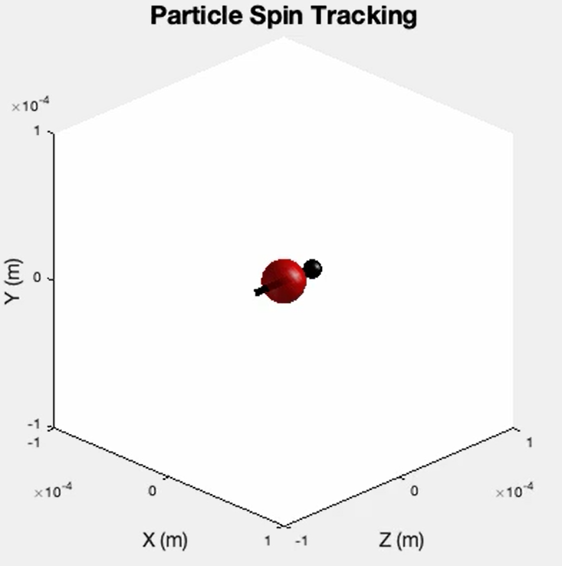
Simulation Results
Theory: $S_{0}$=(0,0,1) -> $S$ =(0,1,0) -> $S$ =(-1,0,0) -> $S$=(-0.707,0,0.707) -> $S$=(-1,0,0)

Slide 12
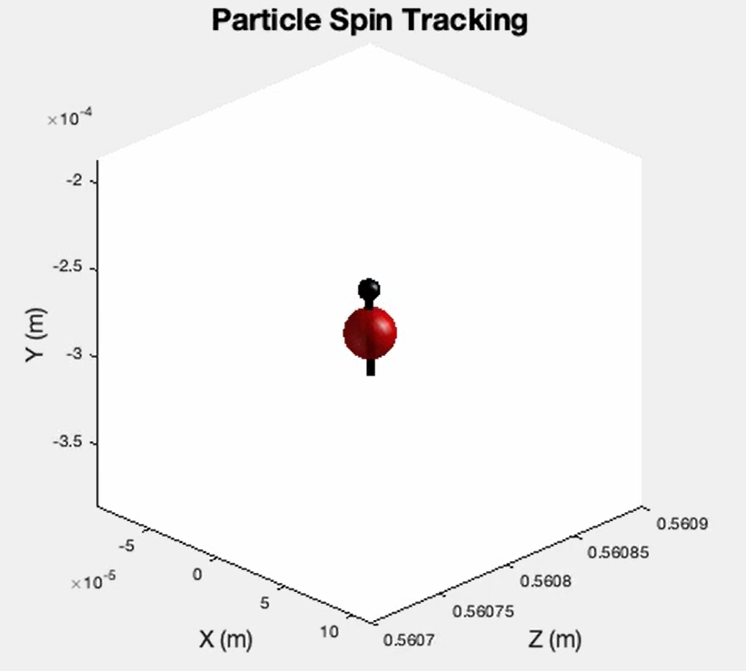
Simulation Results
Theory: $S_{0}$=(0,0,1) -> $S$ =(0,1,0) -> $S$ =(-1,0,0) -> $S$=(-0.707,0,0.707) -> $S$=(-1,0,0)

Slide 13
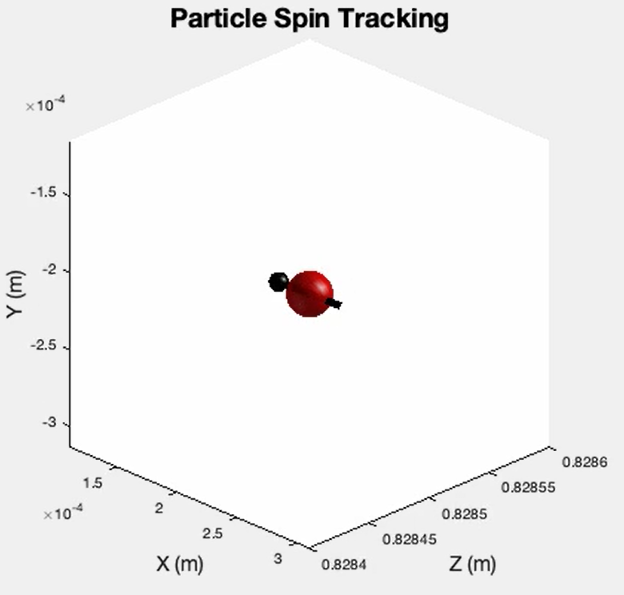
Simulation Results
Theory: $S_{0}$=(0,0,1) -> $S$ =(0,1,0) -> $S$ =(-1,0,0) -> $S$=(-0.707,0,0.707) -> $S$=(-1,0,0)

Slide 14
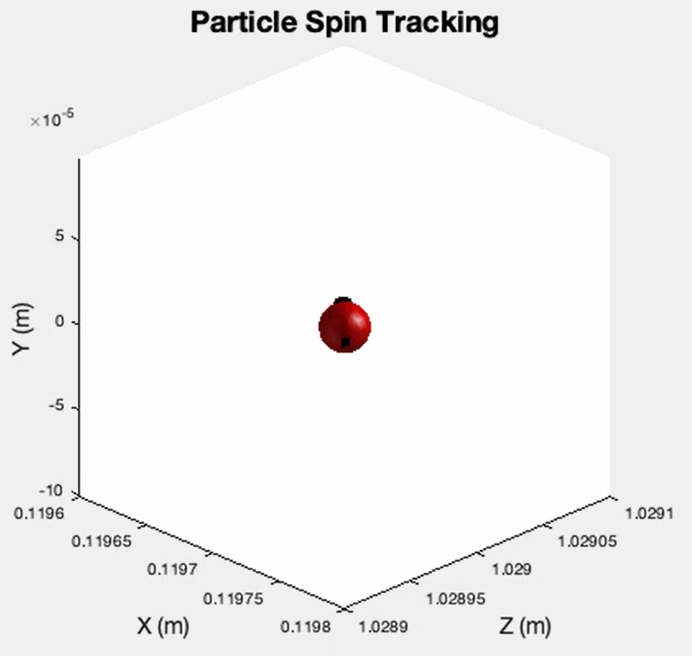
Simulation Results
Theory: $S_{0}$=(0,0,1) -> $S$ =(0,1,0) -> $S$ =(-1,0,0) -> $S$=(-0.707,0,0.707) -> $S$=(-1,0,0)

Slide 15
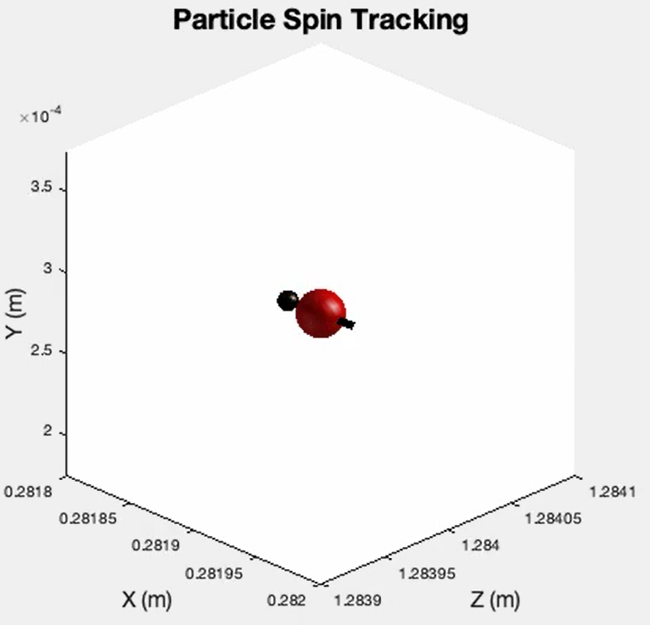
Simulation Results
Theory: $S_{0}$=(0,0,1) -> $S$ =(0,1,0) -> $S$ =(-1,0,0) -> $S$=(-0.707,0,0.707) -> $S$=(-1,0,0)

Slide 16
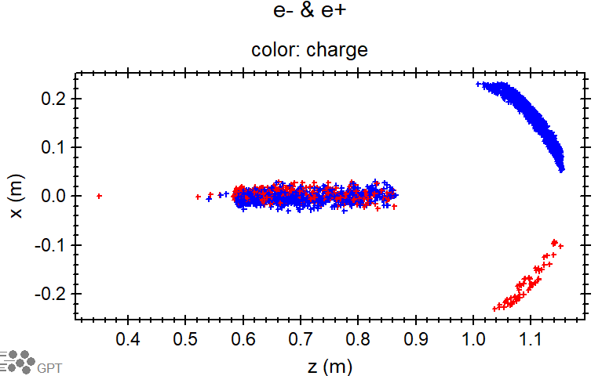
Generalized Particle Properties and Distributions
Arbitrary particle properties and can be specified
Particle: mass, magnetic moment, charge, magnitude of spin
Simultaneous simulation of multiple particles species
Electrons and Positrons
simultaneous propagation and spin tracking
recombination and scattering can be implemented
Arbitrary particle distributions
Spin tracking Minimally requires:
x, y, z, px, py, pz, spinx, spiny, spinz, g, q
Momentum, p, can be defined by $γβ$or simply $β$ of the associated vector
Built in functions can be used to generate arbitration distributions or input files can be used to import distributions from software such as GEANT4 .

Slide 17
GPT elements and programs
Sandbox approach
GDFAs are build in features of GPT that include components of the simulation itself as well as post-processing analysis.
Avgs
Stds
Bstatic
Setspinx
Ect…
Custom elements and programs can be compiled (GPT’s super power).
WriteGBall()
UncorEmit()
Bunchfactor()
Whatever you want to code…
Programs (progs): post-processing features used to analyze simulation results. These are the features that can be used for optimization.

Slide 18
GDFMGO and GDFSolve
Built in Optimization features GDFsolve and GDFMGO
GDFSolve used as a root-finder or as optimizer, assumes that the target objective(s) are smooth with respect to the variables.
Both allow a non-equal number of variables and constraints as well as external boundary conditions for all variables. The objectives are all calculated by standard GDFA data-analysis, allowing both built-in and custom GDFA programs to be used.
In theory GDFMGO is the best algorithm. It can solve, optimize, and it is not very sensitive to local minima. GDFMGO is intrinsically slow, but there is an MPI version that can launch thousands of GPT runs simultaneously
Multi-Objective Genetic Global Optimizer
Less likely to be trapped by local max or mins
.mgo file used to set optimization condition for separate simulation file
Convenient optimization analysis and quickly alternate optimization and standard simulation
Optimization time can be improved by specifying accuracy and number of cores used.

Slide 19
GDFMGO example output

Slide 20
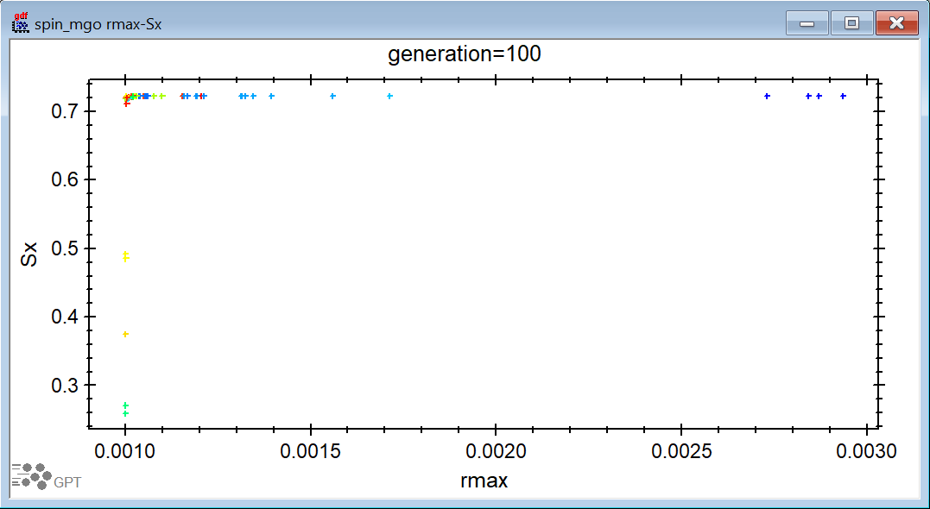
GDFMGO example output

Slide 21
References
S.B. van der Geer, M.J. de Loos. User Manual, http://www.pulsar.nl/gpt
S.B. van der Geer, M.J. de Loos. Custom Elements, http://www.pulsar.nl/gpt
S.B. van der Geer, M.J. de Loos, Mark Stefani. GPT-Spin, http://www.pulsar.nl/gpt
F. Meot. ZGOUBI USERS’ GUIDE, Note C-AD/AP/470 BNL 2012, https://www.bnl.gov/isd/documents/79375.pdf
David Sagan. The BMAD Reference Manual, https://www.classe.cornell.edu/bmad/bmad-manual-2021-09-24.pdf
William H. Press, Brian P. Flannery, Saul A. Teukolsky and William T. Vetterling, Numerical Recipes, The Art of Scientific Computing, Cambridge University Press, 2nd edition, 1992
Jackson J D. Classical Electrodynamics, 3rd ed (New York:Wiley) 1998
Bargmann V, Michel L and Telegdi V L. Phys. Rev. Lett.2435–6 1959
S.B. van der Geer, O.J. Luiten, M.J. de Loos, G. Pöplau, U. van Rienen, 3D space-charge model for GPT simulations of high brightness electron bunches, Institute of Physics Conference Series, No. 175, p. 101. 2005
Gisela Pöplau, Ursula van Rienen, Bas van der Geer, and Marieke de Loos, Multigrid algorithms for the fast calculation of space-charge effects in accelerator design, IEEE Transactions on magnetics, Vol 40, No. 2, p. 714. 2004

Slide 22
Thank you

