Slide 1
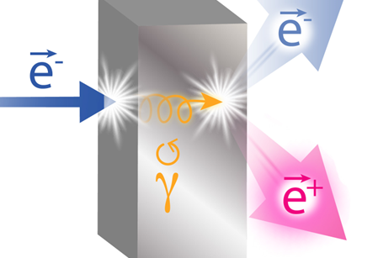
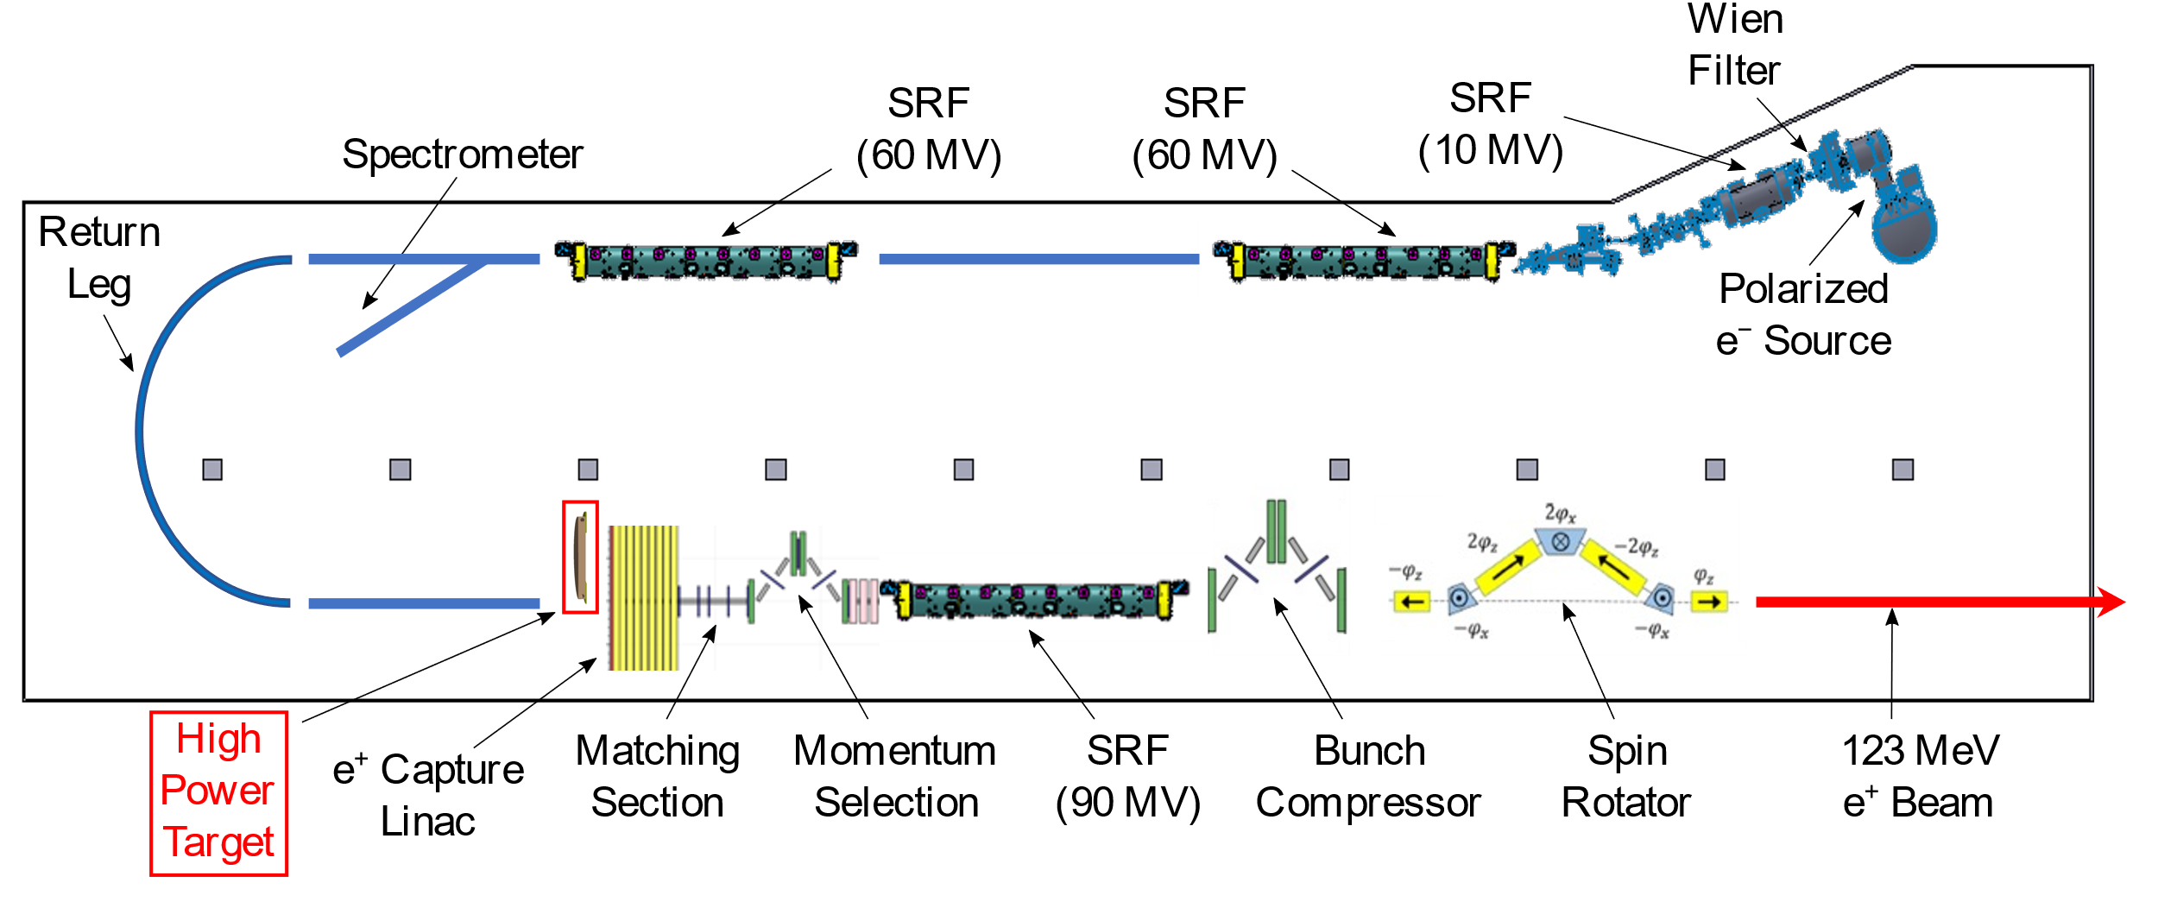
FAQ on positrons
Yves R. Roblin

Slide 2
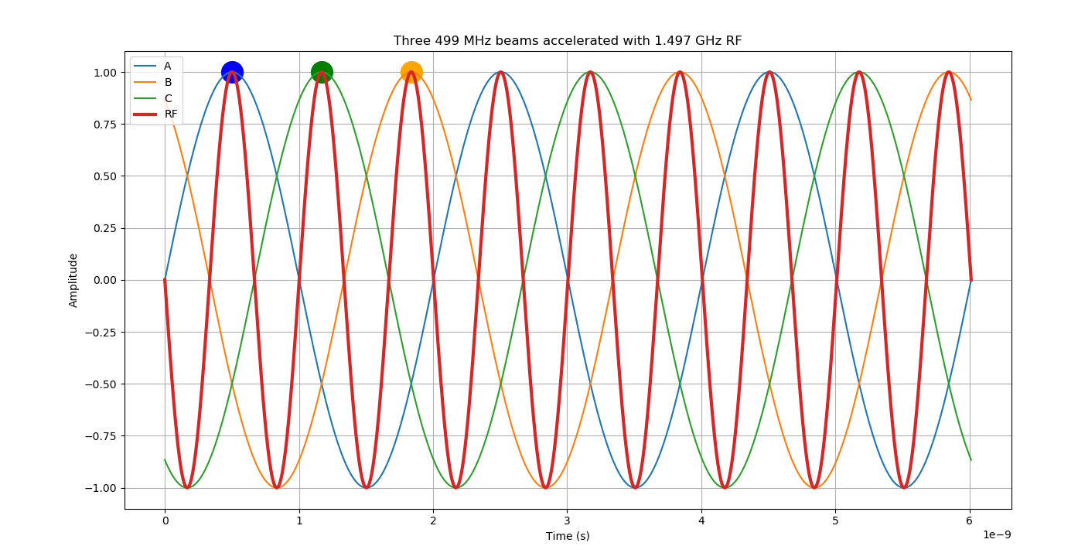
Multihall capabilities
Option 1: Using a 1.5 GhZ laser to generate bunches
Cons: Can not do 3+1. We wont be able to deliver to Hall D along with another hall at pass 5
Option 2: Using two lasers? One of them tunable to 249.5 ?

Slide 3
Current Limits
We can deliver up to 180 nA polarized, 800 nA unpolarized
If it’s coming from a single laser and single target then this is the total for all bunches.
We can not mix high current unpolarized and low current polarized (the capture optimization is drastically different)

Slide 4
Polarization control
If we deliver to one hall:
We can always adjust Wien (e-) for optimal polarization in hall
If we deliver to two halls:
Adjust e- Wien filter
Adjust spin rotator
Choose “magic” energy
A combination of all three can allow for max polarization in two halls. Using the first 2, we can always “share” the polarization between two halls.
I have(almost) the tool to calculate this. Need to update it with the new optics.

Slide 5
Positron beam generation ,phase slippage etc..
For unpolarized positrons, we want to capture them at a few MeV (5 to 10). If so, then there is a significant phase slippage between target and first cold RF module:
$$∆∅=\frac{2π}{λ}\left(1−1/β\right)L$$
For 3 meters, for example its 6 degrees. There is also a debunching effect ( $M55=1−L/{γ^{2}})$ . Consequently, switching from unpolarized e+ to polarized e+ will require adjusting longitudinal matches through the section and possibly the NL => Implication is that this switch will take time

Slide 6
Constraints on systematics and machine setup
In order to reduce systematics in experiments, one has to capture the e- the same way we capture the e+ from the pair production process. We then accelerate them in the main machine and use that to setup.
Adequacy of diagnostics ? We have to insure we can see that beam with diagnostics needed for setup (for example, it may be a problem to match the machine with the standard harps)
Need an estimate of the effect of reversing magnet polarity on the reproducibility. Are both sides of the hysteresis curve perfectly symmetric ? (Ask magnet integrator M. Tiefenback).
Is our LERF capture system designed to capture e- by adjusting a few fields?

