Slide 1
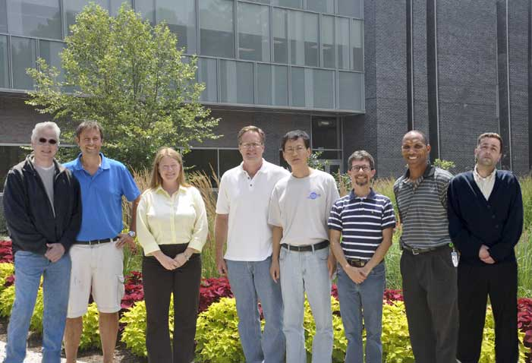
Polarized Electron Sources
Joe Grames
JLAB Summer Lecture Series, July 17, 2014

Slide 2

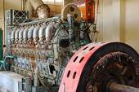

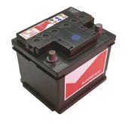
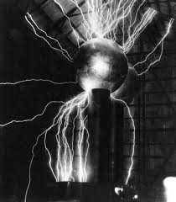
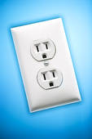

Who needs electrons?
Storage batteries, man-made and natural power generators, power grids and distribution circuits, and…the “free” electrons used in particle accelerators…..

Slide 3
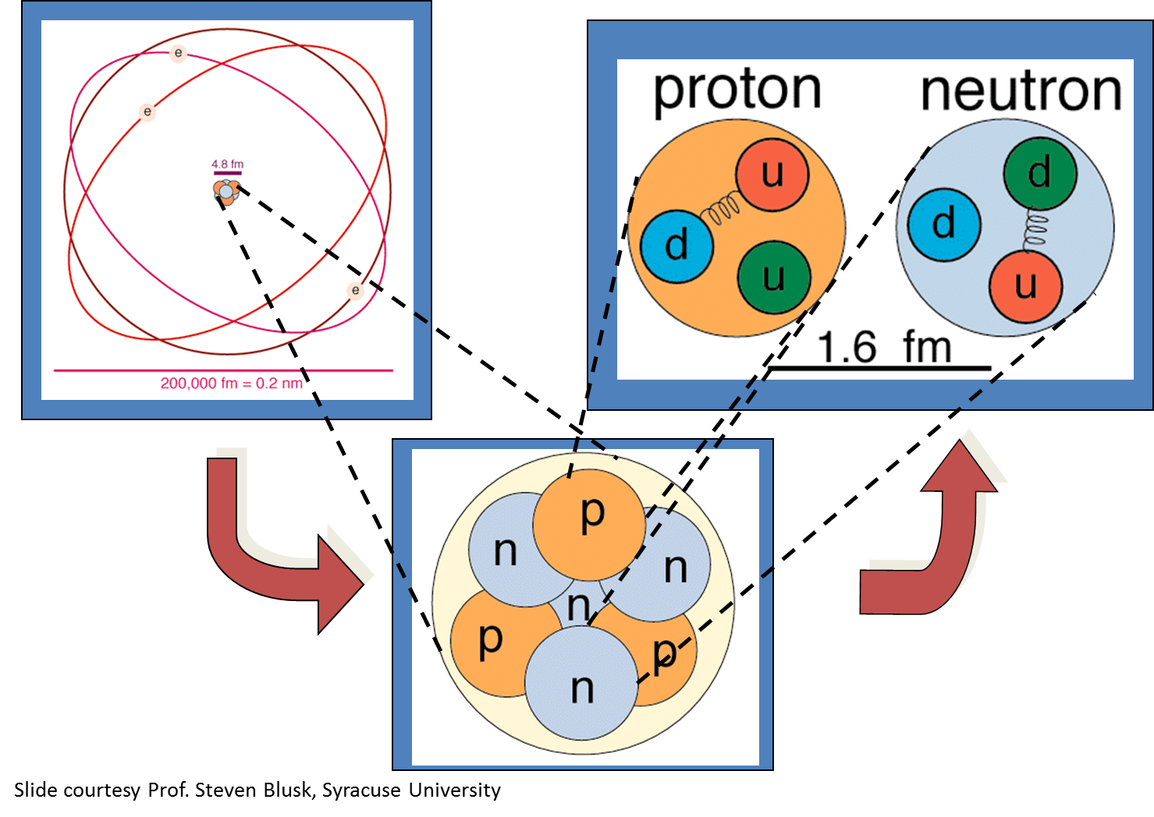
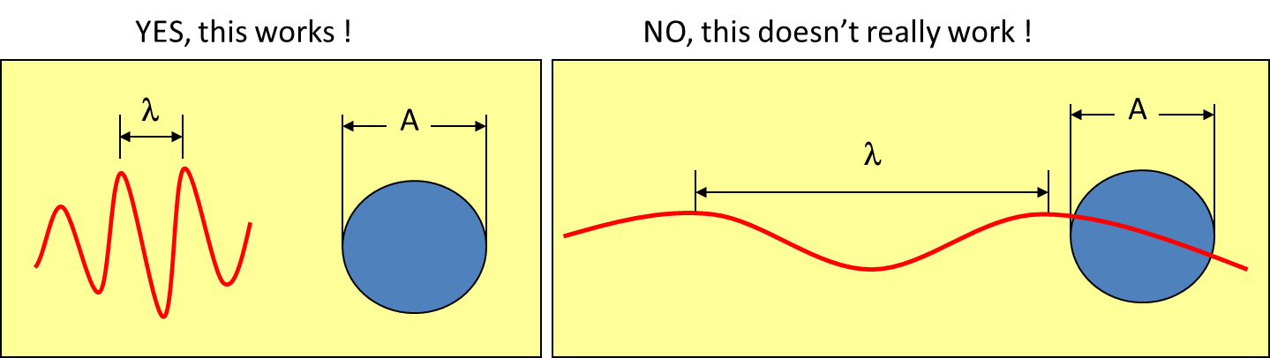
⁷Li

Slide 4
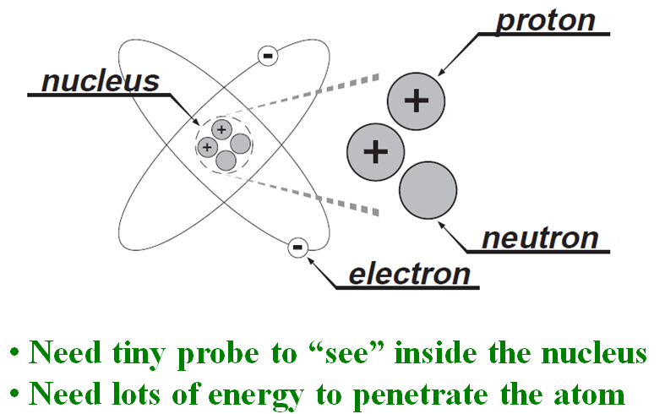
What you “are” is what you “see”…
M ~ 938 MeV/c²
M ~ 0.511 MeV/c²
mass ~ 1/λ ~ energy
E=mc²

Slide 5
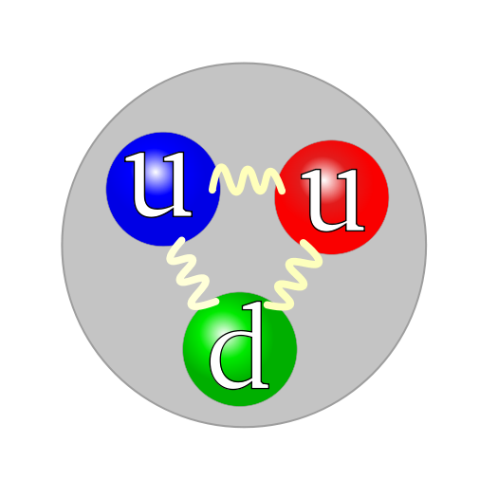
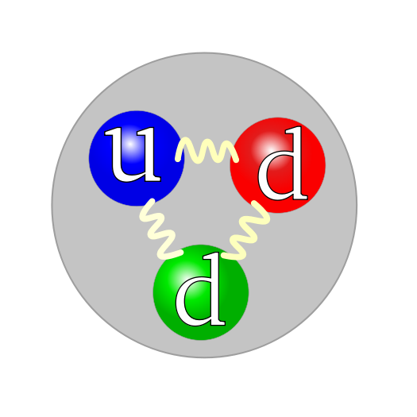
What to do?
Build a 5 mile long electron microscope!
Electron
Proton
Neutron
Make electrons energetic enough (E_{beam}) to peek inside proton or neutron (M_{nucleon}).

Slide 6
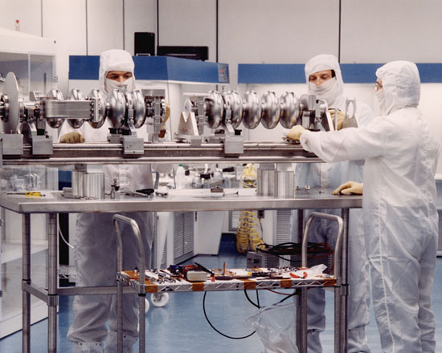
How to make the electrons “powerful” ?
Use radio(frequency) waves !!!
Accelerating
Debunching
Bunching
Decelerating
Electrons gain energy
on each crest!

Slide 7
Continuous Electron Beam Accelerator Facility
A B C A B C
2 Linacs
1497 MHz
111 ps
RF Synchronous
Lasers
499 MHz,
ΔФ = 120°
A
B
C
B
A
RF Separators
499 MHz
B
Pockels Cell
A
C
C
Gun

Slide 8
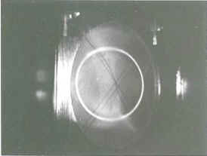
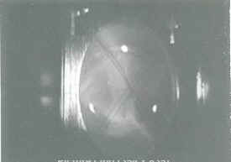
Photo Finish, but at 2 billionths of a second !!!
DC beam, not so useful
3 lasers pulsing
500 MHz
B
A
C
A B C A B C
1497 MHz
60 degrees

Slide 9
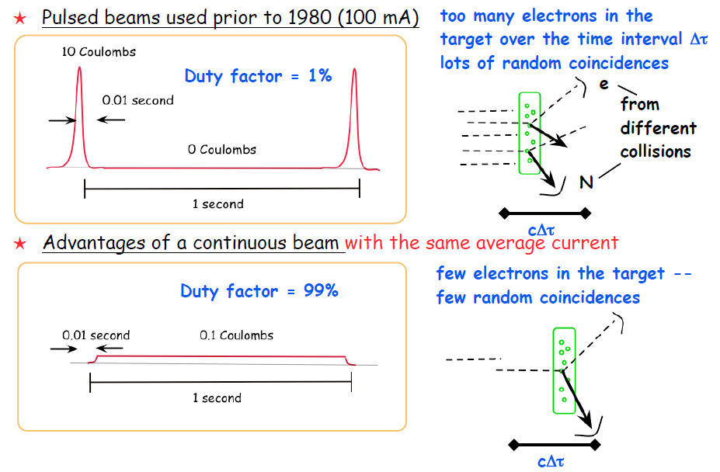
The “C” in CEBAF

Slide 10
Accelerators Need Electron Beams
How do we make them?
Field Emission
Thermionic Emission
Photoemission

Slide 11
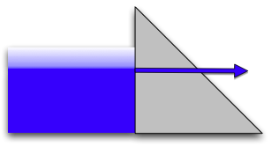

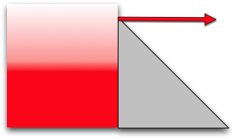

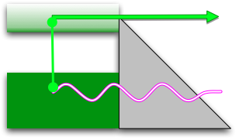

The Canonical Emission Equations
(slide courtesy of Dr. K. Jensen, Naval Research Laboratory)
Field Emission
Fowler Nordheim
E.L. Murphy, and R.H. Good,
Physical Review 102, 1464 (1956).
Thermal Emission
Richardson-Laue-Dushman
C. Herring, and M. Nichols,
Reviews of Modern Physics 21, 185 (1949).
Photoemission
Fowler-Dubridge
L.A. DuBridge
Physical Review 43, 0727 (1933).
Listed chronologically

Slide 12
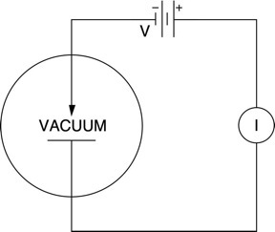
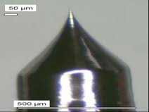
Field Emitter Sources
Explained by Fowler-Nordheim, 1928: a quantum mechanical tunneling effect
“bright” e-beam, good for surface science
I = BV² exp(-C/V)
Vacuum diode
human hair
60°

Slide 13
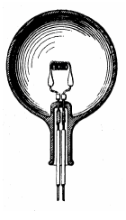
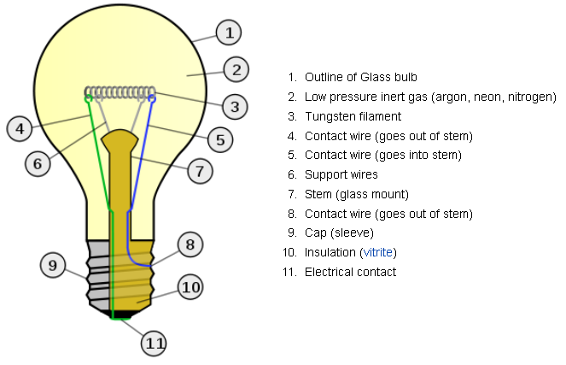
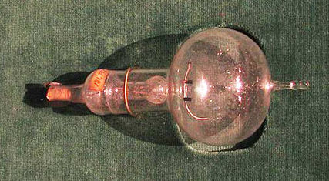
Thermionic Emission
Used to make light….
Studied since early 1800’s and perfected over 100 years, by many inventors (why does Edison get so much credit?)
Thermionic emission from Tungsten filaments and metalloids like LaB6 operating at >1000K are common
~ 90% of consumed power simply generates heat
Melts 3695K
Edison’s patent,
Long-lasting filament

Slide 14
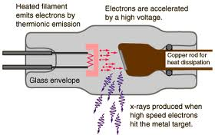
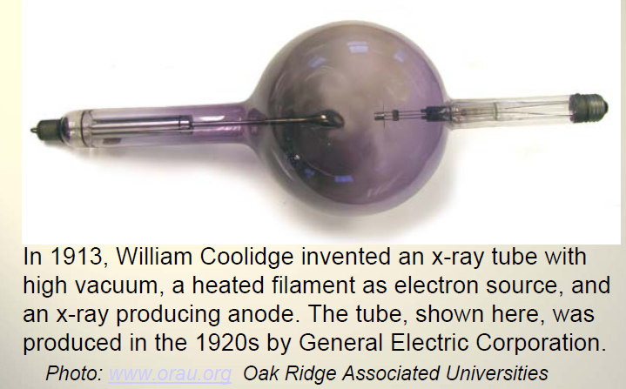

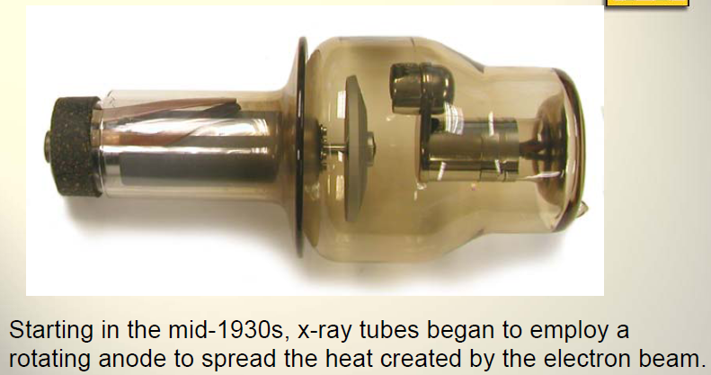
Thermionic Emission
Used to make x-ray light….
bias at high voltage
1880s
Rotating anode to distribute heat
X-rays are generated when a DC electron beam, typically a few mA, strikes a tungsten target at 60-200 keV. e-Beam quality is not a big concern
1930s

Slide 15
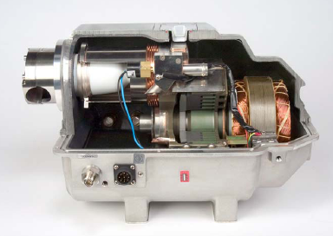
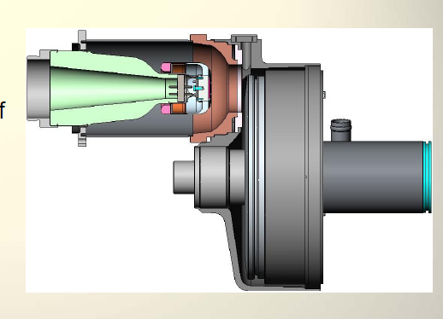
Modern X-Ray Sources
Higher e-beam current…..
Higher x-ray flux
Higher Voltage….
More penetrating x-ray beam
Courtesy Varian

Slide 16
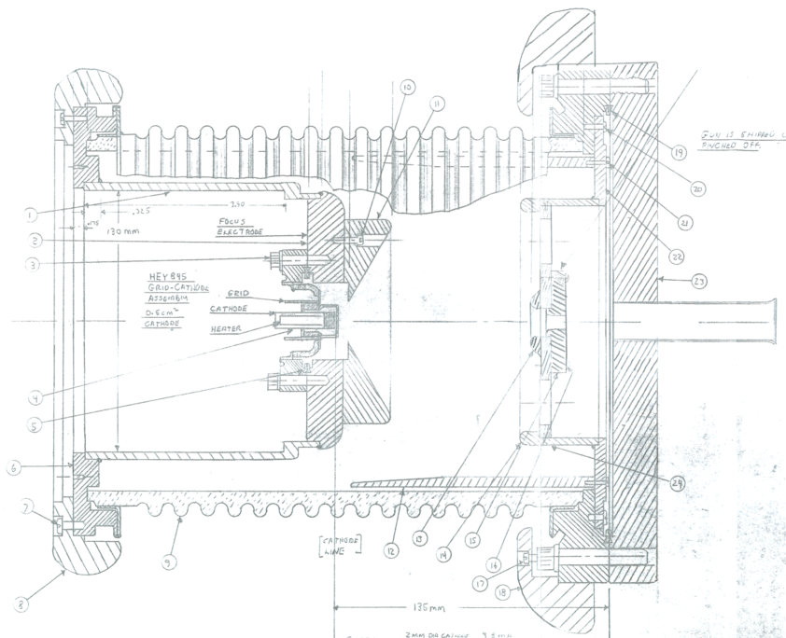
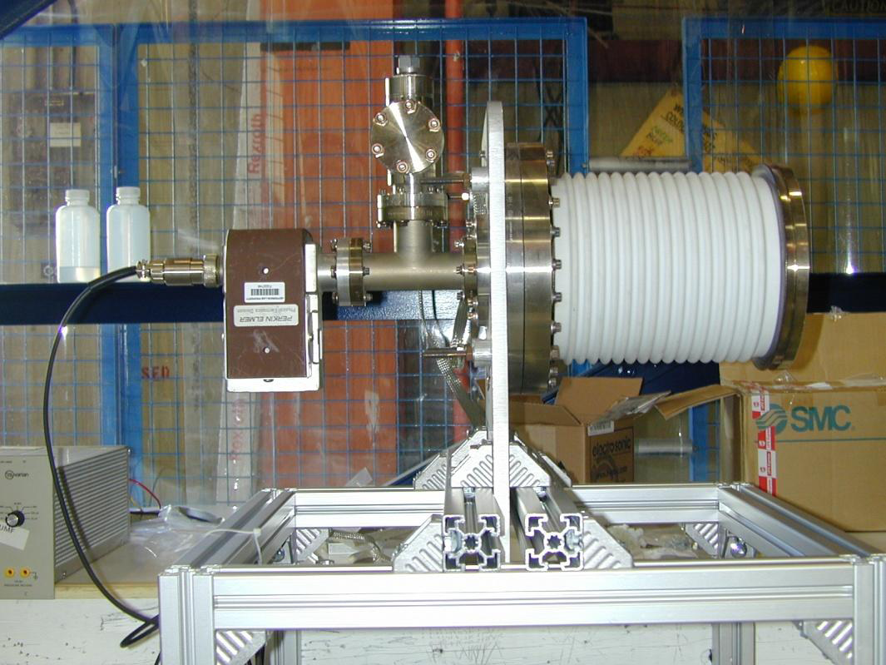
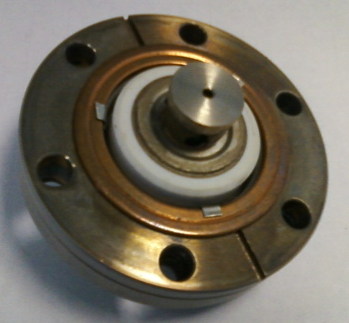
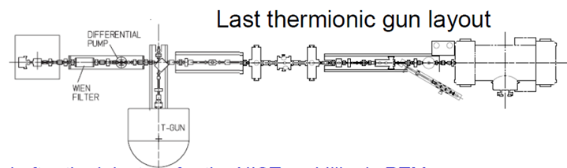
CEBAF’s First Electron Source
Make beam by running current through the filament biased at 100kV
Use “grid” to turn beam ON/OFF, i.e., create machine-safe macropulses
Apertures to improve emittance
Use RF “chopper” to create RF structure
Polarized GaAs photosource
RF-chopper
Thermionic source

Slide 17
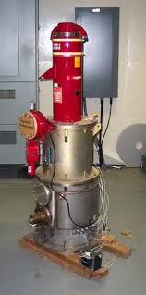
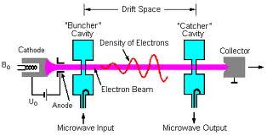
Klystrons — RF generators
Electrons make RF-energy…
Klystrons use a DC electron beam at a few mA to generate/amplify microwaves by velocity modulation.
Klystrons use thermionic cathodes to generate the required electron beam.

Slide 18
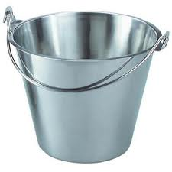
What about the probing with spin ?
Target
You measure
an experimental
asymmetry

Slide 19
Parity Violation Experiments at CEBAF
Experiment | Energy (GeV) | I (µA) | Target | A_{pv} (ppb) | Maximum Charge Asym (ppb) | Maximum Position Diff (nm) | Maximum Angle Diff (nrad) | Maximum Size Diff (δσ/σ)
HAPPEx-II (Achieved) | 3.0 | 55 | ¹H (20 cm) | 1400 | 400 | 1 | 0.2 | Was not specified
HAPPEx-III (Achieved) | 3.484 | 100 | ¹H (25 cm) | 16900 | 200±100 | 3±3 | 0.5±0.1 | 10⁻³
PREx | 1.063 | 70 | ²⁰⁸Pb (0.5 mm) | 500 | 100±10 | 2±1 | 0.3±0.1 | 10⁻⁴
QWeak | 1.162 | 180 | ¹H (35 cm) | 234 | 100±10 | 2±1 | 30±3 | 10⁻⁴
Møller | 11.0 | 75 | ¹H (150 cm) | 35.6 | 10±10 | 0.5±0.5 | 0.05±0.05 | 10⁻⁴
PV experiments motivate polarized e-source R&D

Slide 20
What does “234 ppb” even mean?
A - B
A
1,000,000,000
Target
1,000,000,000
A = 500,000,117
B = 499,999,883
B

Slide 21
Electron Bunch Spin & Polarization
0% Polarization
(thermionic)
☹
v
50% Polarization
☺
v

Slide 22
Polarized Source Landscape 1970s
Self-polarization via Sokolov-Ternov Effect
Electron Scattering (Mott)
Photo-ionization: Fano Effect
Photo-ionization of State Selected alkali atoms
Optically Pumped He Discharge
Field Emission from EuS
Photoemission from GaAs

Slide 23
Sources can be problematic !
Fast spin reversal; some methods difficult to reverse spin greater than 1Hz second (present day experiments want >1kHz)
It would be nice to make RF-time structure directly, instead of DC beam
Most accelerators require reasonably small emittance
Maximize feasability; lasers, pounds of alkali metal, hot and cold things very near each other, strong magnetic fields, very high voltage, challenging vacuum issues can kill a concept
Long term reliability can be an issue (24/7 ops)
Reproducibility, getting the same result twice

Slide 24
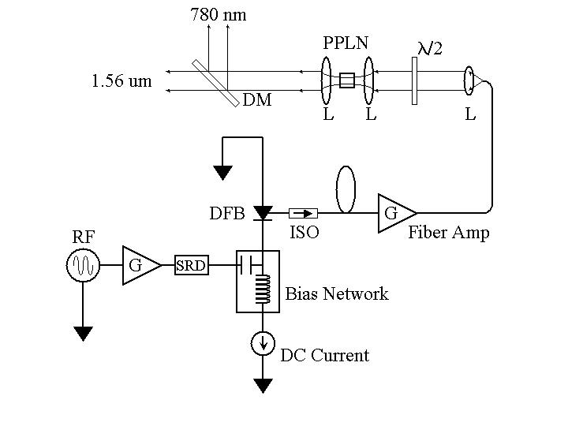
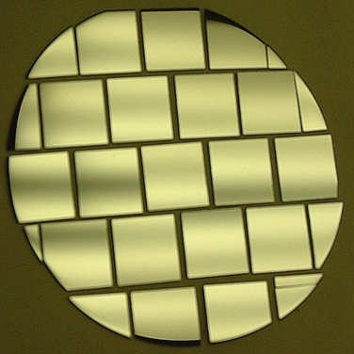
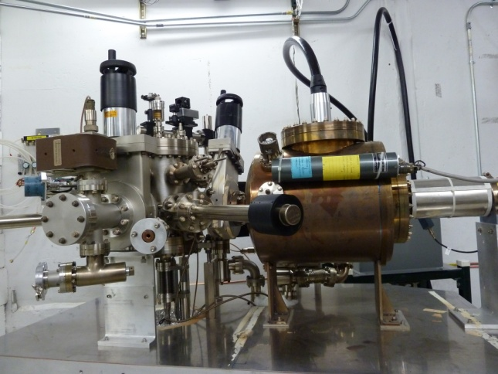
Polarized Source “Musts”
Good
Photocathode
Good
Laser
Good
Electron Gun
Many electrons/photon
High Polarization
Fast response time
Lots of Photons
CW Pulses
High Polariztion
Accelerate Electrons
Happy Photocathode
Integrate Laser

Slide 25
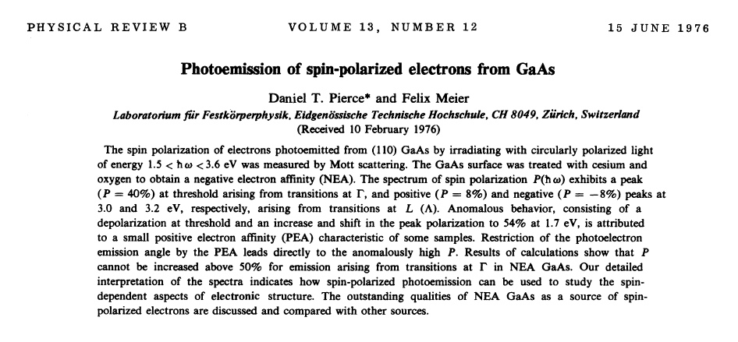
GaAs….the method that caught on

Slide 26
Photoemission from GaAs
Dipole layers of
Cesium + NF₃
Reduces Work Function
Negative Electron Affinity (NEA)
Bare GaAs surface
Large Work Function
Positive Electron Affinity (PEA)
NEA Surface Activation
PEA=4.07 eV
-
Conduction
Band
-
χ^{NEA} ~ 0.2 eV
E_{gap}
Valence
Band
+
Light
GaAs
Vacuum
GaAs
Vacuum
Quantum Efficiency = N_{e-} / N_{γ}

Slide 27
Bulk GaAs
Laser excitation from P_{3/2} to S_{1/2} : E_{gap} < E_{γ} < E_{gap}+Δ
Electron Polarization:
E
E
J
S_{1/2}
-1/2
+1/2
S_{1/2}
E_{gap}=1.42 eV
σ+
3
3
σ-
1
P_{3/2}
E_{F}
P_{3/2}
Δ=0.34 eV
-3/2
-1/2
+1/2
+3/2
P_{1/2}
-1/2
+1/2
P_{1/2}
k
m_{j}
σ+: Right-handed circularly polarized light
σ- : Left-handed circularly polarized light
Reverse electron polarization by reversing light polarization

Slide 28
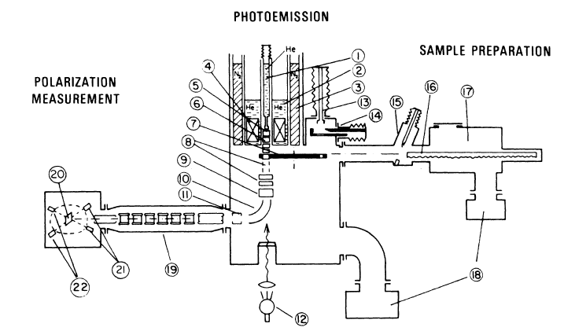
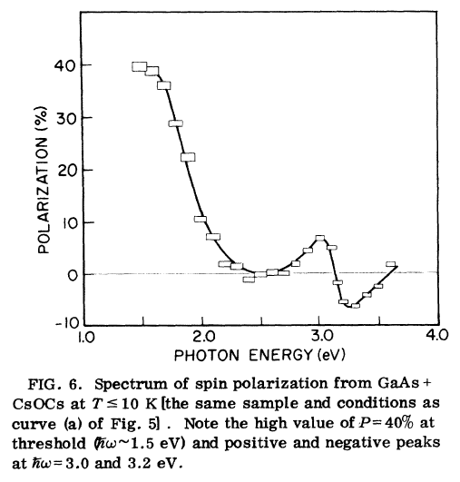
First Observation of Polarization from GaAs

Slide 29
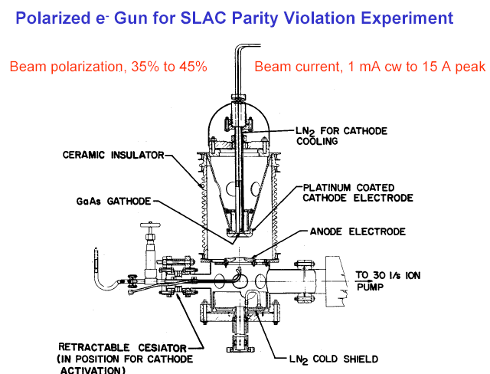
First High Voltage GaAs Photogun
Started with a thermionic gun housing

Slide 30
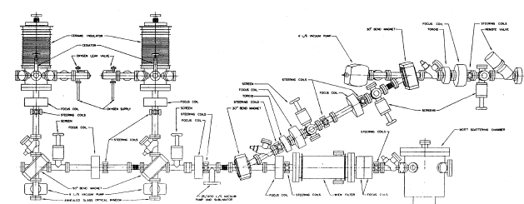
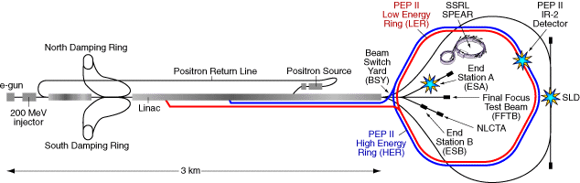
First GaAs Photoinjector
Built for SLAC parity-violation experiment E122
Polarized electrons accelerated December, 1977
E122 announces parity violation June, 1978 - an important verification of the Standard Model

Slide 31
Higher P: Breaking GaAs Degeneracy
Split degeneracy of P_{3/2} : Introduce strain on GaAs crystal by growing it on substrate (GaAsP) with different lattice constant
High polarization by laser excitation from P_{3/2} to S_{1/2} :
  E_{gap} < E_{γ} < E_{gap}+δ
m_{j} = -1/2
+1/2
S_{1/2}
σ+
σ-
E_{gap}
P_{3/2}
m_{j} = -3/2
+3/2
δ=20–50
meV
-1/2
+1/2
Higher QE: Alternating layers of GaAs and GaAsP – Superlattice GaAs

Slide 32
Strained layer GaAs
Bandwidth Semiconductor (formerly SPIRE)
0.1 μm
Strained GaAs
MOCVD-grown epitaxial spin-polarizer wafer
Lattice mismatch
250 μm
GaAs
P
x=0.29
1-x
x
GaAs
P
250 μm
1-x
x
⇒ split
degeneracy of P
0<x<0.29
p-type GaAs
substrate
3/2
600 μm

Slide 33
Strained Layer - Superlattice GaAs
-3
Be doping (cm )
5.10
19
GaAs (5 nm)
17
GaAsP (3 nm)
5.10
14 pairs
GaAs (4 nm)
5.10
18
GaAs P
(2.5 μm)
0.64
0.36
GaAs P
, 0<x<0.36 (2.5 μm)
1-x
x
p-type GaAs substrate
SVT associates, per SLAC specs.

Slide 34
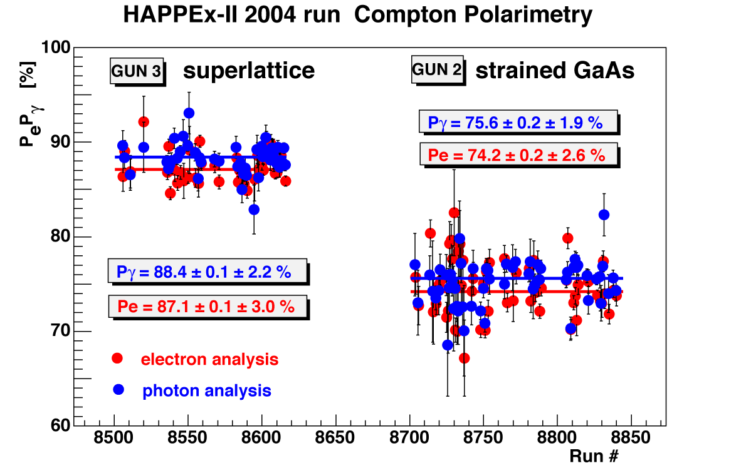
And, it really works!
Experiment Figure of Merit
2
P I
sup.
= 1.38
2
P I
str.

Slide 35
Polarized GaAs Source “Musts”
Good
Photocathode
Good
Laser
Good
Electron Gun
Many electrons/photon
High Polarization
Fast response time
Lots of Photons
CW Pulses
High Polariztion
Accelerate Electrons
Happy Photocathode
Integrate Laser

Slide 36
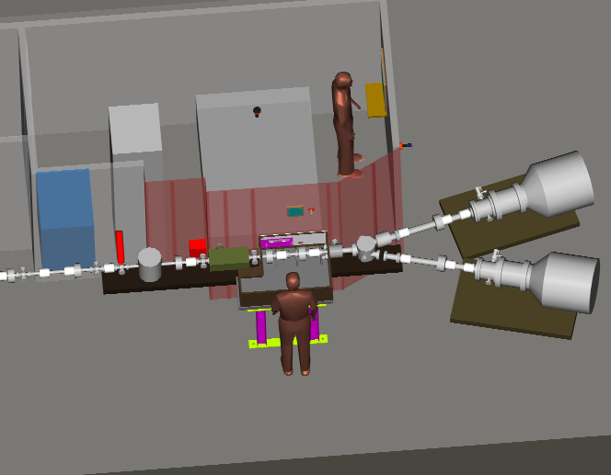
Bird’s Eye View
Laser Room
Electron
Beam Line
Two Guns

Slide 37
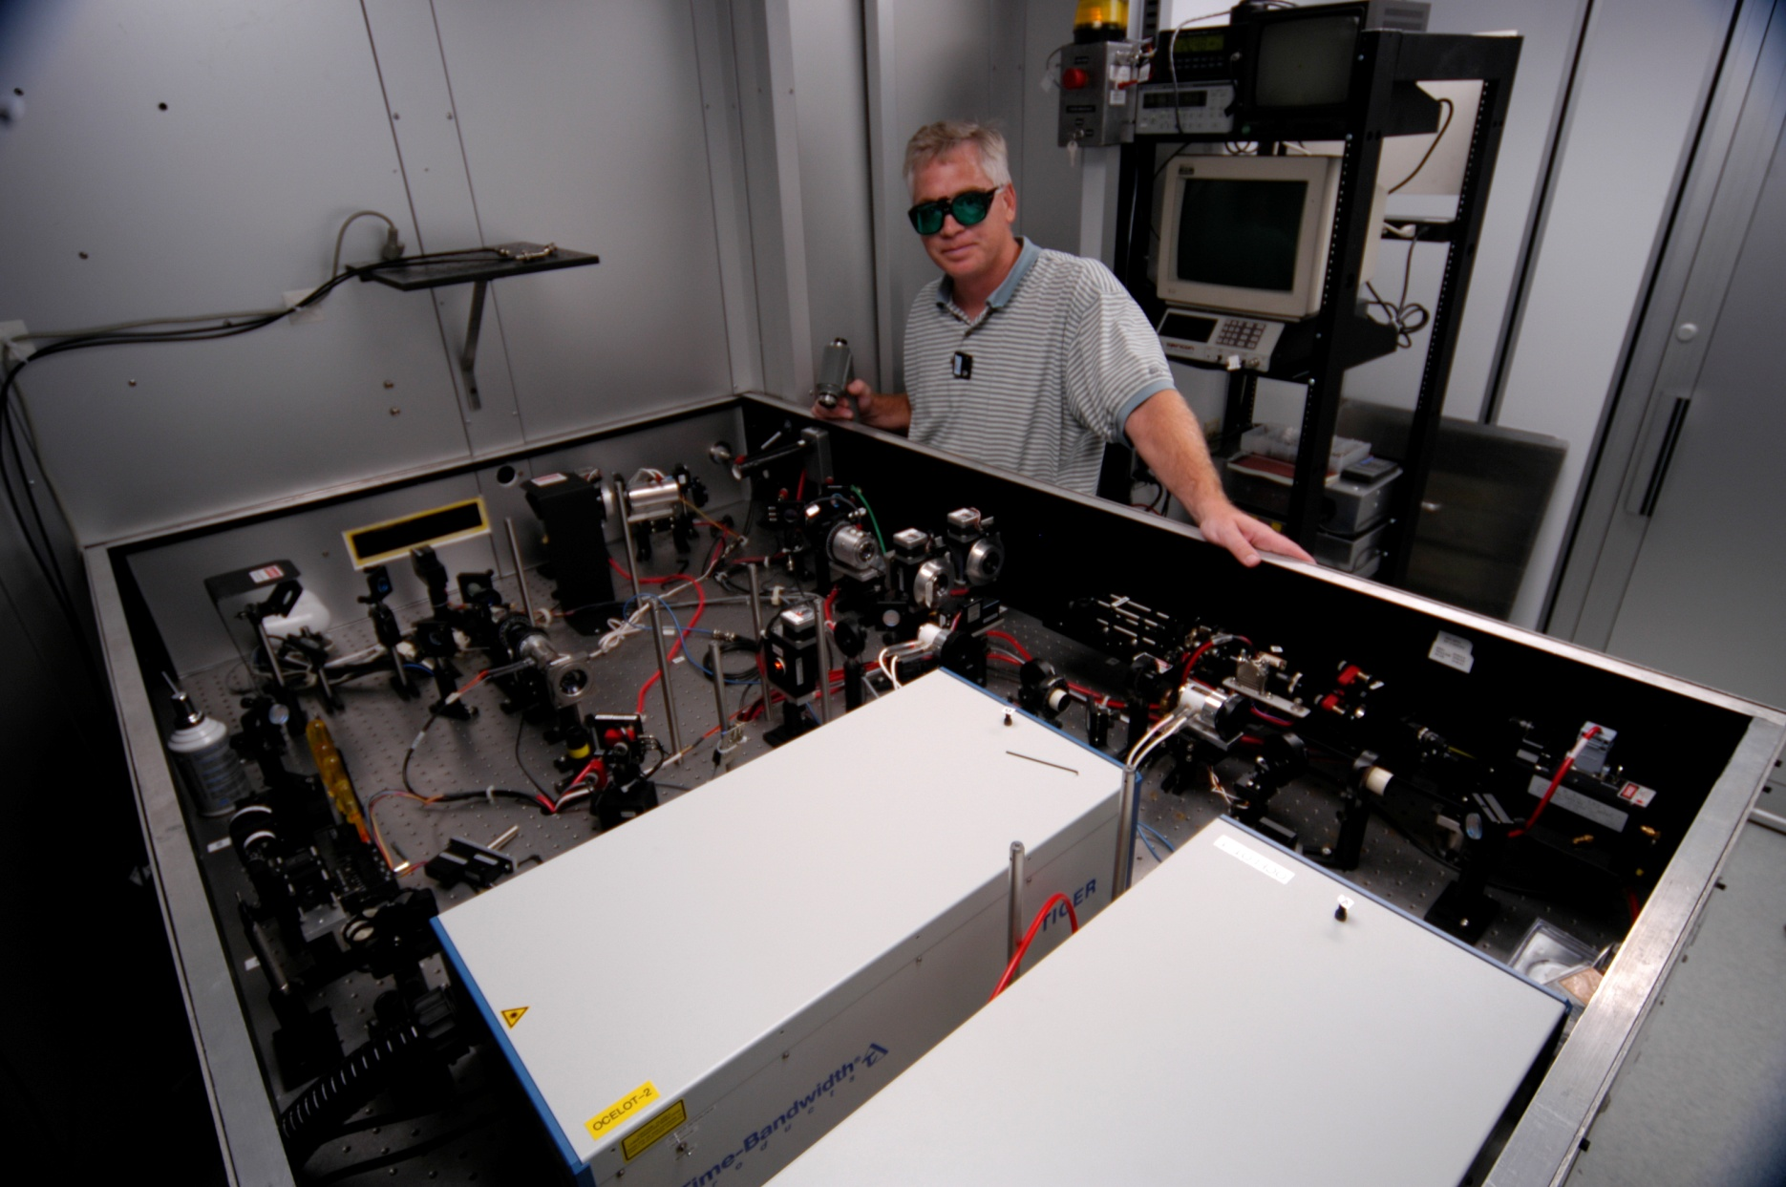
Laser Room for Dust & Climate Control
Lasers are cool !!!

Slide 38
Attenuator
IA
Rotatable GaAs
Photocathode
Gain-switched Diode Laser and Fiber Amplifier
LP HWP LP
PC WP LP
Shutter
Helicity Generator
Helicity Fiber
HV Supply
(0 – 90 V)
15° Dipole
nHelicity
Fiber
Vacuum
Window
Delayed
Helicity Fiber
T-Settle
Fiber
Hall
RHWP
Charge Feedback (IA)
V-Wien Filter
Target
Parity
DAQ
Spin Solenoids
BCM
Charge Feedback (PITA)
H-Wien Filter
BPMs
Position
Feedback
Pockels
Cell
HV Supply
(0 – 4 kV)
CEBAF
5 MeV
Helicity Magnets
PZT
Mirror
IHWP
Electron
Beam

Slide 39
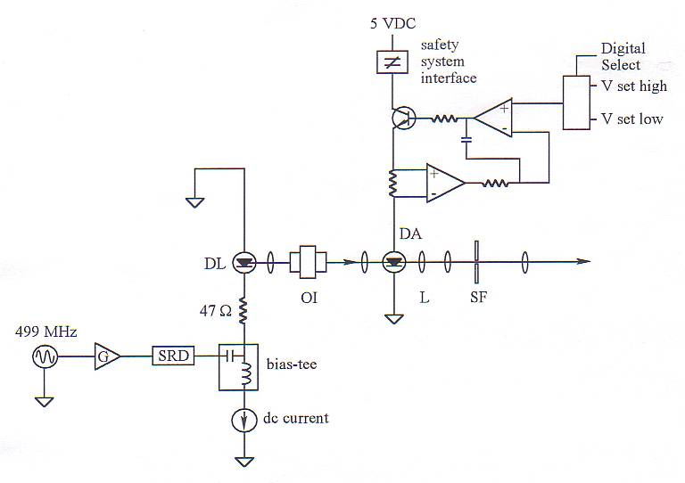
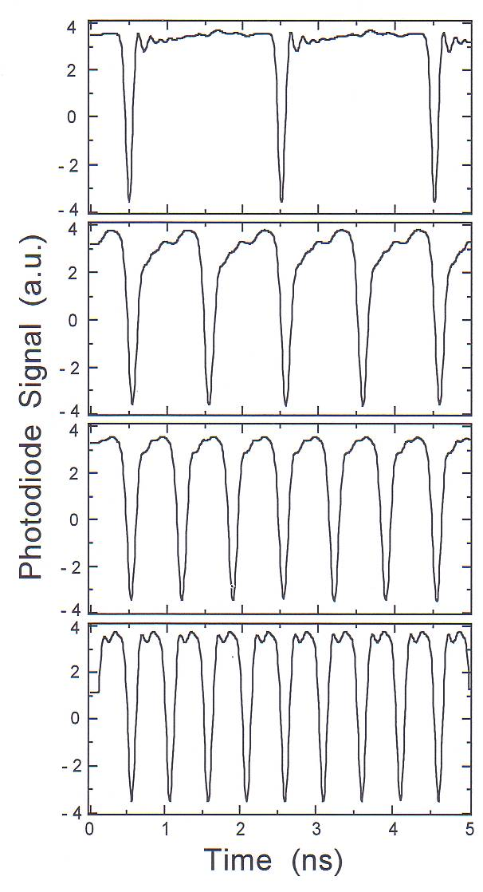
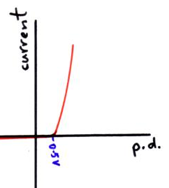
Radio Frequency Pulsed Lasers
M. Poelker, Appl. Phys. Lett. 67, 2762 (1995).
0.5 GHz
Diode seed laser
A
A
A
1 GHz
Diode amplifier
1.5 GHz
A
B
C
A
B
C
A
2 GHz

Slide 40
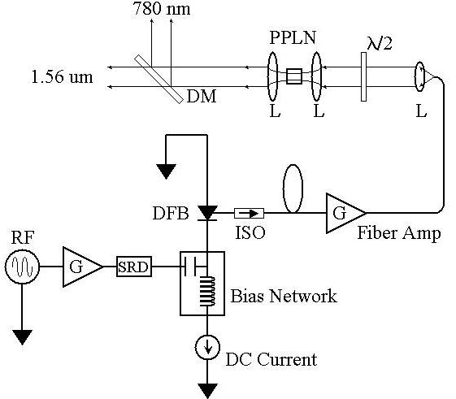




Fiber-based Drive Laser
780 nm
Frequency-doubler
1560 nm to 780 nm
30% Efficiency (2 W)
RF Locked Low-Power (1 mW)
1560 nm Fiber Diode
1560 nm
499 MHz
High Power (6 W) 1560 nm Fiber Amplifier

Slide 41
Polarized GaAs Source “Musts”
Good
Photocathode
Good
Laser
Good
Electron Gun
Many electrons/photon
High Polarization
Fast response time
Lots of Photons
CW Pulses
High Polarization
Accelerate Electrons
Happy Photocathode
Integrate Laser

Slide 42




Slide 43

We understand Alice’s worry…
“The woods were dark and foreboding, and Alice sensed that sinister eyes were watching her every step. Worst of all, she knew that Nature abhorred a vacuum” – Gary Larson

Slide 44
Vacuum regimes
Air ~ 10¹⁶ / Torr-cm³
Low, Medium Vacuum (>10⁻³ Torr)
  Viscous flow
    interactions between particles are significant
  Mean free path less than 1 mm
High, Very High Vacuum (10⁻³ to 10⁻⁹ Torr)
  Transition region
Ultra High Vacuum (10⁻⁹ - 10⁻¹² Torr)
  Molecular flow
    interactions between particles are negligible
    interactions primarily with chamber walls
  Mean free path 100-10,000 km
Extreme High (<10⁻¹² Torr)
  Molecular flow
  Mean free path 100,000 km or greater

Slide 45
Vacuum Conditions at CEBAF
Application | Pressure Range | Location | Vacuum Regime
Beamline to dumps | 10⁻⁵ Torr | Target to dump line | Medium
Insulating vacuum for cryogens | 10⁻⁴ Torr to 10⁻⁷ Torr | Cryomodules, transfer lines | Medium to high
Targets, Scattering Chambers | 10⁻⁶ to 10⁻⁷ Torr | Experimental Halls | High to very high
RF waveguide warm to cold windows | 10⁻⁷ to 10⁻⁹ Torr | Between warm and cold RF windows | High to very high
Warm beamline vacuum | 10⁻⁷ to 10⁻⁸ Torr or better | Arcs, Hall beamline, BSY, some injector | High to very high
Warm region girders | 10⁻⁹ Torr or better | Girders adjacent to cryomodules | Very high to ultrahigh
Differential pumps | Below 10⁻¹⁰ Torr | Ends of linacs, injector cryomodules and guns | Ultrahigh vacuum
Baked beamline | 10⁻¹⁰ to 10⁻¹¹Torr | Y chamber, Wien filter, Pcup | Ultra high vacuum
Polarized guns | 10⁻¹¹ to 10⁻¹² Torr | Inside Polarized guns | Ultra/Extreme high vacuum
SRF cavity vacuum | < 10⁻¹² Torr | Inside SRF cavities with walls at 2K | Extreme high vacuum

Slide 46
Where does the gas come from?
Outgassing from the system
  Metal and non-metal (viton o-rings, ceramics) all outgas
  Primarily water in unbaked systems
  Primarily hydrogen from steel in baked systems
Leaks
  Real
    Gaskets not sealed
    Cracks in welds, bellows, ceramics, window joints
    Superleaks that only open at very low temperatures
  Virtual
    Small volumes of gas trapped inside system (screw threads, etc.) that pump out slowly over time
Gas load caused by the beam
  Desorption of gases by elevated temperatures, electrons or photons striking surfaces, etc.
Engineered Loads (targets, etc.) where gas is added
Permeation of gasses through materials
  Viton gaskets worse than metal seals
  Hydrogen can permeate through stainless steel!

Slide 47


Ultra High Vacuum Pumps
Getter Pumps
  Chemically active surface
    Titanium sublimed from hot filament
    Non-Evaporative Getters
  Molecules stick when they hit
    Does not work well for inert gasses such as Argon, Helium or for methane
Ion Pumps
  Electric field to ionize gasses
  Magnetic field to direct gasses into cathodes where they are trapped
    Has some pumping capability for noble gasses
Baking used to get pressures below 10⁻¹⁰ Torr
  250°C for 30 hours removes water vapor bonded to surface that otherwise limits pressure
Avoid contamination by oils due to roughing pumps, fingerprints, machining residue.
NEG pump array
Ion Pump

Slide 48




Always Tweaking the Design
1
4
Endless (?) quest for perfection
2
3

Slide 49


High Polarization from GaAs:
Trending toward higher current…
E(L)IC
?
Ave. Beam Current (mA)
Year
First polarized beam from GaAs photogun
First low polarization, then high polarization at CEBAF
(Insert your name) breaks world record !!!

