Slide 1
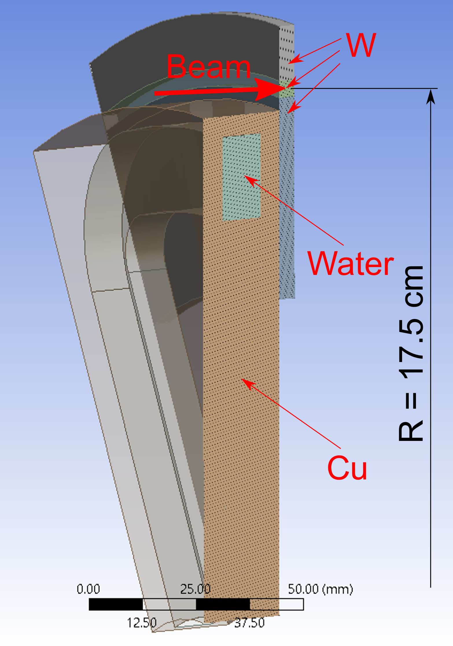
Target Material Test for Positron Injector
Example: 3D view of 60° sector of rotated water-cooled tungsten 17 kW target irradiated by 120 kW e⁻ beam cut in the middle
Issues/challenges of (solid) positron source target:
High average thermal load:
Electron beam power ≥ 100 kW,
Average power deposited in target > 15 kW.
High peak energy deposition density PEDD per pulse/cycle. For 4 mm W target and 1 mA @ 120 MeV e⁻:
PEDD ≈ 17 J/g,
Temperature rise per pulse ≈ 120 °C.
High number of thermal cycles (up to 10⁸ cycles/year) and mechanical fatigue.
Radiation damage limits the target life time.

Slide 2
Test at MAMI (180 MeV e-)
Test at JLab (Laser)
To test the radiation damage of target materials at moderate elevated average temperatures (300 °C)
To test high peak heat load (PEDD) in a wide temperature range (up to 1000 °C)
To test fatigues limits at different T
Tasks
Define target geometry (thickness and other dimensions), target holder, and required beam time structure.
Simulate radiation damage and calculate target temperatures of different materials (pure W, W-Re and W-Cu alloys).
Buy the materials and equipment for the experiments and measure material properties before irradiation
Post-analysis of irradiated materials:
Surface analysis (cracks) using microscopes,
Changes in a bulk material (crystal structure), thermal and mechanical properties,
Measure radiation damage using X-rays (PETRA, DESY, Hamburg).

