Slide 1
Brock Cavity in Injector keV Region – a Current Monitor
February 18, 2016

Slide 2
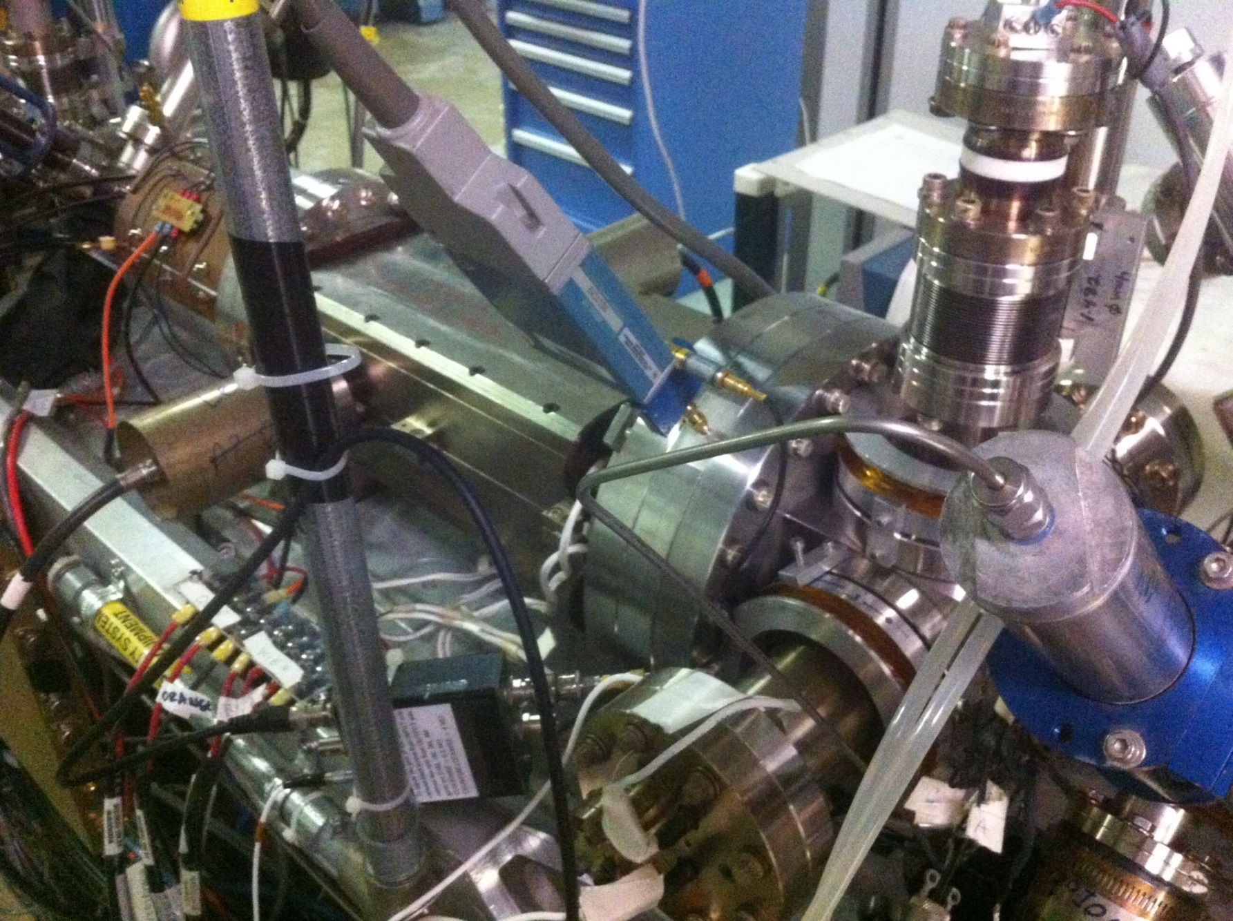
Brock Cavity
A1 Aperture
Horizontal Wien
QWeak I-V Preamp
“MAIN 27”

Slide 3
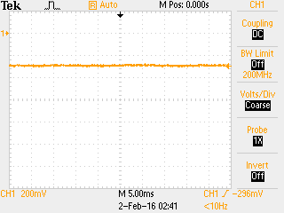

Slide 4
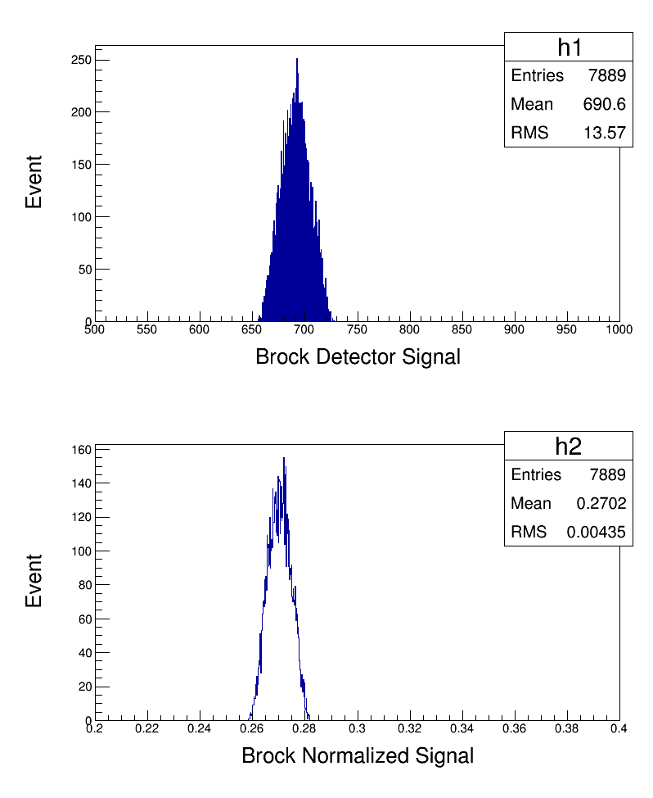
Signal in Mott DAQ

Slide 5
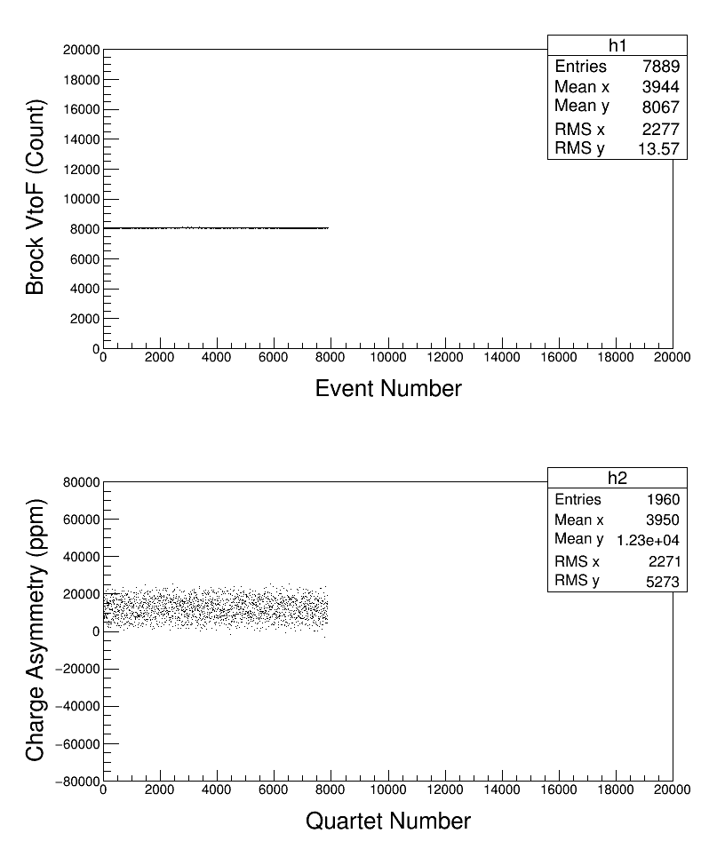

Slide 6
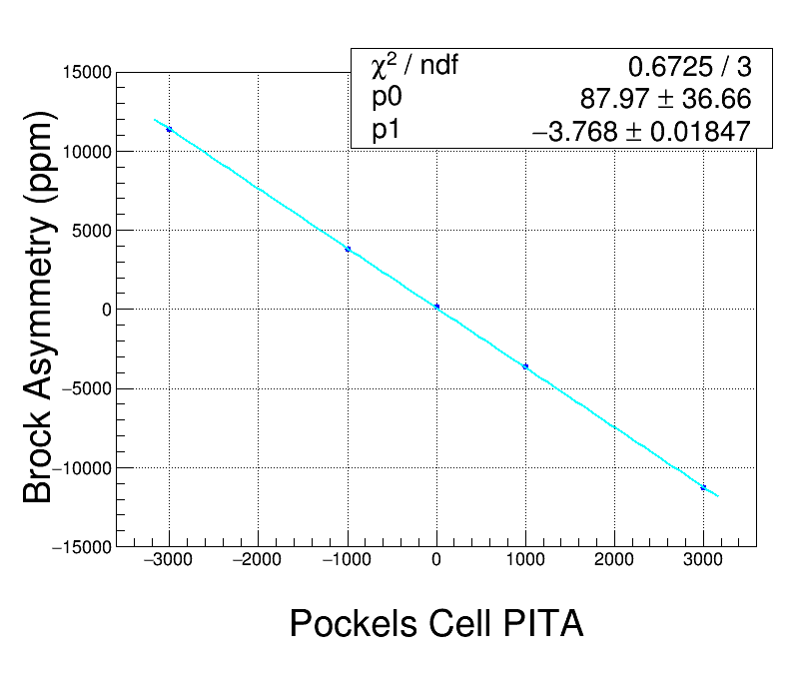

Slide 7
Brock Cavity as a Current Monitor
Located in Injector keV region between A1 Aperture and Horizontal Wien Filter
Available to Hall A Injector Parity DAQ

