Slide 1
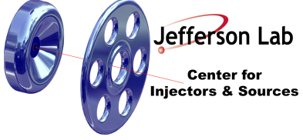
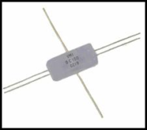
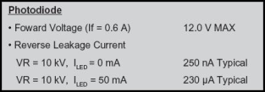
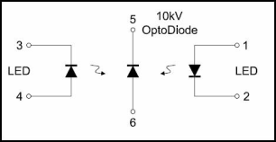
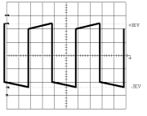
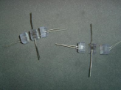
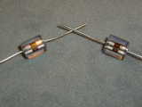
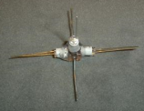
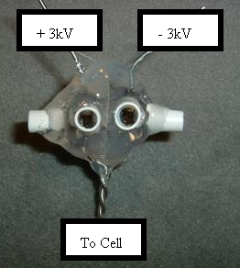
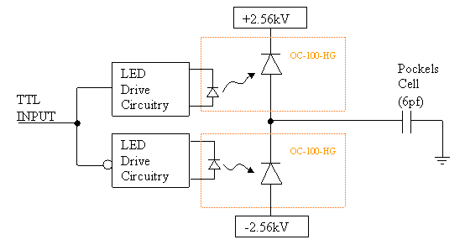
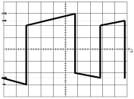
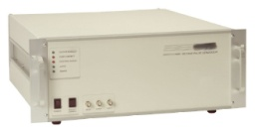
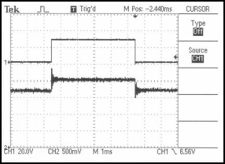
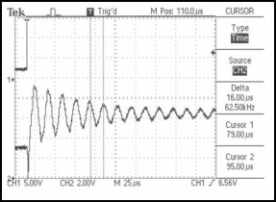
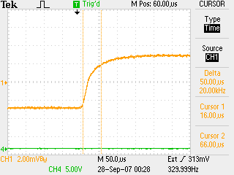
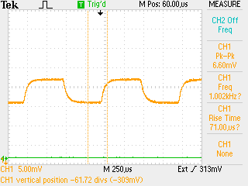
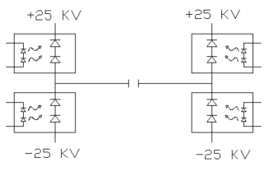
Simple and inexpensive high voltage switch for driving Pockels cells and other low capacitance loads
J. Hansknecht
Notice: Authored by Jefferson Science Associates, LLC under U.S. DOE Contract No. DE-AC05-06OR23177.
ABSTRACT
The delivery of parity quality spin polarized electrons to the Jefferson Lab accelerator presents a unique high voltage engineering challenge. Parity quality infers that both states of polarization are identical in every respect with the exception of spin orientation. We create the optical spin reversal using a Pockels cell. Cell selection and alignment are critical, but the cell also requires a high voltage control system that provides near perfect symmetry between the positive and negative high voltage states to achieve the symmetrical +/- λ/4 birefringence states. We present a brief history of our design challenges and a solution that is simple, inexpensive, and particularly well suited for the application.
Solution step 1- Determine what we really need in terms of drive current to create a 100 microsecond rise-time
Initial attempts and problems encountered
I = CΔV/ Charge time
+λ/4 to - λ/4 = 5120V on our KD*P cell for 780nm Cell capacitance= 6pf Desired charge time = 100us
Calculated charge current is only 307uA !!
Two commercial high-speed / high-voltage transistor switches used to create a symmetrical drive circuit (~$8000)
Solution step 2- Obtain a pair of simple, inexpensive high-voltage Opto-Diodes*
Capacitance behind switch must be much larger than capacitance on cell & cell drive cable. A real safety concern.
Operational specifications
Note the 230uA typical reverse leakage when the LED’s are turned on
Encapsulated Opto-diode $67 each
Operational schematic
* OC-100-HG from Voltage Multipliers, Inc.
Exaggeration of voltage droop on cell and subsequent re-charge after a helicity flip. Not ideal, but still symmetrical
Solution step 3- “Hack” diodes to increase transconductance by adding higher power LED’s
Droop causes a serious problem when helicity flip rate is changed from a toggle pattern to a pseudo-random pattern
Cut off existing
LED’s so we can
add high power
LED’s to boost
transconductance
Optically polish
remaining
encapsulated
HV diode
Add mounting
tubes for new
high-power
LED’s
All-in-one commercial bipolar high-voltage switch (~$10,000)
Push-Pull Circuit Schematic
Glue two assemblies together with and opaque barrier separation
Results
Conclusion
This project validated the old cliché
“Less is sometimes more”
For this application, a switch has been constructed for under $200 that easily out performs switches costing over $10,000.
The old switch was limited to 30 Hz helicity flip rates due to power handling limitations. We can now achieve over 1 kHz flip rate.
The switch design is presently being used to drive the helicity of the Jefferson Lab accelerator with unprecedented parity quality.
Charge droop was greatly improved, but high speed ringing of the cell was a problem for the settling time. In addition, the large high-speed switching currents created a noise induced helicity pickup on sensitive helicity DAQ components.
We concluded that we were going about this in the wrong way. We want to slow down the switch transition time to prevent ringing. A critically damped transition is needed. This significantly drops the switch current handling requirement.
Pockels cell λ/2 transition optical result. ~70us with no ringing.
Pockels cell λ/2 flipping at 1kHz.
Perfect symmetry and no voltage droop over time.
Potential applications include bipolar high voltage biasing of electro-static steering plates in a beamline

