Slide 1
Wien filter: Bolts and washers
03/17/2020
Gabriel Palacios
gabrielp@jlab.org

Slide 2
Three cases are presented:
Bolts and washers material:
All metal (perfect electrical conductor PEC)
Alumina washers (99.6% lossless), PEC bolts
All alumina
All at 20 kV per plate, 15 mm plates gap.
All models simulated with the whole vacuum enclosure setup, but only show plates, mounting tabs, HV spring guide, mounting springs, and plate insulators.

Slide 3
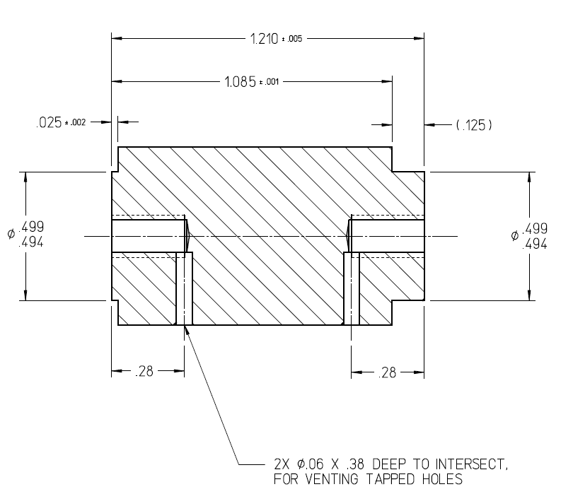
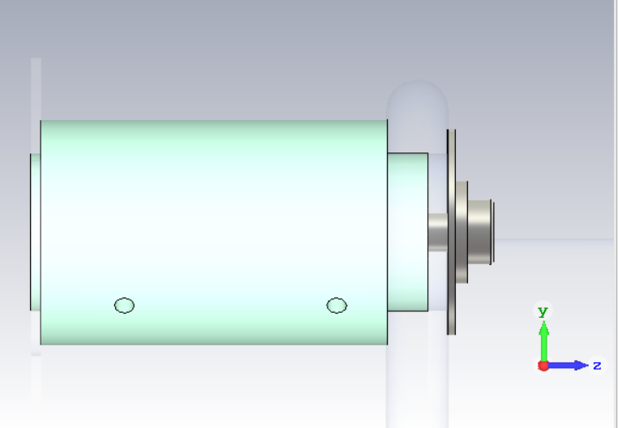
Bolts, washers, long insulators
1 cm radius washer
0.5 cm radius washer
1 mm radius curvature blend at bolt head
Insulator design comes from Danny’s 32893-0112
Now with venting holes!

Slide 4
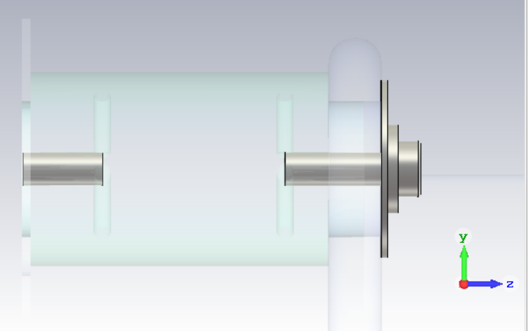
All metal bolts and washers
Defined as PEC in CST Microwave studio

Slide 5
Lateral cross section of the plates
±20 kV
Voltage on plates ±20 kV
5.1 MV/m
4.6 MV/m
5.9 MV/m
15 mm gap
Bolts and washers metal

Slide 6
Zoom to mounting tab
Zoom here
1.1 MV/m
0.7 MV/m
3.2 MV/m
Bolts and washers metal

Slide 7
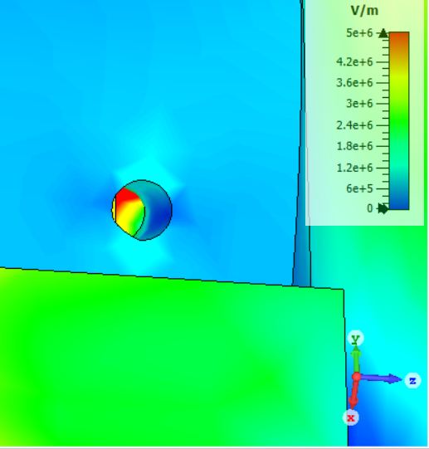
Transparent insulators
Peek through the insulator venting hole: Possible plasma chamber?
Triple point: 11 MV/m
3.2 MV/m
Grounded
Bolts and washers metal

Slide 8
Lateral cross section insulators
E-field channels that might lead particles towards mounting tab surface
Bolts and washers metal

Slide 9
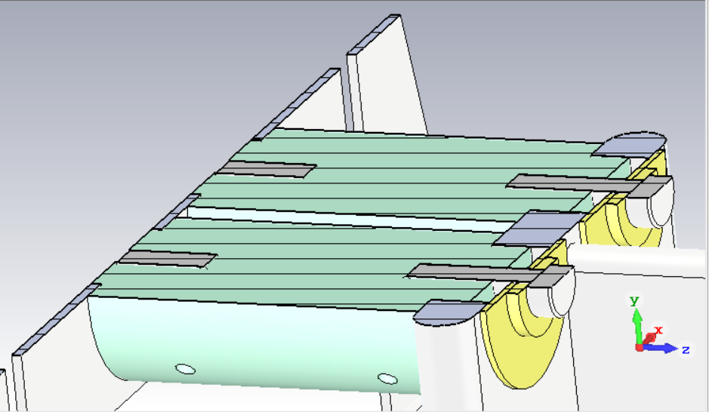
Transversal cross section insulators
This plane
3.2 MV/m
Bolts and washers metal

Slide 10
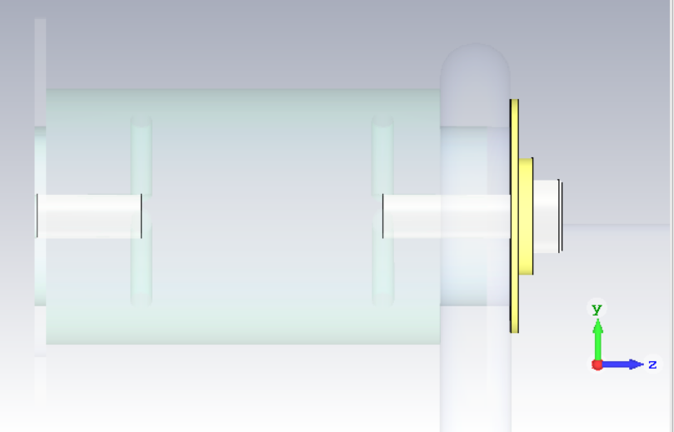
Metal bolts, alumina washers
The bolts are defined as PEC and “floating” potential in CST.

Slide 11
Lateral cross section of the plates
Floating
Voltage on plates ±20 kV
5.3 MV/m
5.2 MV/m
5.9 MV/m
15 mm gap
Metal bolts, alumina washers

Slide 12
Zoom to mounting tab
Zoom here
0.6 MV/m
1 MV/m
11 MV/m
Metal bolts, alumina washers

Slide 13
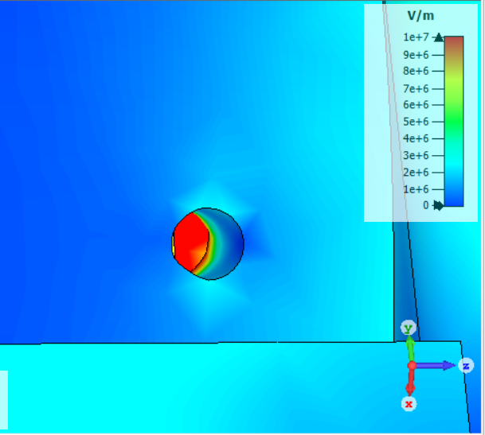
Transparent insulators
Peek through the insulator venting hole: Possible plasma chamber?
Had to change the scale cuz the field was so high!
Triple point: 25 MV/m
Grounded
Metal bolts, alumina washers

Slide 14
Lateral cross section insulators
E-field channels that might lead particles towards mounting tab surface
Metal bolts, alumina washers

Slide 15
Transversal cross section insulators
This plane
3.2 MV/m
Metal bolts, alumina washers

Slide 16
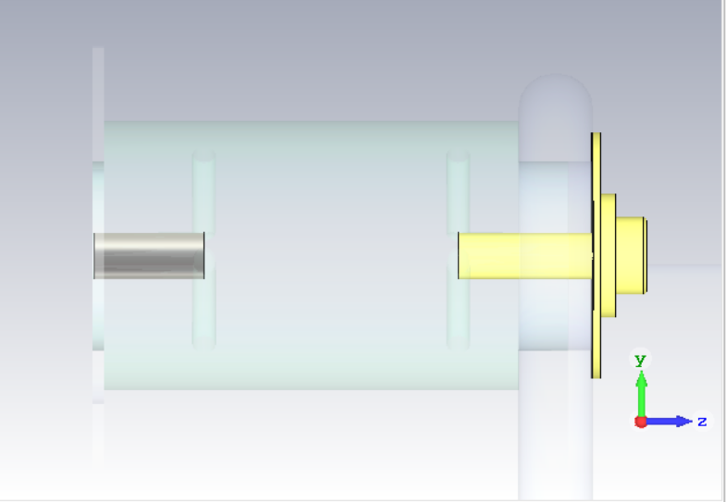
All alumina bolts and washers
Lossless

Slide 17
Lateral cross section of the plates
Voltage on plates ±20 kV
5.3 MV/m
5.2 MV/m
5.9 MV/m
15 mm gap
Alumina bolts and washers

Slide 18
Zoom to mounting tab
Zoom here
0.2 MV/m
0.2MV/m
0.2 MV/m
Alumina bolts and washers

Slide 19
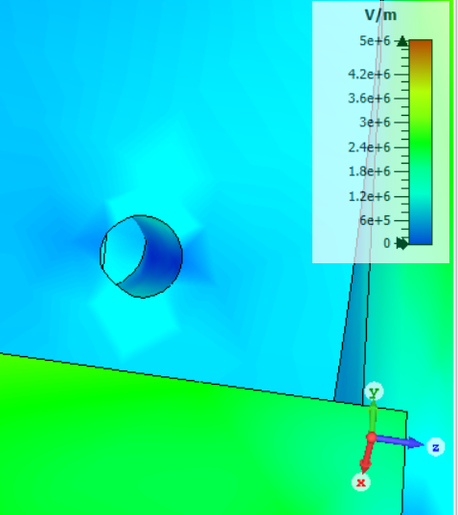
Transparent insulators
Peek through the insulator venting hole: fix!
Triple point: 1.1 MV/m
Grounded
Alumina bolts and washers

Slide 20
Lateral cross section insulators
E-field channels that might lead particles towards mounting tab surface
Alumina bolts and washers

Slide 21
Transversal cross section insulators
This plane
3.2 MV/m
Alumina bolts and washers

Slide 22
Conclusion:
Use all alumina washers and bolts, man!

