Slide 1
Simulated and Measured Extreme High Vacuum in the Jefferson Lab Polarized Electron Source
Marcy Stutzman, Philip Adderley,
Veronica Over, Matt Poelker
Thomas Jefferson National Accelerator Facility
Newport News, VA 23601, USA

Slide 2
Thomas Jefferson National Accelerator Facility
US Department of Energy, 12 GeV electrons, recirculating linear accelerator
Up to 90% polarization from DC photoemission source
Electron currents to 200μA beam (CW) to four experimental halls
Source
Hall D
Halls A, B, C
Polarized source

Slide 3
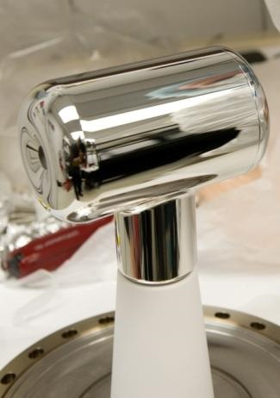
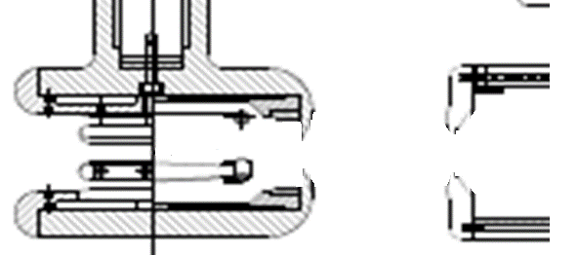
DC Photoemission Source
-100 to
-350 kV
cathode
electrode
anode (ground)
light in
electrons out
GaAs
Polished high voltage electrodes
Strained superlattice GaAs/GaAsP photocathode
Surface preparation: Cs, oxygen or fluorine
Polarized Photoemission
Residual gasses ionized, limit operational lifetime
Base pressure approaching XHV ≡ P < 1x10⁻¹⁰ Pa
14 layers
GaAsP
0.36
Strained
Superlattice
Photocathode
GaAs

Slide 4
Outline
Achieving and measuring pressure in JLab systems
Begin exploration of systems with Molflow+ modeling for static vacuum
Pressure distribution with appendage vs. inboard pumping
Pressure distribution due to electrodes
Can we do any better?
Leybold commercial cryopump
Novel Boron Nitride NanoTubes (BNNT)

Slide 5
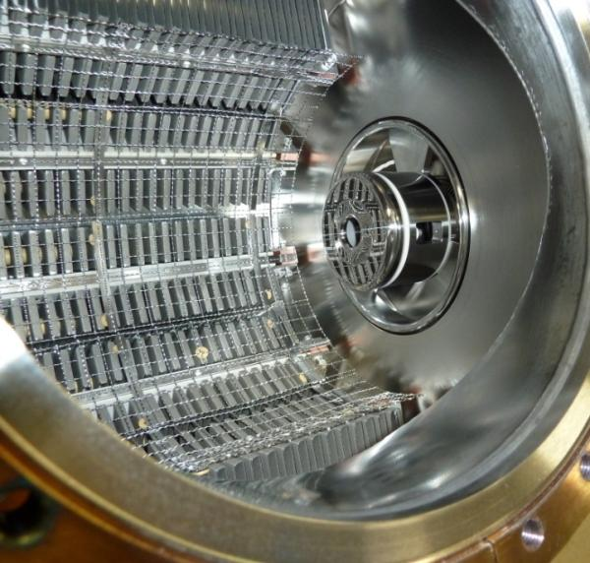
CEBAF Polarized Inverted Gun Vacuum
Installed pumping
SAES WP1250 modules x 10 (5600 l/s total)
Gamma SEM/XHV ion pump
(35 l/s for hydrogen)
~ 25 micron TiZrV coating
400°C heat treatment for outgassing
M.A. Mamun, A.A. Elmustafa, M.L. Stutzman, P.Adderley, and M.Poelker JVSTA,32, 021604 (2014)
Measured pressure ~1-2x10⁻¹² Torr
Charge Lifetime: ~200 Coulombs
- cathode maintenance ~monthly
System works for CEBAF
Future Proposed Polarized Sources
require current ~50x higher

Slide 6
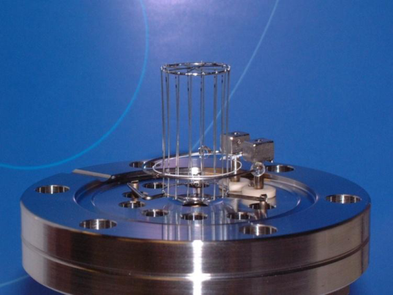
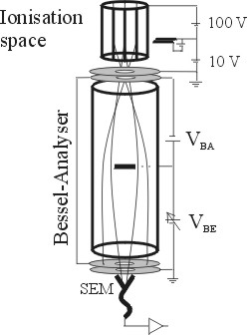
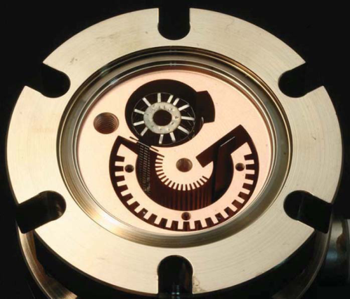
XHV gauges
Extractor gauge
x-ray limit reduced through geometry
Axtran gauge
Bessel box energy discrimination
electron multiplier for low current measurements
Watanabe 3BG (Bent Belt Beam) gauge
230° deflector BeCu housing
JVSTA 28, 486 (2010)
Extractor
Axtran
BBB

Slide 7
Test Chamber Base Pressure
Getters
4 x WP950 modules
1 GP500 pump
Ion pump
35 l/s SEM style Ti/Tan
Outgassing rate
1x10⁻¹² TorrLs⁻¹cm⁻²
Volume: 40 l
Area: 8000 cm²
Simple calculations: expected pressure
4 x 10⁻¹³ Torr

Slide 8
Measured Pressure: 3 XHV gauges
Pressure ~ 4x10⁻¹² Torr
Minor differences between three gauges
Rely on manufacturer sensitivity
Should be sent for calibration
Measured pressure ~10 times pressure from simple calculation

Slide 9
Vacuum System Modeling near XHV
Motivation:
Appended pumping?
Pressure gradients through chamber?
Molflow+ software
R. Kersevan and J.-L. Pons, JVSTA 27, 1017 (2009)
Input:
3D CAD model
Outgassing
Pump speed, locations
Output:
Pressure distribution
Test chamber with ion and NEG pumps

Slide 10
Test Particle Monte Carlo
Tracks simulated particles
Pump speeds defined by sticking coefficients
Outgassing rates as measured previously
Compare simulation with measured results
XHV gauges
NEG GP500 pump
Ion
pump
NEG Sorb-AC WP950 pumps

Slide 11
Molflow+ simulated pressure:
Simulated Gauge Position
P (simulated) = 1.6x10⁻¹² mbar
P (measured) = 4-6 x10⁻¹² mbar
Much better agreement than simple calculations
NEG GP500 pump
Ion
pump
NEG Sorb-AC WP950 pumps
mbar

Slide 12
Add XHV Cryopumping
Cryopumps typically not bakable
Adhesives for charcoal cryosorption surface
Mechanics of closed-cycle helium refrigerators
Leybold bakable cryopump
LN2 chill circuit to keep charcoal, adhesive, mechanics cold during vacuum bakeout
Boron nitride nanomaterial as cryosorber material
Mechanical attachment, no adhesive
Thermally conductive, heat stable, inert, carbon free

Slide 13
Appendage Pumping: Cryopump
gauge
position
Valve Closed
Valve Open
Simulations show outgassing from valve, conductance severely limit
cryo-pumping on chamber
P(simulated)= 1.6x10⁻¹² mbar
P(simulated)= 2.7x10⁻¹² mbar
mbar

Slide 14
Measured Performance of Leybold cryopump
Pressure with CP valve open = ~4x10⁻¹⁰ Pa
Simulation: 3x10⁻¹⁰ Pa
Preliminary studies using Molflow+ simulations
Useful tool
Emphasize conductance limitations

Slide 15
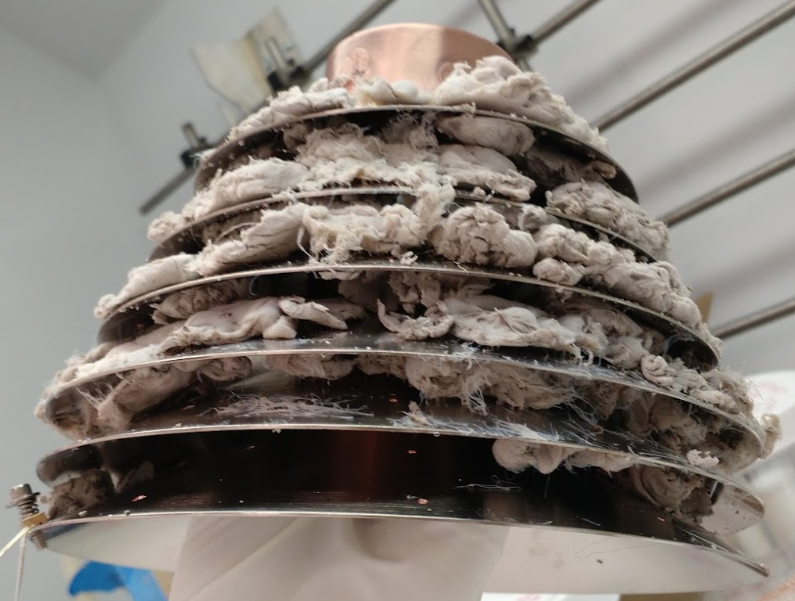
Novel Cryopump: BNNT
Boron Nitride NanoTubes
Freestanding adsorber, no adhesive
1g = 300 m² surface area
BNNT first prototype
T ~ 15K
Heat load due to copper mesh absorption
BNNT second prototype improvements
Fine wire attachment, no copper mesh
Total 4.4g BNNT, ~1000 m²
Attachment on both sides of fins
US Patent 9463433 issued October 2016

Slide 16
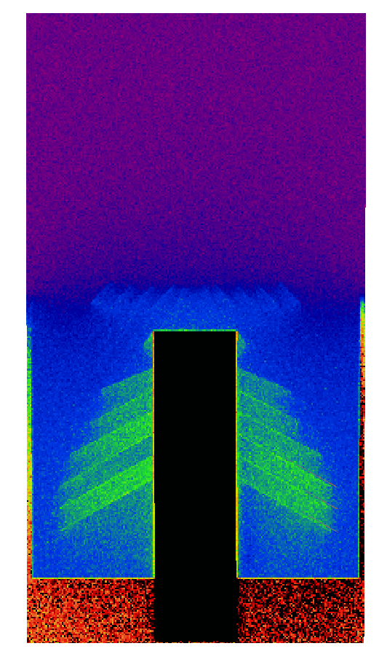
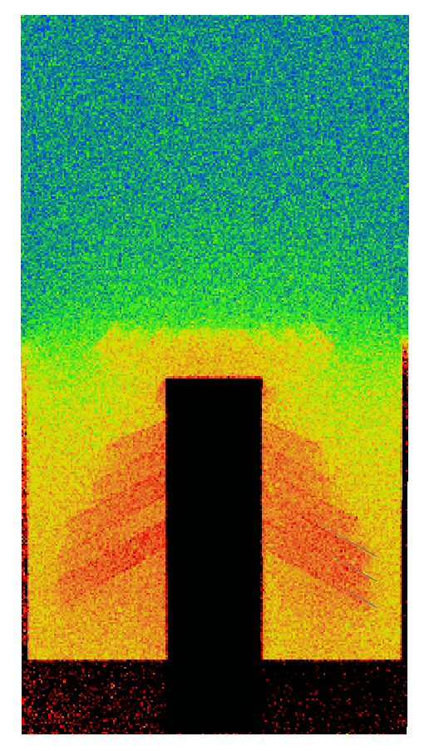
BNNT simulations
as built
α = 0.003
α = 0.012
2nd Prototype model
First BNNT prototype
Sticking coefficient calculated from measured pressure | α =0.003
Measured pressure | 6.2x10⁻⁹ Pa
Simulated pressure profile: Upgraded BNNT cryopump
Sticking coefficient: top and bottom of fins | α =0.003 | α =0.012
Simulated Gauge Pressure | 6.2x10⁻⁹ Pa | 1.55x10⁻⁹ Pa
mbar

Slide 17
BNNT Cryopump: First and Second builds

Slide 18
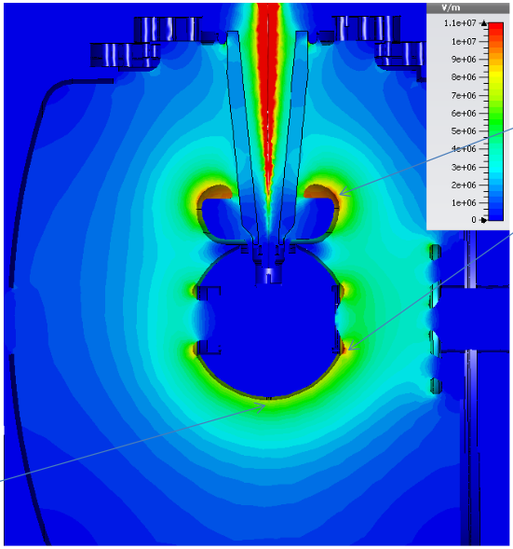
Chamber geometry: High Voltage
350 kV benefits
Eliminate capture
Smaller volume for highest ionization cross section
Higher bunch charge
High voltage modeling determines geometry
Cathode shape
Cathode diameter determines wall distance
11 MV/m
8 MV/m

Slide 19
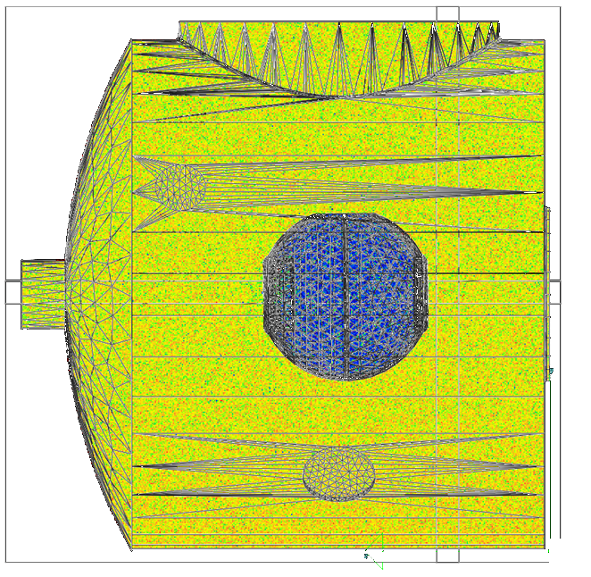
Simulation: 350 kV Chamber

Slide 20
Conclusions
Measured pressure in operational CEBAF photogun: ~1x10⁻¹² Torr (extractor gauge, backgrounds subtracted)
Test chamber pressure measurements with three XHV gauges in reasonable agreement after background corrections
Modeling emphasizes conductance effects with appended cryopump
Modeling BNNT system: BNNT sticking coefficient?
Beginning modeling to determine conductance effects, pressure distribution near high voltage electrodes
Future higher voltage, higher current systems balance high voltage performance and requirements with vacuum conductance

Slide 21
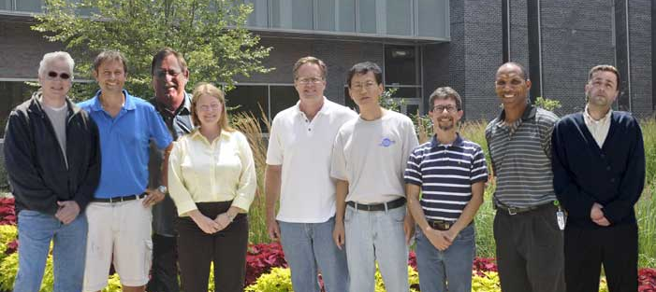
Acknowledgements
U.S. DOE Contract No. DE-AC05-06OR23177 and with funding from the
DOE R&D for Next Generation Nuclear Physics Accelerator
Facilities Funding Opportunity Number: DE-FOA-0000339
Jefferson Lab
Center for
Injectors and
Sources
Matt Poelker, Joe Grames, Don (Bubba) Bullard,
Marcy Stutzman, John Hansknecht, Shukui Zhang,
Carlos Hernandez Garcia, Philip Adderley, Riad Suleiman

Slide 23
Polarized Source Variations
Vertical Gun (100 kV)
SLAC design
First polarized electron source
No NEG pumping
No heat treatment
Poor electron optics

Slide 24
Polarized Source Variations
Vertical orientation
Horizontal gun
Improve electron optics
Add NEG pumping
Cylindrical symmetry
No heat treatment
Vent and bake to change photocathode
Photocathode chemistry (Cs) contaminates electrode, vacuum

Slide 25
Polarized Source Variations
Vertical orientation (100 kV)
Horizontal gun (100 kV)
Load Lock Gun (100 kV)
Separate chemistry from high voltage
Load-Lock for cathodes
400ºC heat treatment
NEG coating
High field points
Thick flange outgassing
Cylindrical symmetry broken

Slide 26
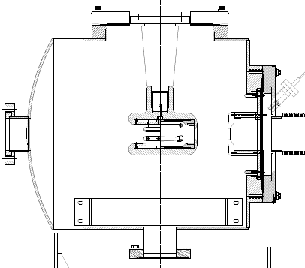
Polarized Source Variations
Vertical orientation (100 kV)
Horizontal gun (100 kV)
Load Lock Gun (100 kV)
Inverted Insulator Load Lock Gun (130-200 kV)
Eliminate DN275 Conflat flanges
Heat treated, NEG coated
Cylindrical symmetry broken
Line of sight: insulator charging

Slide 27
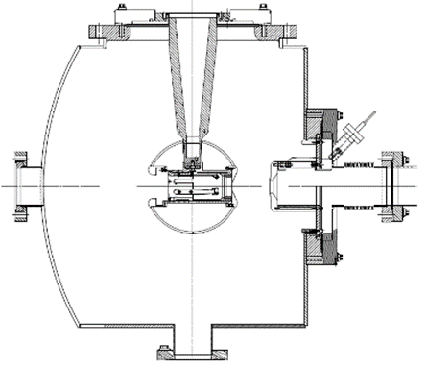
Polarized Source Variations
Vertical gun (100 kV)
Horizontal gun (100 kV)
First Load Lock Gun (100 kV)
Inverted Insulator Load Lock Gun (130 kV)
350 kV Inverted Gun
Heat treated
NEG coated
Larger diameter
Doped ceramic
Version 1: NEG strip
Version 2: WP modules, rotated on side

Slide 28
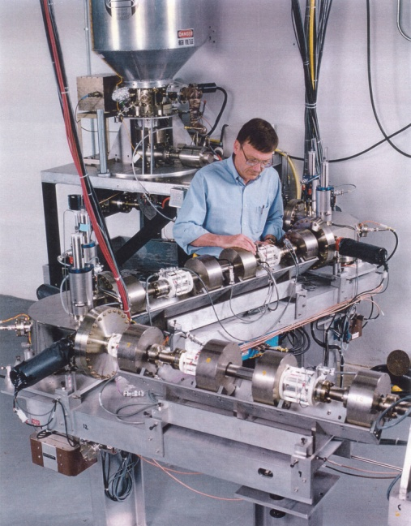
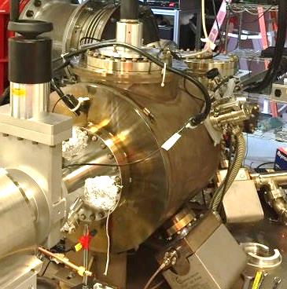
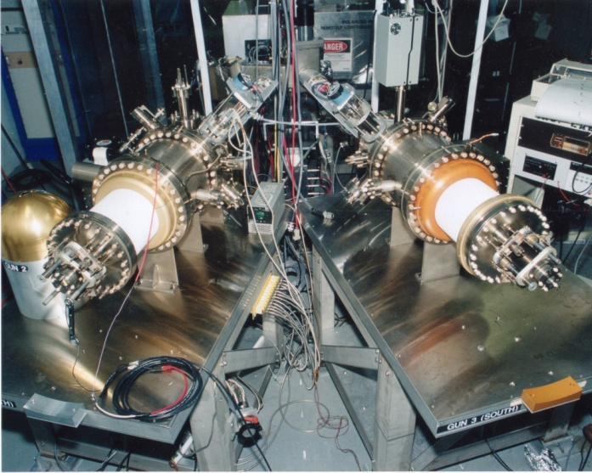
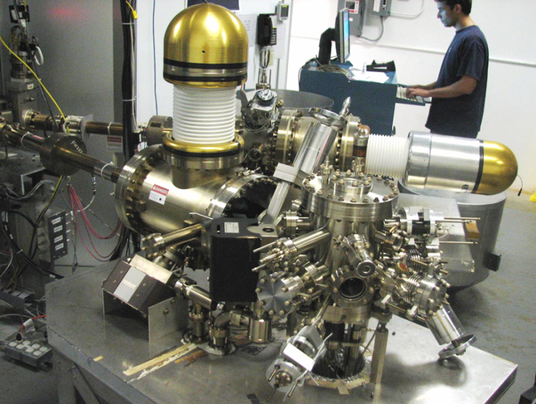
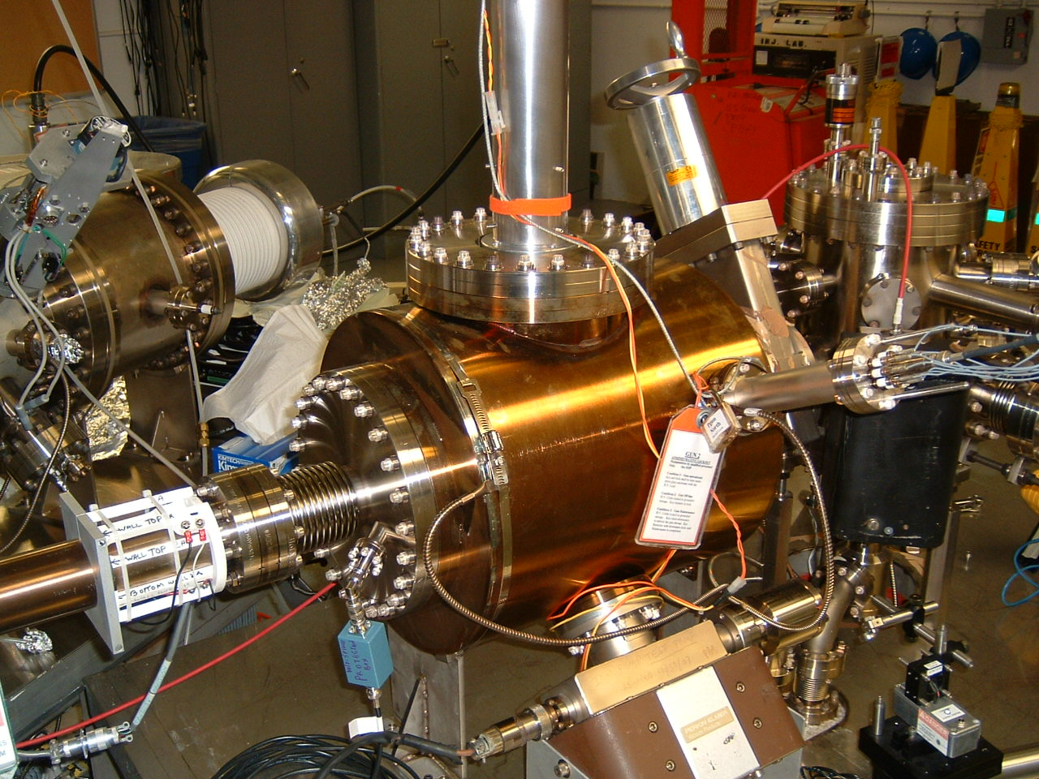
Polarized Source Evolution: 20 years
First JLab polarized gun
Add NEG pumping: high polarization cathodes
Load Lock: avoid electrode and vacuum contamination
NEG coating
Eliminate thick flanges
400 ºC heat treatment
Higher voltage: larger diameter

Slide 29
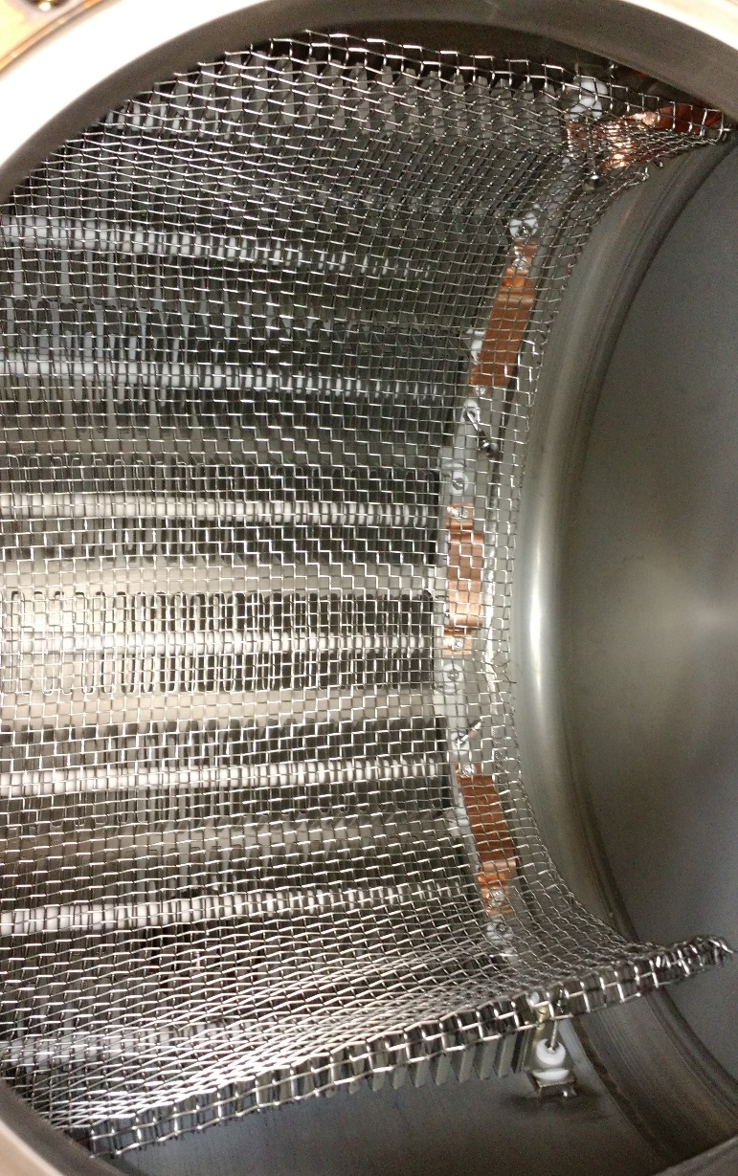
NEG pumping configurations
Initial design
360º array surrounding cathode – anode gap
Load Lock
Hemisphere array
Inverted Gun
Rotate modules: eliminate line of sight to walls
350 kV Inverted Gun
Strips instead of modules
Rotate back to open configuration

Slide 30
Add XHV Cryopumping
Cryopumps typically not bakable
Adhesives for charcoal cryosorption surface
Mechanics of closed-cycle helium refrigerators
Solutions other places:
KEK, Katrin: Silversolder or Thermoguss bakable adhesives
KEK: 2K helium flow, no compressor
Our research
Leybold bakable cryopump
LN2 chill circuit to keep charcoal, adhesive, mechanics cold during vacuum bakeout
Boron nitride nanomaterial as cryosorber material
Mechanical attachment, no adhesive
Thermally conductive, heat stable, inert, carbon free

Slide 31
Leybold pump performance

