Slide 1
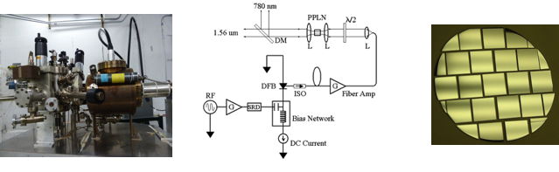
Making high bunch charge at the UITF
Motivations
Higher bunch charge (50pC) short pulse (50ps) from CEBAF polarized gun for JLEIC
Very high bunch charge (nC) for lepton colliders (LHeC, ILC, CLIC) or positron production
Demonstrate capabilities for polarized photoguns at high bunch charge and voltage

Slide 2
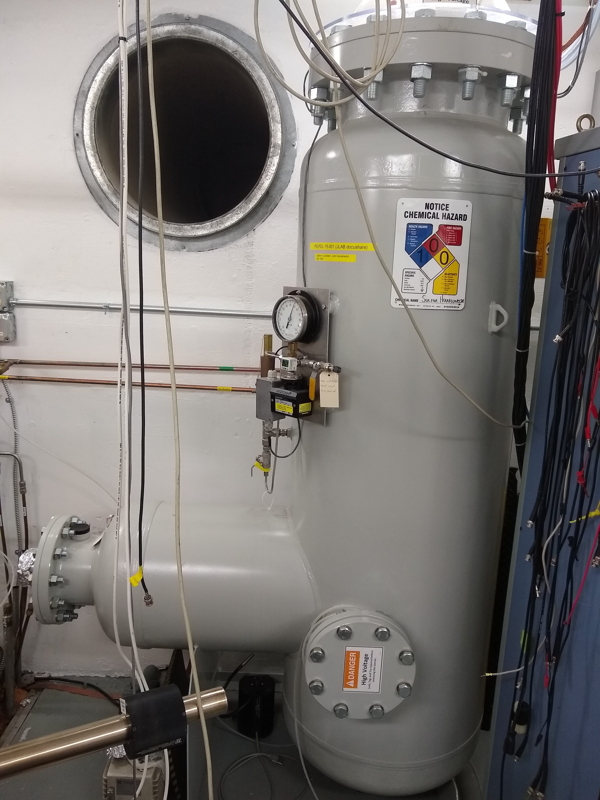
Can we make 50 pC bunch charge at the UITF ?
To make a 50pC/pulse from a bulk GaAs at 780nm with ~10% QE requires ~0.8 nJ/pulse.
The HVPS there is 450kV and 3mA.
A cw rep rate > 60 MHz is desired, and 62.5 MHz (16 ns spacing) is nearest sub-harmonic 750 MHz.
Digital gain switching of a fiber laser (demonstrated at CEBAF) combined with Keopsys amplifier at UITF should provide >50 mW laser power @ 62.5 MHz required (62.5 MHz x 0.8 nJ/pulse). With optical pulse width of 50ps peak currents of ~1 Amp are considered.
By optimizing parameters, production of high bunch charge (>10 pC) from polarization GaAs/GaAsP (1%) and DBR GaAs/GAsP (5%) is a reasonable goal.

Slide 3
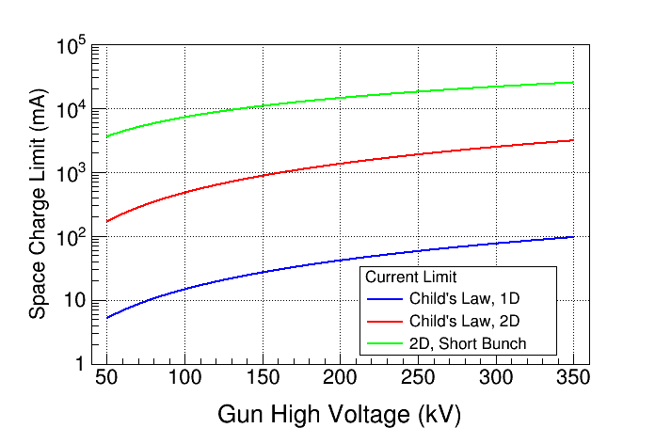
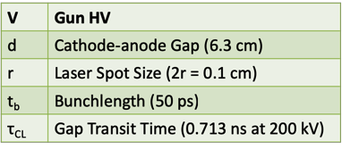
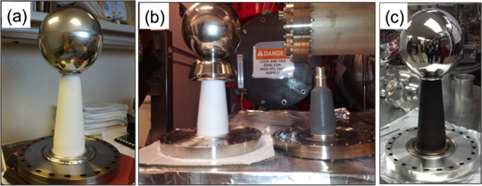
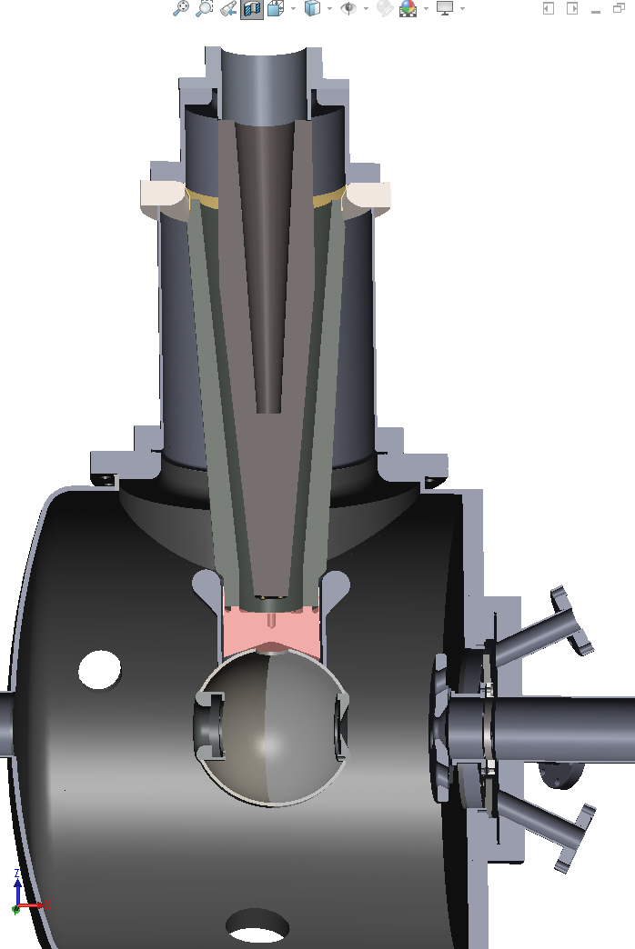
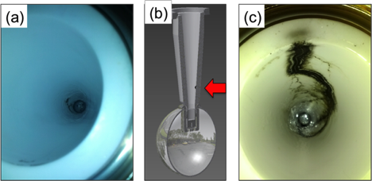
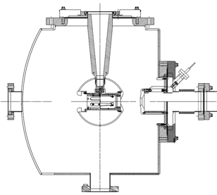
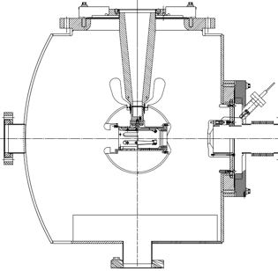
Areas of Interest
Guns – high bunch charge means managing gradients inside/outside the vacuum chamber
Managing gradient on vacuum side (triple point, shed, beam effects)
Managing gradient on the air side (linearity, breakdown, charging)
Managing gradient on electrodes (FE, gas desorption, x-rays)
1A
“150kV Gun”
“300 kV Gun”

Slide 4
Areas of Interest
Polarized Photocathodes – generation of high peak current and limitations
Surface Charge Limit (Surface Photovoltage Effect), reduces NEA of GaAs: Photoelectrons trapped near GaAs surface produce opposing field that reduces NEA resulting in QE reduction at high laser power (LP).
Higher Gun HV suppresses SCL!

Slide 5
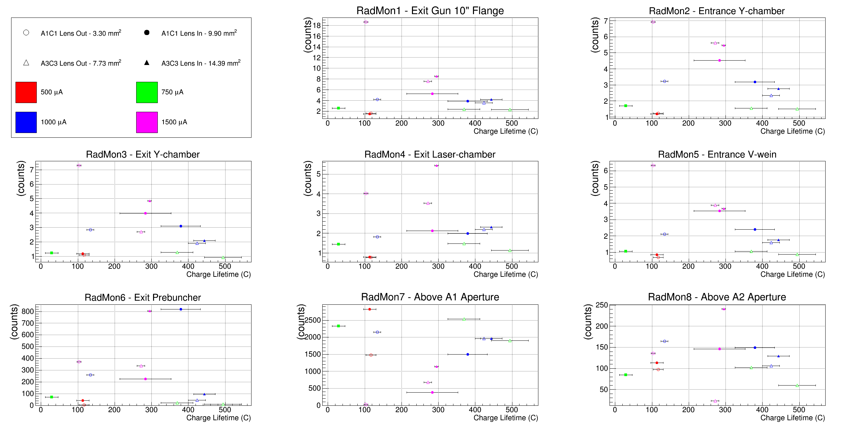
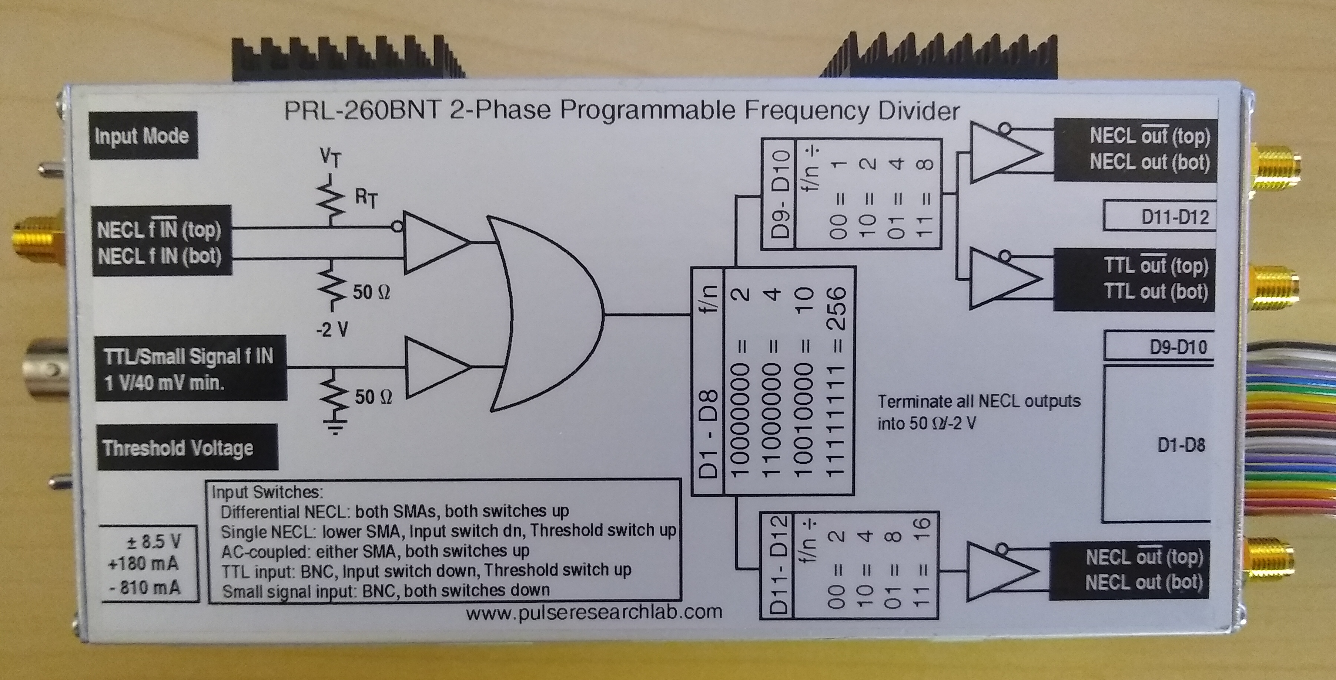
Areas of Interest
Beam – managing every electron counts for photocathode lifetime
Accounting for loss at the ppm level is significant, and becomes increasingly challenging with bunch charge
Lasers – high peak power short pulse rf-synchronized lasers
Digital gain switching provided CEBAF with 250 MHz and 32 MHz rep rate beam; the lower rep rate can be exploited for UITF and phase locking can be investigated to have option at CEBAF for many rep rates

