Slide 1
UITF – Upgrade Injector Test Facility
Deliverables/Milestones
Beam on HDIce by August 2016 (nA current level at ~ 10 MeV)
Staffing
Critical Skills needed NOW: Facilities, Cryo including ODH assessment, Mechanical Design, Safety System Group for ODH, Ops Software
Update since last meeting
Monthly meetings with Mont, on-going
Cave1 north concrete wall demolition complete
Accelerator design sufficiently complete to start building the keV beamline
Shaun Gregory has started the MeV beamline design
Cave1 cleared out, ready for Survey and Alignment
Consensus achieved on entry/exit labyrinth from shielding point of view
We realized we might have unwanted ODH2 conditions. Mat Wright now performing formal ODH assessment, which will include recommendations (?). Suspect we must revisit Cave2 ceiling design, to provide a passive escape path for helium gas
Stairway to top of Cave1 – PR has been awarded
Carlos and Don Bullard are back – they can focus on 350kV gun
Continued progress on “stretch goals”: RF control modules, trim cards, quad magnets, BPMs (and staying within FY15 budget)

Slide 2
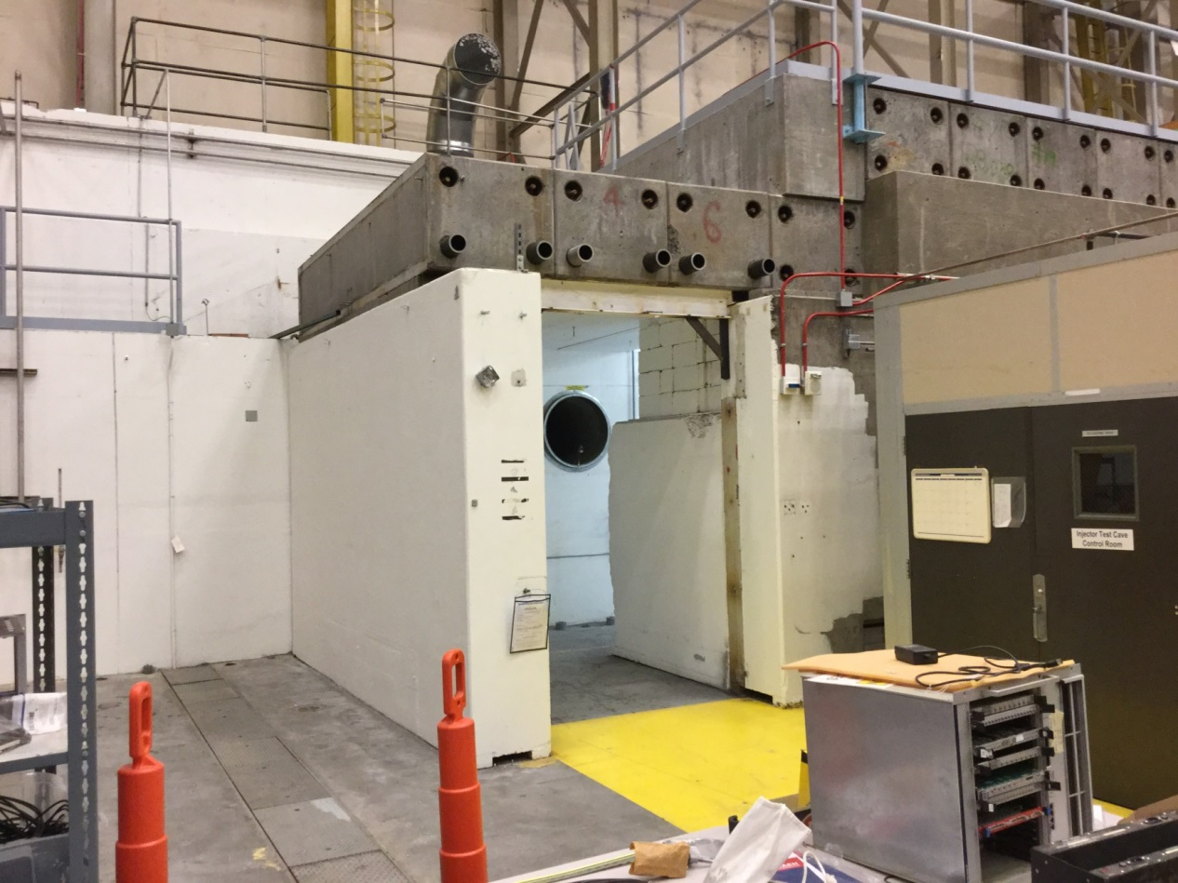
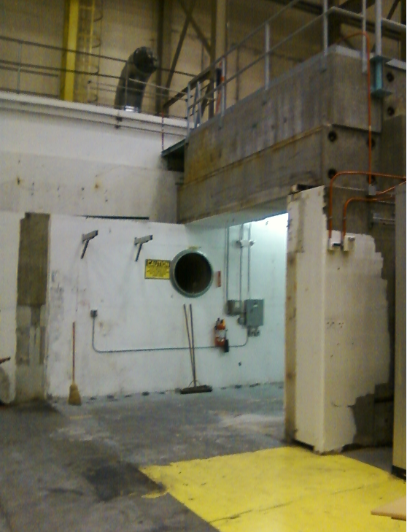
Concrete demolition complete

Slide 3
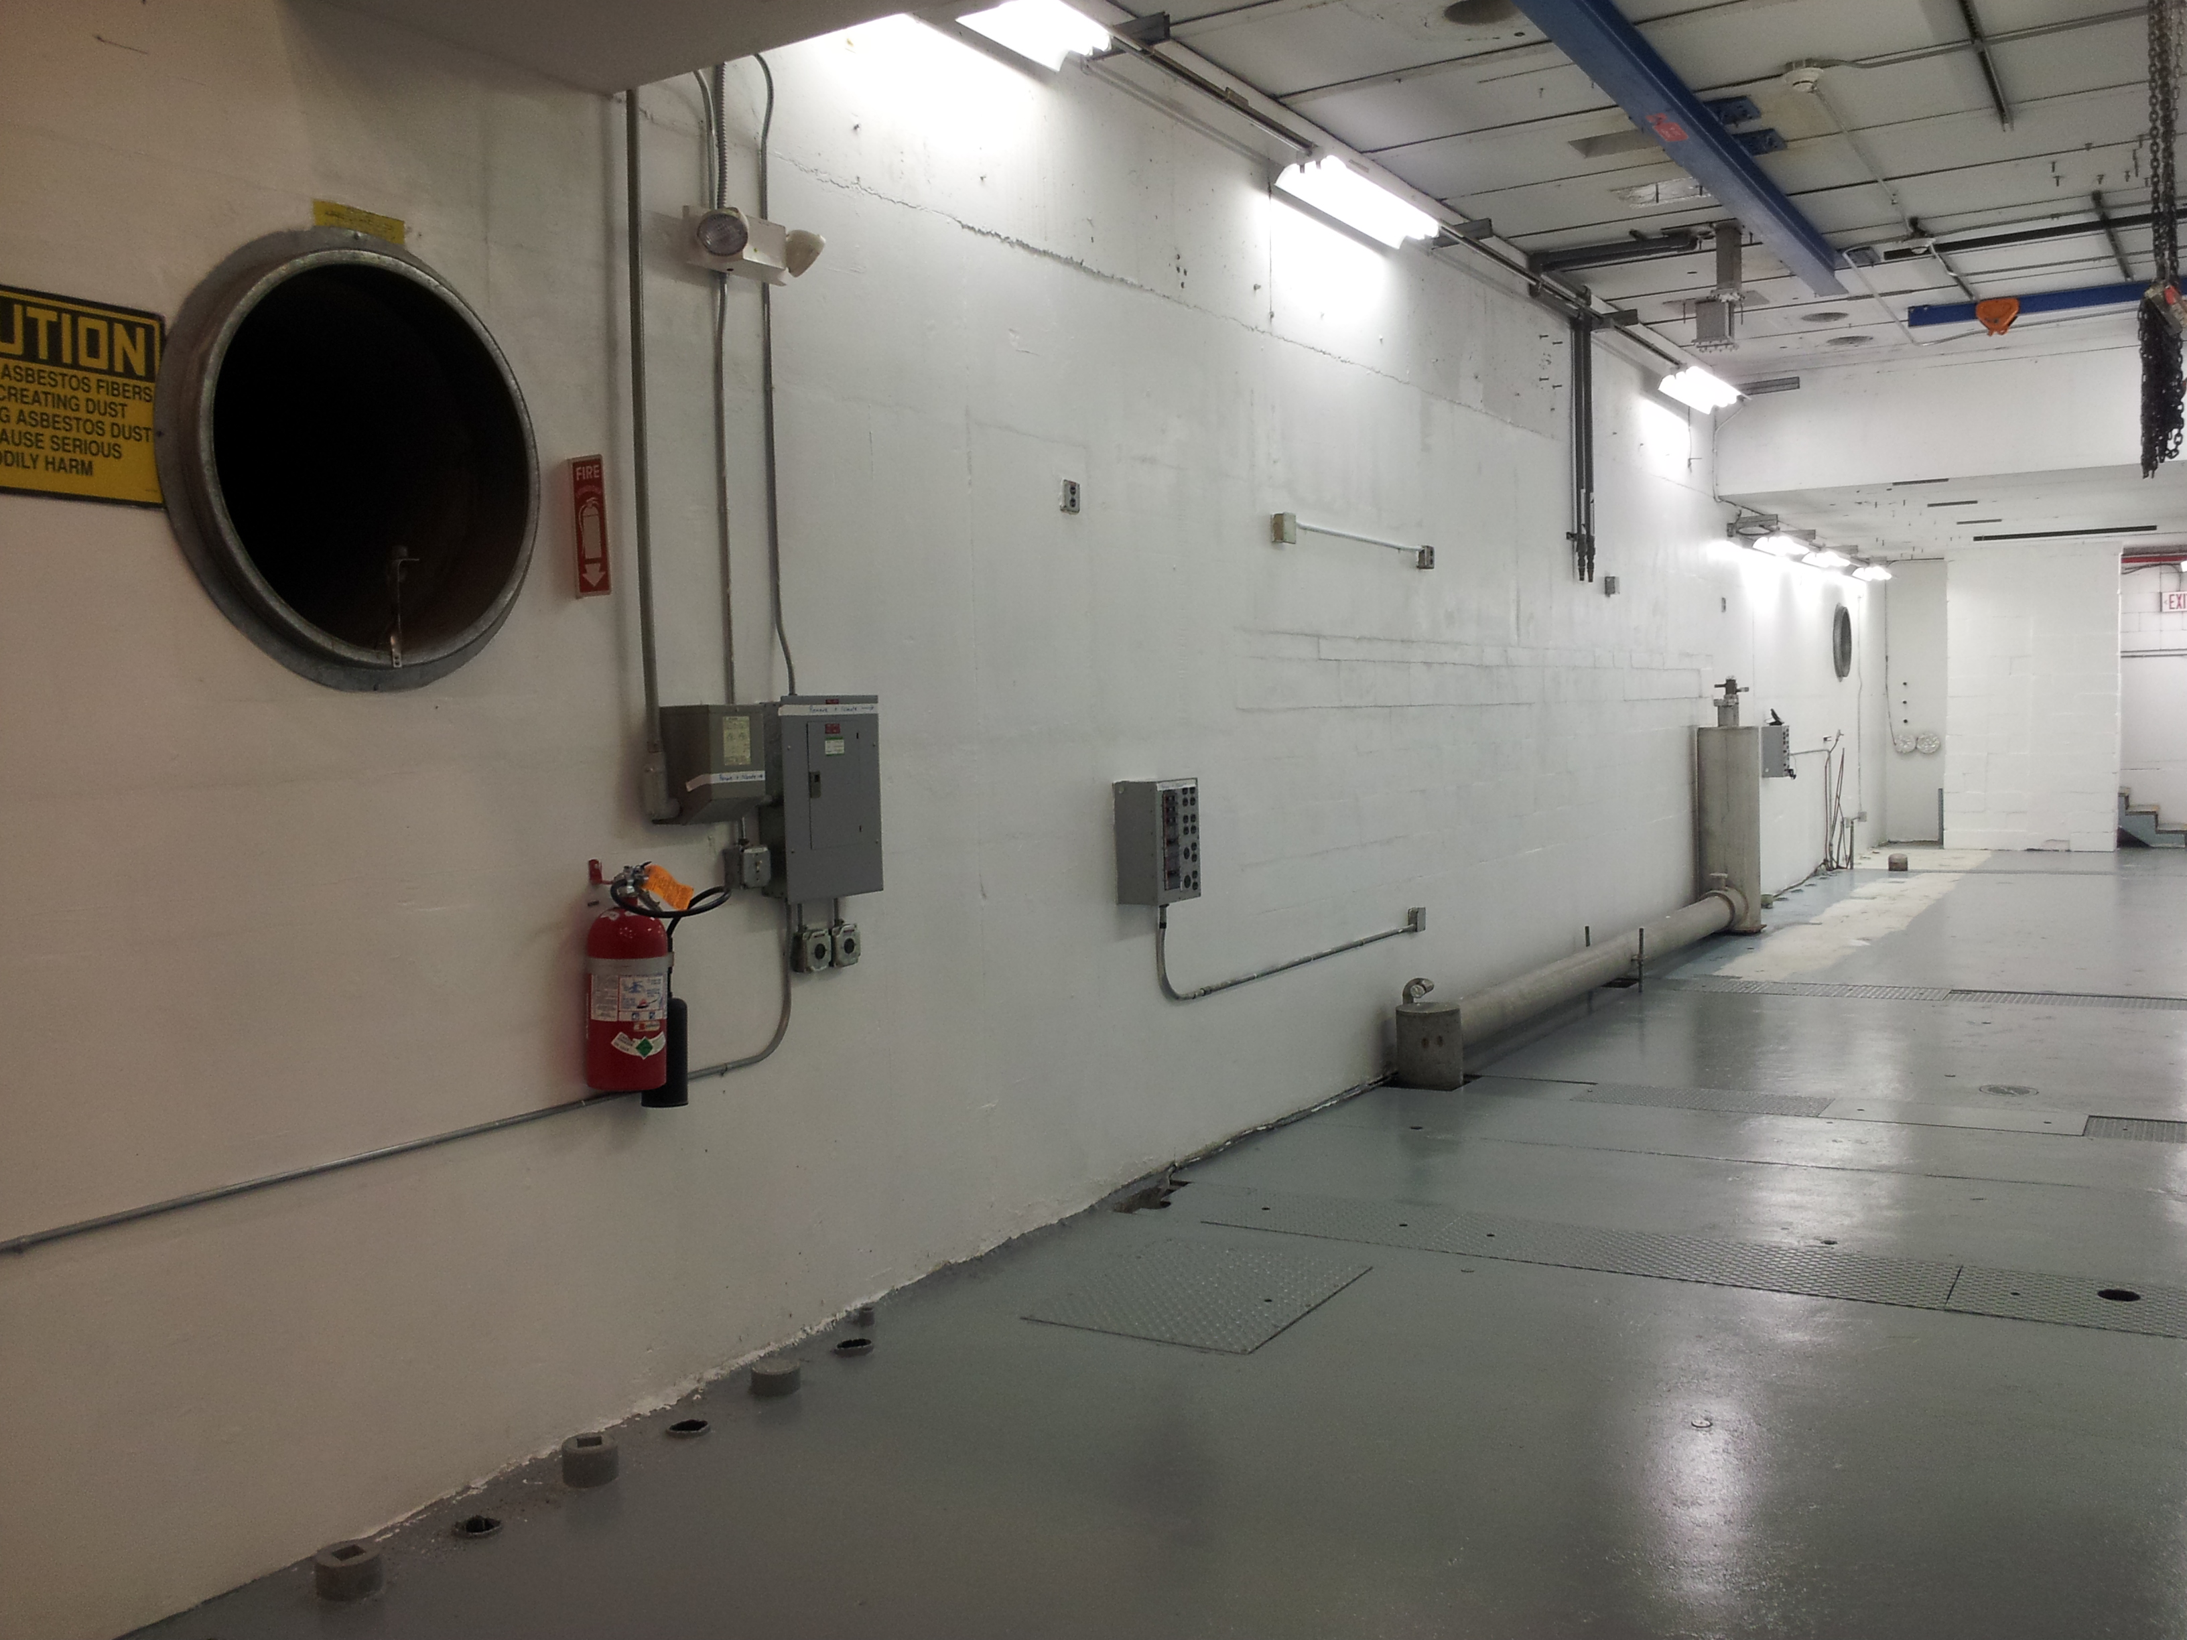
Cave 1 cleared out
in the queue for Survey and Alignment

Slide 4
Ready to build the keV beamline
80/20 girder has been ordered, new gun table to straddle trench, 400kV gun HV power supply in house, waiting for SF6 tank which was evaluated by Tommy Hiatt, method identified to pressure-vessel certify the HV receptacle
Survey and Alignment to add monuments, they will tell us where to put the gun, the 80/20 stand, and the ¼ CM

Slide 5
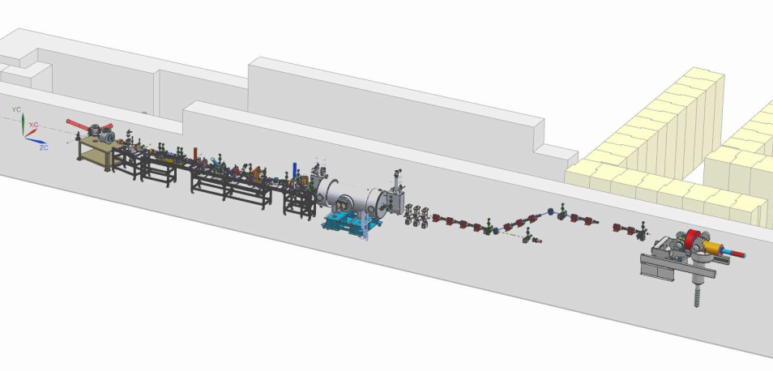
Shaun Gregory has started the MeV beamline design
(we think the MeV portion of accelerator will be easier to design than keV portion)

Slide 6
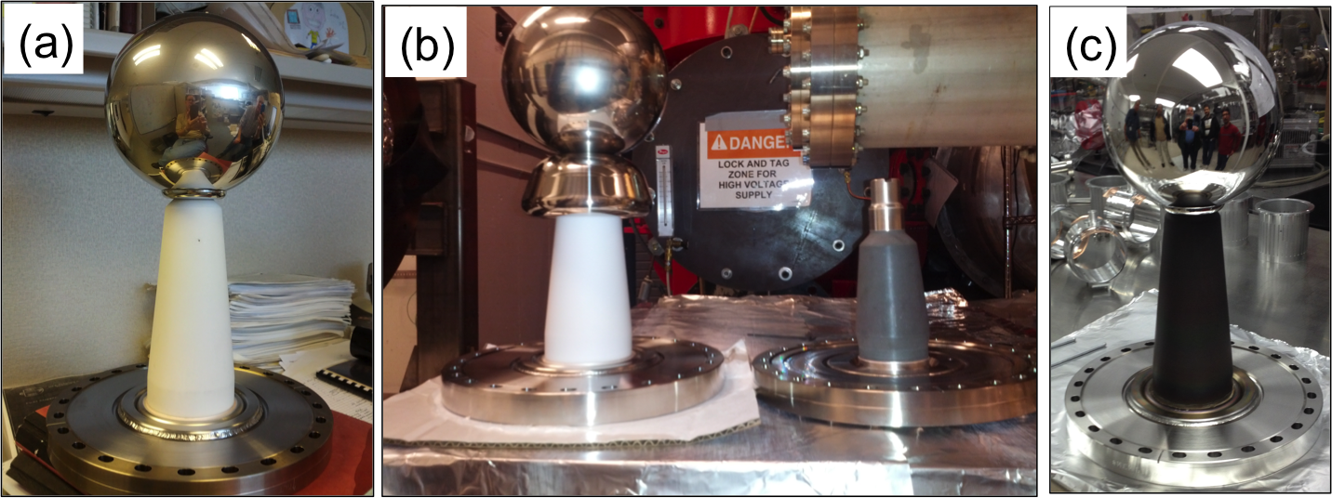
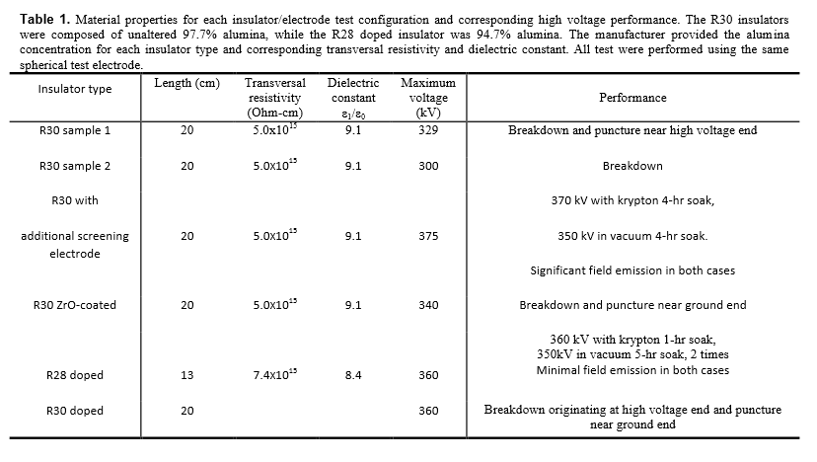
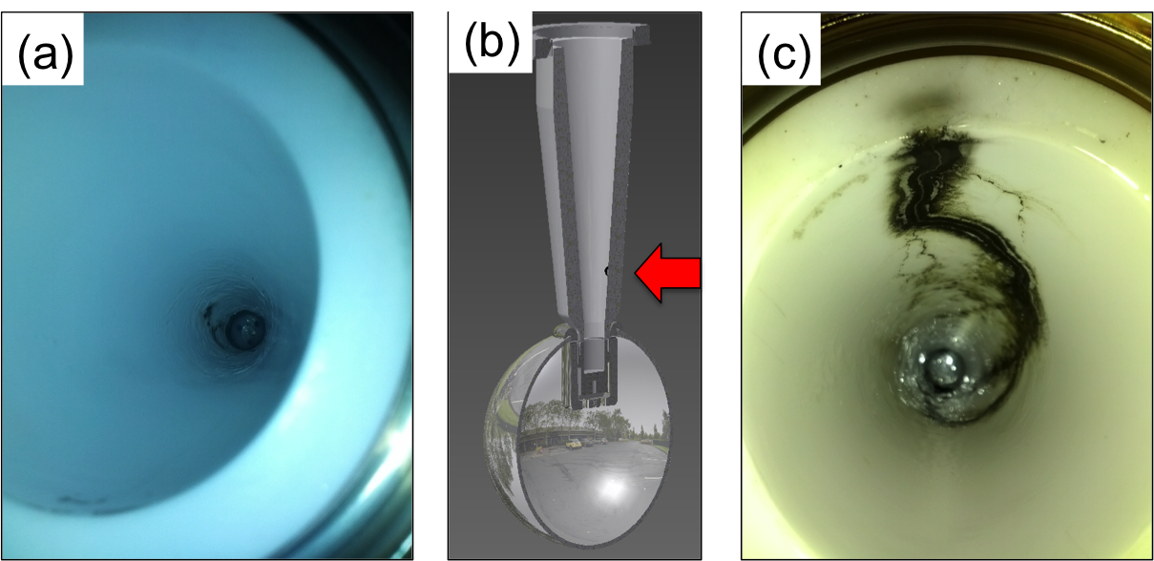
Notes:
Interior Page Design 2

Slide 7
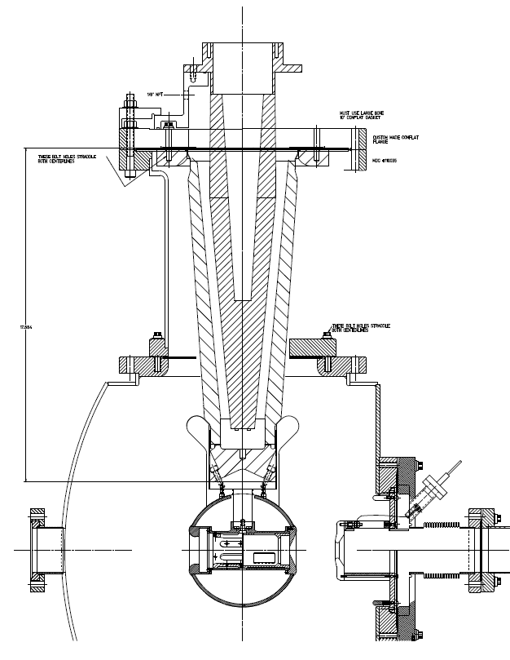
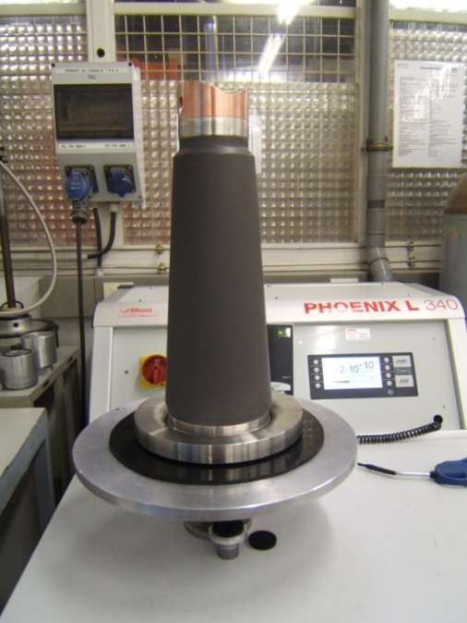
R350 epoxy receptacle
Revisit one of our successful test configurations – polish the shed and test with actual gun electrode
Use a large doped insulator purchased by FEL: Danny Machie working on design
SF6
Doped insulator
“Shed” triple-point protection

Slide 8
UITF – Upgrade Injector Test Facility
To-do list for next 30 days
Setup the electronics racks above Cave1
Agree on layout, RadCon to approve it
Installation Group (Neal Wilson and company) to build it
Need a temporary stairway to access the top of Cave
Provide electrical requirements to Facilities/Jason Willoughby
Obtain the formal ODH assessment, use it to provide Tom Renzo information relevant to Cave2 ceiling design. Modifications to Cave1 ceiling required?
Facilities should remove utilities on Control Room exterior wall (window air conditioner, fire, electric), so that Walter Kehlner can move more concrete block into position to erect the perimeter of Cave2
Installation Group to install unistrut along east wall, for attaching utilities. Installation Group and Facilities to begin attaching utilities to this wall: LCW, GN2, compressed air, electric, lighting, fire suppression
Move the ¼ CM into Cave1 or Cave2
Apply high voltage to gun with shed electrode at FEL Gun Test Stand
Need to make some headway on Bob May’s EHS&Q task list

Slide 9
There’s enough LHe in UITF to completely displace all the air in the room. We don’t want the hassle of ODH2 conditions. Can’t rely on active ventilation, need adequate passive ventilation….

Slide 10
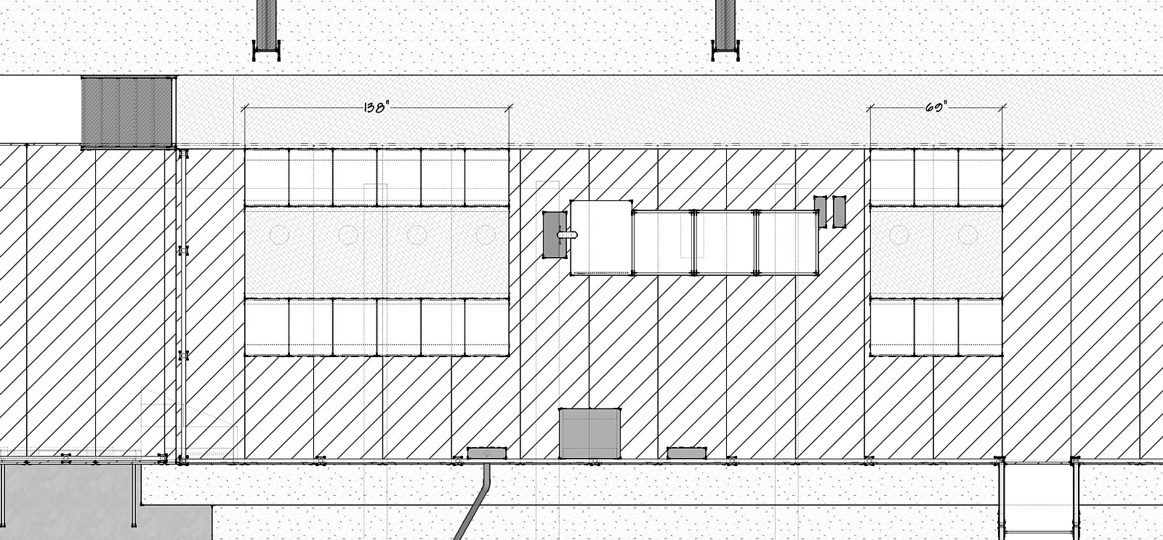
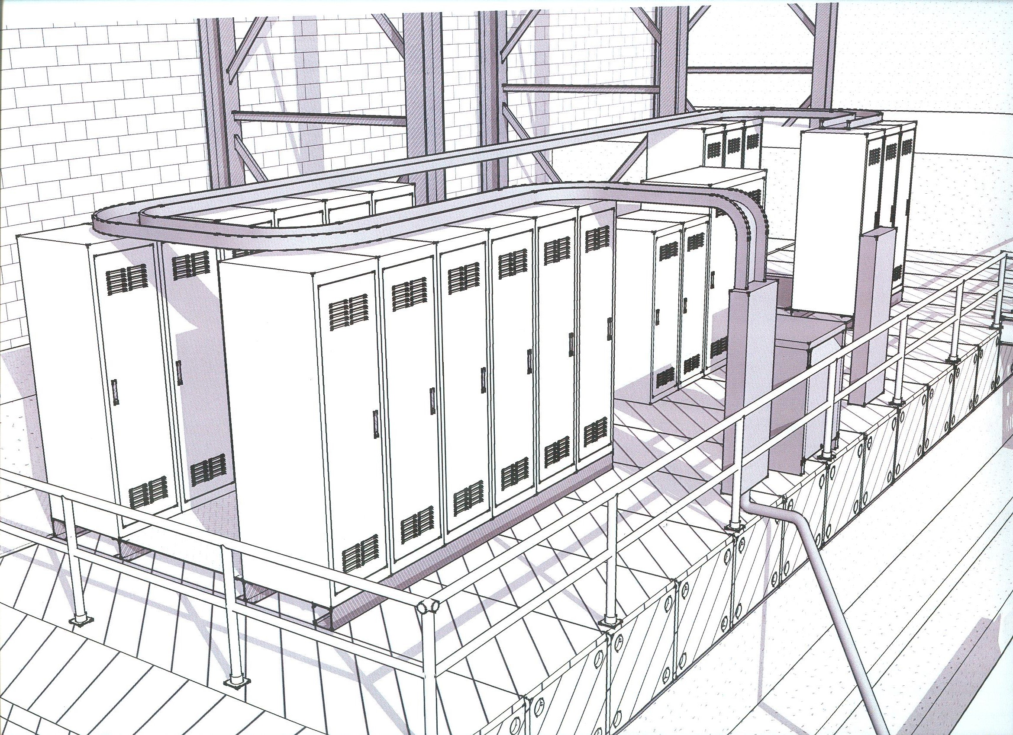
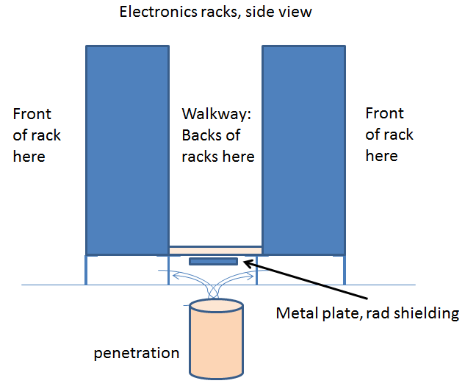
Electronics Racks above Cave1
Fix the design
Finalize electrical requirements
Build it, populate the racks

Slide 11
UITF – Upgrade Injector Test Facility
Issues/Concerns that could affect on-time delivery
Can Cryo provide plumbing soon? Begin work on He recovery system for HDIce? Want to leave space for them to do their work but also want to start “filling up the cave” now
Designers in short supply
Can SSG provide the ODH and PSS systems on schedule?
Facilities end-date February 2016 could delay ¼ CM commissioning, gun HV conditioning, and intentional beam generation
Impact on CTF, a new LHe User
Recommended Mitigation
Purchase contract designer
We can use portable ODH monitoring system for ¼ CM commissioning
Temporary shield wall and OSP could provide a means to commission ¼ CM, condition gun and perhaps make 350kV beam without a completed UITF concrete enclosure and PSS?
Preble, K. Davis, Cryo Group have started conversation related to oversubscribed CTF. However, near term solution is likely a scheduling solution.
Timing is good for Ops Software, provided we (mostly) duplicate existing CEBAF software controls

Slide 12
