Slide 1
Magnetized Electron Beam Source for the Jefferson Lab Electron-Ion Collider Re-circulator Cooler Ring
P. Adderley, B. Bullard, J. Benesch, J. Grames, F. Hannon, J. Hansknecht, C. Hernandez-Garcia, R. Kazimi, G. A. Krafft, M. A. Mamun, G. Palacios-Serrano, M. Poelker, M. Stutzman, R. Suleiman, M. Tiefenback, C.A. Valerio Lizarraga, Y. Wang, S. Wijethunga, J. Yoskovitz and S. Zhang.
Supported in part by DoE and JLab LDRD
Graduate students, Old Dominion University
High Brightness Beams Workshop, Crete, Greece, April 8 - 12, 2019

Slide 2

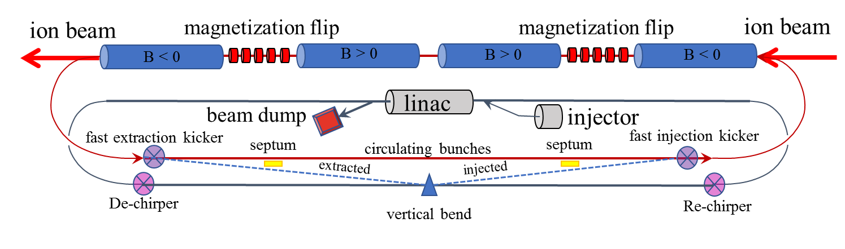
The proposed JLEIC High Energy Electron Cooler is based on magnetized bunched electron beam generated in an Energy Recover Linac
High Energy Bunched Magnetized Electron Cooler
Low Energy DC Electron Coolers
100 meters
Circulator Cooler Ring
Magnetized e-beam injection
Energy Recover Linac Ring

Slide 3
Magnetized bunched-beam electron cooling of the ion beam
Ion beam cooling in the presence of a solenoid field is much more efficient than cooling in a drift (no magnetic field):
  Electron beam helical motion in strong magnetic field increases electron-ion interaction time, thereby significantly improving cooling efficiency
  Electron-ion collisions that occur over many cyclotron oscillations and at distances larger than cyclotron radius are insensitive to electrons transverse velocity
Long cooling solenoid provides desired cooling effect:
  Counteracting emittance degradation induced by intra-beam scattering
  Maintaining ion beam emittance during collisions and extending luminosity lifetime
  Suppressing electron-ion recombination cross-section

Slide 4
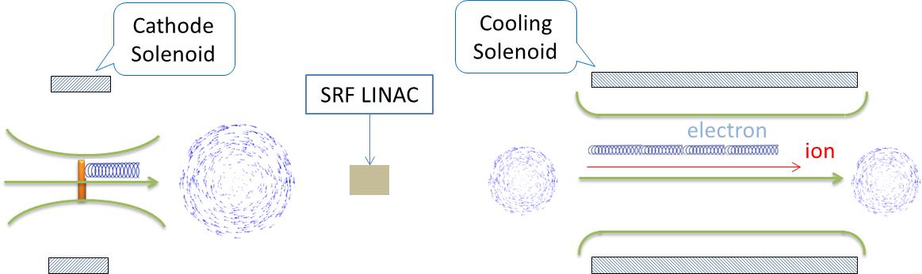
Magnetized cooling schematics
Electron beam suffers an azimuthal kick at entrance of the cooling solenoid. But this kick can be cancelled by an earlier kick at exit of photogun. That is the purpose of cathode solenoid.
Intrinsic transverse momentum of electron at photocathode translates into cyclotron motion
Cyclotron motion is preserved in the cooling solenoid
Equal flux
v
Equal flux
v
B_{z}
B_{z}
a0
55 MeV
re
B_{r}
v
Mechanical angular momentum added to the beam when leaving solenoid field
v
B_{r}
Electrons born in strong uniform B_{z}
Upon exit of Cathode Solenoid
Mechanical angular momentum removed from the beam upon entering the cooling solenoid field

Slide 5
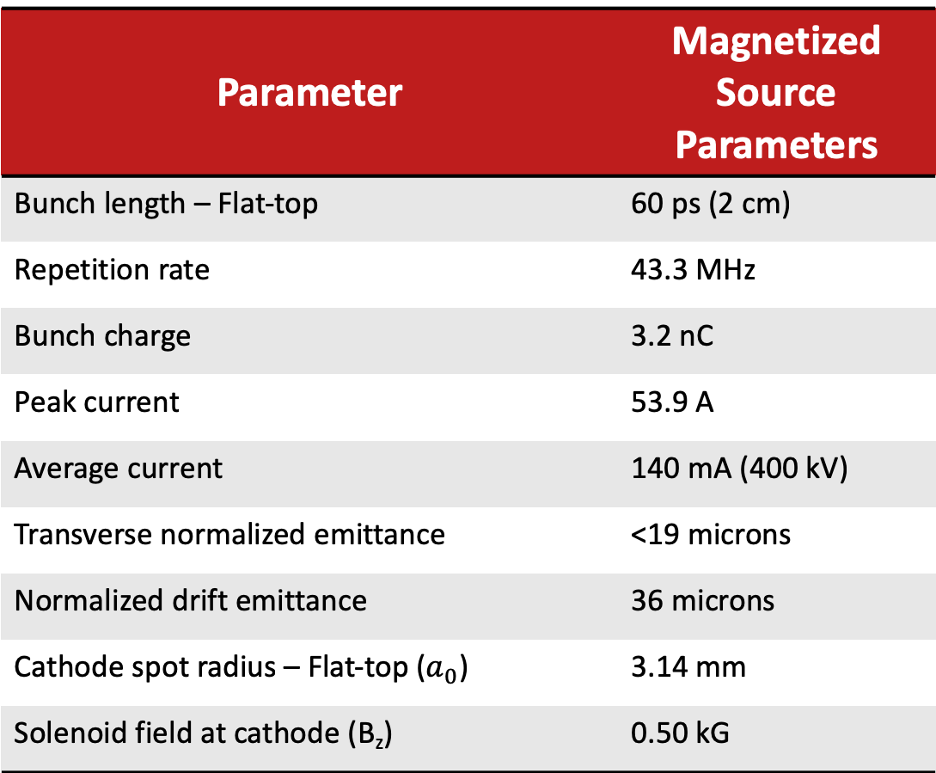
JLEIC magnetized source beam requirements have never been generated simultaneously by any electron gun
Parameter | Magnetized Source Parameters
Bunch length – Flat-top | 60 ps (2 cm)
Repetition rate | 43.3 MHz
Bunch charge | 3.2 nC
Peak current | 53.9 A
Average current | 140 mA (400 kV)
Transverse normalized emittance | <19 microns
Normalized drift emittance | 36 microns
Cathode spot radius – Flat-top ($a_{0}$) | 3.14 mm
Solenoid field at cathode (B_{z}) | 0.50 kG

Slide 6
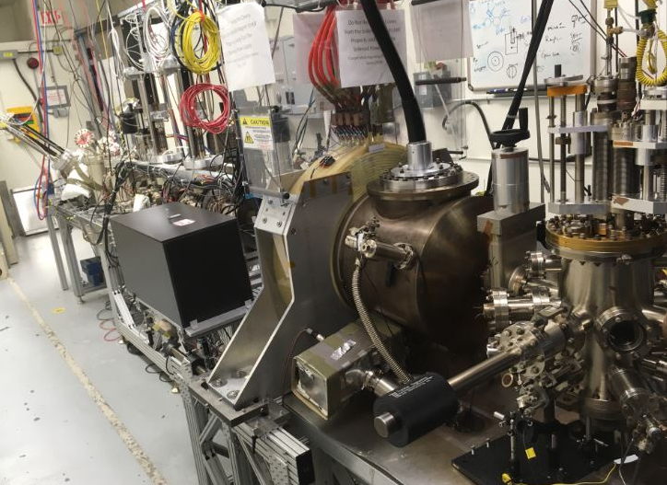
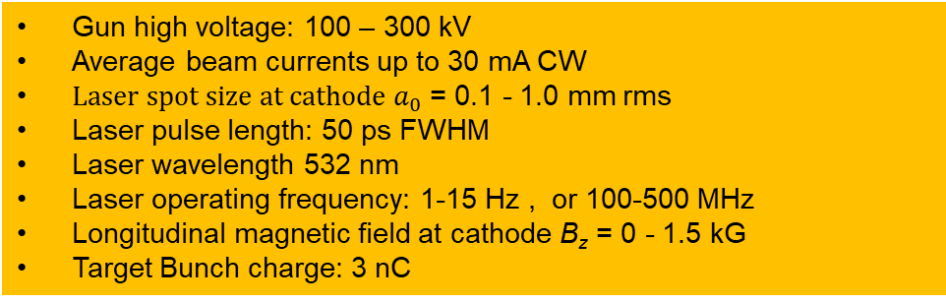
The JLab magnetized source test stand is utilized to develop the technology for achieving the JLEC magnetized source requirements
Prototype magnetized source was funded by the Jefferson Lab LDRD program that aimed to operate up to 30 mA average current. This three-year project concluded in October 2018
Goals of the project:
  Generate magnetized bunched electron beam from dc high voltage photogun and measure its properties
  Explore impact of cathode solenoid on photogun operation
  Perform simulations and measurements to provide insights on ways to optimize JLEIC electron cooler and help design appropriate source
  Provide JLab with direct experience on magnetizing electron beams at high current
Gun high voltage: 100 – 300 kV
Average beam currents up to 30 mA CW
${Laser spot size at cathode a}_{0}$ = 0.1 - 1.0 mm rms
Laser pulse length: 50 ps FWHM
Laser wavelength 532 nm
Laser operating frequency: 1-15 Hz , or 100-500 MHz
Longitudinal magnetic field at cathode B_{z} = 0 - 1.5 kG
Target Bunch charge: 3 nC

Slide 7
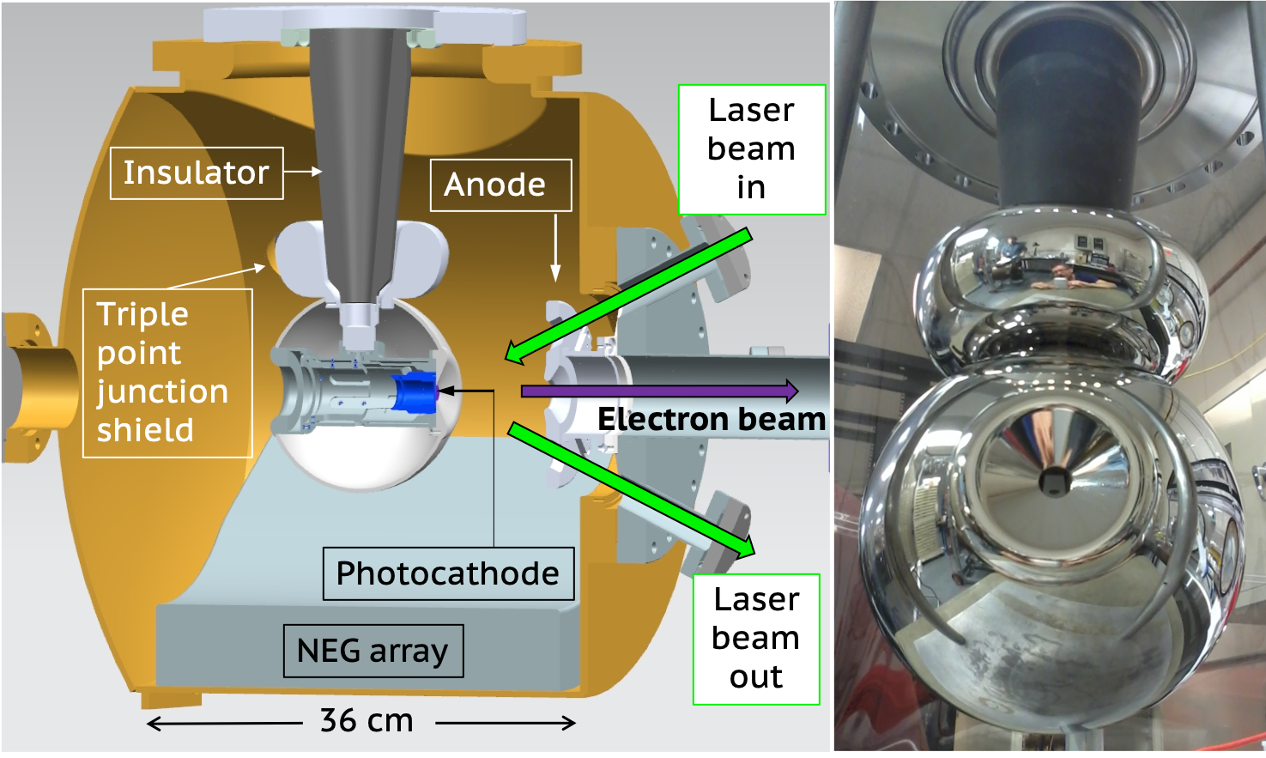
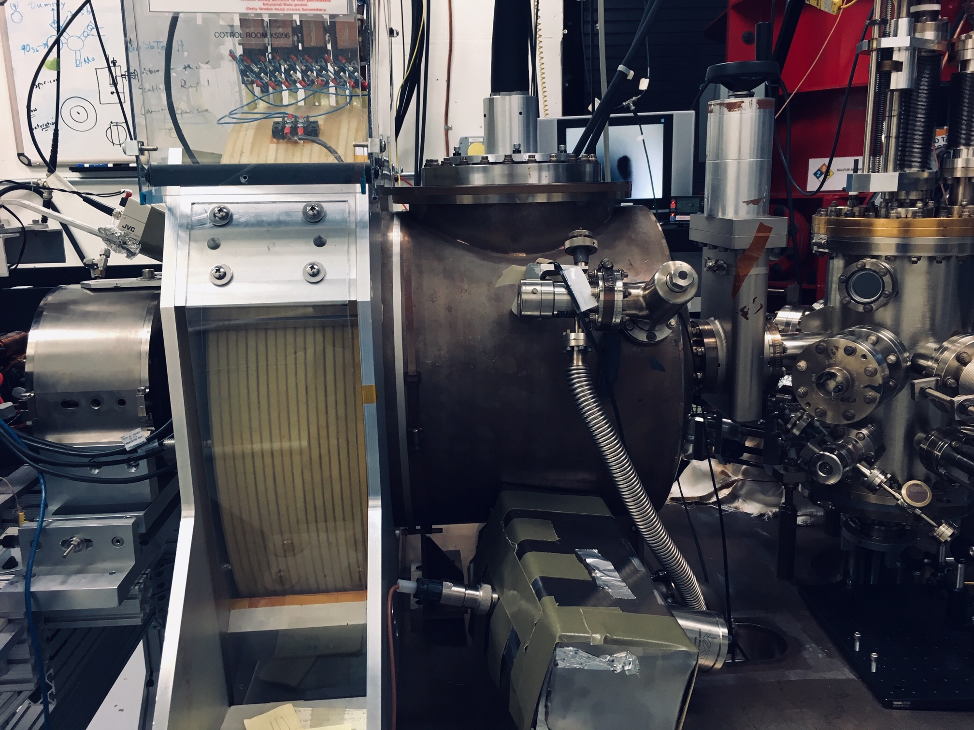
The magnetized source consists of a 300 kV inverted electron gun with K_{x}Cs_{y}Sb photocathode and a cathode solenoid magnetization coil
Magnetic Field with coil at 400 A
Electrostatic Accelerating Field at 300 kV
Beamline
Focusing
Solenoid 1
Beamline
Focusing
Solenoid 2
The photogun
The cathode solenoid provides magnetic field up to 1.5 kG at the cathode using a 400 A, 80 VDC power supply
We learned how to energize solenoid without exciting new field emitters
Photogun operated at 300 kV with gun solenoid at 400 A
Is based on doped-alumina inverted insulator and triple point junction shield for max gradient of 10 MV/m at 350 kV
Has been high voltage conditioned to 360 kV in 70 hours
Nominal vacuum levels ~5x10⁻¹² Torr after vacuum bake and high voltage conditioning

Slide 8
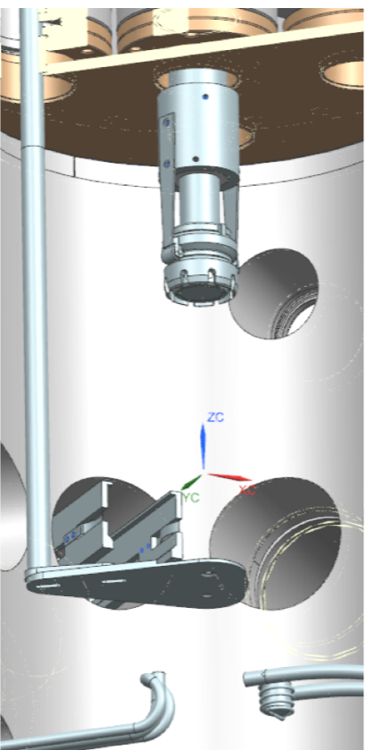
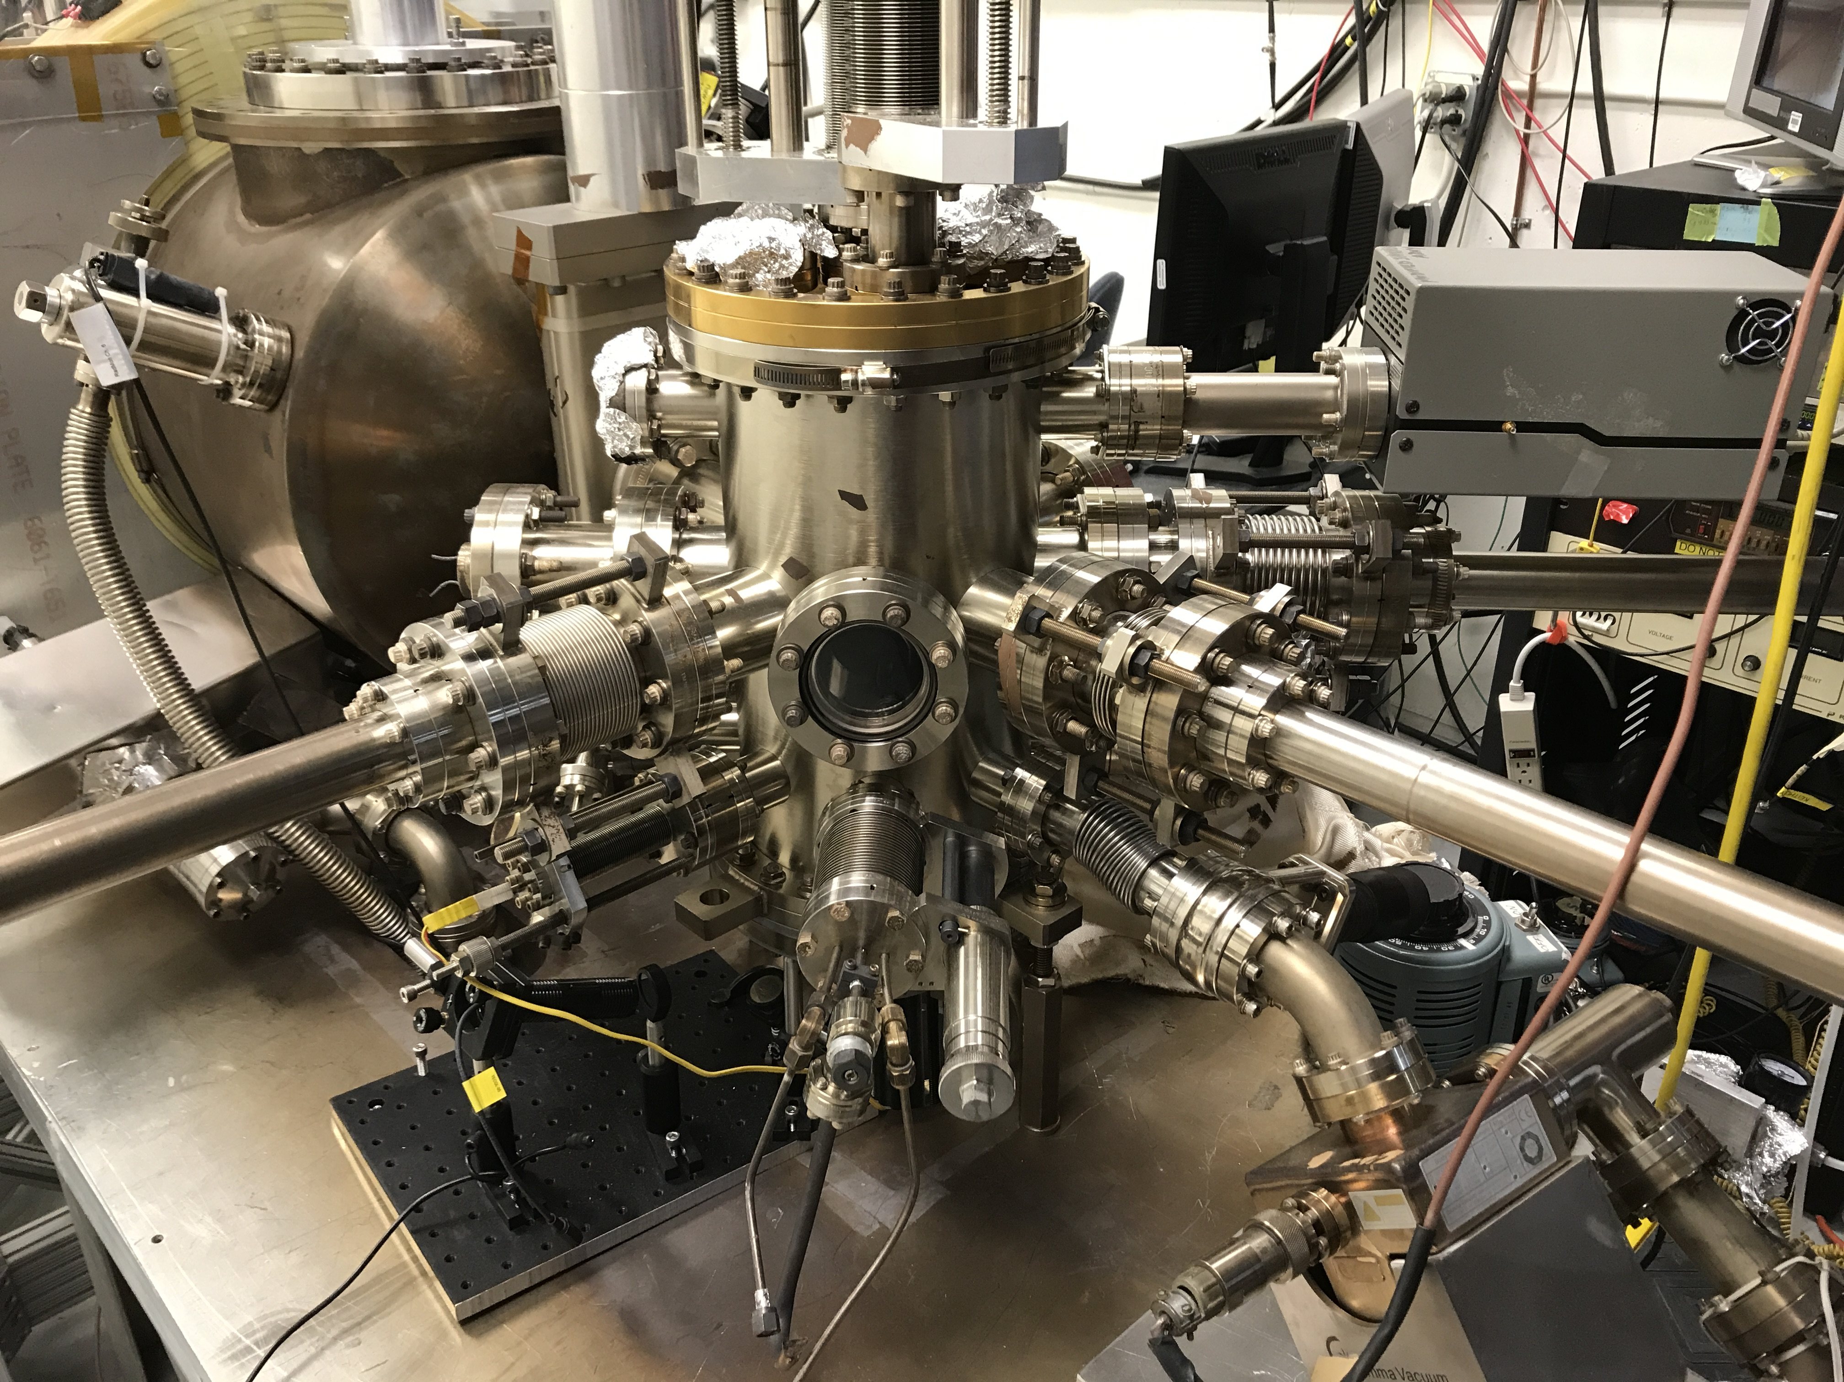
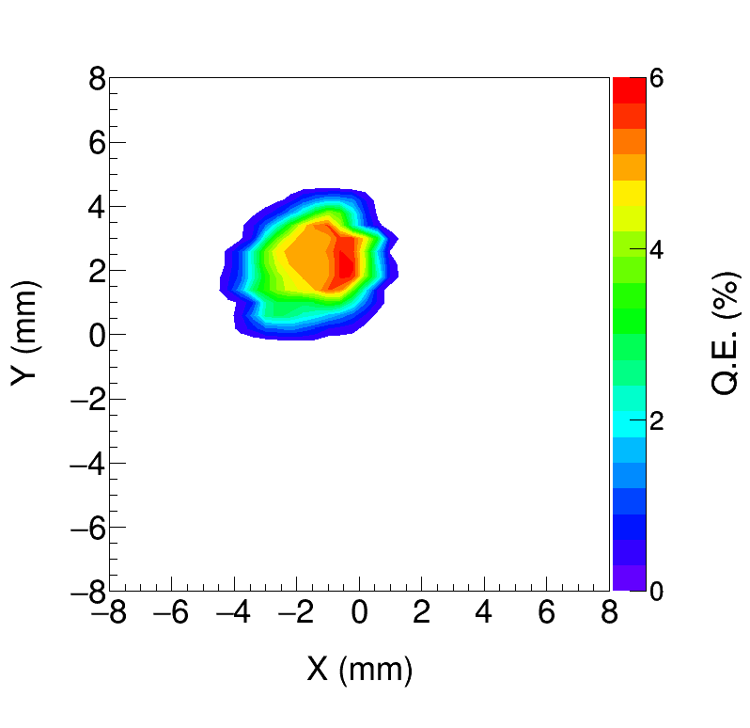
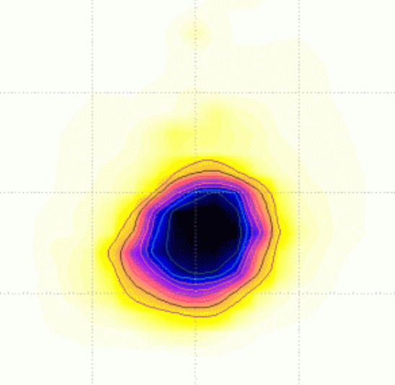
K_{x}Cs_{y}Sb photocathode films are grown on substrates in a vacuum chamber connected to the photogun
K_{x}Cs_{y}Sb grown with a mask – limit photocathode active area (3 and 5 mm diameter) to reduce beam halo and prolong quantum efficiency operating lifetime
Active area can be offset from electrostatic center to minimize damaging on the emission area from ion back bombardment and micro-arcing events during high current run
Moly substrate to reduce laser induced thermal desorption of chemicals during high current run
Consistently fabricated photocathodes with 5-9% QE
Photo
cathode
puck facing down for activation
Rotary
Fork
Manipulator
Activation mask
What makes the change in slope at these two inflection points?
Effusion Cs-K source
Sb
pellets crucible

Slide 9
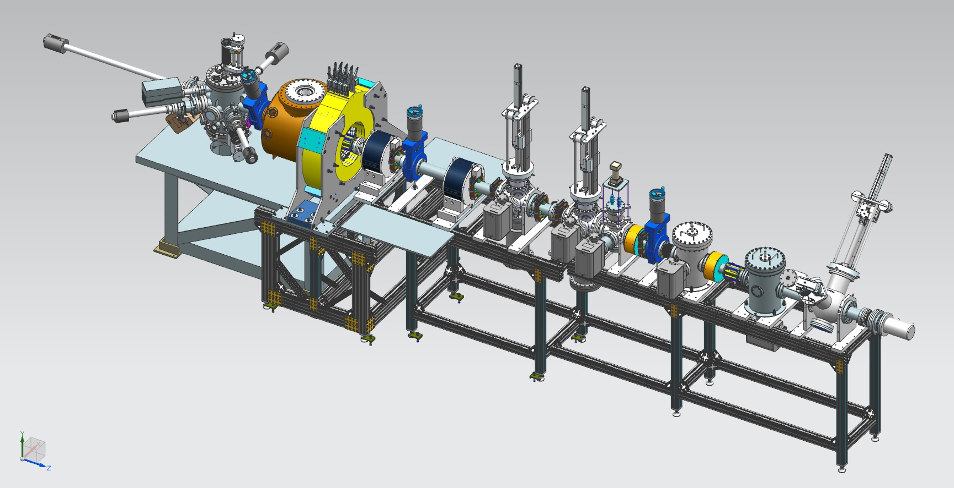
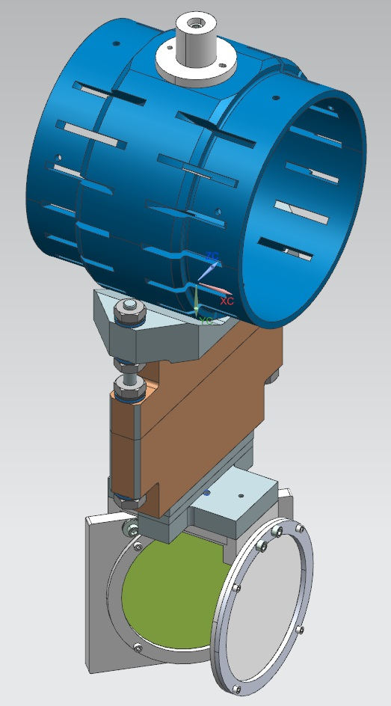
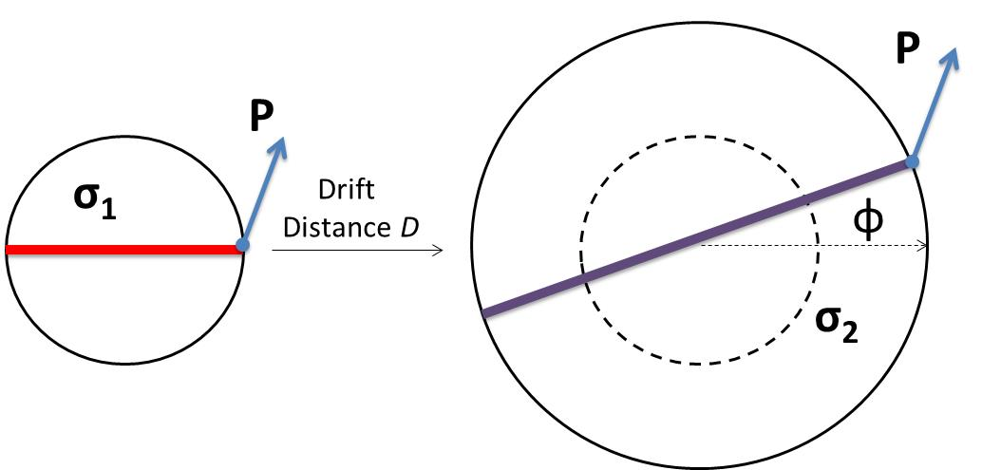
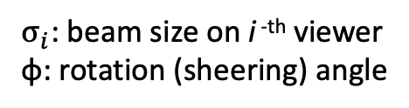
A diagnostic beamline for magnetized electron beam source characterization
Photocathode
Preparation
Chamber
Cathode Solenoid
Viewer 3 Screen
Photogun
Beam Dump
Slit at first viewer screen
The slit crops the magnetized beam into a beamlette that appears rotated when imaged in a downstream viewer screen
Shield Tube
$σ_{i}$: beam size on i ^{-th} viewer
φ: rotation (sheering) angle
Slit
Viewer Screen

Slide 10
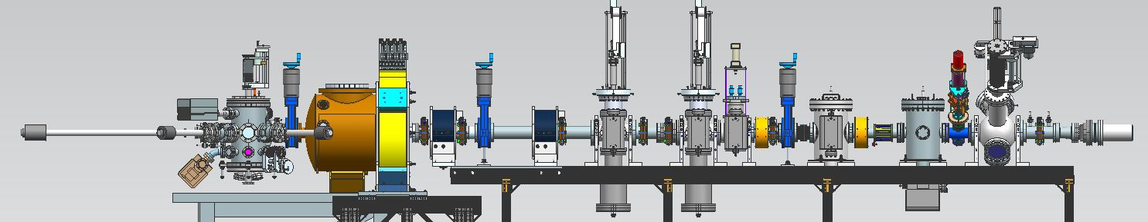
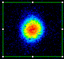
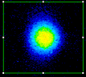


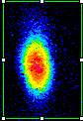
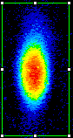
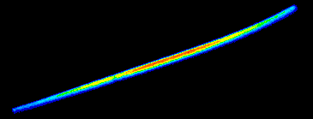

Magnetized beam characterization
Beam and beamlet are observed on viewer YAG screens
Photocathode preparation chamber
Photogun
Cathode solenoid
Slit
No slit
Magnetic field at photocathode = 0 G
Through slit
What is the reason for the curvature? Beam not on center of solenoid
No slit
Magnetic field at photocathode = 1514 G
Through slit

Slide 11
Characterizing beam magnetization
Beam size and Rotation: Experiment vs ASTRA simulation
A non-uniform cathode magnetic field causes mismatch oscillations
repeated focusing inside the solenoid field affects the beam size at the exit of the solenoid field
resulting in varying beam expansion rate in the field free region.
Gun voltage 300 kV and laser spot size 0.2 mm rms on photocathode center
RMS beam size (data)
RMS beam size (sim)
Rotation angle (data)
Rotation angle (sim)
Observed and simulated oscillating beam profiles and corresponding beam rotation

Slide 12
Magnetized beam emittance measurements for two laser spot sizes at 200kV
Beam size too large to transport cleanly
GPT simulation and experimental results show encouraging agreement

Slide 13
Magnetized beam bunch charge measurements
Gun voltage 225 kV, Magnetic field at cathode 757 Gauss, laser pulse width 75ps (FWHM)
Transmission to the beam dump
Irregular pattern due to beam-loss
We encountered space-charge-limited regime within 0.3 nC for different magnetized conditions
Need longer laser pulses, higher gun voltage and better beamline optics to get nC bunches

Slide 14
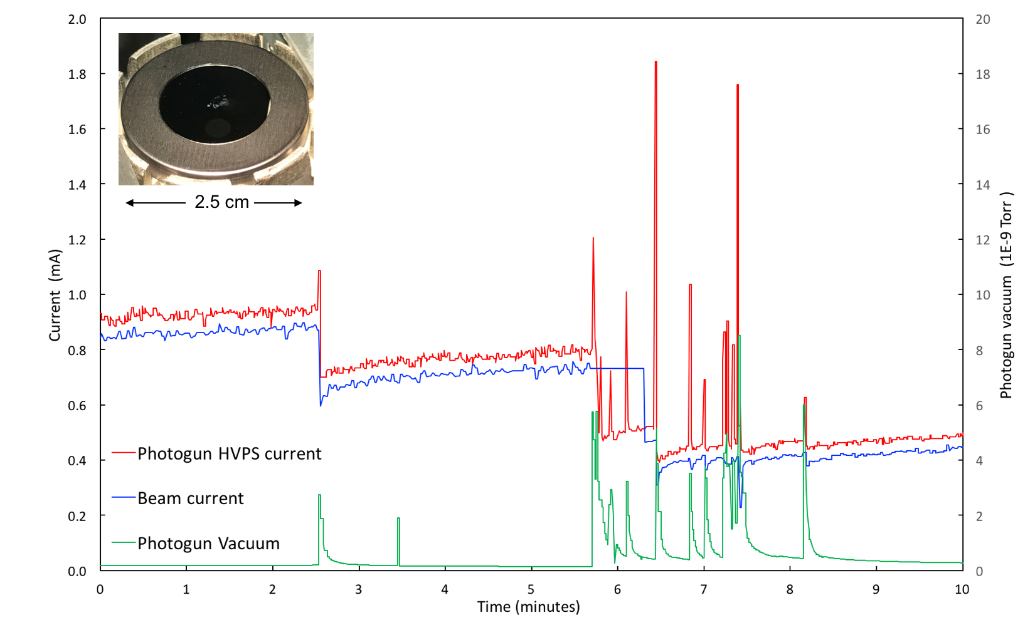
Initial attempts to run high current magnetized beam where limited by gun current surges tripping off the high voltage power supply damaging the photocathode at 1 mA CW
Physical damage on photocathode every time there is a surge in gun HVPS current
Sudden drop in beam current
Gun vacuum pressure surge

Slide 15
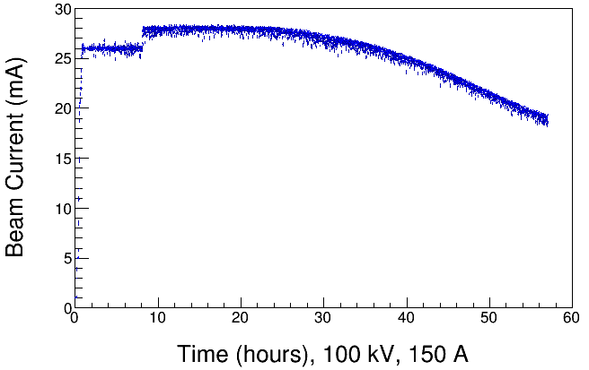
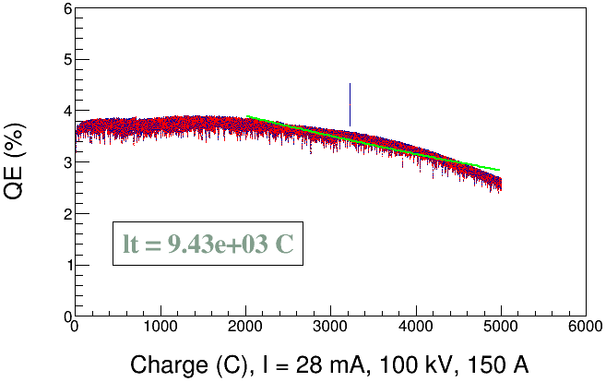
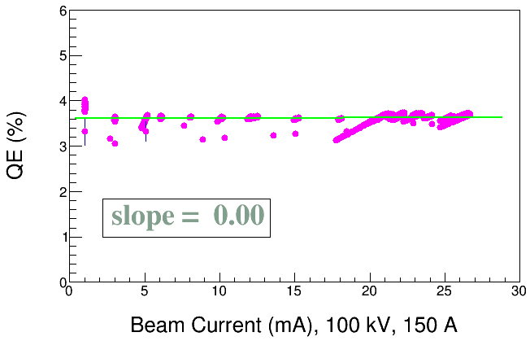
Biasing the gun anode to +1 kVDC was essential to achieve high current magnetized beam for extended periods of time without gun current trip offs
Approval for higher current obtained
Laser rms = 1.4 mm, 374.25 MHz, 50 ps (FWHM)
Cathode magnetic field = 568 Gauss
Gun HV = 100 kV
Anode = + 1 kV
K_{x}Cs_{y}Sb photocathode on molybdenum
Gun Vacuum: 5 X 10⁻¹² Torr (background) increased to 5 X 10⁻¹¹ Torr during 28 mA beam current run
Bunch charge 75 X 10⁻¹² Coulombs
1/e charge lifetime
Cumulative Charge (Coulombs)
Elapsed run time (hours)
Limited lifetime might be a result of photocathode heating and associated bandgap shift, or ion back bombardment
Beam current (mA)

Slide 16
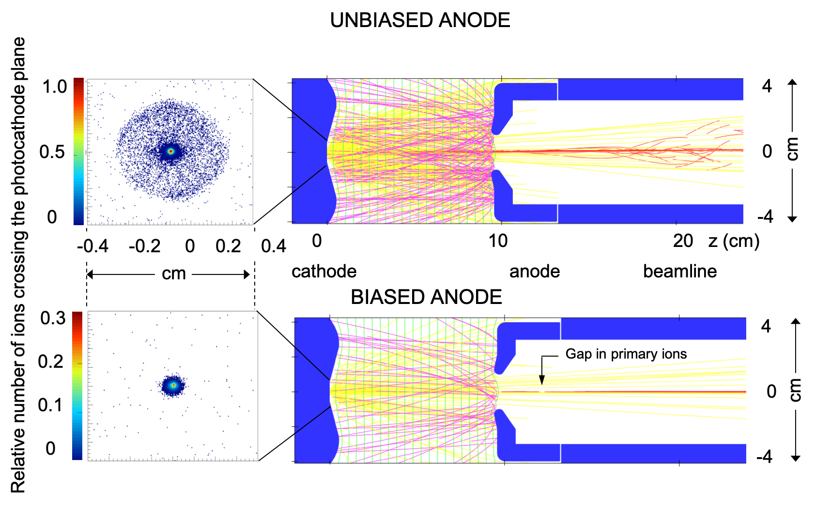
Simulations of ions generated by the high current electron beam suggest that:
Ions in the beamline (red) are attracted to the potential well formed by the electron beam
These trapped ions are then accelerated towards the negatively biased photocathode where they generate secondary electrons (yellow) upon impact which in turn strike the anode and generate secondary ions (pink).
High density ‘channels’ could form leading to arcing between the photocathode and the anode
Biasing the anode repels beamline ions permitting to run high current without gun current trip offs (photocathode arcing)

Slide 17
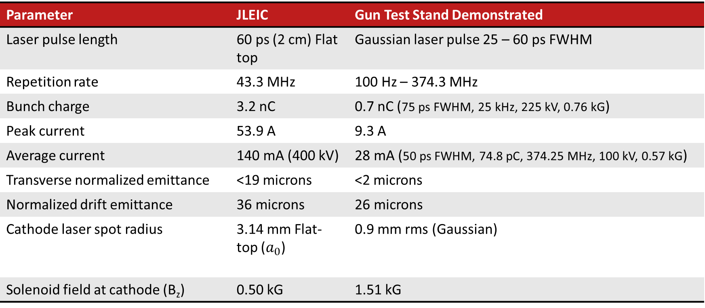
JLEIC magnetized source beam requirements compared to parameters achieved in this work
Parameter | JLEIC | Gun Test Stand Demonstrated
Laser pulse length | 60 ps (2 cm) Flat top | Gaussian laser pulse 25 – 60 ps FWHM
Repetition rate | 43.3 MHz | 100 Hz – 374.3 MHz
Bunch charge | 3.2 nC | 0.7 nC (75 ps FWHM, 25 kHz, 225 kV, 0.76 kG)
Peak current | 53.9 A | 9.3 A
Average current | 140 mA (400 kV) | 28 mA (50 ps FWHM, 74.8 pC, 374.25 MHz, 100 kV, 0.57 kG)
Transverse normalized emittance | <19 microns | <2 microns
Normalized drift emittance | 36 microns | 26 microns
Cathode laser spot radius | 3.14 mm Flat-top ($a_{0}$) | 0.9 mm rms (Gaussian)
Solenoid field at cathode (B_{z}) | 0.50 kG | 1.51 kG
The beam current was limited by the gun the high voltage
power supply (30 mA/225 kV Spellman power supply with 3 kW max power)

Slide 18
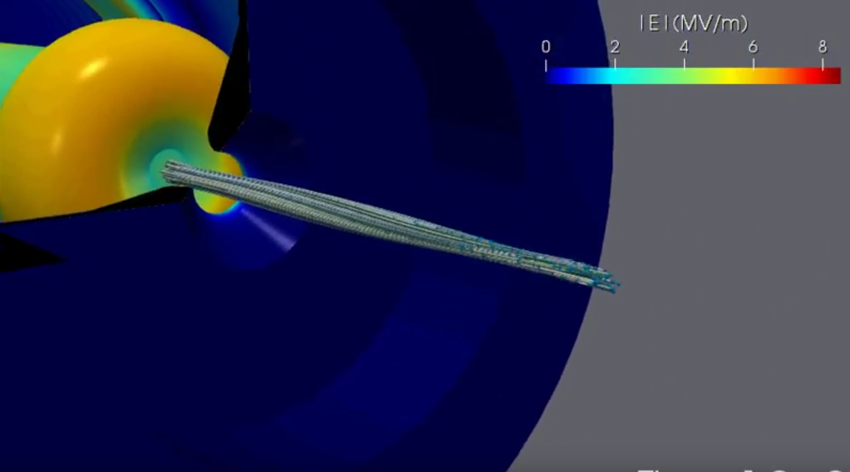
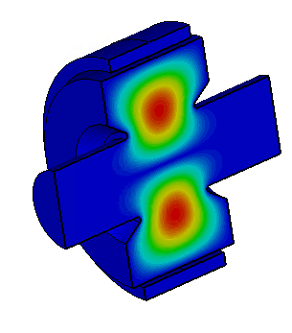
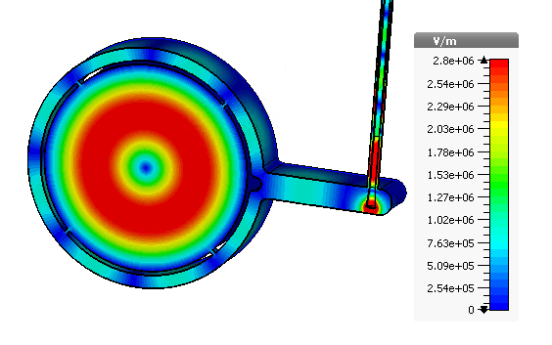
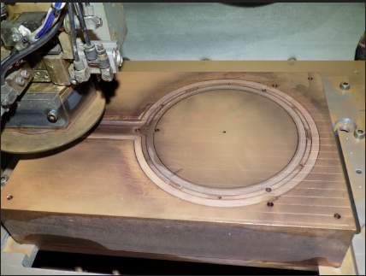
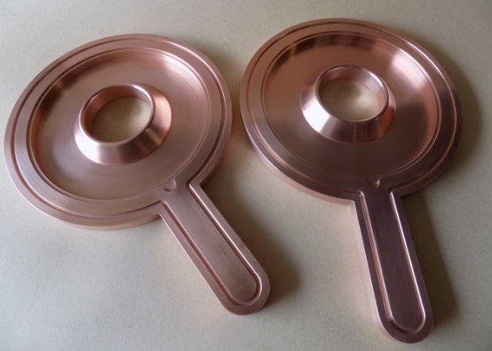
Future Plans
Swap the photogun for the RF-pulsed thermionic gun built by Xelera Research LLC to demonstrate 65 mA magnetized beam (307 G, 500 MHz, 130 pC, 90 ps rms, 125 kV): an SBIR II funded project
Install non-invasive magnetometers - TE₀₁₁ Cavity and “Brock” Cavity from Electrodynamic to measure beam magnetization and electron bunch-length for high bunch charge beam: another SBIR II funded project
Reinstall photogun, now with Xelera’s power supply and BNL laser, the setup will enable high average current AND high bunch charge, simultaneously (65 mA, 3 nC)
Characterize space-charge effects of high bunch charge and high average current beam as a function of beam magnetization
Collaborate with Xelera, Electrodynamic, BNL and others on follow-up projects

Slide 19
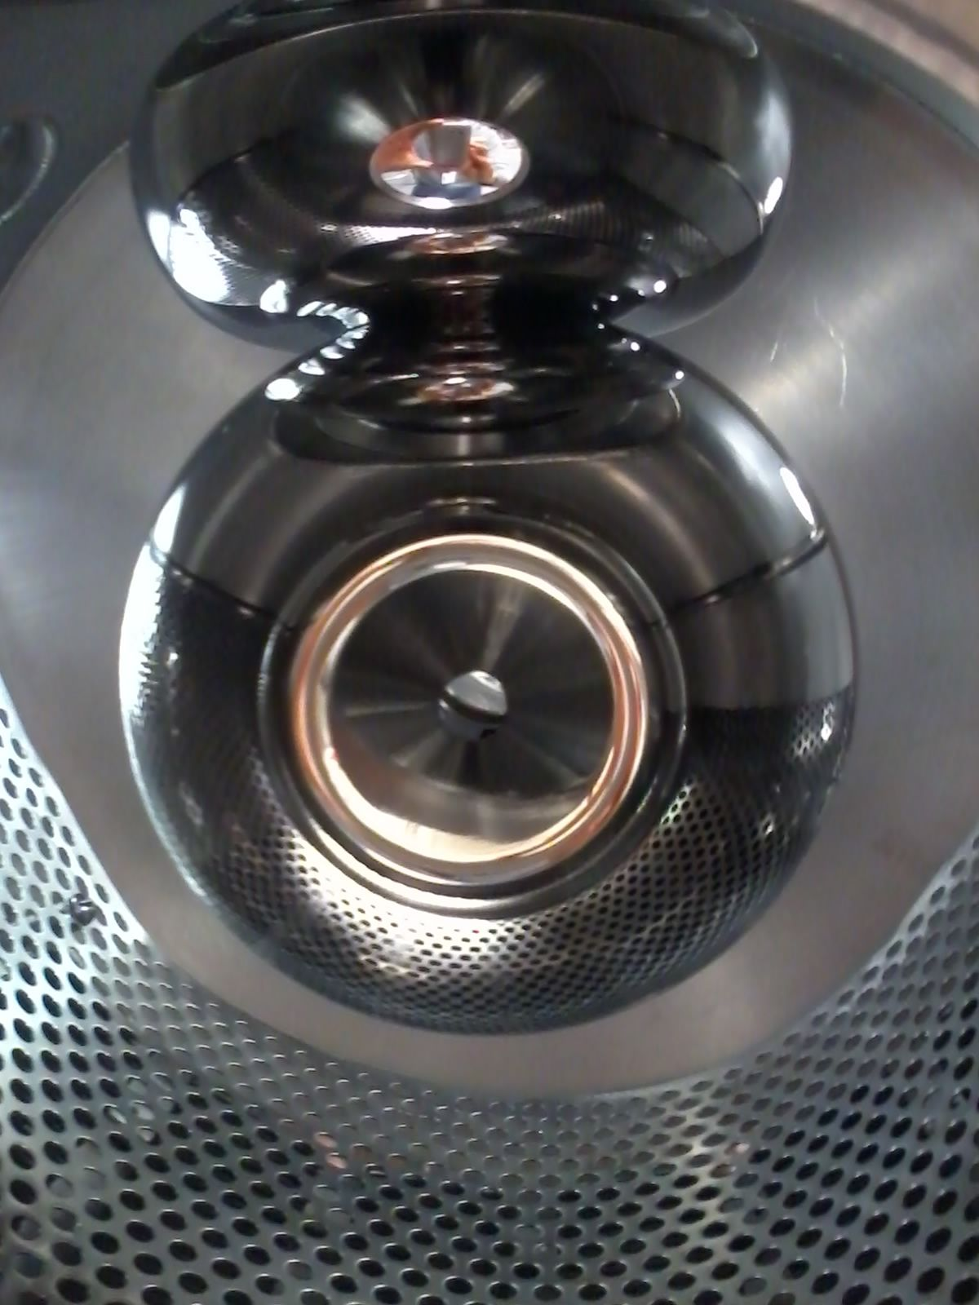
THANK YOU!!!
On behalf of the JLab magnetized source team!
Team picture goes hes

Slide 20
Backup Slides

Slide 21
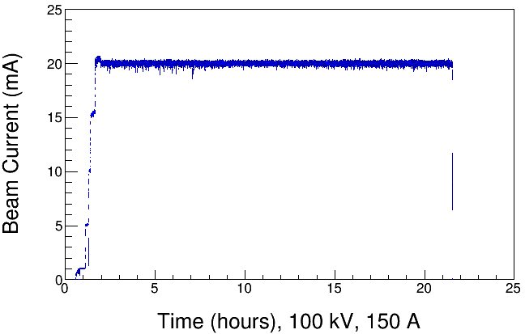
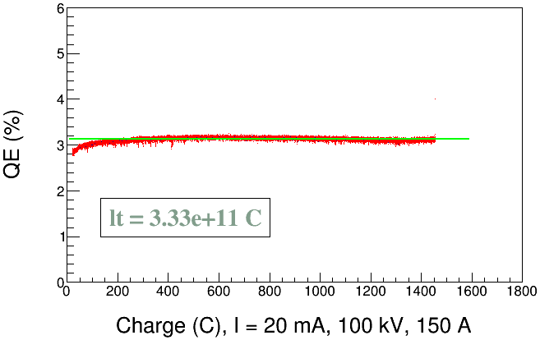
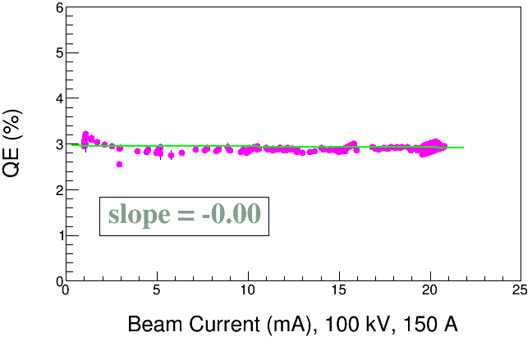
High Current Magnetized Beam: 20 mA at 568 G for 20 h
20 mA, 568 G, 20 h run
Laser rms = 0.9 mm, 303 MHz, 60 ps (FWHM)
Gun HV = 100 kV, Gun Solenoid = 150 A, Anode at + 1 kV
K_{x}Cs_{y}Sb photocathode on molybdenum
Gun Vacuum: 2.7 – 4.2 X 10⁻¹² Torr = 3.6 – 5.6 X 10⁻¹⁰ Pa
(2.0 – 3.2 nA on ion pump)
14 mA, 725 G, 90 h run
Laser rms =0.9 mm, 303 MHz, 60 ps
Gun Sol=200 A, HV=200 kV
No QE degradation over 20 hour run
Positive anode bias (+1 kV) effectively prevented ions in beamline from reaching the gun that causes micro-arcs and sudden QE degradation

Slide 22
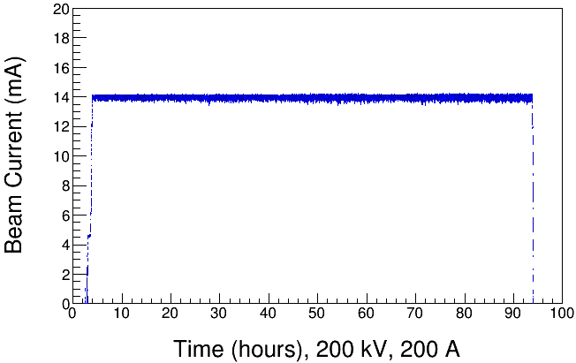
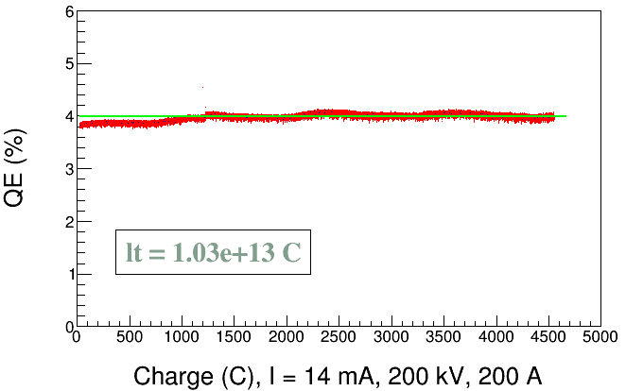
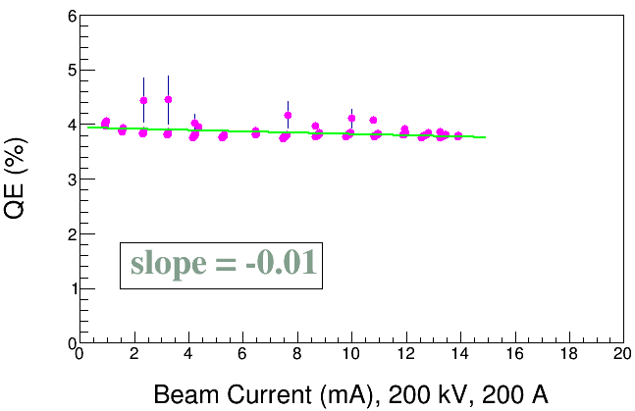
High Current Magnetized Beam: 14 mA at 757 G for 90 h
14 mA, 757 G, 90 h run
Laser rms = 0.9 mm, 303 MHz, 60 ps (FWHM)
Gun HV = 200 kV, Gun Solenoid = 200 A, Anode at + 1 kV
K_{x}Cs_{y}Sb photocathode on molybdenum
Gun Vacuum: 2.0 – 2.9 X 10⁻¹² Torr = 2.7 – 3.9 X 10⁻¹⁰ Pa
(1.6 – 2.2 nA on ion pump)
No QE degradation over 90 hour run
Positive anode bias (+1 kV) effectively prevented ions in beamline from reaching the gun that causes micro-arcs and sudden QE degradation

Slide 23
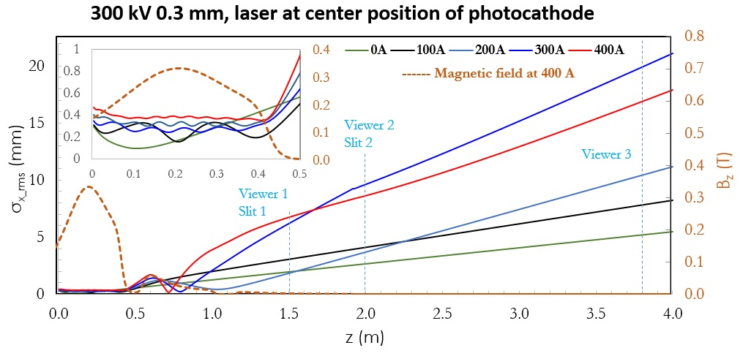
Modeling beam magnetization in GPT
What is this?
Do you want this with the main slides?
Why is it important?
Larmor frequency increases with magnetic field at cathode
Focusing by cathode magnetic field causes mismatch oscillations resulting in repeated focusing inside cathode solenoid field which affects beam size at exit of solenoid field and resulted in varying beam expansion rate in field free region
Rotation angles are influenced by focusing in cathode solenoid

Slide 24
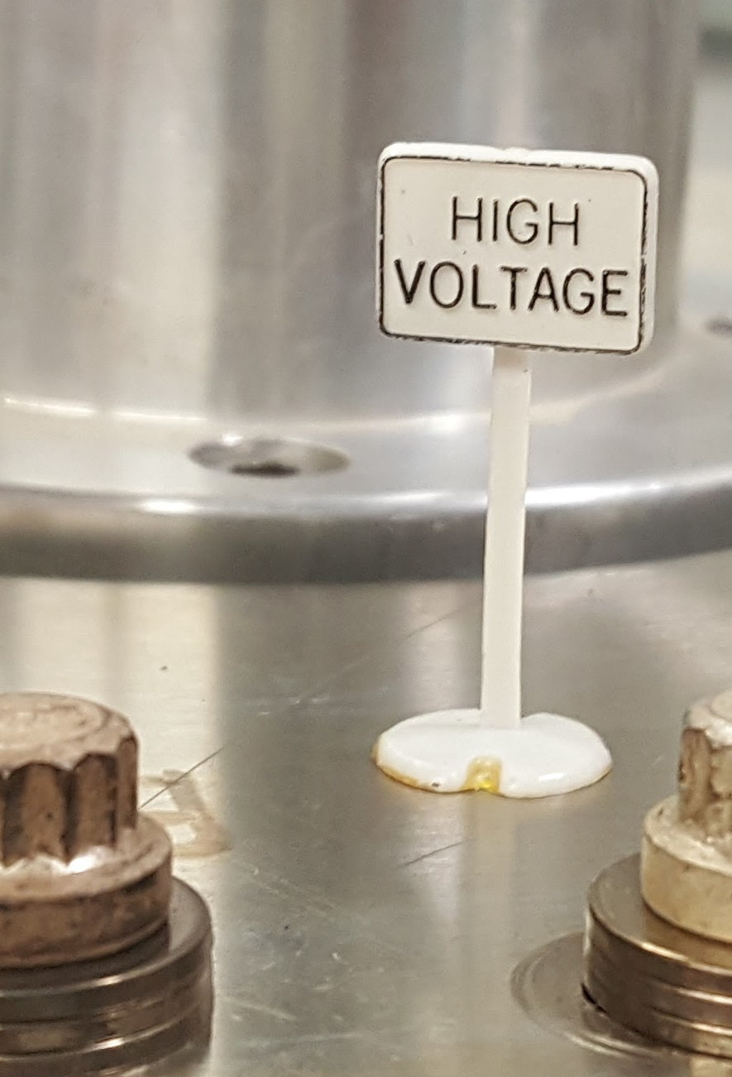
Gun high voltage conditioning took ~70 hours with the magnetization coil off
With the magnetization solenoid energized, the gun had to be high voltage re-conditioned.
Max gradient 10 MV/m at 350 kV
Vacuum and radiation levels indistinguishable from bkgd at 350kV

Slide 25
Summary
K_{x}Cs_{y}Sb photocathode preparation chamber, gun, solenoid and beamline - all operational
Photogun operated reliably up to 300 kV for >1000 h
Cathode solenoid can trigger field emission but we have learned how to prevent this
Have successfully magnetized electron beams and measured rotation angle and drift emittance
Demonstrated high bunch charge up to 0.7 nC
Delivered 28 mA magnetized beam (568 G at photocathode) with RF structure (a gain-switched drive laser, 374.25 MHz, 50 ps FWHM) at 100 kV using 30 mA/225 kV Spellman power supply
(3 kW power limit)
Successfully fabricated bialkali antimonide photocathode with QE ~ 9% on molybdenum substrate that provided longer charge lifetime
Positive bias on anode helps to prevent sudden QE loss from ion-induced micro-arcing events
Thanks to those involved in this team work:
P. Adderley, J. Benesch, B. Bullard, J. Delayen , J. Grames, J. Guo, F. Hannon, J. Hansknecht, C. Hernandez-Garcia, R. Kazimi, G. Krafft, M. Poelker, R. Suleiman, M. Tiefenback, Y. Wang, S. Wijiethunga, S. Zhang.
ODU Graduate Students

Slide 26
Photocathode Preparation by Co-deposition
Co-deposition of alkalis (K and Cs) on Sb layer using an effusion alkali source to grow bialkali antimonide photocathode
Deposition chamber was initially baked at 200 °C for >180 h
Vacuum with NEG pumps and an ion pump, Vacuum ~10 nA (~10⁻¹⁰ Pa)
Sb (99.9999%) , K (99.95%), and Cs (99.9+%)
Working distance: 2 cm, – 280 V bias, low power (4 mW) laser (532 nm) and wavelength tunable light source
Substrate temperatures: 120 °C (for Sb), dropping from 120 °C to 80 °C (for alkalis)
Sb heater current supply from 25 A for 10-20 minutes
RGA as a control to monitor evaporation rate
Temperature kept stable at effusion source and adjusted to control alkali evaporation rate: hot air inlet tube (381 – 462 °C), dispensing tube (232 – 294 °C), and reservoir tube (153 – 281 °C)
Chamber pressure: during bialkali deposition > 1x10⁻⁶ Pa
and post-deposition to ~10⁻⁷ – 10⁻⁸ Pa
H₂O partial pressure < 2x10⁻⁹ Pa

Slide 27
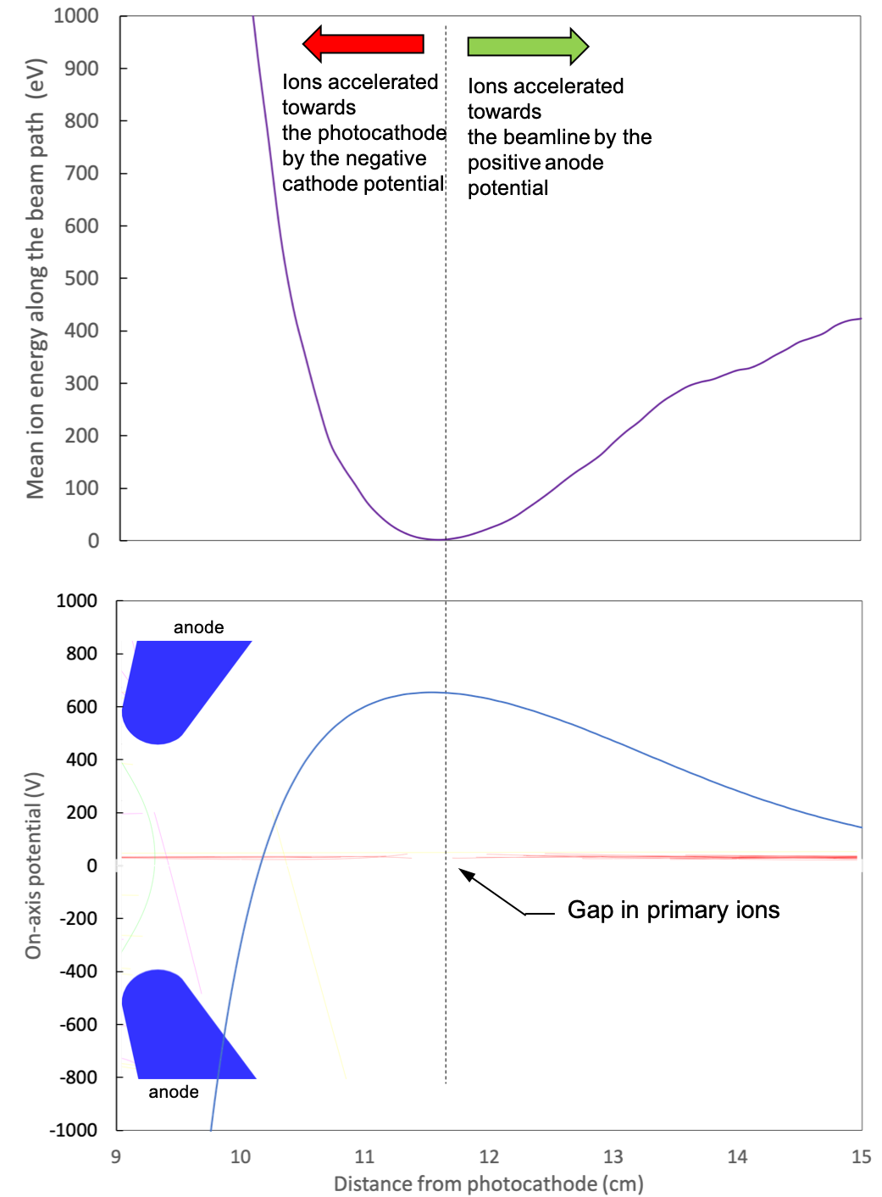
Anode-cathode potential when anode is biased to +1kVDC

Slide 28
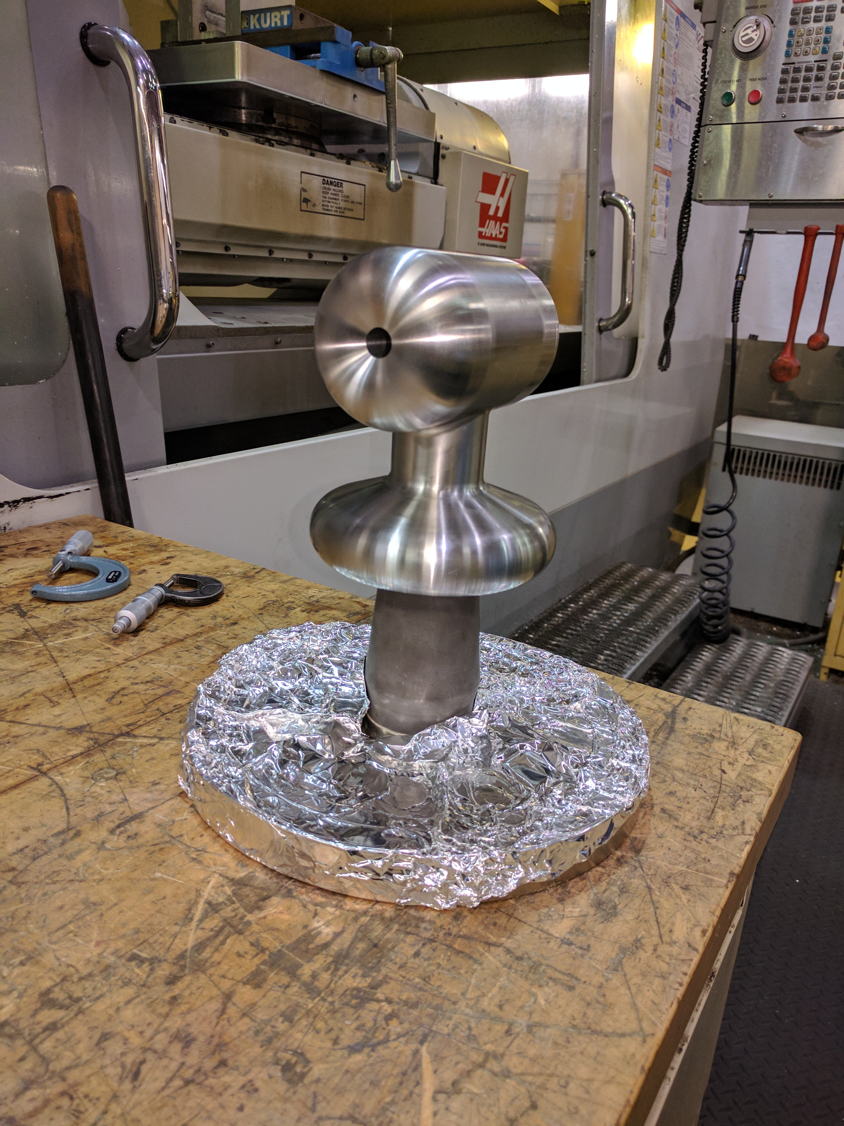
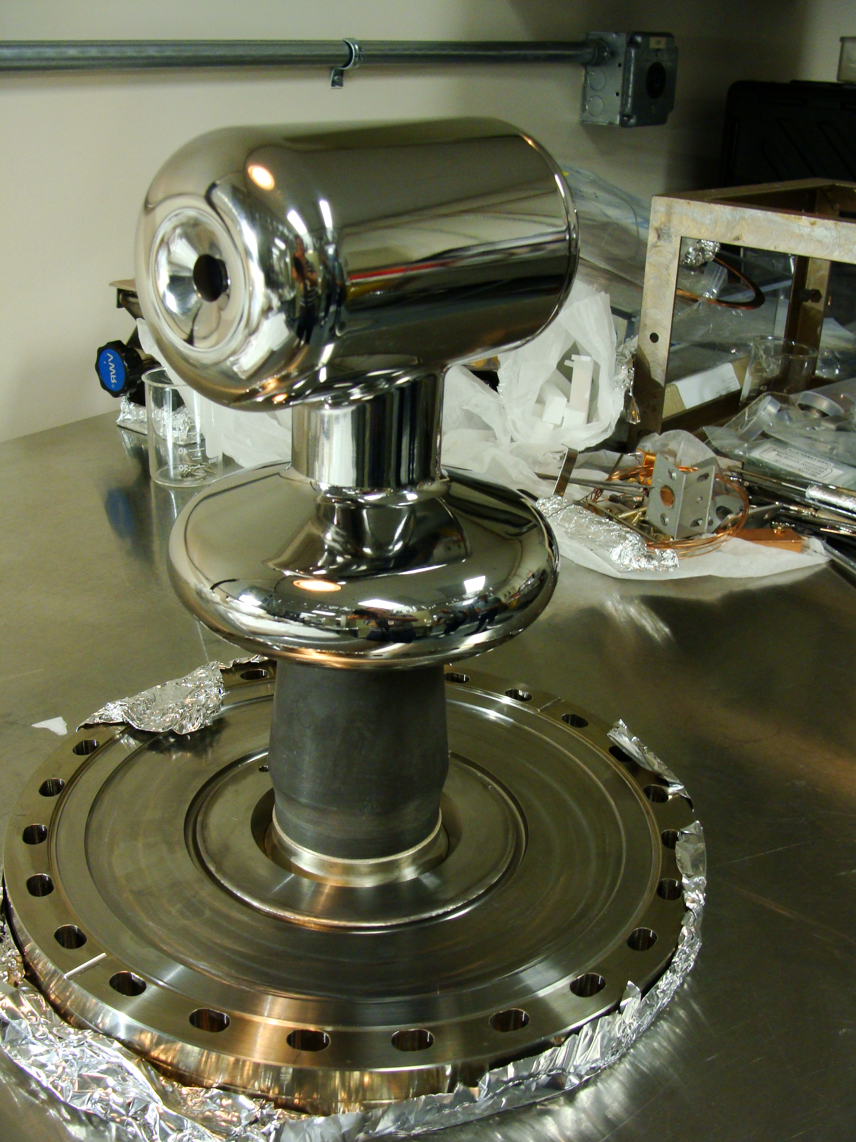
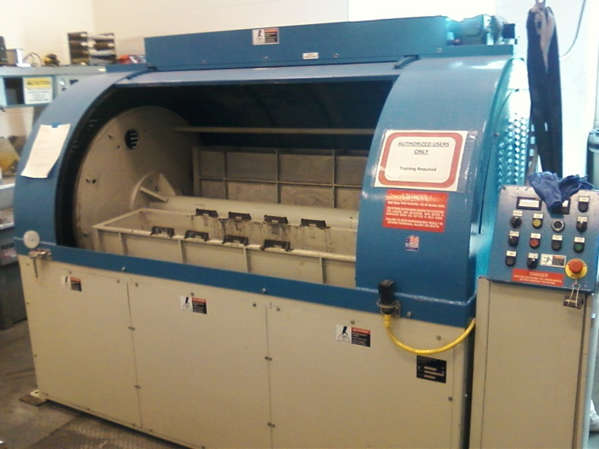
Centrifugal Barrel Polishing to Rescue
Months to hours !!!
30 min. plastic cones
30 min. crushed corncob
  From machine shop
  Barrel polishing machine at JLab SRF

Slide 29
Excellent Surface Finish
similar to traditional hand polishing with sand paper and diamond grit
Diamond paste polishing Ra 30 nm*
* M. BastaniNejad, A. A. Elmustafa, E. Forman, S. Covert, J. Hansknecht, C. Hernandez-Garcia, M. Poelker, L. Das, M. Kelley, P. Williams, “Evaluation of electropolished stainless steel electrodes for use in DC high voltage photoelectron guns,” J. Vac. Sci. Technol. A, Vol. 33, No. 4, Jul/Aug 2015

