Slide 1
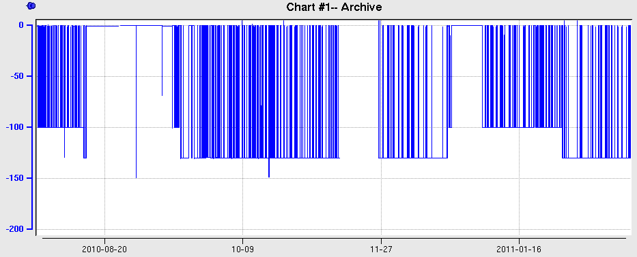
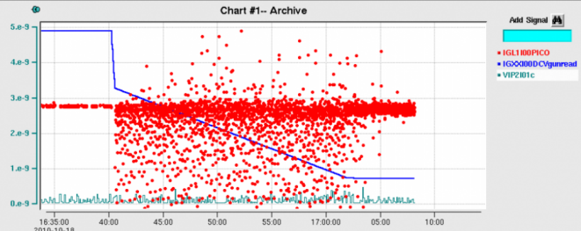
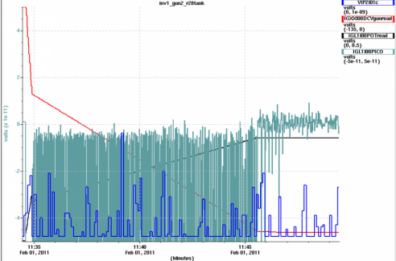
Gun2: hi-potting to 150kV, transition to 130keV operations, Glassman 150kV HVPS failure
9/17 Vwien
9/21 Hwien
Restore at 100kV
Run the program
Need to check performance
Ops setup
@130kV
New oil
tank R28
Recover @100kV
Hi-pot 150kV
Vac burp @150kV
1 hour soak
Glassman 150kV HVPS fails
End of beam 2010
Field emission
Add R28 spring
Hi-Pot 130keV
First ramp 150kV
Vac burp @ 150kV
Data 90-150kV
Noisy anode @140kV
New 150kV HVPS
Restore 130kV and go…
130keV demo
Beam to ILD
10/12 Vac burp
QE loss
X-ray detector

