Slide 1
Fast Feedback – Hall C Test
Quick review of test from December 19, 2023
Ryan Bodenstein
https://tasklists.jlab.org/bslist/tasks/110062

Slide 2
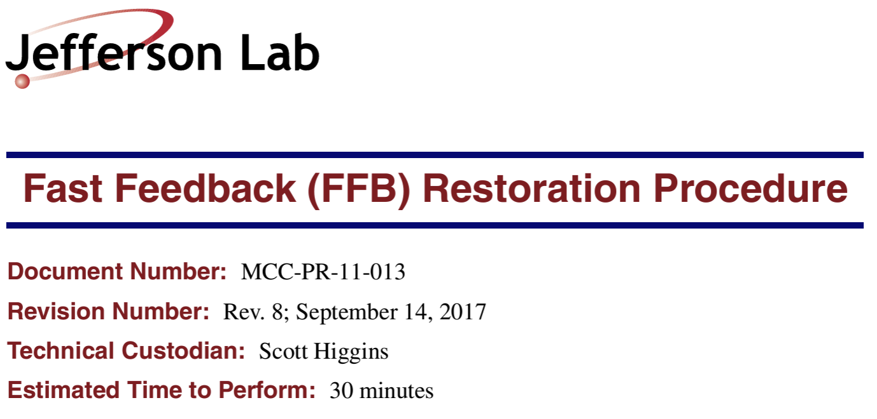
What was the Test?
Essentially, go through the restoration procedures and make sure it works.
https://tasklists.jlab.org/bslist/tasks/110062
Note: we had to run in Hall C instead, as it was the only hall available for the tests.
The procedure is here:
https://jeffersonlab.sharepoint.com/sites/OpsDocs/Docs/fast_feedback_restore_proc.pdf

Slide 3
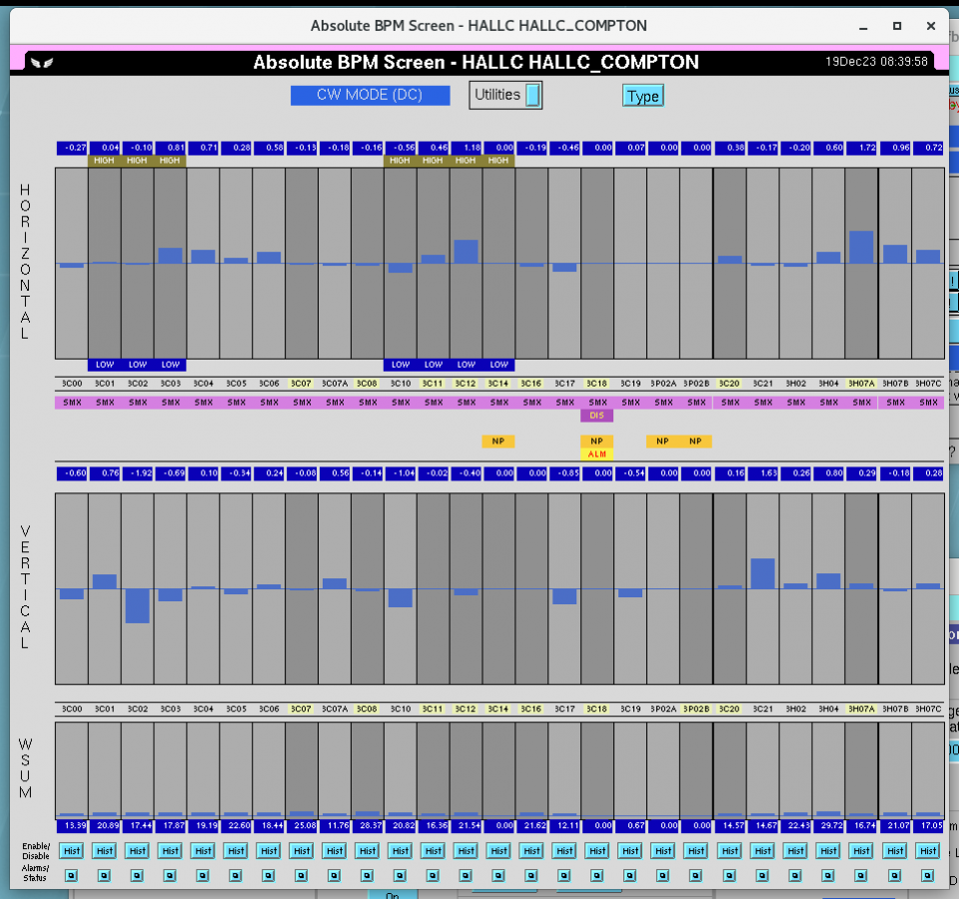
How’d it go?
Swimmingly. There were a few parts of the restoration document that needed updating, but because Dennis Turner was present, we could go through the process pretty quickly.
Beam was set up by OPS as required in the procedure
CW beam to Hall C dump, 5 uA

Slide 4
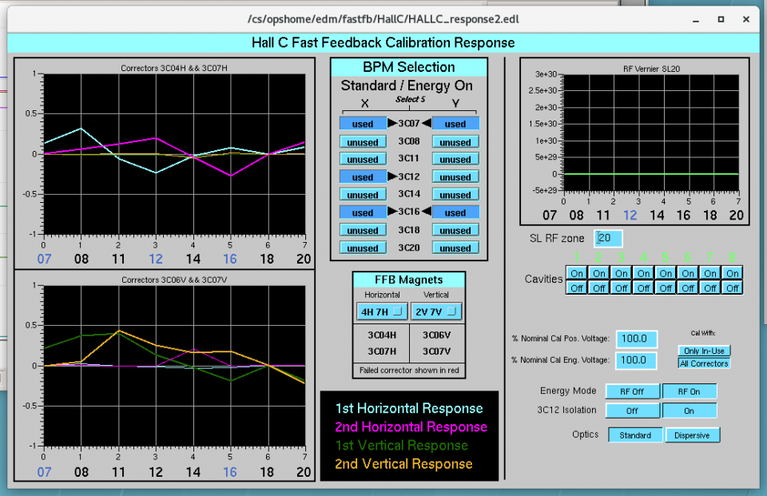
How’d it go?
Swimmingly. There were a few parts of the restoration document that needed updating, but because Dennis Turner was present, we could go through the process pretty quickly.
Beam was set up by OPS as required in the procedure
CW beam to Hall C dump, 5 uA
After selecting BPMs (3C07 and 3C16)

Slide 5
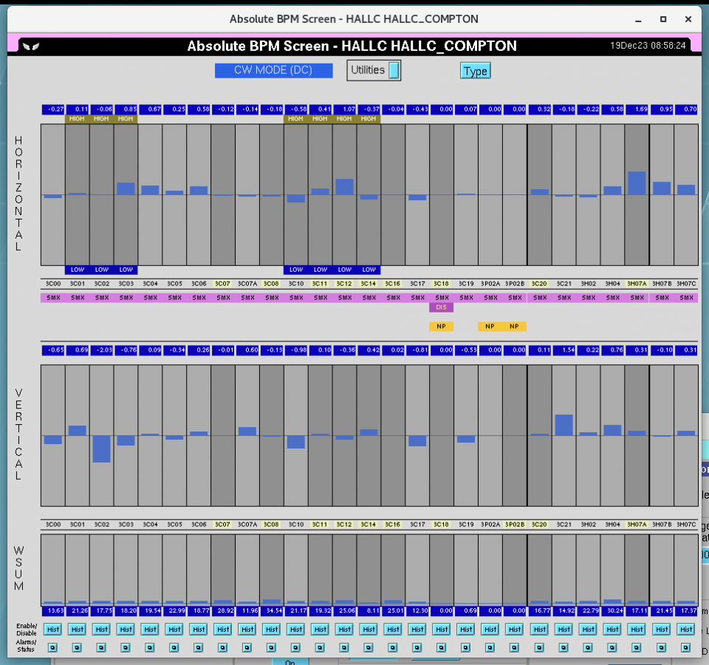
How’d it go?
Swimmingly. There were a few parts of the restoration document that needed updating, but because Dennis Turner was present, we could go through the process pretty quickly.
Beam was set up by OPS as required in the procedure
CW beam to Hall C dump, 5 uA
After selecting BPMs (3C07 and 3C16)

Slide 6
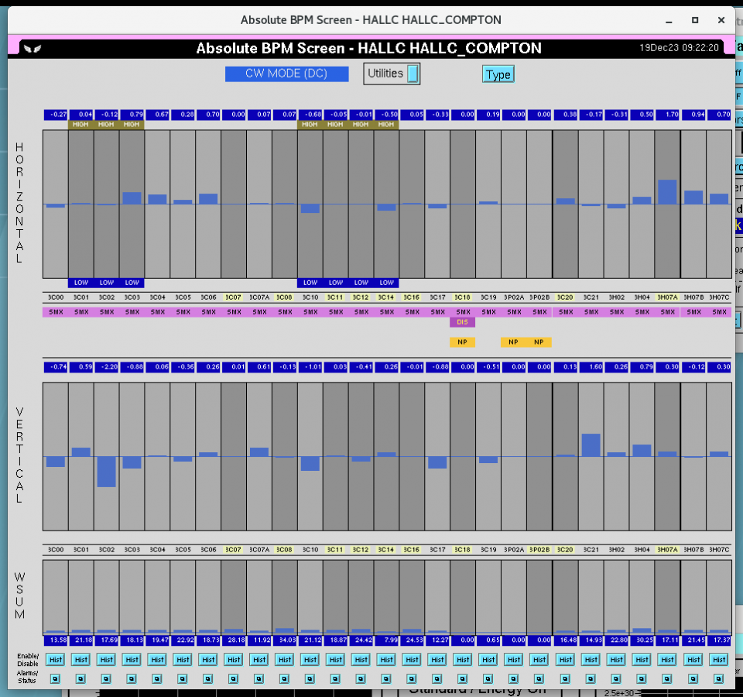
How’d it go?
Swimmingly. There were a few parts of the restoration document that needed updating, but because Dennis Turner was present, we could go through the process pretty quickly.
Beam was set up by OPS as required in the procedure
CW beam to Hall C dump, 5 uA
After selecting BPMs (3C07 and 3C16)
After turning on RF Feedback (3C12)

Slide 7
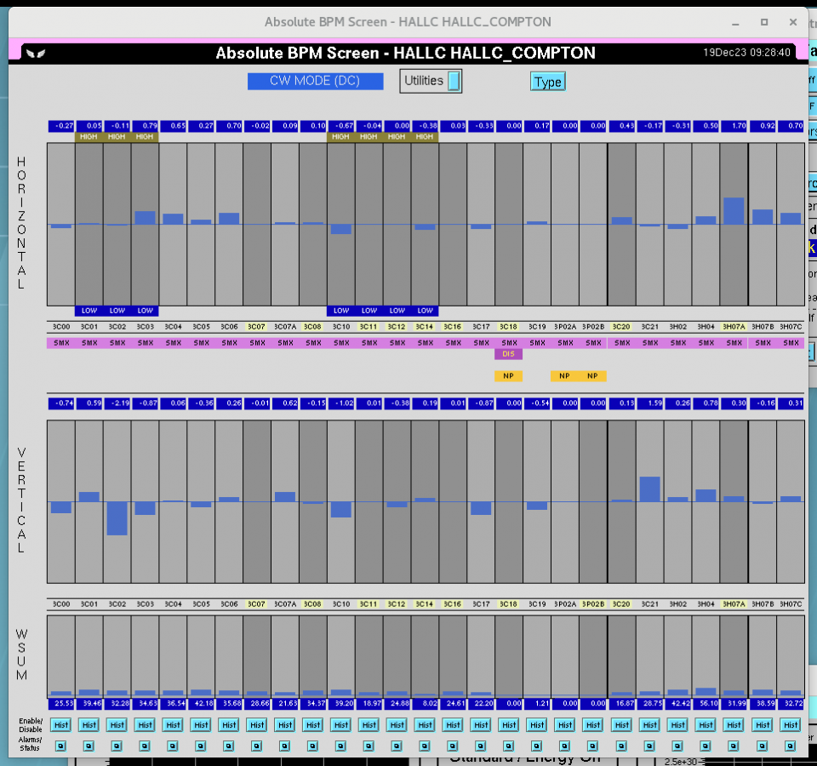
How’d it go?
Swimmingly. There were a few parts of the restoration document that needed updating, but because Dennis Turner was present, we could go through the process pretty quickly.
Beam was set up by OPS as required in the procedure
CW beam to Hall C dump, 5 uA
After selecting BPMs (3C07 and 3C16)
After turning on RF Feedback (3C12)
After ramping to 10 uA

Slide 8
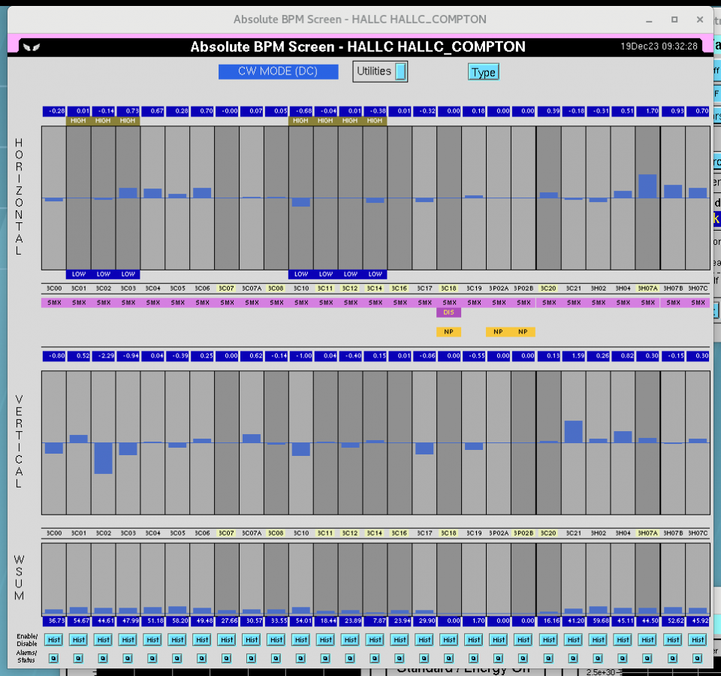
How’d it go?
Swimmingly. There were a few parts of the restoration document that needed updating, but because Dennis Turner was present, we could go through the process pretty quickly.
Beam was set up by OPS as required in the procedure
CW beam to Hall C dump, 5 uA
After selecting BPMs (3C07 and 3C16)
After turning on RF Feedback (3C12)
After ramping to 10 uA
Ramping to 15 uA

Slide 9
How’d it go?
Swimmingly. There were a few parts of the restoration document that needed updating, but because Dennis Turner was present, we could go through the process pretty quickly.
Beam was set up by OPS as required in the procedure
CW beam to Hall C dump, 5 uA
After selecting BPMs (3C07 and 3C16)
After turning on RF Feedback (3C12)
After ramping to 10 uA
Ramping to 15 uA
20 uA

Slide 10
How’d it go?
Swimmingly. There were a few parts of the restoration document that needed updating, but because Dennis Turner was present, we could go through the process pretty quickly.
Beam was set up by OPS as required in the procedure
CW beam to Hall C dump, 5 uA
After selecting BPMs (3C07 and 3C16)
After turning on RF Feedback (3C12)
After ramping to 10 uA
Ramping to 15 uA
20 uA
25 uA

Slide 11
How’d it go?
Swimmingly. There were a few parts of the restoration document that needed updating, but because Dennis Turner was present, we could go through the process pretty quickly.
Beam was set up by OPS as required in the procedure
CW beam to Hall C dump, 5 uA
After selecting BPMs (3C07 and 3C16)
After turning on RF Feedback (3C12)
After ramping to 10 uA
Ramping to 15 uA
20 uA
25 uA
30 uA

Slide 12
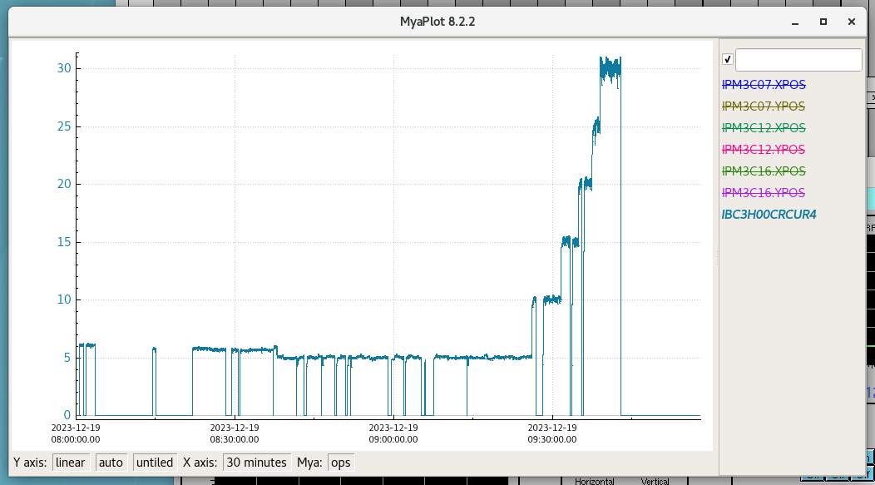
A few more details
Current ramping

Slide 13
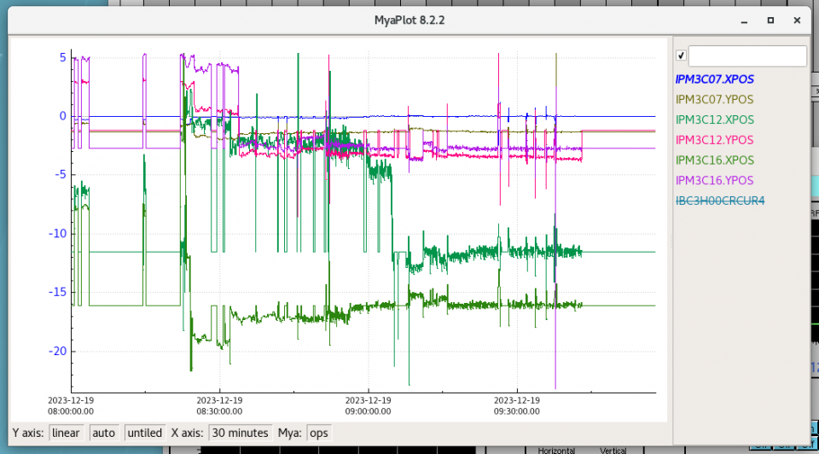
A few more details
BPM Readings

Slide 14
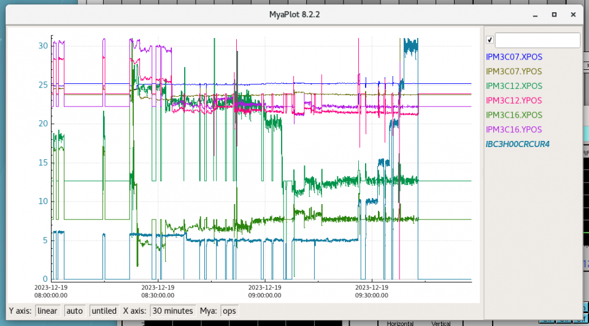
A few more details
Current ramping
BPM Readings

Slide 15
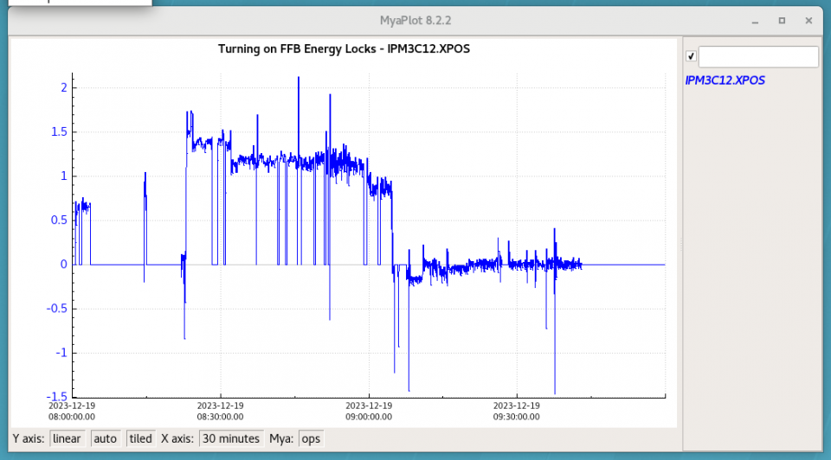
A few more details
Energy Locks

Slide 16
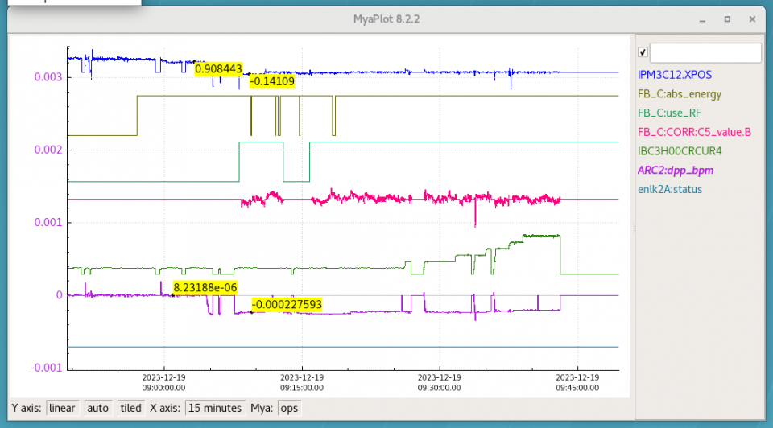
A few more details
Energy Locks
Upon turning on, see small difference with 2A dp/p

Slide 17
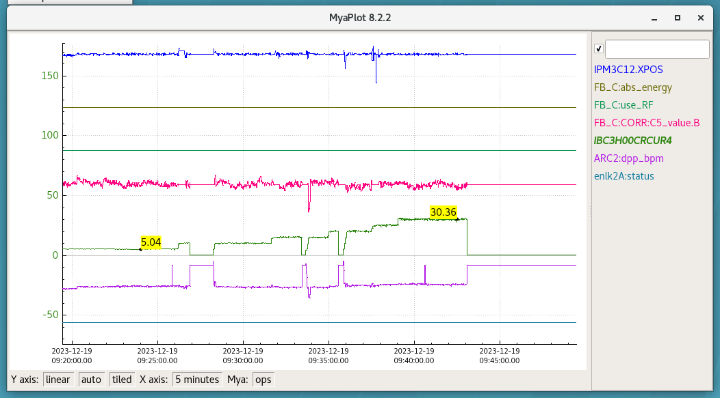
A few more details
Energy Locks
Upon turning on, see small difference with 2A dp/p
As ramping current, energy feedback persists

Slide 18
What’s next?
Need to perform the FFTs and other analysis available through the FFB system.
This test only focused on the startup procedure to make sure things worked.
Should run FFB during regular operations.
This will give insights into long-operation performance of the hardware
Will allow for analysis of system (FFTs, etc…)
Should allow for more stable beam to halls
Should run with Hall A, and take relevant data to be sure background levels are appropriate.

