Slide 1
QWT for unpolarized mode in GPT
Sami habet
November 16th

Slide 2
Goals
The QWT optimization:
Decrease the angular trasnverse momentum spread.
Collect positrons at a given momentum.
Compare the accuracy of my previous results in ELEGANT
Estimate the beam dynamics quantities at the exit of the QWT.

Slide 3
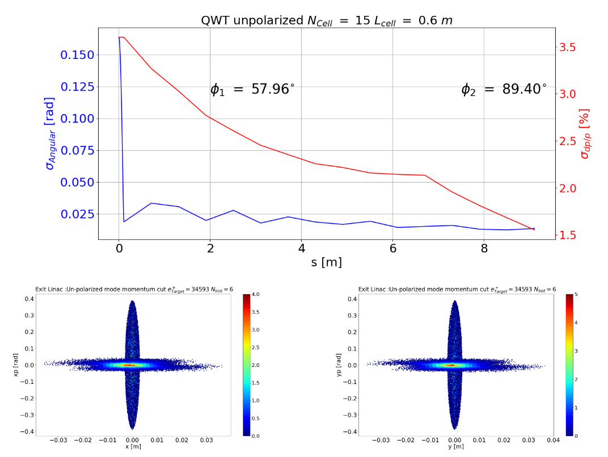
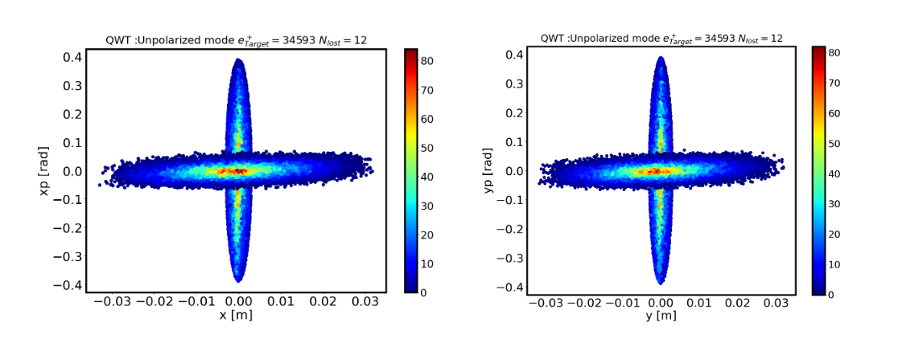
Ppreviously : unpolarized mode
B₁ = 1.9 T
B₂ = 0.2 T
L1 = 0.11 m
L2 = 9.1 m
F = 500 MHz, E = 4 Mv/m
Central momentum 18 – 22 MeV/c

Slide 4
GPT :
The same parameters than in ELEGANT
The magnetic field used in the optimization is a hard edge model
Cannot use the field map in elegant with cavities
The Traveling wave element in elegant use the hard edge model
What’s the equivalent magnetic field in GPT?

Slide 5
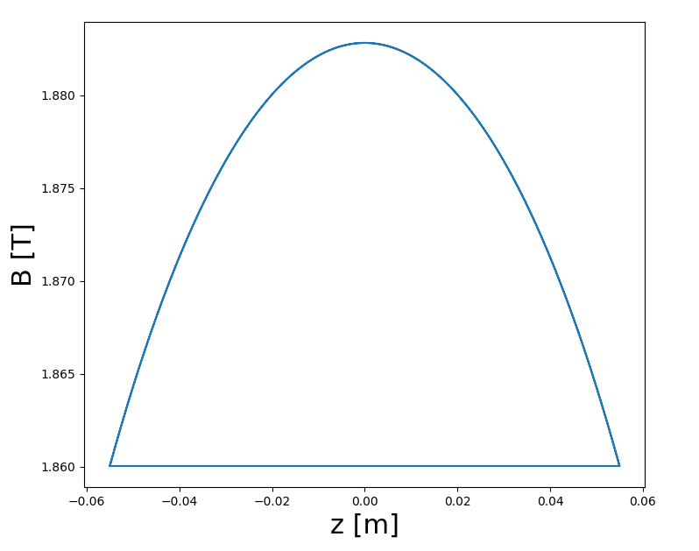
GPT : Magnetic profile
The magnetic profile along the first solenoid is described by :
$B_{z}=\frac{1}{2}μ_{0}nI\left[\frac{z+\frac{1}{2}L}{{\left\{{\left\{(z+\frac{1}{2}L)\right\}}^{2}+R^{2}\right\}}^{\frac{1}{2}}}−\frac{z−\frac{1}{2}L}{{\left\{{\left\{(z−\frac{1}{2}L)\right\}}^{2}+R^{2}\right\}}^{\frac{1}{2}}}\right]$
R is the solenoid radius
L is the solenoid length
nI : Ampere turns per meter [A]
Using the previous solenoid parameters

Slide 6
GPT : Magnetic profile
Results from GPT are not consistent with ELEGANT’s results
How to fix this issue:
The magnetic field over a solenoid is defined by this integral:
$\int_{0}^{L_{1}}{B^{2}dl}$
Generate a field profile with the same integral.
Beam pipe radius : r = 4 cm

Slide 7
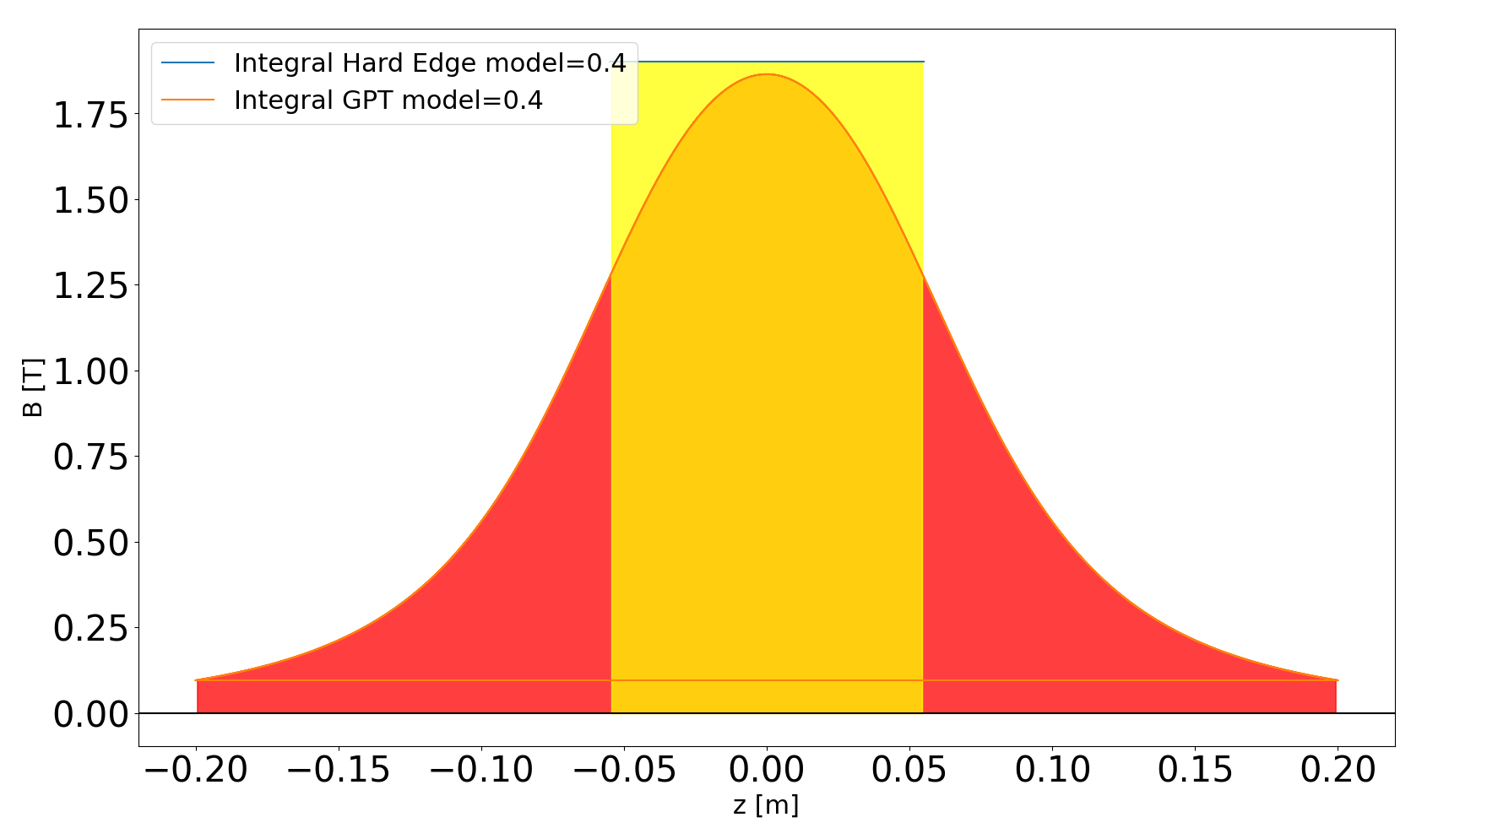
GPT : Magnetic profile
Yellow surface :
$\int_{0}^{L_{1}}{B^{2}dl}$ = 0.4 T².m
Red profile generated using the analytical formula.
Red surface : GPT field profile
$\int_{0}^{L_{1}}{B^{2}dl}$ = 0.4 T².m
Particle are expected to experience the same integral surface.

Slide 8
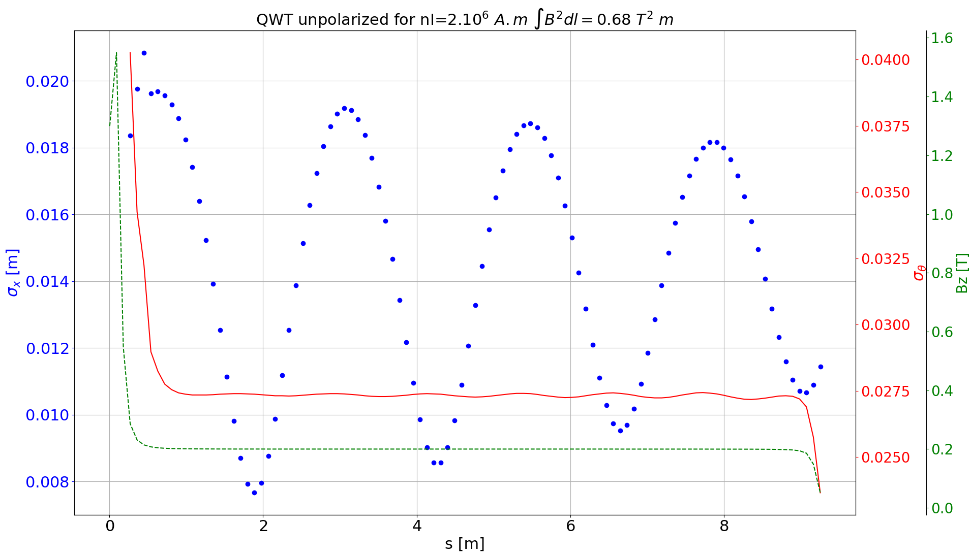
GPT : Beam size and angular aperture

Slide 9
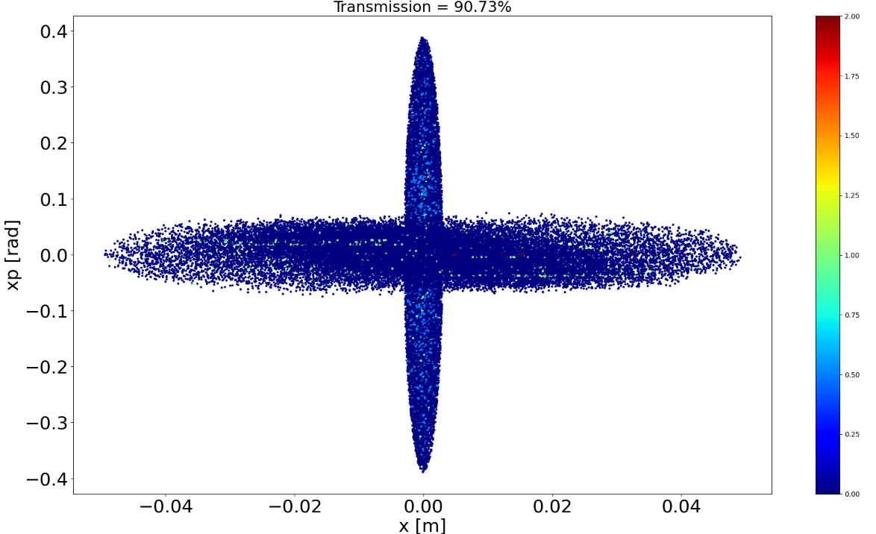
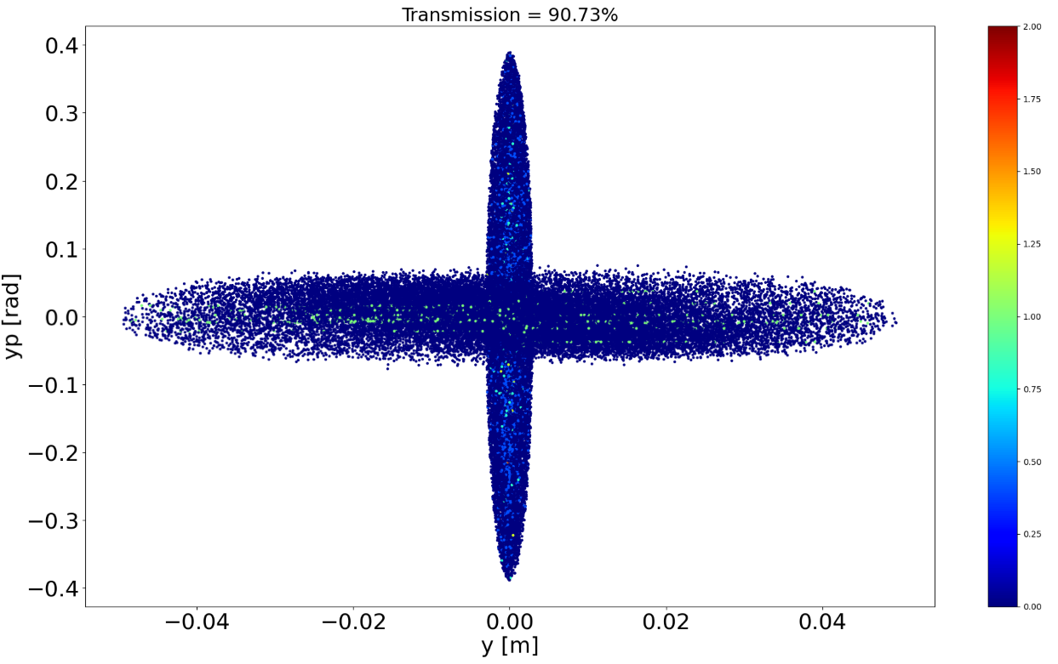
GPT : Transverse rotation

Slide 10
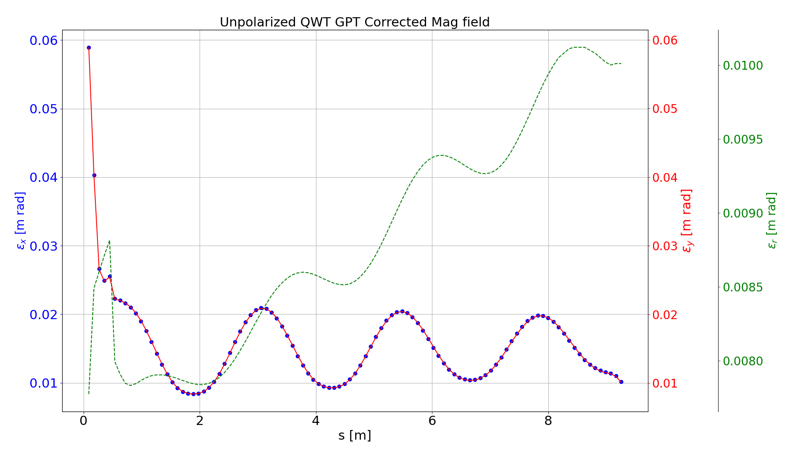
GPT : Normalized Transverse emittance

Slide 11
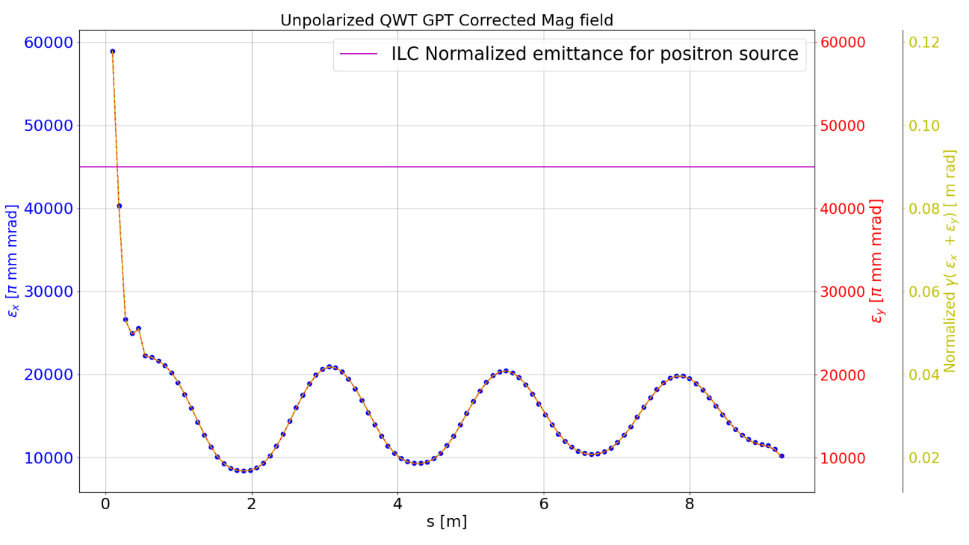
GPT : Normalized transverse emittance Vs ILC
ILC Normalized emittance
$γ\left(ε_{Nx}+ε_{NY}\right)<0.07 m rad$
At the exit of the long solenoid I get :
$γ\left(ε_{Nx}+ε_{NY}\right)<0.02 m rad$
Transmission > 90 %

Slide 12
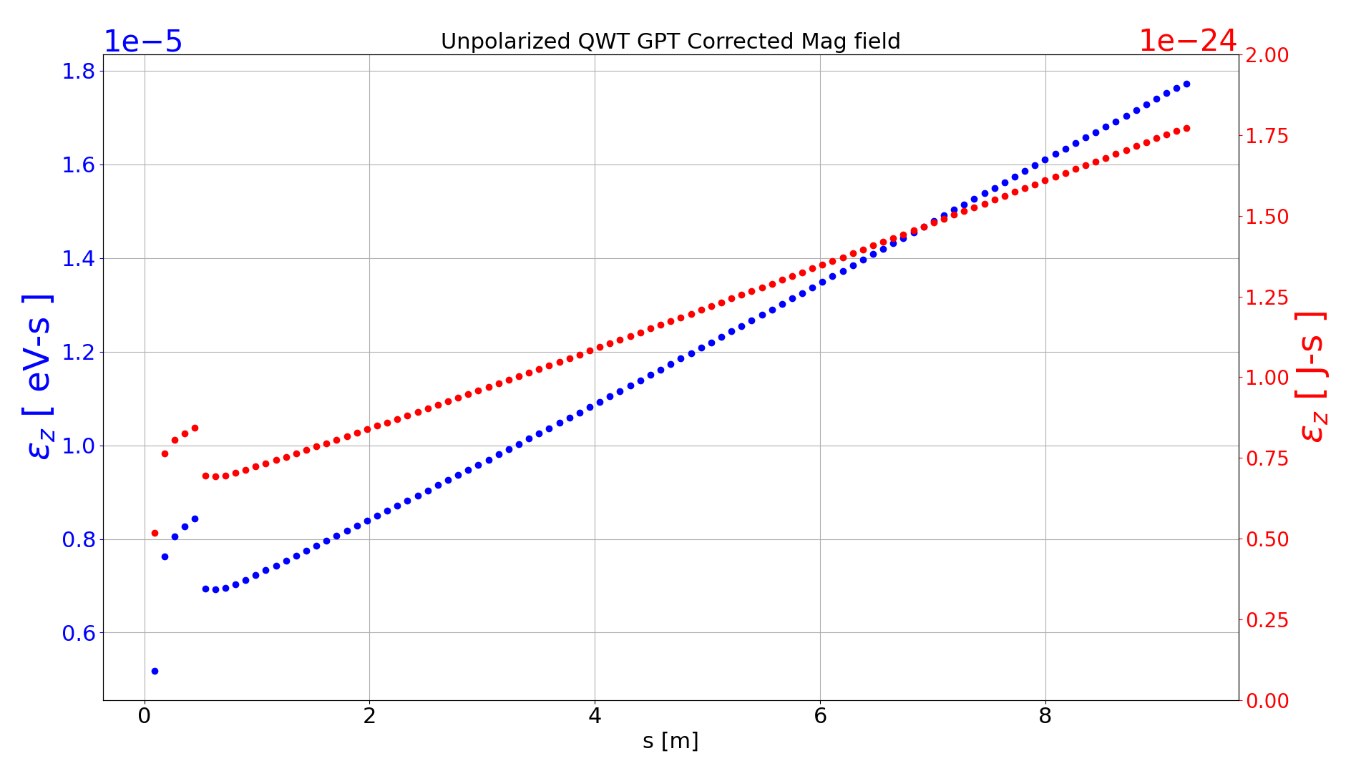
GPT : Longitudinal emittance
Longitudinal emittance
$ε_{z_{RMS}}= \frac{mc²}{qe}\sqrt{{<tc}^{2}><{γc}^{2}> − <tcγc>²}$
Where:
$tc=\left(t−tmean\right)$
$γc=(γ−γmean)$

Slide 13
Conclusion
The length of the first solenoid is longer than expected
GPT’s results are consistant with my previous QWT optimization done in ELEGANT
The transmission over 10 meters is about 90% in GPT
Next steps:
Send the whole distribution in GPT (in progress…).
Compare the acceleration with ELEGANT results.
Estimate the the total number of positrons reaching the exit of the accelerating section.

