Slide 1
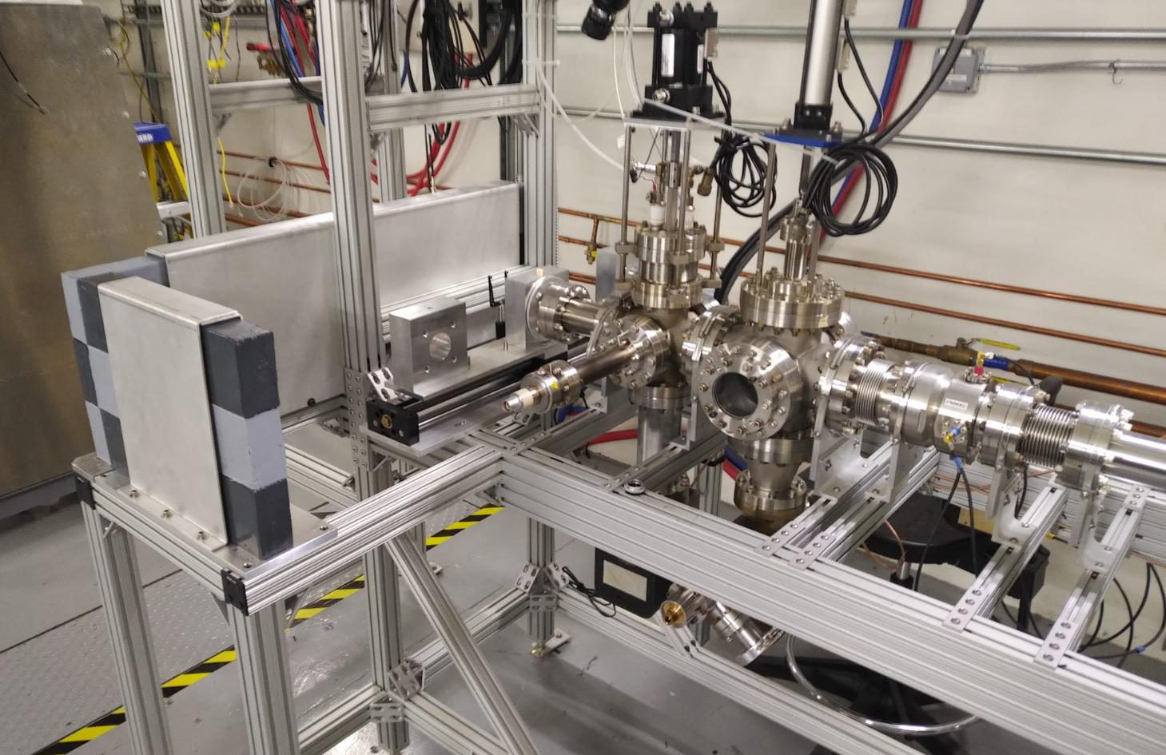
Environmental Applications and first Results from UITF
J. Vennekate

Slide 2

Outline
Motivation for Environmental Applications of Accelerators
Role of SRF in the Field
Nb₃Sn & Cryocoolers
Ongoing R&D Projects at JLab
Irradiation Beamline at UITF
  $↪$ 1st Results

Slide 3

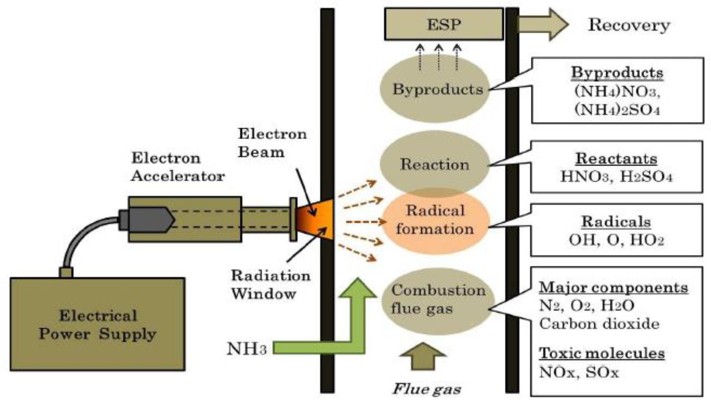
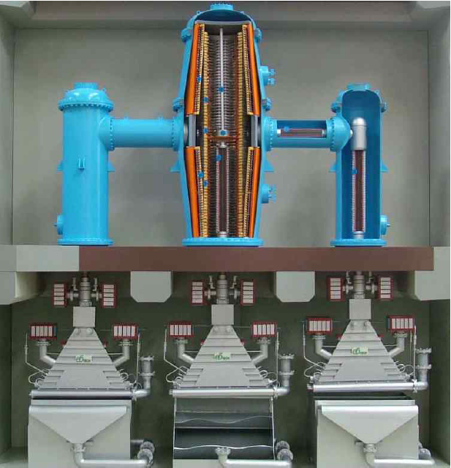
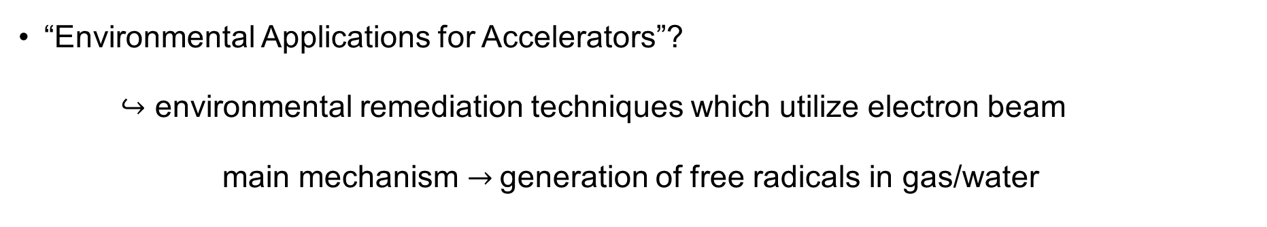
Motivation
“Environmental Applications for Accelerators”?
$↪$ environmental remediation techniques which utilize electron beam
main mechanism $→$generation of free radicals in gas/water
flue gas treatment
wastewater treatment
reducing
oxidizing

Slide 4
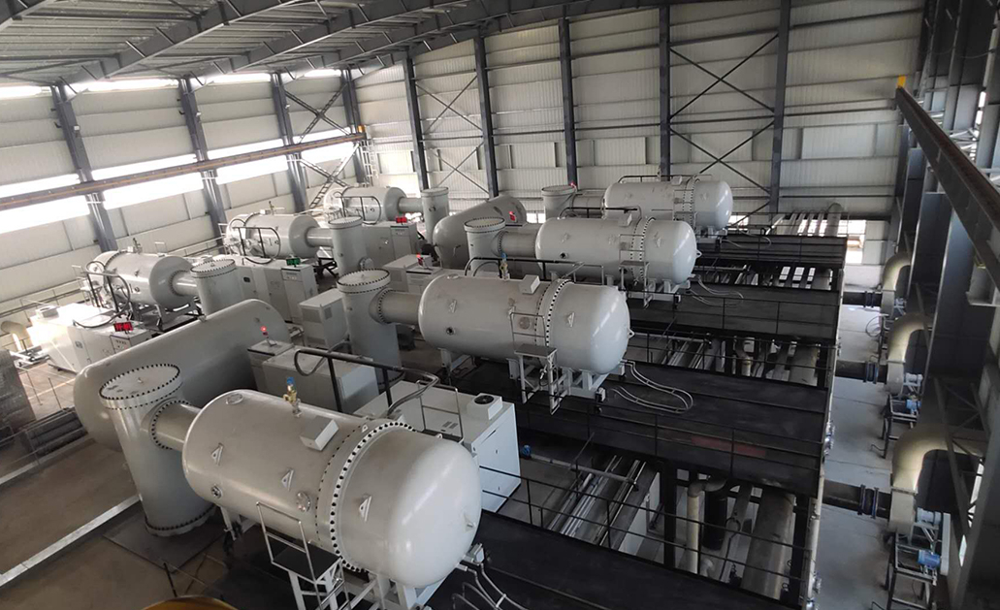
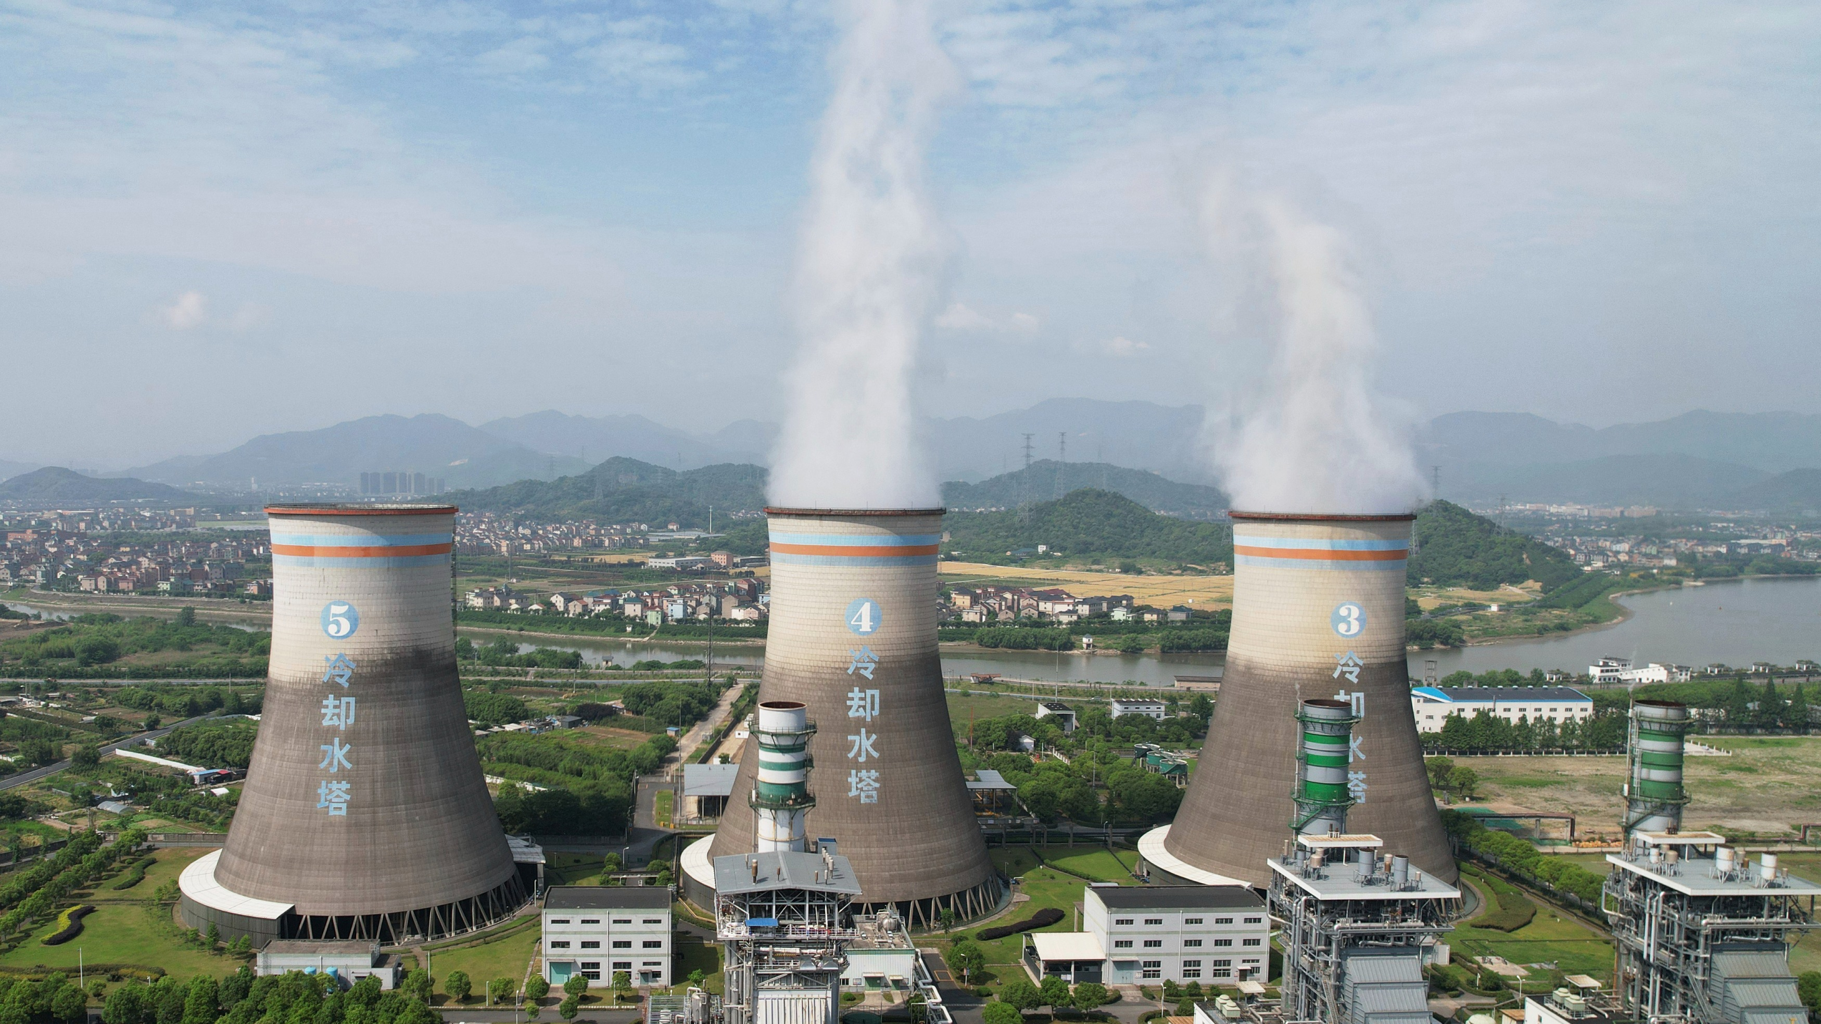
Example facilities for Wastewater Treatment
Hangzhou & Chengdu
coal power plants in China
  300,000 Nm³/h
  two 800 keV,
  320 kW accelerators
  started 1997
Deagu dyeing treatment plant in South Korea
  10,000 m³/h
  1 MeV, 400 kW accelerator
  started 2006
Guanhua Knitting Factory
industrial wastewater in
China
  30,000 m³/h
  total of 7 accelerators
  started 2020

Slide 5
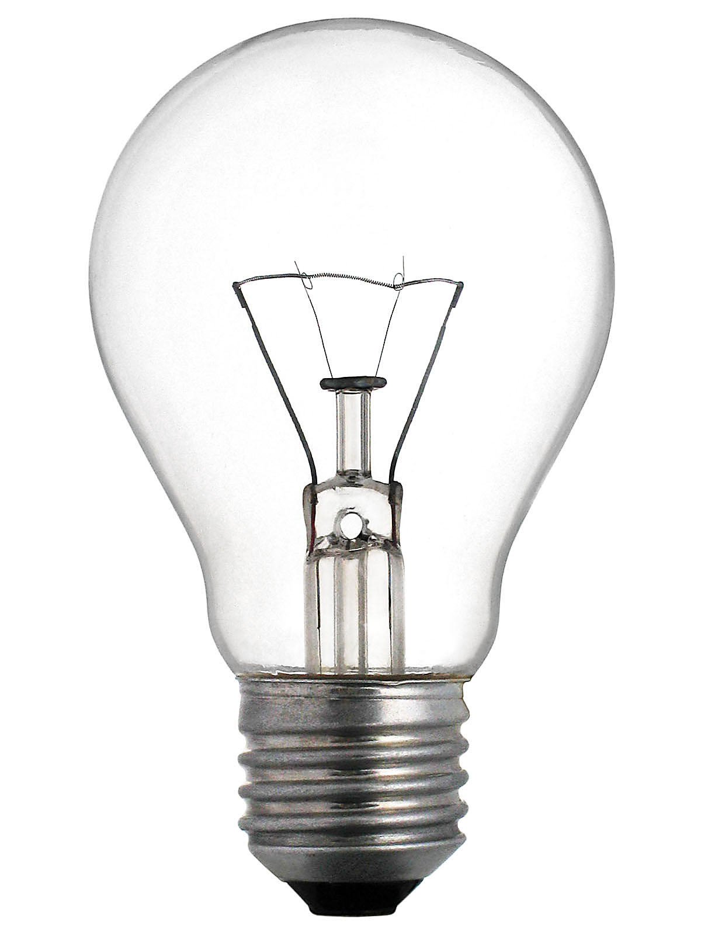
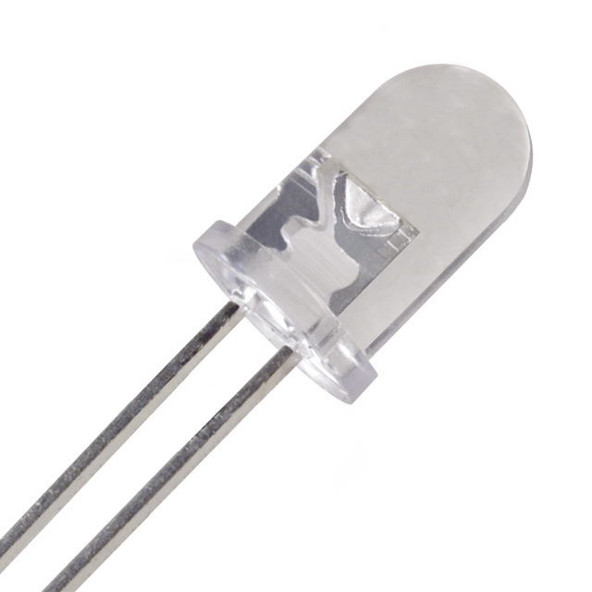

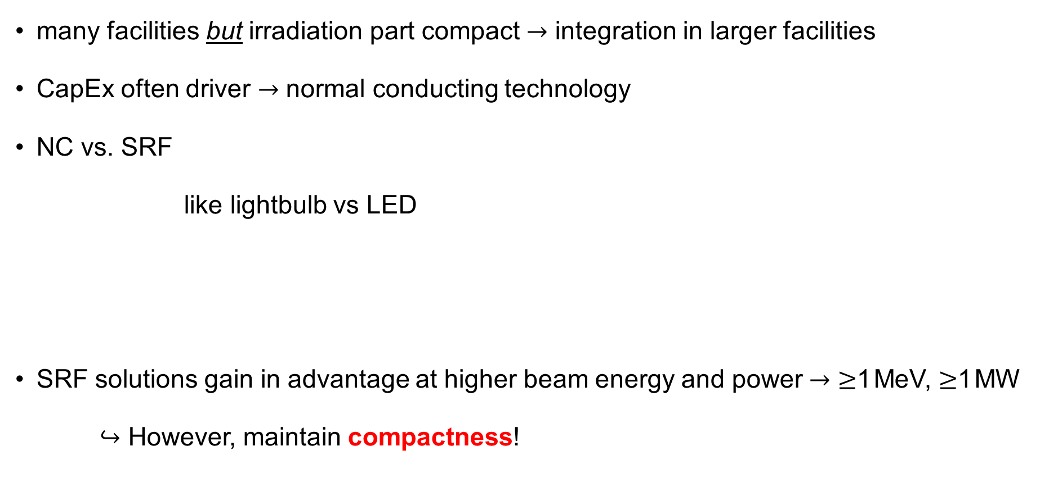
Accelerator R&D – Role of SRF
many facilities but irradiation part compact $→$ integration in larger facilities
CapEx often driver $→$ normal conducting technology
NC vs. SRF
like lightbulb vs LED
SRF solutions gain in advantage at higher beam energy and power $→$ $≥$1 MeV, $≥$1 MW
$↪$ However, maintain compactness!
$$↔$$
Cryoplant?
less efficient
but cheap & simple
very efficient
but more complex

Slide 6
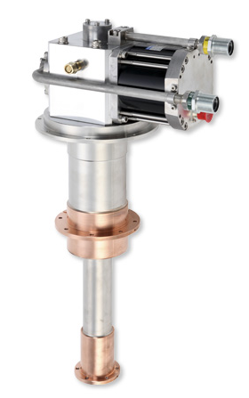
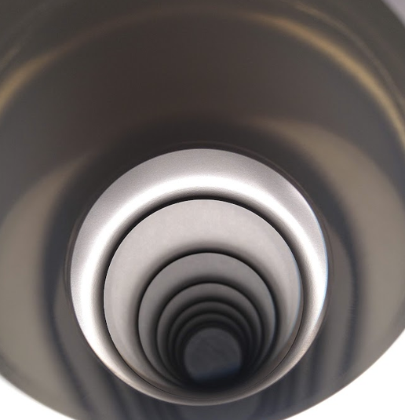
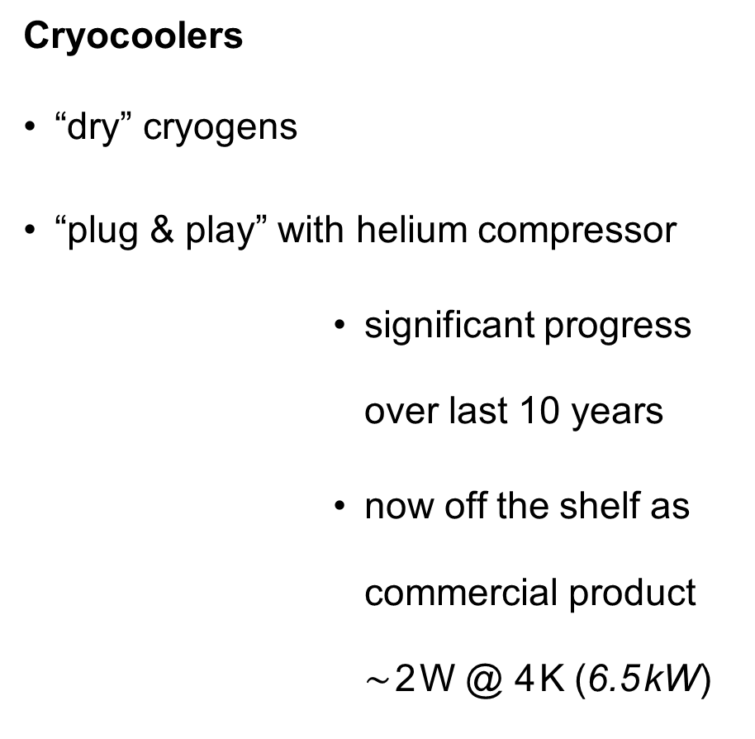
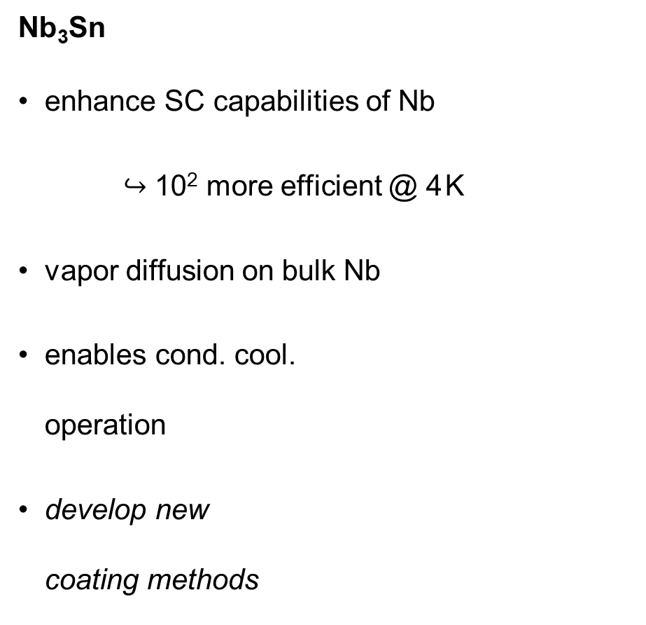

Recent developments – Key Technology
Nb₃Sn
enhance SC capabilities of Nb
$↪$ 10² more efficient @ 4 K
vapor diffusion on bulk Nb
enables cond. cool.
operation
develop new
coating methods
Cryocoolers
“dry” cryogens
“plug & play” with helium compressor
          significant progress over last 10 years
          now off the shelf as commercial product $\sim$ 2 W @ 4 K (6.5 kW)
$$∞$$

Slide 7
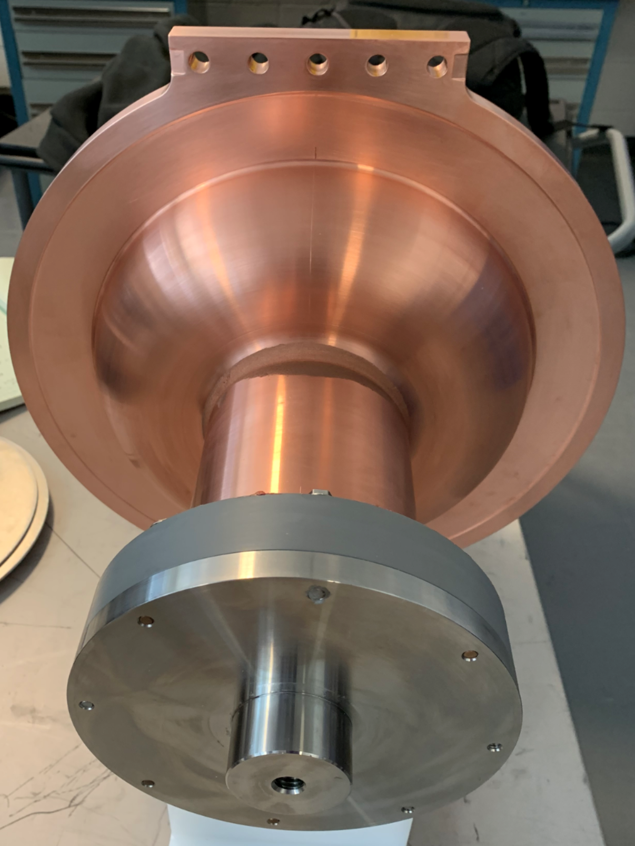
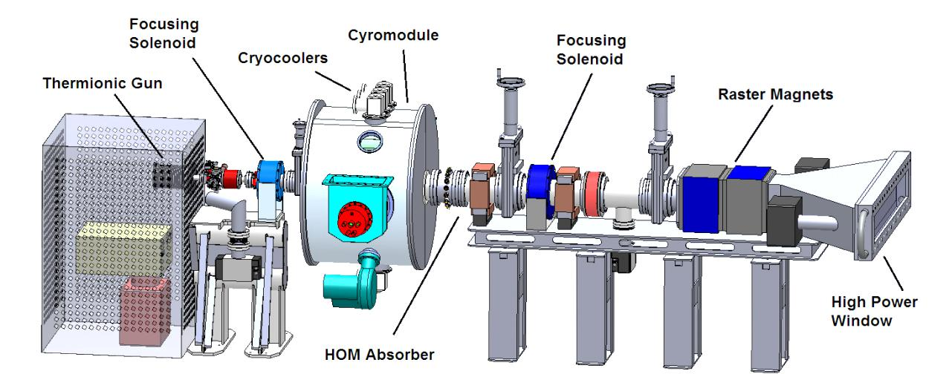
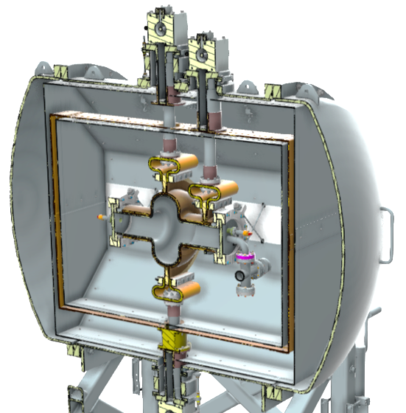
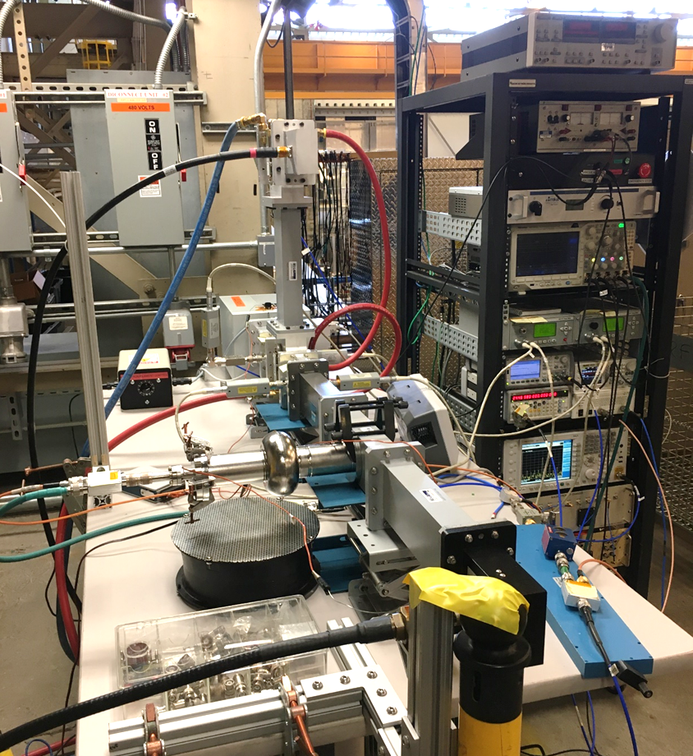
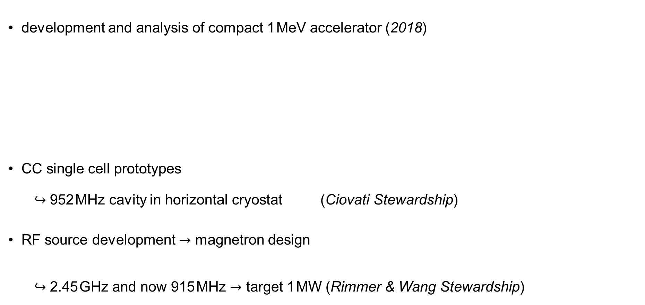
Technology Projects at the Lab I
development and analysis of compact 1 MeV accelerator (2018)
CC single cell prototypes
$↪$ 952 MHz cavity in horizontal cryostat (Ciovati Stewardship)
RF source development $→$ magnetron design
$↪$ 2.45 GHz and now 915 MHz $→$ target 1 MW (Rimmer & Wang Stewardship)

Slide 8
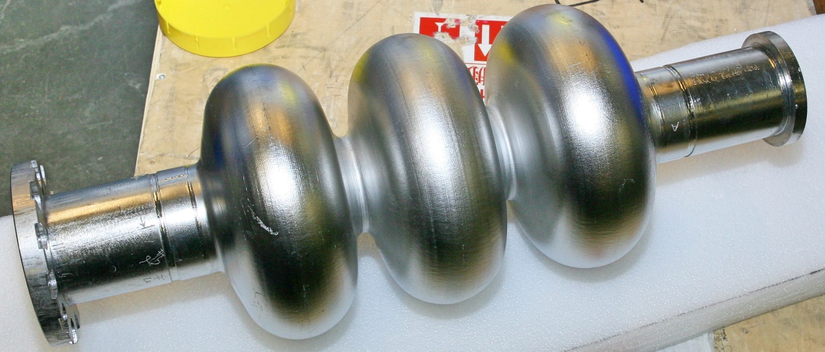
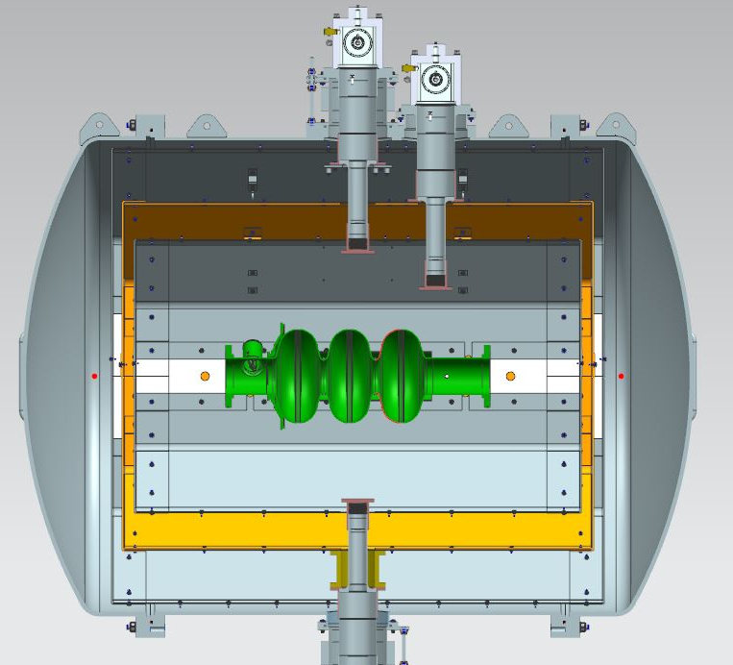
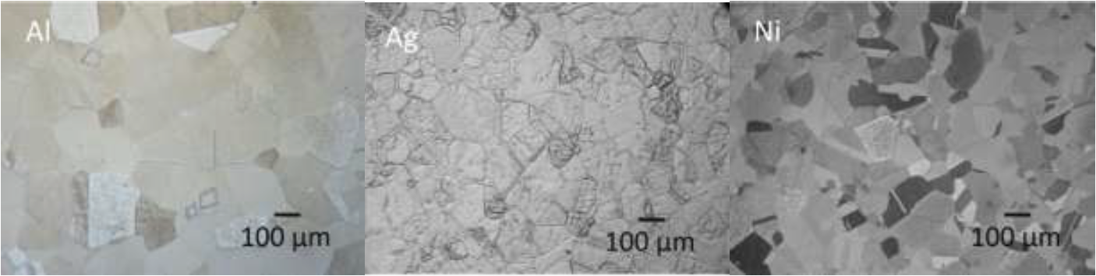
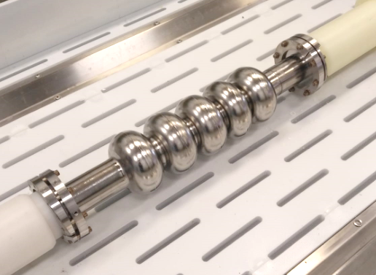
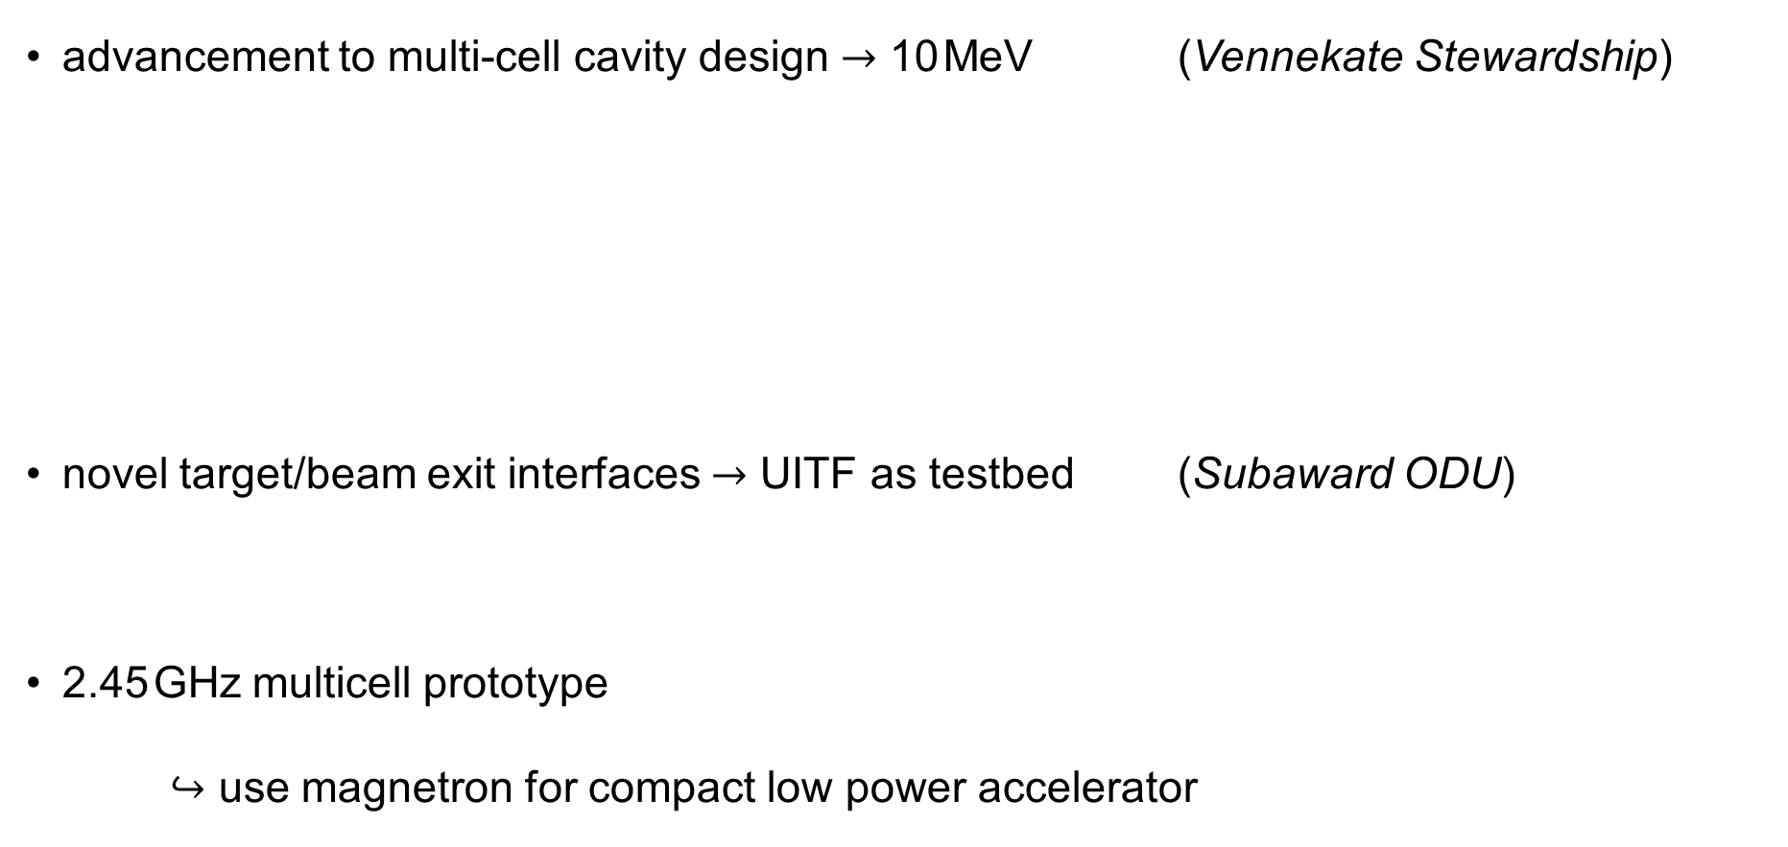
Technology Projects at the Lab II
advancement to multi-cell cavity design $→$ 10 MeV (Vennekate Stewardship)
novel target/beam exit interfaces $→$ UITF as testbed (Subaward ODU)
2.45 GHz multicell prototype
$↪$ use magnetron for compact low power accelerator

Slide 9

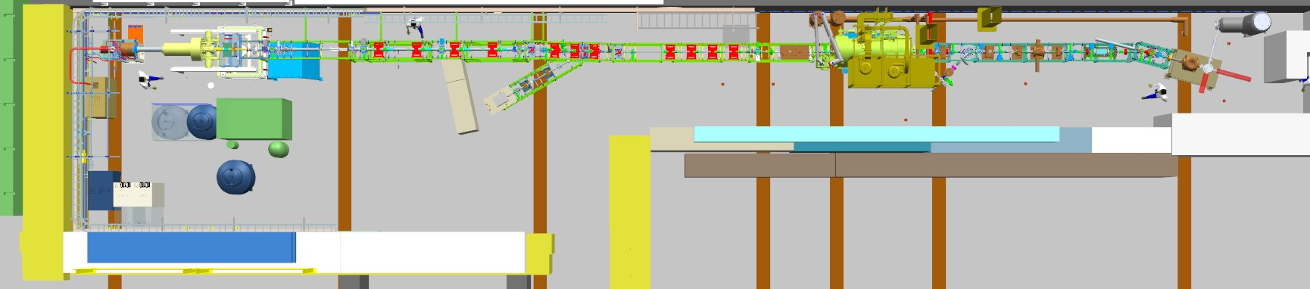
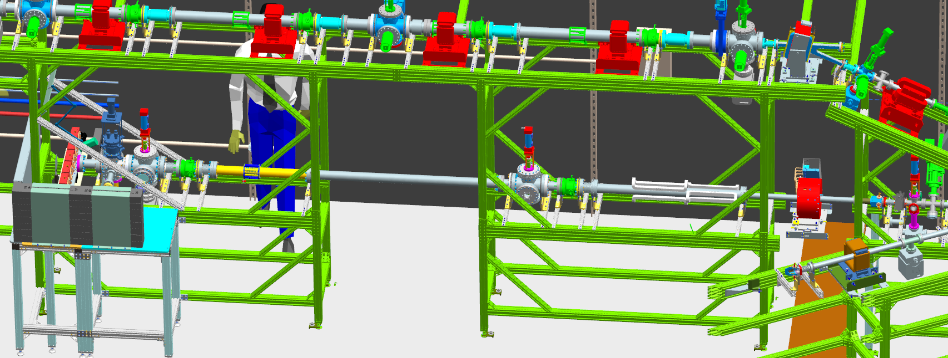
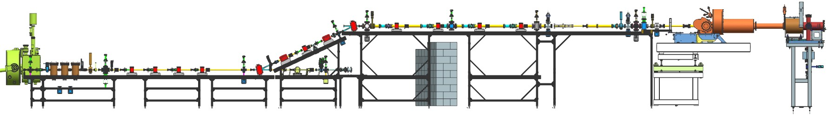

Irradiation at the UITF I
LDRD project & collaboration with
testbed for irradiation studies – up to 10 MeV, 100 nA (max. 150 nA)
$→$ We want/need more!
dose accumulates $→$ control irradiation time $→$ 0.5 - 20 kGy $\hat{≈}$ 1 - 40 min
built a new beamline

Slide 10
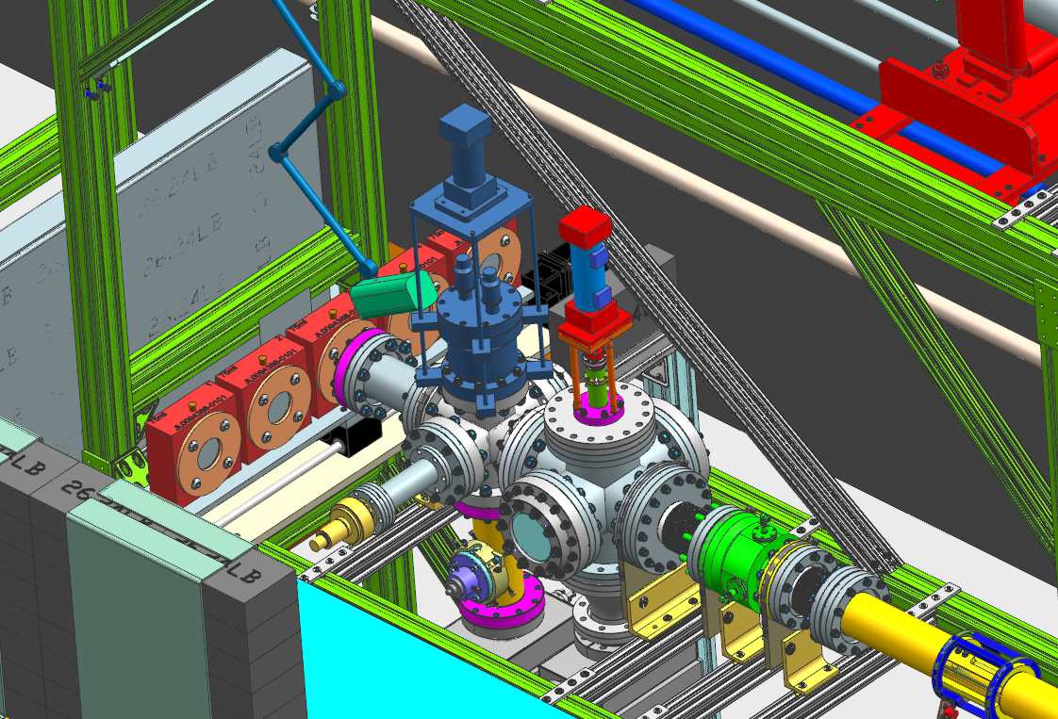
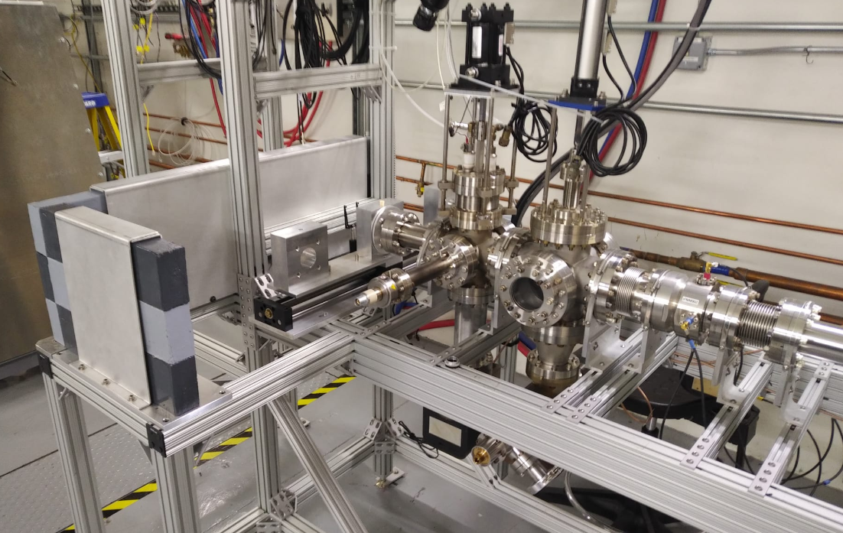
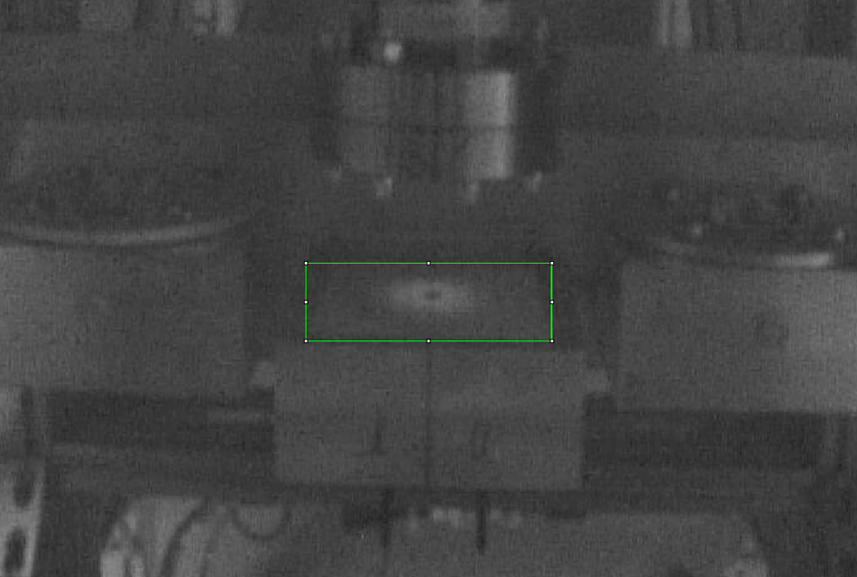
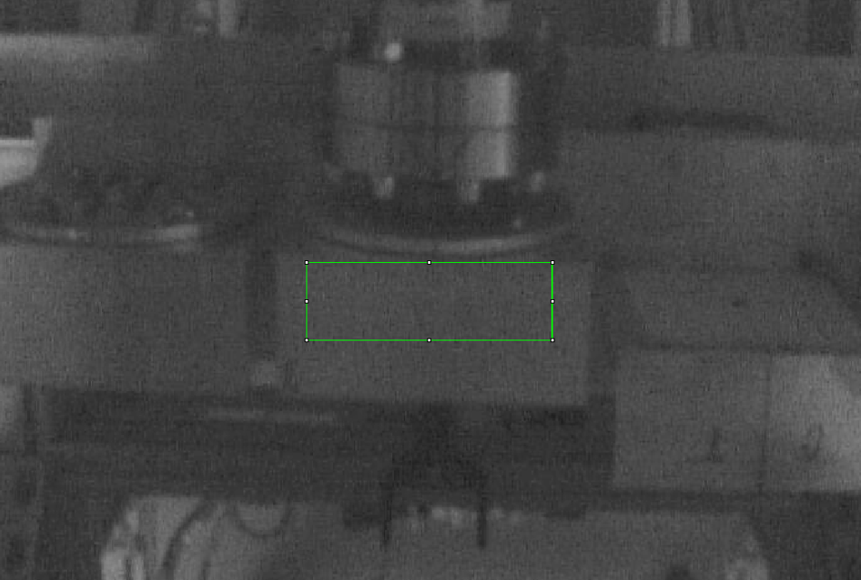

Irradiation at the UITF II
target rail
target container with ~ 60 mL water
$↪$ opti-chromic rods to verify dose

Slide 11
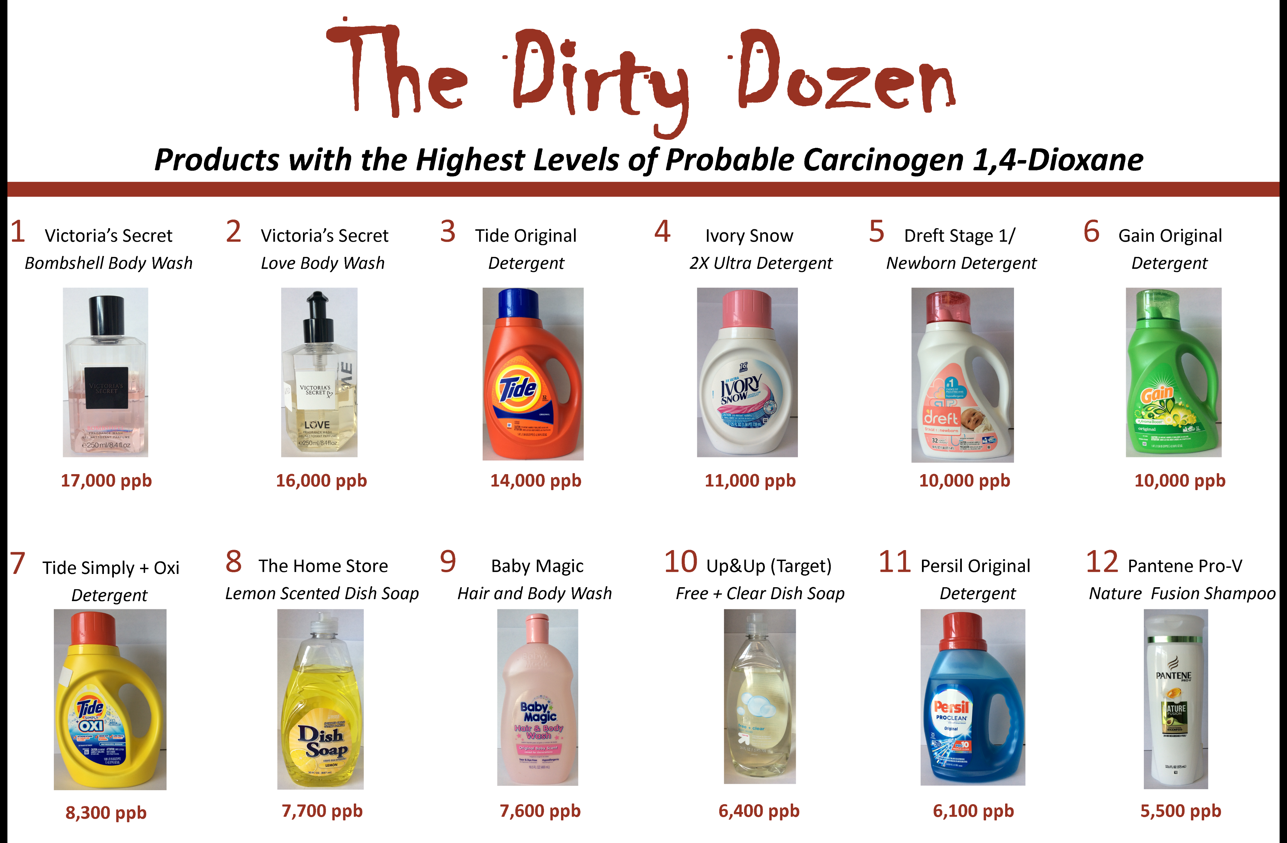
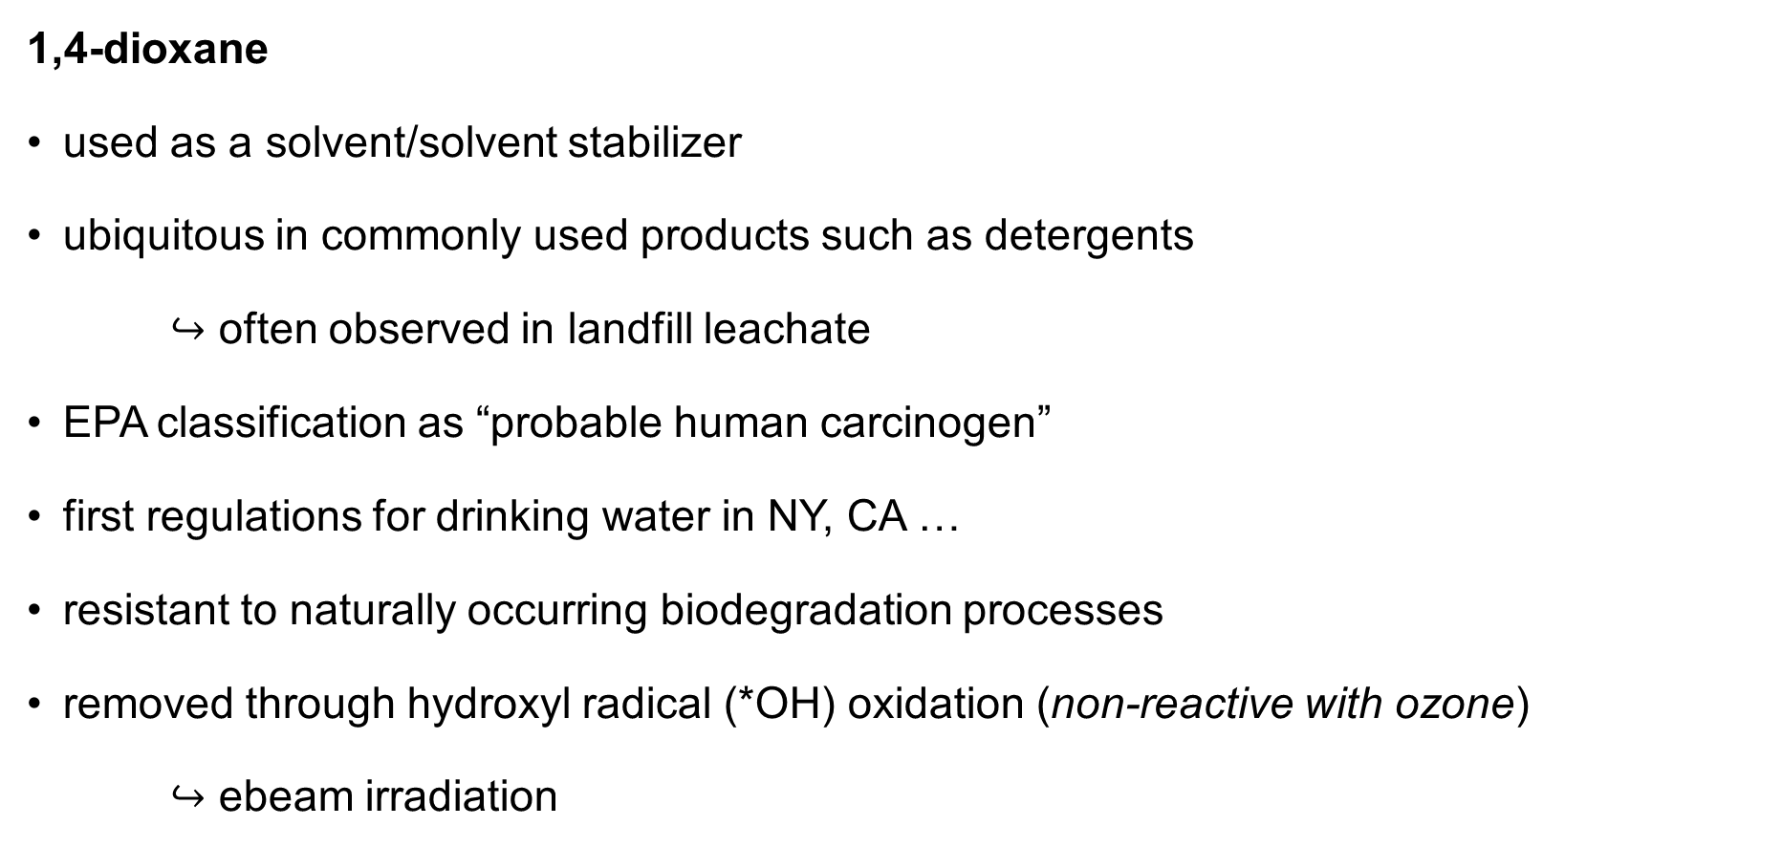
What is we are “shooting” at?
1,4-dioxane
used as a solvent/solvent stabilizer
ubiquitous in commonly used products such as detergents
$↪$ often observed in landfill leachate
EPA classification as “probable human carcinogen”
first regulations for drinking water in NY, CA …
resistant to naturally occurring biodegradation processes
removed through hydroxyl radical (*OH) oxidation (non-reactive with ozone)
$↪$ ebeam irradiation
reducing
oxidizing

Slide 12
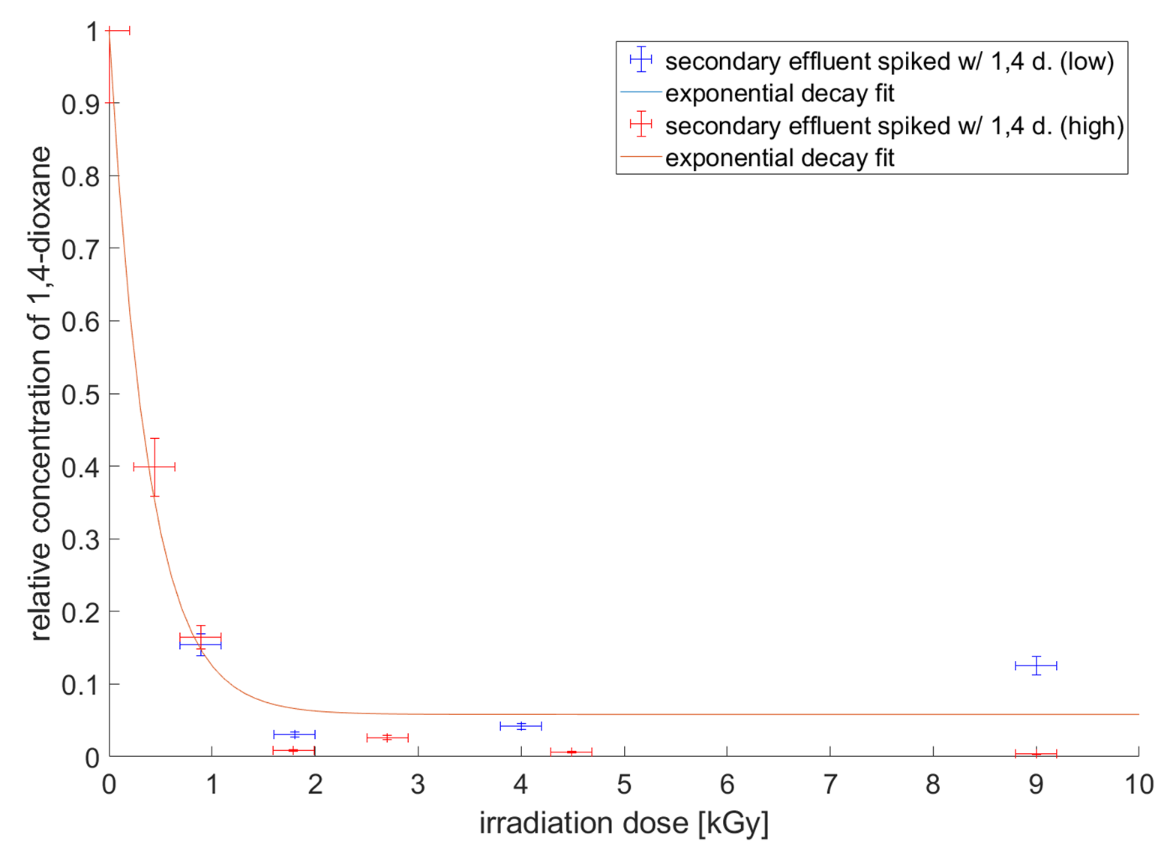

Preliminary Results
different water samples
  DI water (spiked)
  secondary effluent (spiked)
  unspiked water
  GAC, …
first results show significant reduction
at ~1 - 2 kGy ($≥$96 %)
we also irradiated PFAS …
$↪$ Stay tuned!
preliminary

Slide 13
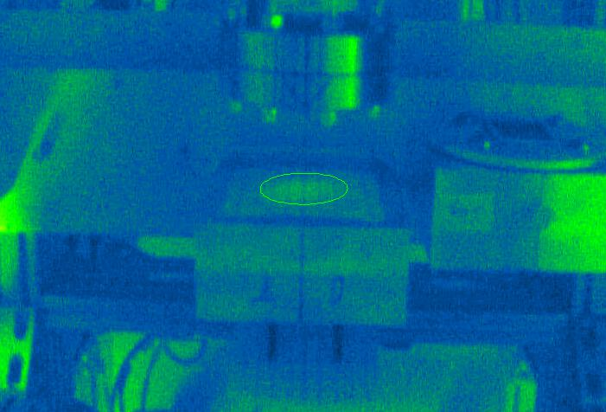
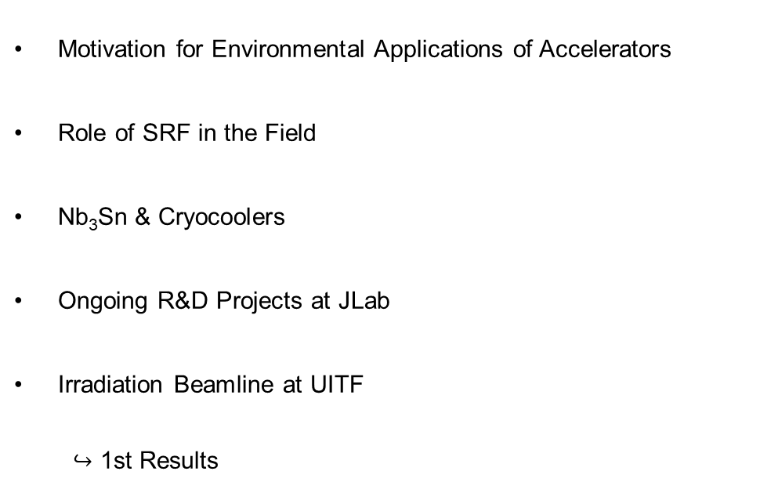
Questions?
J. Vennekate
hannesv@jlab.org
Motivation for Environmental Applications of Accelerators
Role of SRF in the Field
Nb₃Sn & Cryocoolers
Ongoing R&D Projects at JLab
Irradiation Beamline at UITF
  $↪$ 1st Results
Many thanks to GA, HRSD, ODU, the UITF team
and the SRF R&D department!

