Slide 1
PARITY BEAM STUDIES
6/09/2016
Caryn Palatchi

Slide 2
Beam charge asymmetry
 | GeV | uA | ppm | ppm | ppm
Run | energy | current | dbcm 1MHz Aq | dbcm RMS ps=0 | dbcm RMS | notes
2333 | 4.4 | 12 | 62.64 | 493.9 | 576.4 | IHWP out
2358 | 8.8 | 13.7 | 44.7 | 309.1 | 428.6 | IHWP out
2488 | 8.8 | 60 | 30.79 | 121.9 | 326.8 | IHWP in
2494 | 8.8 | 45 | 25.37 | 117.7 | 317 | IHWP in
2498 | 8.8 | 45 | 42.7 | 116 | 314 | IHWP in
Run | energy | current | Inj bcm Aq | injbcm RMS ps=0 | Inj bcm RMS
1905 | 8.8 | 60 | -0.7 |  | 223.9 | IHWP in

Slide 3
Beam Asymmetry widths
  Higher energies don’t appear to bear much relationship to widths observed
  Higher currents may generally tend to be associated with smaller widths

Slide 4
Beam Asymmetry widths
INjector
  Injector
  Higher frequencies tend to result in smaller widths (scaled to counting statistics)
 |  | GeV | uA | Hz | bcm 0L02 |  |  | ppm/sqrt(Hz)
 | Run | energy | current | frequency | RMS ps0=0 | bcm RMS | Analysis with ADC subblocks of helicity window | RMS/sqrt(f)
Injector, multiple frequencies, 4pass | 1905 | 8.8 | 60 | 30 | 208.1 |  | normal | 37.99
 | 1905 | 8.8 | 60 | 60 |  | 273.1 | (b1+b2-b3-b4)/(b1+b2+b3+b4) | 35.26
 | 1905 | 8.8 | 60 | 120 |  | 212.7 | 1/2((b1-b2)/(b1+b2)+ (b4-b3)/(b3+b4)),(60Hz filtered out) | 19.42
 | 1902 | 8.8 | 60 | 567 |  | 653.6 | (b1+b2-b3-b4)/(b1+b2+b3+b4) | 27.45
 | 1902 | 8.8 | 60 | 1134 |  | 531.3 | (b1-b2)/(b1+b2) | 15.81

Slide 5
Beam position differences injector
NOW
30Hz fliprate

Slide 6
Beam position differences injector
2010
120Hz fliprate
  PREXI Ref: Silwal Thesis, Fig. 6.7.5

Slide 7
Beam position difference Widths injector

Slide 8
Beam position difference Widths
 | GeV | uA | Hz |  | RMS um | RMS um | RMS um | RMS um | RMS um | RMS um | RMS um | RMS um | RMS um | RMS um
Run | energy | current | frequency | conditions | bpm4ax | bpm4ay | bpm4bx | bpm4by | bpm8x | bpm8y | bpm12x | bpm12y | bpm14x | bpm14y
2347 | 2.2 | 18.6 | 30Hz |  | 6.395* | 14.23* | 11.91 | 9.46 | 18.53 | 8.04 | 12.41 | 8.9 | - | -
2349 | 2.2 | 18.7 | 30Hz |  | 6.644* | 12.15* | 10.97 | 7.48 | 14.83 | 8.87 | 7.97 | 8.08 | - | -
2333 | 4.4 | 12 | 30Hz | noisy run, ffb might not be on | 9.805* | 17.5* | 15.87 | 8.95 | 48.84 | 9.73 | 27.14 | 14.55 | - | -
2358 | 8.8 | 13.7 | 30Hz |  | 10.4* | 34.55* | 10.4 | 13.27 | 30.96 | 13.34 | 15.47 | 43.87 | - | -
2494 | 8.8 | 45 | 30Hz |  | 11.17* | 24.41* | 11.05 | 13.31 | 23.34 | 7.32 | 12.27 | 10.15 | 4.96 | 8.55
2488 | 8.8 | 60 | 30Hz |  | 7.22* | 23.48* | 10.27* | 28.27* | 21.06 | 7.12 | 11.26 | 10.41 | 6.51 | 9.82
2434 | 11 | 15 | 30Hz |  | - | - | 12.91 | 10.03 | 21.27 | 9.76 | 13.39 | 21.99 | 6.55 | 6.97
2434 | 11 | 15 | 120Hz | 1/2((b1-b2)/(b1+b2)+ (b4-b3)/(b3+b4)) (60Hz filtered out) | - | - | 10.45 | 10.81 | 22.87 | 6.22 | 13.8 | 10.14 | 4.75 | 5.58
2437 | 11 | 15 | 2370Hz | (b1-b2)/(b1+b2), pairsynch=0 | - | - | 26.98 | 43.32 | 25.6 | 26.72 | 17.98 | 30.14 | 6.32 | 29.39
2434 | 11 | 15 | 120Hz | (b1-b2)/(b1+b2) , pairsynch=0, (60Hz sensitive) | - | - | 18.66 | 16.34 | 34.27 | 36.33 | 19.4 | 66.9 | 10.34 | 15.07
*filtered: evt_bpm4ax[0]<a&&evt_bpm4ax[1]<a

Slide 9
Beam position differences
Not very dependent on number of passes
1 pass
4 pass

Slide 10
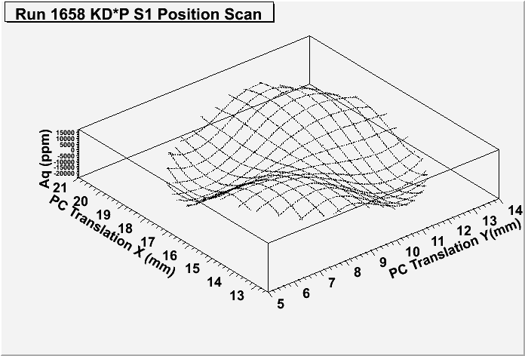
PARITY QUALITY
Do we have it? We are in a good position to get it.
We already have small helicity correlated changes in Aq : ~30ppm
What about the noise? Aq widths and bpm widths look similar to the past: 10’s of um
Increasing the flip rate will improve matters even further
How will small position differences be achieved? In the usual way: Pockels Cell centering, RHWP & photocathode rotation
Will we have it? Yes, with some small adjustments to the source alignment.
Is the beam usable? Yes. If the beam can be delivered to the hall, it is usable for parity experiments.
Are the monitors working? We have sufficient monitors currently operational to perform a parity experiment. We want to optimize the additional monitors.
Ref:
Silwal Thesis,
Fig 6.7.2
Ref: Silwal Thesis, Fig 6.8
RHWP scan
PC centering
Photocathode rotation

Slide 11
Monitor Tests

Slide 12
PITA SCAN
Test
PITA scan functions as a test of the monitor linearity, test of the calibrations, and assesses the analyzing power of the photocathode
We performed a PITA scan at 30Hz, 8.8GeV, 45uA, with IHWP in, LH2 target in, and SAMs on
Range: +- 2000 counts (65535counts/4000V conversion factor)
Results
1MHz dbcm indicates PITA slope of -38ppm/V (+-2000ppm measurement)
  PREX I (2010), observed PITA slopes of 22-31ppm/V which corresponded to a photocathode analyzing power of ~6% (Ref: Silwal Thesis)
  Suggests photocathode analyzing power of 8-10%
Position Differences – go through 0, have slopes of ~0.1-1nm/ppm
SAMs – slopes reveal non-linearity of up to several % for various HV settings

Slide 13
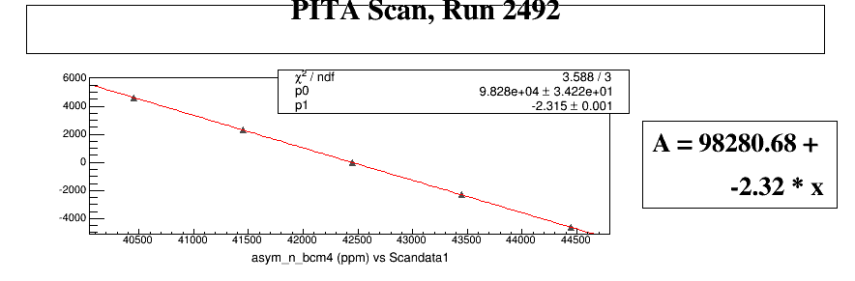
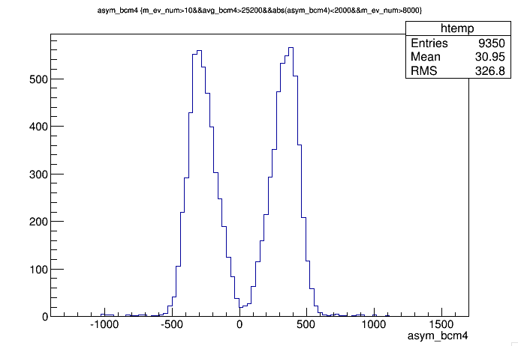
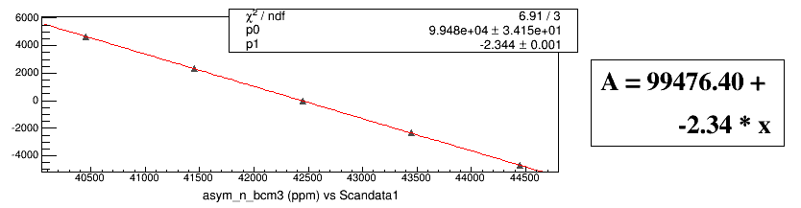
PITA SCAN
1MHz dbcm indicates PITA slope of -38ppm/V
(+-2000ppm measurement, 65535counts/4000V conversion factor)
Central value of Aq
30.95ppm
1MHz dbcm
ppm
1MHz dbcm
Aq=30.95ppm
HV+ counts
ppm
HV+ counts

Slide 14
BEAM Current monitors

Slide 15
Digital bcms delay & linearity
The 1MHz system has a small ~10us delay = 2.5us(latency)+7-8us(risetime)
New digital receiver system has 3 outputs– ‘fast’/OPS, ‘adjustable’,‘slow’/EPICS
Digital reciever slow’/EPICS output setting has a 5.1 ms delay(measured with tune beam) due to low pass filters and additional latency
By changing the output mode to ‘fast’, removing many of the applied low-pass filters, we can reduce the delay to ~16-18us(relative to the 1MHz system) and ~26-28us total delay relative to beam
We can further reduce the delay by bypassing several filters in ‘straight through’ mode,
delay down to 1us (relative to the 1MHz system)
and 11us total delay =4.5us(latency)+ 6.5(risetime)
Comparing both 1MHz and digital reciever systems, we – we can adjust the gate delay on our ADCS by 0us or 2us and adjust the receiver gain to keep output below 10V(our ADC limit) and we’ll be set.
New Mussons saturated at 40uA for a particular gain setting during running, but the gain settings were simply adjusted. We are going to put some attenuators on the receiver input and adjust the internal attenuators to make it physically impossible for any experiment to saturate the receivers in the future If we properly make use of the digital system settings, it looks nice and linear
We can tailor digital filters applied to suit our needs
This low-latency setting will work for us in PREXII

Slide 16
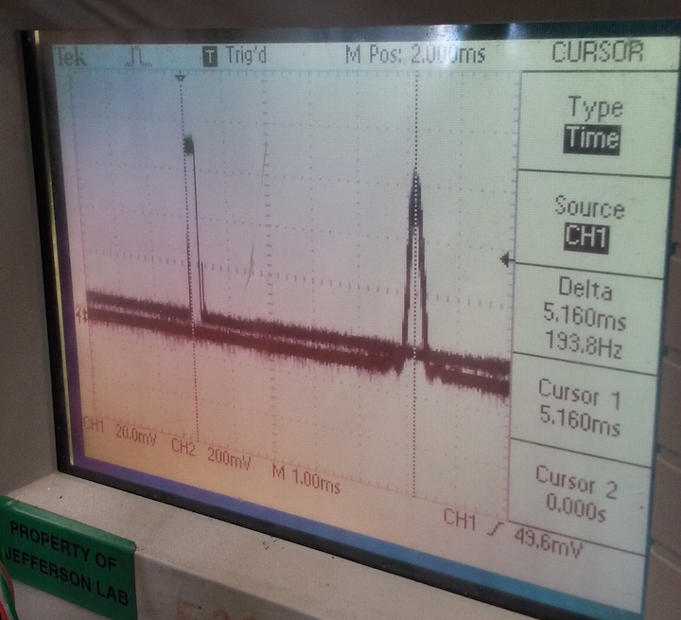
Dbcm ‘slow’
1MHz dbcm tune beam
new dbcm ‘slow’

Slide 17
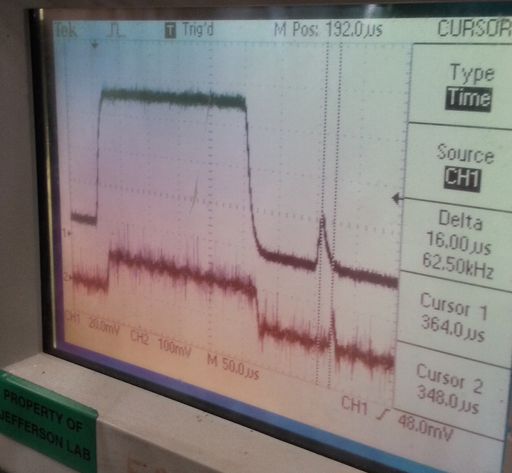
Dbcm no filter
1MHz dbcm tune beam
new dbcm no filter

Slide 18
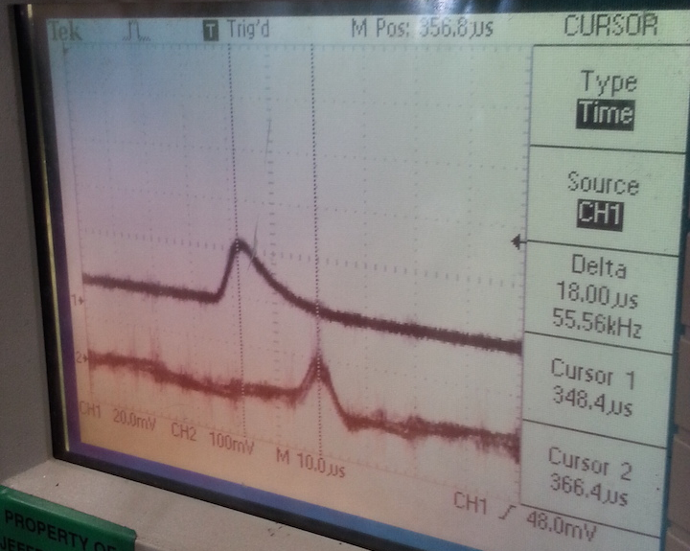
Dbcm no filter
1MHz dbcm tune beam
new dbcm no filter

Slide 19
EVIDENCE leading up to bcm delay measurement
There were many symptoms which indicates delay was happening with the digital receivers
It is important to make note of these symptoms so that we can diagnose delay in other signals
The evidence appeared as
Less correlation with other monitors, more uncorellated noise, wider DDs
60Hz signal (detected by beat oscillation between near120Hz subblock rep rate) showed phase delay relative to other signals
Earlier (sub-block) data points showed more correlation with other monitors than same-event (sub-block) data points
Beam trips weren’t happening at the same event (or subblock event) as other signals
(Smaller PITA slopes)

Slide 20
BCM Resolution
1MHz Bcm’s behave well most of the time and resolution looks good
Resolution of 1 MHz system improves with higher current and improves with higher frequency
Resolution can be assessed from double difference widths of upstream and downstream 1MHz bcms
  For 120Hz, at 12uA, we have a resolution of ~43ppm
  For 30Hz, at 60uA, we have a resolution of ~11ppm
Resolution measurement can be independently checked using the SAMs
  For 30Hz, 20uA, we have a resolution of ~30ppm
  For 30Hz, 45uA, we have a resolution of ~13ppm
This is sufficient bcm resolution for PREXII (>70uA, 120Hz)

Slide 21
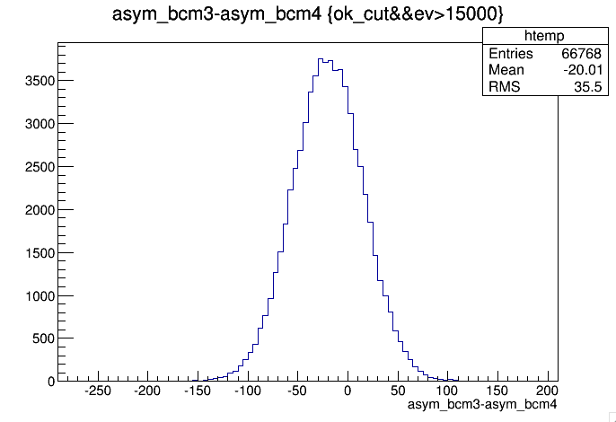
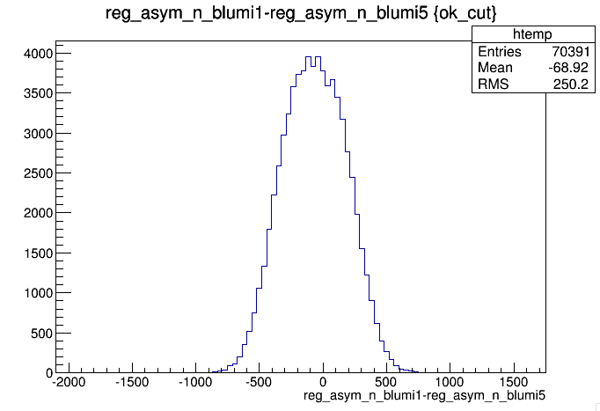
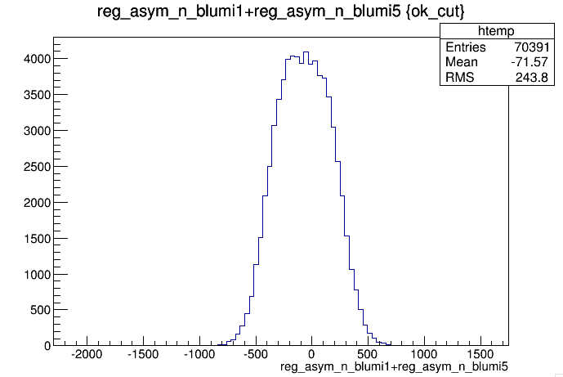






BCM 1MHz noise from SAMs
$S_{+}={SAM}_{1}$+${SAM}_{5}−2S_{bcm}$
Run 2347 – carbon 2.2GeV 18.6uA 30Hz , regress with 4a,4b,12x
$$S_{−}={SAM}_{1}−{SAM}_{5}$$
$σ_{+}^{2}=σ_{1}^{2}$+$σ_{5}^{2}$+4$σ_{bcm}^{2}$
regressed after reanalysis with pairsynch normal maxevent 5000 | RMS ppm
(asym_bcm3-asymbcm4)/sqrt(2) | 25.1
reg_asym_n_blumi1+reg_asym_n_blumi5 | 250.2
reg_asym_n_blumi1-reg_asym_n_blumi5 | 243.8
sqrt(pow(250.2,2)-pow(243.8,2))/2 | 28.1
$σ_{−}^{2}=σ_{1}^{2}$+$σ_{5}^{2}$
$$σ_{bcm}^{2}=(σ_{+}^{2}−σ_{−}^{2})/4$$
$$σ_{bcm}\sim { (σ}_{ubcm}−σ_{dbcm})/\sqrt{2}$$
- regress with all bpms except 14
reg_asym_n_blumi1+reg_asym_n_blumi5 | 234.7
reg_asym_n_blumi1-reg_asym_n_blumi5 | 225.2
sqrt(pow(234.7,2)-pow(225.2,2))/2 | 33.0
Run 2503 – Al dummy 8.8GeV 45uA 30Hz, regress with all bpms
regressed after reanalysis with pairsynch normal maxevent 5000 | ppm
(asym_bcm3-asymbcm4)/sqrt(2) | 13.1
reg_asym_n_blumi1+reg_asym_n_blumi5 | 98.61
reg_asym_n_blumi1-reg_asym_n_blumi5 | 95.37
sqrt(pow(98.61,2)-pow(95.37,2))/2 | 12.5

Slide 22
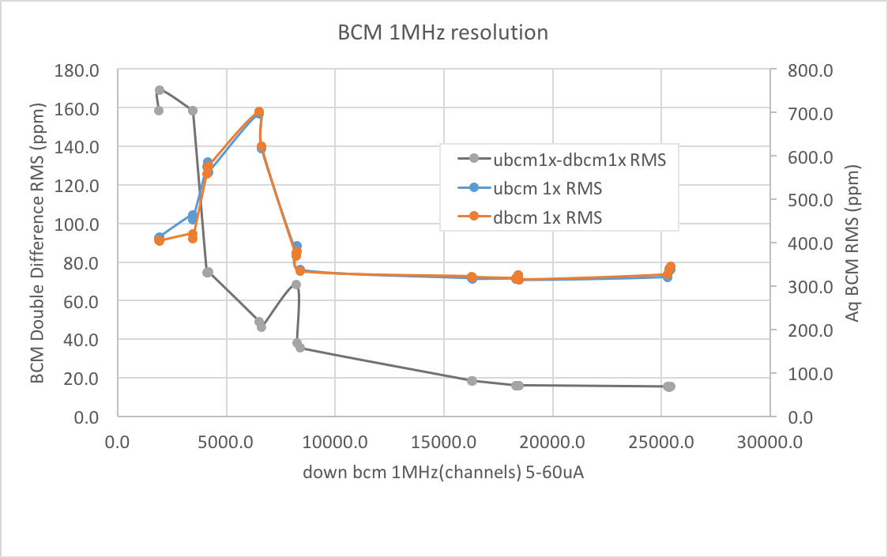
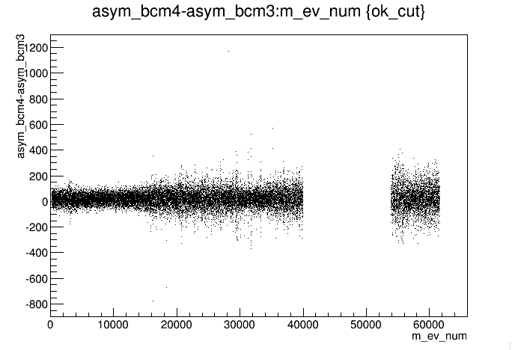

Bcm 1MHz resolution
$$σ_{bcm}\sim { (σ}_{ubcm}−σ_{dbcm})/\sqrt{2}$$
Wide because of
P.C.4 peak effect
Jump because of
noise later in run
Current

Slide 23
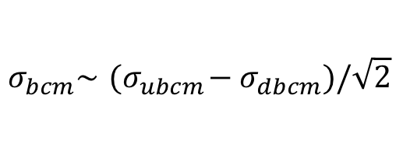
Bcm 1MHz resolution
$$σ_{bcm}\sim { (σ}_{ubcm}−σ_{dbcm})/\sqrt{2}$$

Slide 24
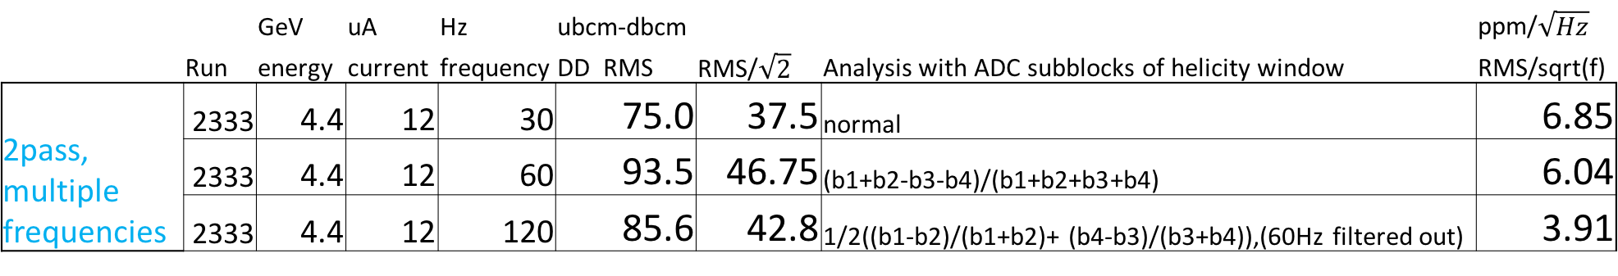


BCM 1MHz Resolution frequency
  BCM Double Differences - Resolution
  Higher frequencies tend to result in smaller widths (scaled to counting statistics)
  DD in 1MHz system beats $\sqrt{N}$ statistics from number of samples in integration time-> as we increase rep rate, we are ‘winning’ in that the level of noise at 30Hz is more than at 60Hz, 120Hz
$$σ_{bcm}\sim { (σ}_{ubcm}−σ_{dbcm})/\sqrt{2}$$
 |  | GeV | uA | Hz | ubcm-dbcm |  |  | ppm/$\sqrt{Hz}$
 | Run | energy | current | frequency | DD RMS | RMS/$\sqrt{2}$ | Analysis with ADC subblocks of helicity window | RMS/sqrt(f)
2pass, multiple frequencies | 2333 | 4.4 | 12 | 30 | 75.0 | 37.5 | normal | 6.85
 | 2333 | 4.4 | 12 | 60 | 93.5 | 46.75 | (b1+b2-b3-b4)/(b1+b2+b3+b4) | 6.04
 | 2333 | 4.4 | 12 | 120 | 85.6 | 42.8 | 1/2((b1-b2)/(b1+b2)+ (b4-b3)/(b3+b4)),(60Hz filtered out) | 3.91

Slide 25
SMALL ANGLE monitors

Slide 26
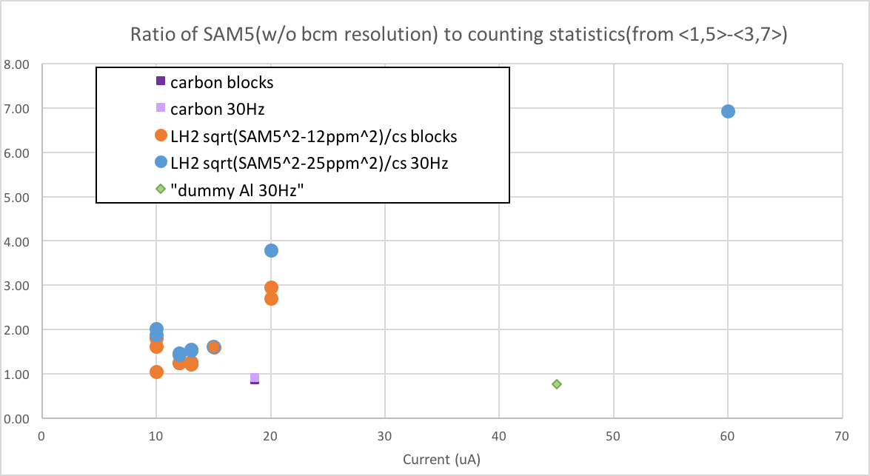
SAM Asymmetry Widths

Slide 27
SAM Linearity
PITa scan
Settings during PITA scan
LH2 target, 45uA, 8.8GeV
Bases: SAM1/3/5/7=R7723, SAM2/6=R375&UNITY GAIN, SAM4/8=R375
Preamps: SAM1/5=100kOhm, SAM2/6=5MOhm, SAM3/7=36kOhm, SAM4/8=300kOhm
HVs: SAM1/5=600V, SAM2/6=75V, SAM3/7=700V, SAM4/8=350V
Layout:SAM1=TOP,SAM2=TR, SAM3=RIGHT,SAM4=BR,SAM5=B,SAM6=BL,SAM7=L,SAM8=TL
Pedestals: calculated from beam trips during PITA scan
Analysis
Because SAMs are also sensitive to position differences, must use regression with respect to bpms to get best estimate of actual SAM non-linearity
Lower slopes than bcm indicate either pedestal error, SAM saturation
Higher slopes than bcm indicate either pedestal error or nonlinearity

Slide 28
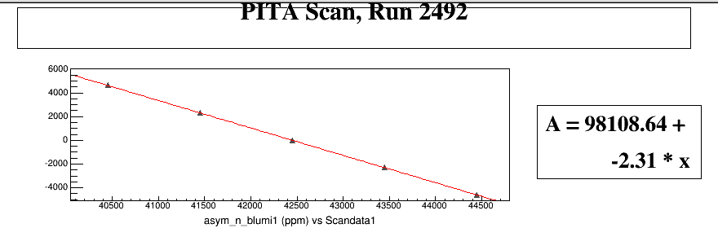
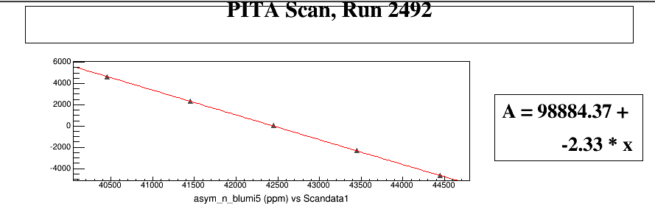
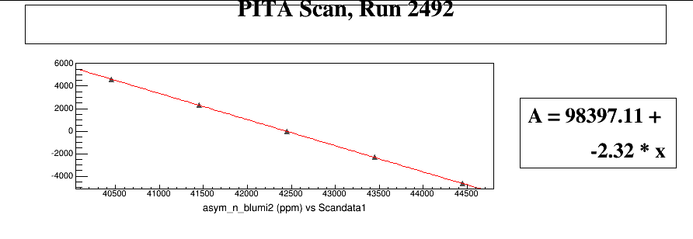
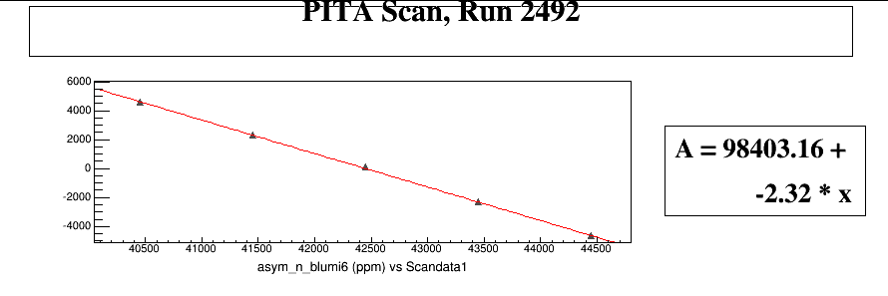
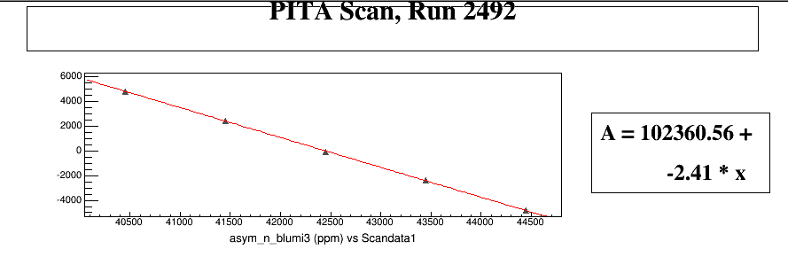
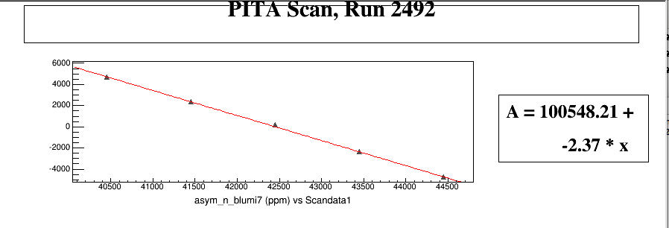

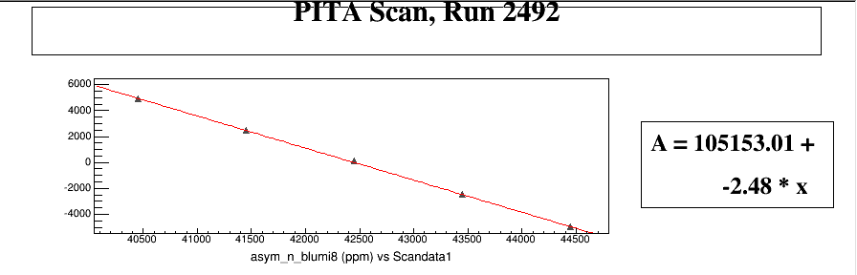
SAM1
SAM1
SAM5
SAM5
SAM2
SAM6
SAM2
SAM6
SAM3
SAM7
SAM3
SAM7
SAM4
SAM8
SAM4
SAM8

Slide 29
SAM Linearity
PITa scan
Rate 1.3-2GHz
Put bound on sam nonlinearity, factoring in the possible error in PITA slope measurement from bcms and possible pedestal error of SAMs
Assume max pedestal error of 100ch on SAMs (from beam trip decay)
PITA Slope | dbcm 1MHz | ubcm 1MHz
dAq/dPITA from dbcm | -2.3156ppm/V | -2.34356ppm/V
Max error on PITA slope meas (%) | 1.21%
 | SAM1 | SAM5 | SAM2 | SAM6 | SAM3 | SAM7 | SAM4 | SAM8
SAM base type | R7723 | R7723 | R375 | R375 | R7723 | R7723 | R375 | R375
HV setting (V) | -600V | -600V | -75V | -75V | -700V | -700V | -350V | -350V
anode current (uA) | 27.7uA | 36.0uA | 0.0011uA | 0.0016uA | 73.6uA | 55.7uA | 8.6uA | 11.6uA
gains estimate | 2.08E+04 | 2.71E+04 | 1 | 1 | 5.53E+04 | 4.18E+04 | 6.43E+03 | 8.73E+03
Max pedestal error(%) | 0.28% | 0.21% | 14.38% | 9.54% | 0.29% | 0.38% | 0.30% | 0.22%
SAM PITA slopes | SAM1(PITA slp) | SAM5(PITA slp) | SAM2(PITA slp) | SAM6(PITA slp) | SAM3(PITA slp) | SAM7(PITA slp) | SAM4(PITA slp) | SAM8(PITA slp)
dAsam/dPITA | -2.31111ppm/V | -2.32939ppm/V | -2.32183ppm/V | -2.31818ppm/V | -2.41158ppm/V | -2.3687ppm/V | -2.43821ppm/V | -2.47723ppm/V
d(Asam-Aq)/dPITA | 0.00425ppm/V | -0.014ppm/V | -0.00304ppm/V | -0.0029ppm/V | -0.096ppm/V | -0.053ppm/V | -0.123ppm/V | -0.162ppm/V
d(regressed (Asam-Aq))/dPITA | 0.00272ppm/V | -0.00752ppm/V | -0.01866ppm/V | 0.01980ppm/V | -0.10737ppm/V | -0.0161ppm/V | -0.12680ppm/V | -0.11845ppm/V
SAM implied nonlinearity (%) | SAM1(nonlin) | SAM5(nonlin) | SAM2(nonlin) | SAM6(nonlin) | SAM3(nonlin) | SAM7( nonlin) | SAM4(nonlin) | SAM8(nonlin)
from dAsam/dPITA | -0.20% | 0.59% | 0.27% | 0.11% | 4.14% | 2.29% | 5.29% | 6.98%
from d(Asam-Aq)/dPITA | -0.43% | 1.40% | 0.30% | 0.29% | 9.60% | 5.30% | 12.30% | 16.20%
from d(regressed (Asam-Aq))/dPITA | -0.27% | 0.75% | 1.87% | -1.98% | 10.74% | 1.61% | 12.68% | 11.85%
factoring out max sam ped errors | 0.00% | 0.54% | 0% | 0% | 10.45% | 1.23% | 12.38% | 11.63%
MINIUMU NON LINEARITY (%) | 0% | 0% | 0% | 0% | 9.24% | 0.02% | 11.18% | 10.42%
(factoring out max PITA slp error)

Slide 30
SAM Linearity
PITA SCAN
Results
The high gain SAMs with the R375 bases show a positive non-linearity of
  >10% (when run at 350V, 10uA anode current, gain~7k)
The unity gain SAMs have a non-linearity of
  0%(<1.5% )(when run at 75V, 1-2nA anode current, 1.3-2GHz rates)
The high gain R7723 base SAMs have a positive non-linearity of
  0-1% (when run at 600-700V, 26-36uA, gain~25k)
  0.02-2%(when run at 700V, 56uA anode current, gain ~42k)
  10% (when run at 700V, 74uA anode current, gain ~55k)

Slide 31
Beam position monitors

Slide 32
BPM Status
Previously had an auto gaining issue near 20uA, there was a transition in gain setting near that current region producing 1V square waves in the wire channel signal every second or so. The settings were changed, and the problem was solved.
Now we have a very small jumping issue (50mV jumps in x wire channels every couple seconds) which is not always present (went away in 4a and showed in in 4b for 60uA) and is likely also caused by some sort of internal setting
Pete Francis going replace IF modules during summer, so this may go away after that
If the 50mV wire channel shifts are still present in the RF injected noise tests after IF modules are replaced, then need to examine internal settings, how IF gain and gain interplay with FFB, etc.
Musson cavity bpms– being commissioned

