Slide 1
UCSB Photocathode tests in MicroMott
Marcy Stutzman
14 December 2023

Slide 2
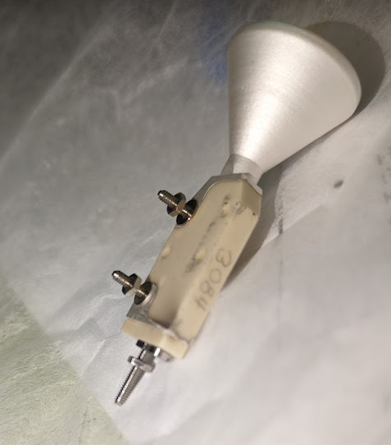
MicroMott functional again
Root cause:
Metallization on CEM changed
Existing design puts HV at or nearly touching support
Back: 3kV
Front: Ground
Collector: 3kV
Mechanical support
Biased 0-300V

Slide 3
MicroMott functional again
Root cause:
Metallization on CEM changed
Existing design puts HV at or nearly touching support
Back: 3kV
Front: Ground
Collector: 3kV
Problem area
Mechanical support
Biased 0-300V

Slide 4
UCSB cathode results
Sample 144
InAlGaAs/AlGaAs SSL
Higher strain
Sample 199: in progress
InAlGaAs/AlGaAs SSL
Standard strain, 505C growth temp

Slide 5
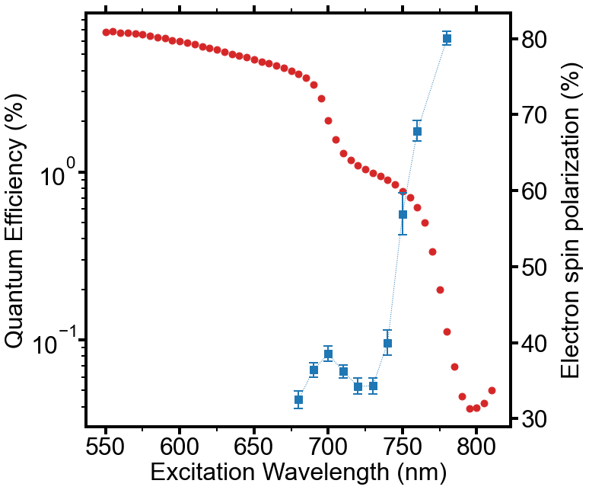
UCSB sample 1 (520C): 2022
 | Polarization | QE@max
Sample 1: 520C | 80% | 0.15%
Sample 2: 505C | 90% | 0.3%
Sample 3: high strain | 89.5% | 0.42%
HH2
LH1
HH1
Polarimeter back in operation
UCSB samples show promise
They can add DBR structures
If they get a good formula for InAlGaAs, easy to get commercial growers -- no Phosphorus residue

