Slide 1
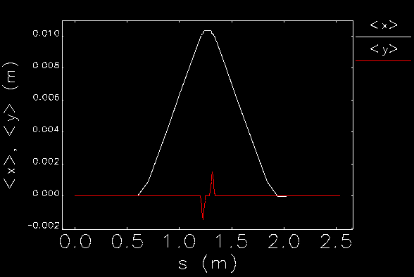
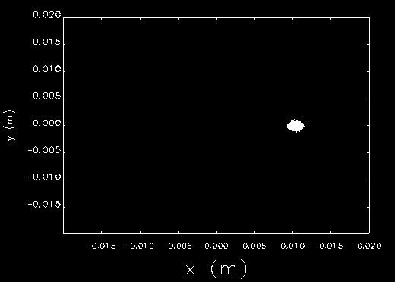
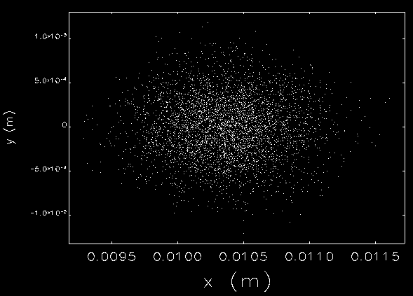
CEBAF chopper arrangement
S1 – Focus to center of chopper
C1 – Deflect to chopper radius
S2 – Deflect through MS (F=C1)
S3 – Deflect to C2 (F=C2)
C2 – Deflect to S4
S4 – Focus to cryounit
Viewer at center of chopper
Viewer at center of chopper

Slide 2
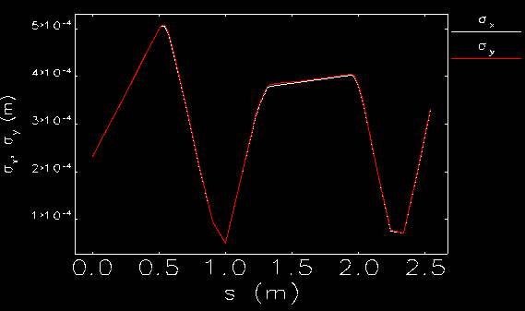
CEBAF chopper arrangement
S1 – Focus to center of chopper
C1 – Deflect to chopper radius
S2 – Deflect through MS (F=C1)
S3 – Deflect to C2 (F=C2)
C2 – Deflect to S4
S4 – Focus to cryounit
Next steps…
Prototype buncher-cryounit
Add to model
Adjust optics for waist @ S1
Adjust chopper lengths to reality
Adjust S1 for MS
Adjust S4 for cryounit
Result is Gun to cryounit (less Wien)

