Slide 1
Bubble Chamber:
Status and Test
September 1, 2015
https://wiki.jlab.org/ciswiki/index.php/Bubble_Chamber

Slide 2
Outline
Nucleosynthesis and ¹²C(α,γ)¹⁶O Reaction
Time Reversal Reaction: ¹⁶O(γ,α)¹²C
Bubble Chamber
Electron Beam Requirements
Bremsstrahlung Beam
Penfold-Leiss Cross Section Unfolding
JLab Projected Results
Bubble Chamber Test Plans

Slide 3
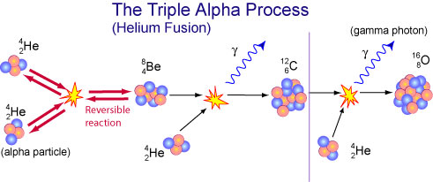

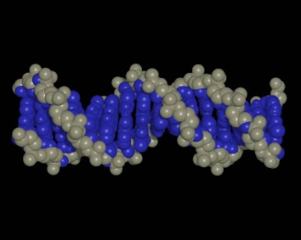

Nucleosynthesis and ¹²C(α,γ)¹⁶O
Stellar Helium burning
The holy grail of nuclear astrophysics:
Affects synthesis of most of elements in periodic table
Sets N(¹²C)/N(¹⁶O) (≈0.4) ratio in universe
Determines minimum mass star requires to become supernova

Slide 4
Heroic Efforts in Search of ¹²C(α,γ)¹⁶O
Previous cross section measurements:
    Helium ions on carbon target: ¹²C(α,γ)¹⁶O
    Carbon ions on helium gas: ⁴He(¹²C, γ)¹⁶O or ⁴He(¹²C,¹⁶O)γ (Schürmann)
Experiment | Beam Current (mA) | Target (nuclei/cm²) | Time (h)
Redder | 0.7 | ¹²C, 3 10¹⁸ | 900
Ouellet | 0.03 | ¹²C, 5 10¹⁸ | 1950
Roters | 0.02 | ⁴He, 1 10¹⁹ | 5000
Kunz | 0.5 | ¹²C, 3 10¹⁸ | 700
EUROGAM | 0.34 | ¹²C, 1 10¹⁹ | 2100
GANDI | 0.6 | ¹²C, 2 10¹⁸
Schürmann | 0.01 | ⁴He, 4 10¹⁷
Plag | 0.005 | ¹²C, 6 10¹⁸ | 278

Slide 5
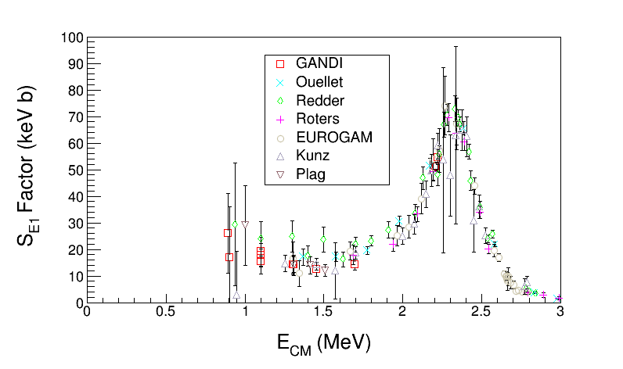
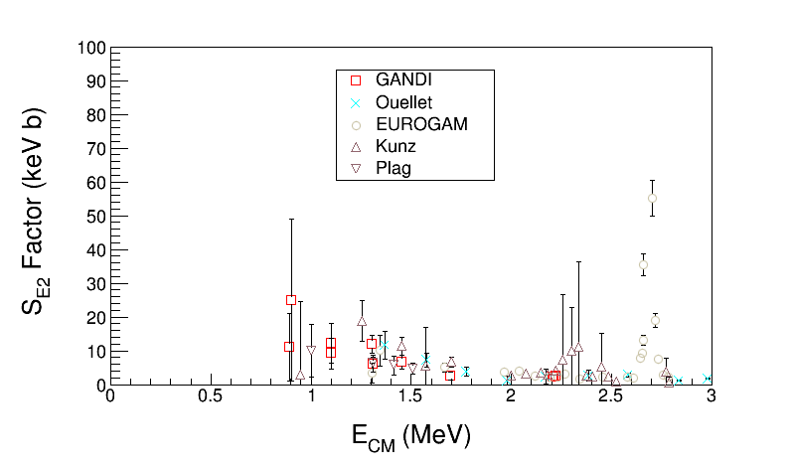
Astrophysical S-Factor ¹²C(α,γ)¹⁶O
Define S-Factor to remove both 1/E dependence of nuclear cross sections and Coulomb barrier transmission probability:
Author | S_{tot}(300) (keV b)
Hammer (2005) | 162±39
Kunz (2001) | 165±50
R-matrix Extrapolation to stellar helium burning at E = 300 keV
Notes:
What do you think about the table shown in this slide? See Schurmann data on slide 44. How did he come up with this small error?

Slide 6
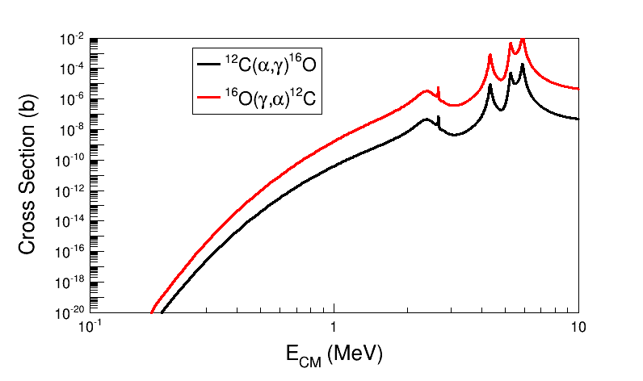
Time Reversal Reaction
¹²C
¹⁶O
MeV
γ
MeV
α
Stellar helium burning at
E = 300 keV, T=200 10⁶ K
Notes:
If we use linearly polarized gammas, we need also to measure the alpha-carbon angular distributions to separate E1 and E2 contributes.
What about right-handed or left-handed circularly polarized gammas? Circularly polarized light is a linear combination of linearly polarized light with a phase phi=90 deg. This is to say we cannot separate E1 and E2 with circularly polarized gammas.
At JLab Injector we can produce left-handed or right-handed gammas (our electron beam in linearly polarized).
To produce linear polarized gammas, we need to use a crystal radiator.
See paper: Y. Xu et al. on the wiki.

Slide 7
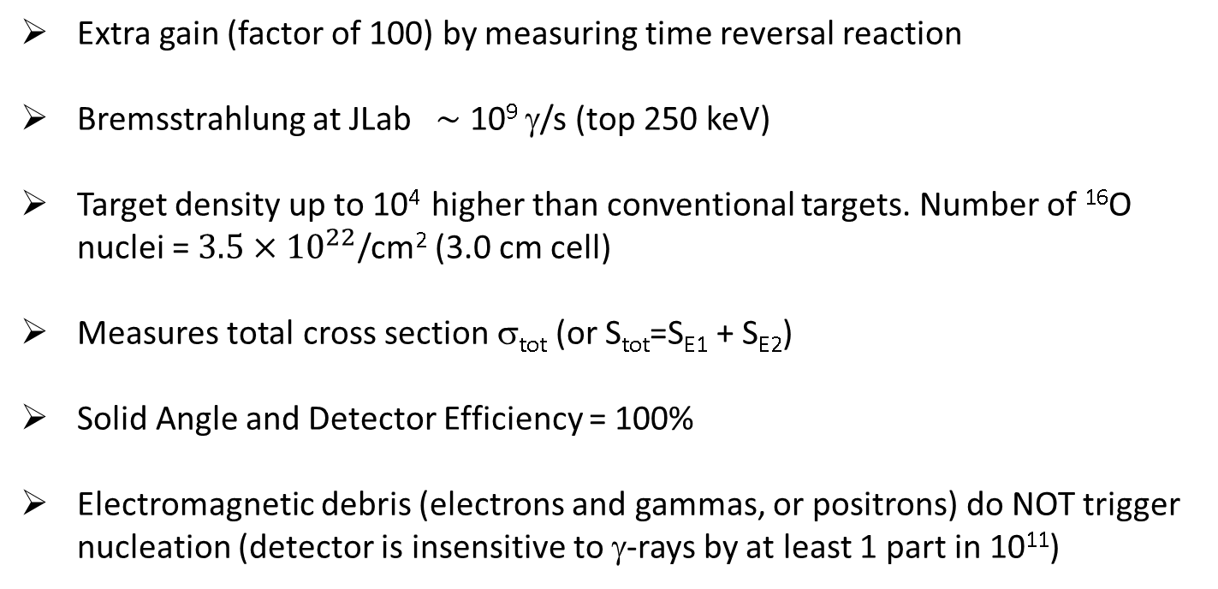
New Approach: Reversal Reaction + Bubble Chamber
beam
target
signal
γ + ¹⁶O → ¹²C + α
Extra gain (factor of 100) by measuring time reversal reaction
Bremsstrahlung at JLab $\sim$ 10⁹ γ/s (top 250 keV)
Target density up to 10⁴ higher than conventional targets. Number of ¹⁶O nuclei = $3.5×{10}^{22}$/cm² (3.0 cm cell)
Measures total cross section σ_{tot} (or S_{tot}=S_{E1} + S_{E2})
Solid Angle and Detector Efficiency = 100%
Electromagnetic debris (electrons and gammas, or positrons) do NOT trigger nucleation (detector is insensitive to γ-rays by at least 1 part in 10¹¹)
Notes:
Looking at the number of gammas we will have (slide 37), we will need to be insensitive to gamma-rays by at least 1 part in 10^15. I will keep using the factor of 10^11?

Slide 8
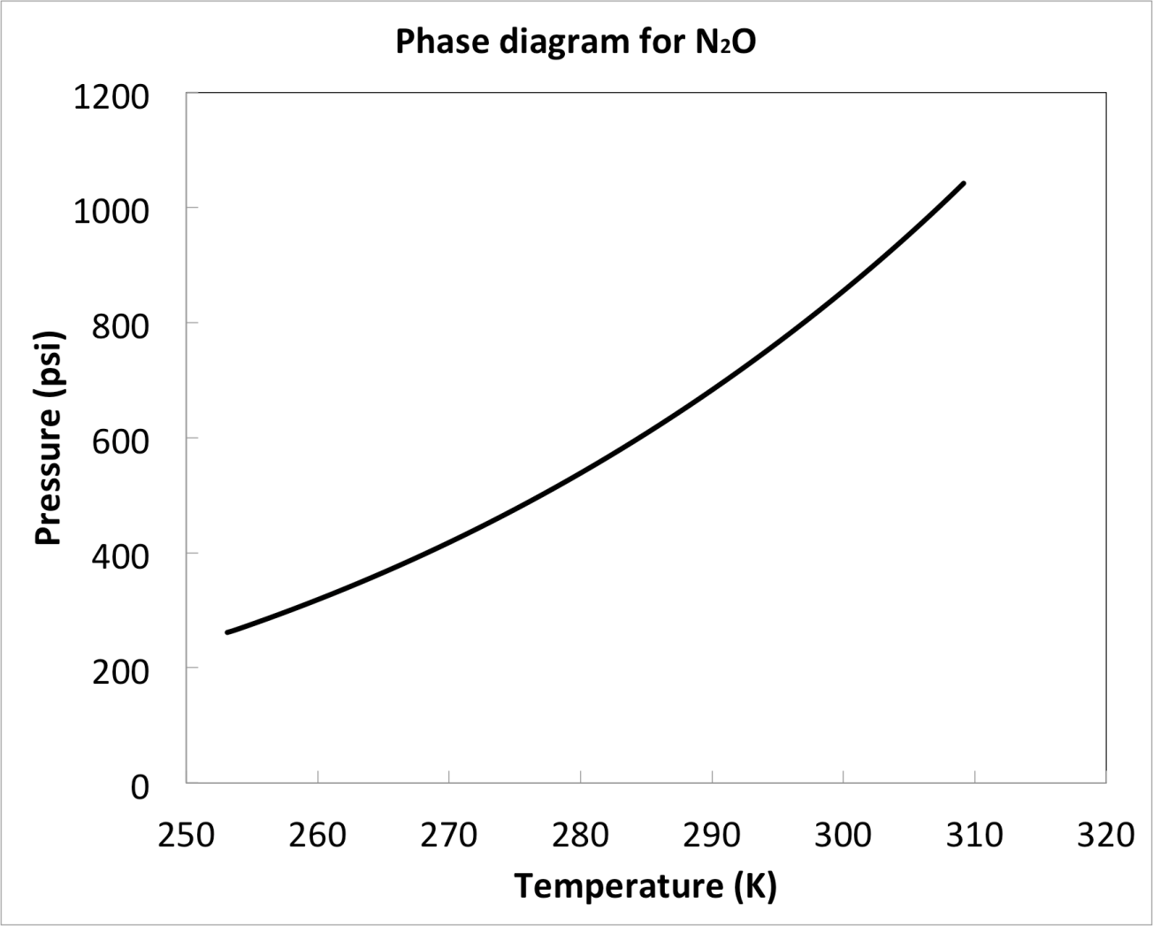
The Bubble Chamber
1 Cell is cooled then filled with room temperature gas
2 Gas is cooled and condenses into liquid
3 Once cell is completely filled with liquid, pressure is reduced creating a superheated liquid
3 Nuclear reactions induce bubble nucleation
2 High speed camera detects bubble and repressurizes
3 System depressurizes and ready for another cycle
1051
Critical point
Liquid
2
1
Vapor
3
309
Notes:
Do we have a similar figure for N2O?
The superheat is changed by changing the pressure not the temperature.

Slide 9

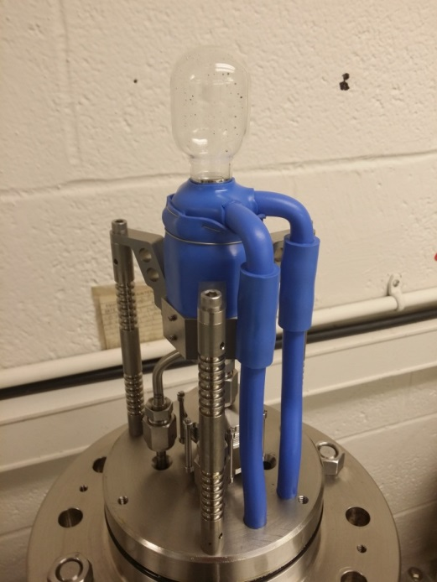
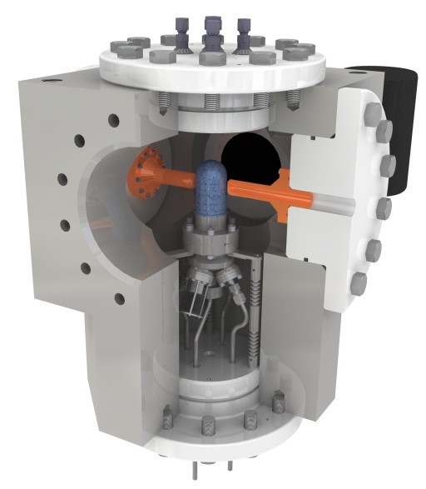
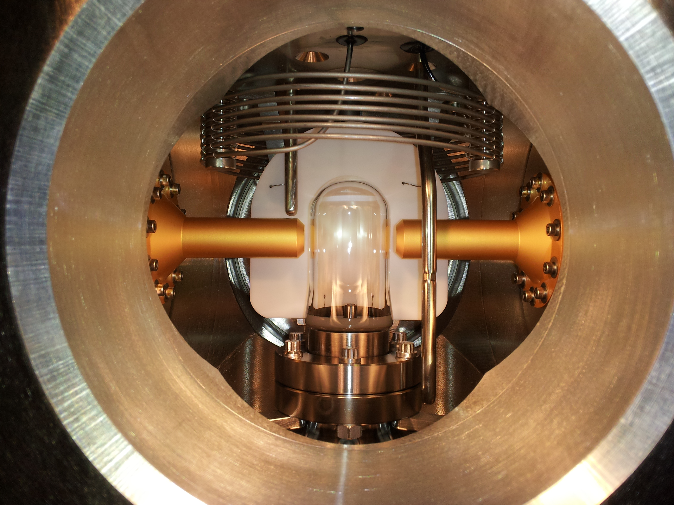
N₂O (Laughing Gas) Bubble Chamber
  T = -10˚C
  P = 50 atm
Notes:
Why the bubble in N2O rises? But not in C4F10. And why the liquid is cloudy for N2O? What was the buffer liquid?
The bubble is far more buoyant in N2O than C4F10 and rises faster. The buffer liquid is water and we had water absorbed in the N2O, but not in C4F10.

Slide 10
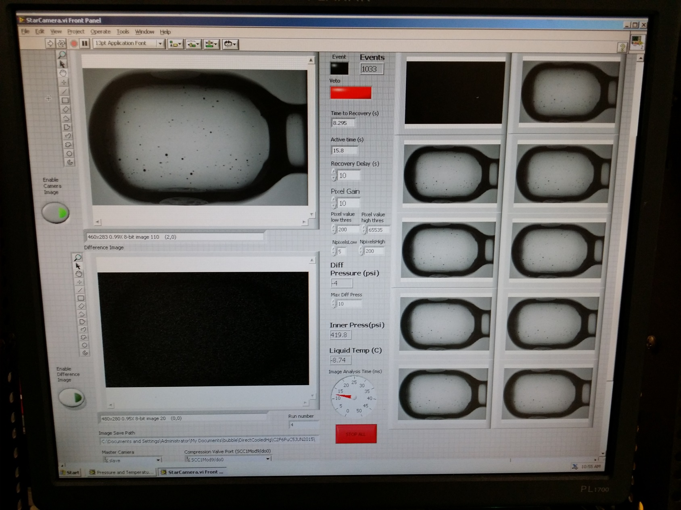
User Interface

Slide 11
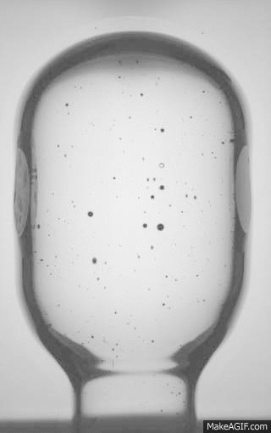

Bubble Growth and Quenching
3.0 cm
100 Hz Digital Camera
Δt = 10 ms
N₂O Chamber with PuC neutron source
Notes:
That is writing on the glass.

Slide 12
Electron Beam Requirements
Beam Properties at Radiator:
Beam Kinetic Energy, (MeV) | 7.9 – 8.5
Beam Current (µA) | 0.01 – 100
Absolute Beam Energy Uncertainty | <0.1%
Relative Beam Energy Uncertainty | <0.02%
Energy Resolution (Spread), σ_{T} /T | <0.06%
Beam Size, σ_{x,y} (mm) | 1
Polarization | None

Slide 13
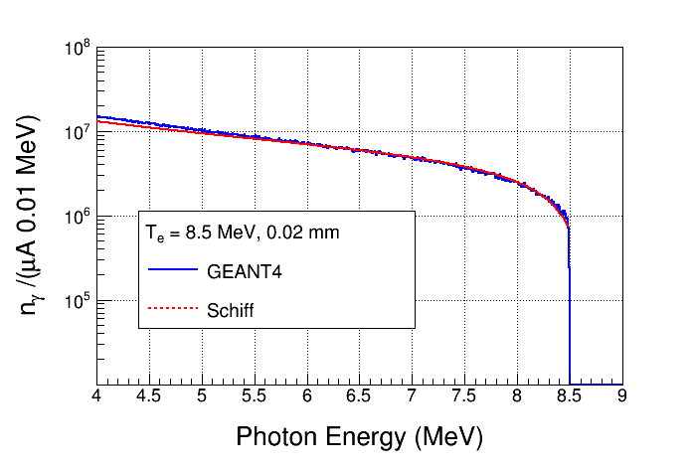
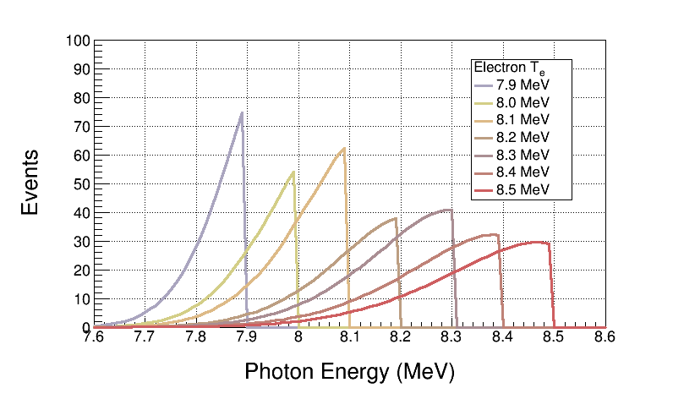
Bremsstrahlung Beam
Use both GEANT4 and FLUKA to calculate Bremsstrahlung spectra (we will not measure Bremsstrahlung spectra)
Monte Carlo simulation of Bremsstrahlung at radiotherapy energies is well studied, accuracy: ±5%
Bremsstrahlung Peaks
¹⁶O(γ,α)¹²C is ideal case for Bremsstrahlung beam and Penfold–Leiss Unfolding:
  Very steep cross section; only photons near endpoint contribute to yield
  No-structure (resonances)

Slide 14

Penfold-Leiss Cross Section Unfolding
Measure yields at: $E=E_{1}, E_{2}, …, E_{n}$ where, $E_{i}−E_{i−1}=Δ$, $i=2,n$
Solution can be written in two forms:
Or, Matrix form:
Volterra Integral Equation of First Kind
Method of Quadratures: numerical solution of integral equation based on replacement of integral by finite sum

Slide 15
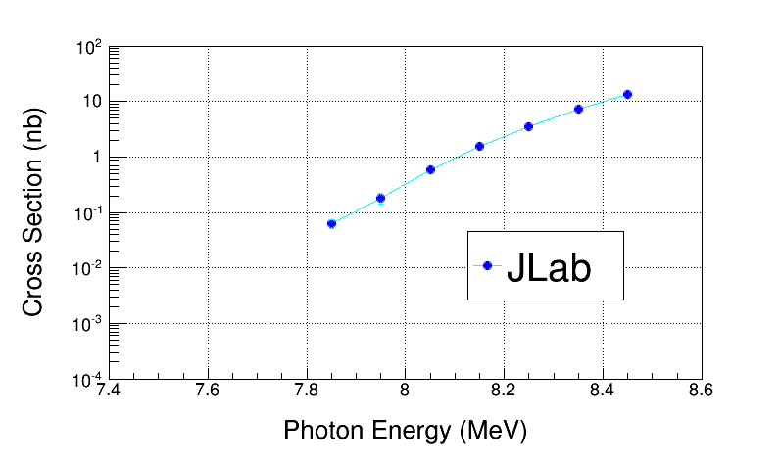
Electron Beam K. E. | Cross Section (nb) | Stat Error (no bg, %) | Stat Error (with bg, %)
7.9 | 0.046 | 4.4 | 24.5
8.0 | 0.185 | 6.0 | 20.7
8.1 | 0.58 | 6.3 | 14.7
8.2 | 1.53 | 8.2 | 13.8
8.3 | 3.49 | 9.1 | 13.3
8.4 | 7.2 | 10.6 | 13.8
8.5 | 13.6 | 12.2 | 14.8
Absolute Beam Energy, δE | 0.1%
Beam Current, δI/I | 3%
Photon Flux, δφ/φ | 5%
Radiator Thickness, δR/R | 3%
Bubble Chamber Thickness, δT/T | 3%
Bubble Chamber Efficiency, ε | 5%
Electron Beam K. E. | Cross Section (nb) | Sys Error (Energy, %) | Sys Error (Total, %)
7.9 | 0.046 | 12.5 | 15.3
8.0 | 0.185 | 10.2 | 13.5
8.1 | 0.58 | 8.3 | 12.2
8.2 | 1.53 | 7.0 | 11.4
8.3 | 3.49 | 6.0 | 10.7
8.4 | 7.2 | 5.3 | 10.5
8.5 | 13.6 | 4.7 | 10.1

Slide 16
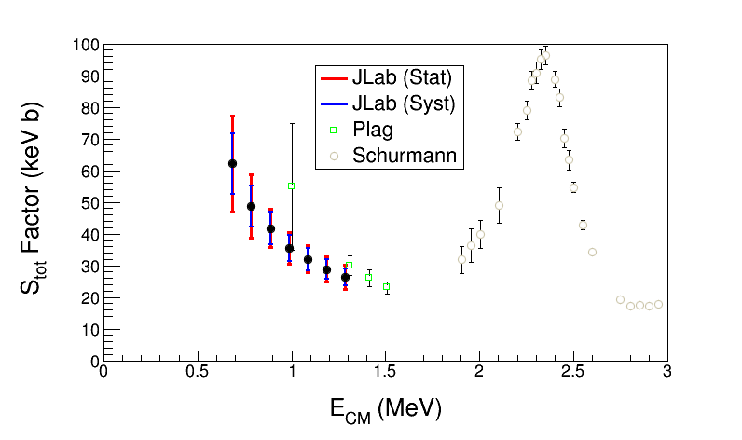
JLab Projected ¹²C(α,γ)¹⁶O S-Factor
Statistical Error: dominated by background subtraction from ¹⁸O(γ,α)¹⁴C (depletion = 5,000)
Electron Beam K. E. | Gamma Energy (MeV) | E_{CM} (MeV) | Cross Section (nb) | S_{tot} Factor (keV b) | Stat Error (%) | Sys Error (Total, %)
7.9 | 7.85 | 0.69 | 0.046 | 62.2 | 24.5 | 15.3
8.0 | 7.95 | 0.79 | 0.185 | 48.7 | 20.7 | 13.5
8.1 | 8.05 | 0.89 | 0.58 | 41.8 | 14.7 | 12.2
8.2 | 8.15 | 0.99 | 1.53 | 35.5 | 13.8 | 11.4
8.3 | 8.25 | 1.09 | 3.49 | 32.0 | 13.3 | 10.7
8.4 | 8.35 | 1.19 | 7.2 | 28.8 | 13.8 | 10.5
8.5 | 8.45 | 1.29 | 13.6 | 26.3 | 14.8 | 10.1
Bubble Chamber experiment measures total S-Factor, S_{E1} + S_{E2}
Notes:
Notes:
1- Schurmann at low energy is limited by 16O contamination of 12C ion beam.

Slide 17
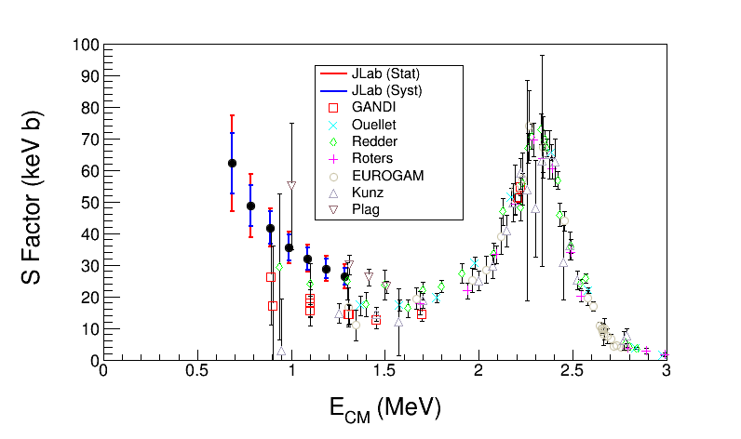
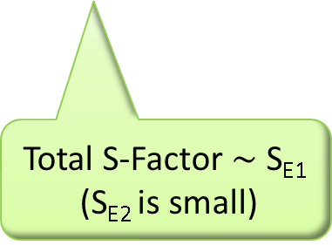
Total S-Factor $\sim$ S_{E1}
(S_{E2} is small)

Slide 18
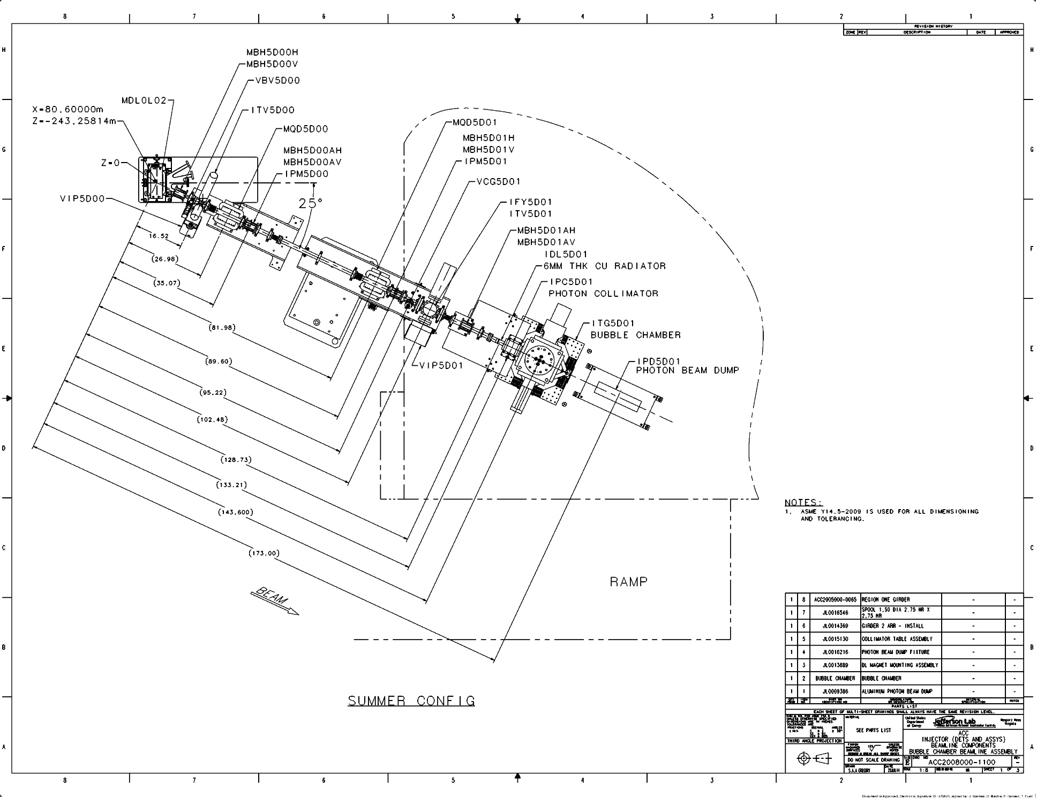
Test Beamline

Slide 19
Schematics of Test Beamline
Power deposited in radiator (100 µA and 8.5 MeV) :
  6 mm: Energy loss = 8.5 MeV, P = 850 W
Pure Copper and Aluminum (high neutron threshold):
  ⁶³C(γ,n) threshold = 10.86 MeV
  ²⁷Al(γ,n) threshold = 13.06 MeV
Electron K.E.
7.9 – 8.5 MeV
0.01 – 100 µA
Cu
Radiator/Dump
6 mm
Al Beam Pipe
Cu Photon
Collimator
Ceramic
Insulator
Al Photon Dump
40 cm long
Bubble Chamber
Superheated N₂O
3 cm long
-10°C, 50 atm
Notes:
Interior Page Design 2

Slide 20
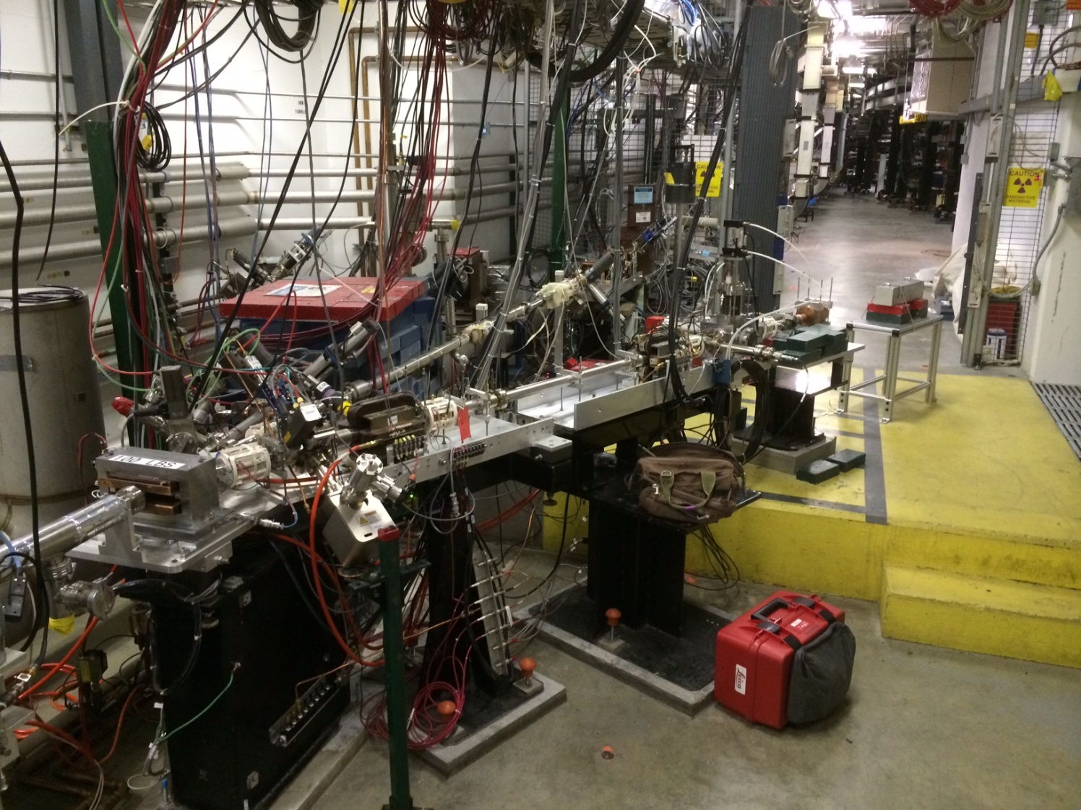
Bubble
Chamber
location
5 MeV
Dipole
5D Spectrometer
Notes:
Interior Page Design 2

Slide 21
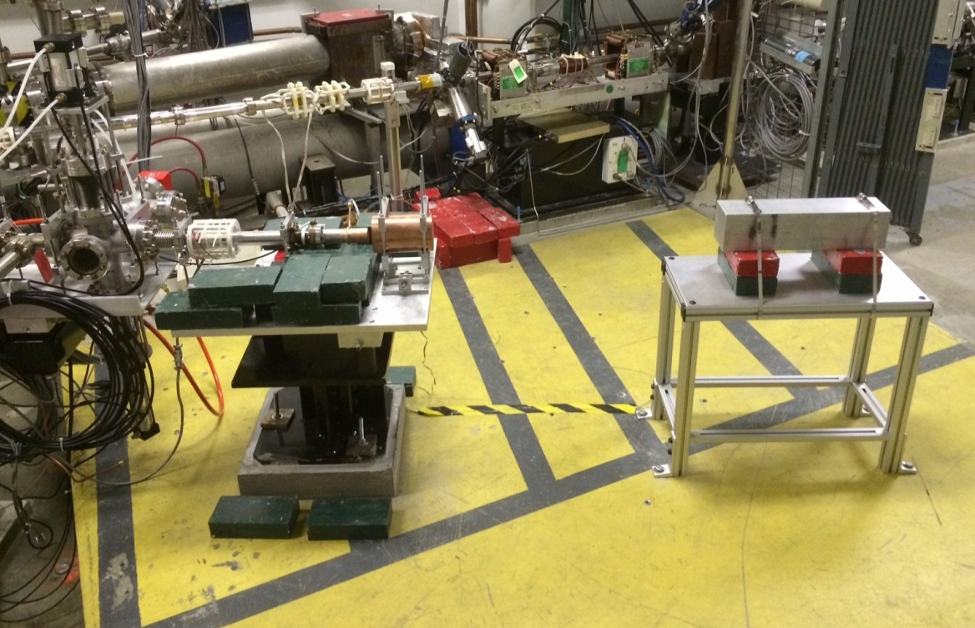
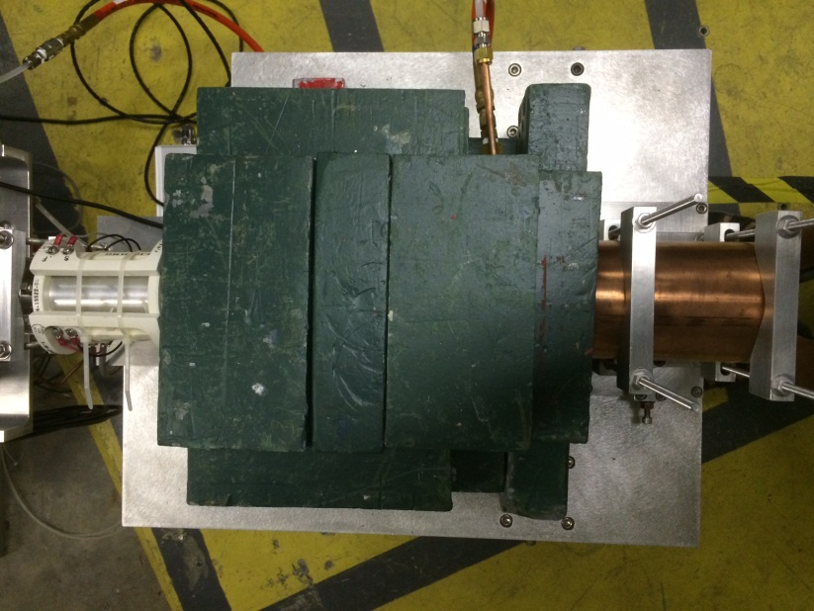
Cu Electron Radiator/Dump
Al Photon Dump
Cu Photon Collimator

Slide 22
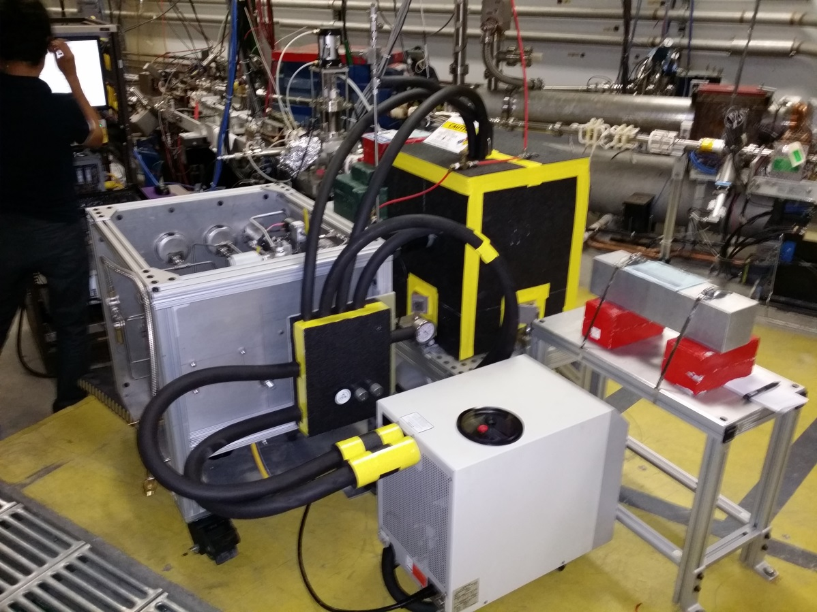

Slide 23
Measuring Absolute Beam Energy
5 MeV
Dipole
Installed new higher field
dipole with better uniformity
Installed new Hall probe:
0.01% accuracy, resolution
to 2 ppm, and a temperature
stability of 10 ppm/°C
Still need to shield Earth’s
and other stray magnetic fields
Beam Position Monitor (BPM)
Electron Beam
Momentum
Notes:
Interior Page Design 2

Slide 24
Test Beamline Commissioning
Beamline was ready since Fall 2014
Approved to run 10 μA CW and total energy of 10 MeV
Completed hot checkout and beam checkout
Beam Studies completed so far:
  Delivered 10.0 μA and 9.65 MeV (kinetic) for 5 hours in August 2015
  Measured beam momentum at different ¼ cryo-unit settings
  Measured beam charge at different beam currents
Re-doing realistic thermal analysis to run at 100 μA

Slide 25
Bubble Chamber Test Plans
Fill with natural N₂O – test bubble chamber systems operation
With beam on bubble chamber radiator (Sept 8 – 18, 2015):
  How does CCD camera perform under beam-on conditions?
  Count rates on bubble chamber. Do we get single or multiple bubbles from Bremsstrahlung beam exposure?
  Measure gamma ray beam spatial profile as reflected by bubble distribution. Is collimator effective in defining the gamma-ray beam?
Background measurements:
  Measure beam off environmental background in chamber-injector area
  Measure beam on background by looking outside fiducial volume
  Measure background with beam to Faraday Cup in CEBAF beamline (about two meters from chamber)
  Measure neutron events in chamber. Neutron radiation detectors in injector region will indicate if any neutrons are generated (especially at beam kinetic energies higher than 8.5 MeV).

Slide 26
Fill with C₂F₆ – test bubble chamber systems operation. This is planned later in September after first beam test.
With beam (planned in Oct 16 – 22, 2015)
  Measure few data points of from ¹⁹F(γ,α)¹⁵N (Q = +4.013 MeV) to perform a Penfold-Leiss unfolding
  Compare measured cross section to our HIGS data
  Fluorine is suitable for a first Penfold-Leiss unfolding:
    Only one stable natural isotope (¹⁹F)
    Low electron beam kinetic energy (4.6 – 5.2 MeV) – below threshold of any background reaction
Can we measure a cross section below our limit at HIGS of 3 nb?

Slide 27

Bubble Chamber Safety Reviews
Superheated liquid: N₂O, Nitrous oxide (laughing gas)
  Colorless, non-flammable gas, with slightly sweet odor and taste
High pressure system:
  Design Authority: Dave Meekins
  T = -10˚C
  P = 50 atm
Buffer liquid: Mercury
  Closed system
  Volume: 150 mL
Bubble Chamber Safety Review was on Aug 18, 2015
Temporary Operational Safety Procedures (TOSP) is approved
0
2
0
OX
0
3
0

Slide 28
Backup Slides

Slide 29
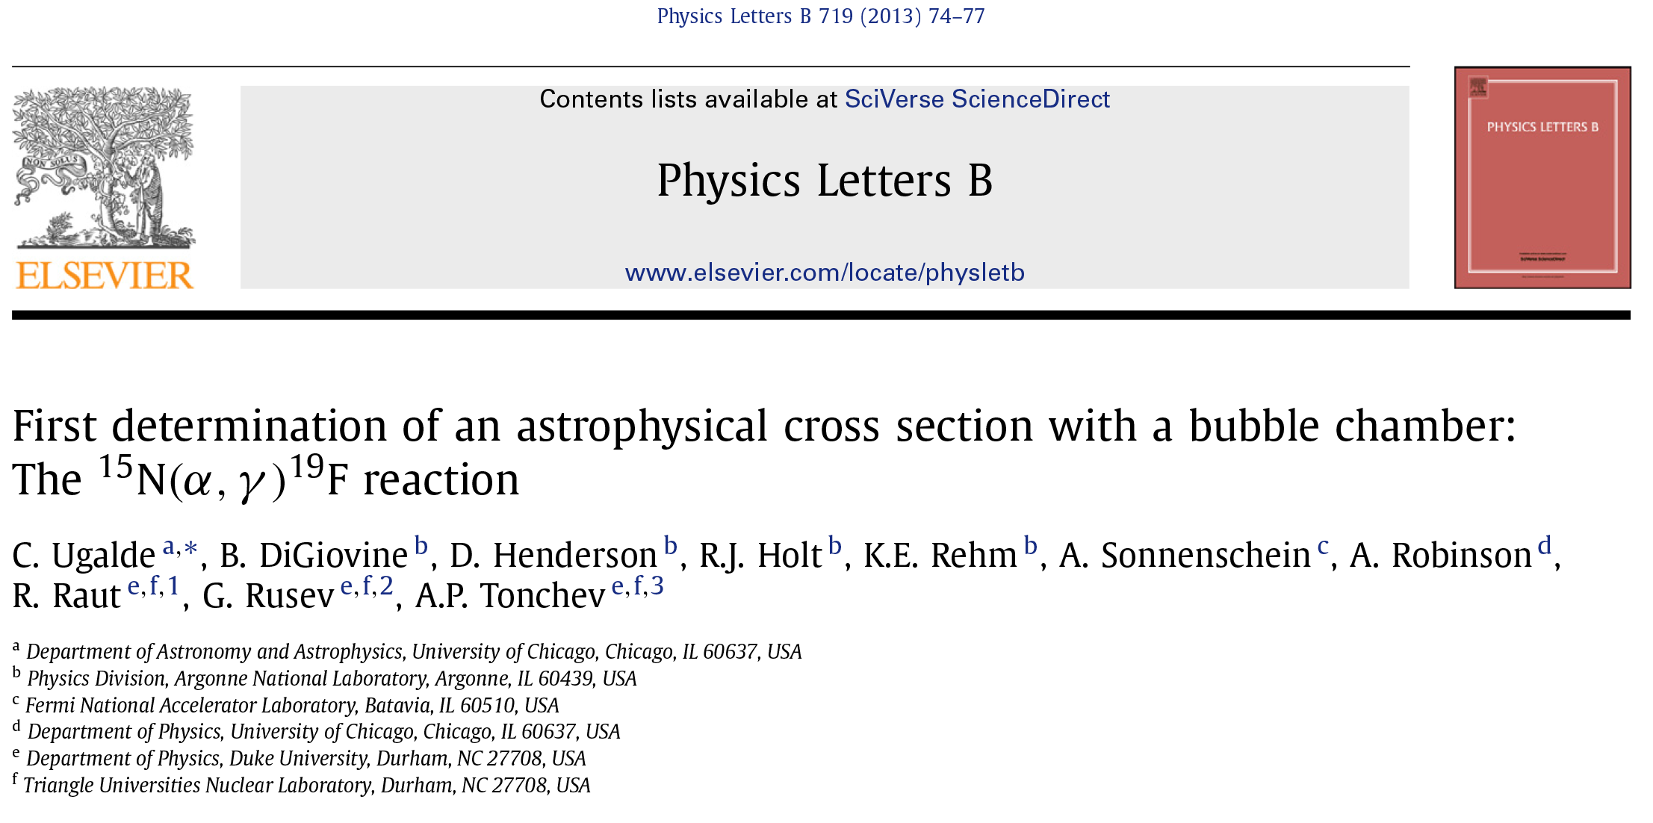
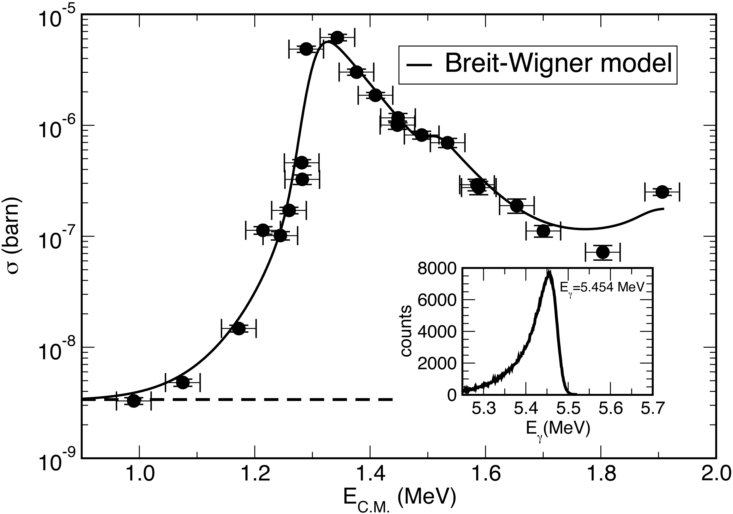
Measuring ¹⁹F(γ,α)¹⁵N at HIGS
Notes:
That is a wire in the background of the bubble photo on the left. It was a wire attached to a piezoelectric on
the bottom of the glass for the acoustic signal. If not this, it was just a thermocouple wire.

Slide 30
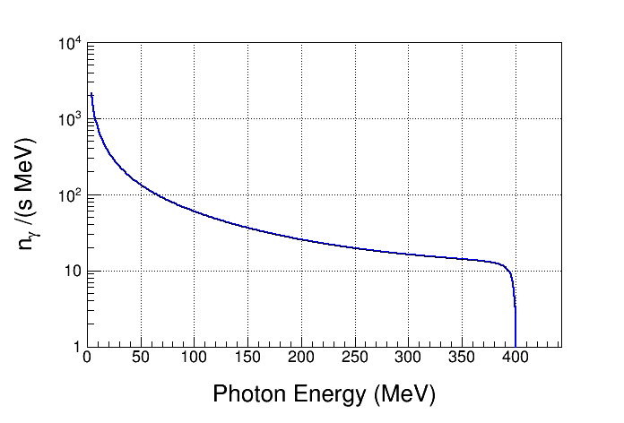
Bremsstrahlung Background at HIGS
Electron Beam Energy: 400 MeV
Electron Beam Current: 41 mA
Interaction Length: 35 m
Vacuum: 2x10⁻¹⁰ Torr
Residual Gas: Z = 10
Strong Bremsstrahlung
Background
(when coupled with large
cross sections at high energies)
Notes:
If it is neutron background that we worry about at HIGS then we can the acoustic signal. At HIGS, we can get more than (g,n) produced by the bremsstrahlung. All photo breakup reactions are possible because of the high energy bremsstrahlung.

Slide 31
Superheated Targets
List of superheated liquids to be used in experiment:
Readout:
  Fast Digital Camera
  Acoustic Signal to discriminate between neutron and alpha events
N₂O Targets | ¹⁶O | ¹⁷O | ¹⁸O
Natural Target | 99.757% | 0.038% | 0.205%
¹⁶O Target |  | Depleted > 5,000 | Depleted > 5,000
¹⁷O Target |  | Enriched > 80% | <1.0%
¹⁸O Target |  | <1.0% | Enriched > 80%
Physics
Measure
Backgrounds
Notes:
(g,p) events have acoustic signal similar to (g,a).

