Slide 1
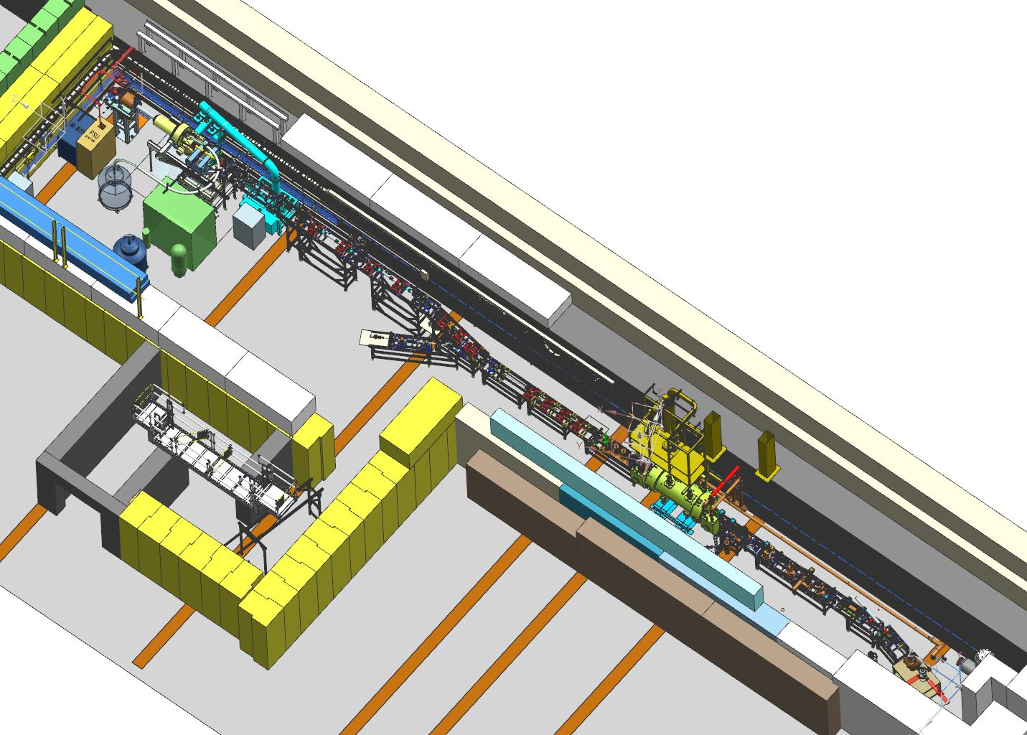
Status of Upgraded Injector Test Facility (UITF)
Matt Poelker
Status of UITF and dependence on CTF LHe (charge #1, 7, 9)
UITF goals: CEBAF injector, QCM tests, HDIce
Status of RadCon assessment, ARR, ASE, other approvals
Status of beam hardware & software control
Modes/Staff for providing beam
HDIce @ UITF – Experimental Readiness Review
November 19, 2019

Slide 2
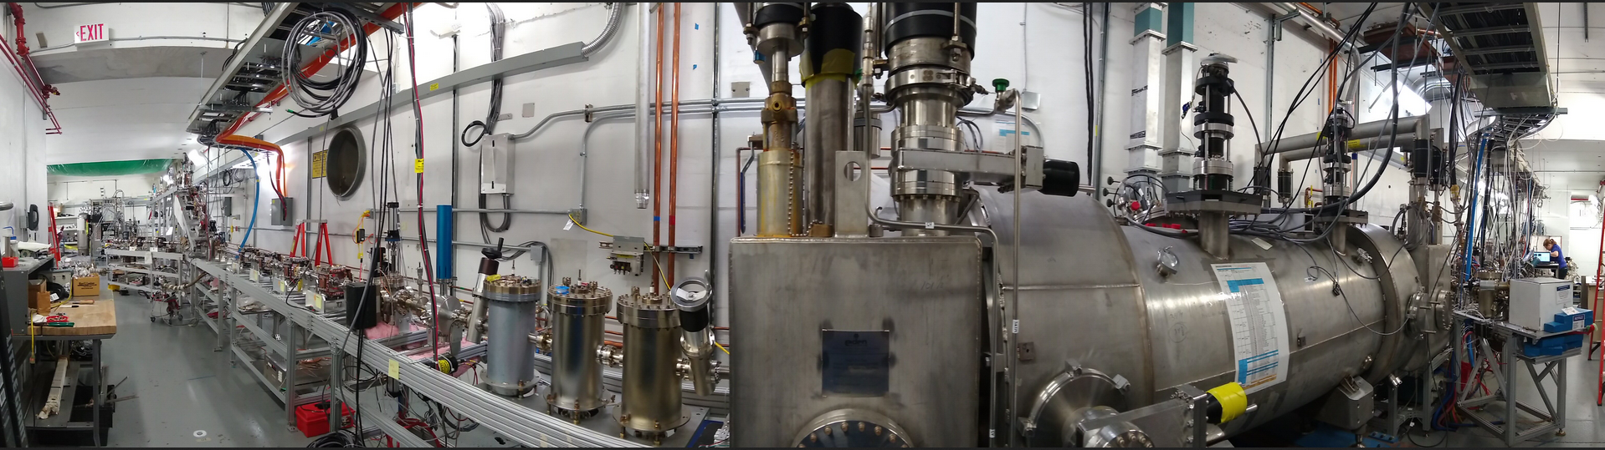
UITF is a 10 MeV spin-polarized electron accelerator
Q. 1
the UITF accelerator is built, ready to use….
(photogun getting baked, buncher not yet commissioned, we have not made MeV beam yet)

Slide 3
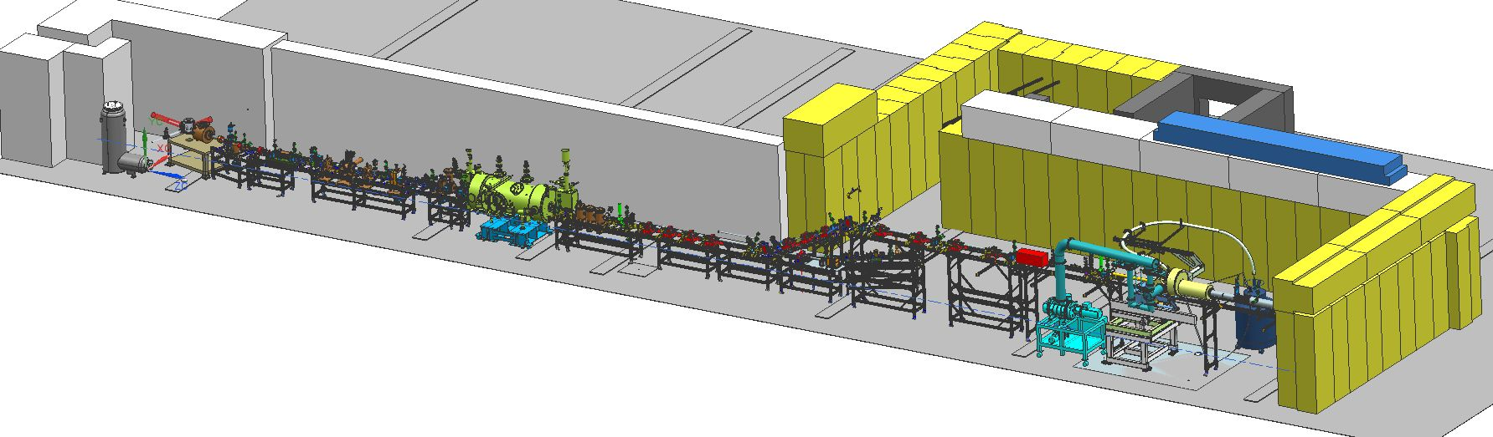
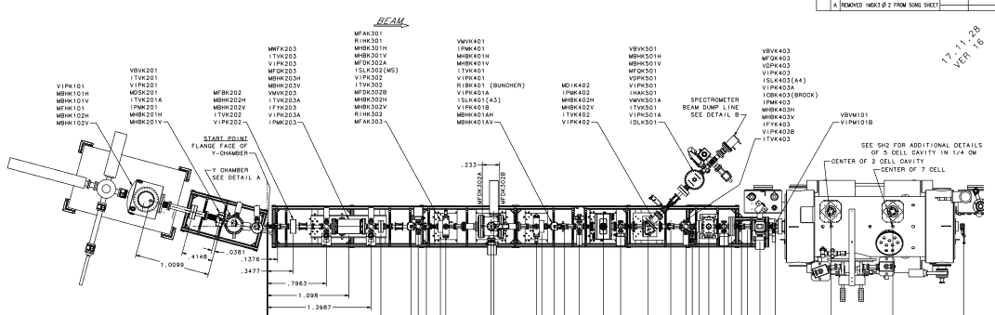
keV beamline commissioned*, RF applied to cold “Booster”, no MeV beam yet
* we are presently restoring operation of the photogun, cathode electrode was moved to CEBAF during SAD

Slide 4
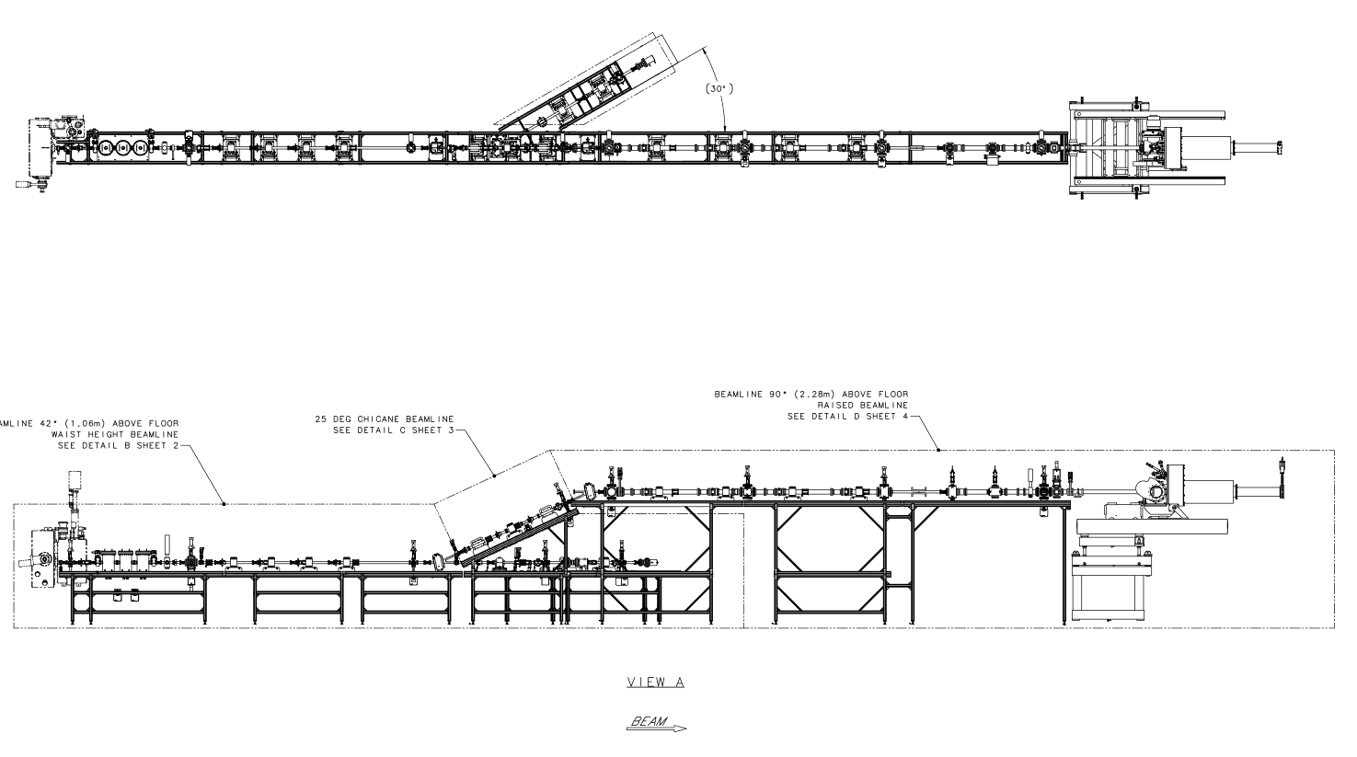
MeV beam….the accelerator
Design, construction, songsheets, software, everything is cabled up waiting for hot check out….
Run 0
Run 1

Slide 5
“Standard” tools available at UITF, just like at CEBAF
Low duty factor modes of operation: Viewer Limited and Tune Mode
Viewers, BPMs, harps, current monitoring
Spectrometers, Yao cavity, and Brock bunchlength monitor
Ditherer to center beam in solenoids and quads
Elegant to predict device settings
Archiver, save/restore, twiddle save
Frame grabber, viewer image fitting tool
StepNGraph
…
The HDIce beamline is “normal”, no anticipated problems putting beam on viewer upstream of the IBC

Slide 6
Unique aspects of HDIce, i.e., low current
After threading normal tune-mode beam (100 nA ave current) to last viewer, we will:
insert the chopper slit to obtain nA beam at Faraday cup in front of IBC. Chopper slit current (i.e., beam that is dumped) serves as good gun current monitor
use viewers in CW mode as current monitors, one viewer in front, one viewer behind IBC. Viewer image intensity cross-calibrated against faraday cup. Downstream viewer provide real-time current monitoring (and position monitoring)
apertures with proper holes prevent dumping beam on cell walls
if there's a steering magnet in between apertures, it will be interlocked
radiation monitors at apertures in front of IBC, and behind IBC. Beam trips OFF when radiation levels exceed nominal good readings
ragowski coil (we hope) provides real-time beam position and beam current monitoring, it will serve as go/no go indicator, with fsd interlock to trip OFF beam
solenoid magnet will also be interlocked via fsd

Slide 7
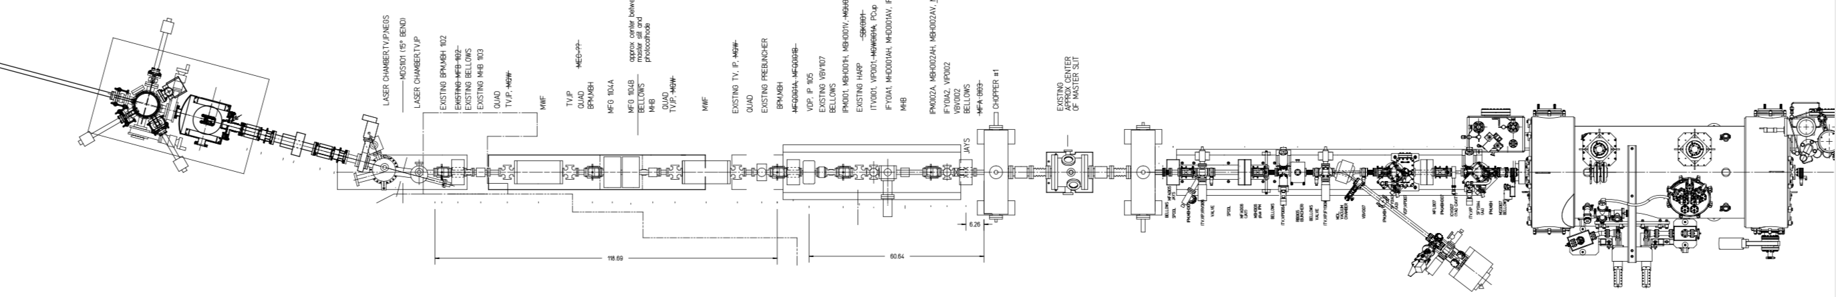
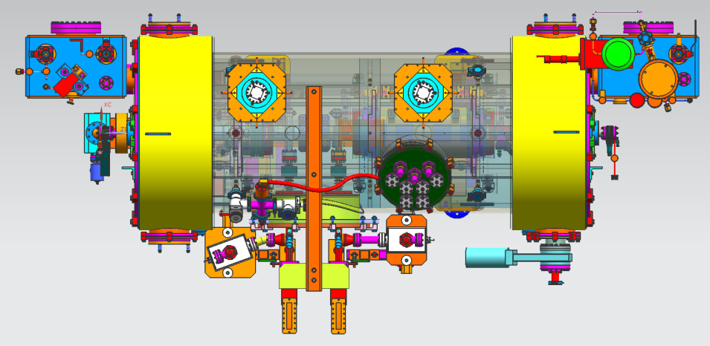
Test the Booster before installing at CEBAF in 2020
Increase gun voltage and Wien filters for 200 kV operation to suppress space-charge effects and improve parity quality beam
Locate Wien filters (energy filters) upstream of pre-buncher cavity and install quadrupoles to better compensate astigmatism
Increase aperture of chopper and beam line solenoids to suppress existing astigmatism and improve parity quality beam
Install new SRF booster that eliminates warm-rf capture cavity, RF deflection and x/y coupling
Our new “booster”:
2 cell capture section + 7 cell cavity,
should provide 10 MeV beam and introduce no x/y coupling, allow better matching, more adiabatic damping

Slide 8
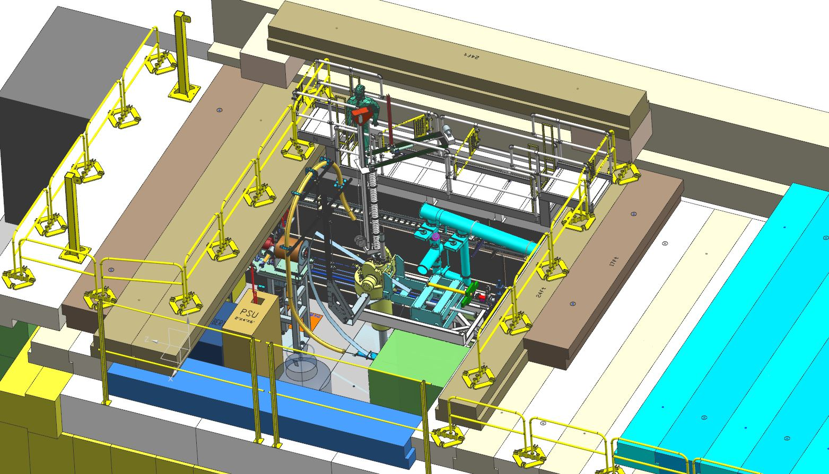
Test the spin-polarized target “HDIce”

Slide 9
Past Reviews of UITF
Review #1: UITF Operations Review, aka “will it work?” March 18, 2016
  https://wiki.jlab.org/ciswiki/index.php/UITF_Meeting_-_March_18,_2016
Review #2: UITF Safety Review, May 10, 2016
  https://wiki.jlab.org/ciswiki/index.php/UITF_Meeting_-_May_10,_2016
Review #2.5: PSS BCM review *, October 21, 2016
  https://wiki.jlab.org/ciswiki/index.php/UITF_Meeting_-_October_21,_2016
Review #3: Conduct of Operations Review, April 24, 2019
  https://wiki.jlab.org/ciswiki/index.php/UITF_Meeting_-_April_24,_2019
Shielding Design Package, June 2019, JLAB-TN-18-020
Accelerator Readiness Review: June 26-28, 2019
  https://www.jlab.org/indico/event/322/timetable/#20190626
* the PSS BCM, once deemed necessary now deemed optional, following detailed shielding assessment

Slide 10

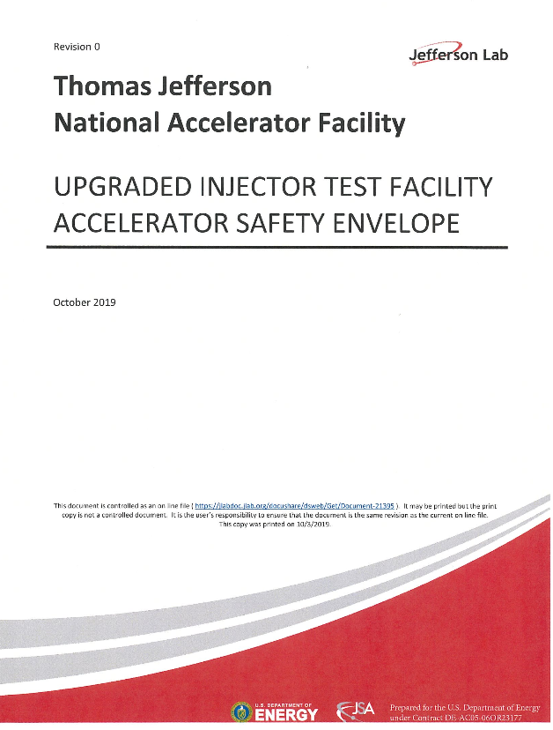
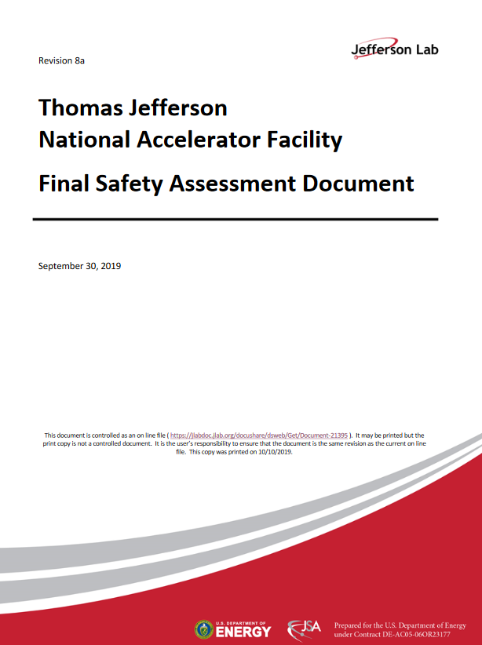
Official Documentation
These documents were approved by Lab Leadership and TJSO
https://wiki.jlab.org/ciswiki/index.php/UITF_Official_Documents
https://www.jlab.org/eshq/ProgramDocs

Slide 11
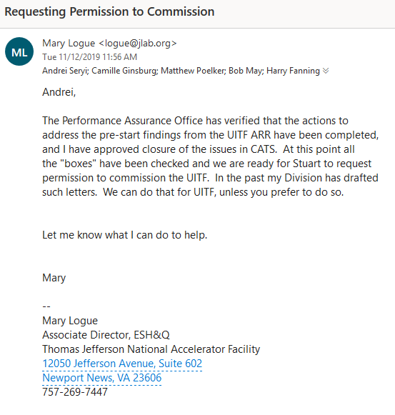
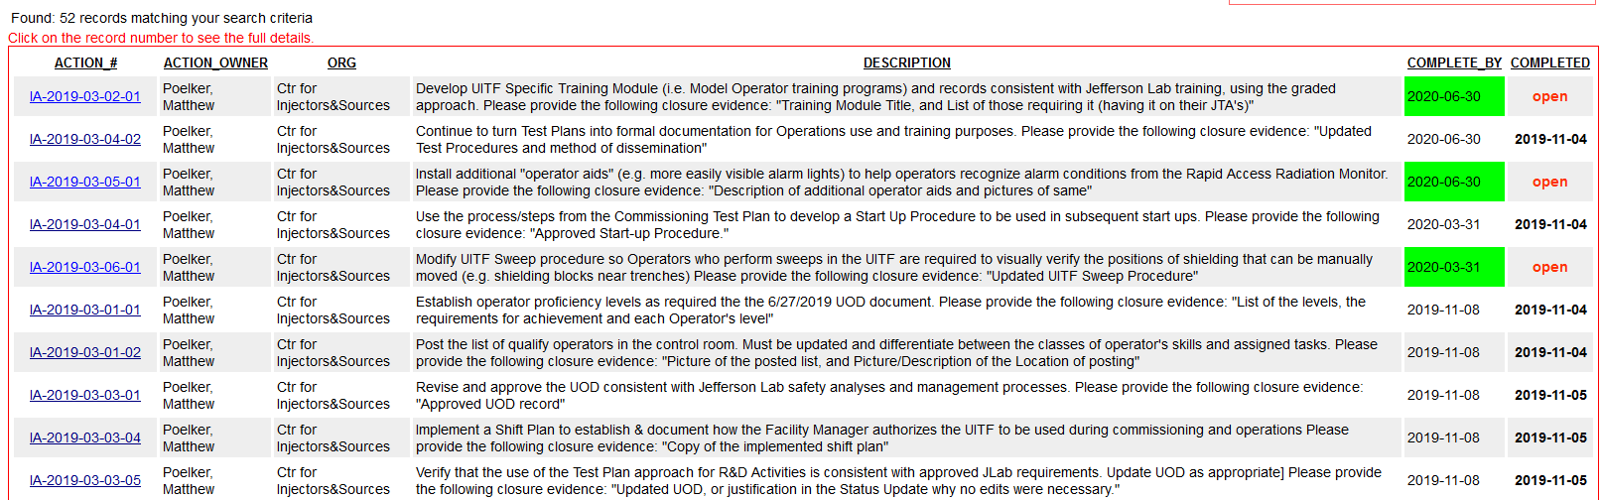
CATS items
Q. 1
all prestart findings have been addressed

Slide 12
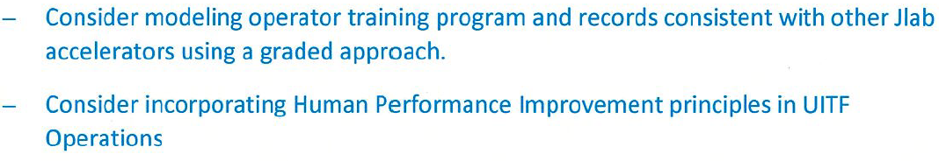
Post Start Findings of ARR
Q. 1
Post-start Findings will need to be addressed soon after Commissioning:

Slide 13
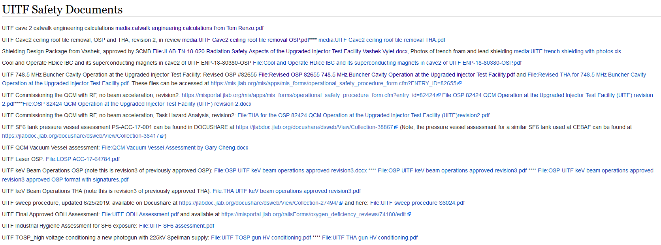
Official Documentation
https://wiki.jlab.org/ciswiki/index.php/UITF_Safety_Documents

Slide 14
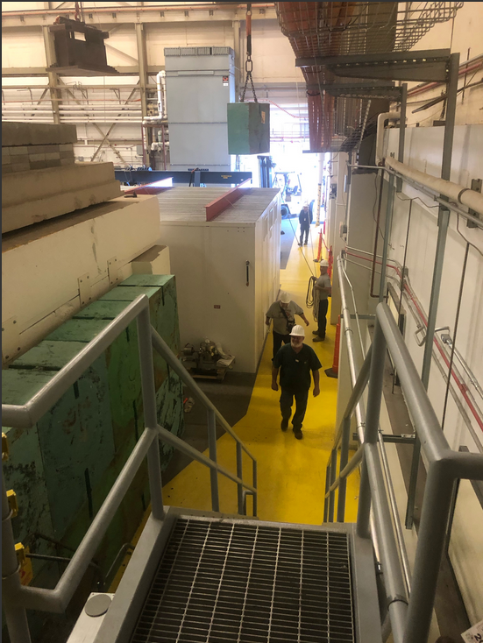
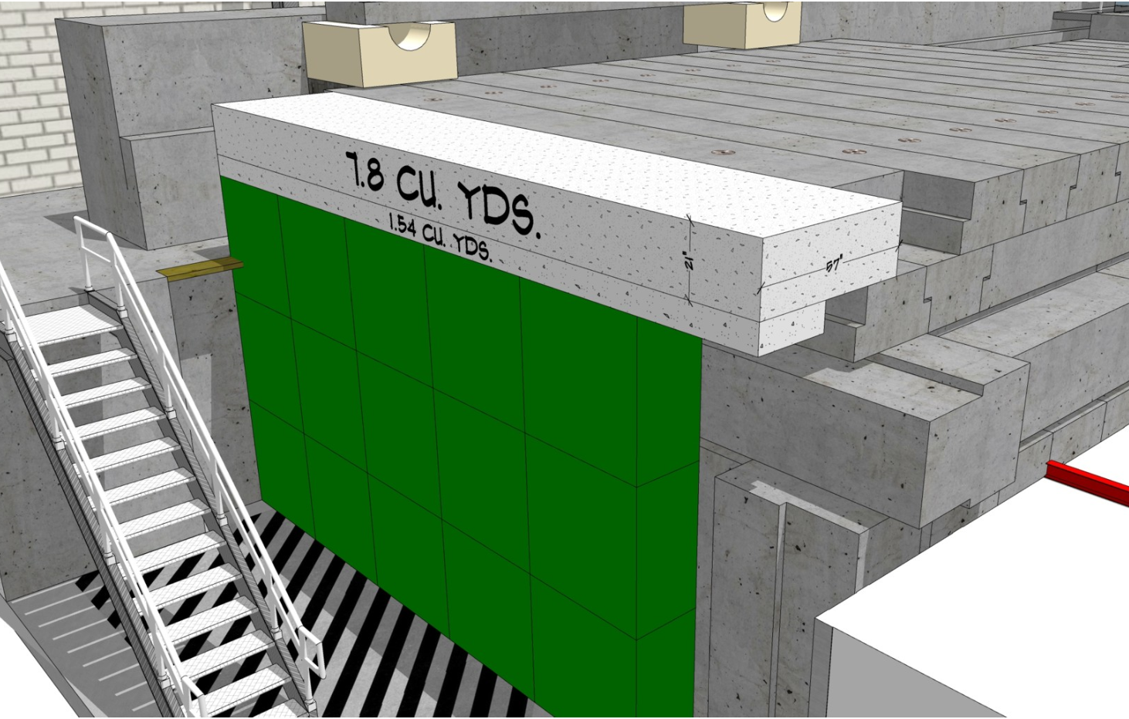
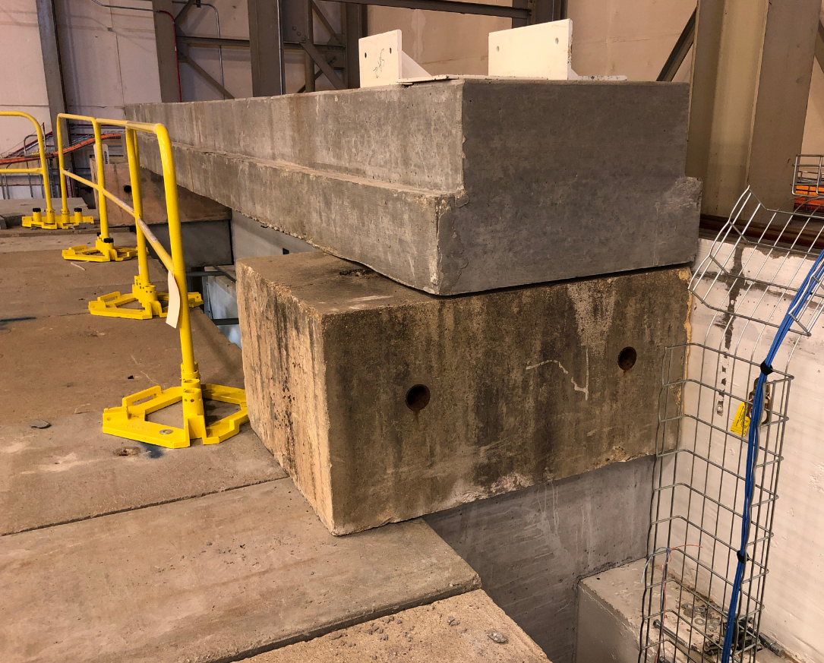
Augmenting Cave2 Shielding
helium vent – used to maintain ODH0, ODH1 status

Slide 15
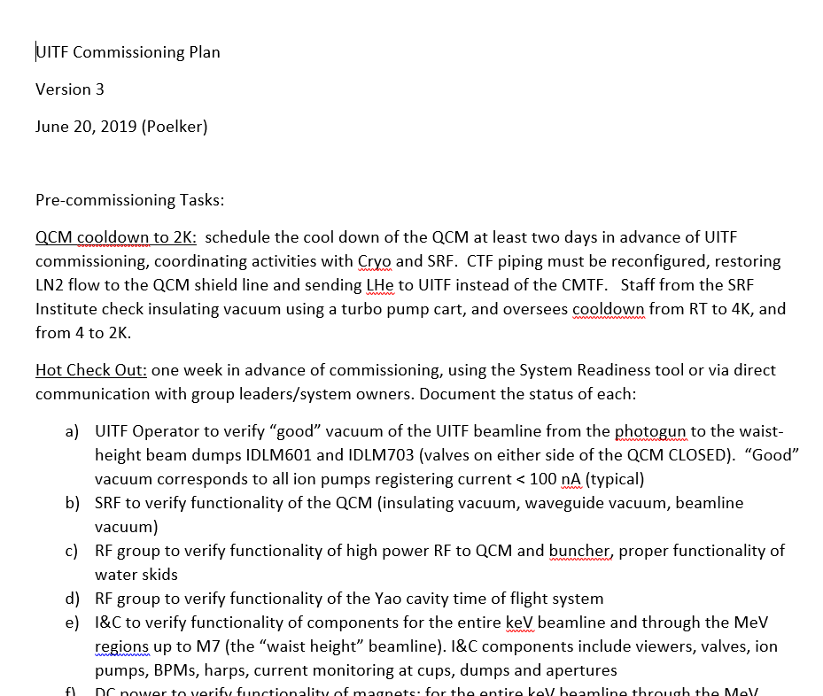
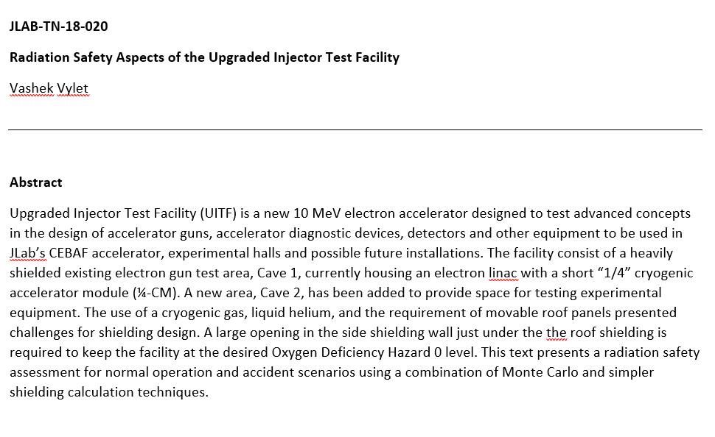
Radiation Shielding Assessment and Commissioning Plan
Q. 9
https://wiki.jlab.org/ciswiki/index.php/UITF_Safety_Documents
Shielding is adequate for 100 uA CW beam
https://wiki.jlab.org/ciswiki/index.php/UITF_Official_Documents

Slide 16
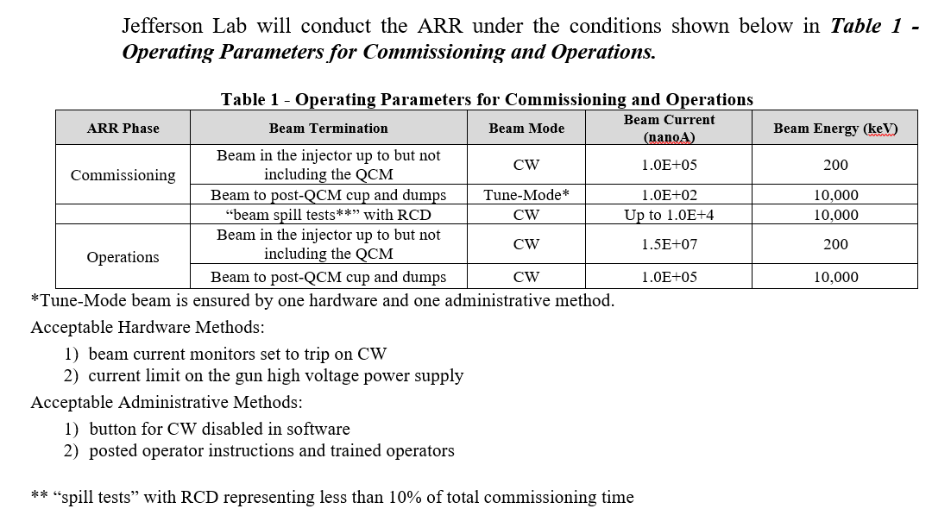
Table 1 of the UITF ARR Plan, presented to ARR Review Committee June 26-28, 2019

Slide 17
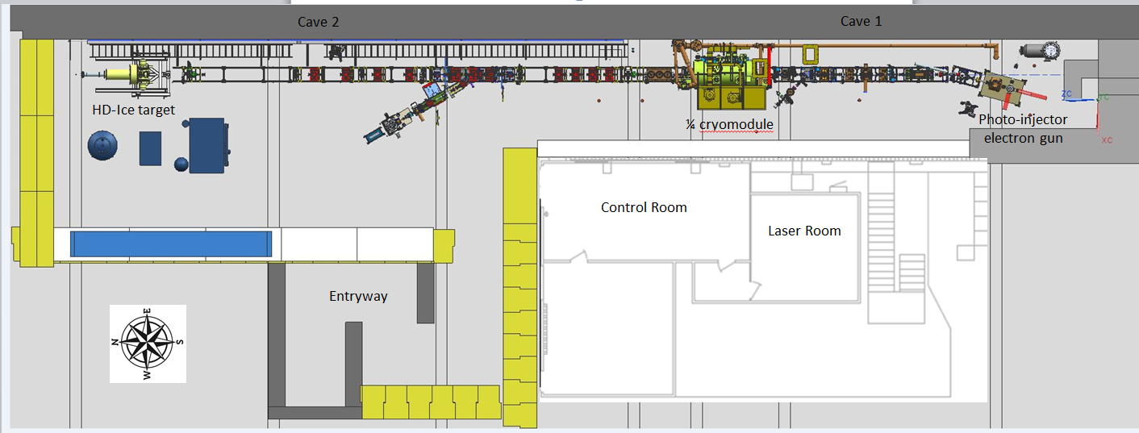
Commissioning process “break points”, verify shielding is adequate
BLM locations (ILMM401, 601 and 701)
Good locations for spill tests:
proximity to control room and labyrinth

Slide 18
MeV beam….the accelerator
Run 0
Run 1

Slide 19
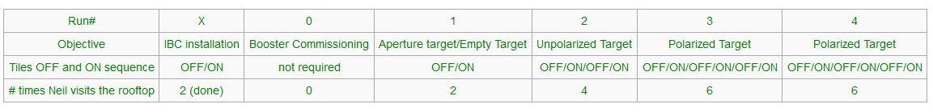
UITF “schedule”
Q. 7
HDIce proposed run schedule
done
waiting for permission
January, February, March, April, May?
Buncher commissioning December
Booster commissioning January

Slide 20
UITF “schedule”
Q. 7
Task | Comment
Restore 200 kV beam operation (photogun bakeout, HV conditioning, activate photocathode) | Gun bakeout now, then HV conditioning
Commission the 200 kV buncher cavity | waiting for amp, Injector Group focused on CEBAF start up
Obtain permission from TJSO to commission the "waist-height" accelerator | EH&S approval, Andrei to ask Stuart to ask TJSO
Set a date for commissioning "waist-height" beamline (Run #0) | hard to do without having permission to commission
coordinate with Cryo and SRF, u-tube swap at CTF, booster cool down
Engineering gets two weeks notice for HCO
HDIce completes work inside enclosure: magnet, dump, halo counter installation | now through…..
administrative tasks: beam authorization, shift plans, coordinate control room staffing approved operators
Commission the Booster | estimate one week of beam, no access to the enclosure
Obtain permission to operate UITF accelerator to test HDIce, another round of signatures | Is this time consuming?
Set a date for commissioning the elevated beamline (Run #1)
installation work, HDIce specific controls and diagnostics
Engineering gets two weeks notice for HCO
accelerator checks: beam size, energy spread, stability
HDIce specific checks: ragowski coil BPM calibration, raster magnets, fsd functionality, current calibration
Remove Booster and install at CEBAF | May-20
Install CEBAF 1/4 CM

Slide 21
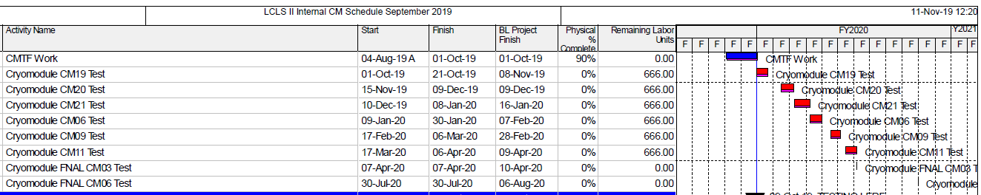
CTF Schedule
Q. 7
CTF is broken now, CM20 moved to LERF for testing, no plans for CMTF tests through 2019
December 2019, send beam through warm booster, commission the buncher
Jan 2-9/20 commission cold booster and waist height accelerator
HDIce tests:
Jan 31-Feb 16/20 (17 days = 4 d switch-overs + 13 d UITF OPS)
Mar 7-16/20 (10 days = 4 d switch-overs + 6 d UITF OPS)
Apr 11-May 5/20 (25 days = 4 d switch-overs + 21 d UITF OPS)

Slide 22
Approved UITF Operators (underlined names)
Gun Group (Center for Injectors and Sources)
Scientists: J. Grames, C. Hernandez-Garcia, M. A. Mamun, M. Poelker, R. Suleiman, M. Stutzman and S. Zhang
Technical staff: P. Adderley, B. Bullard, (plus replacement for John Hansknecht)
Graduate Students: G. Palacios, S. Wijiethunga, J. Yoskovitz
Injector Group
Scientists: R. Kazimi, Y. Wang, A. Hofler

Slide 23
UITF – Summary (slide presented at JLAAC and P&C Meeting)
Testing the “booster” and HDIce target remain high priority tasks, now with “deadline” May 2020
Project started 2014…..now the Accelerator is built with three MeV beam destinations, waiting for permission to commission
Conduct of Operations Review, Shielding Design Package, and Accelerator Readiness Review
UOD, ASE and updated FSAD
Commissioning Plan and a number of OSPs
While working towards MeV operations, we have been using UITF as a Gun Test Stand:
  Tested a number of cathode electrodes, and two gun designs
  Modified Wien filter to operate at +/-20kV per plate, for 200 keV beam
  Assisted visiting scholar Max Herbert, testing LiCsNF3:GaAs, does lithium prolong operating lifetime?
  Installed the non-invasive resonant polarimeter from sbir-partner Electrodynamic, beam tests soon
When booster leaves UITF for CEBAF May 2020, we will install a traditional ¼ CM, and then we need 350 kV photogun (this is an R&D project for us)
Held Workshop on Uses of UITF
Nb₃Sn coated cavities inside ¼ CM, waste water treatment, fast kicking, bubble chamber astrophysics experiment, PEPPo….all these topics represent potential R&D for UITF

Slide 24
UITF – Summary (~ slide presented at JLAAC and P&C Meeting)
Q. 7
Future challenges:
  The Gun and Injector Groups (nominally, the people we originally imagined operating UITF) need to focus on the CEBAF injector upgrade, scheduled to start May 2020, ~ five months from now
  After Booster commissioning, HDice needs a minimum of three (preferably four) two-week run periods BEFORE the Booster is removed in May of 2020
  Formality of DOE requirements….suggests fulltime Facility Manager and Operations staffing required
  Liquid helium: the CTF refrigerator at building 58 cannot provide sufficient LHe to operate Vertical Test Area, Cryomodule Test Facility and UITF simultaneously

Slide 25
Back Up Slides

