Slide 1
RTP Driver Prototype Crosstalk tests
Jim Kortze 20 October 2024

Slide 2
Summary:
Tests done to identify HV channel crosstalk
Tests conducted using Rigol MSO5204 oscilloscope and 1000:1 HV divider box.
For each test, the ground lead of the divider box was connected in parallel to the common lead of the RTP box and crystal being tested, and the lead under test connected to the HV divider signal input. All leads not under test were connected to their respective crystal connections
For each lead, four measurements were made: All supplies on, DUT supplies on with all others off, Pos on/ Neg off, Pos off/ Neg on

Slide 3
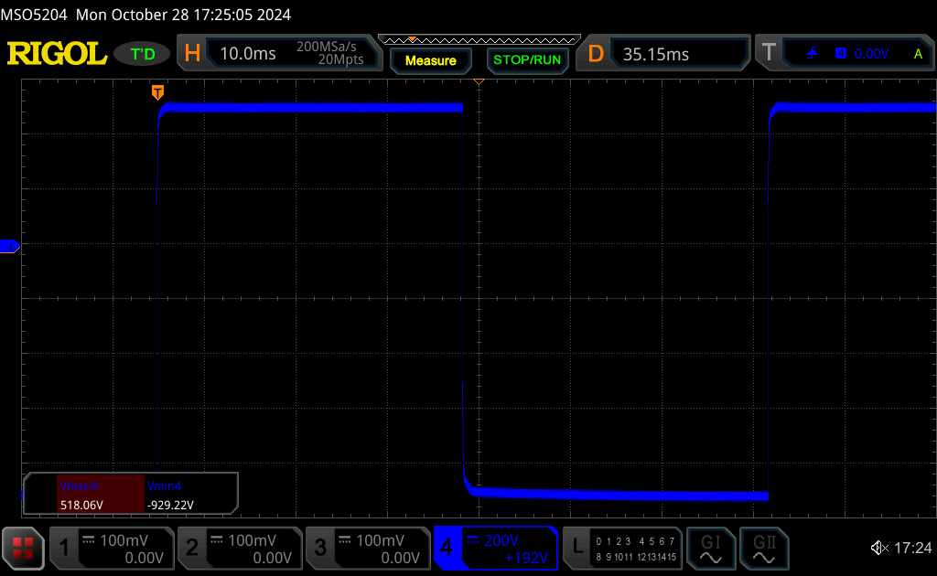
RTP1 POS LEAD ALL ON
518.06V/-929.22V

Slide 4
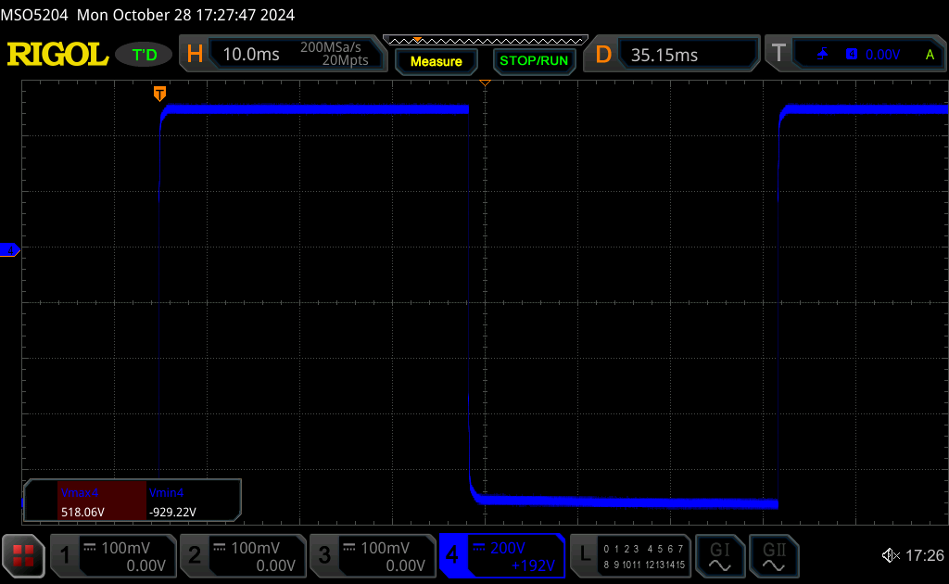
RTP1 POS LEAD OTHERS OFF
518.06V/-929.22V

Slide 5
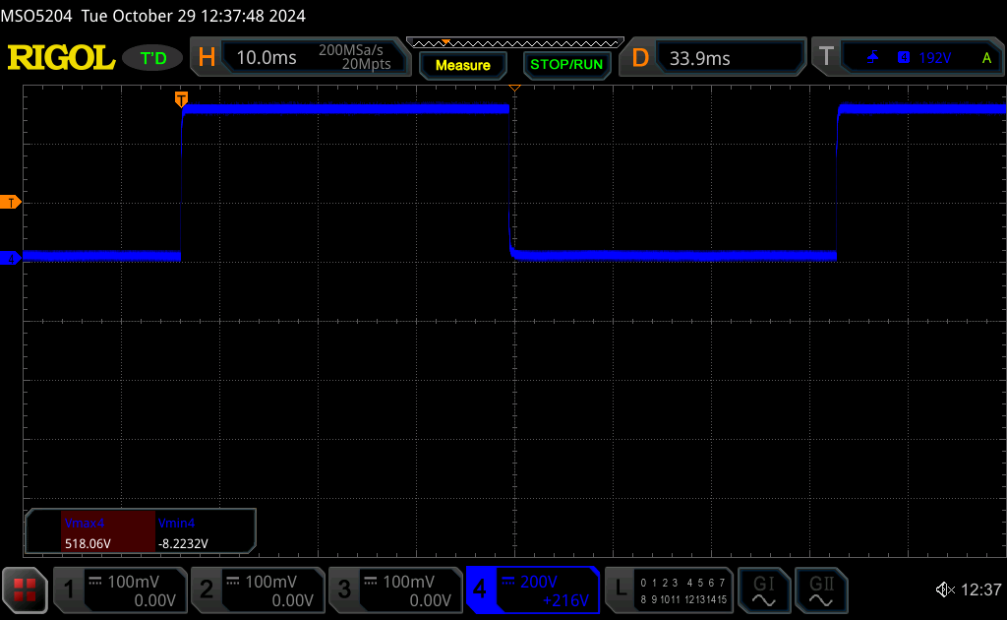
RTP1 POS LEAD POS ON/ NEG OFF
518.06V/-8.223

Slide 6
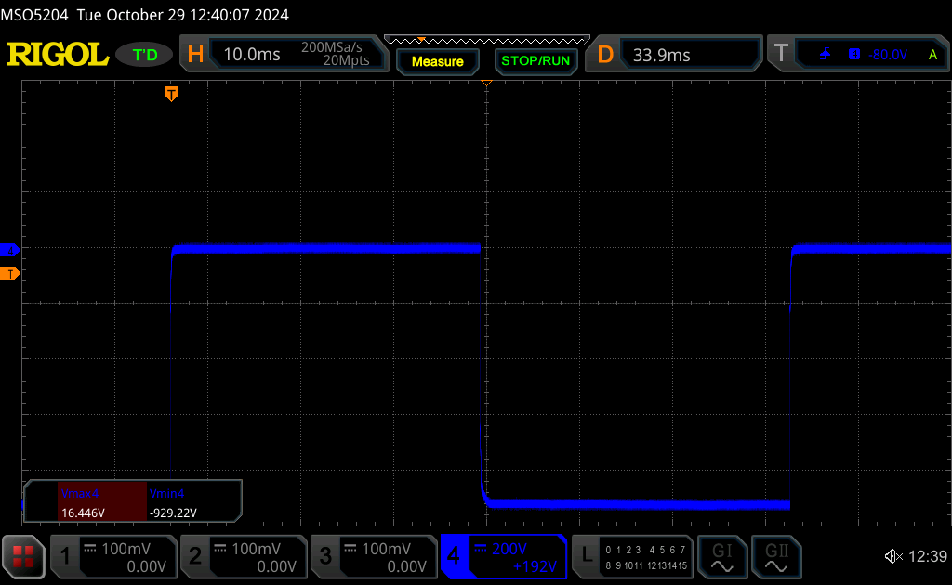
RTP1 POS LEAD POS OFF/ NEG ON
16.446V/-929.22V

Slide 7
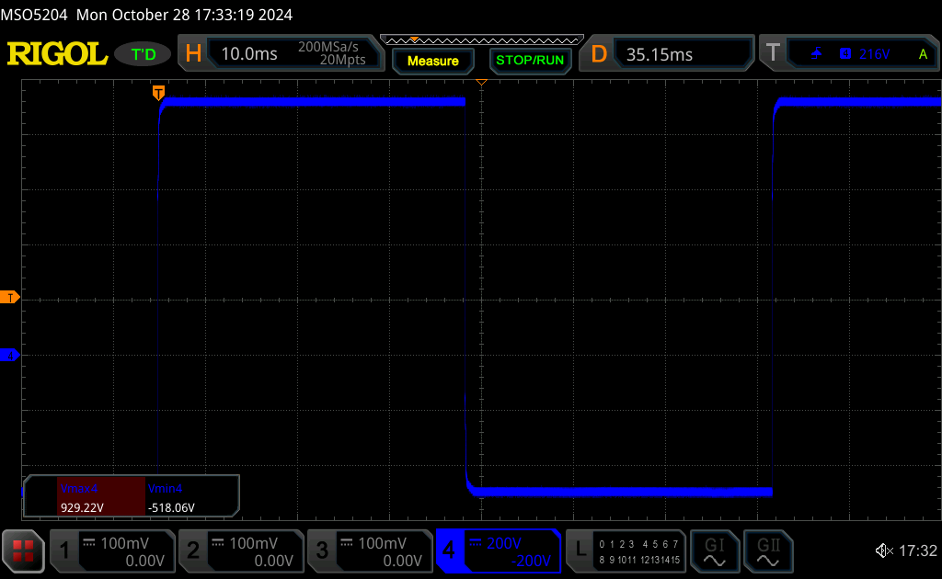
RTP1 NEG LEAD ALL ON
929.22V/ -518.06V

Slide 8
RTP1 NEG LEAD OTHERS OFF
929.22V/ -518.06V

Slide 9
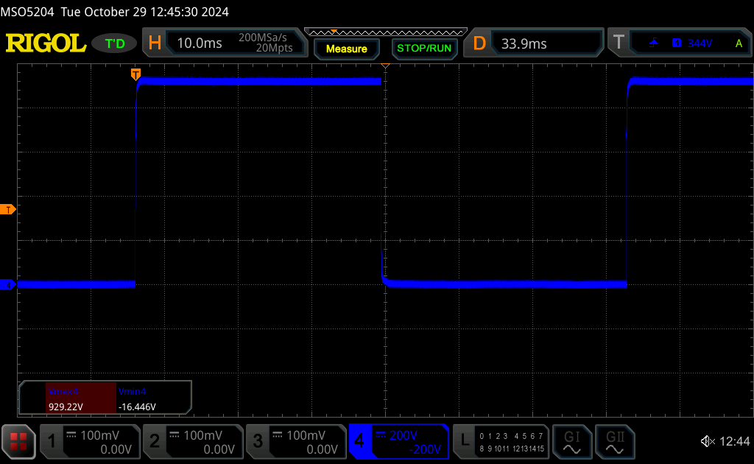
RTP1 NEG LEAD POS ON/ NEG OFF
929.22V/ -15.446V

Slide 10
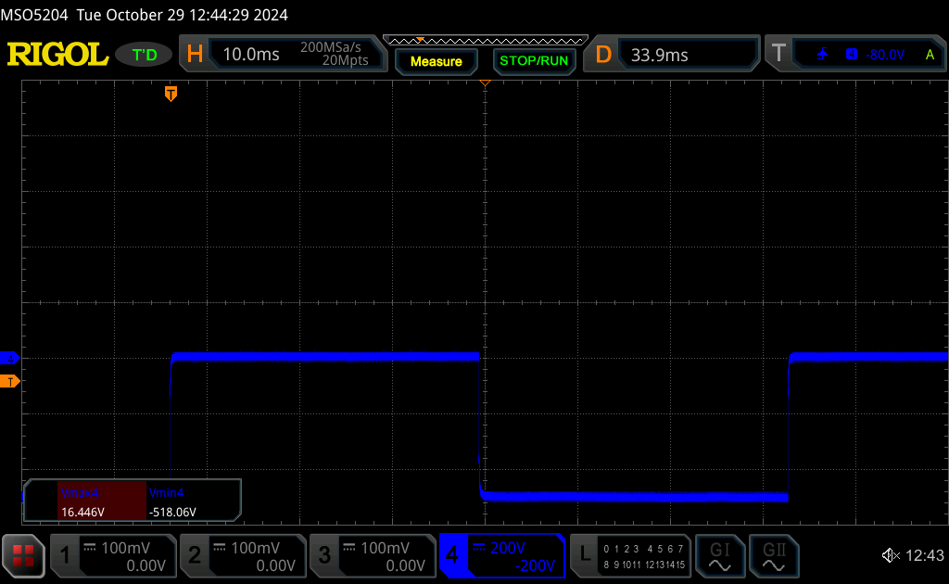
RTP1 NEG LEAD POS OFF/ NEG ON
16.446V/ -518.06V

Slide 11
RTP2 POS LEAD ALL ON
509.84V/ -921.00V

Slide 12
RTP2 POS LEAD OTHERS OFF
509.84V/ -929.22V

Slide 13
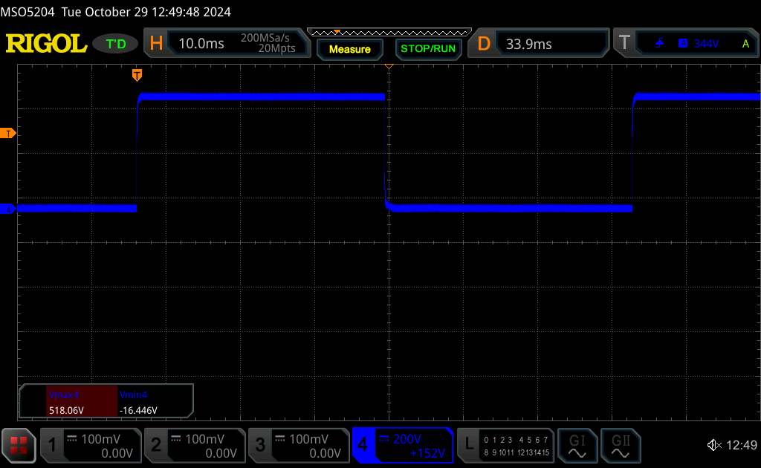
RTP2 POS LEAD POS ON/ NEG OFF
518.06V/ -16.446V

Slide 14
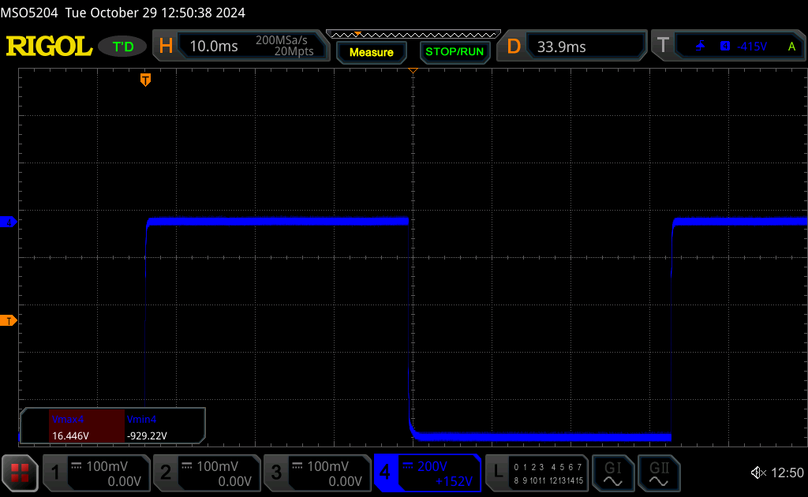
RTP2 POS LEAD POS OFF/ NEG ON
16.446V/ -929.22V

Slide 15
RTP2 NEG LEAD ALL ON
921.00V/ -518.06V

Slide 16
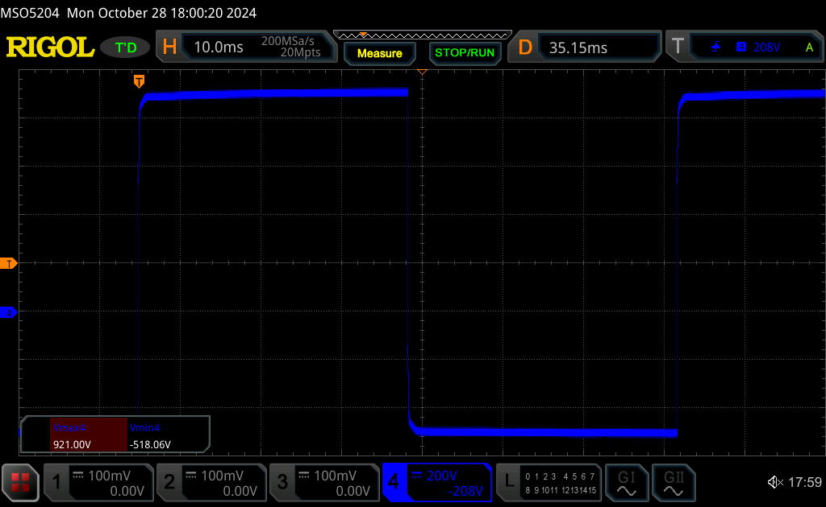
RTP2 NEG LEAD OTHERS OFF
921.00V/ -518.06V

Slide 17
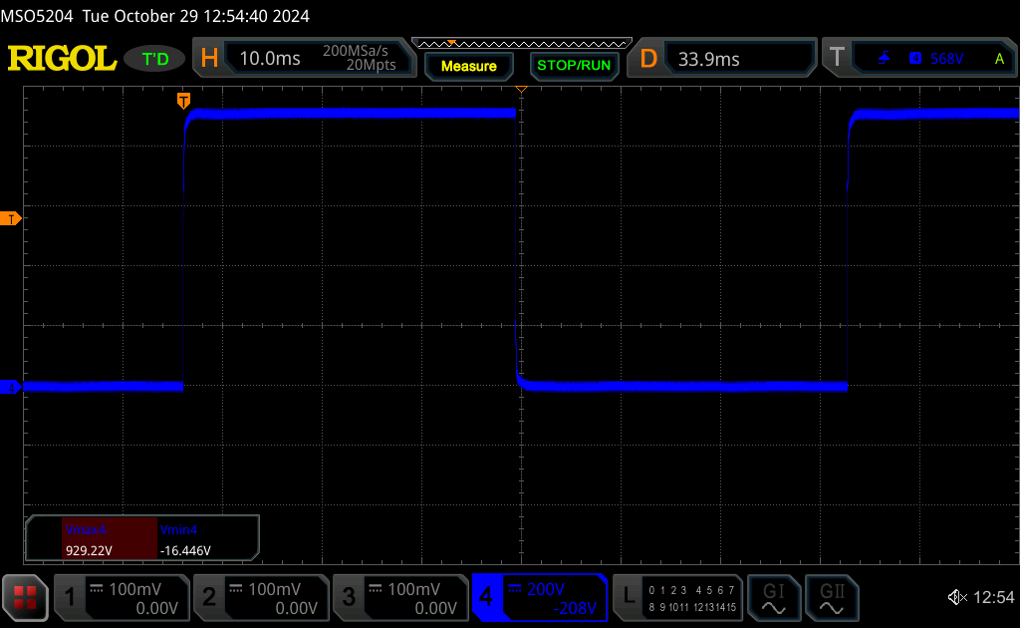
RTP2 NEG LEAD POS ON/ NEG OFF
929.22V/ -16.446V

Slide 18
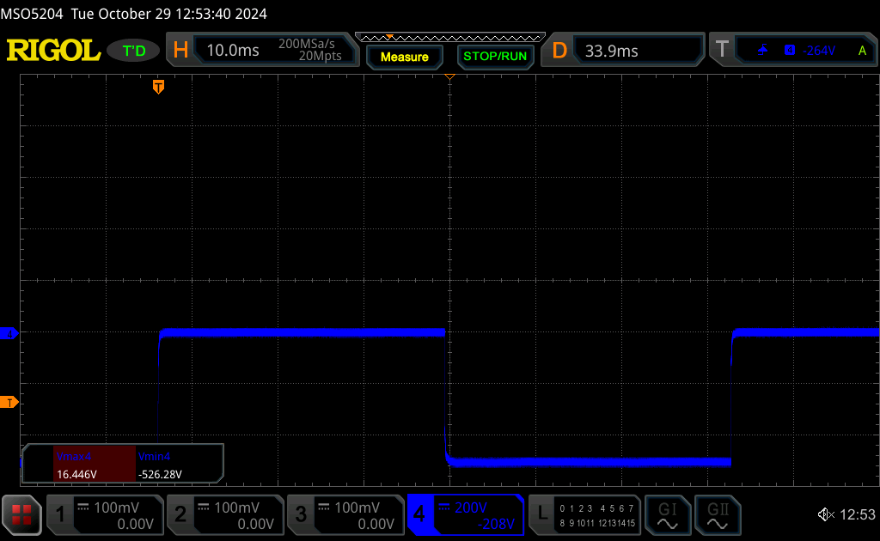
RTP2 NEG LEAD POS OFF/ NEG ON
16.446V/ -526.28V

Slide 19
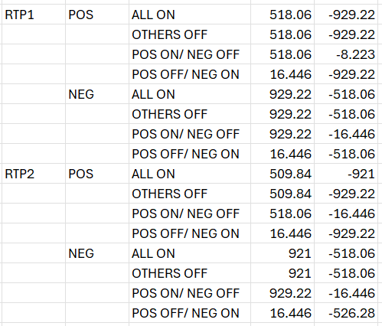
Conclusions
No notable signs of crosstalk between measurements
The largest variance between supply measurements was less than 2%, which is attributed to measurement noise

