Slide 1
Magneto-Optic Kerr Effect in a Magnetized Electron Gun
A Jefferson Lab summer project by Benjamin Hardy, overseen by Joseph Grames

Slide 2
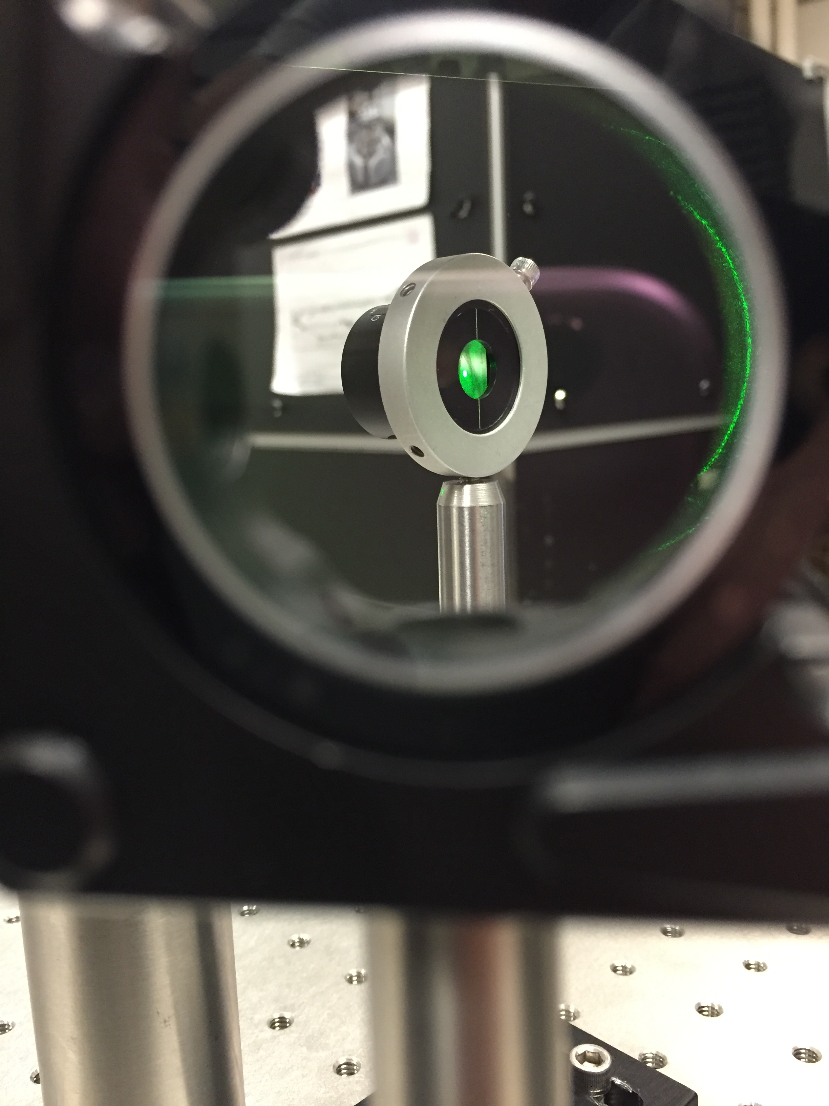
Outline
Motivation – measuring magnetic field in vacuum
Method – Magneto-Optic Kerr Effect as a diagnostic
Results – Lock-in amplifier technique
Next Steps – Calibration with Magnetic Field
Overview – the experiment’s accomplishments

Slide 3
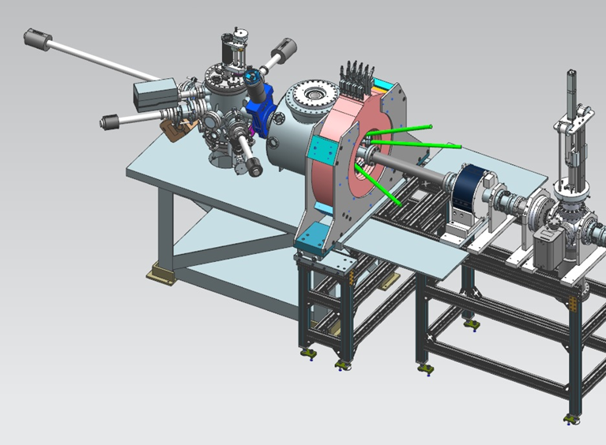
Motivation – Solenoid Magnetic Field
Magnetization of beam induced by Solenoid just off-center of photocathode
Photocathode operates in Vacuum chamber
Conventional methods of measuring magnetization would require breaking vacuum
in-situ diagnostic of the magnetic field strength/uniformity would be very practical
Beamline
Vacuum Chamber
Solenoid Magnet
Figure 1 – depicts basic Electron beam source in relation to solenoid position.

Slide 4
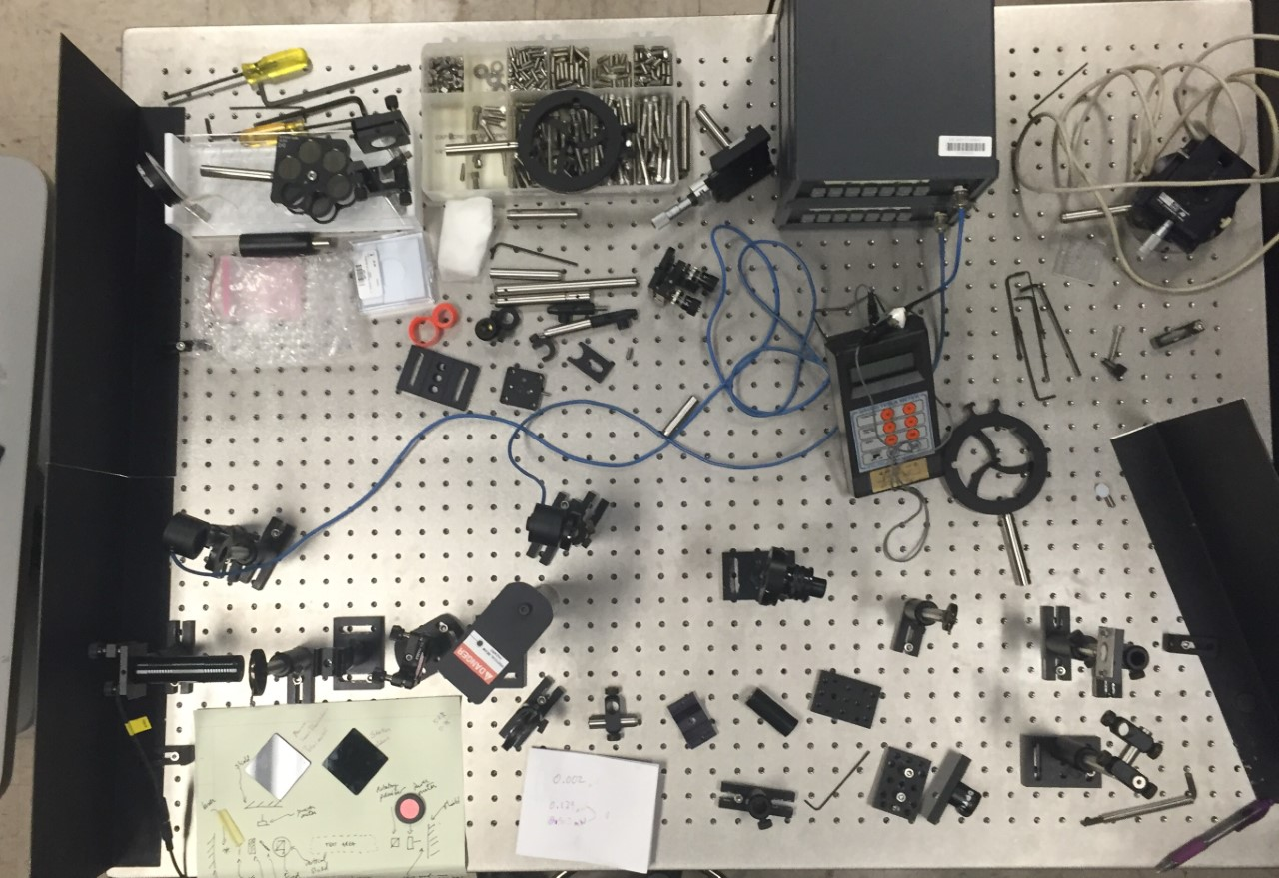
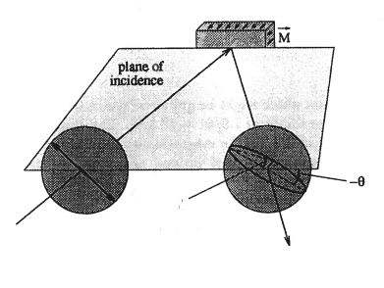
Method- The Magneto-Optic Kerr Effect
Figure 2 (right) – early optics table setup beam reflection path
Magneto-Optic Kerr Effect (MOKE)
Polarized laser light reflects off of magnetized surface
Induces rotation of plane of polarization (Ө)
Changes degree of ellipticity (ε)
Kerr ε and Ө are linearly related to magnetization of sample
Figure 3 (left) – Principle behind the Kerr measurement
Ө
ε

Slide 5
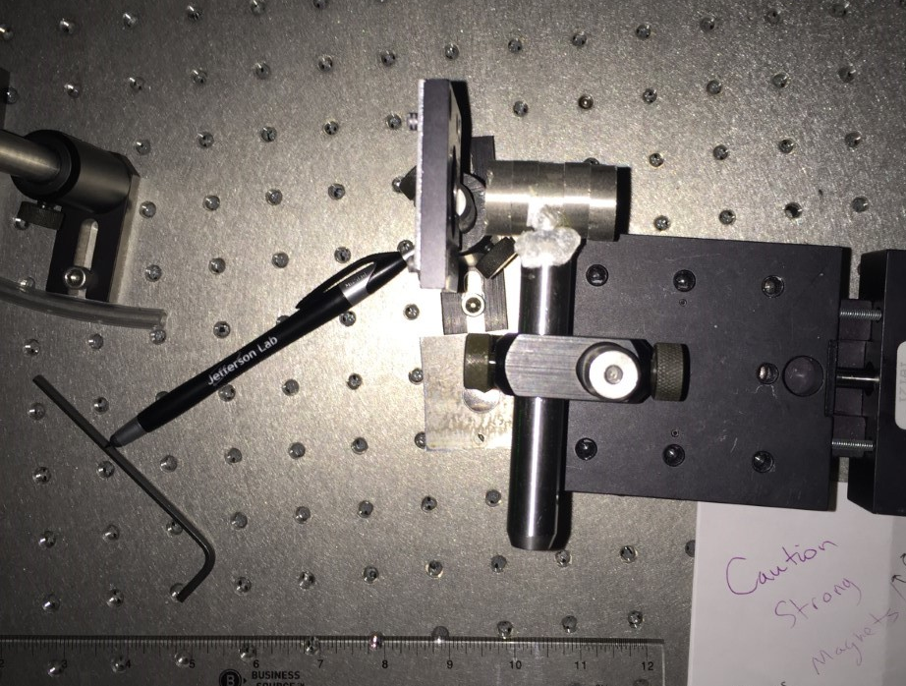
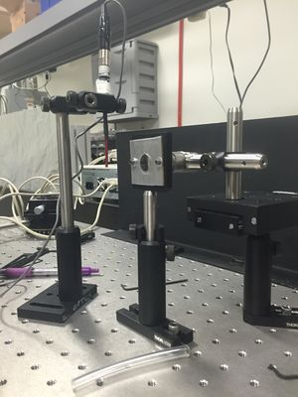
Method- reflection and initial bench tests
Permanent magnets are mounted on micrometer and used to magnetize foil
Gives a linear relation of B field with Ө and ε
Serves as bench test
Figures 4,5 – further demonstrating bench test. Pure polished Iron foil, and permanent magnets.
99.9% Iron Foil
Permanent Magnets

Slide 6
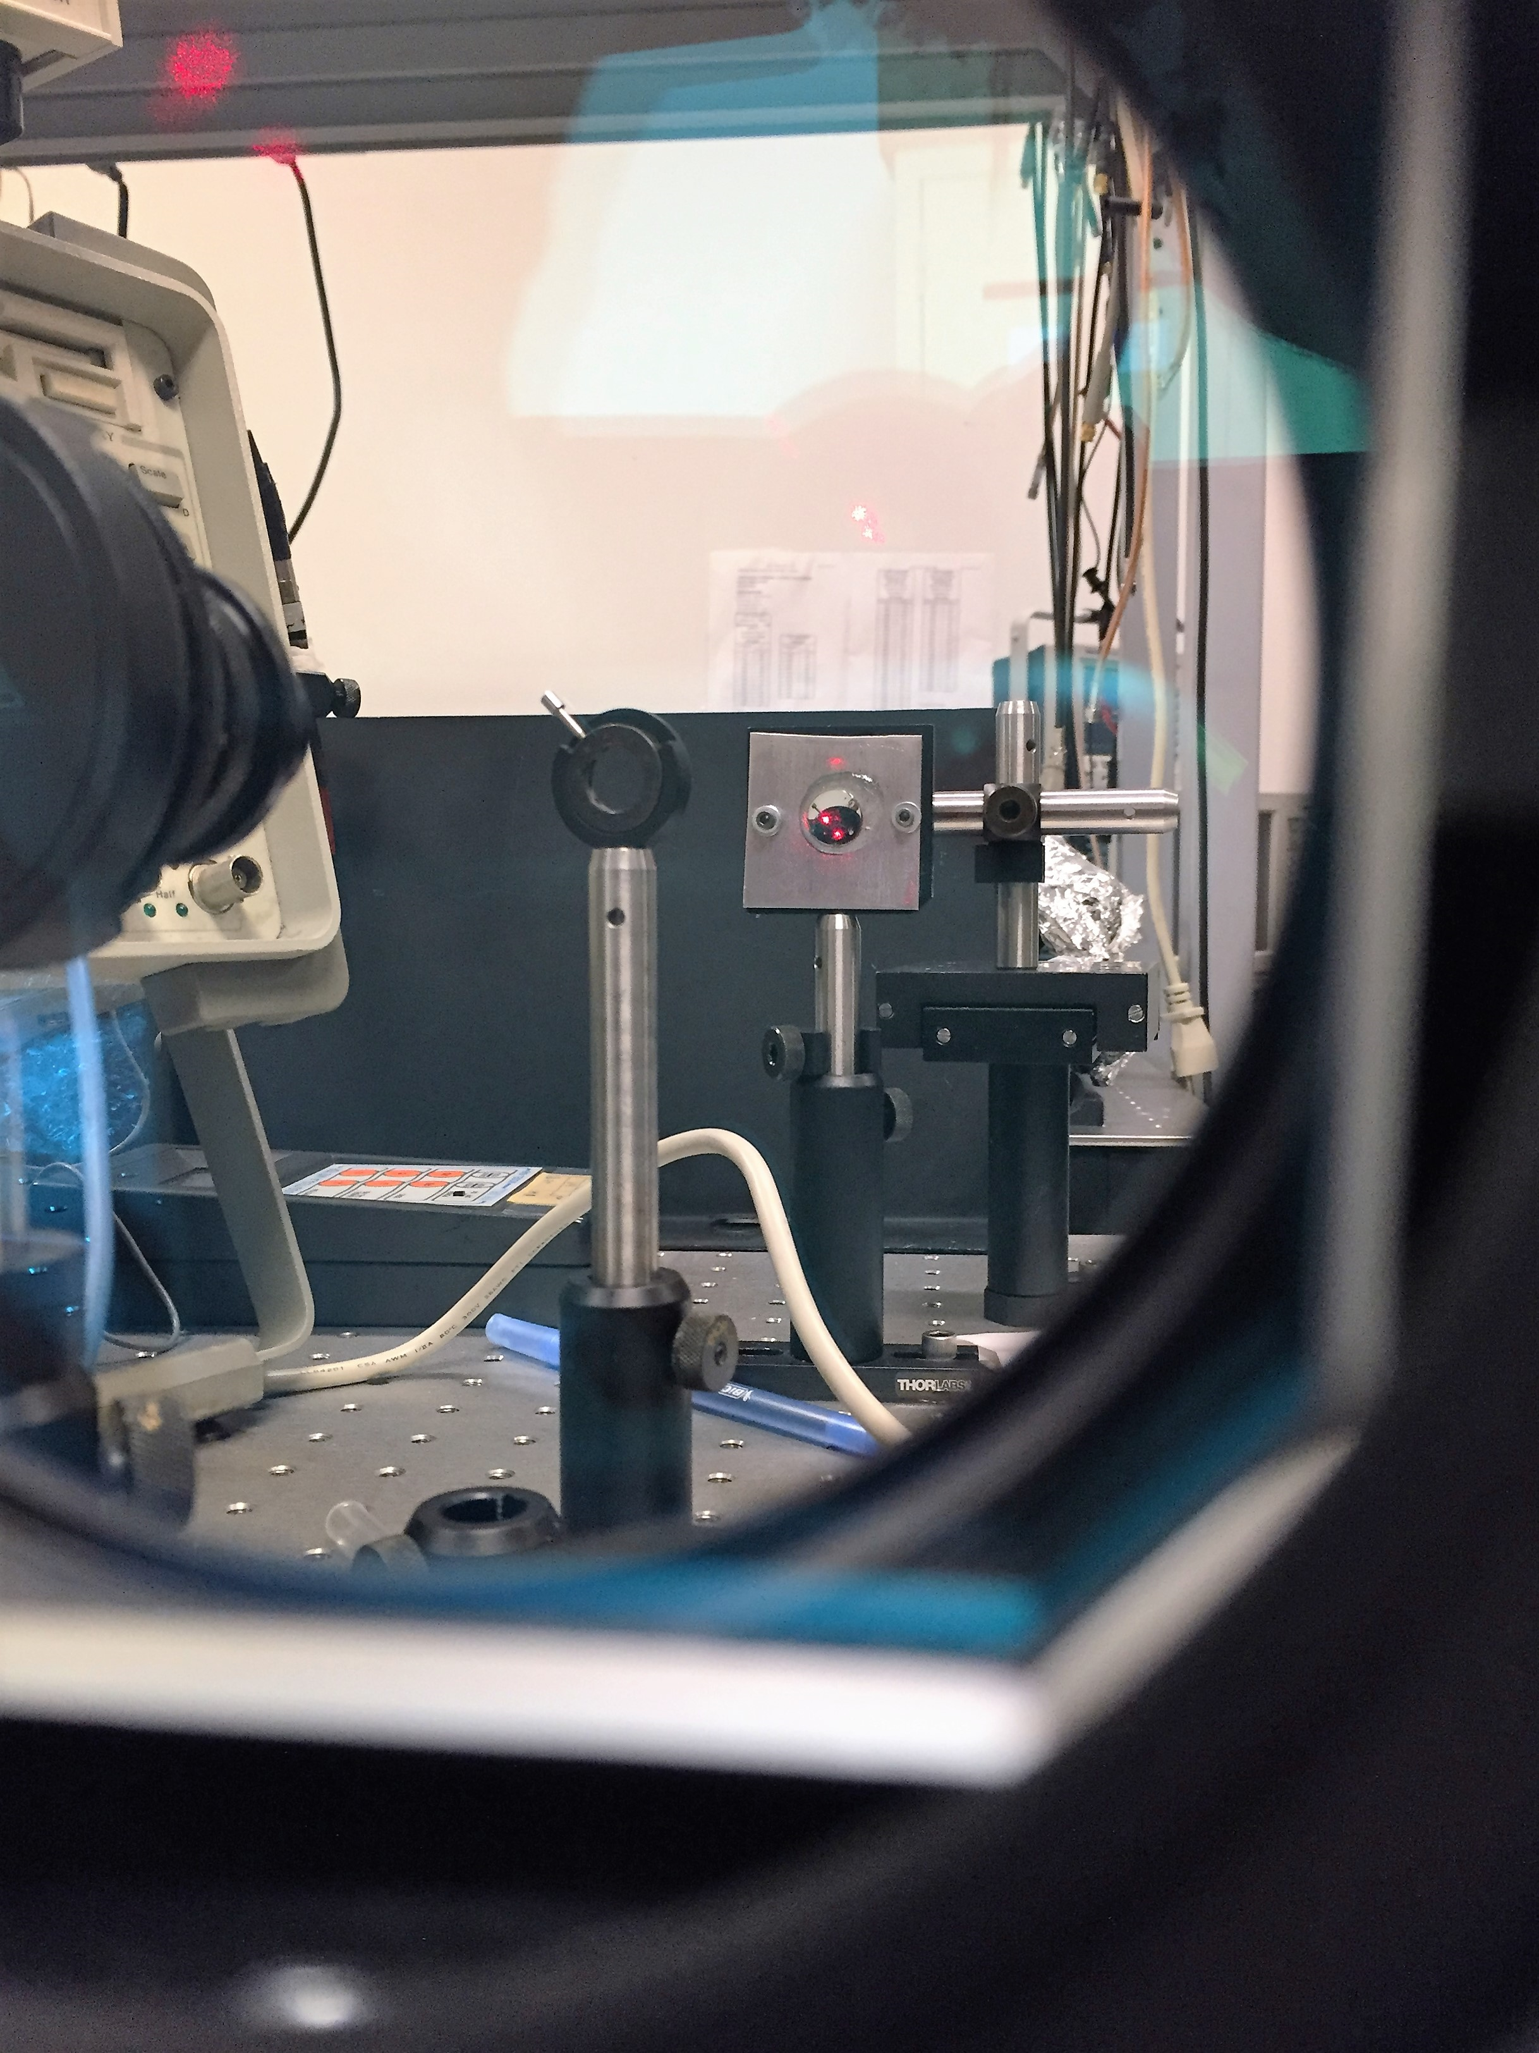
Method- Implementing the Photo-elastic modulator
Analyzer
Photo-Elastic Modulator (PEM) modulates polarization of light at a resonant frequency 1f (≈42. kHz)
Photo-elastic effect changes the birefringence of the silica crystal
1f and 2f are proportional to ε and Ө in certain bench set ups.
Lock-in Amplifiers lock on to 1f and 2f and report their amplitudes
Laser
Fused Silica Bar
Figure 6 – a view of the foil from the perspective of the PEM

Slide 7
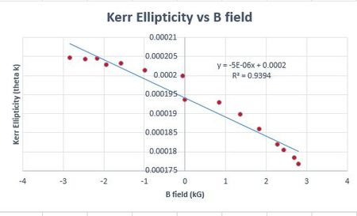
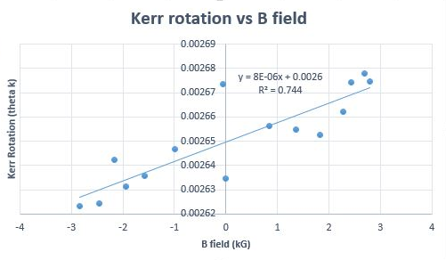
Results – Lock-in Amplifier signal
Figure 7(a,b) – Equations for ε Ө
Figure 8 – Literature reports ε to be more sensitive to magnetic field
Figure 9 – This was the intitial measurement. The system can be optimized to produce a more linear progression of data

Slide 8
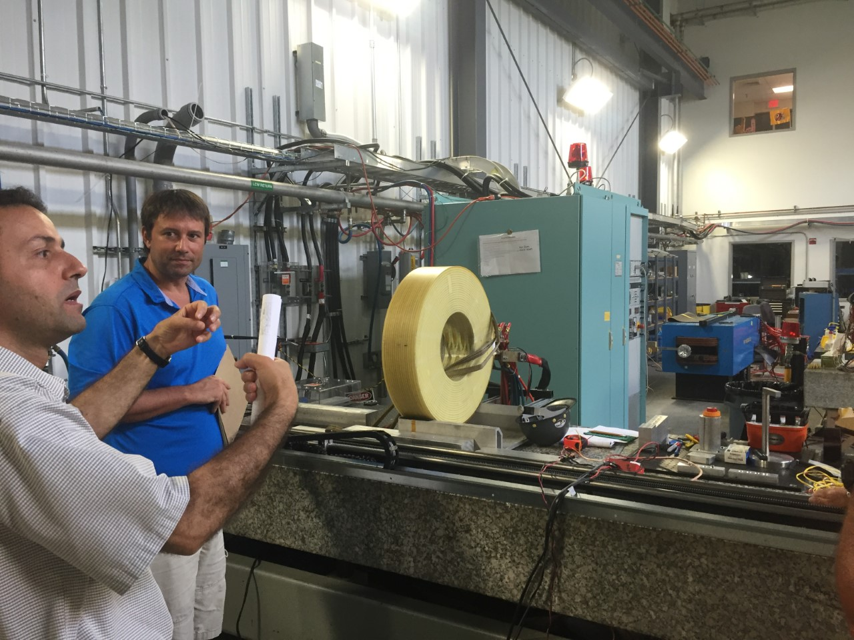
What’s next? – Calibration of bench tests with Solenoid
Calibration of field in relation to position with respect to solenoid in the Magnet Measurement Facility (MMF)
Implementation of “Kerrmometer” onto portable bread board
Further optimization of Lock-In technique
Solenoid Magnet in MMF
Joe Grames
Riad Suleiman
Figure 10 – Riad Suleiman and Joe Grames discuss mapping of solenoid magnetic field

Slide 9
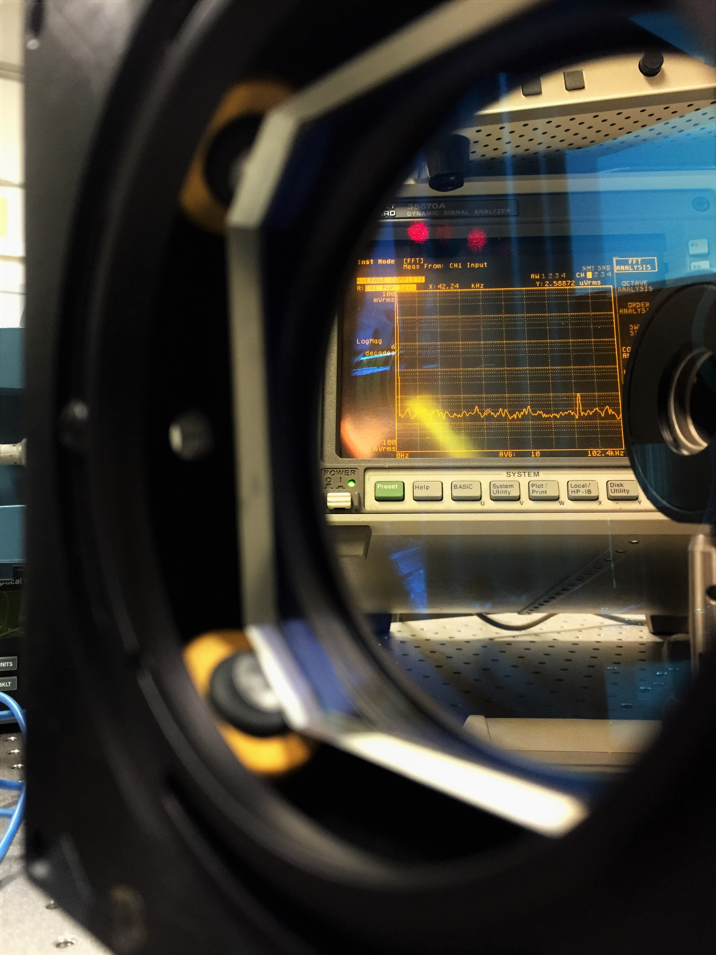
Overview- our GOals
Correlate change in ε and Ө directly to magnetization
Measure magnetic field at photocathode
Monitor its uniformity across photocathode surface
Give freedom to the experiment, allow the solenoid to be moved if needed, without losing ability to measure magnetic field

Slide 10
References- figures
1 – Courtesy of Riad Suleiman; LDRD proposal “Generation and Characterization of Magnetized Bunched Electron Beam from DC Photogun for JLEIC Cooler”
2 – Captured by myself
3 – Robinson, Stephan. "Kerr Measurements of Electron Polarization." Inaugural-Dissertation (1994): 14.
4 - Captured by myself
5 - Captured by myself
6 - Captured by myself
7(a,b) - Kliger, Lewis and Randall, Polarized Light in Optics and Spectroscopy, Academic Press, 1990.
8 – Compiled by myself
9 – Compiled by myself
10 – Captured by myself
11 - Burov, A., S. Nagaitsev, A. Shemyakin, and Ya. Derbenev. "Optical Principles of Beam Transport for Relativistic Electron Cooling." Phys. Rev. ST Accel. Beams Physical Review Special Topics - Accelerators and Beams 3.9 (2000): 1

Slide 11
ThAnk YӨU!!

Slide 12
Back up slides

Slide 13
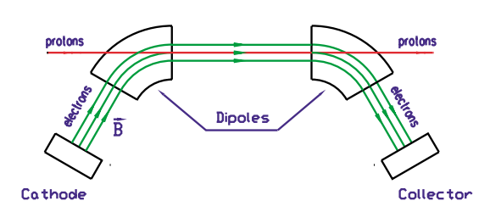
Motivation- Magnetized cooling
Magnetized electron Ion cooling (MEIC) techniques are used in Colliders
Helps extend Luminosity lifetime and ion beam emittance
MEIC requires a bunched magnetized electron beam
Electron beam produced by K₂CsSb Photocathode
Figure 11 – Electron Ion cooling explained in a picture of the NAP-M cooler at Fermi National Accelerator Lab. A Bunched Electron beam helps prevent intra-beam scattering of the ions in our case.

Slide 14
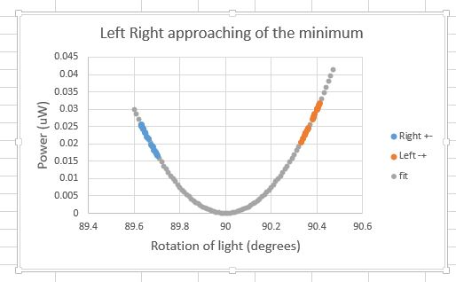
Results- First measurement of Kerr Ө
Simple test involved linear polarized light
Path… Linear polarizer – foil – analyzer – power meter
In Theory, as B field increases, so should the Kerr Ө
Reversed magnet polarities, should reflect power increase and decrease
Different cross polarization points with an increase and decrease for the + and - polarities
In theory, perfectly crossed polarizers

