Slide 1
WIEN-FILTER SPIN ROTATOR IN THE CONTEXT OF pEDM
G. Palacios-Serrano, C. Hernández-García,
Thomas Jefferson National Accelerator Facility, Newport News, VA 23606, USA

Slide 2
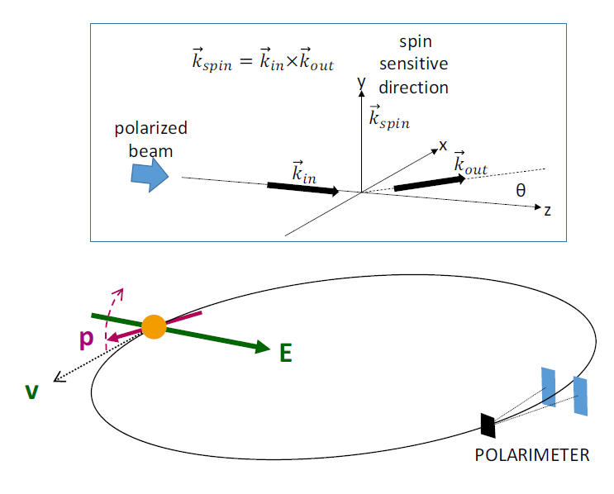
Introduction
The proton-electron dipole moment (pEDM) experiment requires*:
Study the optimum material, height, and shape of electric field plates with a field strength of 4.4 MV/m for 4 cm plate separation, in order to minimize the highest E-field value.
Small surface area E-field plates made of aluminum and coated with TiN have been developed and used at JLab; rather cheap and robust. Need to expand this technology to large-area, about 20 cm high and 2m long.
Diagram of the storage ring EDM concept. Jim Alexander et al, 2022.
* The storage ring proton EDM experiment. J. Alexander et al, 2022.

Slide 3
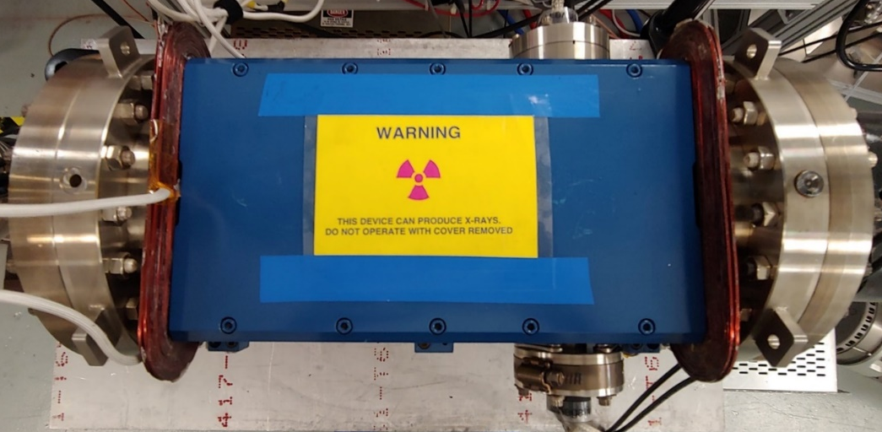
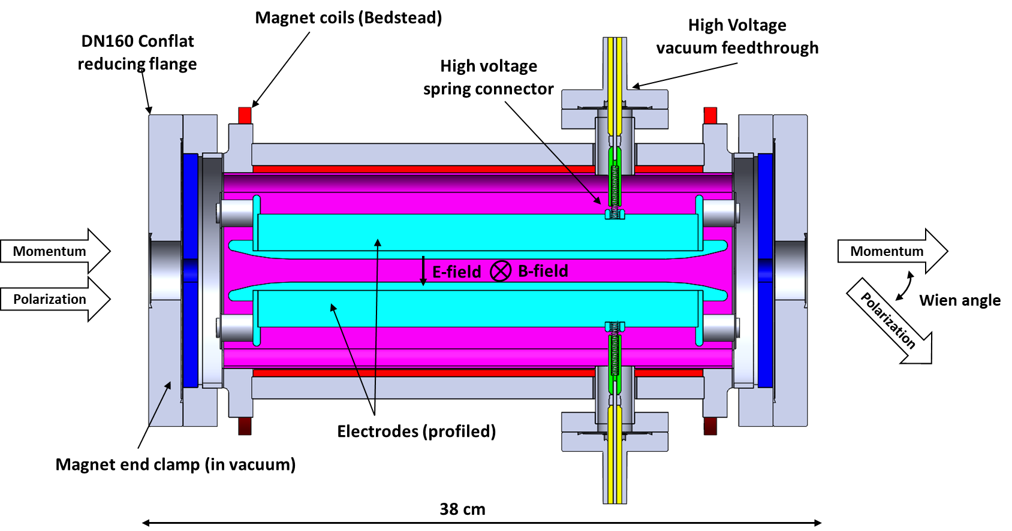
We have experience!
We have built four Wien filters at JLab:
Two 200 keV at CEBAF
In operation since February 2021
32 cm electrode plate
1.5 cm gap
20 kV max achieved voltage per plate
2.7 MV/m max gap electric field
Undergoing optics matching studies.
A shorter-gap 300 keV at UITF
In operation since July 2022
32 cm electrode plate
1.3 cm gap
26 kV max achieved voltage per plate
3.9 MV/m max gap electric field
One with integrated ion pump at test lab
Patent!
Still on the works

Slide 4
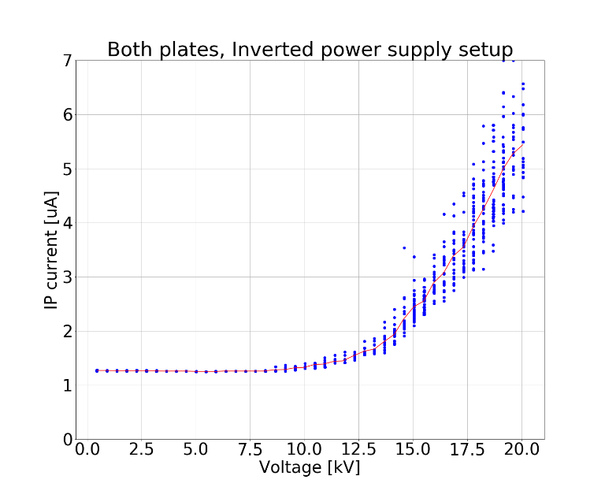
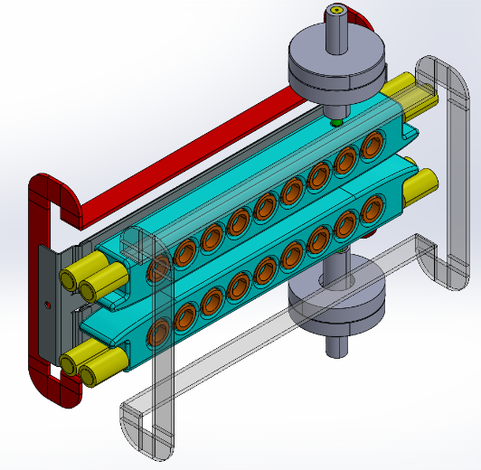
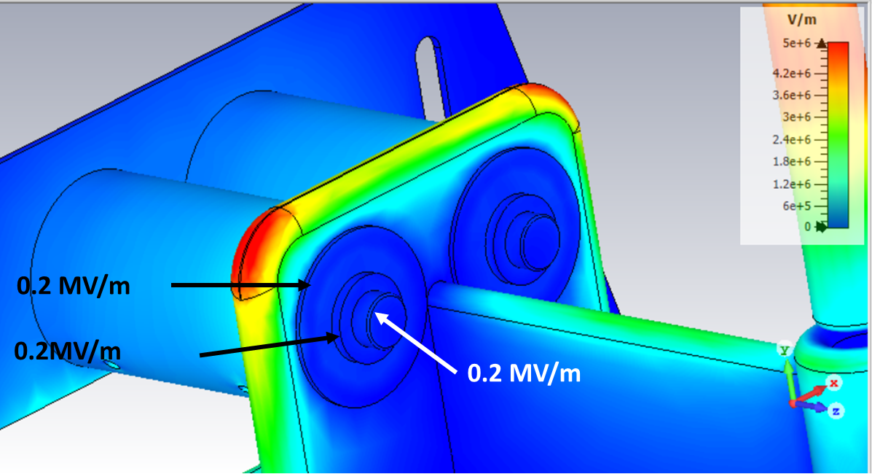
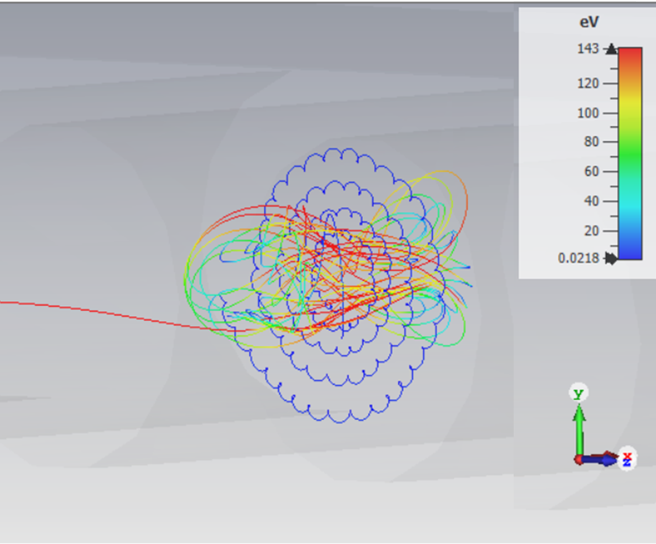
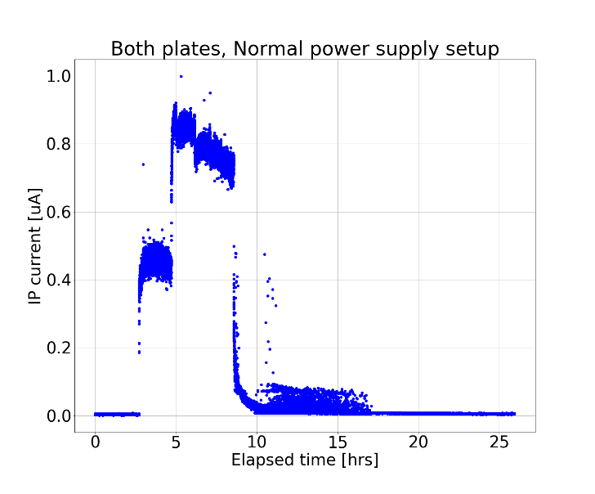
Ok but, what have we actually done?
3D modeling
Simulations
E and B field maps
Particle tracking
Optimization
Assembled
Polished
Surveyed
HV tested

Slide 5
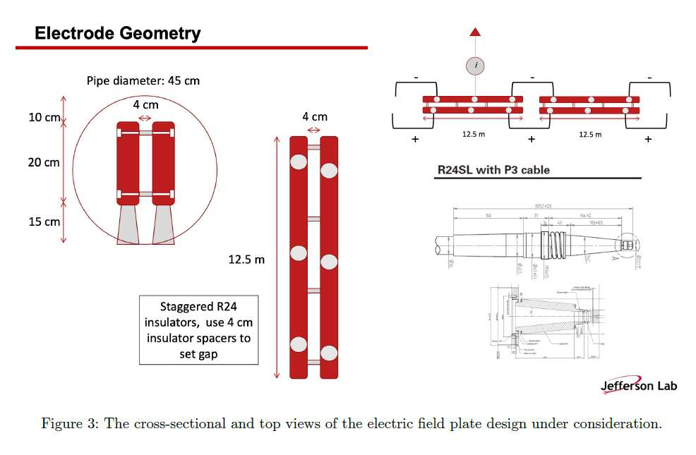
Challenges for the pEDM electrodes
Significant engineering concept and design!
176 kV gap voltage (88 kV per plate)
TiN-coated aluminum electrodes
JLab has done this before on a smaller scale.
Tolerances
R28 alumina insulators
Structural
HV
Ripple
Field homogeneity
Fringe fields
Spin dynamics
The storage ring proton EDM experiment. J. Alexander et al, 2022

Slide 6
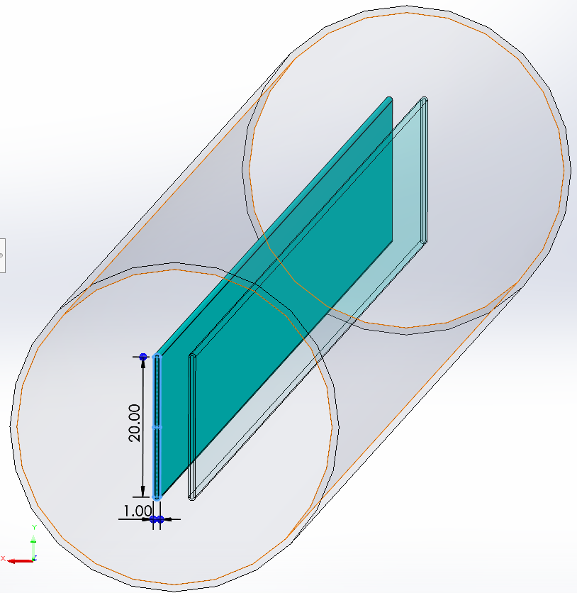
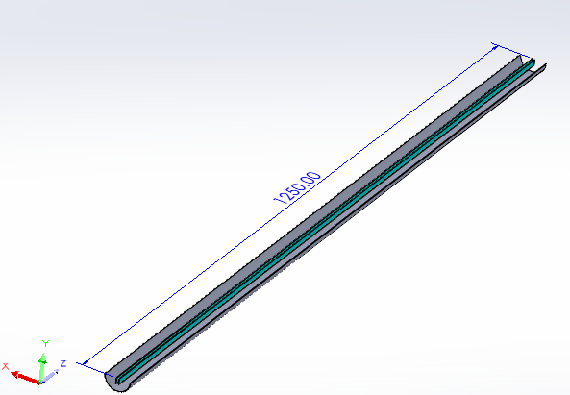
A start:
4.4 MV/m

Slide 7
Thanks!
Fin

Slide 9
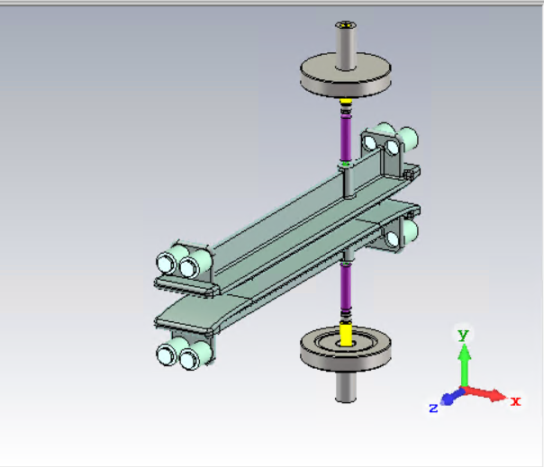
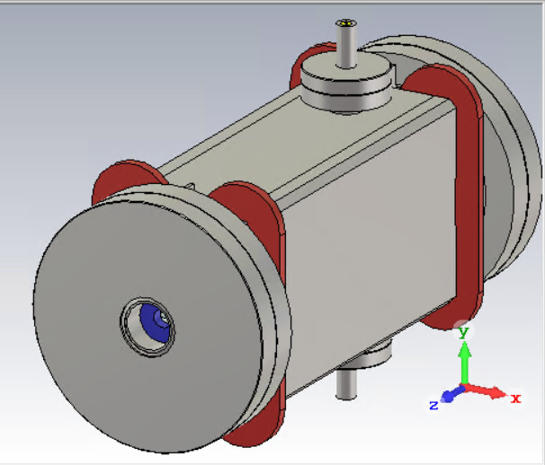
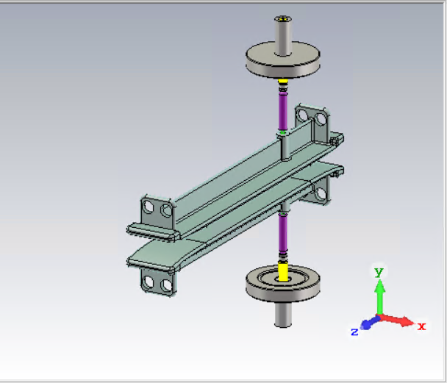
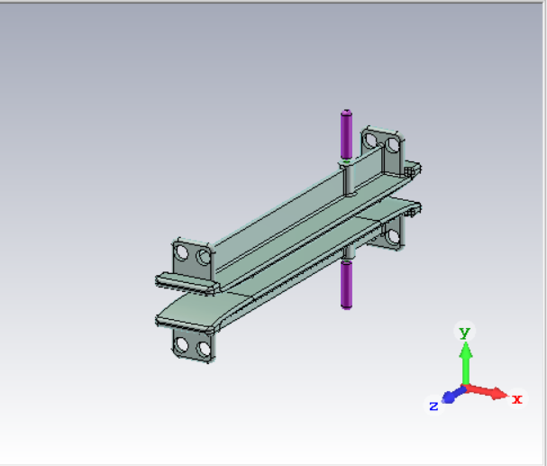
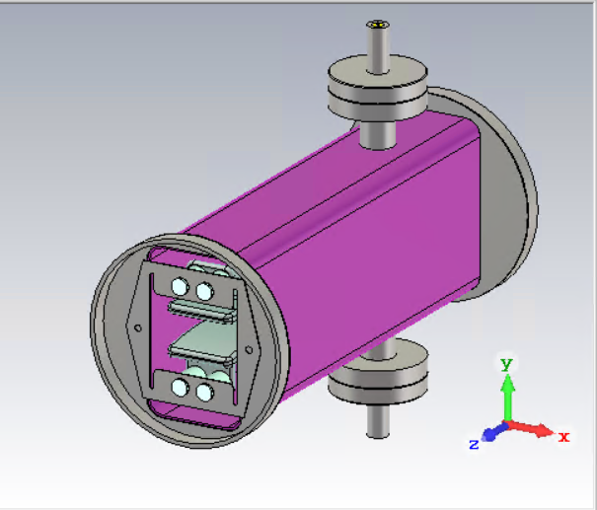
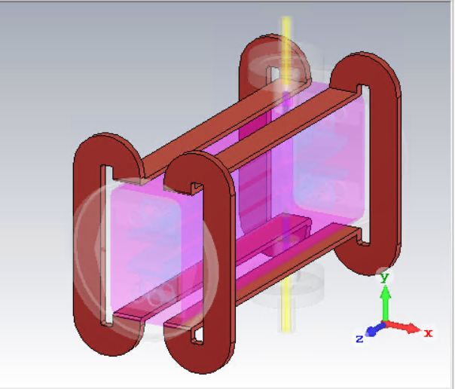
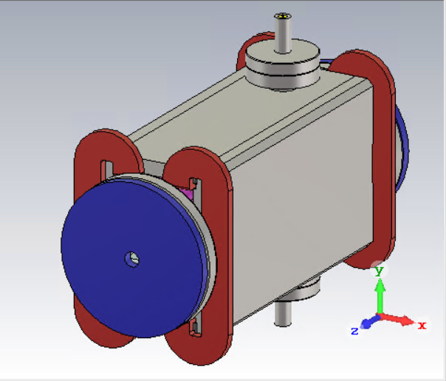
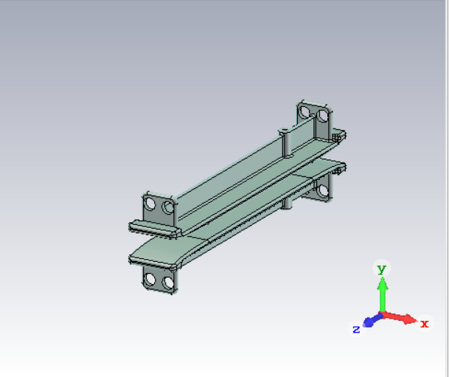
Extras
Isometric view of 3D model of the existing CEBAF 130 keV Wien filter based on SLAC’s original design.
Modelling
The Wien filter is composed of
HV electrode plates with mounting tabs and Rogowski profile
HV spring guide contacts with spring coils
HV electrical feedthroughs with alumina insulators
MACOR mounting insulators
Vacuum chamber with electrode mounting springs
Magnet coils
Magnet mirrors, pole plates and return yokes

