Slide 1
Cooler e-source
Magnetized Beam LDRD Progress Report
March 9, 2017

Slide 2
Magnetized Beam at GTS
K₂CsSb photocathode was made – QE ~ 4%
Gun HV operating at 300 kV with magnet at 400 A (B_{z}=1.4 kG with standard molybdenum photocathode holder and B_{z}=2.0 kG with steel holder)
Beamline under vacuum with slits installed
Generated magnetized beam on March 8
Sajini Wijethunga, student from ODU (advisor: Jean Delayen, funded by 75% JLab + 25% ODU) started her Ph.D. thesis on magnetized beam
Plan to submit LDRD proposal for 3rd year funding

Slide 3
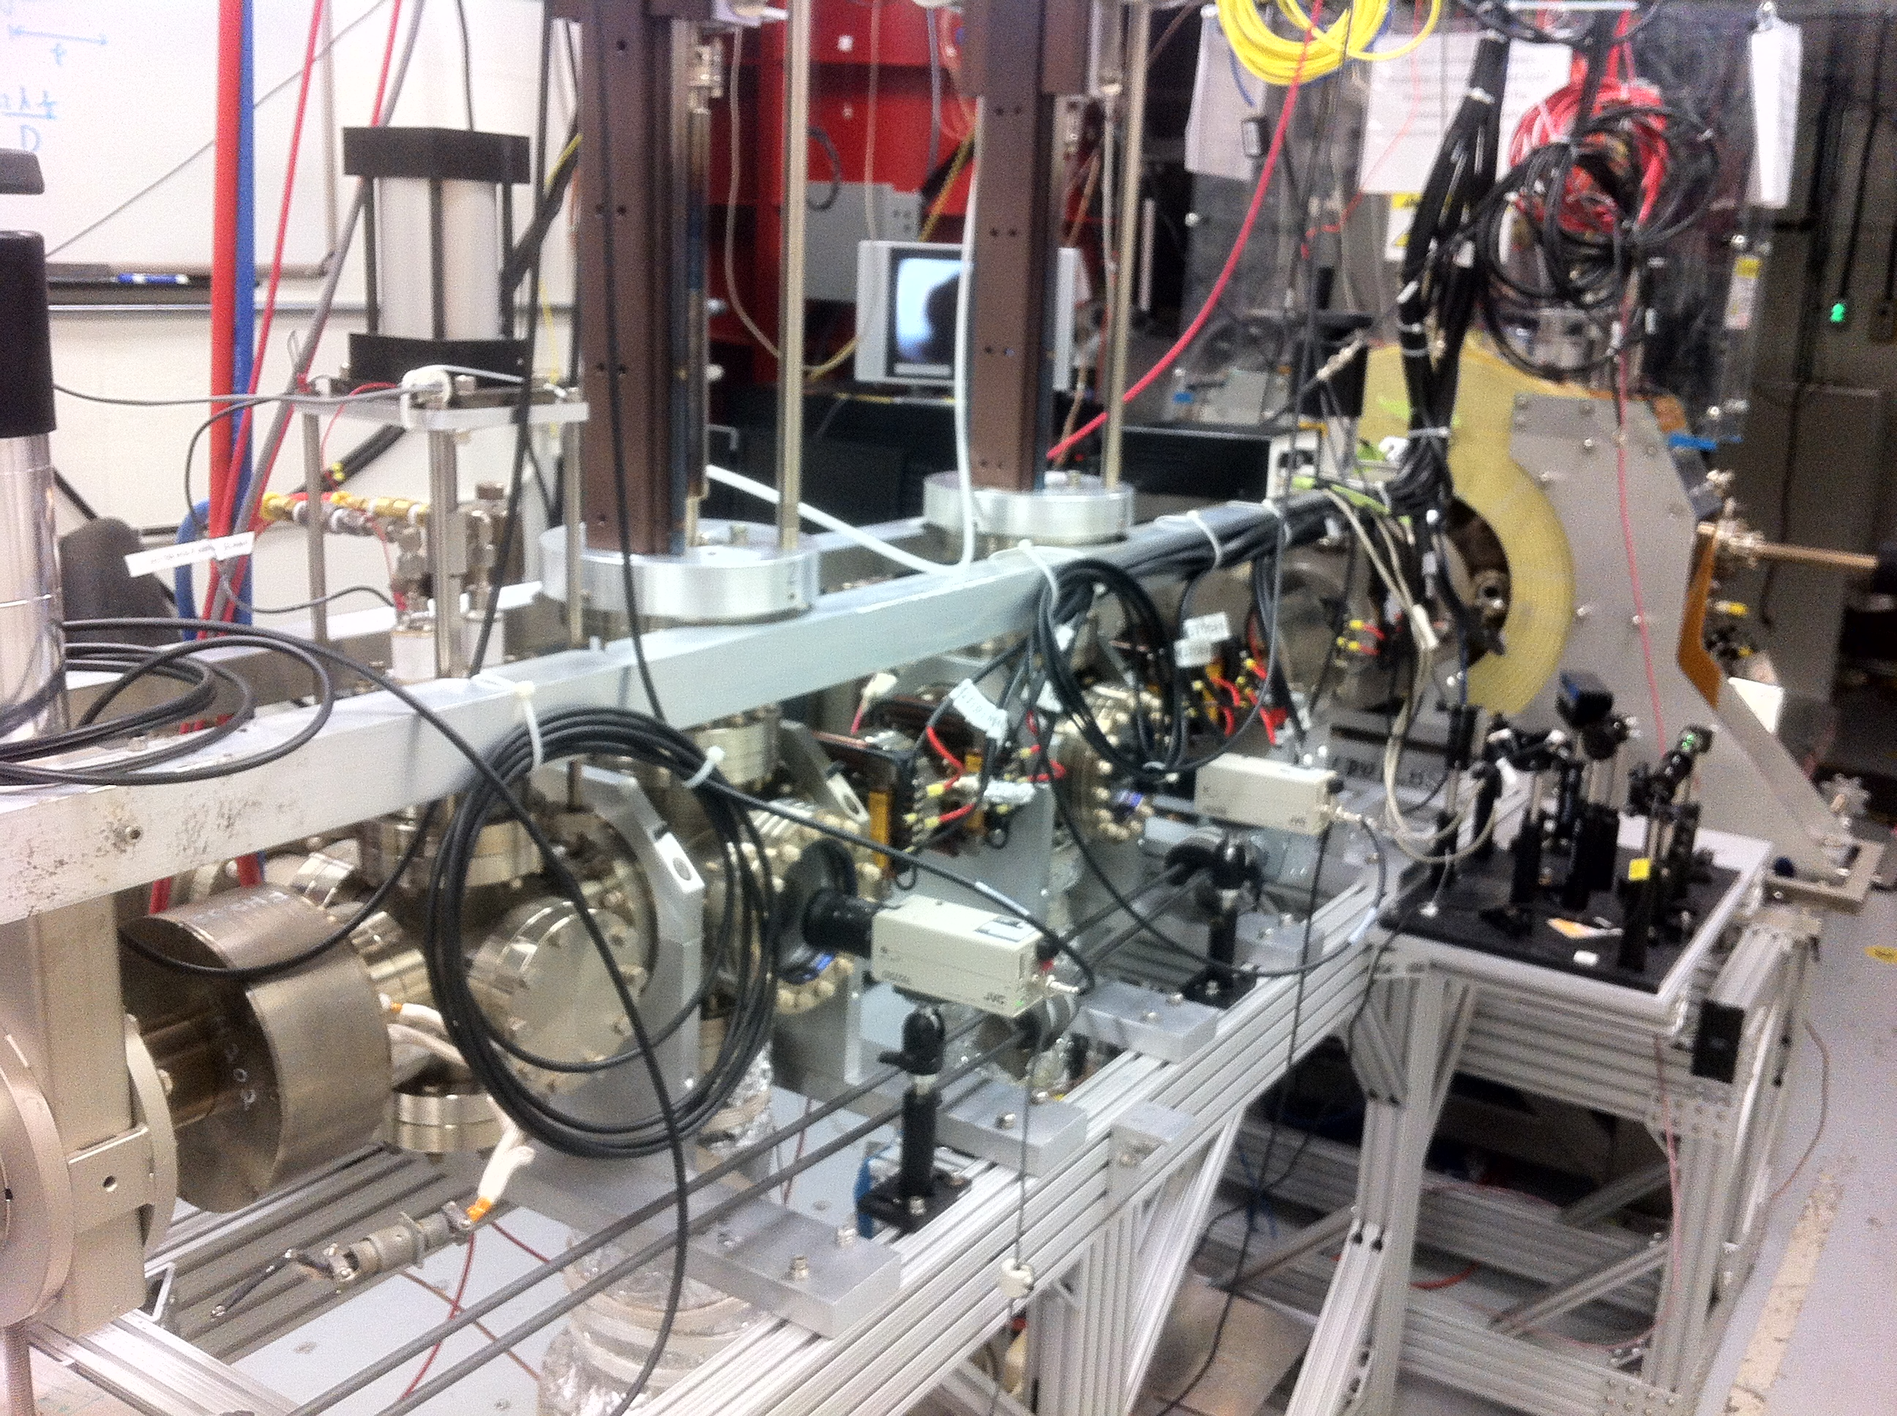
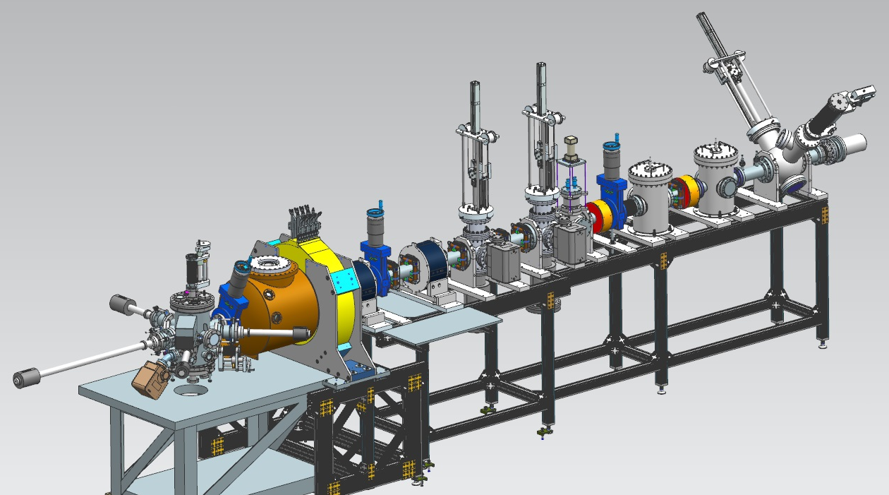
Magnetized Electron Source at GTS
Solenoid
Magnet
Beamline
HV Chamber
Photocathode
Preparation
Chamber

Slide 4
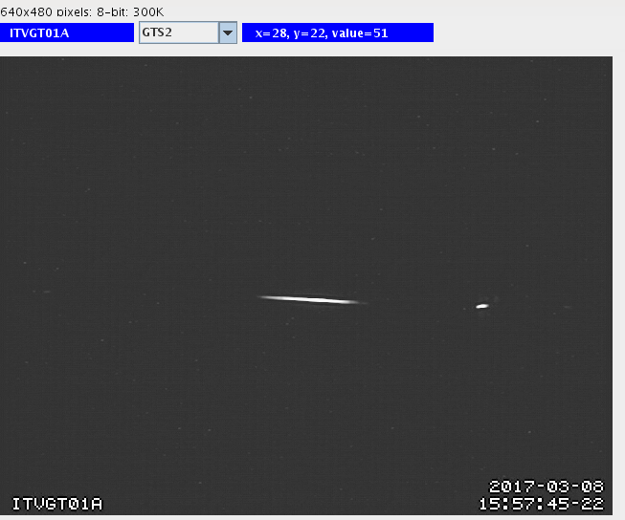
0 A

Slide 5
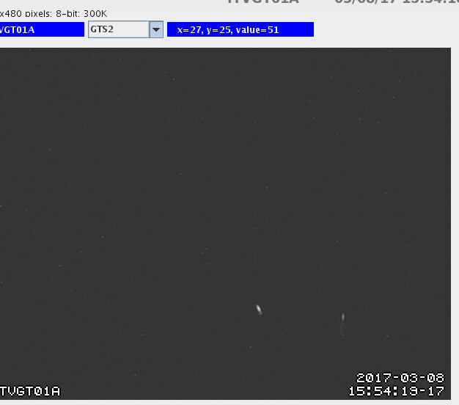
50 A

Slide 6
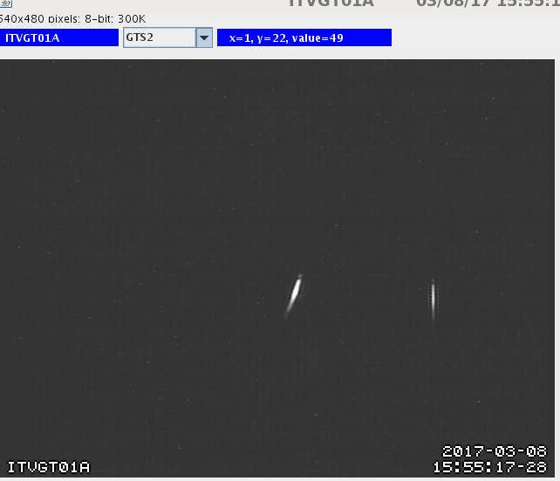
100 A

Slide 7
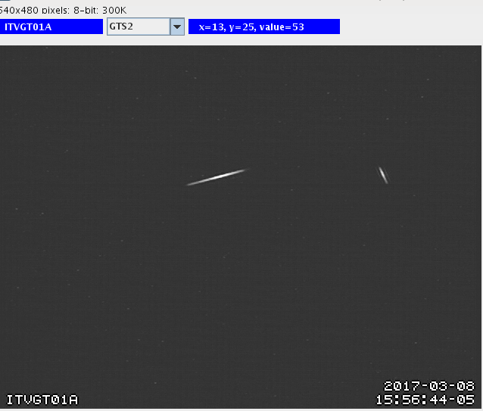
150 A

Slide 8
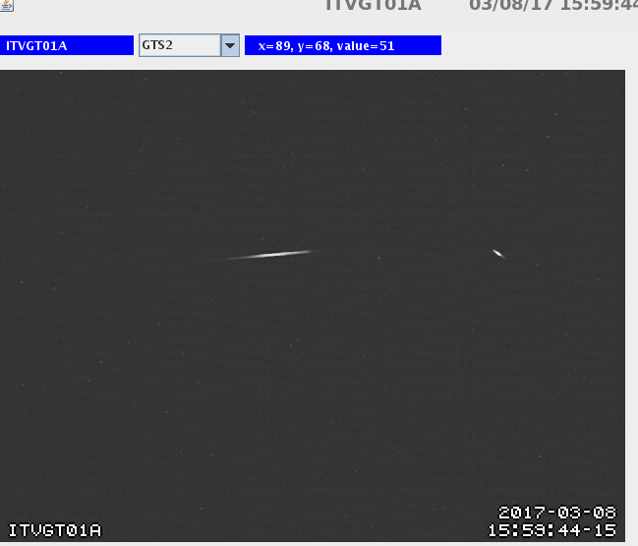
200 A

Slide 9
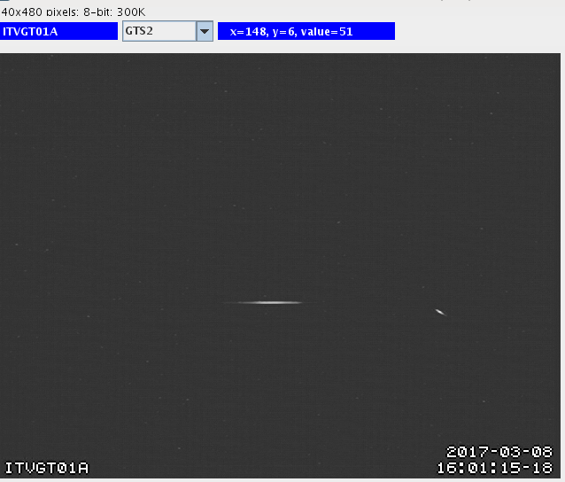
250 A

Slide 10
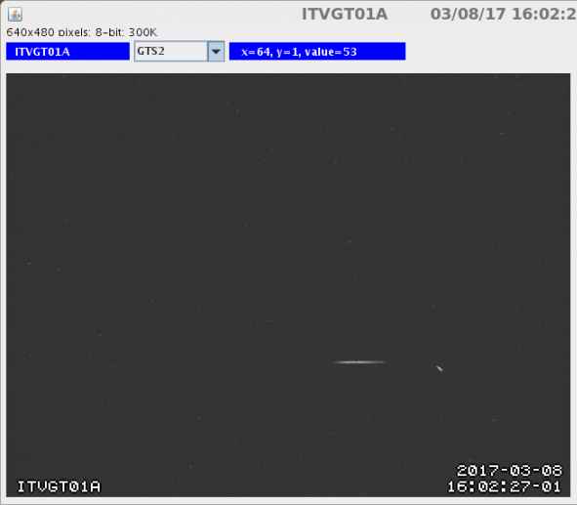
300 A

Slide 11

350 A

Slide 12
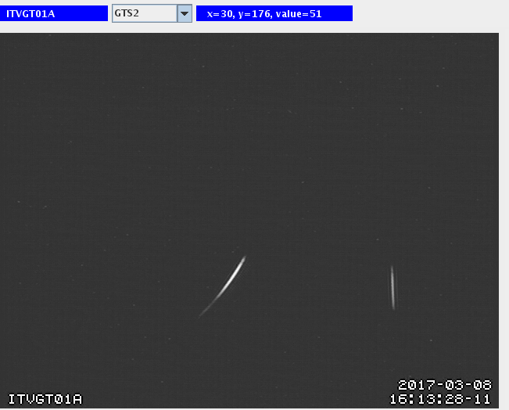
400 A

Slide 13
Thanks to hard work of: Yan, Mamun, Bubba, Phil, John, Carlos, Fay, Shukui, Geoff, Sajini

Slide 14
Measuring Magnetization with RF Cavity

Slide 15
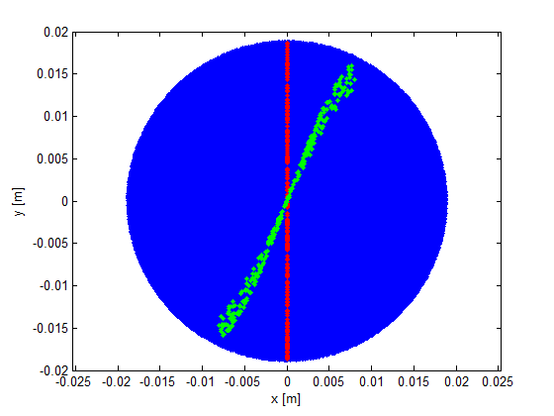
Measuring Magnetized Beam – I
Use slit and viewscreens to measure mechanical angular momentum:

Slide 16
Measuring Magnetized Beam – II
Having a non-invasive technique to measure beam magnetization is very critical for JLEIC e-cooler. An RF cavity could be right device. Cavities distributed around e-cooler will monitor magnetization and others installed inside cooling solenoid will ensure magnetization is completely removed during cooling process. Once beam exists solenoid, cavities will measure whether magnetization is fully restored.
RF field will be excited by rotating bunched beam producing an easily detectable signal – beam will deposit energy into cavity, but not angular momentum
Coupling to both electric and magnetic fields – expect main contribution to signal from electric field

Slide 17
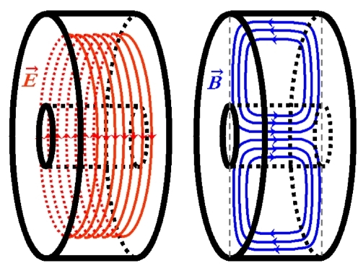
TE011 Mode in Pill-box Cavity
$$H_{r}=\frac{iωε}{k_{c}}AJ_{0}^{′}(k_{c}r)e^{−ik_{z}z}$$
$$E_{r}=0$$
$$E_{φ}=\frac{iωμ}{k_{c}}AJ_{0}^{′}(k_{c}r)e^{−ik_{z}z}$$
$$H_{φ}=0$$
$$E_{z}=0$$
$$H_{z}=AJ_{0}(k_{c}r)e^{−ik_{z}z}$$

Slide 18
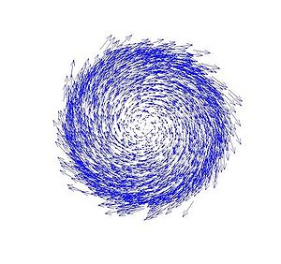
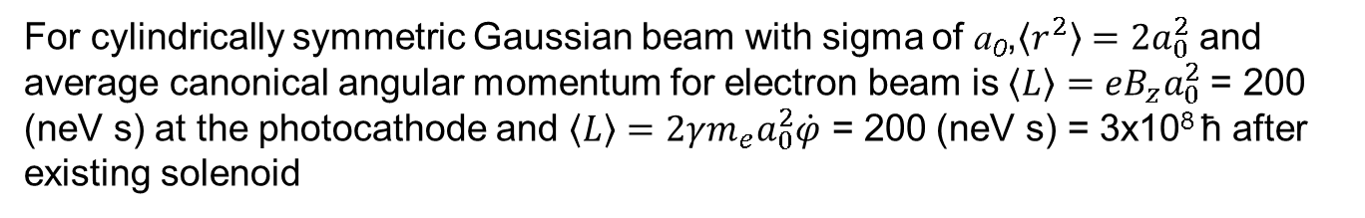
Magnetic Moment of Magnetized Beam
Magnetic moment along beam axis:
$$M=\frac{e}{2mc}L$$
$$L=\frac{1}{2}B_{z}r^{2}$$
at photocathode
$$L=γmr^{2}\dot{φ}$$
at cavity
For cylindrically symmetric Gaussian beam with sigma of a₀,$〈r^{2}〉=2a_{0}^{2}$ and average canonical angular momentum for electron beam is$〈L〉=eB_{z}a_{0}^{2}$ = 200 (neV s) at the photocathode and $〈L〉=2γm_{e}a_{0}^{2}\dot{φ}$ = 200 (neV s) = 3x10⁸ ħ after existing solenoid

Slide 19
Can We Generate Magnetized Beam with TE011 Cavity?
Axially-symmetric electric field mode cannot create angular momentum for a passing e-beam – one must take into account presence of associated RF magnetic field – due to conservation of canonical angular momentum before and after cavity
Plan to build and install a cavity at GTS to measure beam magnetization in collaboration with Brock and SRF Institute – good project for a student

