Slide 1
UITF Noteworthy Developments
(12/4/2020)
HDIce Run3, we are halfway through it
Run2 ended successfully November 9, 2020, tests with unpolarized HD target, currents up to 3.5nA, raster working well, Andy’s summary of Run2 can be found: https://wiki.jlab.org/ciswiki/images/a/a3/HDIce_summary_of_run2.pdf
Run3, with polarized HD target started Nov. 23 – two days late due to field emission from the photogun
Finished tests with polarized target #1 Monday November 30
Recall the Goal: target stays polarized for 7 straight days with 1.5 nA beam current
Polarization maintained at 0.125 nA but depolarized with 0.25 nA
Team HDIce is now installing polarized target #2, expect to resume beam delivery Monday Dec. 7 and finish Run3 Dec.18
Accelerator is performing well (at least with some booster faults “masked”)
Sufficient number of CEBAF Operators now trained, we can support three-shift operations if Andy requests it

Slide 2
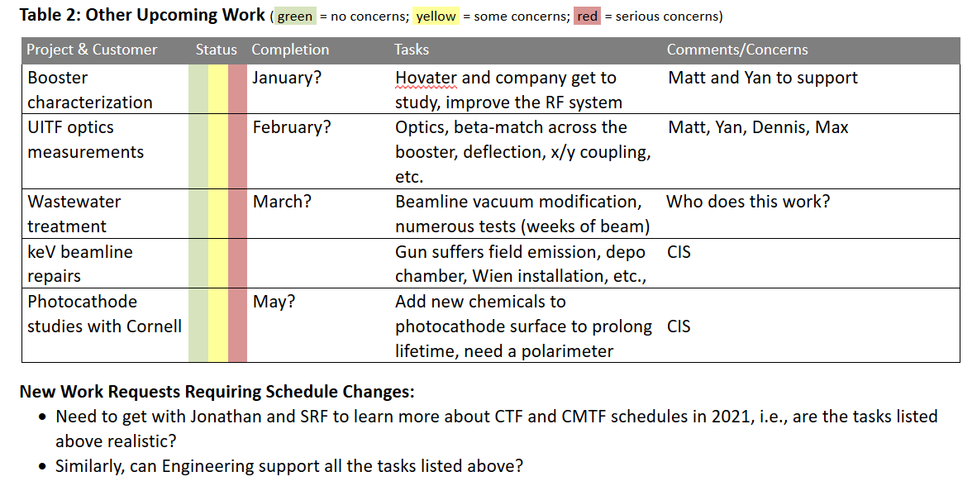
Comments
(12/4/2020)
What work remains at UITF?

Slide 3
UITF/HDIce Program Overview (for reference)
(10/27/2020)
Finished Run0, accelerator commissioning (July 20 – August 19, CTF goes down for repairs)
Finished Run1, HDIce tests with alignment target, Cu with a hole pattern (August 31 – October 6, CMTF gets LHe)
We just finished a 3 week UITF accelerator down while CM11 was tested at CMTF
Un-polarized HD target loaded into IBC on October 17
Run2: starts today, October 27, with un-polarized target
Run3: begins ~ 4 days after Run2 (~ November 16 or sooner) and ends December 18, 2020, with polarized targets
Goal: target stays polarized for 7 straight days with 1.5 nA beam current

Slide 4
HDIce SAD activities (for reference)
(12/4/2020)
Loading a target
Roof off – Mon or Tues morning, 10/12–10/13
Purify Al-J1 HD gas H₂: 9%, D₂:1.5%, air: 0.1%
Prep target on Inj Tool & bake – Tues evening, 10/13
Cold test of Target cell on inj tool – Wed, 10/14
Condense unpolarized HD into production dewar –Thur, 10/15
Remove Aperture target from transfer cryostat (RadCon) –Thur –10/15
NMR check in production dewar (with exchange gas) – Fri, 10/16
rotate IBC vertical – Fri, 10/16, 15:00
pump exchange gas from production dewar – Fri, 10/16
NMR in production dewar (no exchange gas) – Fri, 10/16
Transfer target to IBC, rotate horizontal – Sat, 10/17
NMR study in IBC
Roof back on – Mon,10/26

