Slide 1
Exploring the GTS spherical electrode with flat front face in the CEBAF HV chamber
C. Hernandez-Garcia
July 14 2023

Slide 2
Pondering
Why is the focusing so strong in the 18” HV chamber so strong? (current delivering beam in CEBAF) – R30-3 assembly
  See upcoming Gabriel’s slides
How is the focusing in the GTS electrode with flat front and flat anode? (Sajini’s work for high bunch charge) – R30-2 assembly
  I could not find beam dynamics plots to show this
Would swapping the CEBAF electrode for the GTS electrode alleviate the strong focusing?
  Is this mechanically possible? YES!
  Is this electrostatically feasible? YES! See Gabriel’s slides
  Will it work for beam dynamics? See Gabriels’s slides. A careful beam dynamics study is in order.
Is a DETAILED electrostatic/optics cathode-electrode redesign in order?
  For discussion

Slide 3
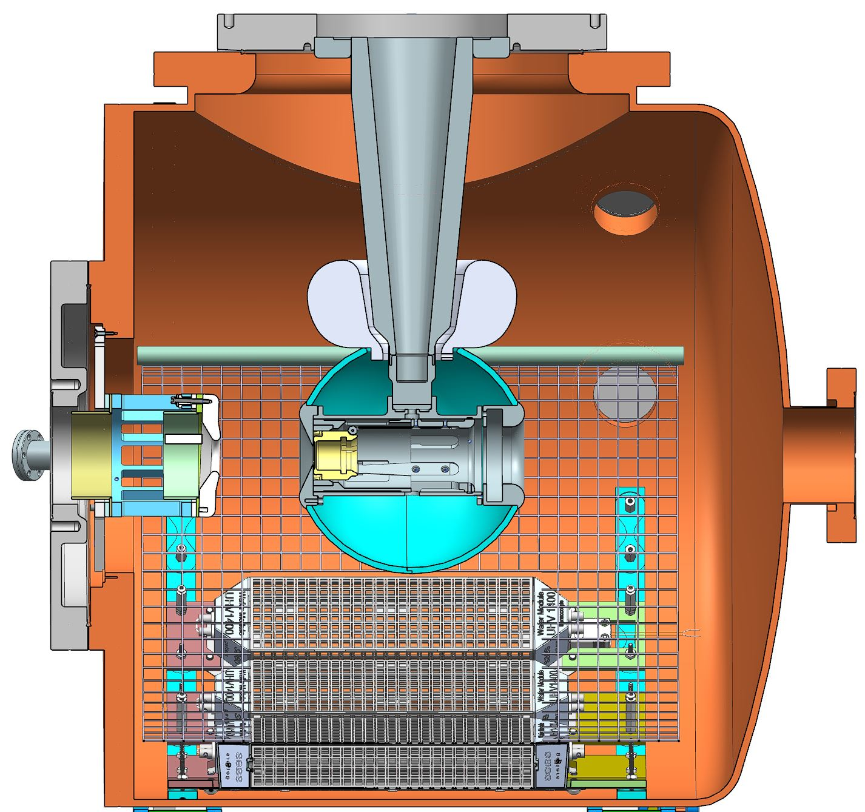
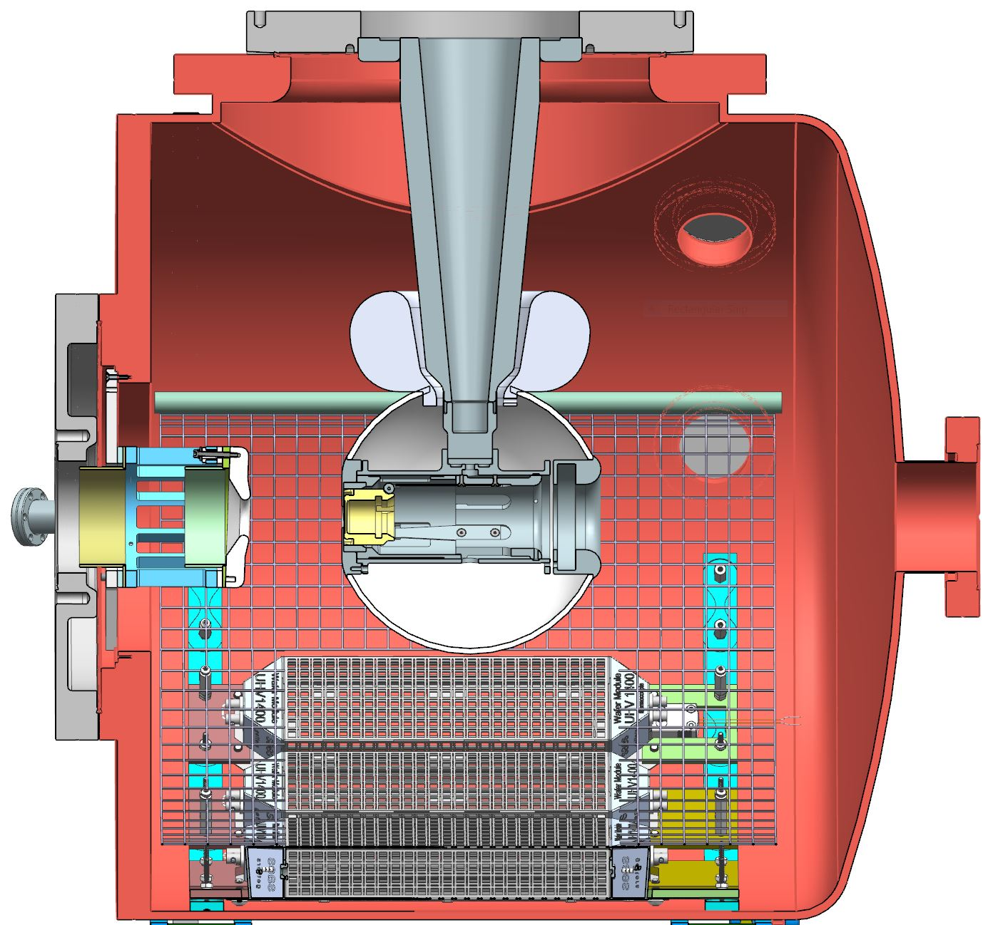
R30-3 delivering beam in CEBAF
R30-4 hypothetically replacing R30-3
electrode with
GTS’ flat front face

Slide 4
Is there enough travel in the long manipulator?
2.75-2.46=0.29 inches
Need 7.36 mm of additional manipulator travel

Slide 5
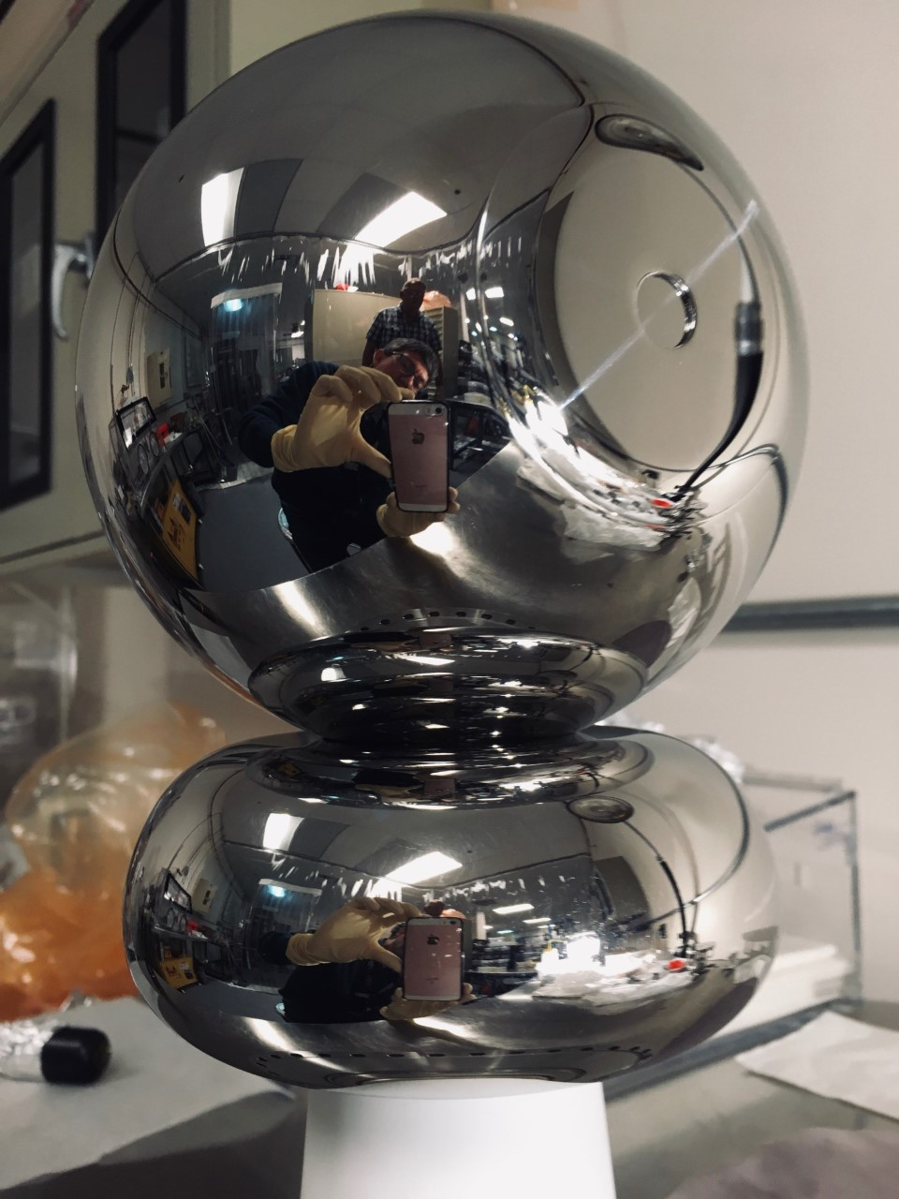
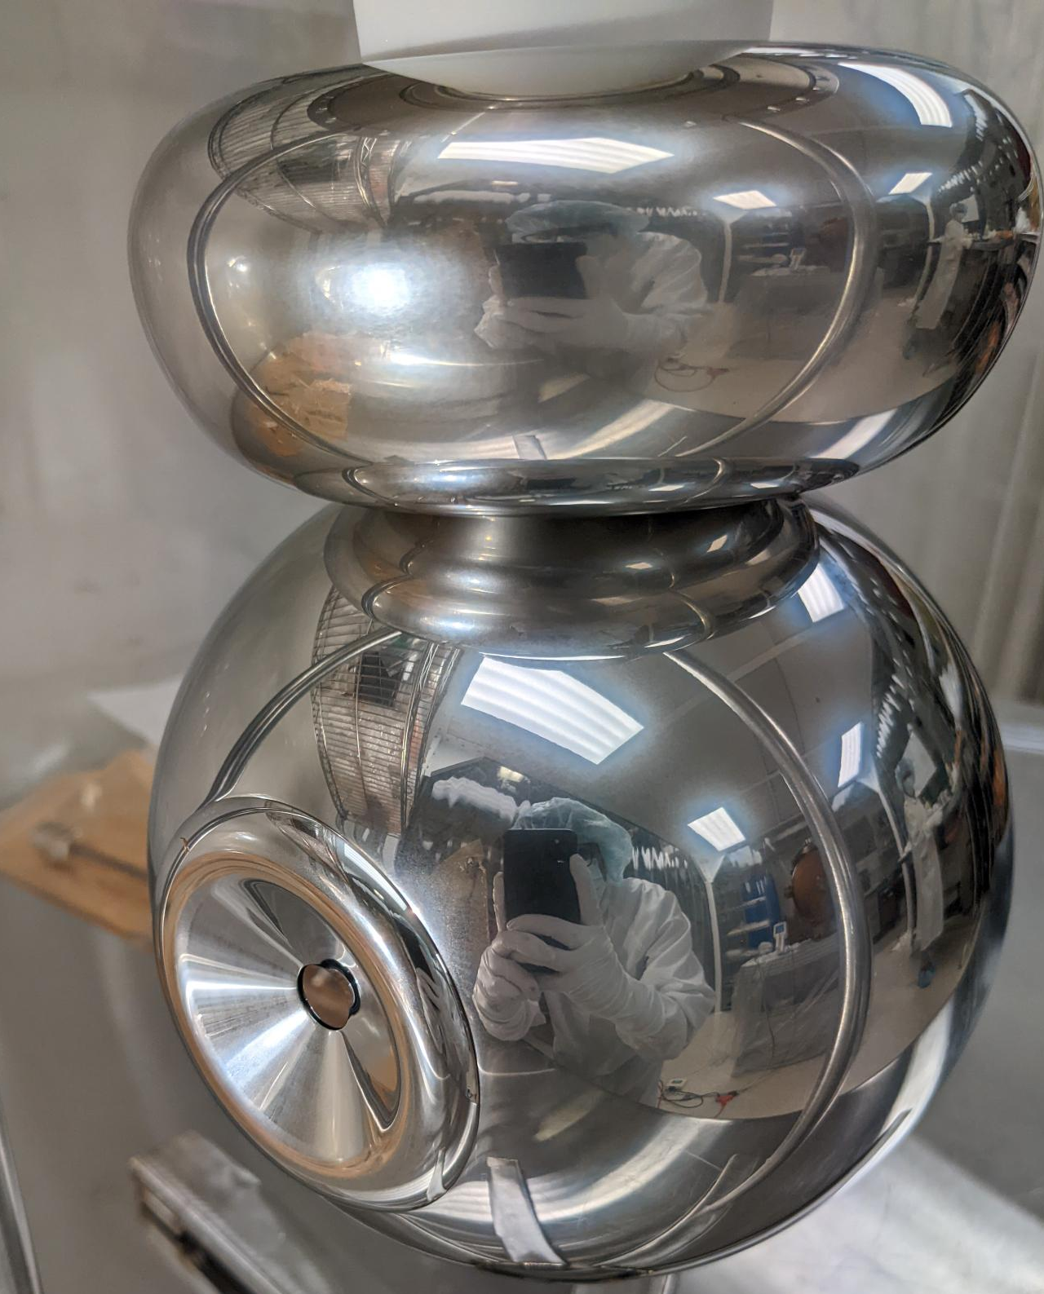
R30-3 CEBAF
R30-2 GTS

Slide 6
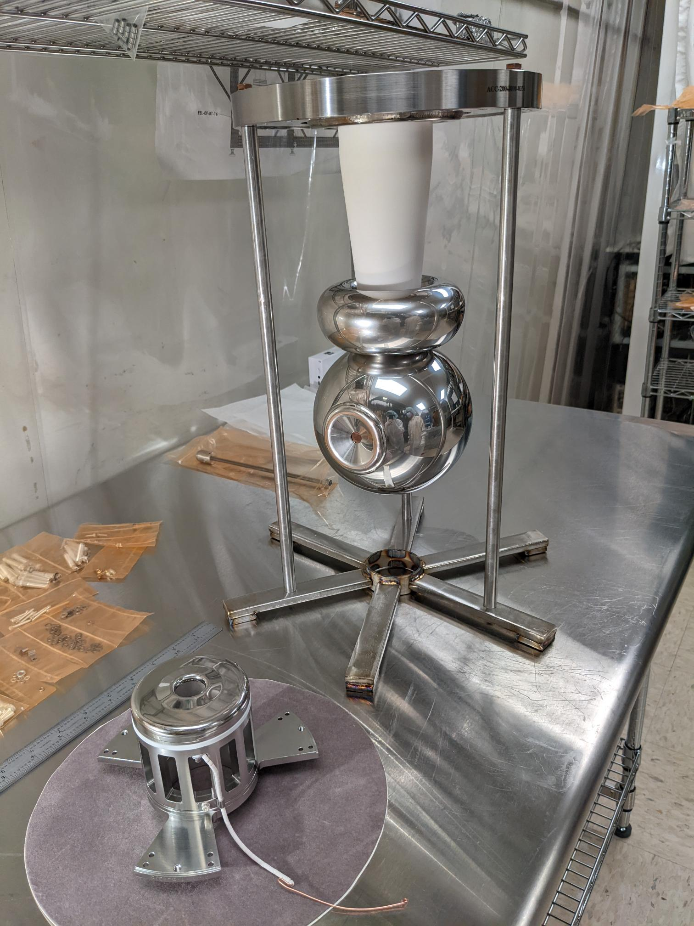
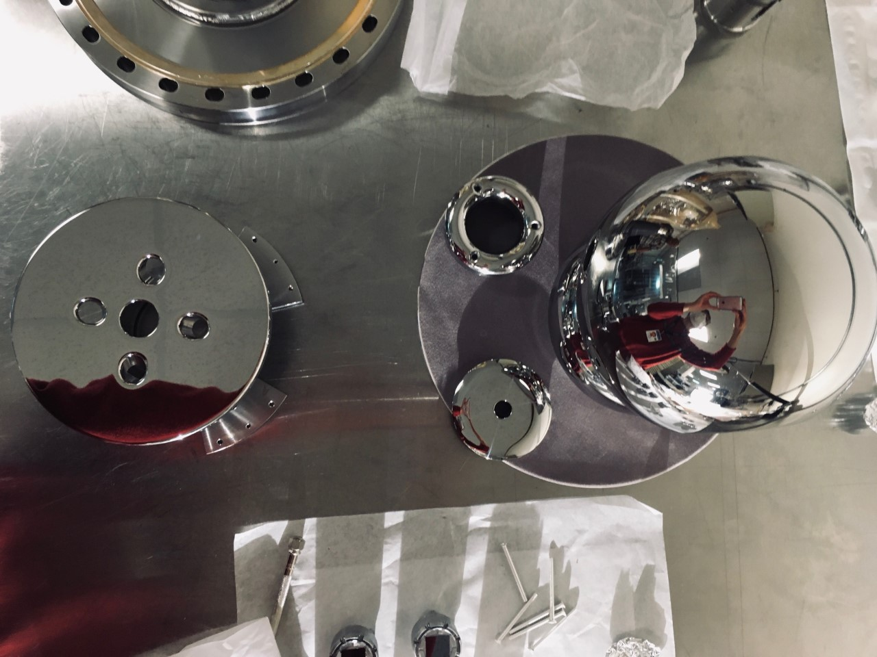
R30-3 CEBAF
R30-2 GTS
Flat anode, flat electrode front face

Slide 7
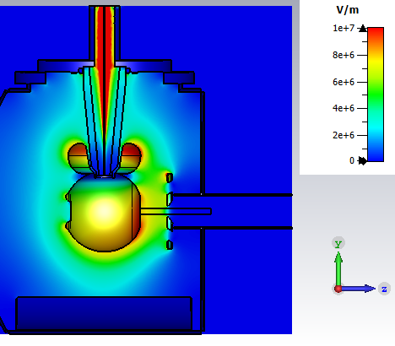
Sajini’s simulations at 350 kV for 5 cm anode-cathode gap
8.2 MV/m
10.5 MV/m
8.21 MV/m
9.10 MV/m
10 MV/m
10 MV/m

Slide 8
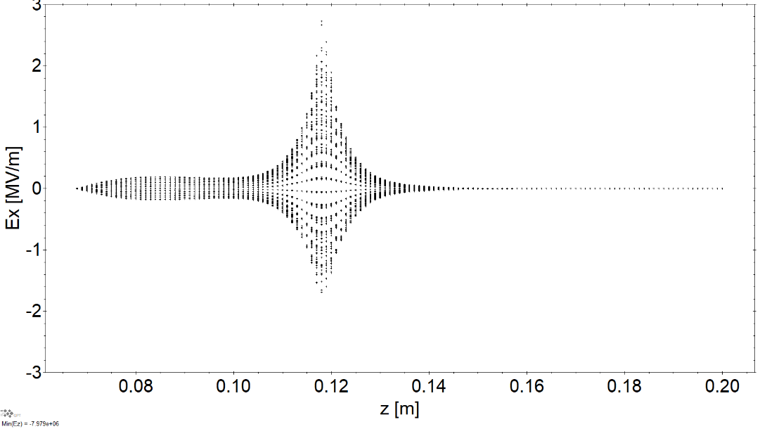
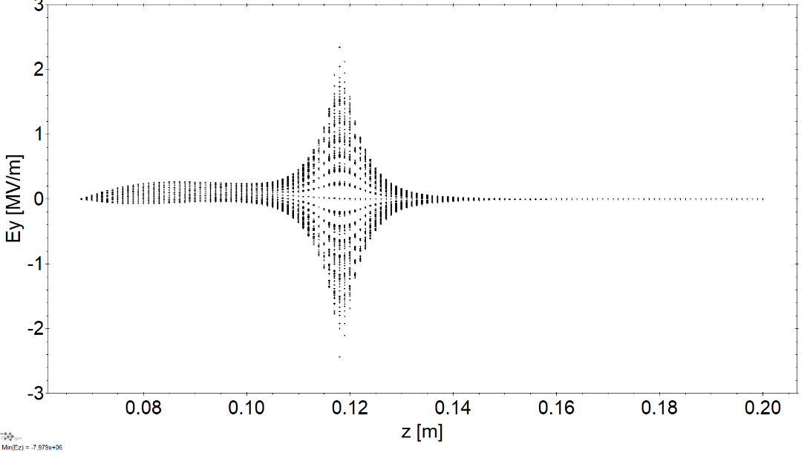
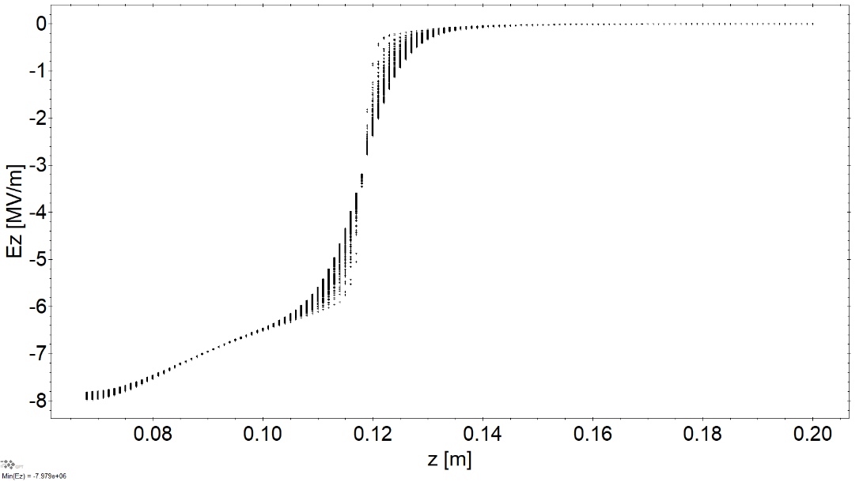
Sajini’s simulations at 350 kV for 5 cm anode-cathode gap
E fields

Slide 9
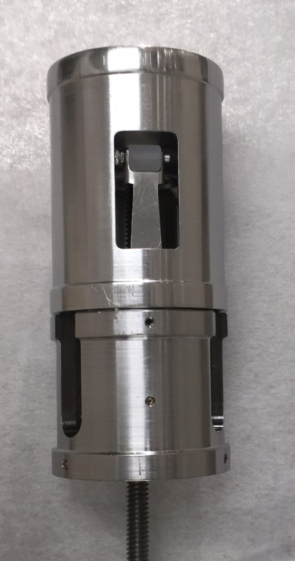
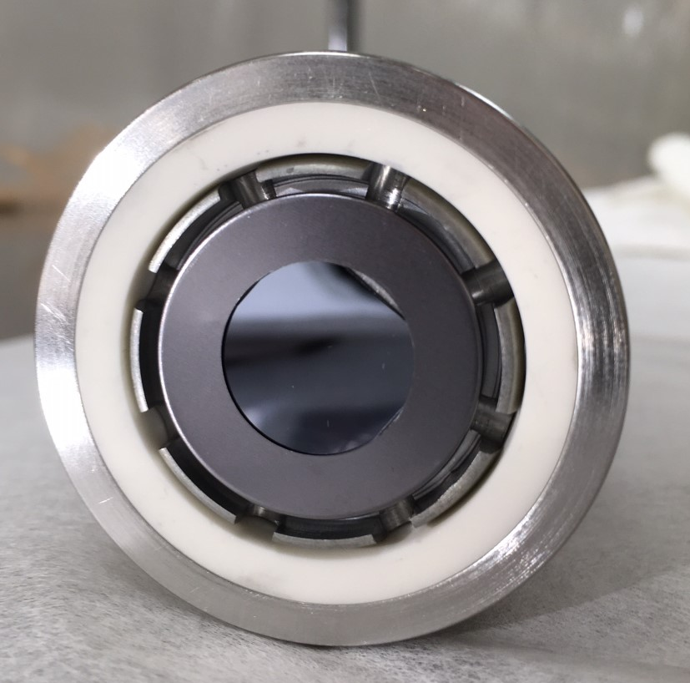
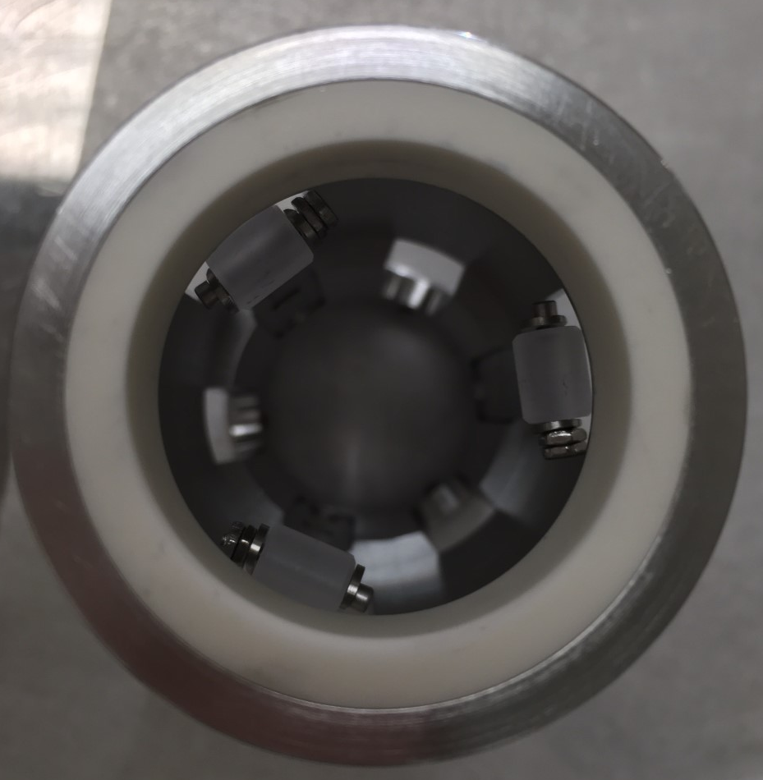
In case anyone wants to talk about puck seating inside the spherical electrode

