Slide 1
MEIC Polarized Electron Source
April 29, 2015

Slide 2
MEIC Polarized Source
Bunch Charge
26 pC – 6.6 pC
Helicity Reversal
220 bunches
at 68.05 MHz
(14.69 ns)
72.07 µs
700 ms – 12 ms
…
…
…
…
3.233 µs
Damping Time
3 GeV – 12 GeV
Pockels cell switching time at CEBAF today ~70 us. Planned for Moller Exp. ~10 us
Bunch charge 72 x larger than typical CEBAF, 20 x greater than G0 – Expect to use a gun operating at higher voltage
68.05 MHz pulse repetition rate not be a problem for gun, maybe for LINACs
We are not considering simultaneous beam delivery to fixed target halls, using typical CEBAF beam
Message: MEIC polarized source requirements do not pose significant challenges

Slide 3
Source Parameter Comparison
Parameter | JLab/FEL | CEBAF | EIC MEIC | EIC eRHIC | Cornell ERL | LHeC | CLIC | ILC
Polarization | No | Yes | Yes | Yes | No | Yes | Yes | Yes
Photocathode | Bulk GaAs | GaAs / GaAsP |  |  | K₂CsSb
Width of microbunch (ps) | 35 | 50 | 50 | 100 | 2 | 100 | 100 | 1000
Time between microbunches (ns) | 13 | 2 | 14.69 | 106 | 0.77 | 25 | 0.5002 | 337
Microbunch rep rate (MHz) | 75 | 499 | 68.05 | 9.4 | 1300 | 40 | 1999 | 3
Width of macropulse | - | - | 3.233 µs | - | - | - | 156 ns | 1 ms
Macropulse repetition rate (Hz) | - | - | 2x83 | - | - | - | 50 | 5
Charge per microbunch (pC) | 133 | 0.36 | 26 | 5300 | 77 | 640 | 960 | 4800
Peak current of microbunch (A) | 3.8 | 0.008 | 0.52 | 53 | 38.5 | 6.4 | 9.6 | 4.8
Laser spot size (cm, diameter) | 0.5 | 0.1 | 0.3 | 0.6 | 0.3 | 0.5 | 1 | 1
Peak current density (A/cm²) | 19 | 1 | 7.4 | 188 | 500 | 32 | 12 | 6
Average current from gun (mA) | 10 | 0.2 | 0.001 | 50 | 100 | 25 | 0.015 | 0.072
Proposed
* Unpolarized: Bulk GaAs (Cs,F), K₂CsSb, Na₂KSb, …
Polarized: GaAs/GaAsP (Cs,F).
Notes:
Why multi-alkali (bulk material, Eg = 1.5 eV) photocathodes are not sensitive to ion bombardment?
No NEA activation layer.
eRHIC: electron Relativistic Heavy Ion Collider
LHeC: Large Hadron electron Collider
CLIC: Compact Linear Collider
ILC: International Linear Collider
---
Why Laser Spot Size? to reduce space-charge emittance growth and suppress surface charge limit.
---
eRHIC: 20 photocathodes, 2.5 mA from each
---
How to fill the numbers:
Microbunch rep rate = 1.0/Time between microbunches
Number of microbunches = Width of macropulse / Time between microbunches
For CW machines: Duty Factor = 100% (for CW machines)
For pulsed machines: Duty Factor = Width of macropulse * Macropulse repetition rate
Charge per microbunch = Number electrons/microbunch * Electron Charge(1.6e-19 C)
Peak current of microbunch = Charge per microbunch / Width of microbunch
Peak current density = Peak current of microbunch / ( (Laser Spot Size/2)**2 * Pi)
Average Current = Charge per microbunch * Microbunch rep rate * Duty Factor

Slide 4
Addressing MEIC Bunch Charge
20 to 72 times larger than CEBAF
Larger Laser Size (reduces space-charge emittance growth and suppresses surface charge limit)
Higher Gun Voltage:
Reduce space-charge emittance growth, maintain small transverse beam profile and short bunch-length; clean beam transport
Compact, less-complicated injector
To accelerate large bunch charge in CEBAF: use RF feedforward system for C100 cryomodules

Slide 5
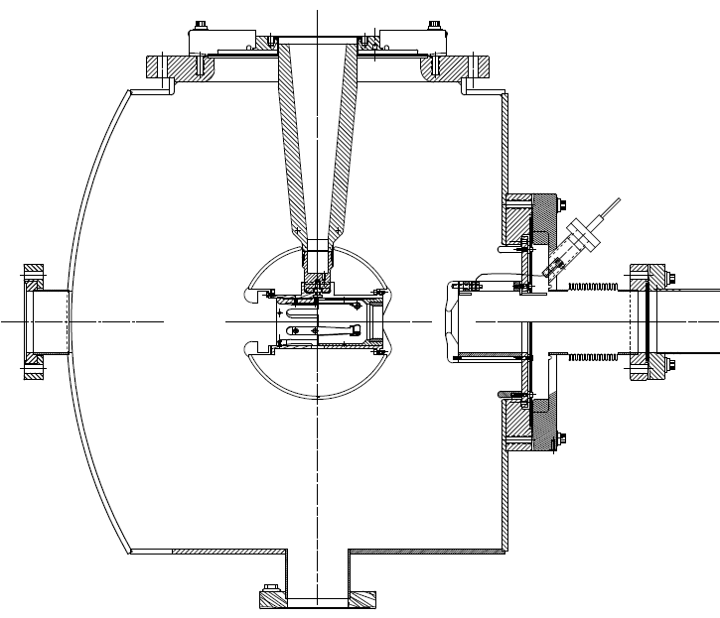
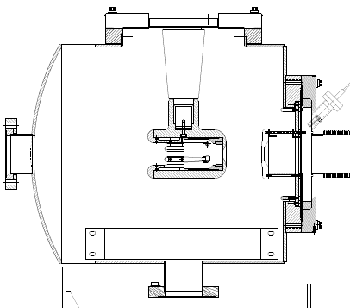
JLab 500 kV Inverted Gun
7”
5”
200 kV Inverted Gun
Longer insulator
Spherical electrode

