Slide 1
Test of W Foils with 3.5 MeV e‒ Beam at MAMI
Andriy Ushakov
Ce+BAF Design Group Meeting
January 11, 2023

Slide 2
Target Material Tests at MAMI (3.5 MeV or 180 MeV e‒ Beam)
Radiation damage test of target materials
at elevated average temperature
0.215 dpa at 300 °C for tungsten
Fatigue test at expected for JLab e⁺ injector
cycling temperatures
T_{ave} ≈ 300 °C and ΔT = 125 °C
MESA
accelerator
& experiments
50 µA @ 3.5 MeV
50 µm RMS
22 µA @ 180 MeV
250 µm RMS

Slide 3
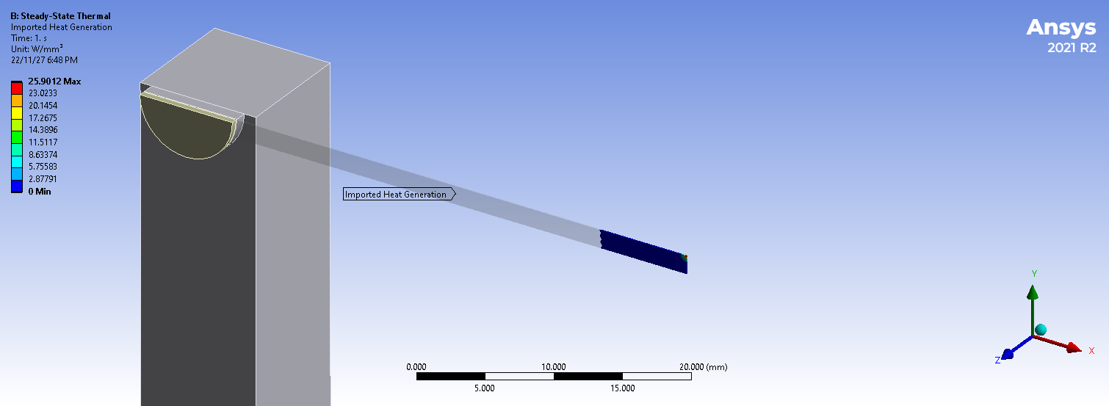
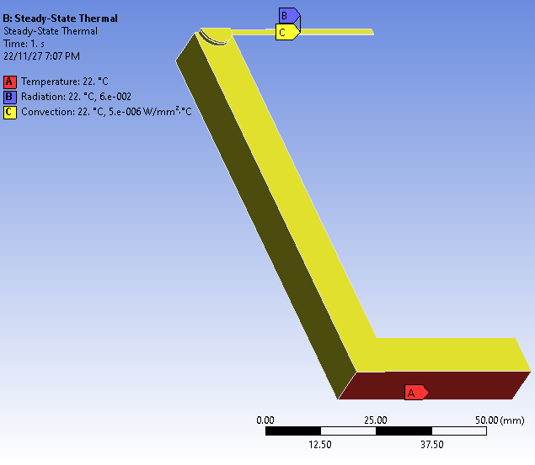
180 MeV e‒ Beam and W Target
22 μA @ 180 MeV e- beam with 250 μm RMS spot size on target
Thickness of W target: 100 μm
Length of W target: 80 mm
Width of W target: 3 mm
Thickness of Al₂O₃ ceramic: 1 mm
Al₂O₃
3D View of ¼ of Target
W
Beam
Al
Temperature,
Radiation and
Convection

Slide 4
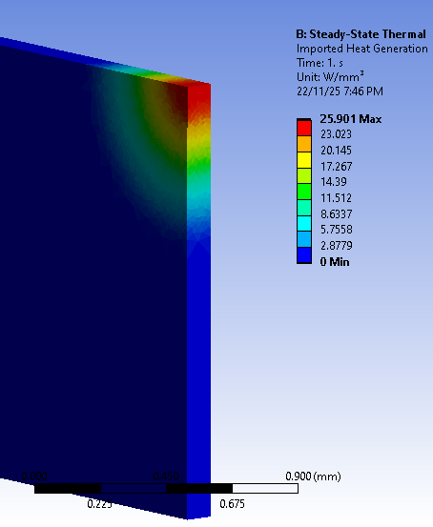
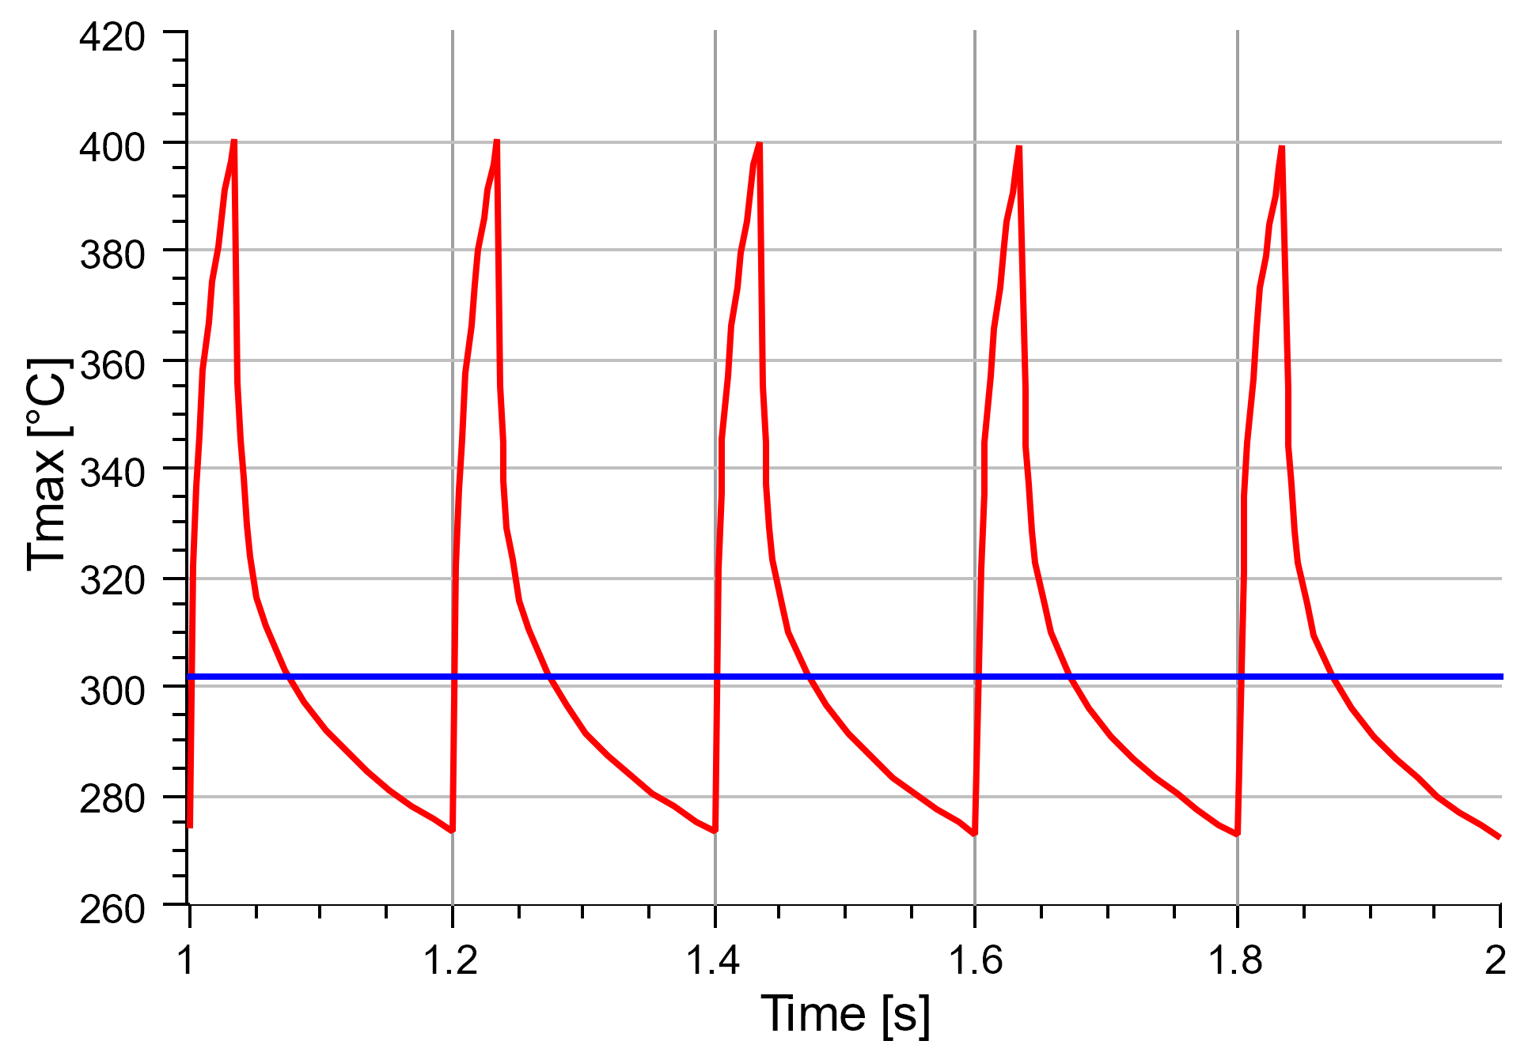
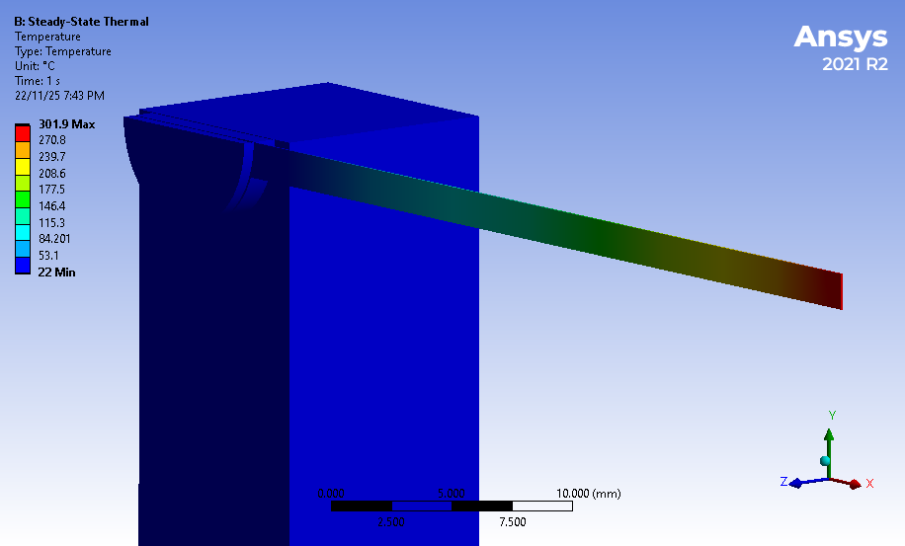
180 MeV e‒ : Heat Power and Target T for Duty Cycles of 0.17
Average P = 25.9 W/mm³
Cycling Temperature for
Pulse Length = 34 ms, Pulse Period = 200 ms
Average Temperature
P_{pulse} = 152 W/mm³
T_{ave} = 302 °C
ΔT = 125 °C

Slide 5
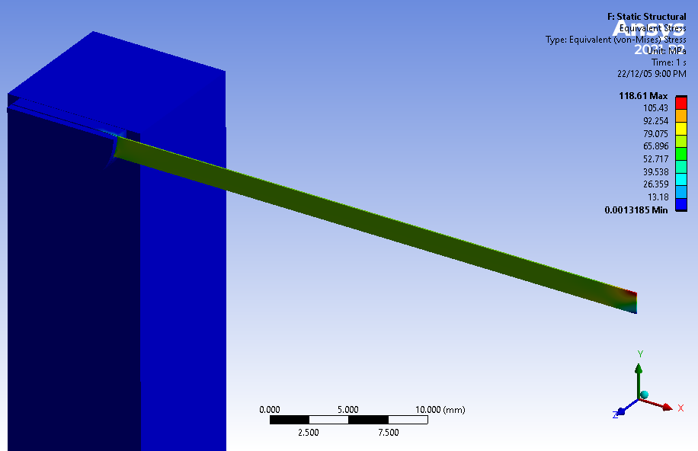
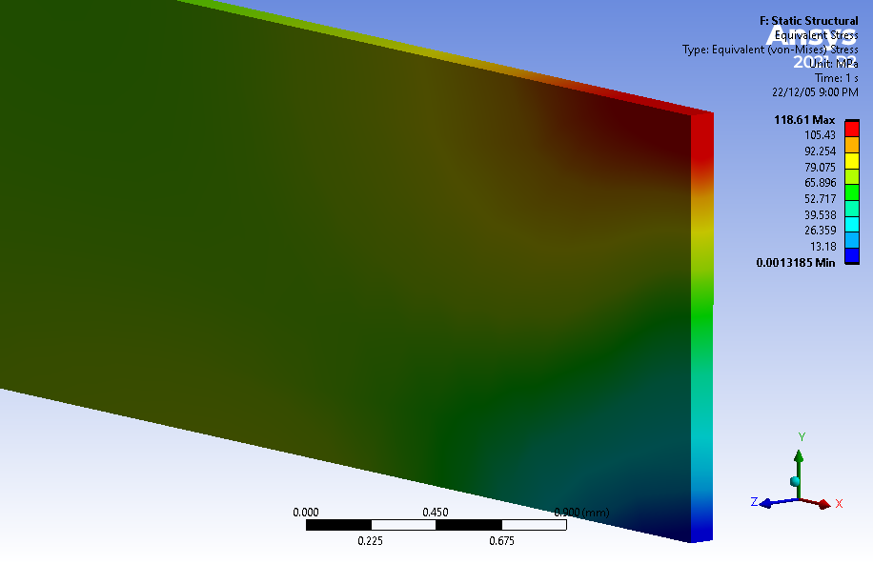
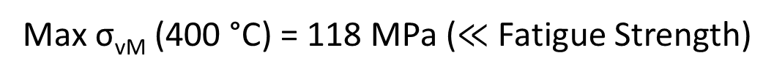
180 MeV e‒ Beam: Peak Equivalent Stress (W: 0.1mm x 3mm x 80mm)
Pulse Length = 34 ms and Pulse Period = 200 ms
Max σ_{vM} (400 °C) = 118 MPa ($≪$ Fatigue Strength)

Slide 6
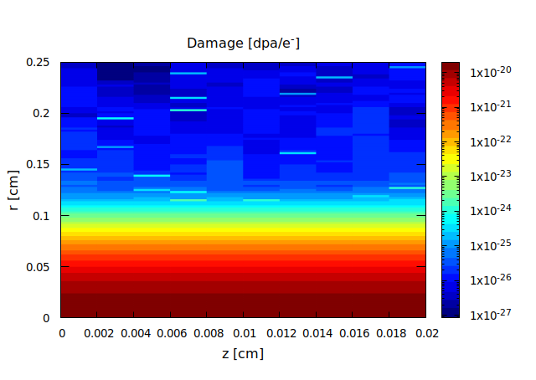
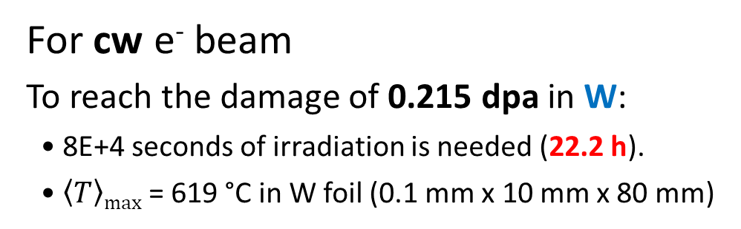
Radiation Damage by 22 μA @ 180 MeV e‒ Beam with 250 μm RMS Spot Size
22 μA → 1.375E+14 e⁻/s
Tungsten
For cw e⁻ beam
To reach the damage of 0.215 dpa in W:
• 8E+4 seconds of irradiation is needed (22.2 h).
• $\left\langle T\right\rangle max$ = 619 °C in W foil (0.1 mm x 10 mm x 80 mm)
Material | Displacement Threshold Energy [eV] | Rad. Damage [dpa/e⁻]
Ta | 90 | 1.94E-20
W | 90 | 1.96E-20
Re | 60 | 3.37E-20
Cu | 30
W40Cu |  | 5.27E-20
Rad. Damage of Tungsten = 1.96E-20 dpa/e⁻

Slide 7
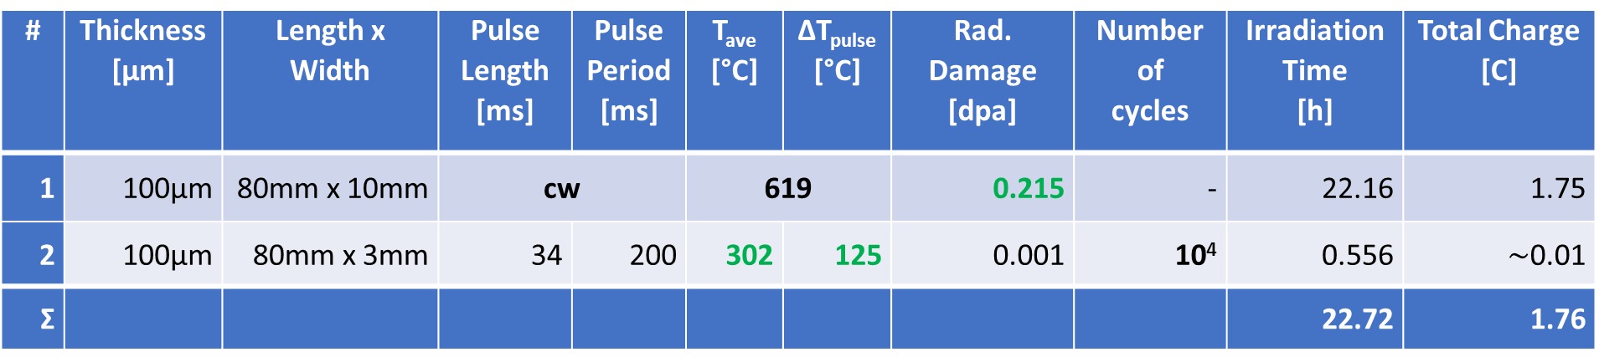
Options for Test of W Targets at 180 MeV
# | Thickness [μm] | Length x Width | Pulse Length [ms] | Pulse Period [ms] | T_{ave} [°C] | ΔT_{pulse} [°C] | Rad. Damage [dpa] | Number of cycles | Irradiation Time [h] | Total Charge [C]
1 | 100μm | 80mm x 10mm | cw |  | 619 |  | 0.215 | - | 22.16 | 1.75
2 | 100μm | 80mm x 3mm | 34 | 200 | 302 | 125 | 0.001 | 10⁴ | 0.556 | $\sim$0.01
Ʃ |  |  |  |  |  |  |  |  | 22.72 | 1.76
Target #1: test of radiation damage
Target #2: test 10k thermal cycles with expected temperatures at JLab e⁺ target

Slide 8
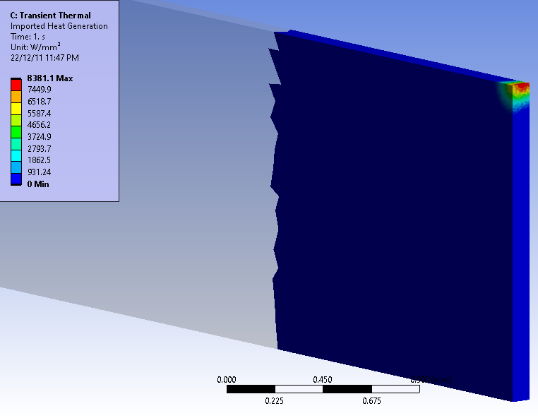
3.5 MeV e‒ Beam and W Target
50 μA @ 3.5 MeV e‒ beam with 50 μm RMS spot size on target
Thickness of W target: 100 μm
Length of W target: 80 mm
Width of W target: 3 mm
Al₂O₃
3D View of ¼ of Target
W
Beam
Al
Peak Deposited Power = 8.38 kW/mm³ vs 152 W/mm³ at 180 MeV

Slide 9

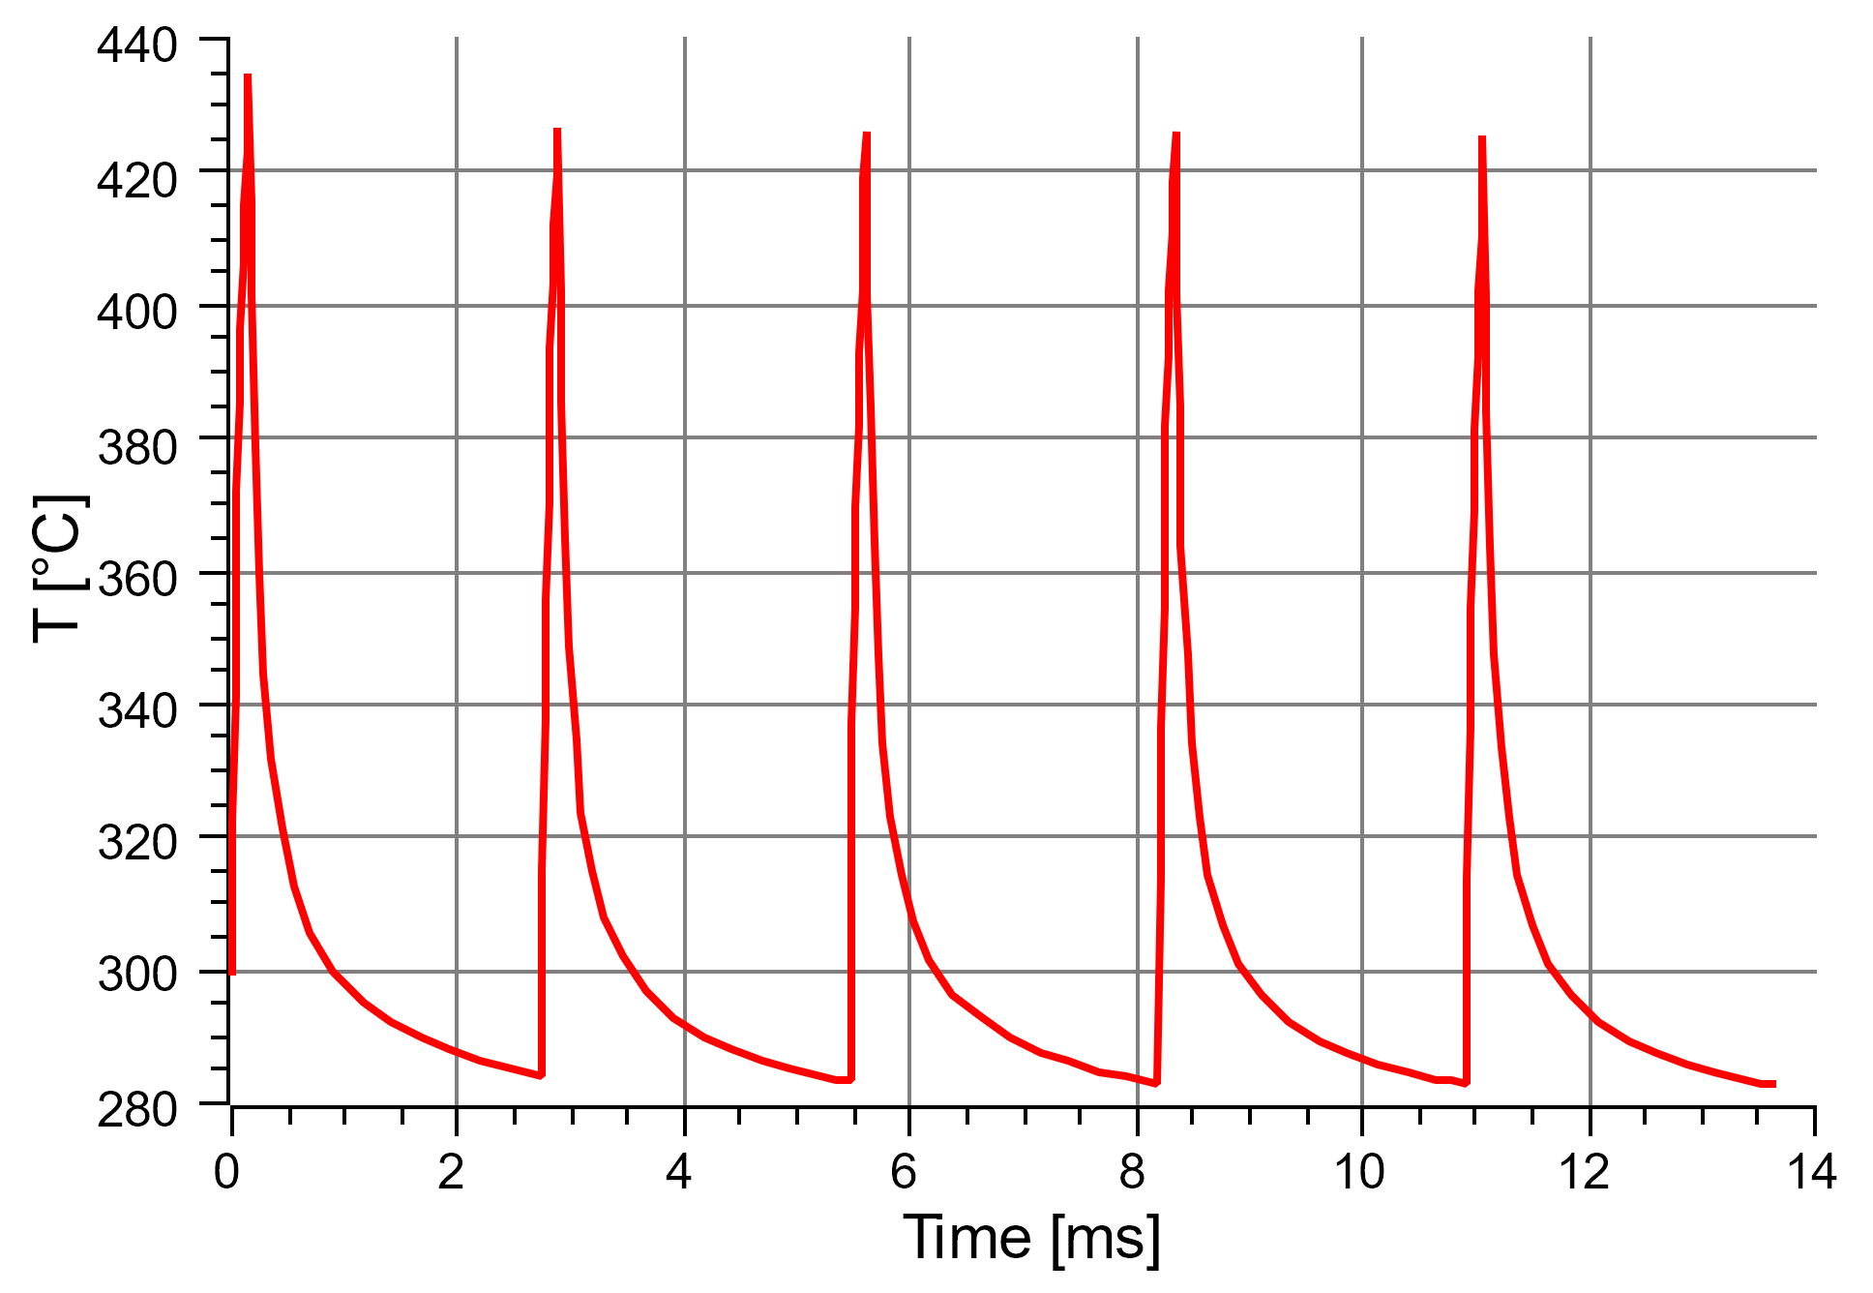
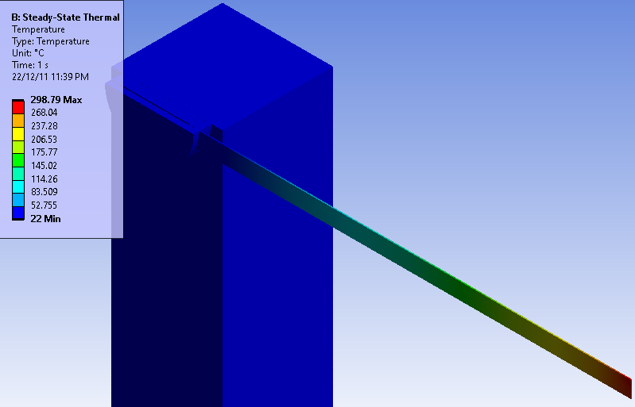
3.5 MeV e‒ Beam: Heat Power and Target T for Duty Cycles of 0.055
Average P = 461 W/mm³
Cycling Temperature for
Pulse Length = 0.15 ms, Pulse Period = 2.73 ms
Average Temperature
T_{ave} ≈ 300 °C
ΔT ≈ 140 °C
Pulse length = 0.15 ms vs 34 ms at 180 MeV
Pulse length is too short

Slide 10
How pulse length can be increased
keeping
300 °C average temperature (1)
and
120 °C temperature rise per pulse (2)?
Reduce heat path: reduce length of W foil to (0.1 mm x 3 mm x) 42 mm
  Target holder for 42 mm target length was used in the past
Reduce heat density: increase RMS beam size to 100 µm

Slide 11
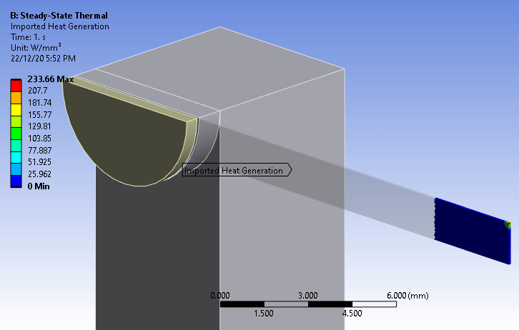
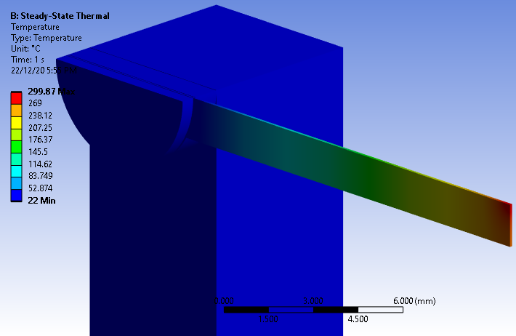
W Target 3.5 MeV e‒ Beam with Duty Cycle of 0.107
50 μA @ 3.5 MeV e‒ beam with 100 μm RMS spot size on target
Thickness of W target: 100 μm
Length of W target: 42 mm
Width of W target: 3 mm
Average Power
Average Temperature

Slide 12
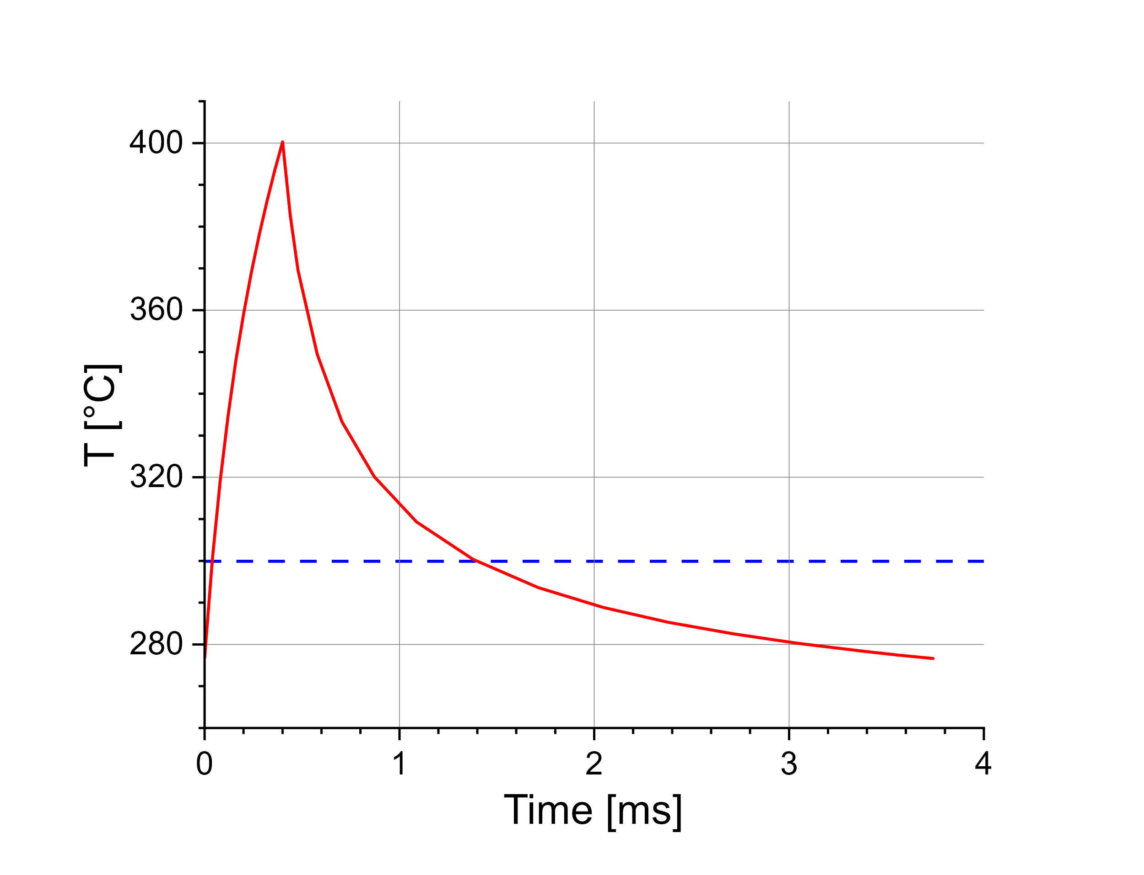
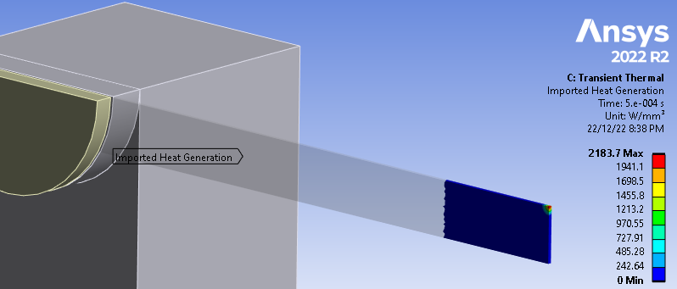
3.5 MeV e‒ Beam: Heat Power and Thermal Cycle
Deposited Power = 2.18 kW/mm³
Pulse Length = 0.4 ms
Pulse Period = 3.74 ms

Slide 13
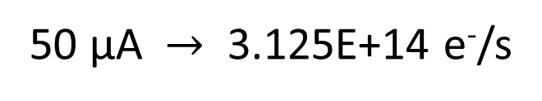
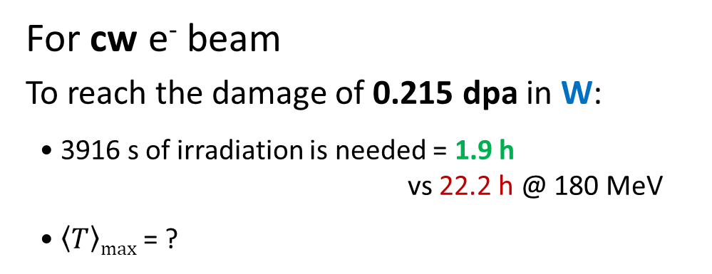
Radiation Damage by 50 μA @ 3.5 MeV e‒ Beam with 50 μm RMS Spot Size
50 μA $→$ 3.125E+14 e⁻/s
For cw e⁻ beam
To reach the damage of 0.215 dpa in W:
• 3916 s of irradiation is needed = 1.9 h
vs 22.2 h @ 180 MeV
• $\left\langle T\right\rangle max$ = ?
Rad. Damage = 1.02E-19 dpa/e⁻
vs 1.96E-20 dpa/e⁻ at 180 MeV

Slide 14
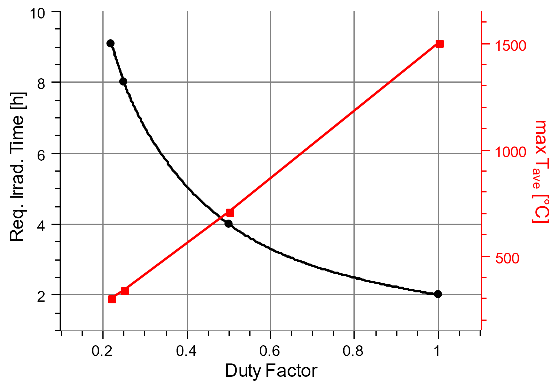
Required Irradiation Time and Maximal Average Temperature for CW and Pulsed 3.5 MeV e‒ Beam with 50 μm RMS Spot Size to reach 0.23 dpa in W target (0.1mm x 10mm x 42mm)

Slide 15
Summary
Beam focusing system at 3.5 MeV allows to reduce RMS beam size down to 50 µm
Beam current of 50 µA was used in the past. Beam is stable if pulse length is not too short
No activation and long cooling time
Easier to get beam time, lower costs
Targets are in vacuum, no uncertainty connected with cooling by air.
Beam size can be measured precisely
Many millions thermal cycles can be tested: 10M cycles with 0.4 ms pulse length and 3.74 ms pulse period will require 10.4 h irradiation time
Radiation damage in wide temperature range can be tested: 0.23 dpa @ 300 °C will require 9.1 h beam time

