Slide 1
Radiation Control
Vashek Vylet RadCon Manager
UITF Internal Safety Review
May 10, 2016

Slide 2
Radiation Control
Goal: Insure radiation safety of workers, public and the environment, in compliance with regulatory and Jlab requirements (Shielding Policy)
Radiation Control System (ANSI N43.1):
Shielding
Monitoring - in process
Beam Containment (Henry Robertson)

Slide 3
Shielding Policy
Normal operation (incl. beam mis-steering)
< 250 mrem/y in occupied RCAs
< 100 mrem/y in other occupied areas
< 10 mrem/y at site boundary
radionuclides in groundwater per VPDES permit
Max. credible accident: <15 rem per incident

Slide 4
Shielding – Envisioned Phases
A – HDIce: operation at 10 MeV for 900 h/y
I_{av} = 5 nA for 80% of time
I_{av} = 100 nA for 20% of time (for tuning)
B – Operation at 10 MeV with I_{av} = 100 μA
C – Operation at 35 MeV with I_{av} = 100 μA

Slide 5
Shielding – Phase A
This review: partial phase A – no HDIce, beam ends in cave 2 at 42” beam height
Cave 1 shielding as is; I_{av} = 100 μA (mA) is desired in cave 1
Cave 2 has 4 ft forward and lateral concrete shielding, with a 1.75 ft thick roof

Slide 6
Cave 1 at 100 μA
CAVE 1 | Dose rate
 | [mrem/h] | Note
Side 100% loss | 41 | RA
Side 1% loss | 0.4 | RCA
Side up 1% loss | 26 | RA
30”
Thinner wall may be an issue for stairs (and ground due to skyshine).
Cable penetrations under
west wall must be filled
with grout or similar
28”
27”

Slide 7
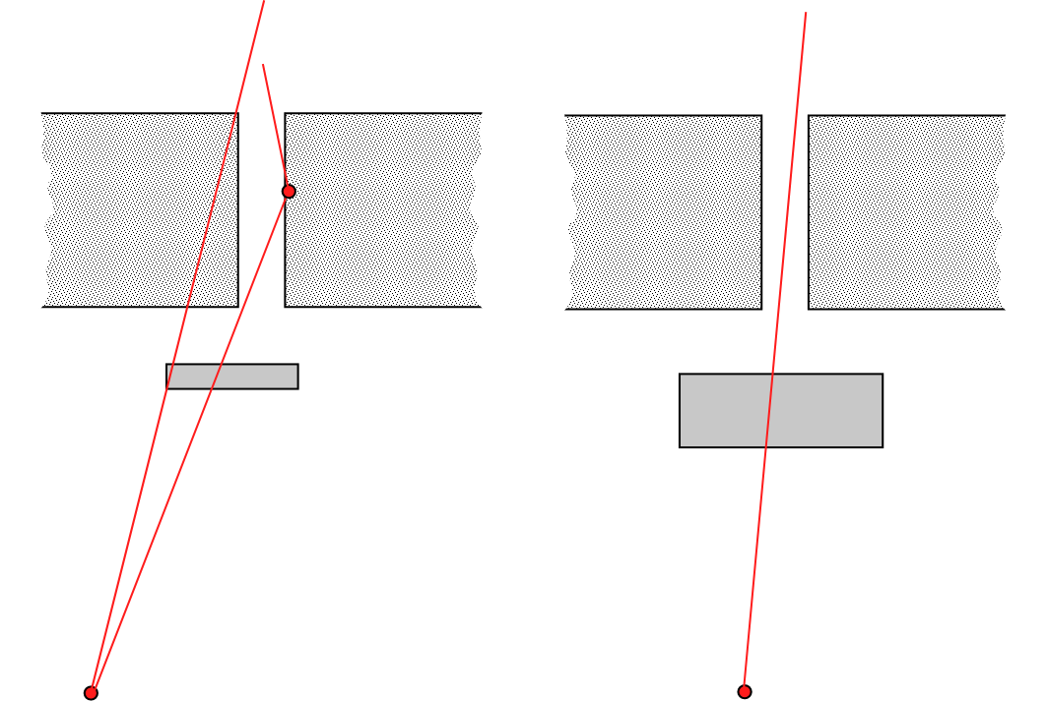
Cave 1 at 100 μA
CAVE 1 | Dose rate
 | [mrem/h]
Roof 100% loss | 2973
Roof 1% | 30
Penet* 100% | 40621
Penet* 1% | 406
* with current 3.25" Fe shield
30” concrete
3” steel
7.8” steel
Penetrations are above the beamline – about 8” of steel is needed for same attenuation as the 30” concrete slab. Roof will have to be inaccessible; Depending on results of measurements, full 100 μA may not be feasible at 10 MeV

Slide 8
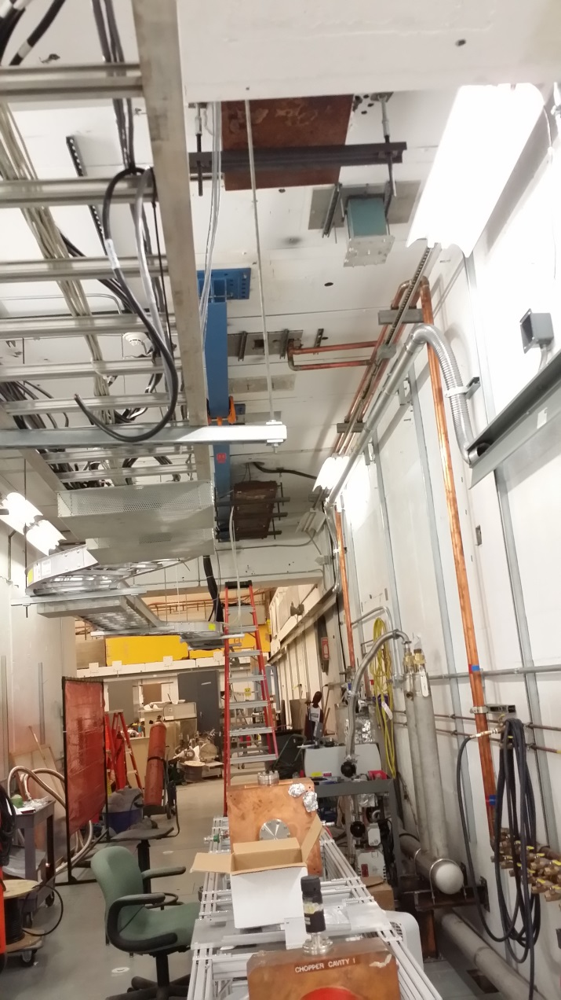
Cave 1 at 100 μA

Slide 9
Cave 2 at 100 nA
Existing side shielding (4 ft) adequate for both 5% and 100% loss
RCA on roof, potential for RA for large losses
Local shielding needed for FARCs and beam dump
Local shielding needed at ODH vent
HDIce config & forward shielding to be modeled in detail for forward shielding

Slide 10
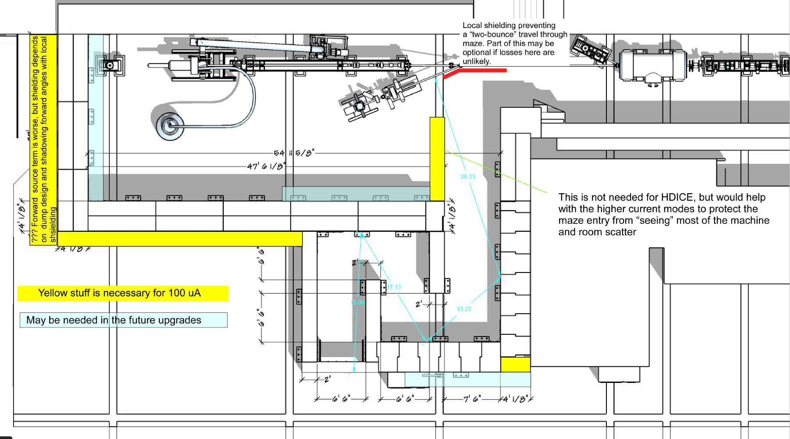
Cave 2 at 100 nA

Slide 11
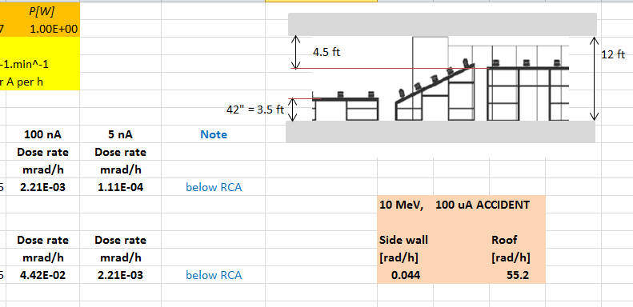
Cave 2 at 100 nA
42” dump
Side 5%
loss
Side 100 %
Existing shielding is adequate in this regime; HDIce dump to be designed + few other details

Slide 12
Cave 2 at 100 nA
Local shielding needs to be
added on the roof to keep
streaming radiation from ODH
vent reaching occupied areas
Skyshine on ground and adjacent
Areas may be an issue – will be
addressed by monitoring

Slide 13
Summary
Both caves sufficiently shielded for 100 nA
100 uA in Cave 2 has issues
Monitoring layout (CARMs) to be defined (include probes for skyshine)
MC calculations needed to address HDIce dump and possible special configurations

