Slide 1
GPT -s
Example script
GDFAs, elements and progs
GDFMGO (Multi-objective genetic global optimizer)
Optimizations currently in progress
What is still missing
Mark Stefani

Slide 2
Typical Simulation
.bat file
  Details the execution of the simulation, what files are to me read and written, interface readout and special features such as spin tracking.
.in file
  Details of the simulation. Output conditions and elements that comprise the system being simulated.
.mr files
  Optional. Useful for controlling simulation parameters and performing scans.

Slide 3
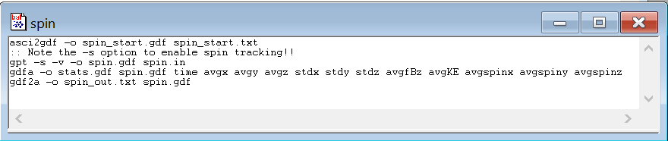
.bat file

Slide 4
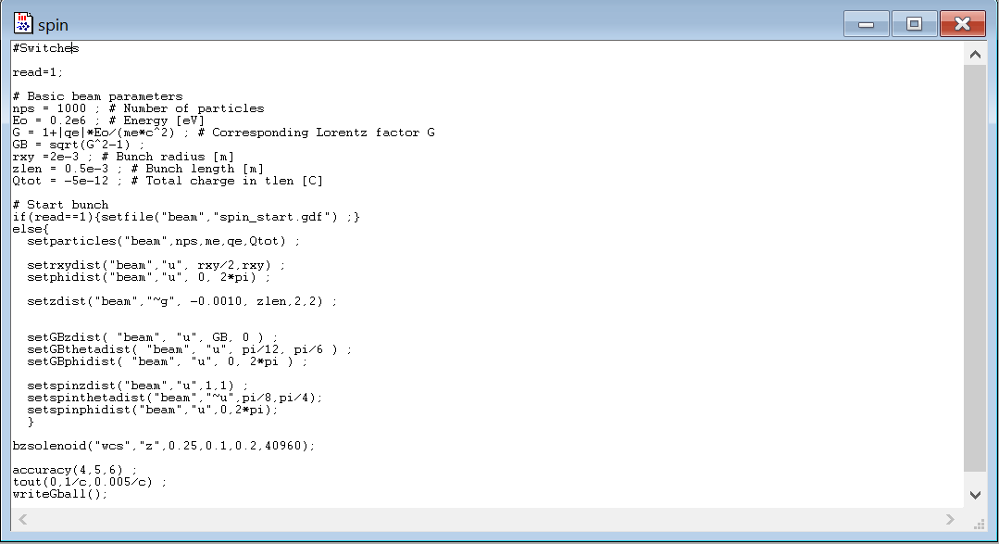
.in file

Slide 5
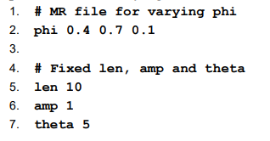
.mr file
.bat file line:
mr -o result.gdf phi.mr gpt inputfile.in

Slide 6
GDFAs: elements and programs
GDFAs are build in features of GPT that include components of the simulation itself as well as post-processing analysis.
  Avgs
  Stds
  Bstatic
  Estatic
  Ect…
Custom elements and programs can be compiled (GPT’s super power).
  WriteGBall()
  UncorEmit()
  Bunchfactor()
  Whatever you want to code…

Slide 7
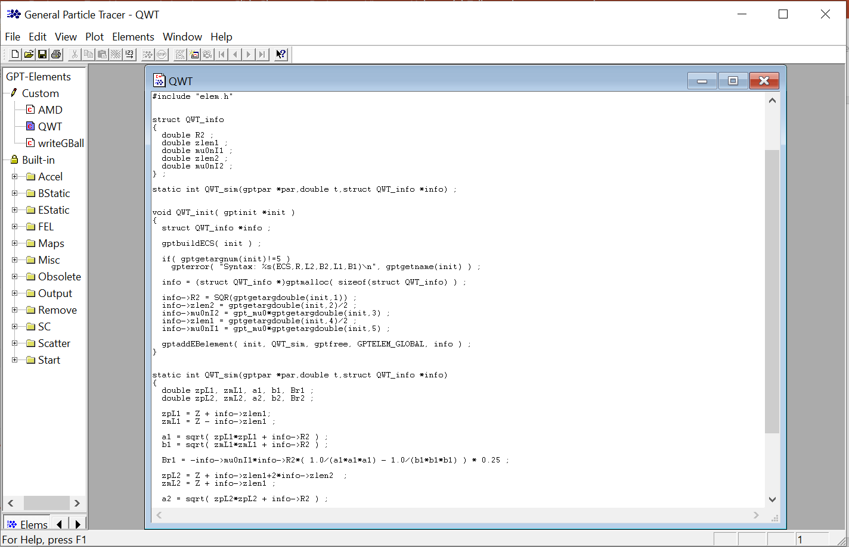
GDFAs continued
Elements: components of a simulation that utilized within the .in file.
Sets conditions for accelerators components and beam parameters

Slide 8
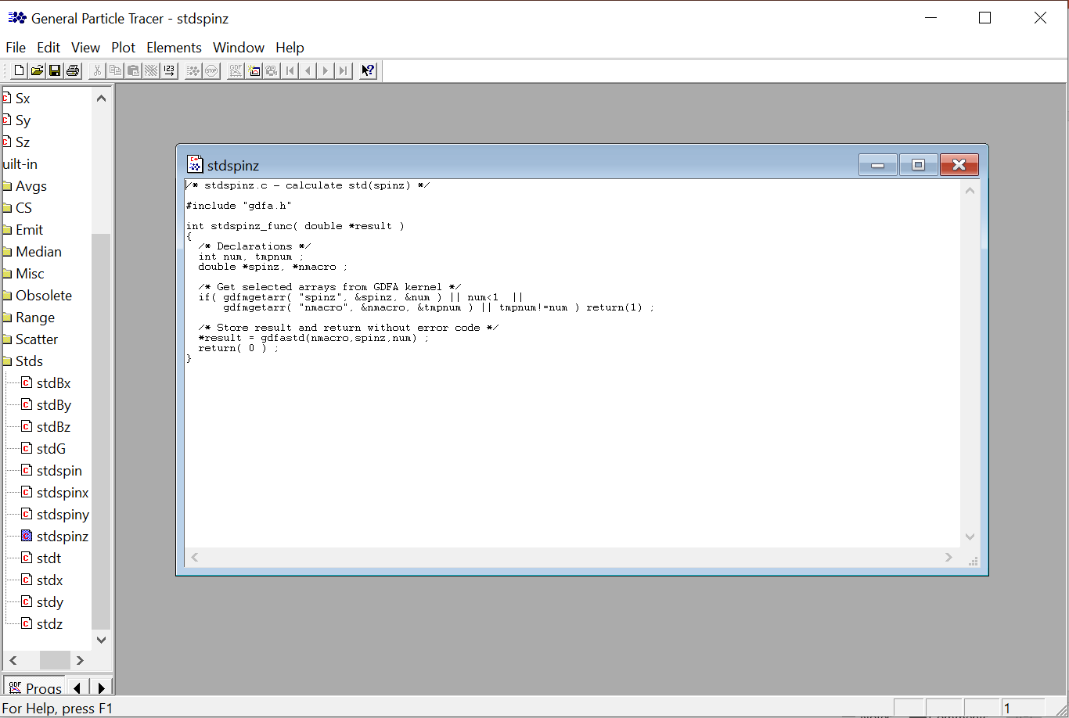
GDFAs continued
Programs (progs): post-processing features used to analyze simulation results. These are the features that can be used for optimization.

Slide 9
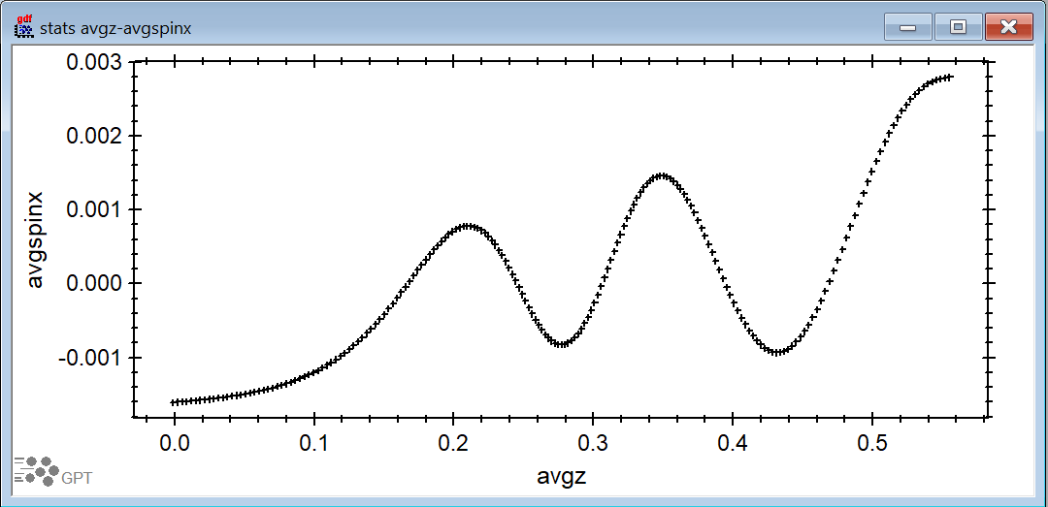
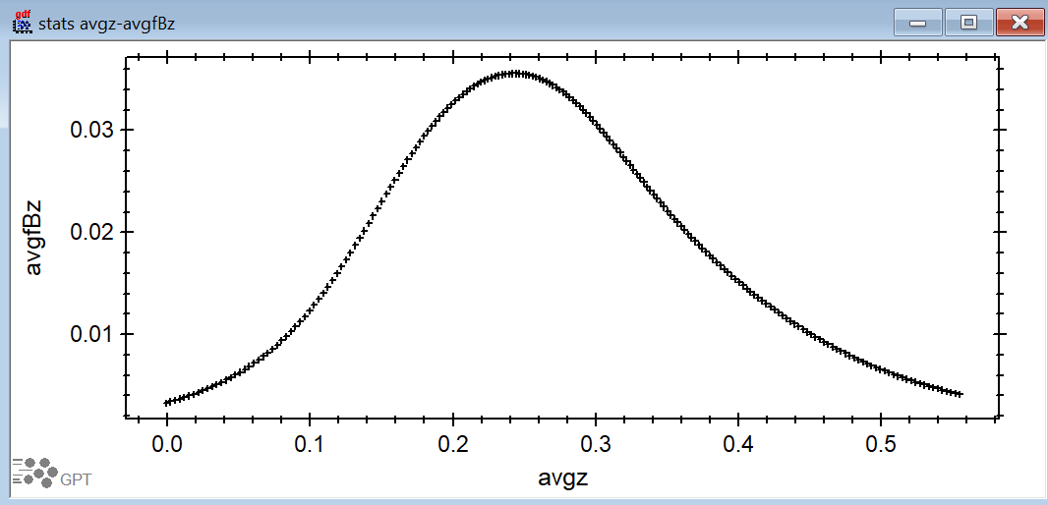
Examples of GDFA Plots

Slide 10
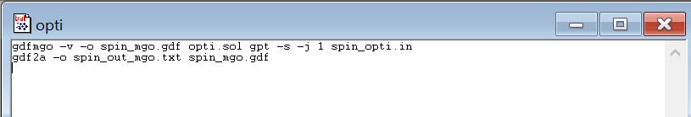
GDFMGO
Multi-objective genetic global optimizer
Less likely to be trapped by local max or mins
.sol / .mgo
  Used to set optimization conditions.
.bat file and .in file still required with specific changes
  .bat needs to specify files and cores to be used.
  .in functions best with screen() element as output.

Slide 11
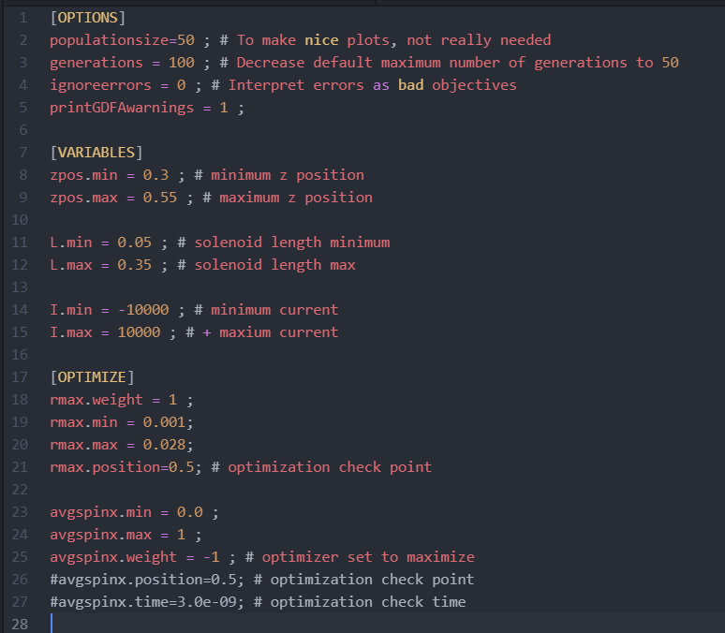
.sol or .mgo file

Slide 12
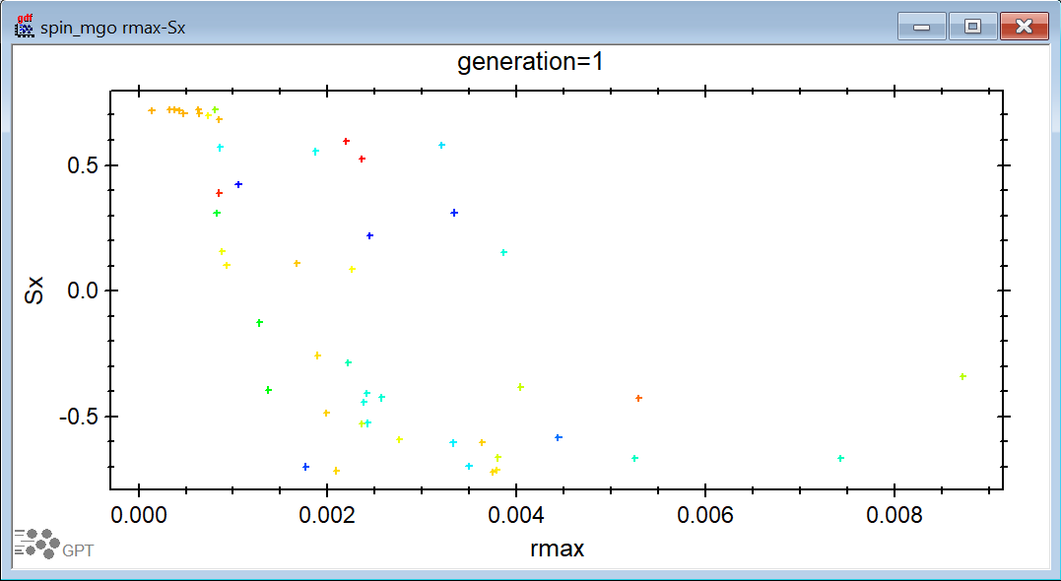
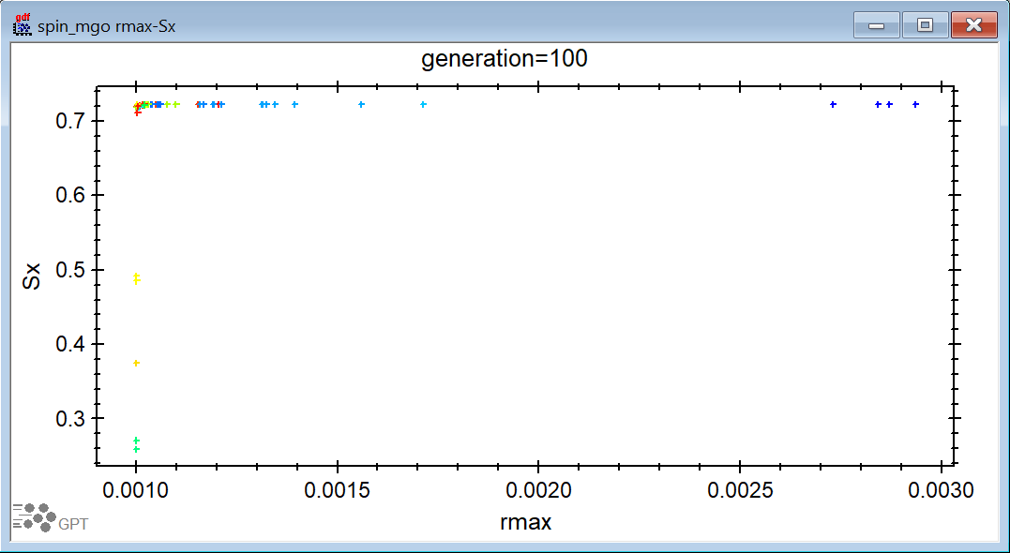
GDFMGO example output

Slide 13
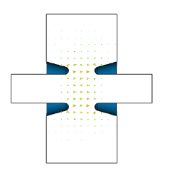
Optimizations currently in progress
AMD to Capture Cavity. Particles from GEANT4 and spin elements
  Will be using this to create poisson/SF AMD file and basic features of buncher cavity
E-field bending element for longitudinal to horizontal spin. Particles from spin elements

Slide 14
What is GPT -s still missing?
The spin dynamics are hard coded for electrons.
GPT particles can be given a charge and mass, but these currently are not passed to the spin calculation.
Proposing modification to setparticle() element
Charge, mass, and magnetic moment
Suggestions? Questions?

