Slide 1


Slide 2
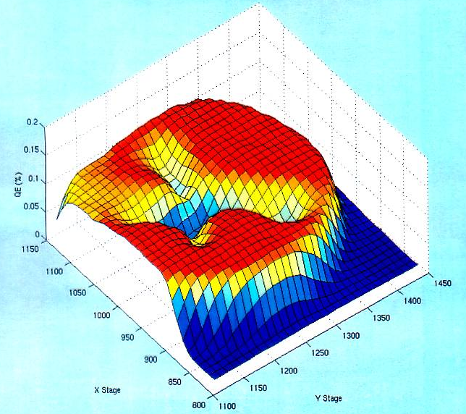
Pragmatically Avoiding the “EC”
We don’t run beam from the electrostatic center of the cathode/anode
Laser spot diameter <1 mm can be moved to different locations on the photocathode (5mm)
Electrons
OUT
Laser
IN
Gas
Ions create QE trough to electrostatic center
Here, QE ion damage forms QE trough from four spots to EC.

Slide 3
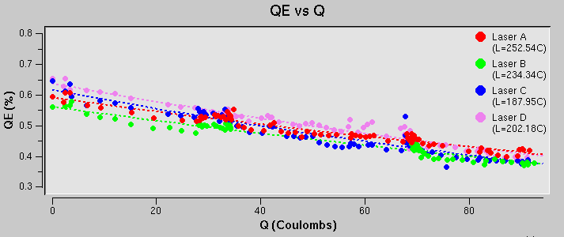

Laser Profile
Photocathode QE
Beam Profile

Slide 4


Improving Lifetime with Larger Laser Size
J. Grames, et al., Phys. Rev. ST Accel. Beams 14 043501 (2011)
GaAs @ 532nm

Slide 5
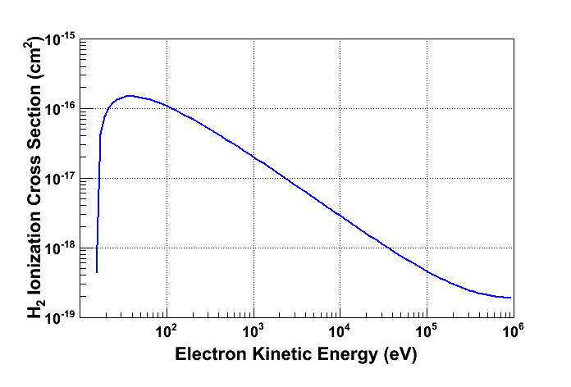
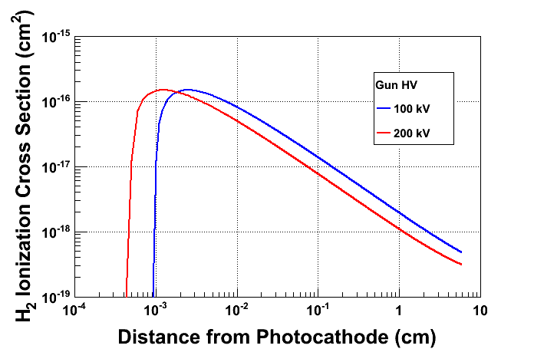
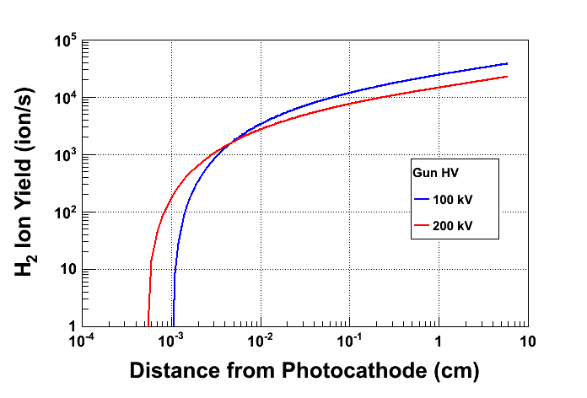
Generation of ions
Most ions created at low energy
Most ions created close to GaAs surface
Beam Current: 2.0 mA
Vacuum: 8.0 × 10⁻¹² Torr

Slide 6
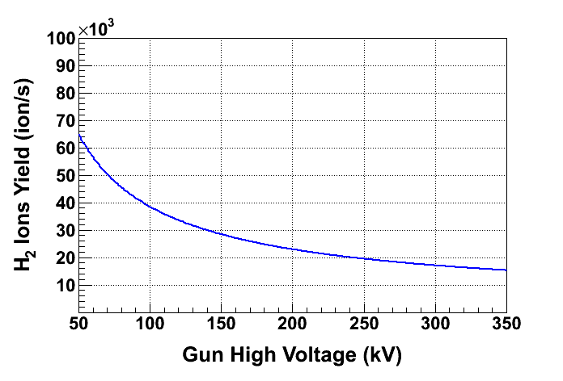
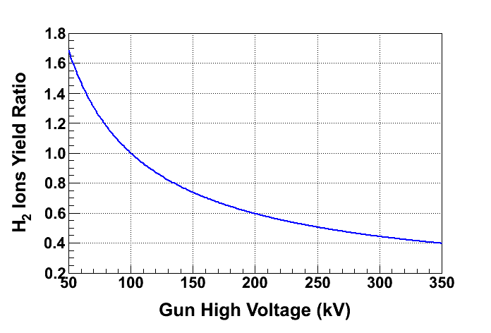
Ion energy
Low energy ion column for 100 kV gun
Low energy ion column for 200 kV gun
At 200 kV, only 60% of ions are created compared to 100 kV, longer lifetime

Slide 7
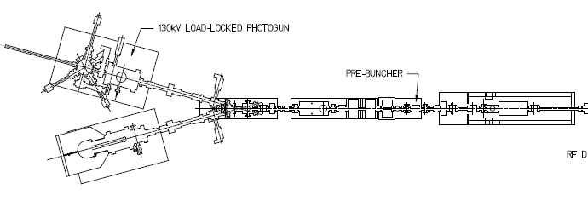
Varying beam voltage
Best vacuum
Electric Fields
Laser Profile
QE Surface
Fixed beam voltage
Good vacuum
Electric & Magnetic Fields
Ion collectors or filters
Beam loss and radiation

Slide 8
QE x Laser Profiles
=>
Initial
Distribution
Initial Distribution
x Gun + Beamline
=>
Beam Tracking
Ion Impact x Sputter/Implant
=>
QE modification
Beam Tracking
x Electron Impact Ionization
=>
Ion Generation
Ion Motion x Gun
=>
Ion Impact Photocathode
Ions x Beam x Beamline
=>
Ion Motion

