Slide 1
200 mA Magnetized Beam for MEIC Electron Cooler
MEIC Collaboration Meeting
Spring 2015
Riad Suleiman and Matt Poelker
March 30, 2015

Slide 2
Outline
MEIC Magnetized Electron Beam Cooling Requirements
Source Pros and Cons
Gun Options:
CW RF guns, warm and cold
Thermionic gun
Photogun
Magnetized Beam
Summary

Slide 3
Bunched Magnetized Electron Gun Requirements
Bunch length | 100 ps (3 cm)
Repetition rate | 476 MHz
Bunch charge | 420 pC
Peak current | 4.2 A
Average current | 200 mA
Emitting area | 6 mm ɸ
Transverse normalized emittance | 10s microns
Solenoid field at cathode | 2 kG

Slide 4
Source Pros and Cons
Warm CW RF gun: thermionic emitter or photocathode, the promise of high bunch charge, but long low-energy tail, managing heat load for CW operation (AES and LANL examples)
CW SRF gun: huge potential, but also huge technical challenges including applied mag field (Rossendorf and BNL)
RF-pulsed grid thermionic gun: simple, long lifetime, but also long pulse and worst emittance (TRIUMF and BINP’s NovoFEL)
DC high voltage photogun: good emittance, delicate photocathodes, high bunch charge demands high bias voltage (JLab and Cornell)

Slide 5
Source Dependencies
Thermal Emittance: Intrinsic property of a cathode. Depends on work function, surface roughness, laser wavelength, temperature.
Achievable Current: QE, laser wavelength, laser power, laser damage, heating, emitter size, temperature.
Bunch Charge: laser peak power, repetition rate, active cathode area, bunch length.
Cathode Lifetime: ion back bombardment, dark current, contamination by residual gas, evaporation, beam loss, halo beam.
What will applied magnetic field do?

Slide 6
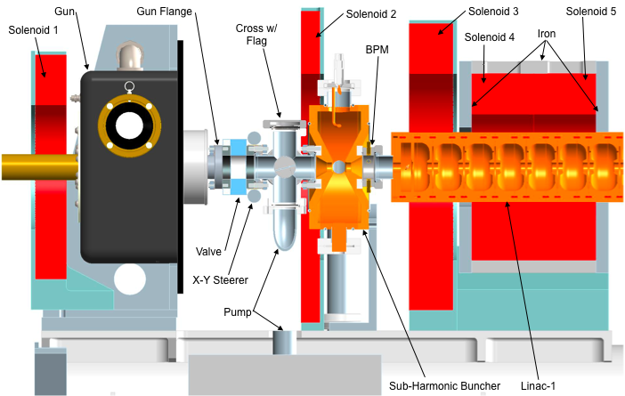
Warm CW RF gun options
Example 1: Advanced Energy Systems (AES), Inc., NCRF gun (A. Todd, ERL11):
RF frequency | 1 GHz
Bunch length | 1 – 5 ps
Bunch charge | 0.2 nC
Normalized emittance | 20 microns
Bean energy (after pre-booster) | 1 MeV
Micropulse length | 1 – 8 µs
Micropulse repetition rate | 10 Hz
Pulsed gun – Could it be used as CW?

Slide 7
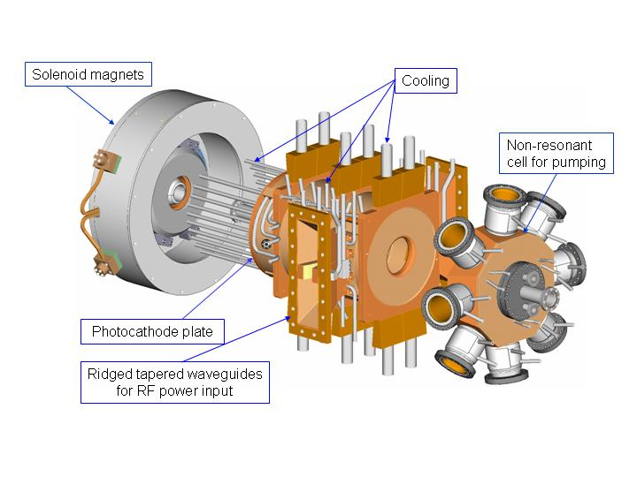
Example 2: LANL/AES 2.5-cell Photocathode NCRF gun:
RF frequency | 700 MHz
Bunch repetition rate | 35 MHz
Average current | 100 mA
Bunch length | 9 ps
Bunch charge | 1 – 3 nC
Normalized emittance | 7 microns
Bean energy | 2.5 MeV
Energy spread | <1.3%
Ohmic losses | 780–820 kW
E cathode | 10 MV/m
D.C. Nguyen et al., NIM A 528, 71 (2004)

Slide 8
CW SRF Gun Options
Example 1: Rossendorf (BESSY-DESY-FZD):A. Burrill, EIC14
 | Injector 0 | Injector 1 | Injector 2
Goal | Beam Demonstrator | Brightness R&D Injector | High-current injector
Electron energy | ≥ 1.5 MeV
RF frequency | 1.3 GHz
Design peak field | ≤ 50 MV/m
Operation launch field | ≥ 10 MV/m
Bunch charge | ≤ 77 pC
Repetition rate | 30 kHz | 54 MHz / 25 Hz | 1.3 GHz
Cathode material | Pb | CsK₂Sb | CsK₂Sb
Cathode QE | 10⁻⁴ at 258 nm | 2-10% at 532 nm | 2-10% at 532 nm
Laser wavelength | 258 nm | 532 nm | 532 nm
Laser pulse energy | 0.15 µJ | 1.8 nJ | 1.8 nJ
Laser pulse shape | Gaussian | Gaussian/Flat-top | Gaussian/Flat-top
Laser pulse length | 2.5 ps FWHM | ≤ 20 ps | 20 ps
Average current | 0.5 µA | ≤ 10 mA / 0.1 mA | 100 mA
2015 focus

Slide 9
Example 2: BNL SRF guns program (S. Belomestnykh, EIC14):
Two SRF photoemission guns are under active development:
704 MHz ½-cell elliptical gun to deliver high bunch charge and high average current beams for R&D ERL
112 MHz QWR gun is designed to produce high bunch charges, but low average beam currents for Coherent electron Cooling (CeC) Proof-of-Principle experiment
Preparing for first beam test
Two other SRF guns under development:
1.3 GHz SRF plug gun for GaAs photocathodes
84.5 MHz SRF gun for eRHIC CeC injector

Slide 10
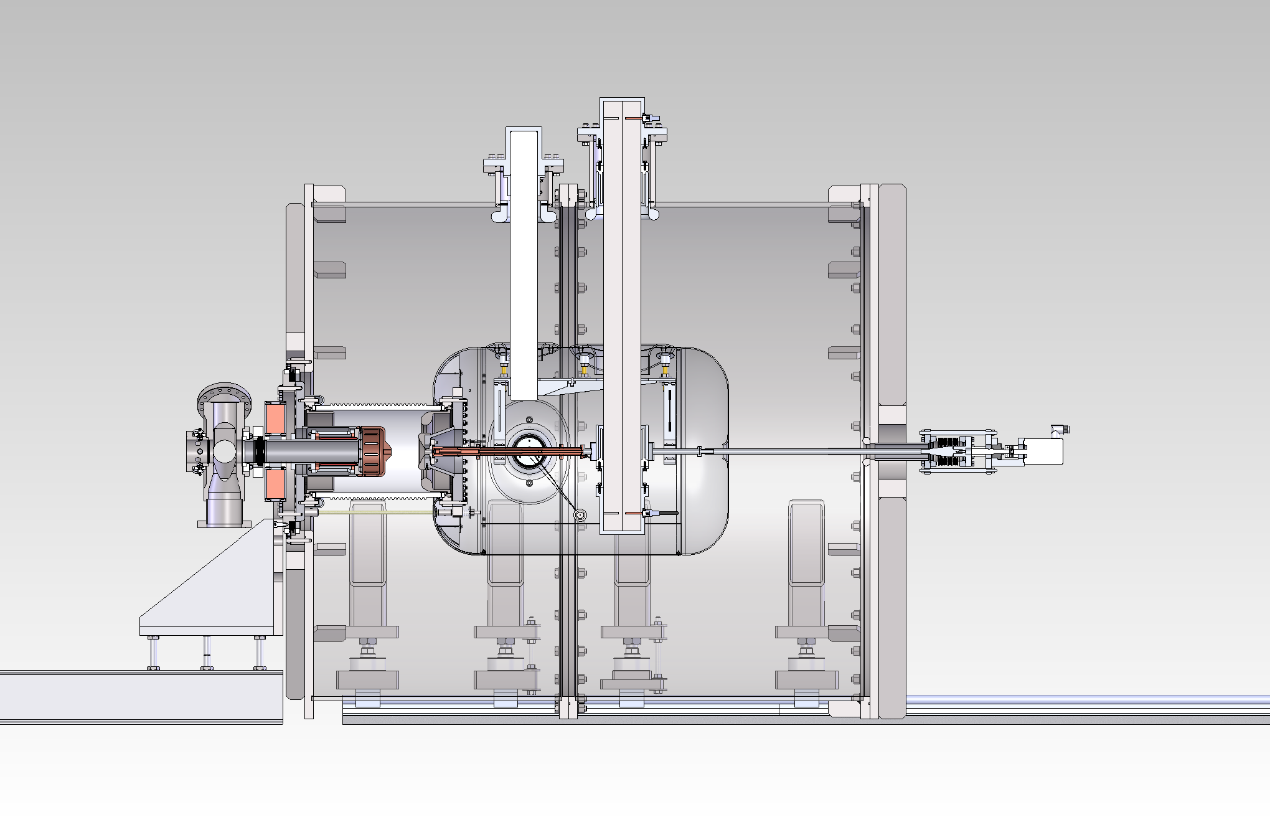
Thermionic Gun Options
Example 1: TRIUMF e-Linac for photo-fission of actinide target materials to produce exotic isotopes:
BaO: 6 mm diameter, 775˚C
Grid at 650 MHz
Gun HV: 300 kV
Average current: 25 mA
Bunch charge: 38 pC
Normalized emittance: 30 microns. Emittance is dominated by electric field distortion caused by grid.
support
ceramic waveguide
high voltage shroud
rf tuner

Slide 11
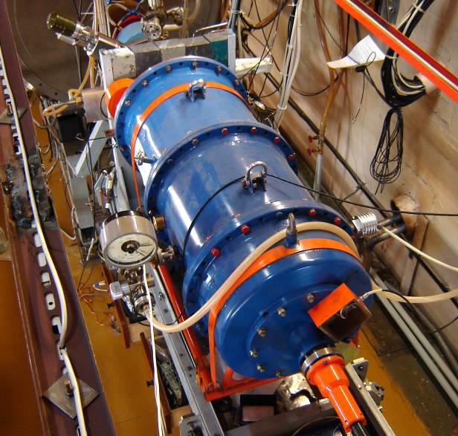
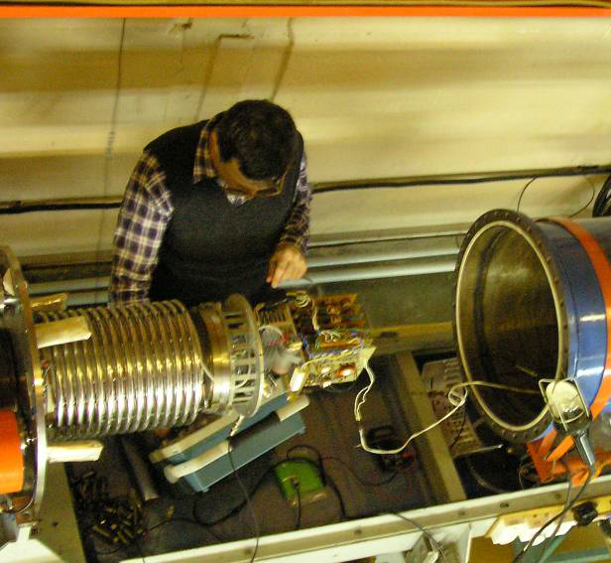
Example 2: Thermionic Gun and 1.5 MeV Injector of BINP’s NovoFEL. B.A. Knyazev et al., Meas. Sci. Tech. 21, 054017 (2010):
Gun HV | 300 kV
Maximum peak current | 1.8 A
Maximum average current | 30 – 45 mA
Maximum bunch repetition rate | 22.5 MHz
Bunch length | 1.3 ns
Bunch charge | 1.5 – 2 nC
Normalized emittance | 10 microns

Slide 12
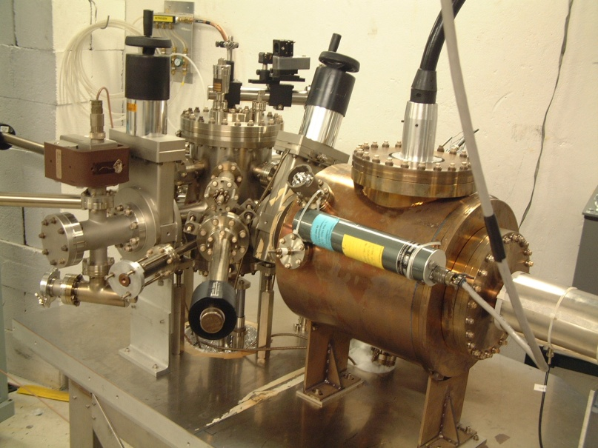
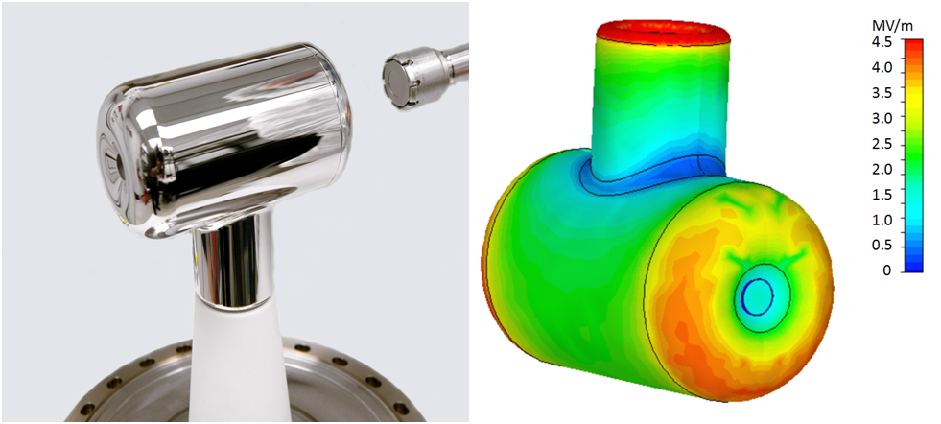
Photogun Options
Example 1: JLab 200 kV Inverted dc Gun with K₂CsSb photocathode:
Average beam current: 10 mA
Laser: 532 nm, dc
Lifetime: very long (weeks)
Thermal emittance: 0.7 microns/mm(rms)
Mammei et al., Phys. Rev. ST AB 16, 033401 (2013)

Slide 13
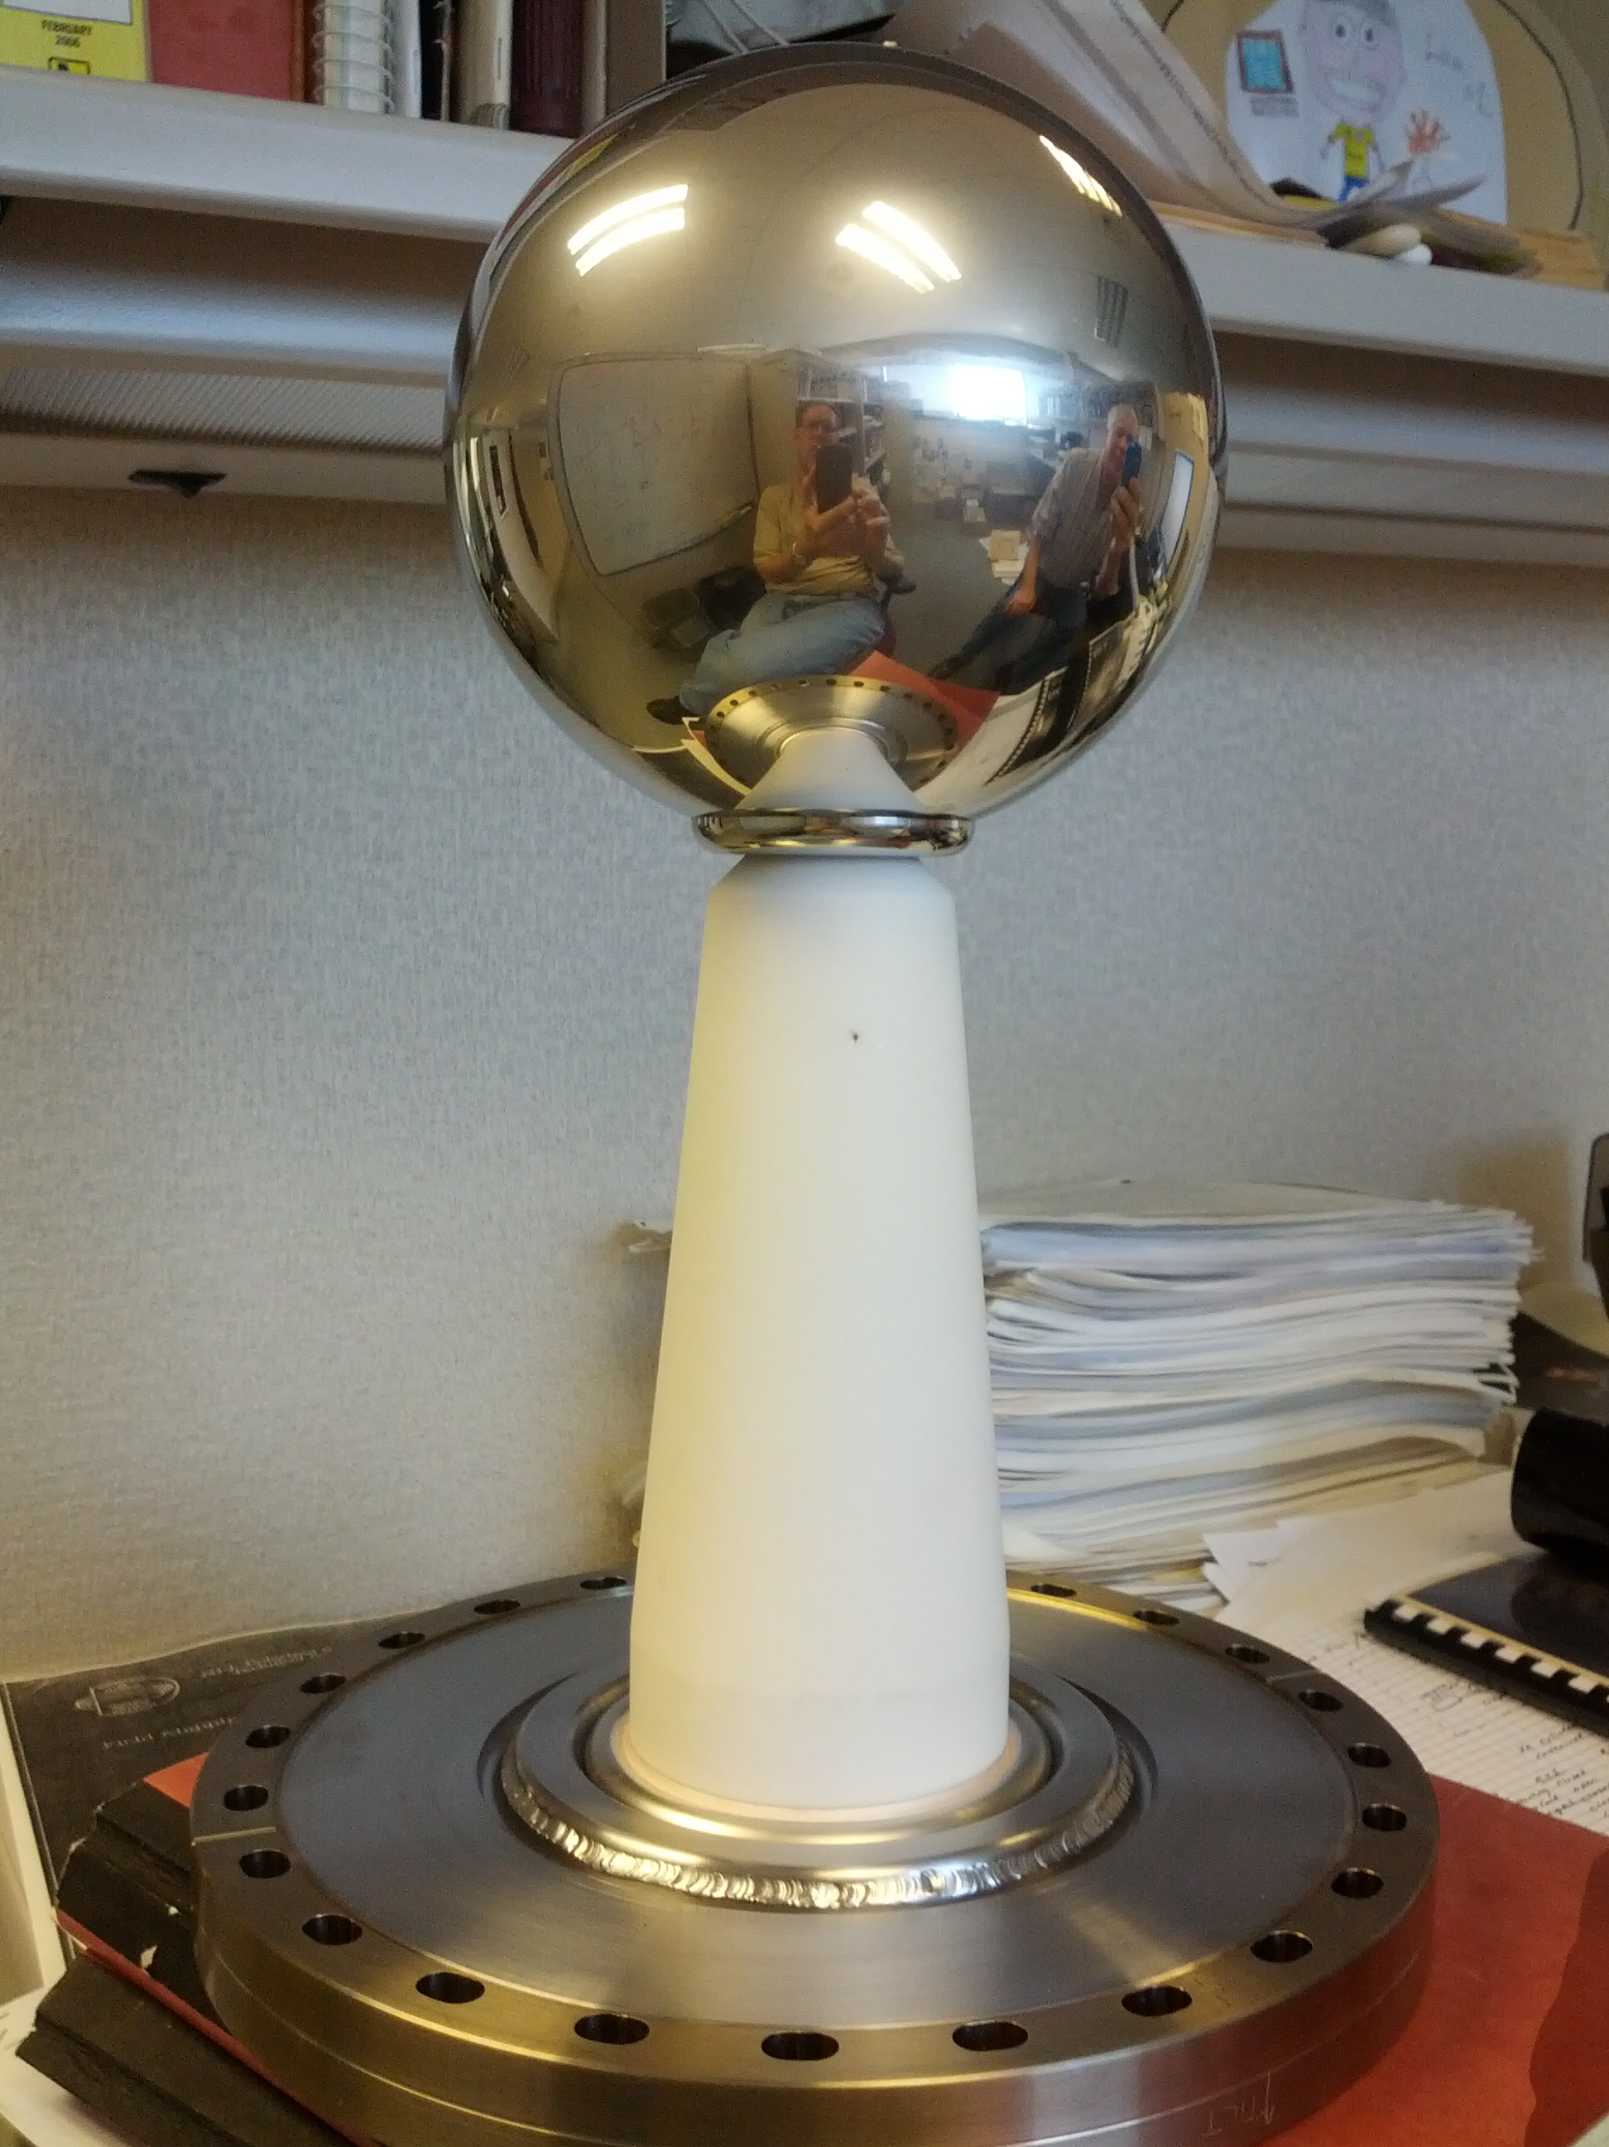
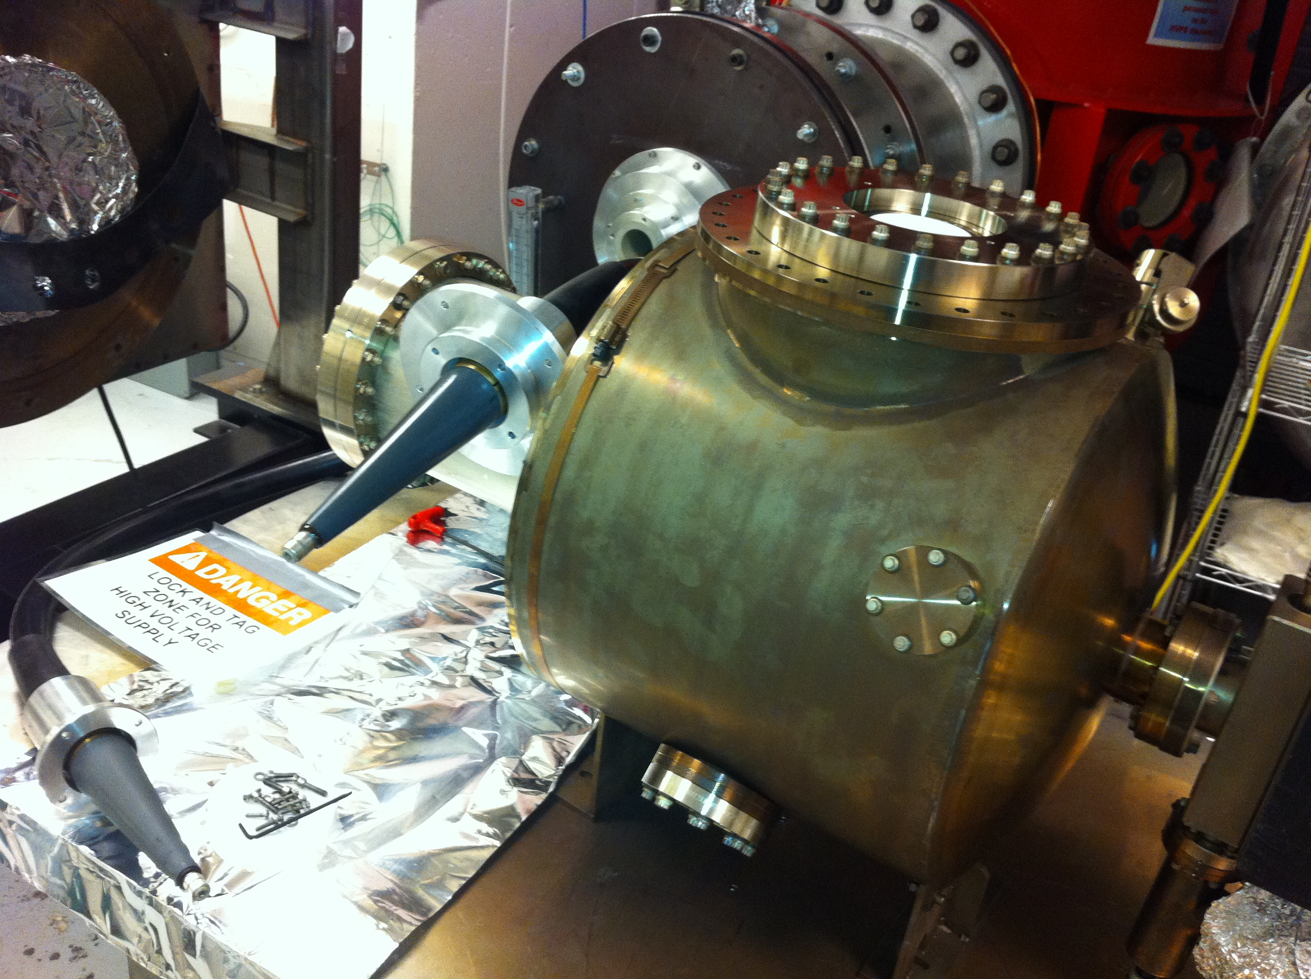
Example 2: JLab 350/500 kV Inverted dc Gun:
 | 200 kV Gun | 350/500 kV Gun
Chamber | 14” ɸ | 18’’ ɸ
Cathode | 2.5” T-shaped | 6” ɸ Ball
Cathode Gap | 6.3 cm | 6.3 cm
Inverted Ceramic | 4” long | 7” long
HV Cable | R28 | R30
HV Supply | Spellman 225 kV, 30 mA | Glassman 600 kV, 5 mA
Maximum Gradient | 4 MV/M | 7 (10) MV/m
Achieved 350 kV with no FE, next:
Keep pushing to reach 500 kV
Run beam with K₂CsSb photocathode

Slide 14
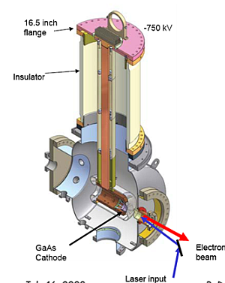
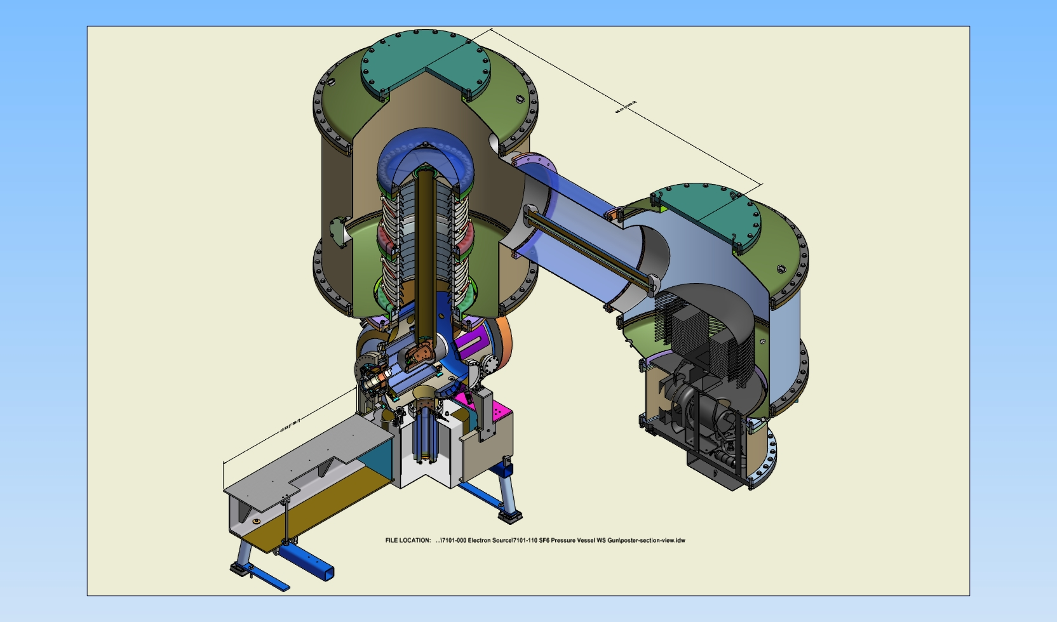
Example 3: Cornell dc Gun with K₂CsSb photocathode:
Dunham et al., Appl. Phys. Lett. 102, 034105 (2013)
Gun HV: currently operating at 350 kV (designed 500-600 kV)
Average beam current: 65 mA for 9 hours (lifetime 2.6 days)
Bunch charge: 50 pC
Bunch length: 10 ps, 1.3 GHz
Normalized emittance: <0.5 microns

Slide 15
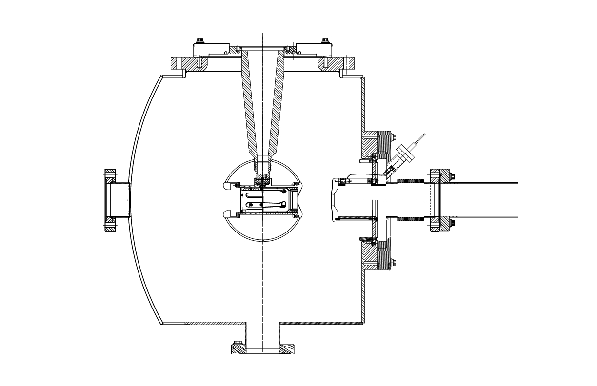
Magnetized Beam and Emittance Compensation
Solenoid (B_{z}~2kG)
(magnetized beam)
Magnetized Cathode:
To produce magnetized (angular-momentum-dominated) electron beam to ensure zero angular momentum inside cooling-solenoid section)
Injector Solenoids:
To compensate space-charge emittance growth
Will be easier to implement with compact gun (inverted photogun or thermionic gun)
Solenoids (B_{z}~2kG)
(space-charge emittance growth compensation)

Slide 16
Summary
Thermionic gun would be our first choice (less maintenance but may need complicated injector):
TRIUMF/BINP Gun with Inverted Ceramic
For better emittance, a dc HV photogun is good option:
JLab 350/500 kV Inverted Gun and JLab multi-alkai photocathode (Na₂KSb or K₂CsSb)
If one gun cannot provide 200 mA, then use two or three guns and combine beams using RF combiner or dipole magnet

Slide 17
LDRD: 200 mA Magnetized Beam
Use JLab 350/500 kV Inverted Gun and K₂CsSb photocathode
Design and build Cathode Solenoid
Generate magnetized beam
Measure beam magnetization:
Measure beam emittance vs. beam size
Measure directly using slit and screen
Measure after round to flat transformation
Study transportation of magnetized beam and round to flat beam transformation
Measure magnetized photocathode lifetime at high currents
Repeat with 100 kV thermionic gun loaned to TRIUMF

Slide 18
Backup Slides

Slide 19
MEIC Polarized Electron Source

Slide 20
MEIC Polarized Source
Bunch Charge
26 pC – 6.6 pC
Helicity Reversal
220 bunches
at 68.05 MHz
(14.69 ns)
72.07 µs
700 ms – 12 ms
…
…
…
…
3.233 µs
Damping Time
3 GeV – 12 GeV
Pockels cell switching time at CEBAF today ~70 us. Planned for Moller Exp. ~10 us
Bunch charge 72 x larger than typical CEBAF, 20 x greater than G0 – Expect to use a gun operating at higher voltage
68.05 MHz pulse repetition rate not be a problem for gun, maybe for LINACs
We are not considering simultaneous beam delivery to fixed target halls, using typical CEBAF beam
Message: MEIC polarized source requirements do not pose significant challenges

Slide 21
Source Parameter Comparison
Parameter | JLab/FEL | CEBAF | EIC MEIC | EIC eRHIC | Cornell ERL | LHeC | CLIC | ILC
Polarization | No | Yes | Yes | Yes | No | Yes | Yes | Yes
Photocathode | Bulk GaAs | GaAs / GaAsP |  |  | K₂CsSb
Width of microbunch (ps) | 35 | 50 | 50 | 100 | 2 | 100 | 100 | 1000
Time between microbunches (ns) | 13 | 2 | 14.69 | 106 | 0.77 | 25 | 0.5002 | 337
Microbunch rep rate (MHz) | 75 | 499 | 68.05 | 9.4 | 1300 | 40 | 1999 | 3
Width of macropulse | - | - | 3.233 µs | - | - | - | 156 ns | 1 ms
Macropulse repetition rate (Hz) | - | - | 2x83 | - | - | - | 50 | 5
Charge per microbunch (pC) | 133 | 0.36 | 26 | 5300 | 77 | 640 | 960 | 4800
Peak current of microbunch (A) | 3.8 | 0.008 | 0.52 | 53 | 38.5 | 6.4 | 9.6 | 4.8
Laser spot size (cm, diameter) | 0.5 | 0.1 | 0.3 | 0.6 | 0.3 | 0.5 | 1 | 1
Peak current density (A/cm²) | 19 | 1 | 7.4 | 188 | 500 | 32 | 12 | 6
Average current from gun (mA) | 10 | 0.2 | 0.001 | 50 | 100 | 25 | 0.015 | 0.072
Proposed
* Unpolarized: Bulk GaAs (Cs,F), K₂CsSb, Na₂KSb, …
Polarized: GaAs/GaAsP (Cs,F).
Notes:
Why multi-alkali (bulk material, Eg = 1.5 eV) photocathodes are not sensitive to ion bombardment?
No NEA activation layer.
eRHIC: electron Relativistic Heavy Ion Collider
LHeC: Large Hadron electron Collider
CLIC: Compact Linear Collider
ILC: International Linear Collider
---
Why Laser Spot Size? to reduce space-charge emittance growth and suppress surface charge limit.
---
eRHIC: 20 photocathodes, 2.5 mA from each
---
How to fill the numbers:
Microbunch rep rate = 1.0/Time between microbunches
Number of microbunches = Width of macropulse / Time between microbunches
For CW machines: Duty Factor = 100% (for CW machines)
For pulsed machines: Duty Factor = Width of macropulse * Macropulse repetition rate
Charge per microbunch = Number electrons/microbunch * Electron Charge(1.6e-19 C)
Peak current of microbunch = Charge per microbunch / Width of microbunch
Peak current density = Peak current of microbunch / ( (Laser Spot Size/2)**2 * Pi)
Average Current = Charge per microbunch * Microbunch rep rate * Duty Factor

Slide 22
Addressing MEIC Bunch Charge
20 to 72 times larger than CEBAF
Larger Laser Size (reduces space-charge emittance growth and suppresses surface charge limit)
Higher Gun Voltage:
Reduce space-charge emittance growth, maintain small transverse beam profile and short bunch-length; clean beam transport
Compact, less-complicated injector
To accelerate large bunch charge in CEBAF: use RF feedforward system for C100 cryomodules

Slide 23
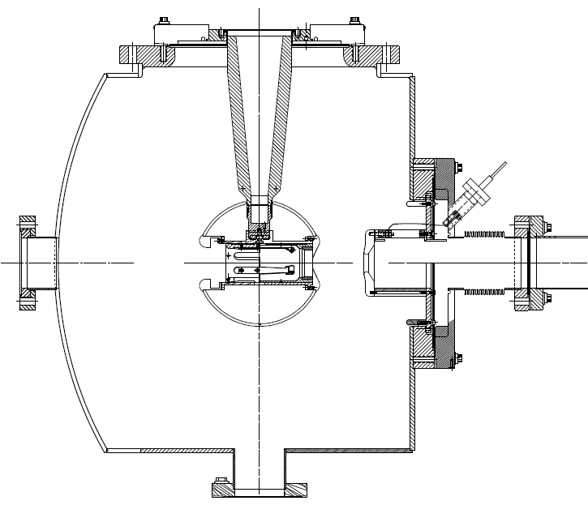
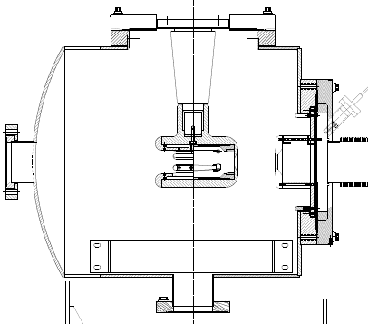
JLab 500 kV Inverted Gun
7”
5”
200 kV Inverted Gun
Longer insulator
Spherical electrode

