Slide 1
CEBAF Wien 200 keV upgrade HV controls update meeting
October 28 2020

Slide 2
HV controls layout

Slide 3
UITF Wien HV controls system flow diagram (G. Croke)

Slide 4
HV and interlock cables
Old Wien HV cables have been disconnected but still in place
Gun2 and Gun3 HV cables and conduit to be reused for running new Wien HV cables from ISB to tunnel
Cables have been staged at ISB
Electricians to re-conduit top of Wien HV controls rack to top of IN01B01 to run each pair of HV cables through each conduit
Cables for interlocks are ready, still deciding if they will be run through same conduit or outside of conduit through penetration
Bracket design to be on top of Wien for interlock cable system

Slide 5
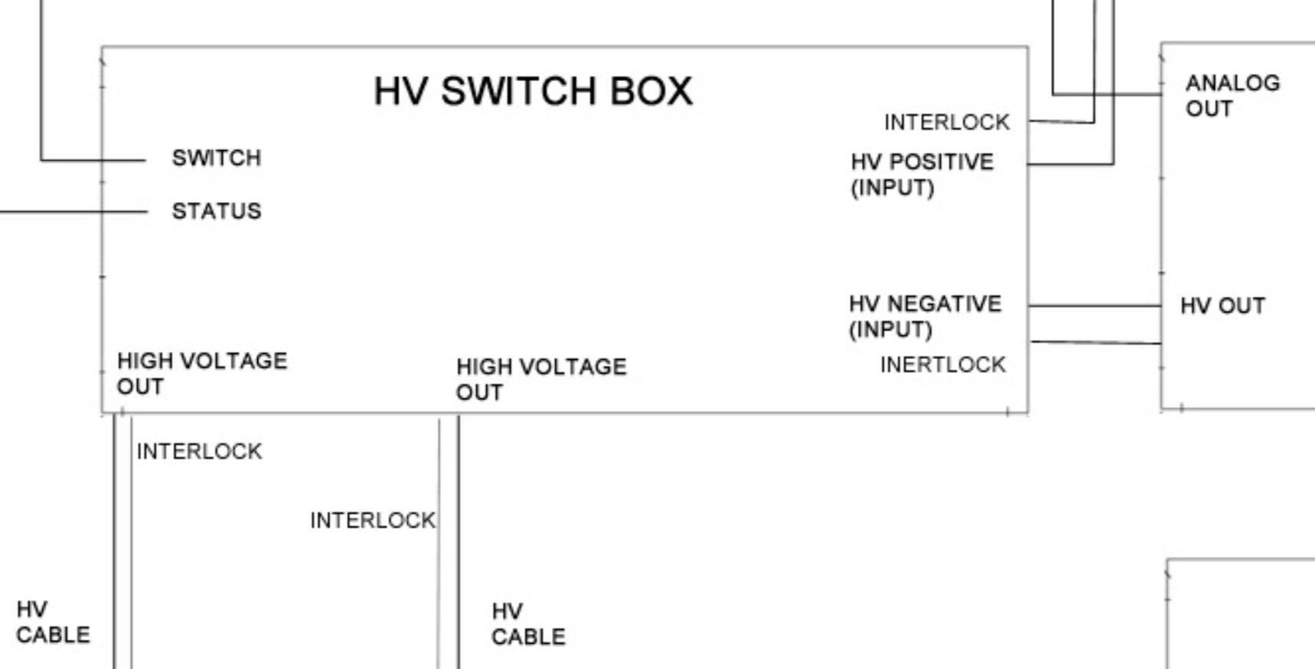
HV Switch box
There is no status from HV switch box to prevent switching when HV is present.
Chassis for two CEBAF units are on order. Main components gigavac switches are on hand.
Test fixture with voltage divider expected to be ready for week of Nov 2 test in UITF
HV switchbox needs to be inspected by B. Rodriguez. Tony to follow up on this. Should inspect UITF prototype too.

Slide 6
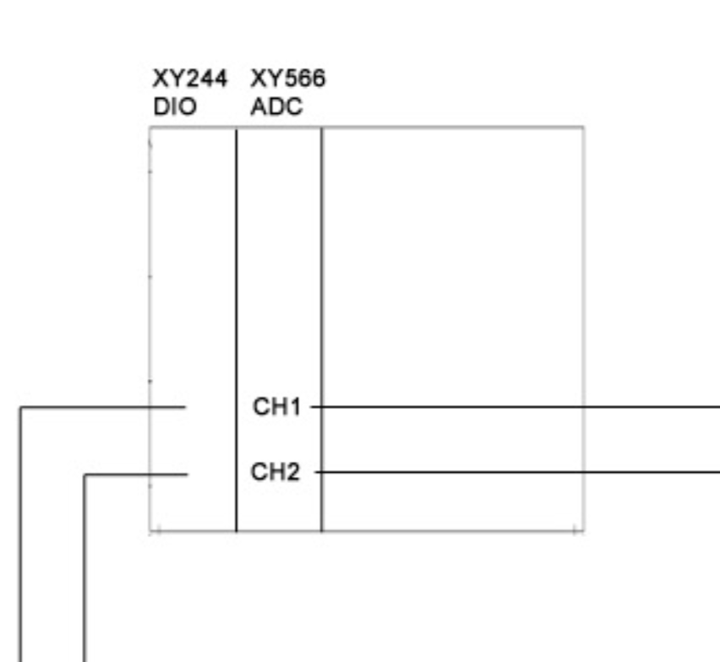
DIO XY244 and ADC XY566
Need to make system drawing for CEBAF
S. Windham to identify which channels are available and will provide info to I&C during the week of Nov 2.

Slide 7
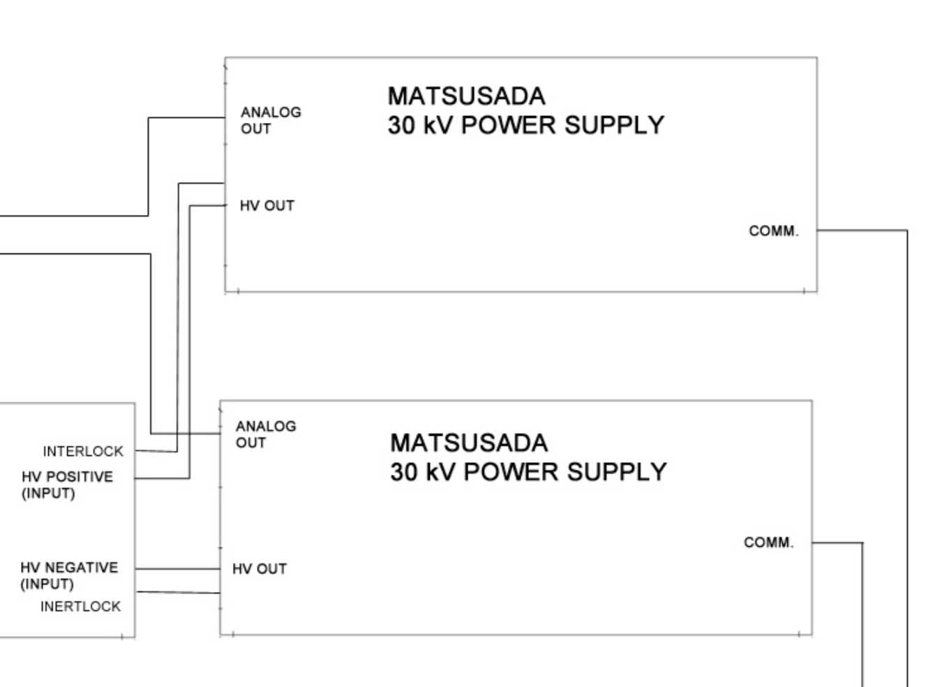
Matsusada power supplies
The four PS (2 per Wien) are in the Wien rack at ISB. Not connected yet.
Plan for week of Nov 9: Wire up PS and install comm chassis to start testing communications. Work on this while switcher box is being built
HV cables will be installed first, then HV switcher box.

Slide 8
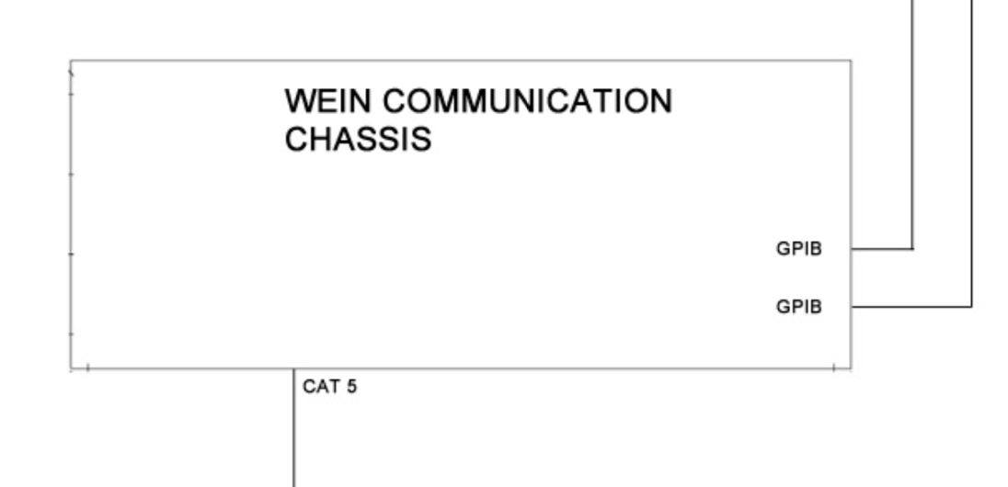
Communications chassis
Digiport already installed and functional in Wien HV rack
S. Windham will connect the comms chassis to the digiport week on Nov 2.
One GPIB chassis per PS (2 per Wien)

Slide 9
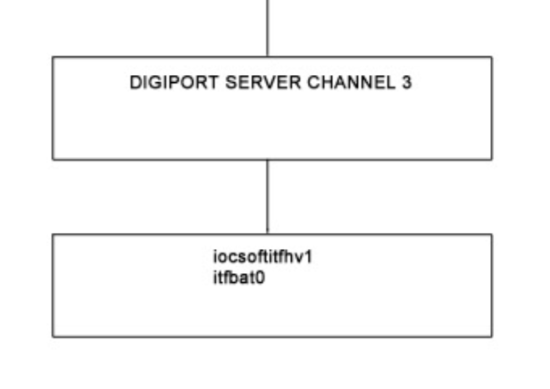
Digiport server & IOC
Scott installed digiport in Wien rack
Digiport converts signal to ethernet, then routes to soft ioc
Iocsoftinj3 presently running there. Connection is in place.

Slide 10
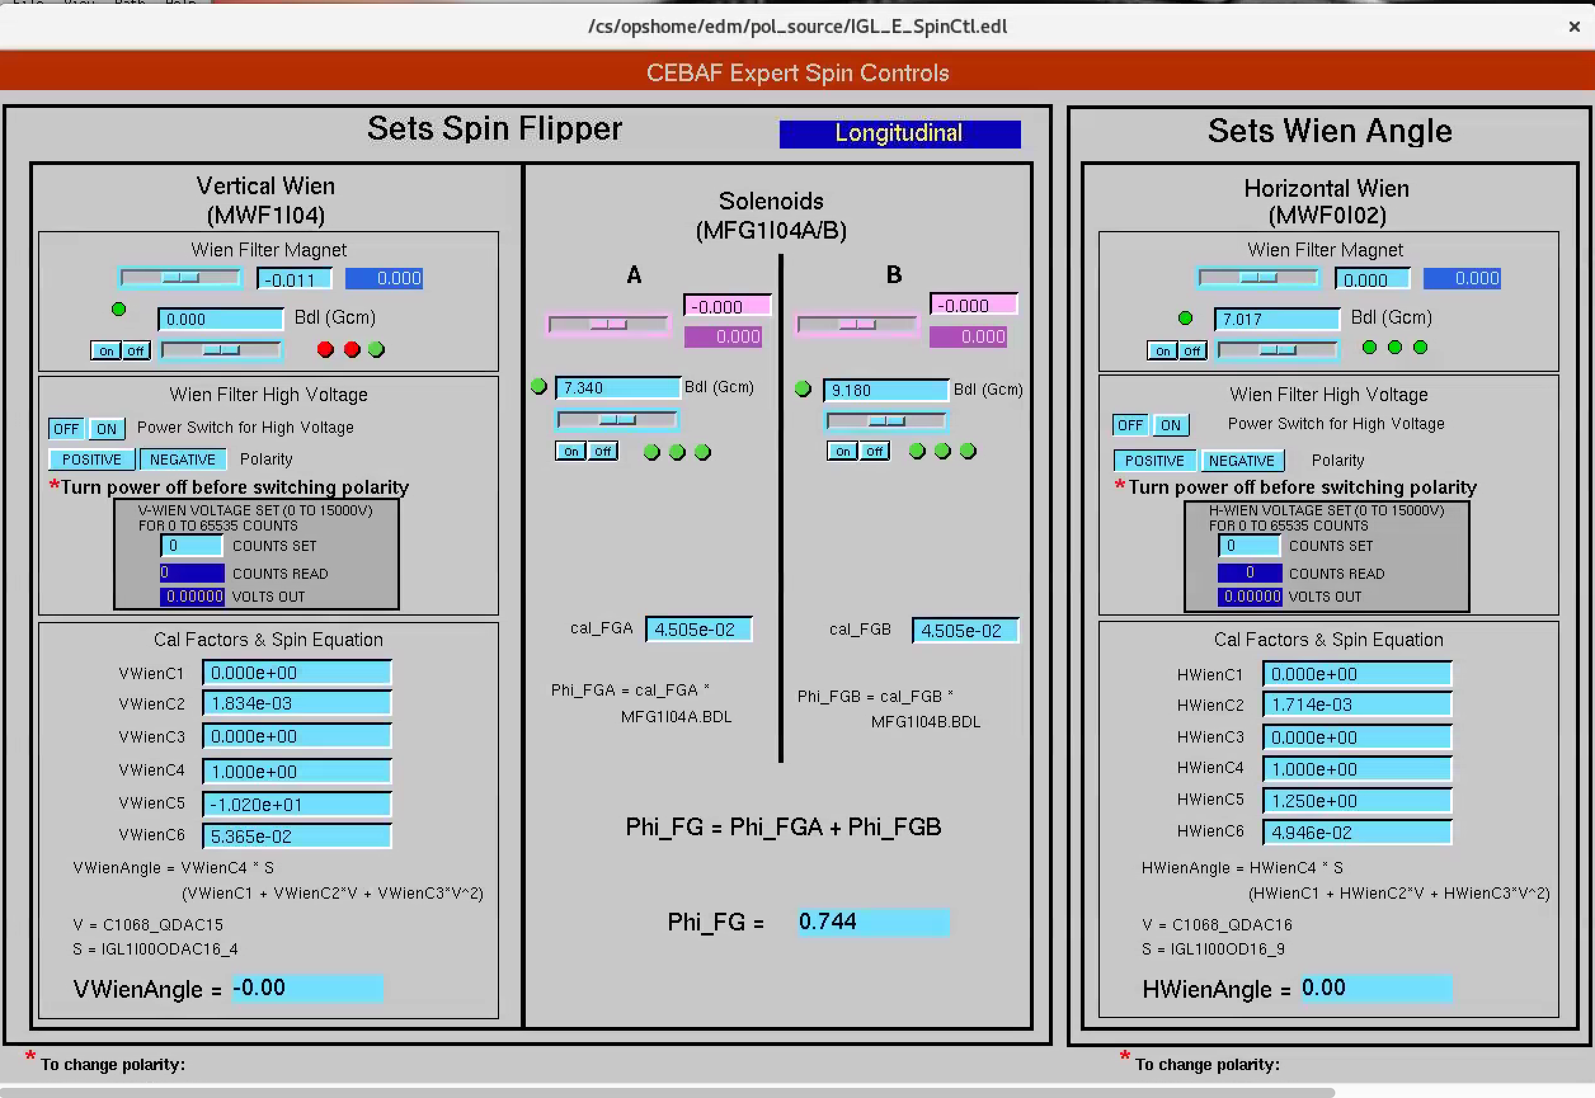
High level applications and other notes
Controls screens
To set the spin, need only 3 PVs per Wien:
  Magnet current
  Voltage Plate #1
  Voltage Plate #2
Riad will work with Gary on calculations and provide more representative Cal names.
New Cal factors will be provided by Riad/Carlos.
We would like the ability to enter voltage in volts instead of counts. Do we really need to keep the ability to set voltage by counts? Carlos to check with Joe. (16 bit DAQ)
Gary and Michele have a detailed plan on how to set BDL, HV values and polarity. Handling will be done through ioc rather than by injector steering script as presently done.

Slide 11
Other notes & Milestones
HV PS wired up and comm chassis so we can start testing comm. Tony & Scott start this week for at least one of the PS. Goal would be test comm by end of Nov 2 week.
For comm testing PS, Tony to cap HV output in each supply.
I&C to provide SOP for safeing the system, in particular when cables are installed.
PS 30kV / 1 mA
Finish cabling + switches/controls, contingent to injector work. Likely can happen in the next week or two.
HCO => turn over to CIS
Electricians working conduit connecting equipment rack to rack above penetration, needed for cable installation. Tony to check with Ernest.

