Slide 1
Beam Energy Measurements for Mott Run II :
Joe Grames
March 16, 2016

Slide 2
Oct 2015 studied Mott analyzing power vs. beam energy.
Varied beam kinetic energy 4.5-5.3 MeV in 0.2 MeV steps.
Record cavity gradient, Bubble dipole, steering coils, beam positions.
θ = 25.0°

Slide 3
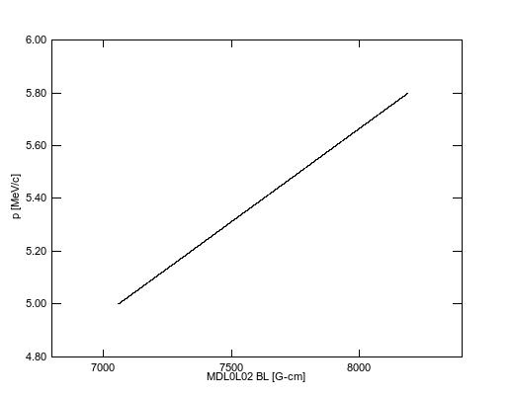
J. Benesh, “A detailed examination of the MDL field map and the TOSCA model of this “5 MeV” dipole”, JLab-TN-15-017.
TN provides model for ideal operation with δP/P = 0.1%
BL = M₀ + M₁ P + M₂ P² + M₃ P³ + M₄ P⁴ + M₅ P⁵
M₀ = +4.811
M₁ = -1416.2
M₂ = +1.2399
M₃ = -0.1646
M₄ = +0.009795
M₅ = -0.00021257
R028 | MDL0L02 | P | dP
MV/m | G-cm | MeV/c | MeV/c
3.35 | 7109.57 | 5.035 | 0.005
3.74 | 7384.34 | 5.229 | 0.005
4.12 | 7646.01 | 5.415 | 0.005
4.5 | 7927.59 | 5.614 | 0.006
4.89 | 8185 | 5.797 | 0.006

Slide 4
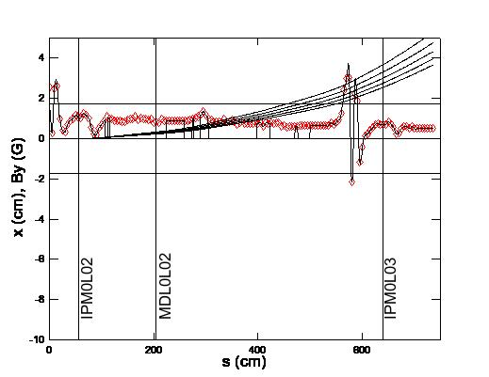
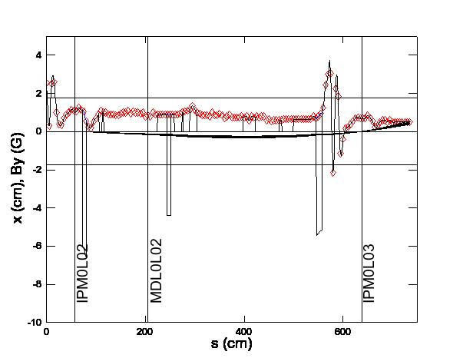
Magnetic fields other than dipole play important role:
  Stray B_{y} field (red points) from Earth and Ion Pumps
  Distributed mu-metal helps shield beam from stray field
  Steering coils provide distributed point-correction
Constructed simple model to track fields
  Plots show trajectories for 4.5-6.5 MeV/c in 0.5 MeV/c increments
  Without steering coils beam is “lost” to pipe wall x=1.75cm
  With steering coils orbit is realistic and quasi-independent of momentum
Without Fields
With Stray, Mu-Metal, Steering Coils

Slide 5
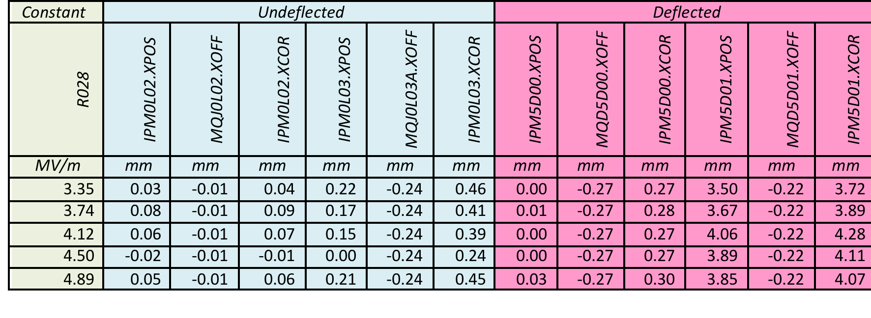
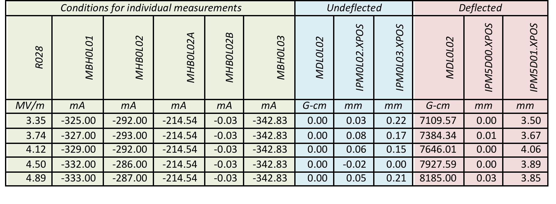
Record SRF gradient, steering coils, Bubble dipole and beam positions.
Convert recorded beam positions (.XPOS) to absolute survey positions (.XCOR).
  Assumed calibration of beam position monitor to quadrupole σ = 0.50 mm
  Assumed survey of quadrupole to absolute coordinates σ=0.25 mm

Slide 6
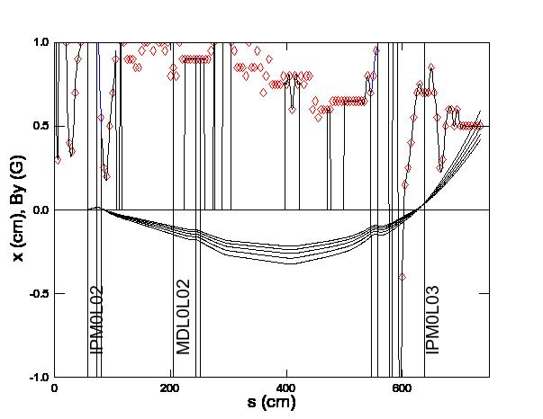
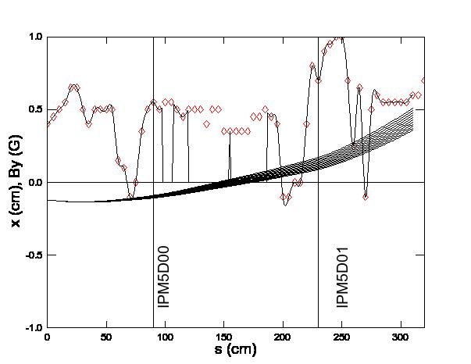
Model trajectories using beam positions and propagate uncertainties
  Use 0L BPM’s to constrain orbit and predict beam (X,X’) at dipole MDL0L02
  Use (X,X’) at dipole and 5D BPM’s to determine how much θ <> 25.0°
  Correct Jay’s model calculation proportionally : P_{TOSCA}(25.0°)•[25.0°/(25.0°+θ)]
Model of Undeflected 0L beam line
Model of Deflected 5D beam line
Model predicts dipole deflected beam in excess of 25.0° by <θ>:
<θ> = 1.311 ± 0.267 mrad = 0.0751° ± 0.015°

Slide 7
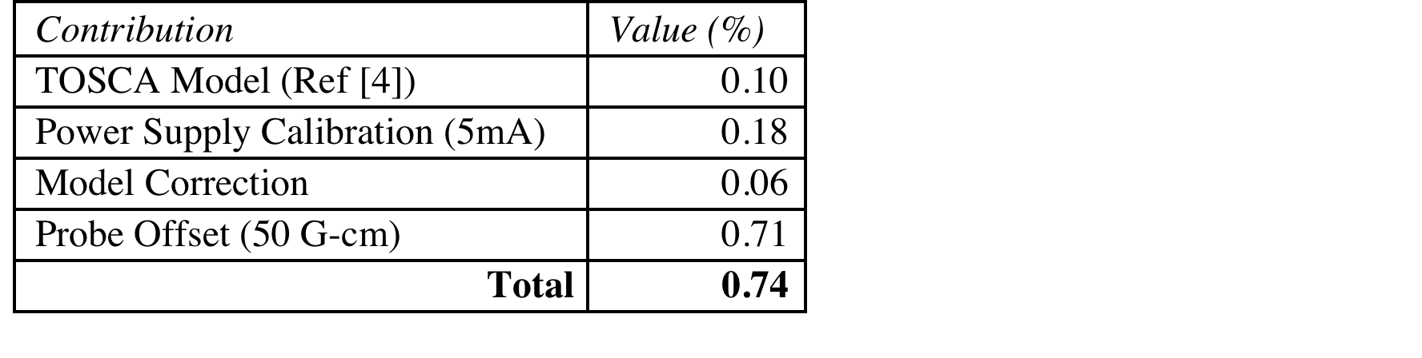
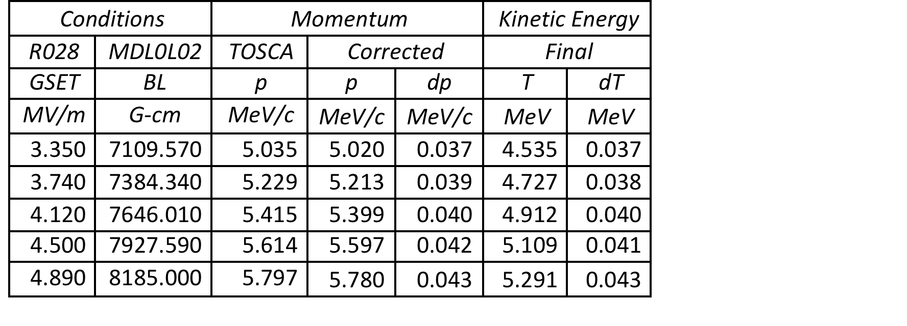
Error budget for Mott Run II
Summary for Mott Run II
Conclusions
  (Riad) Resolve the probe/magnet/EPICS discrepancy
  (Joe) Re-compute and finalize energies and uncertainties
  Extent to which this matters depends on sensitivity of S_eff v. Energy

