Slide 1
ASY-R30-3: Hinged anode tilts
Gabriel Palacios Serrano
01/11/2021
gabrielp@jlab.org

Slide 2
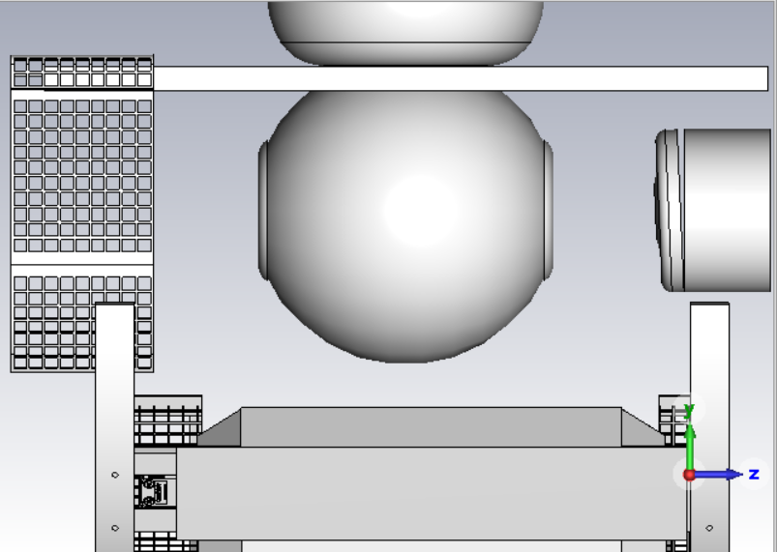
Model
Hinge location

Slide 3
Tilt effect on vertical trajectory

Slide 4
Tilt effect on horizontal trajectory

Slide 5
Normalized emittance: horizontal

Slide 6
Normalized emittance: vertical

Slide 7
Spot size: horizontal

Slide 8
Spot size: vertical

Slide 9
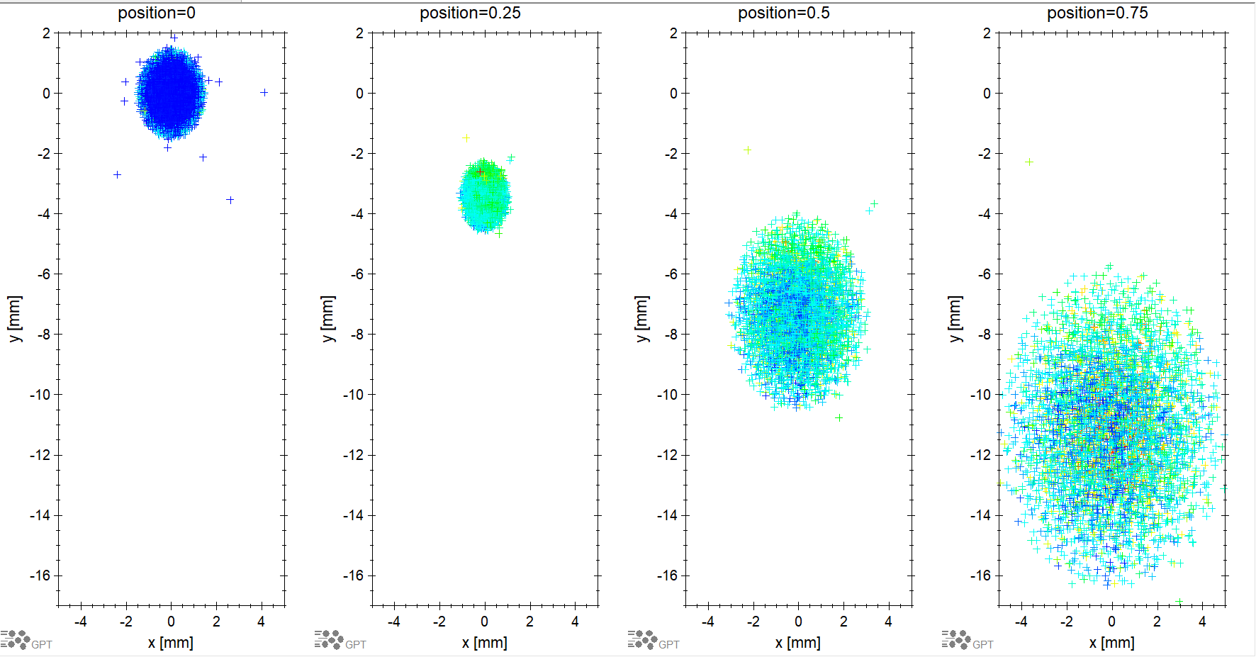
Coordinate space 0deg: x-y at z-positions

Slide 10
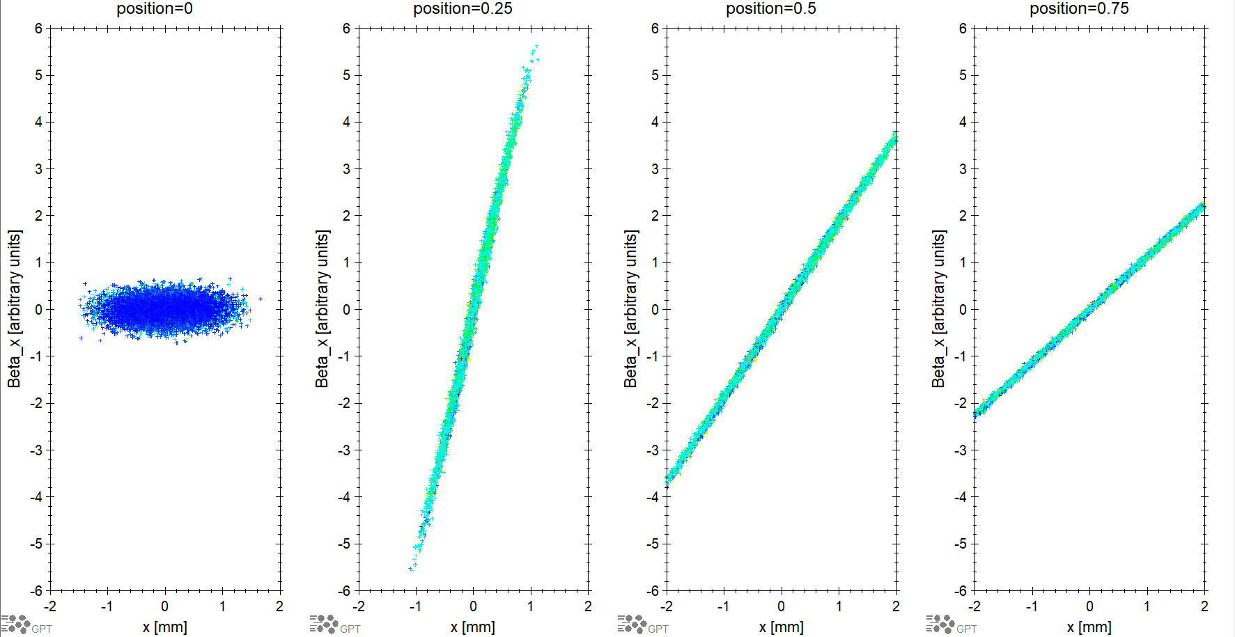
Phase space 0deg: x-β_{x} at z-positions

Slide 11
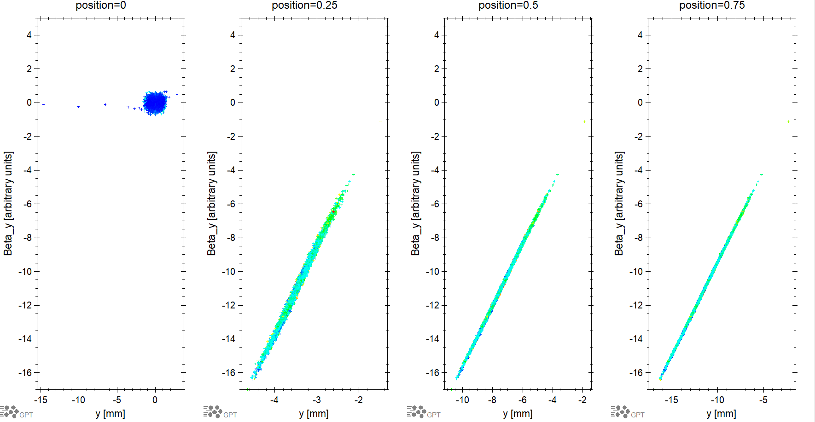
Phase space 0deg: y-β_{y} at z-positions

Slide 12
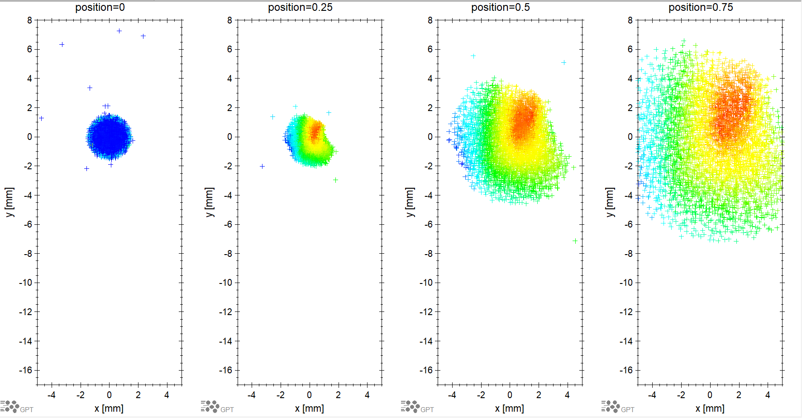
Coordinate space -2.43deg: x-y at z-positions

Slide 13
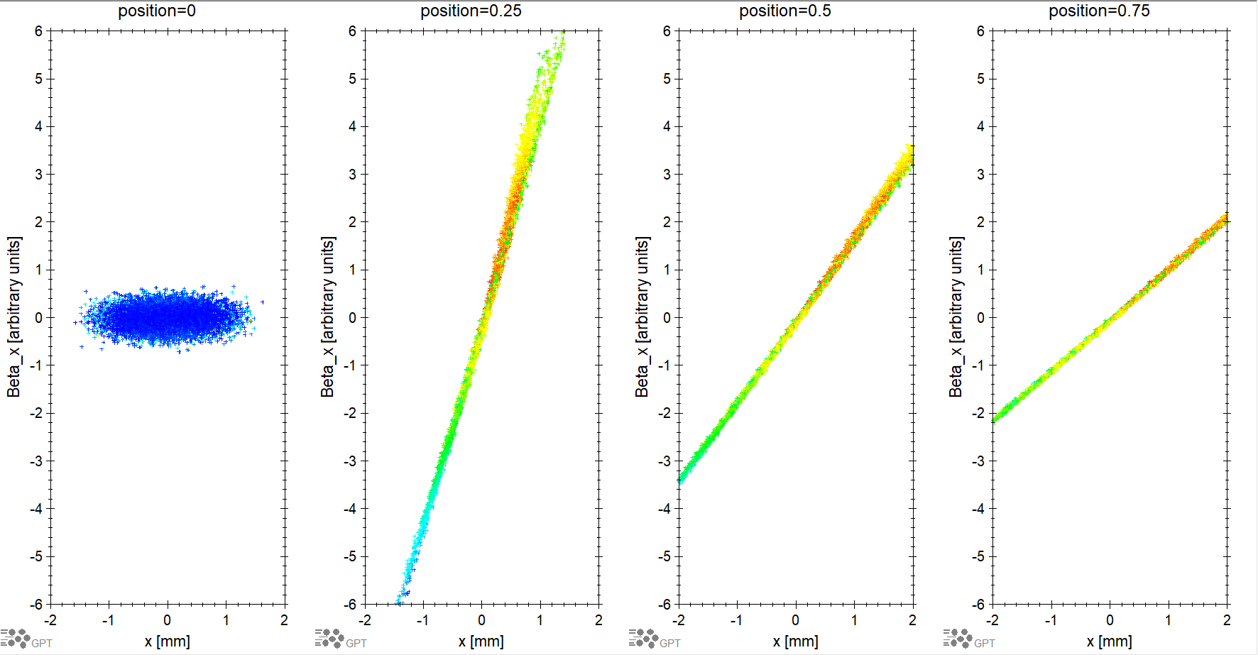
Phase space -2.43deg: x-β_{x} at z-positions

Slide 14
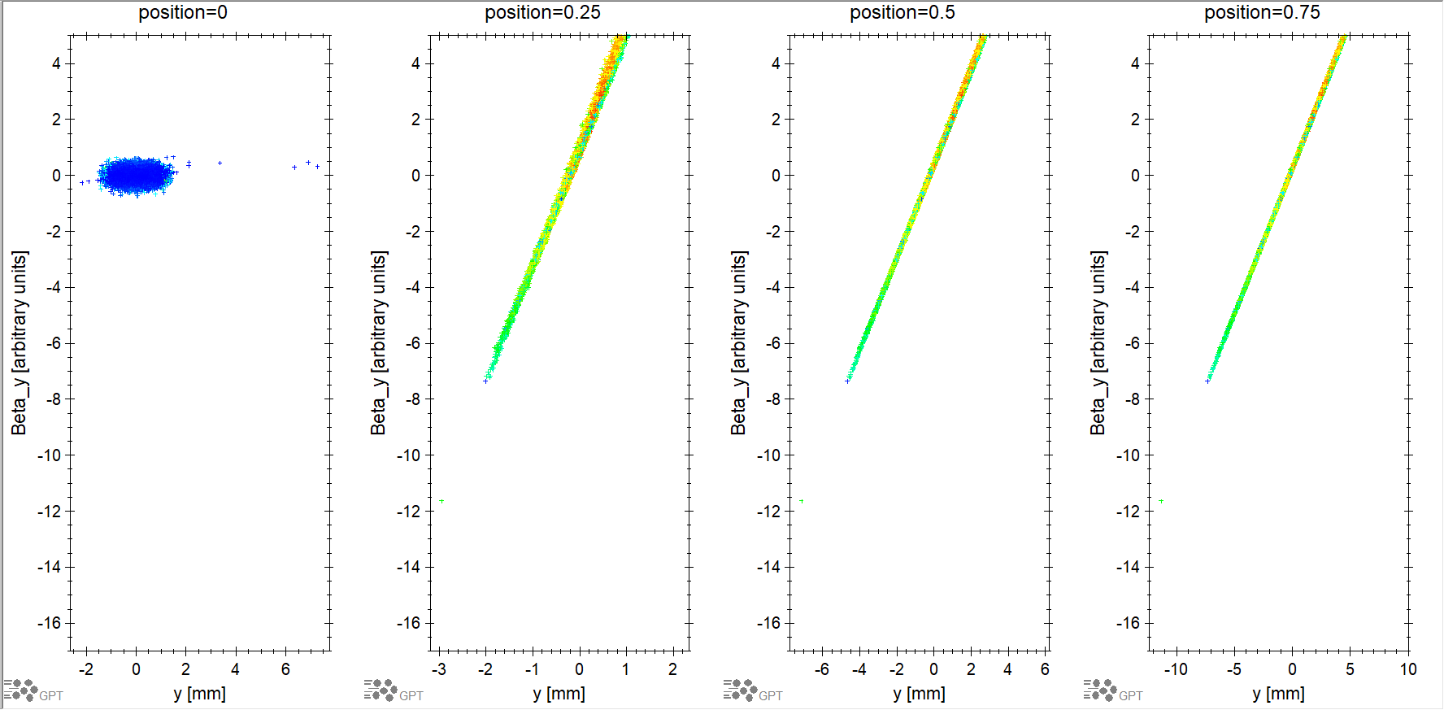
Phase space -2.43deg: y-β_{y} at z-positions

Slide 15
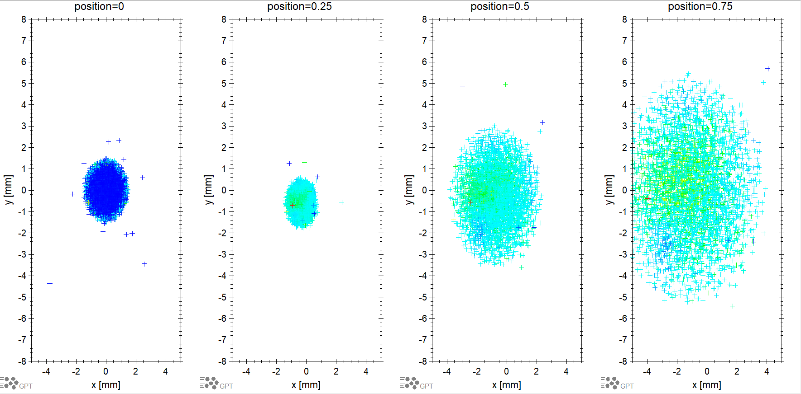
Phase space y-shifted anode : x-y at z-positions

Slide 16
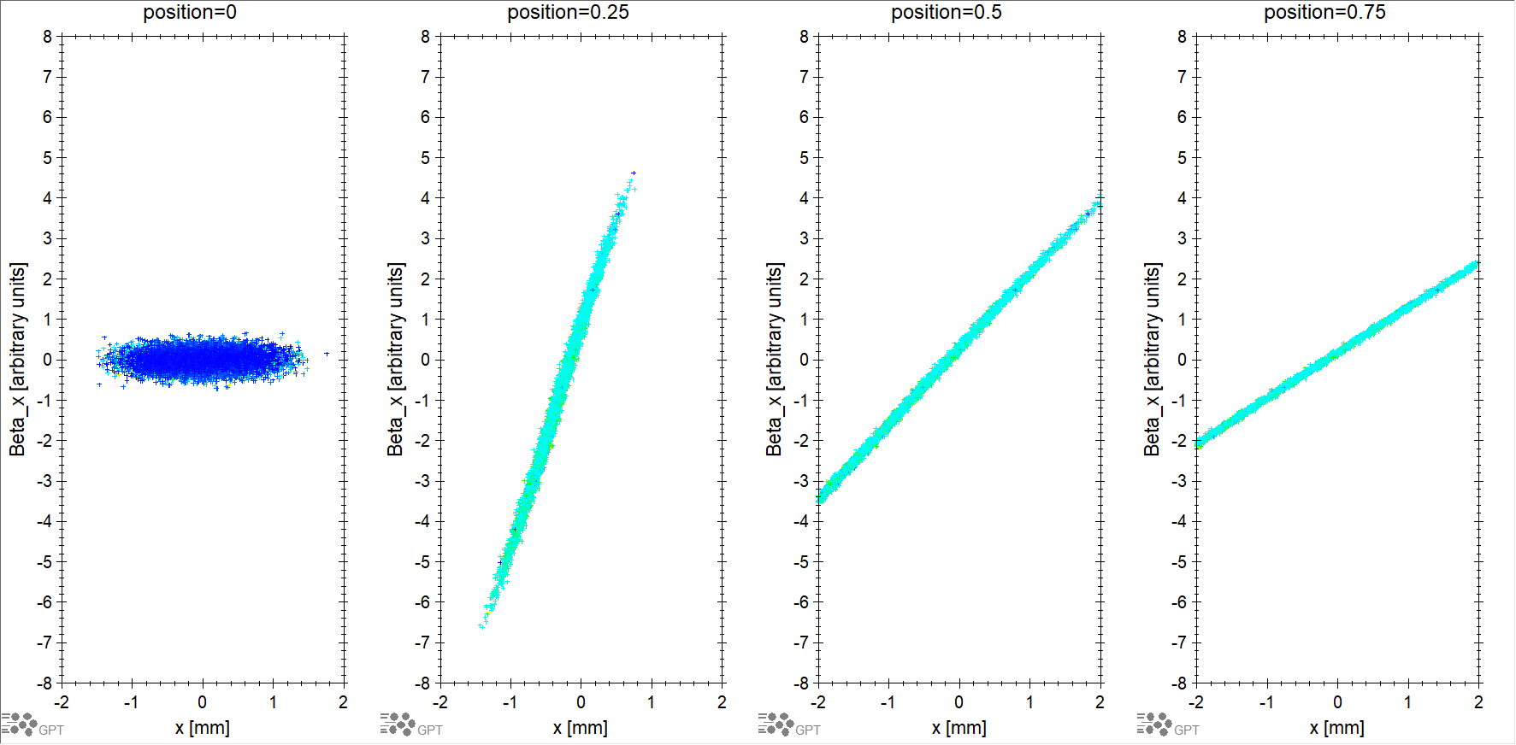
Phase space y-shifted anode: x-β_{x} at z-positions

Slide 17
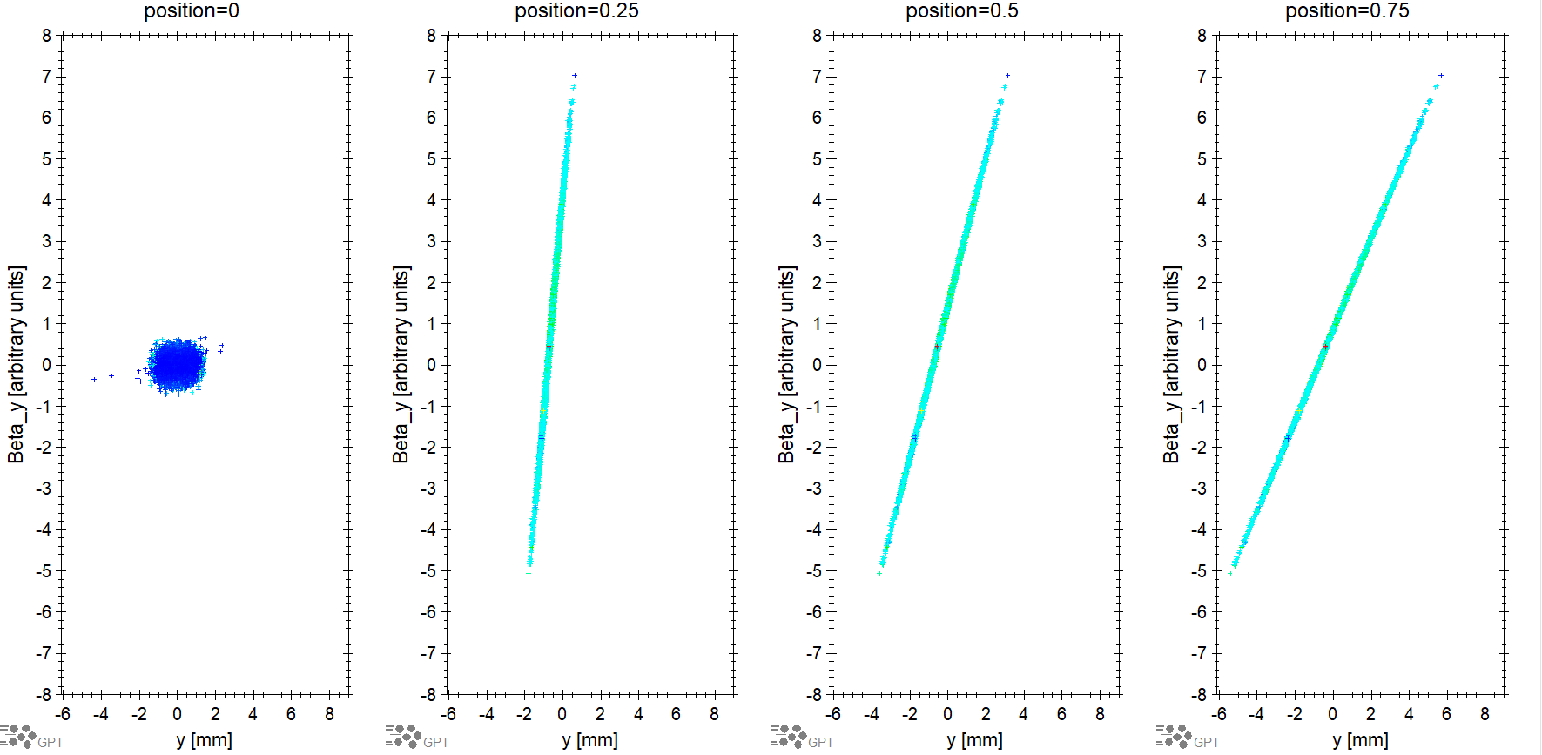
Phase space y-shifted anode : y-β_{y} at z-positions

Slide 18
Ex, Ey, Ez very near to the photocathode surface to try and see if Ez is the cause of NEMI mismatch.

