Slide 1
UITF PSS BCM mini-review
Limit beam current to limit the radiation dose outside UITF enclosure
Matt Poelker
October 21, 2016

Slide 2
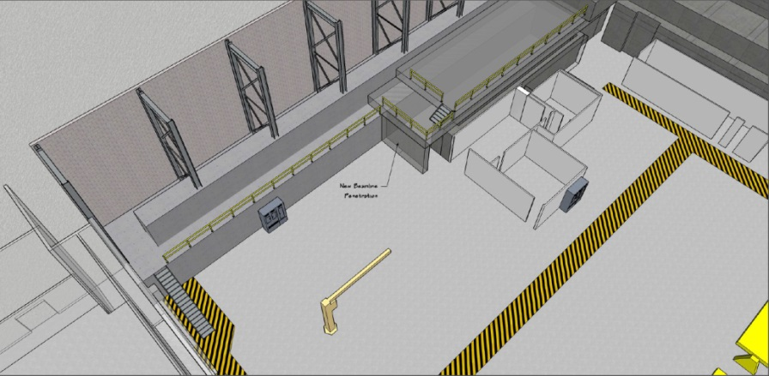
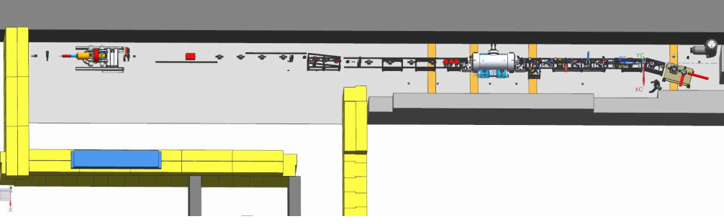
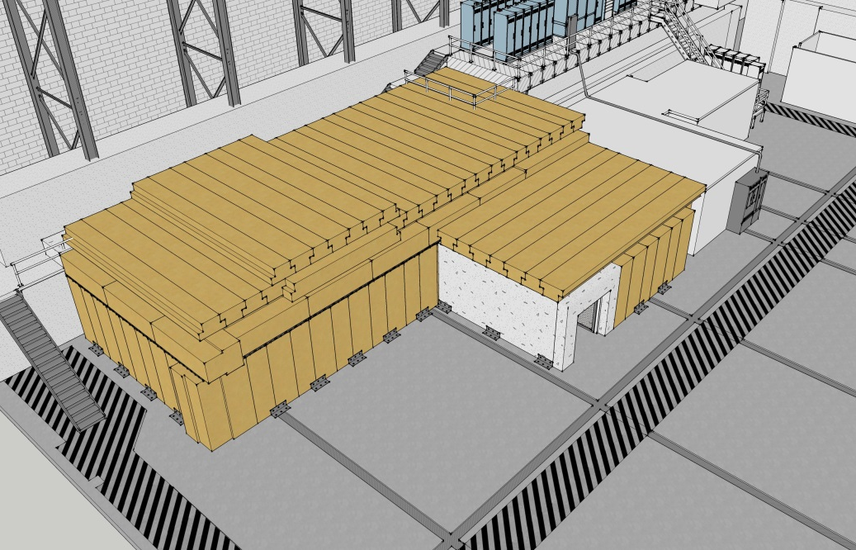
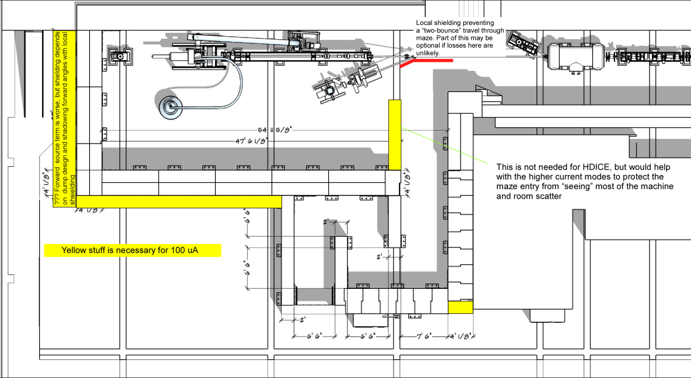
Upgraded Injector Test Facility - UITF
What we started with…

Slide 3
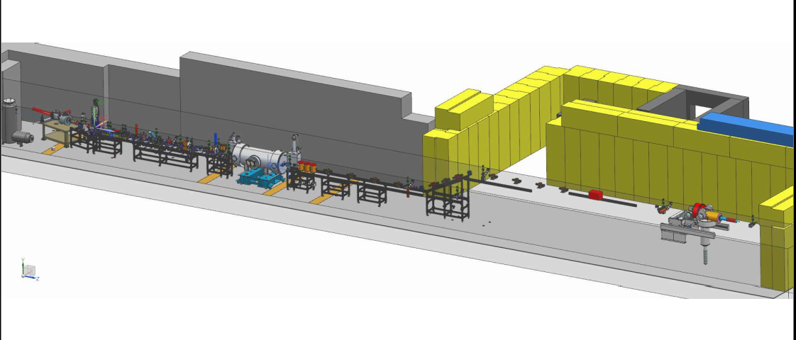
A place for keV beam and MeV beam
Cave 1 (old)
Cave 2 (new)

Slide 4
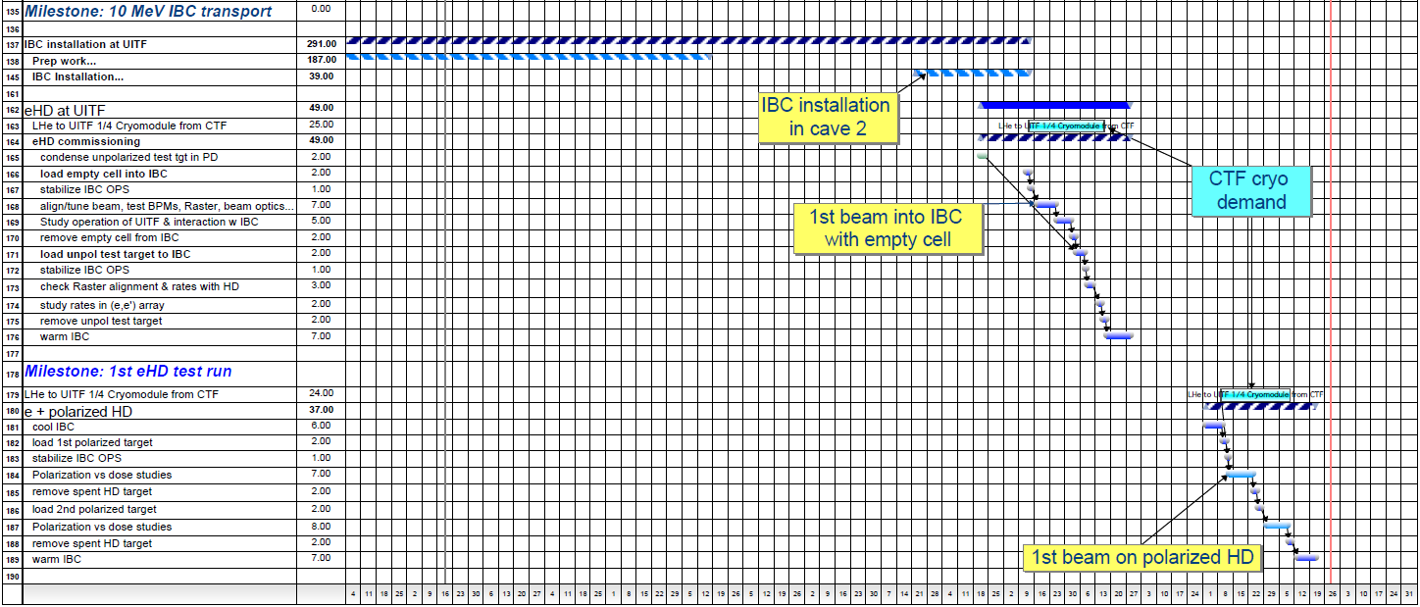
Status HDIce
Planning MeV beam tests Summer 2017

Slide 5
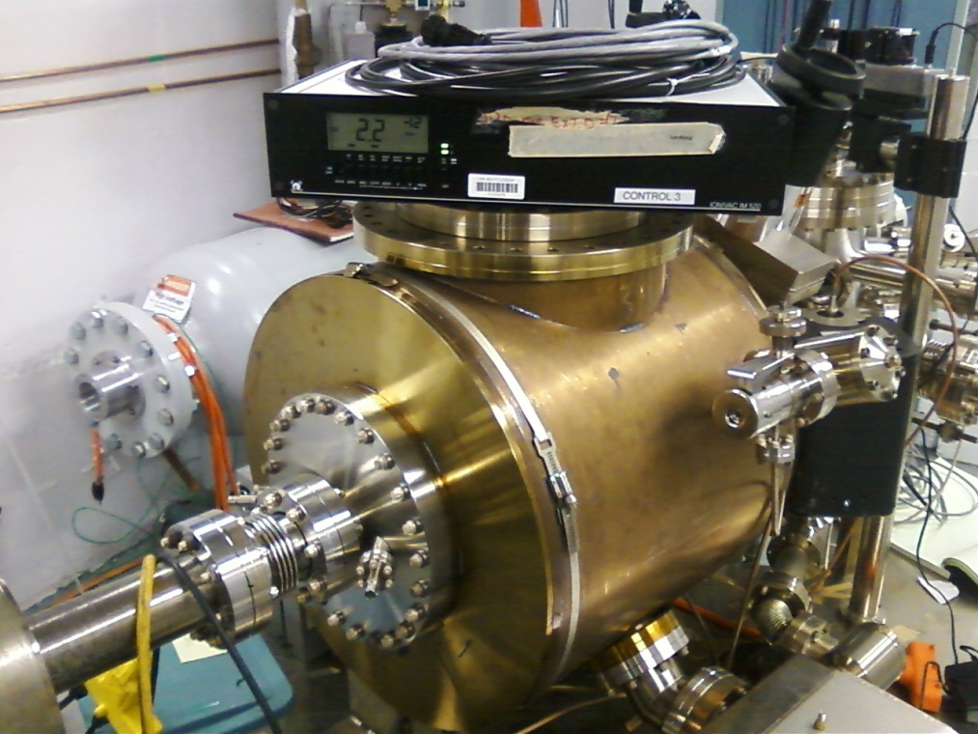
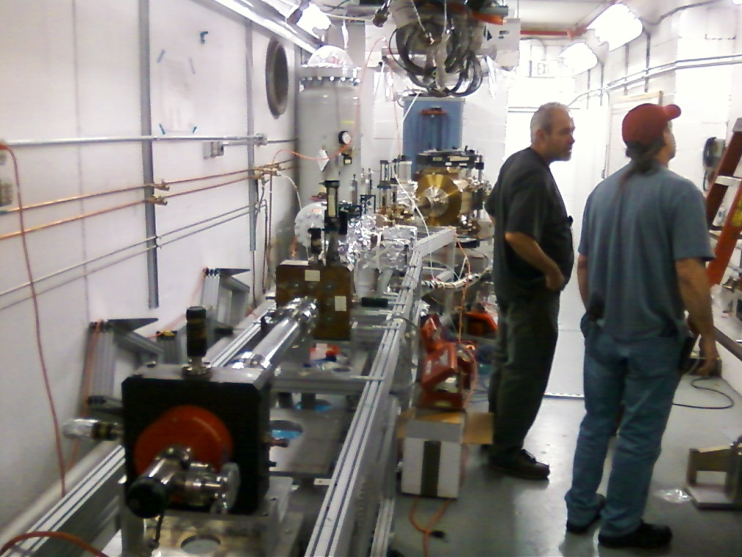
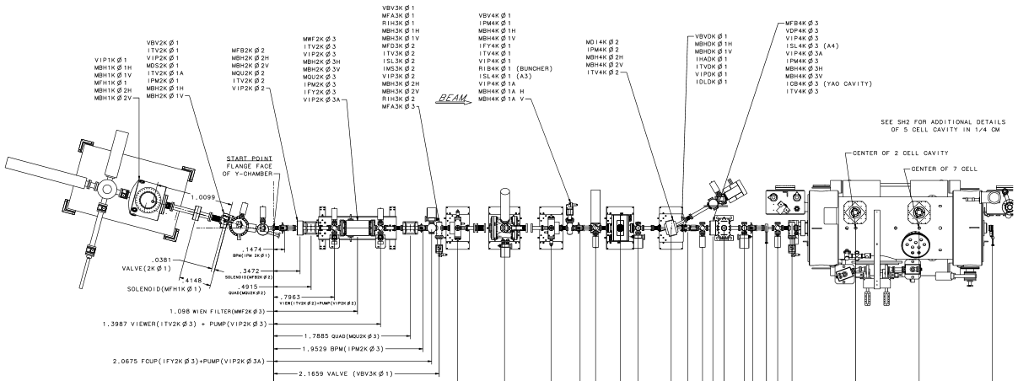
Status Cave1

Slide 6
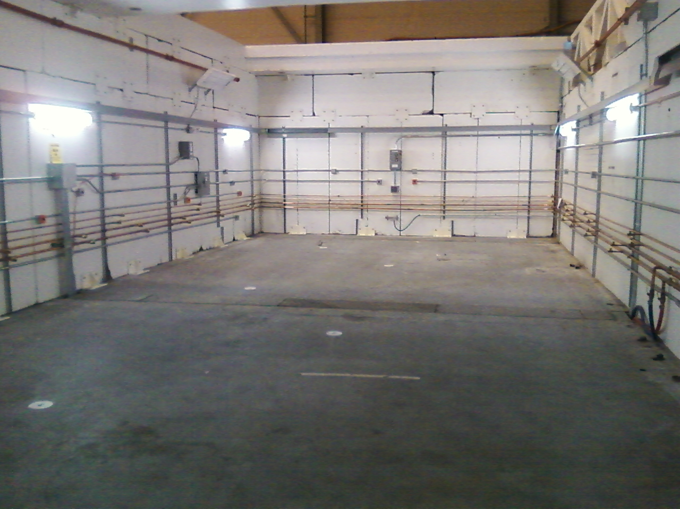
Status Cave2

Slide 7
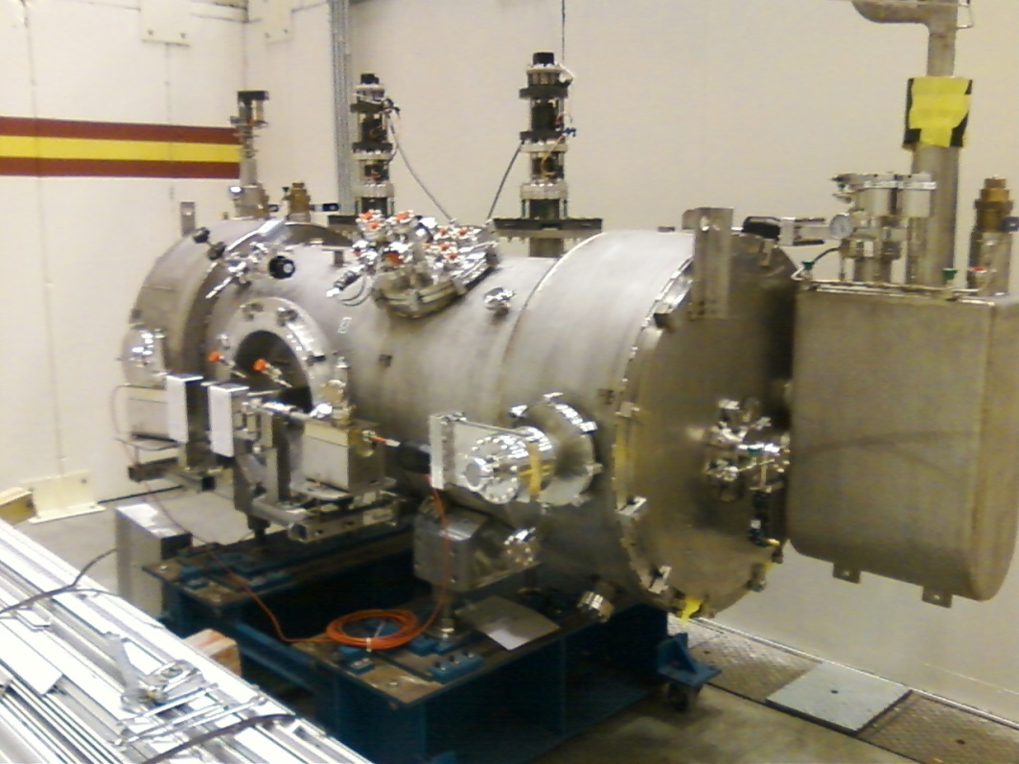
Status New ¼ CM – Done!
Tests at CMTF complete, reached high gradients without field emission
Sitting outside the cave, waiting to be craned in

Slide 8
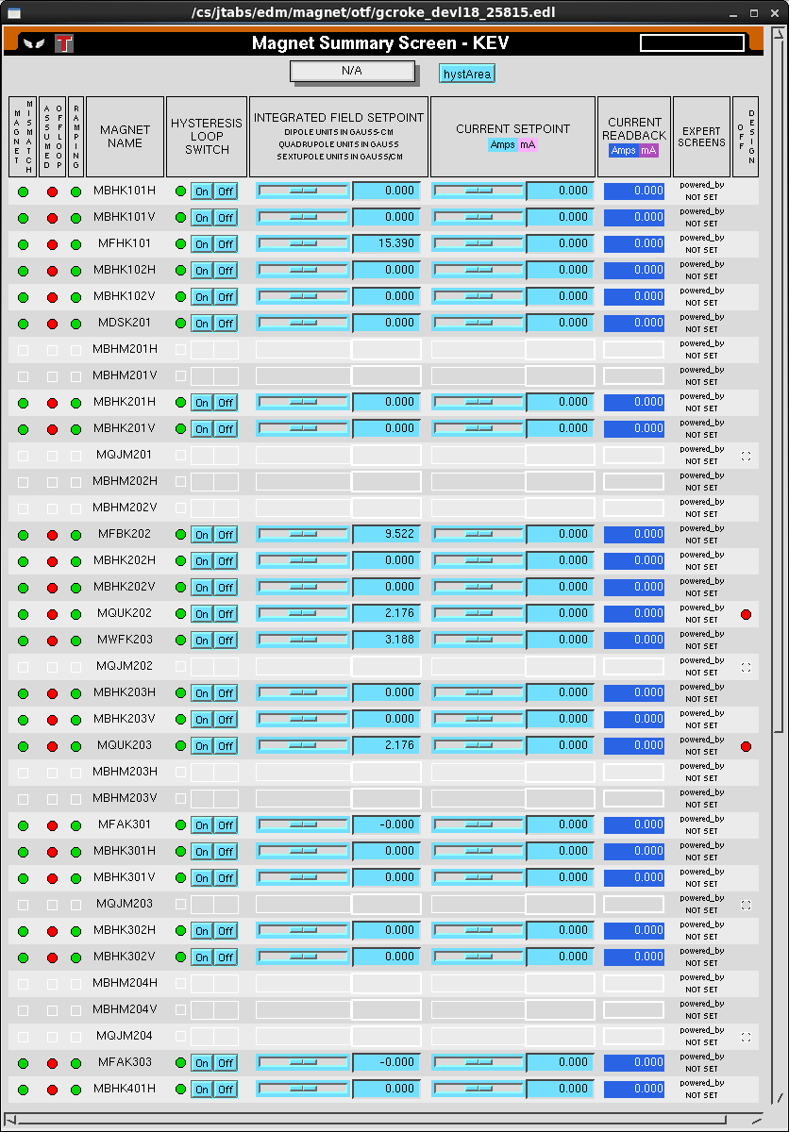
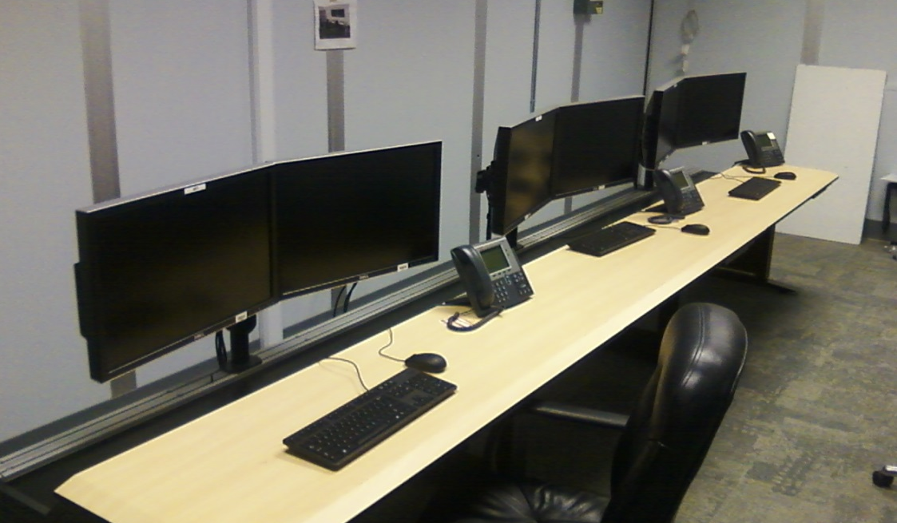
Status Operations
Software requests are coming in: Magnets, Gun HV power supply, RF controls
But many more required: viewers, video, valves, current monitoring, laser controls, etc.,

Slide 9
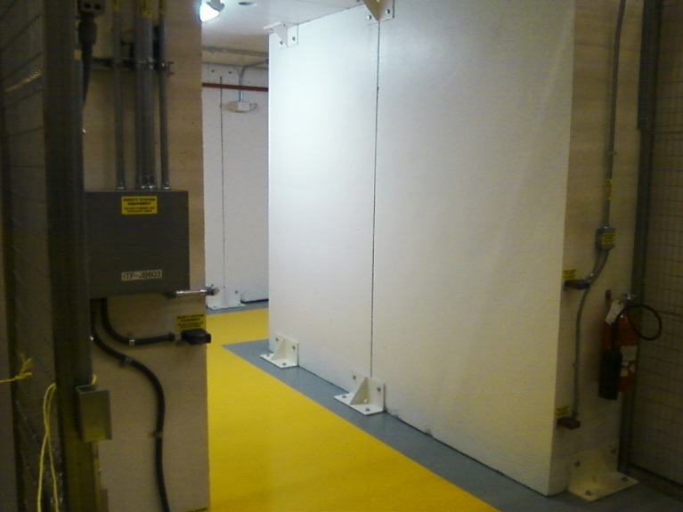
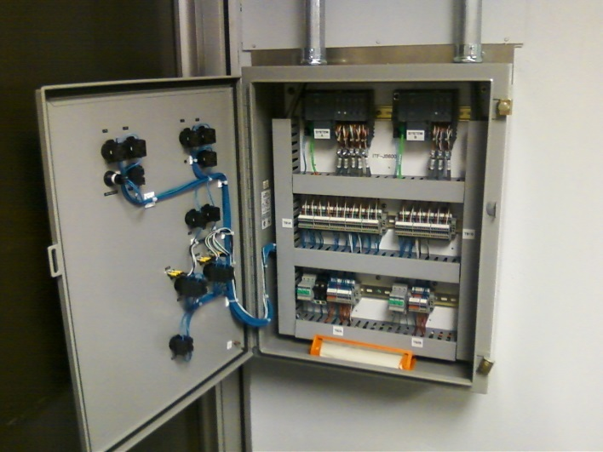
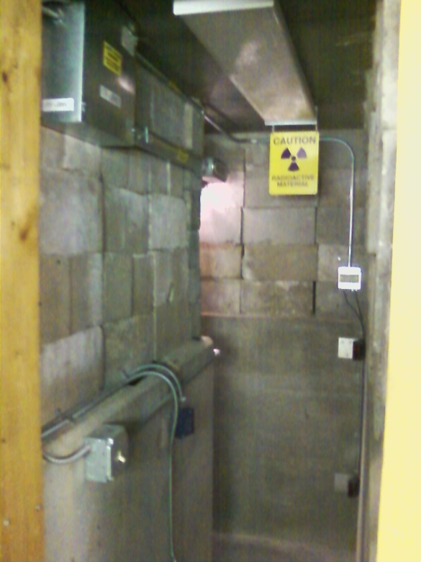
Status Safety System Group
Competing with CEBAF for resources but making progress, 4 person weeks labor gets a lockable enclosure for Gun high voltage conditioning
RF interlocks will be added when staff available

Slide 10
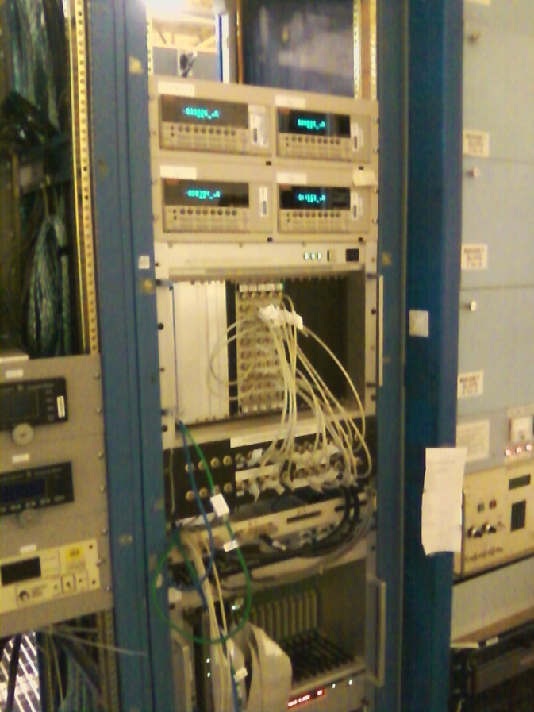
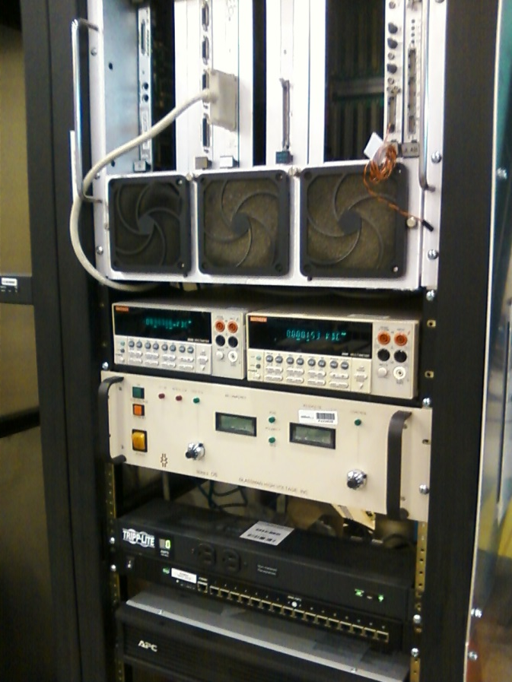
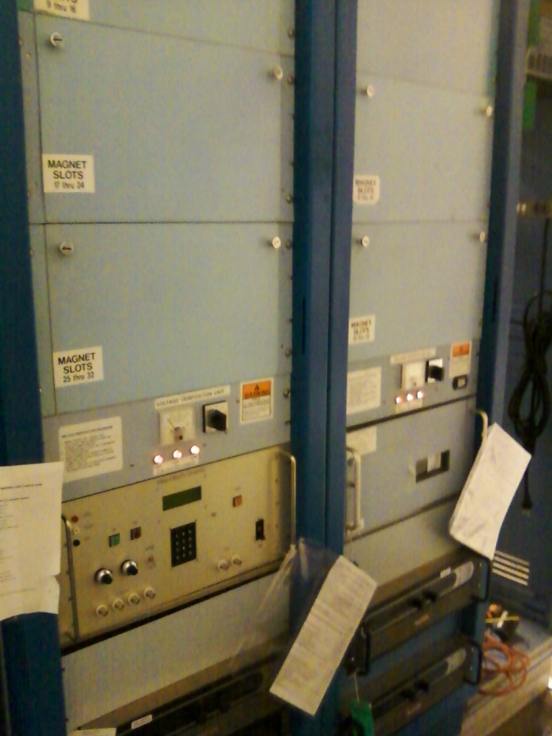
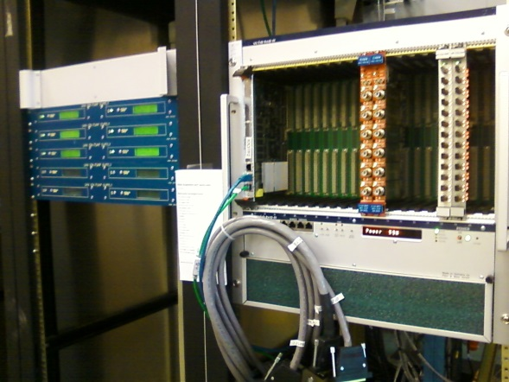
Status Electronics and Software
Current monitoring, ion pump power supplies, gun HV power supply, magnet racks

Slide 11
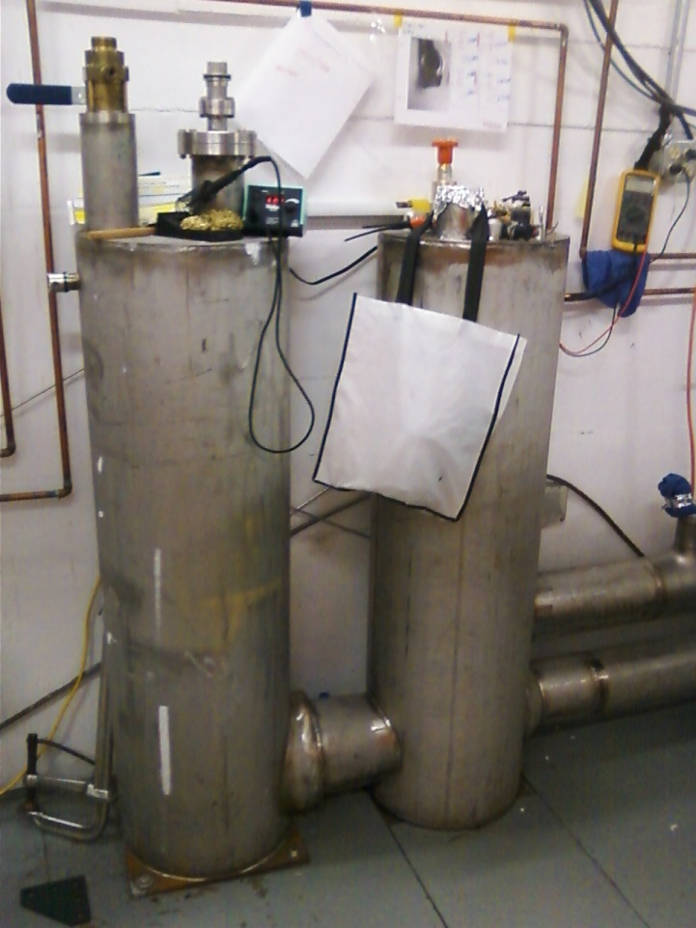
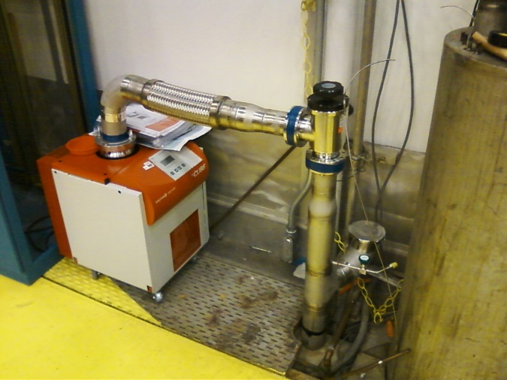
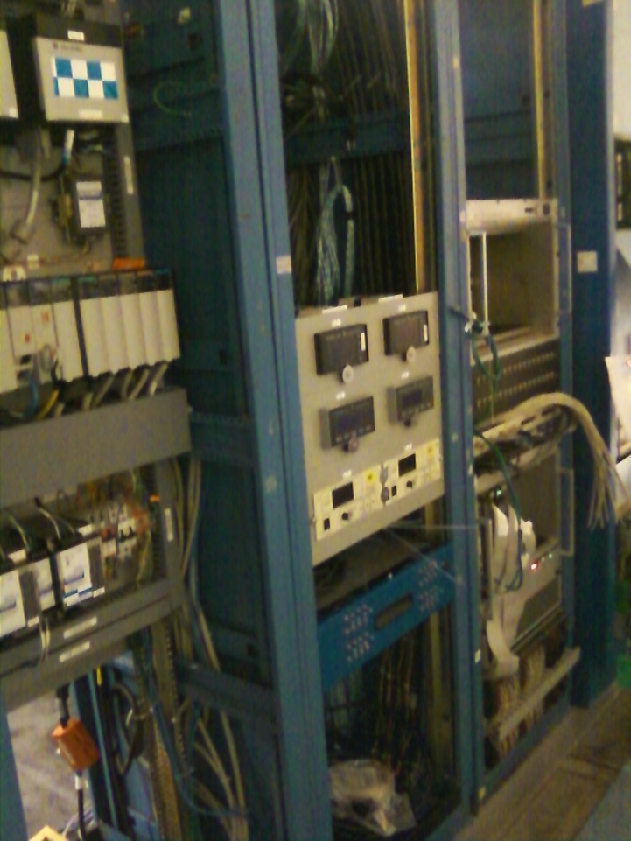
Status Cryo Group
Need to leak check ¼ CM plumbing, wrap up electronics, plumb-in the turbo pump, fabricate U-tubes, add the HDIce warm return

Slide 12
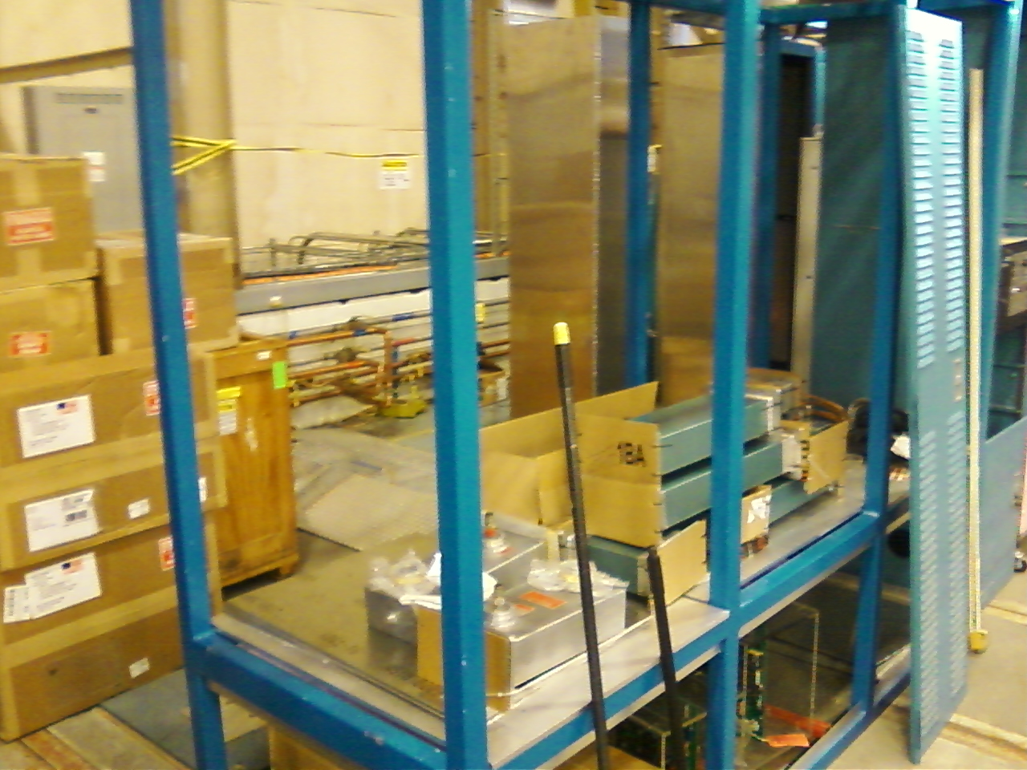
Status RF
Klystrons, waveguides and assorted components, all on top of cave – hoping RF group can put it all together soon
Control modules ready, Scott Higgins working on software
Chopper amps ordered, water skids can now be installed

Slide 13
Near Term: focused on keV beam
1st quarter FY17
Facilities work complete
PSS/ODH systems fully functional, at least related to the gun, RF can come later…
By end of 2016, keV beamline complete and the new ¼ CM in place and connected to the keV beamline, but NOT connected to CTF
Starting to put beam on viewers, adding incremental capability (RF structure, choppers, BPMs, etc.)
Begin lifetime tests at keV beam energy, high polarization photocathodes
Paperwork, procedures and approvals….

Slide 14
When can HDIce expect beam?
CTF: no final word on scheduling. The CTF down lasts four months. The soonest this work might happen is during the winter break of 2017. Imagine start January 2017 through April 2017
CTF down provides time to finish the MeV beamline design and build it
Accelerator Readiness Review
Making MeV beam May 2017. HDIce beam tests Summer 2017...

Slide 15
Status Reviews
UITF Accelerator Review: beamline design reviewed by Ops/CASA/SRF, March 18, 2016, “Will it work?” review
Geoff Krafft, Mike Spata, Reza Kazimi, Arne Freyberger, Todd Satogata, Fay Hannon
Yes, it will work. Summary distributed, Bruce Lenzer helping to make the review “official”
Internal Safety Review, May 10, 2016
Personnel safety, including radiation protection, and machine protection, assessment will be sent to SCMB
Key outcome of Internal Safety Review - Bob May recommended in-house mini-review of our PSS BCM system, suggested time frame August 2016
Met with RadCon, SSG, I&C and RF groups: schedules dictate mid-October for review : Specification on allowed Integrated Dose, and sensitivity of CEBAF PSS BCM downconverter

Slide 16
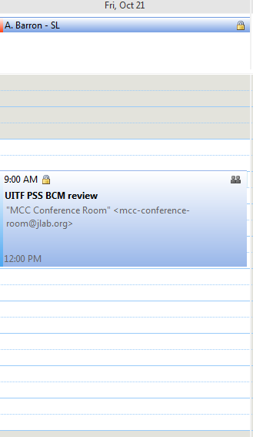
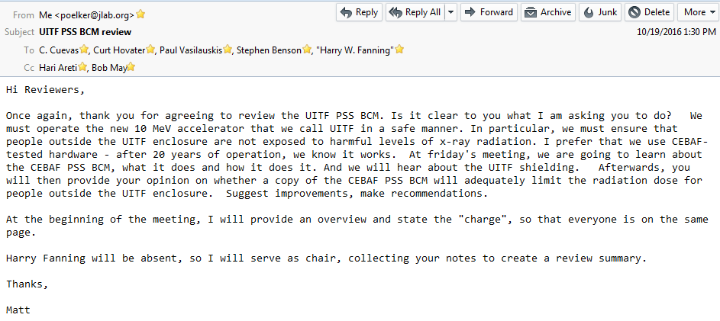
Status Safety – PSS BCM Review
Can we use the CEBAF PSS BCM as Credited Control for UITF?

Slide 17
PSS BCM
PSS BCM
Insertable Faraday Cup
Today’s focus on MeV beam, not keV beam
Vashek: describe shielding limitations, exposure and dose
Trent, Jerry, Henry: describe the CEBAF PSS BCM
Discussion

Slide 18
PSS BCM
PSS BCM
Insertable Faraday Cup
CEBAF PSS BCM, minimum beam current 1uA, beam off in ~ 1ms
Cave2 ceiling thickness, don’t want to exceed 100nA beam current
Can we operate UITF with beam current loss between 100nA and 1uA? Self limiting? (i.e., we vent)

Slide 19
PSS BCM
PSS BCM
Insertable Faraday Cup
Can sensitivity of CEBAF PSS BCM be improved?
Are Vashek’s calculations too conservative?
New BCM receiver, or more concrete?

