Slide 1
Collection system
Sami habet

Slide 2
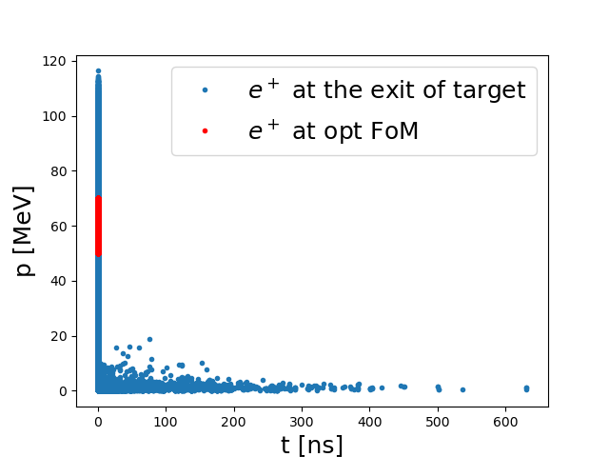
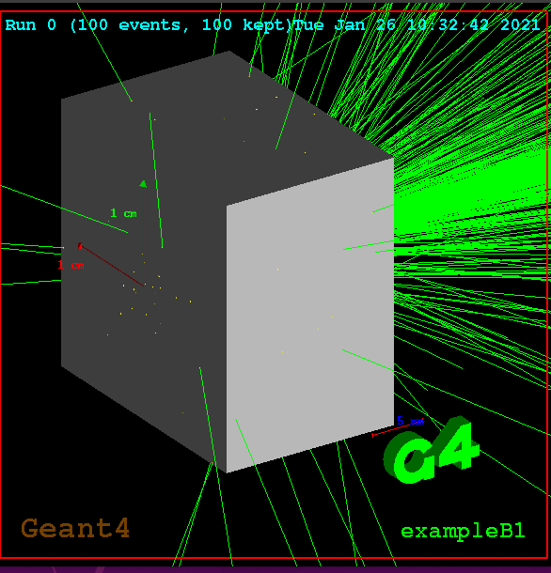
My Setup

Slide 3
Optimum cavity phase
B₁ = 2 T
B₂ = 0.5 T
L1 = 31 cm
Linac length = 10 * 0.2 = 2 m
F = 1497 Mhz
T _{period} = 66 ns
Aceeleration gradiant = 1 MV/m
Efficiency according to the total initial e+ at the exit of the target : 1.8%
Max

Slide 4
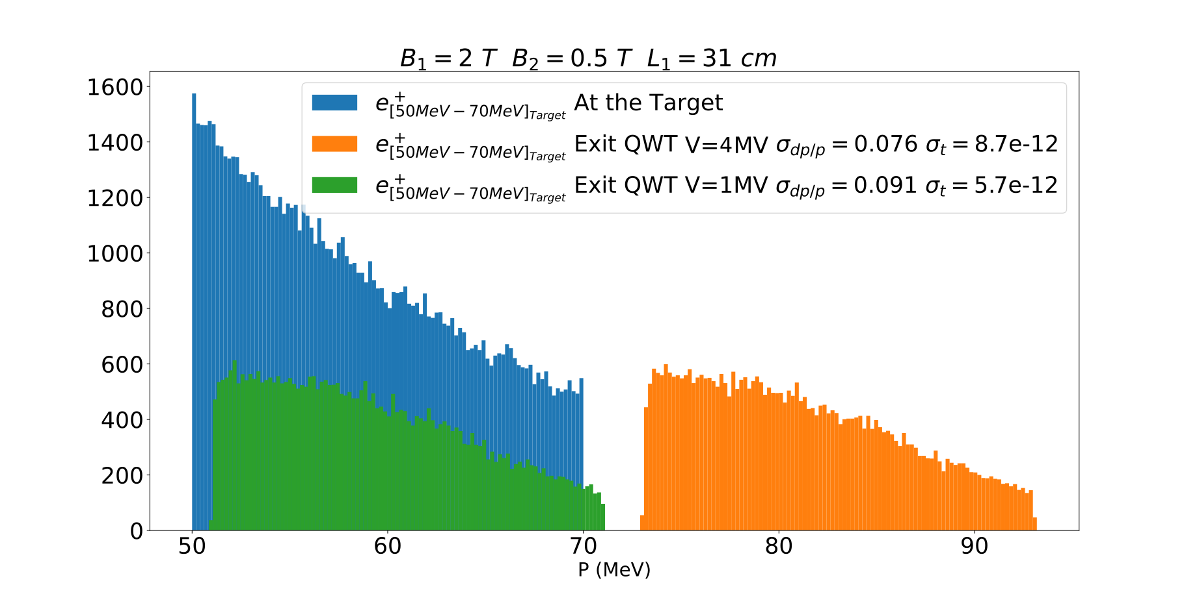
1 MV/m Vs MV/m at optimum phase
1 MV/m = L_{cell} = 0.2 m
Central momuntum : 61 MeV
4 MV/m = L_{cell} = 0.6 m
Central momuntum : 84 MeV

Slide 5
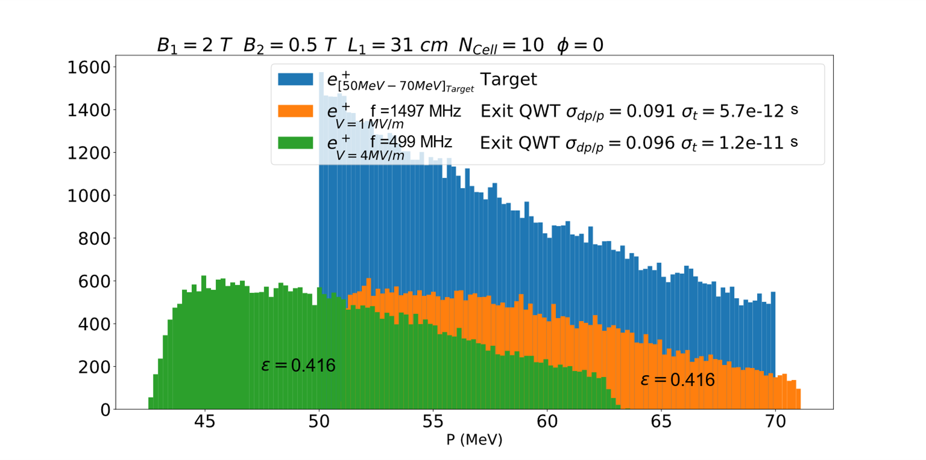
1 MV/m Vs MV/m at 0 phase
1 MV/m = L_{cell} = 0.2 m
Central momuntum : 61 MeV
4 MV/m = L_{cell} = 0.6 m
Central momuntum : 54MeV

Slide 6
Efficiency VS B field
Optimum e+ collected e⁺ at B₁= 2 T
Efficiency according to the total initial e+ at the exit of the target : 1.8%

Slide 7
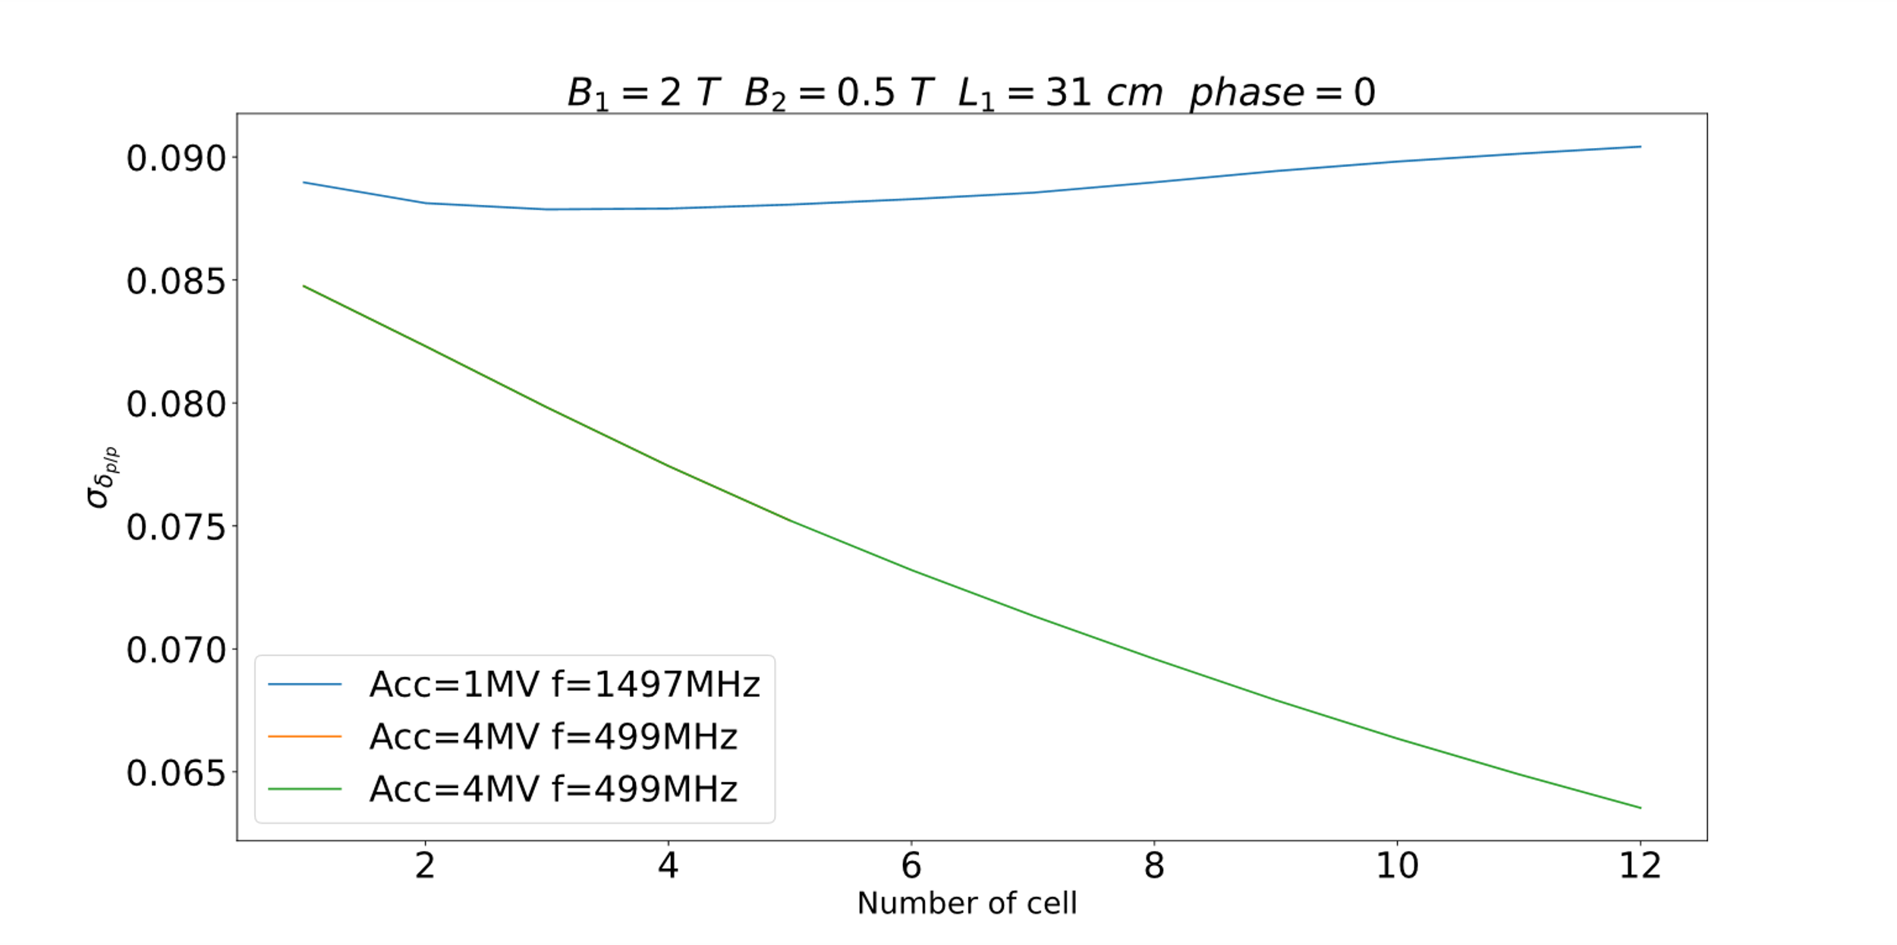
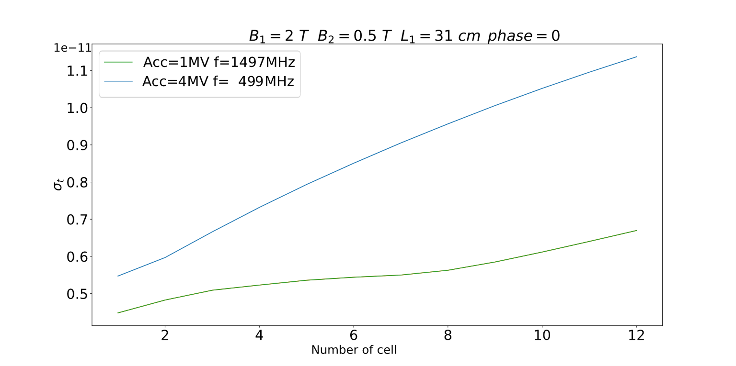
Linac length
With higher gradiant we get less momentum dispersion
With lower frequency the bunch lenght get larger
Important longitudinal variation according to the length of the linac

Slide 8
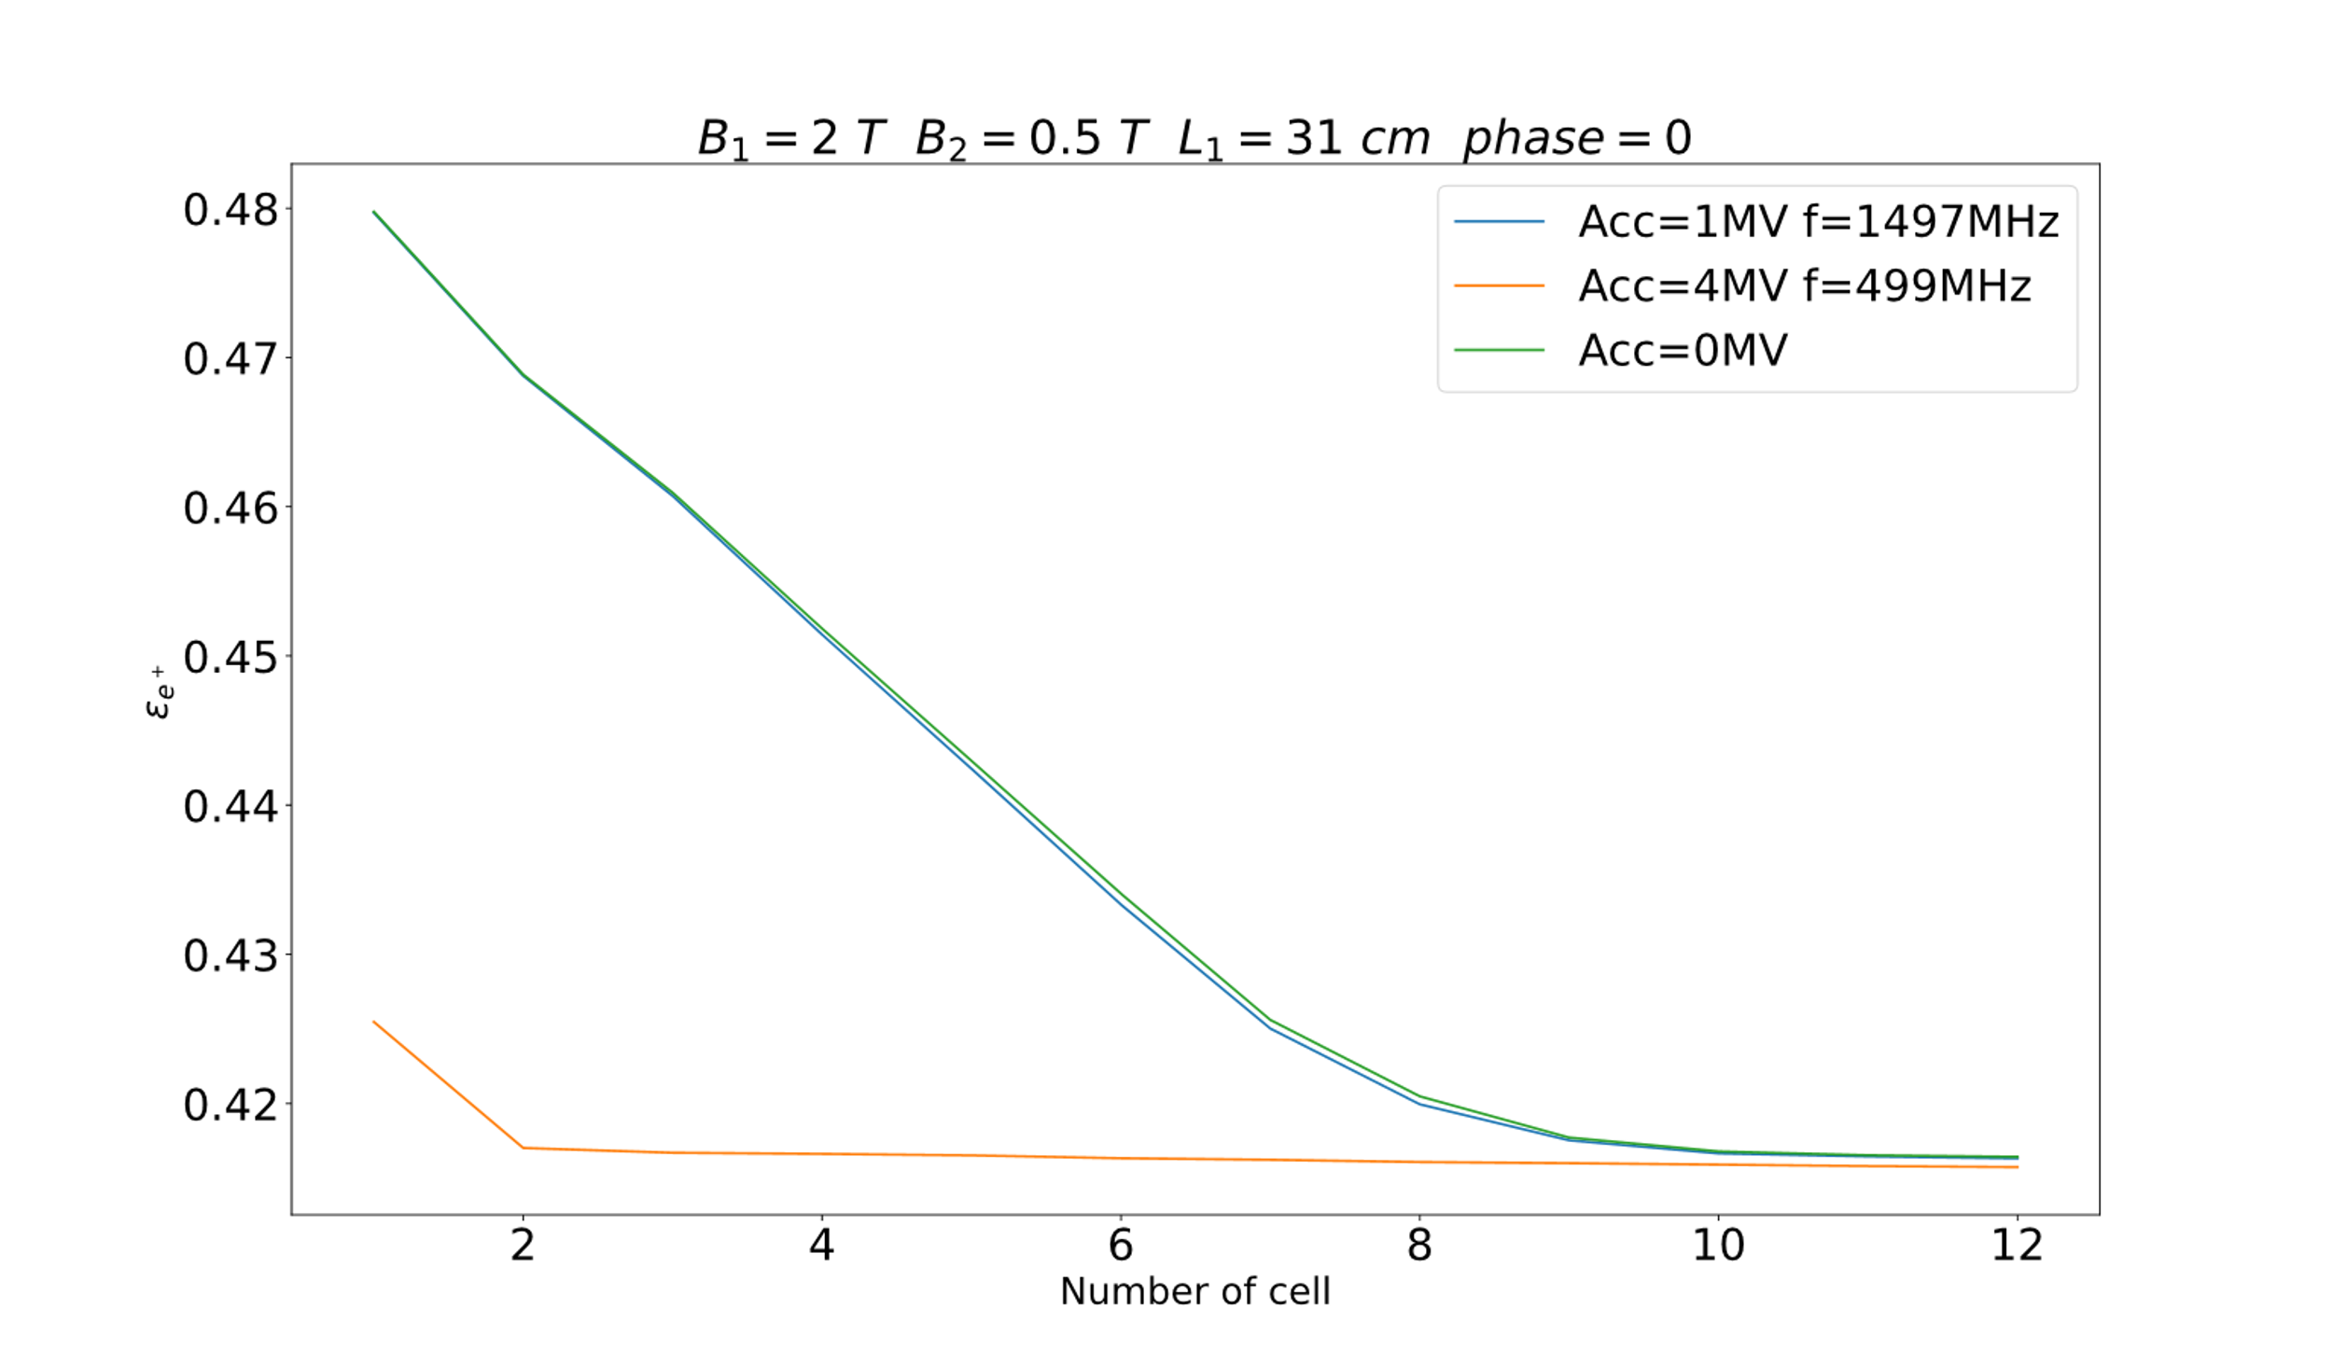
Linac length

Slide 9
exit of the linac at zero crossing
Params | Values | Values
Gradiant | 1 MV/m | 4 MV/m
Ncell | 8 | 8
F | 1497 MHz | 499 MHz
Lcell : c/f | 20 cm | 60 cm
Momentum dispersion | ~9% | ~7%
Bunch length | 0.1 ps | ~ 5.5 ps
Central momentum | 60 MeV | ~ 54 MeV
Efficiency | ~41% | ~ 41%

Slide 10
Different phasing

