Slide 1
Rate vs. Thickness
Jan 18, 2017

Slide 2
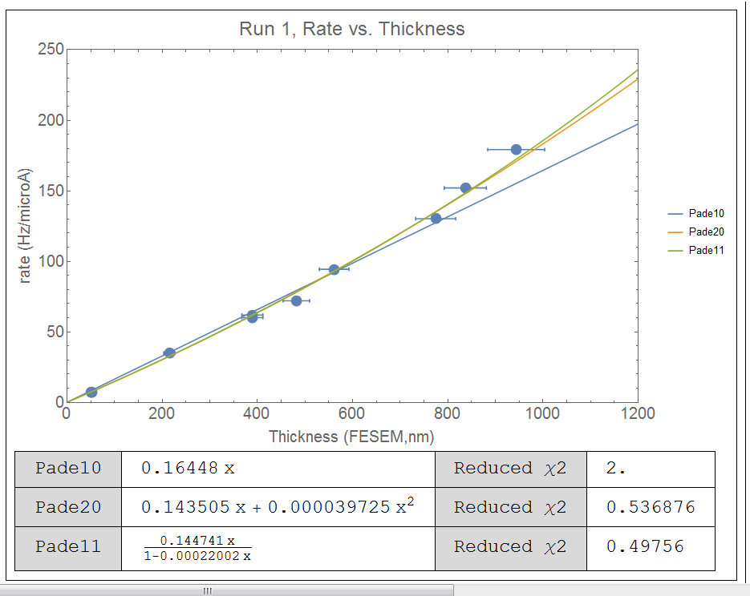
Mathematica run 1 RvT

Slide 3
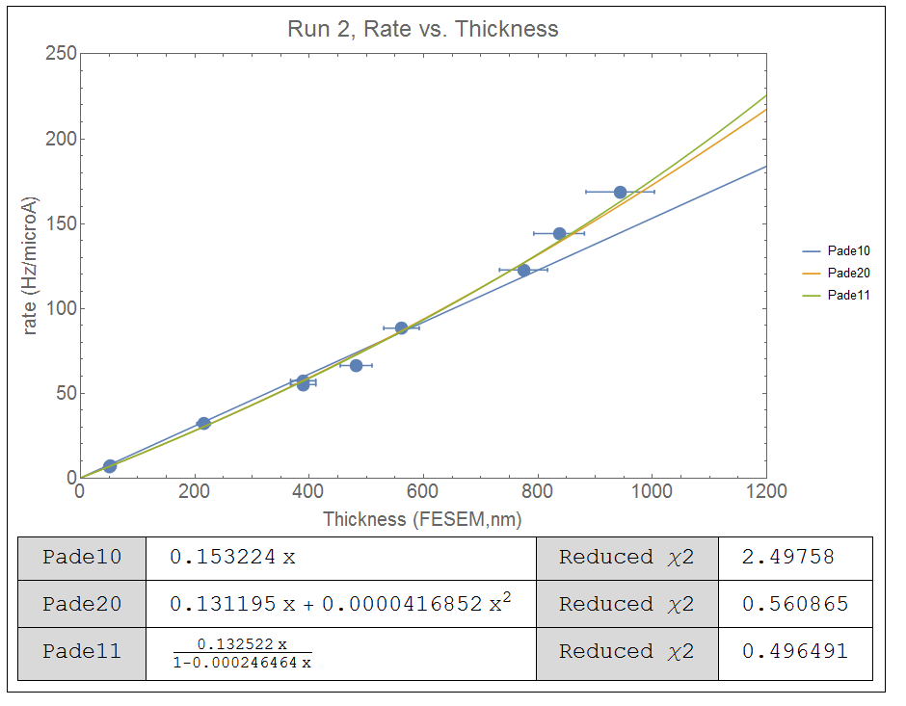

Slide 4
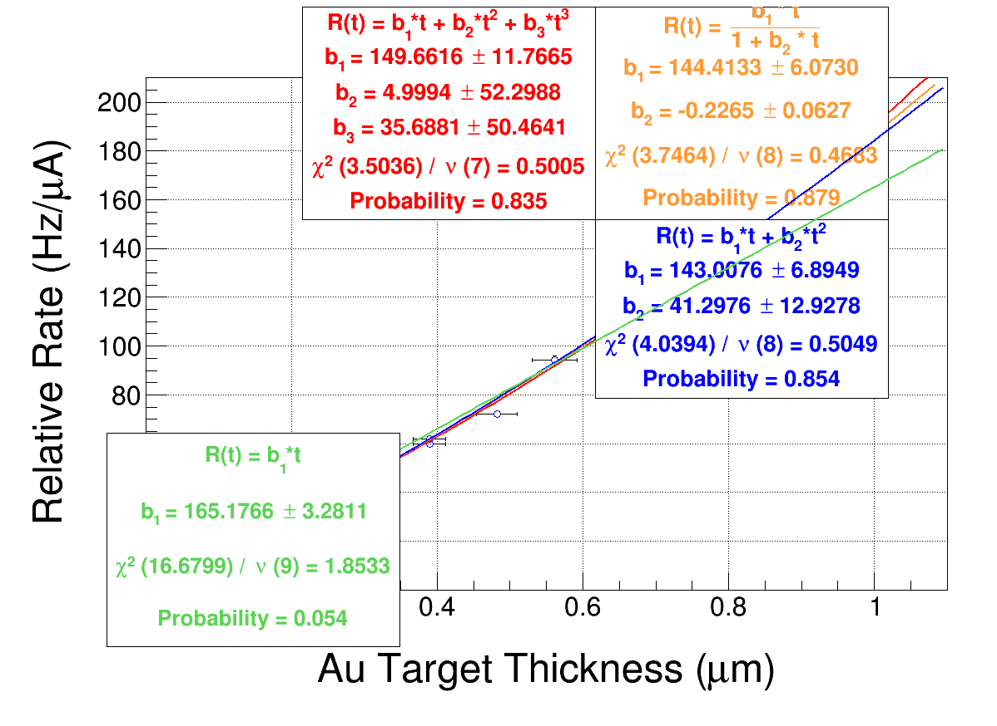
R vs. T run 1

Slide 5
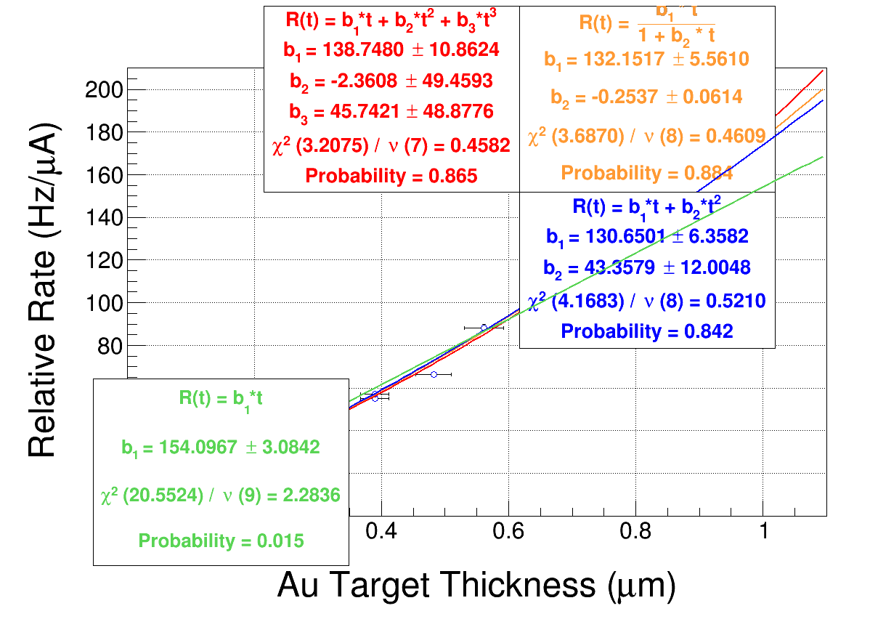
RvsT run 2

Slide 6
Root vs. Mathematica
R vs. T | a1 | Δa1 | a2 | b1 | Chi sq
Pade (2,0) | 143.01 | 6.9 | 41.3 |  | 0.505 | Root
Pade(1,1) | 144.41 | 6.1 |  | -0.23 | 0.47 | Root
Pade (1,0) | 165.2 | 3.28 |  |  | 1.85 | Root
Pade (2,0) | 130.65 | 6.4 | 43.36 |  | 0.842 | Rt run2
Pade(1,1) | 132.15 | 5.6 |  | -0.26 | 0.88 | Rt run2
Pade (1,0) | 154.1 | 3.08 |  |  | 2.3 | Rt run2
R vs. T | a1 | Δa1 | a2 | b1 | Chi sq
Pade (2,0) | .144 | 0.005 | 3.97e-5 |  | 0.54 | MM run 1
Pade(1,1) | 0.145 | 0.0043 |  | -0.00022 | 0.498 | MM run 1
Pade (1,0) | 0.164 | 0.0044 |  |  | 2 | MM run 1
Pade (2,0) | 0.131 | 0.0049 | 4.2e-5 |  | 0.56 | MM run 2
Pade(1,1) | 0.133 | 0.00395 |  | -2.4e-4 | 0.496 | MM run 2
Pade (1,0) | 0.153 | 0.0046 |  |  | 2.49 | MM run 2

