Slide 1
GTS GUN
August 3
Yan Wang

Slide 2
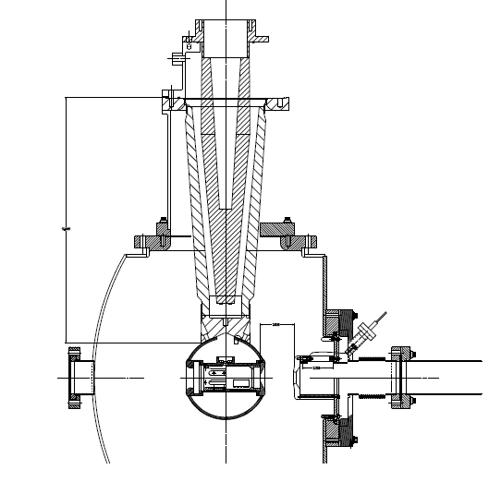
GST Gun

Slide 3
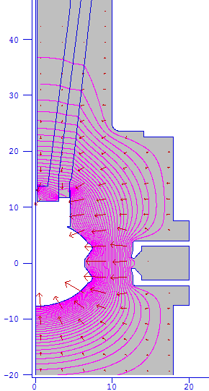
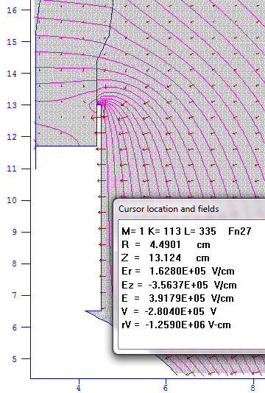
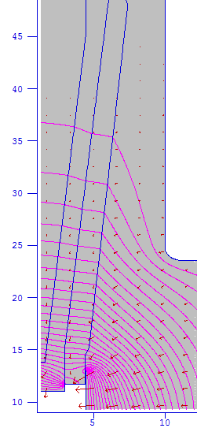
Field in the Chamber (350kV)
High Field
E=70 MV/m
Nonlinear

Slide 4
What Needs to Be Done
Protects the triple-junction point by lowing the field below 12 MV/m.
Linearizes the potential drop along the insulator

Slide 5
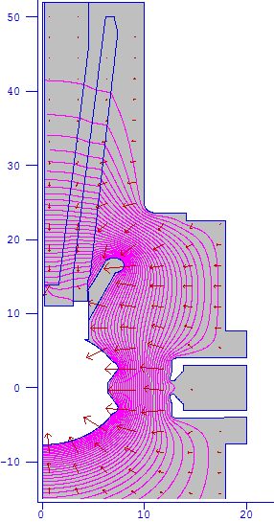
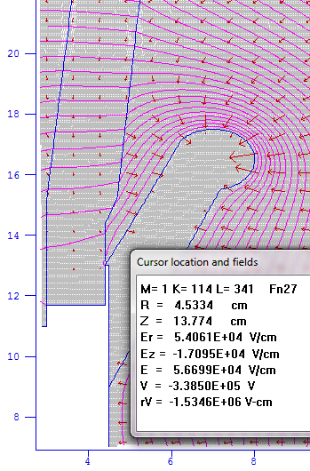
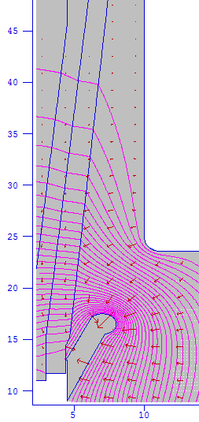
After Adding A Shed
Lower field
E=9MV/m
Potential drop
More linear
E=13Mv/m

Slide 6
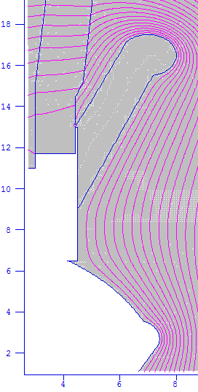
The Shed
R: 8 cm
r: 1 cm
Θ: from 40 to -80 deg.
L1: 4.53 cm
L2: 6.96 cm
R
r
L1
L2

Slide 7
Modified Chamber & Insulator
Beam direction

Slide 8
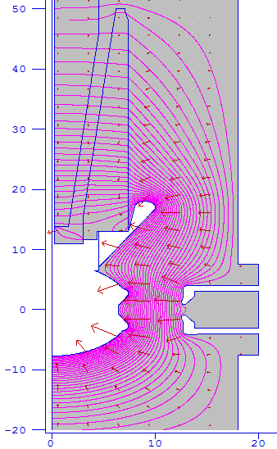
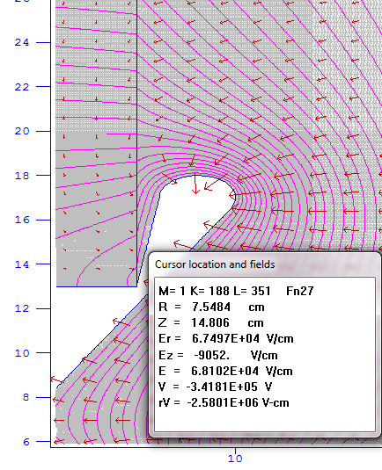
Modified Chamber & Insulator

Slide 9
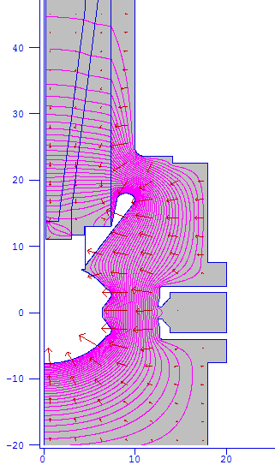
Only the Insulator Modified
Low Field
High Field

